Slide 1
Sense Everything, Control Everything - Integrating the Physical and Virtual Worlds
Henning Schulzrinne
(with Omer Boyaci, Victoria Beltran, Jan Janak, Hyunwoo Nam and others)
Columbia University

Slide 2
Overview
Programming is not just for programmers
The information silos
SECE as glue
Events and actions
Context
What’s next?

Slide 3
A Pyramid of programmers
Clocks at home blink 12:00
Can program a DVR
Writes Excel formulas
Creates simple HTML
Writes script in PHP or Ruby
Java programmer
C & kernel code
Firmware
JAIN

Slide 4
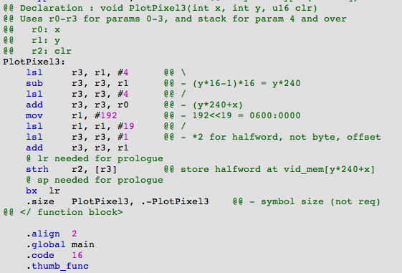
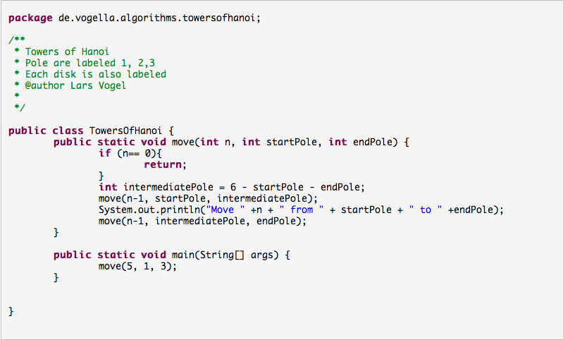
Old-style programming
Lars Vogel (2009)
Notes:
http://www.vogella.de/articles/JavaAlgorithmsTowersOfHanoi/article.html

Slide 5
Example: Scratch

Slide 6
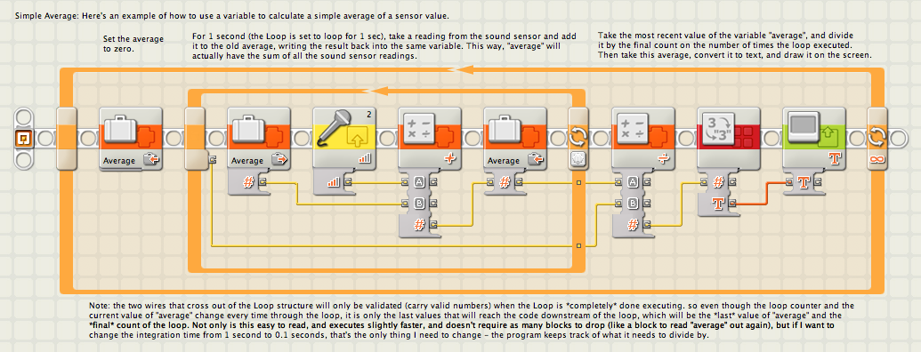
Is this programming?
<html>
<body>
<h1>My First Heading</h1>
<p>My first paragraph.</p>
</body>
</html>
Sub CopyRange() Range("A1:A3").Copy Destination:=ActiveCell End Sub

Slide 7
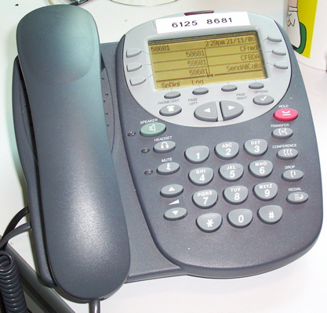
Old view of (telecom) services
call redirect
voice interaction (IVR)
call center distribution

Slide 8
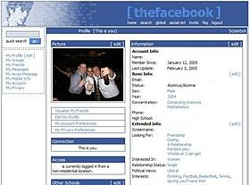
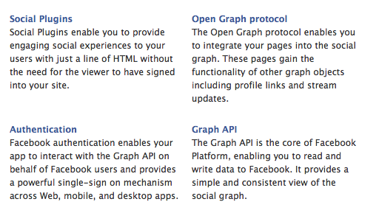
From web pages to APIs

Slide 9
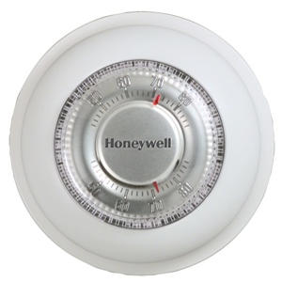
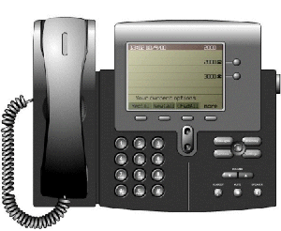
The silos

Slide 10
SECE
Real world
(location & sensors)
Communication
(VoIP, SMS, email)
Web services
(SNs, calendar, contacts, ..)
SECE

Slide 11
Events & actions
Events
Actions
Presence updates
Incoming calls
Email
Calendar entries
Sensor inputs
Location updates
Control the delivery of email
Route phone calls
Update social network status
Control actuators such as lights
Reminders (email, voice call, SMS)
Interact with Internet services

Slide 12
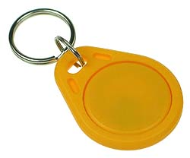
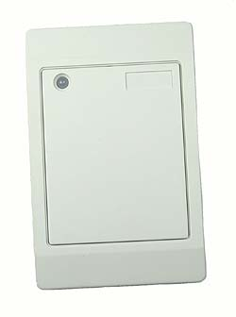
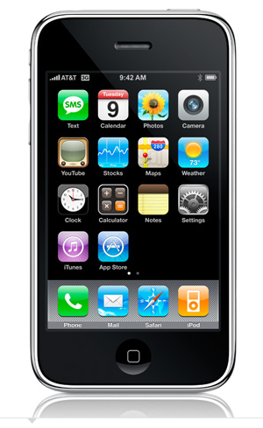
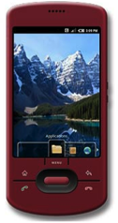
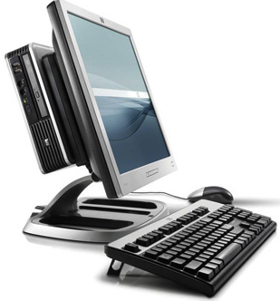
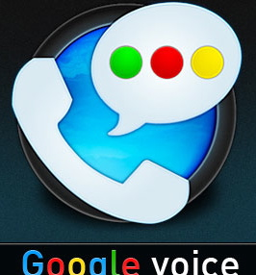
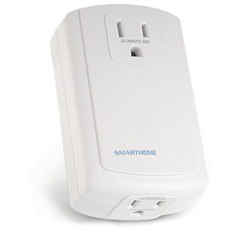
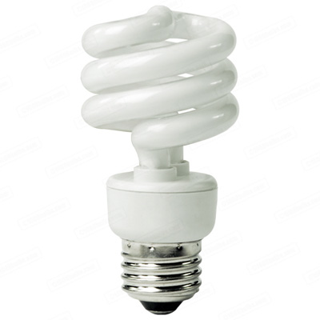
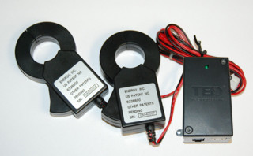
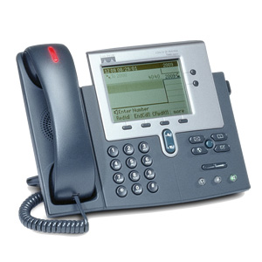
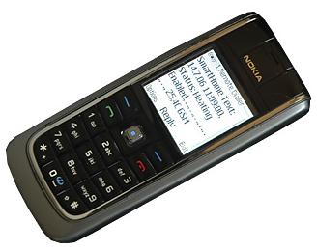
SECE: The glue for Internet applications
GW
next appt.
RFID
Alice → a@b.com,
+1 212 555 1234
geocoding
travel time
SUB/NOT
PIDF-LO, RPID,
others
SECE
PUBLISH
PIDF-LO
update SNs, , email…
GW
GW
call state
Call events, VM, SMS
monitor energy
usage
B2BUA
control appliances

Slide 13
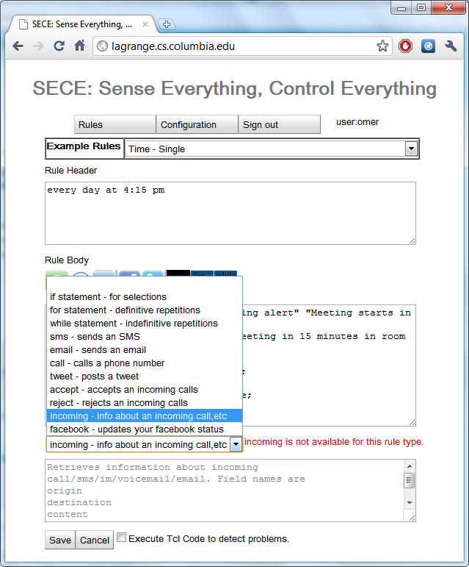
GUI- Action command assistant

Slide 14
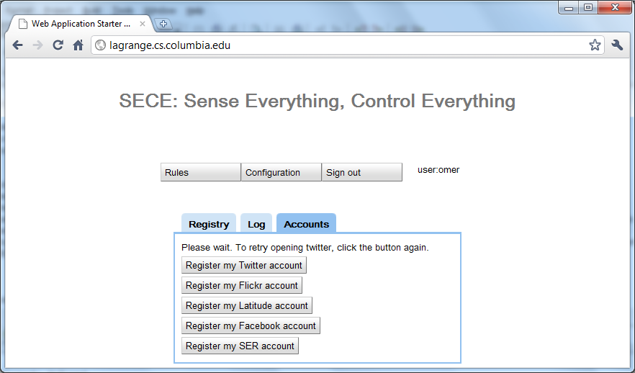
GUI- Registration of third-party services

Slide 15
Saving energy
every sunrise {
lights off
}
every sunset {
lights on
}
me within 2 miles of home {
thermostat 68
}
me outside of “Columbia University” {
turn off 720CEPSR
}

Slide 16
Making the phone more polite
incoming call {
if {[my activity] == “performance"} forward voicemail
schedule "call received from [incoming origin]”
sound mute
turn on lights
sleep 1
turn off lights
}
incoming call from Anne {
if {[my location] != "office"} auto_answer away.mp3 –record
}

Slide 17
“Don’t forget the milk”
me near a grocery store {
sms me “don’t forget the milk”
}
every Anne’s birthday {
sms me “Remember to call Anne”
}
when 30 minutes before ”weekly meeting” {
if {me not within 3 miles of campus} {
email [even participants] ”Running late” ”I’m at [me location]”
}
}

Slide 18
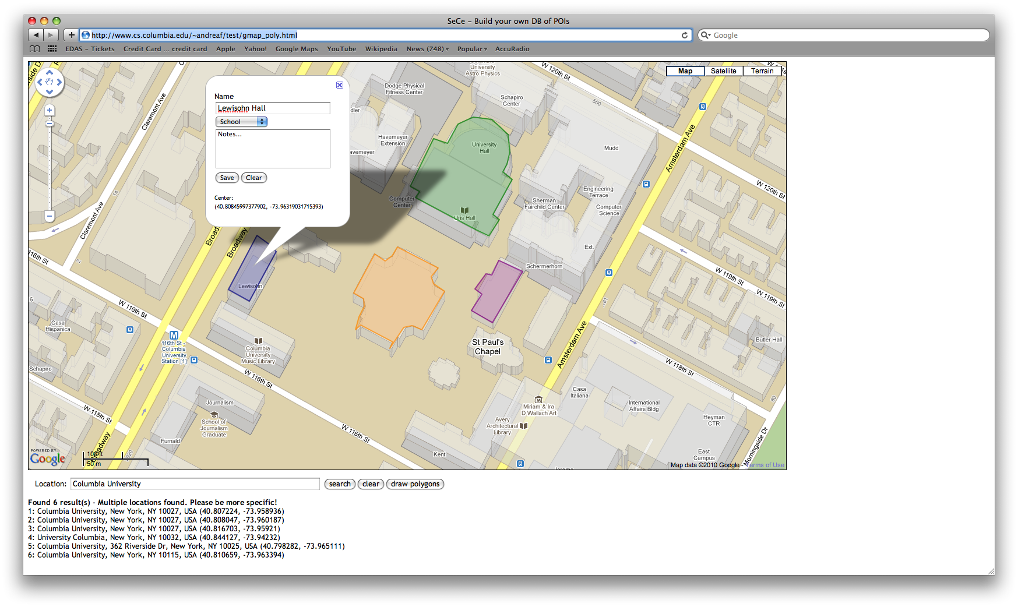
Location-based rules (Geographical database)

Slide 19
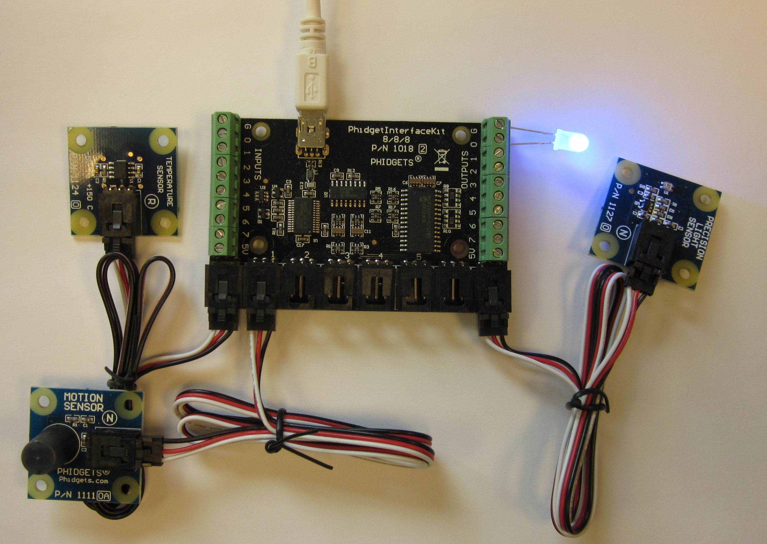
Building a POI database

Slide 20
Light controller

Slide 21
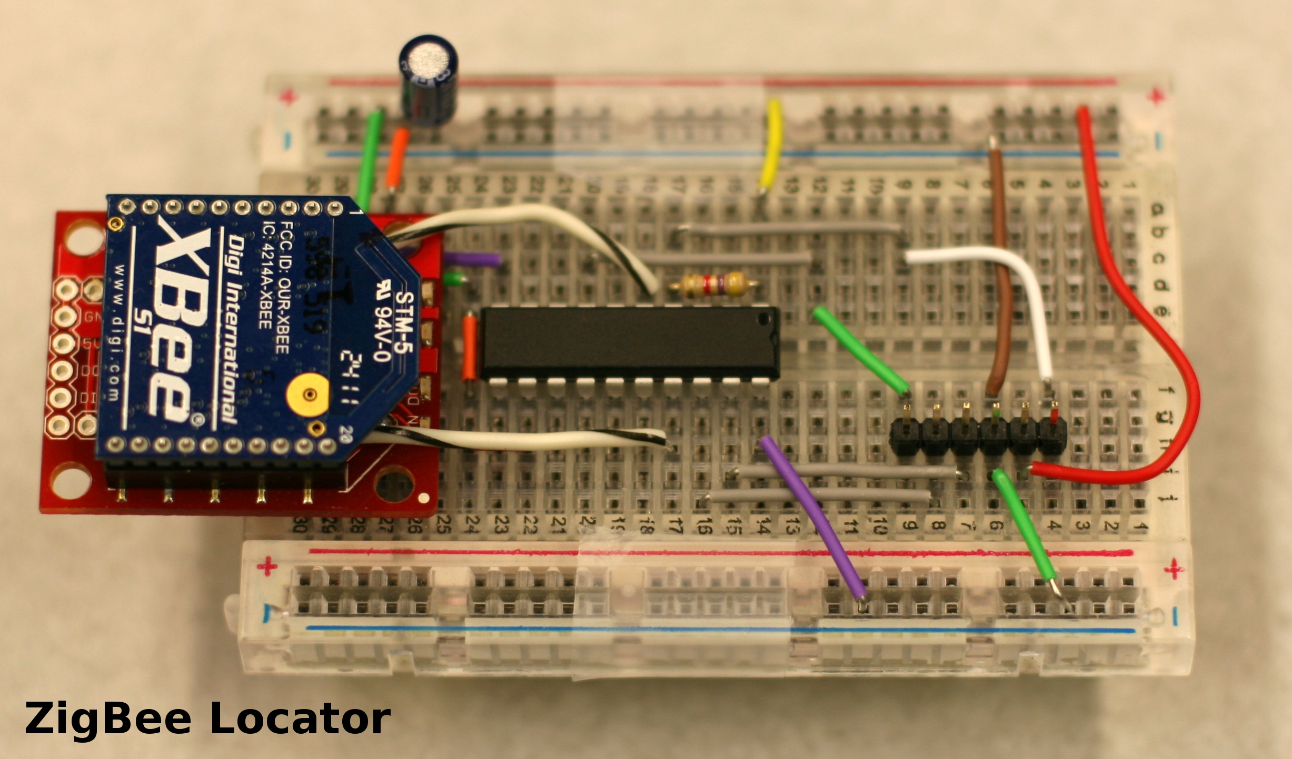
ZigBee Locator

Slide 22
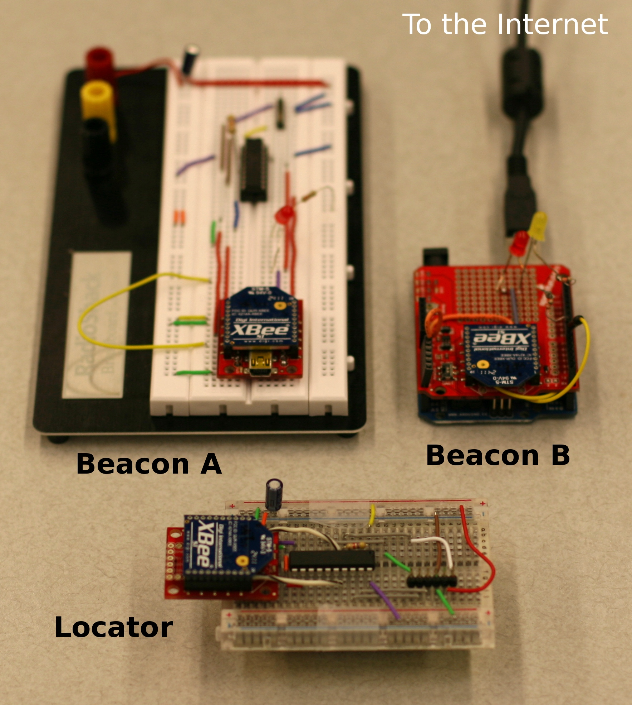
ZigBee location setup

Slide 23
What’s next?
True natural language input?
or building block interface
Lots of devices
home energy management
weather sensors
More extensible architecture
new sources of information
new events

Slide 24
Conclusion
User-generated content → user-generated functionality
Programming is not just Java & PHP
Create functions in the large
combine tools

Slide 25
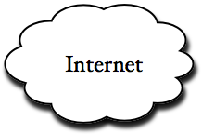
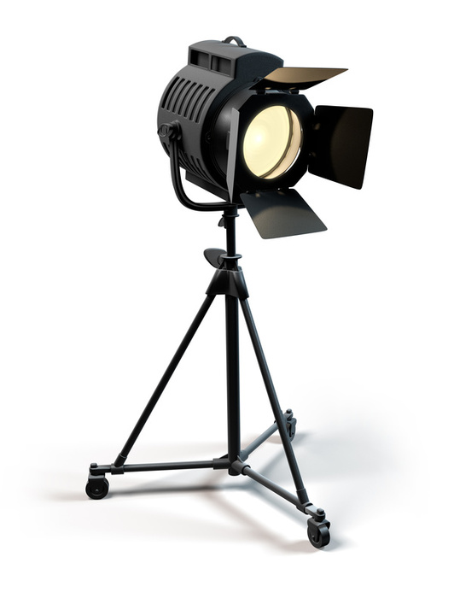
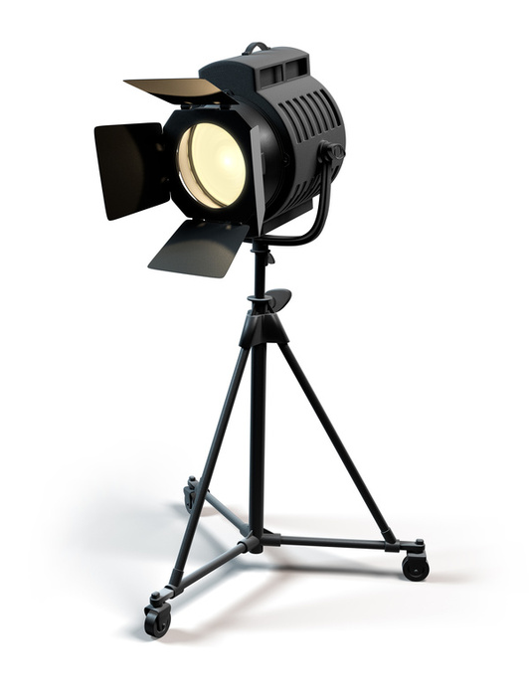
Automatic spot light
If my.position is left
turn on light1
turn off light2
SECE
ZigBee tag reports location of the speaker to SECE over the Internet
SECE controls individual lights using remote power switches
SECE turns lights ON/OFF depending on speaker's position on stage
If my.position is right
turn on light1
turn off light2
speaker
position
Light 1
Light 2
Location tag
Left Beacon
Right Beacon

