Slide 1
SECE: Sense Everything, Control Everything
Prototype Sensor and Actuator
Presented by Hyunwoo Nam
Internet Real Time Lab
I
R
T

Slide 2
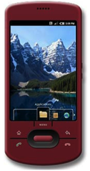
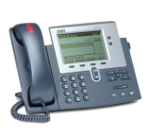
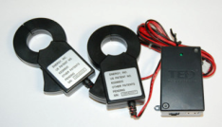
The big picture
“Prototype sensor/actuator for devices that are not IP-capable”
RFID
Alice → a@b.com,
+1 212 555 1234
Presence Server
SECE
GW
control appliances
PUBLISH
PIDF-LO
SUB/NOT ..
edit scripts
call state
update SNs, SMS, email
Geocoding
travel time
monitor energy
usage
B2BUA
“SECE allows non-technical users to create service that combine Communication,
Calendaring, Location and Device in the physical world. ”
Internet Real Time Lab
I
R
T

Slide 3
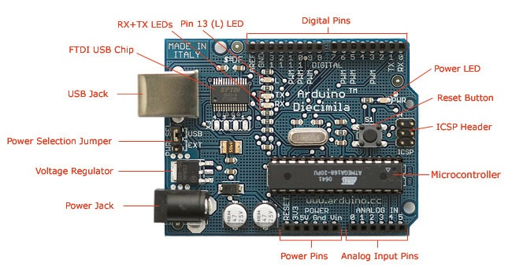
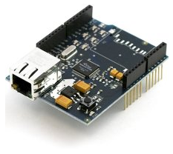
The Arduino
• $21
• Programming Environment
(C language) or AVR-Studio
• Easy to start with
• Phidgets, X10, Zigbee available
• Huge community
• Software development on
Mac OS-X and Windows
• How to connect to the Internet?
Microcontroller: ATmega328
Operating voltage: 5v
Flash memory: 32KB
SRAM: 2KB
EEPROM: 1KB
TCP/IP stack built in
“ Arduino Ethernet shield (stackable) ”
Internet Real Time Lab
I
R
T

Slide 4
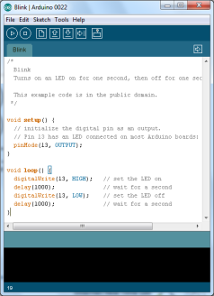
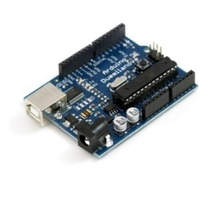
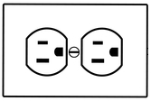
Appliances controlled by Arduino
“ Control Lamp using Arduino ”
Arduino
USB/Serial
Arduino IDE
X10 PLC Controller
X10 Lamp Module
RJ11 Cable
X10 power line signal
Internet Real Time Lab
I
R
T

Slide 5
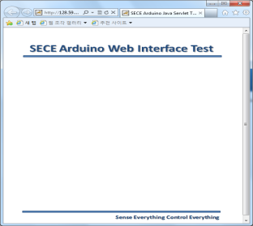
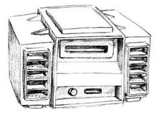
Appliances controlled by Arduino (continue)
SECE server
“ Control IR Electronics ”
-SAMSUNG:
TV, AUDIO..
-LG:
TV, PROJECTOR..
IR standard table
SECE users
LG
- TV_ON:0x8A75F20D
- TV_OFF:0x5A63B203
SAMSUNG
- AUDIO_ON:0x8A75F20D
AUDIO_OFF:0x5A63B203
..
0x8A75F20D
The Internet
IR Electronics
0x8A75F20D
IR LED
Arduino
Internet Real Time Lab
I
R
T

Slide 6
Communication with SECE server
LAMP
ARDUINO
DHCP
SECE SERVER
SECE USER
Turn on Arduino
&& Button pressed
Get IP address
DNS
Get SECE server IP
address using Hostname
TCP/IP
Webscoket handshake via HTTP
Update DNS
User login
Stored in EEPROM
OAuth Token
Turn on lamp
POST /lamp?v=100 HTTP/1.1
Auth.token
Send X10 Signal
JSON Format
Internet Real Time Lab
I
R
T

Slide 7
Conclusion
Achievements
• Implemented a set of Arduino libraries for SECE project
• Can control Arduino from SECE server over the Internet
• Can control other commercial modules (Phidgets/X10/Infrared) via Arduino
• Can communicate with Zigbee modules for location tracking system
Future works
• Implement OAuth communication between Arduino and SECE server
• Discover individual sensors from Arduino - figuring out what types of sensors are connected to a particular Arduino and naming
them • Setup permissions for individual sensors
- public, private, shared within a group, etc..
Internet Real Time Lab
I
R
T

