Slide 1
NetServ – Software-defined networking end-to-end
Henning Schulzrinne & IRT Lab
Columbia University

Slide 2
Usage transition
Limited personal communication
Content-based
Personalized content and computation
email
static information retrieval (ftp → web)
phone
large-scale distribution of popular content (entertainment video)
social networks
context-based information
millions of tiny apps
3 core applications

Slide 3


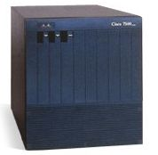
From fixed-function to APIs everywhere
customizable apps
user-controlled
upgradeable
APIs
NetServ
fixed-function
vendor controlled

Slide 4
NetServ: Key ideas & requirements
Common programming environment across platforms
  Java
Scalable network-based services
  from handling each packet to exporting measurement APIs
From link layer to applications
Isolation & protection
Available to vendors, network operators & users
Automated and distributed management of functionality

Slide 5
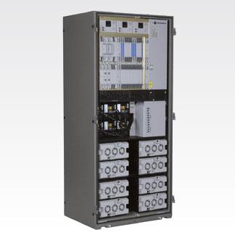
NetServ end-to-end
OpenFlow switches
server
BSC

Slide 6
NetServ motivation
Old world
  (computation, storage) ←→ forwarding
1990s: active networking
  mainly IP-level & per-packet
Exploring new opportunities
  providing additional services in the current Internet → NetServ
  CDNs and content-centric networks
  MIBs → “intelligent” network management
  virtualized networks
  denial-of-service attack prevention
  QoS monitoring

Slide 7
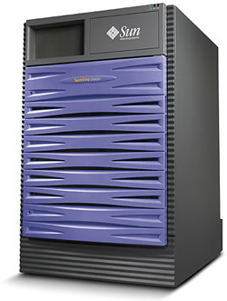
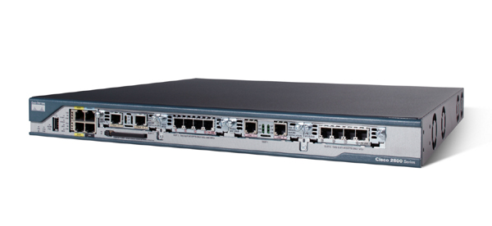
Enabler 1: merging of server & router
10+ interfaces
0 GB disk
1 low-end processor
1 interface
TB disk
1-32 multi-core processors

Slide 8

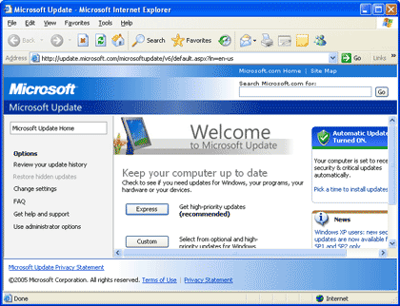
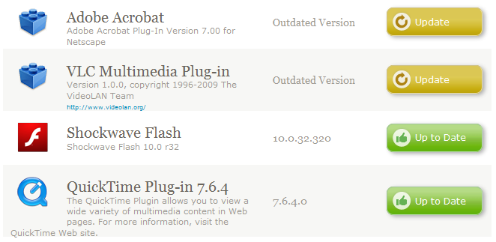

Enabler 2: Software: from floppy to autonomous

Slide 9
The grand vision
NetServ everywhere
  Common service API on router, PC, set-top box, ...
  Storage and computation on network nodes
  Enabling platform for NGI
Internet is a multi-user computer
  Code modules run anywhere
  Secure and extensible
  Active networking redux!

Slide 10
Not-so-grand initial focus
Activate the network (edge)
  Eyeball ISPs sell router resources to content publishers
  Content publishers install servers and packet processors on edge routers
Economic incentives
  New revenue source for ISPs
  Alternative to CDN for content publishers

Slide 11
In-router & side-car
RE
“side car”
storage & computation
storage & computation
PIC
PIC
PE
multiple computation
& storage providers
data center or
POP
10GigE

Slide 12





NetServ operations
also: flow level (1st packet) operations

Slide 13
Different from active networks?
Active networks
  Packet contains executable code or pre-installed capsules
    Can modify router states and behavior
    Mostly stateless
  Not successful
    Per-packet processing too expensive
    Security concerns
    No compelling killer app to warrant such a big shift
  Notable work: ANTS, Janos, Switchware
NetServ
  Virtualized services on current, passive networks
    Service invocation is signaling driven, not packet driven
    Some flows & packets, not all of them
    Emphasis on storage
  Service modules are stand-alone, addressable entities
    Separate from packet forwarding plane
    Extensible plug-in architecture

Slide 14
Deployment scenarios
Three actors
  Content publisher (e.g. youtube.com)
  Service provider (e.g. ISP)
  End user
Model 1: Publisher-initiated deployment
  Publisher rents router space from providers (or end users)
Model 2: Provider-initiated deployment
  Publisher writes NetServ module
  Provider sees lots of traffic, fetches and installs module
  Predetermined module location (similar to robots.txt)
Model 3: User-initiated deployment
  User installs NetServ module to own home router or PC
  or on willing routers along the data path

Slide 15
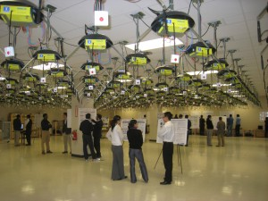
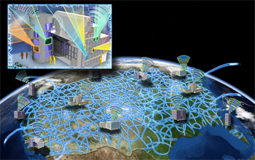
How about GENI?
GENI = global-scale test bed for networking research
  parallel experiments in VMs
➔ initially, long-term, “heavy” services
NetServ tutorials at GEC 9, 11

Slide 16
NetServ node architecture
Module download
Signaling message
forwarded to next hop
Signaling message
to install module
NetServ controller
Module install
Service modules
Service modules
Service modules
Building block layer
Building block layer
Building block layer
Virtual execution
environment
Virtual execution
environment
Virtual execution
environment
Data packets processed
by service modules
NetServ packet transport

Slide 17
NetServ current prototype
Server
modules
Client-
Server
data
packets
NSLP
daemon
OSGi control sockets
OSGi
Service
Container
UNIX
socket
NetServ
Controller
Packet
processing
modules
NetServ Control
Protocol (TCP)
GIST
daemon
Transport layer
OSGi
OSGi
Service
Container
Service
Container
Raw
socket
iptables
command
Forwarded
data packets
Netfilter
NFQUEUE #1
NFQUEUE #2
Signaling
packets
Linux kernel

Slide 18
Packet processing
application module 1
Packet processing
application module 2
Server
application
module 1
Client-server data packets
dispatcher.addPktProcessor(this);
Servlet API
Xuggler
Packet dispatcher
XML-RPC
Command from NetServ controller
…
…
…
System modules
Library modules
Wrappers for native
functions
Building block layer
OSGi
JVM
Forwarded data
packets
libnetfilter_queue
NFQUEUE
Linux kernel

Slide 19
Background: What’s OSGi?
“Dynamic module system for Java”
  originally for set top boxes
Why OSGi? Why not just JAR files?
  More than just JAR files; much richer encapsulation, metadata in manifest
  Automatic dependency resolution
  Version management
  Provides systems services (logging, configuration, user authentication, device access, …)
  ~ Debian's apt-get or Apple's App Store methods of installation

Slide 20
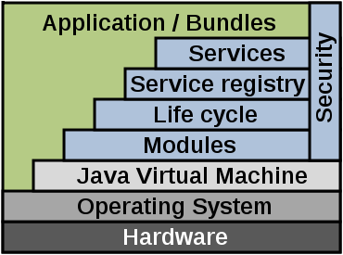
OSGi
Architecture
  Bundles: JAR files with manifest
  Services: Connects bundles
  Services Registry: Management
  of services
  Modules: Import/export interfaces
  for bundles
Possible to “wrap” existing Java apps and JARs
  Add additional manifest info to create OSGi bundle
  E.g.: Jetty web server now ships with OSGi manifest; now extensively used with OSGi containers and custom bundles
  For NetServ, we created a OSGi bundle for the Muffin HTTP proxy server
Image credit: Wikipedia

Slide 21
OSGi
Many core frameworks
  Eclipse Equinox, Apache Felix, Knoplerfish
Real-world examples
  Eclipse IDE uses OSGi for plugin architecture
Mostly finds use in enterprise applications needing plug-in functionality
  IBM Websphere, SpringSource (now VMWare) dm server, Red Hat's Jboss, …

Slide 22
Signaling

Slide 23
Signaling
How to get code (pointers) into nodes?
Modalities:
  everywhere within a certain scope
  nodes matching characteristics (“all base stations”)
  along data path
can’t be manually installed

Slide 24



NSIS-based on-path signaling
NetServ repository
N1
N2
N3
Signaling message is sent towards the destination rather than to a specific router

Slide 25
NSIS architecture
Signaling application-specific functions
(packet filter, NAT setting, etc)
NetServ NSLP
NSLP for QoS
NSLP for
NAT/firewall
NSLP
GIST
API
Control
plane for
signaling:
NSIS
GIST
(General Internet Signaling Transport)
NTLP
Transport layer security
UDP
TCP
SCTP
DCCP
IP layer security
IP

Slide 26
NSIS Signaling

Slide 27
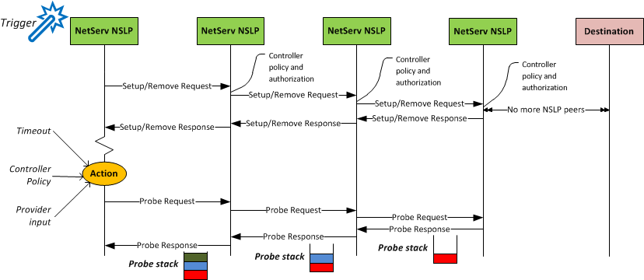
Design of NetServ Protocol 2
Only NSIS nodes with a running NetServ NSLP will process the protocol messages
Other nodes forward the packets transparently

Slide 28
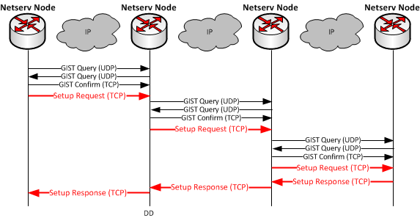
GIST and NetServ Protocol
NetServ Protocol runs on top of GIST
GIST provides hop by hop node discovery, peer association and message transport

Slide 29
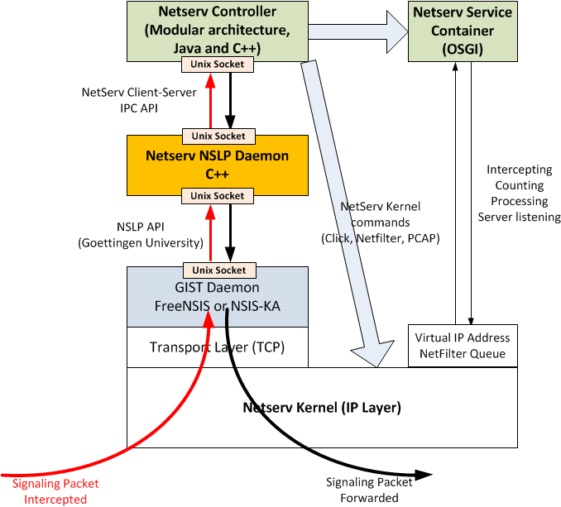

Slide 30
How does code get into nodes?
gossip
All nodes in (enterprise) network

Slide 31
NetServ + OpenFlow

Slide 32
Performance evaluation
Java packet processing overhead:
Overhead significant, but not prohibitive
Handles typical edge router traffic on modest PC hardware

Slide 33
NetServ data path
Currently: Linux kernel
  Pass packets to user-level service container processes
  Use Netfilter queues
  Flexible – can modify, add, delete, store packets
  Problem:
  Slow Performances compared to hardware routers

Slide 34


What is OpenFlow?
Controller
OpenFlow Firmware
Software Layer
OpenFlow Switch
PC
Flow Table
MAC
src
MAC
dst
IP
Src
IP
Dst
TCP
sport
TCP
dport
Action
OF
Protocol
Hardware Layer
*
*
*
5.6.7.8
*
*
port 1
following packets
routing
1st packet
routing
port 1
port 2
port 3
port 4
PKT
PKT
IP dst: 5.6.7.8
5.6.7.8
1.2.3.4

Slide 35
What is OpenFlow?
OpenFlow = API for switches
Control how packets are forwarded
  not packet transformation
Operations implemented on (cheap) packet switch
  smaller or no control processor
  omits routing (BGP & OSPF), spanning tree, firewall, QoS, …
  move control functionality to general-purpose server(s)
Typically, centralized control
but: NetServ enables distributed control

Slide 36
OpenFlow integration
Openflow controller as a NetServ service module
  Runs inside the OSGi Service Container
  Modified version of the Beacon OF Controller (Java)
  Listens for signaling commands through JSON-RPC (sent by NetServ Controller or external services)
  Sends commands to OF-enabled hardware (OpenFlow protocol)

Slide 37


OpenFlow operation
OpenFlow Switch
PacketIn
(2)
Flow Table
OpenFlow
Protocol
MAC
src
MAC
dst
IP
src
IP
dst
TCP
sport
TCP
dport
Action
OpenFlow
Controller
(3)
FlowMod
*
*
*
10.0.0.1
*
*
Output
port 1
(4)
(1)
PKT
1st pkts
dst: 10.0.0.1
10.0.0.1
(5)
PKT
subseq. pkts
dst: 10.0.0.1
PKT
PKT
Notes:
1° Packet that must go to 10.0.0.1 arrives to the switch, but no flowtable entries matches it, so it goes to the OFC
The OFC decides the forwarding port for this packet according to the routing algorithm, and the packet arrives to the destination host
At the same time it writes a flowmod inside the flowtable, saying that this flow must be outputted to port 1
Following packets arrive to the switch, and they match a flowtable entry, so they are routed in hardware

Slide 38



Processing Unit
(PU)
Other networks
OF Switch
NetServ
Controller
OF Controller
1
Flow Mod
NetServ SETUP packet arrives
Add_filter
2
Processing module installed
1° Packet arrives
Packet_IN
Flow Mod
3
Packet
processing time
1° Packet gets routed
Packet_IN
4
Flow Mod
Data
OF Protocol
JSON-RPC
Following Packets path
Packet processing
time
5
Notes:
Proactive GIST filter
Processing module installed and add filter data structure inside OF controller
Packet header is matched to the services filtering rules inside the OFC, and if match, the packet is forwarder to the PU
The output packet is sent to the OFC another time, for the regular routing
Subsequent packets are forwarded in hardware

Slide 39
NetServ/OpenFlow prototype
NetServ Host
Signaling packet:
NetServ Controller
OSGi Container
OpenFlow Controller
UDPEcho
service
Install UDPEcho service.
Filter UDP
Port 2222
Filter Added
JSON
RPC
Forwarded to next hop
      Linux Kernel
OF Protocol
port 1
OpenFlow Switch
PKT
Flow Table
port 2
Host 1
1.2.3.4
MAC
src
MAC
dst
IP
Src
IP
Dst
UDP
sport
UDP
dport
Action
*
*
*
*
*
2222
port 1
port 3
Host 2
5.6.7.8
aa:bb:cc
dd:ee:ff
5.6.7.8
1.2.3.4
2222
3333
port 2

Slide 40
NetServ Node
OSGi
NetServ
Controller
OpenFlow Controller
Packet
Processing
Module
Linux kernel
SETUP signaling message
(1)
OpenFlow Switch
Port 2
Flow Table
(4)
(2)
PKT
1st packet
Dst: 10.0.0.1
MAC
src
MAC
dst
IP
src
IP
dst
UDP
sport
UDP
dport
Action
(7)
(5)
PKT
Subsequent packets
Dst: 10.0.0.1
(3)
PKT
PKT
11:22
33:44
*
10.0.0.1
*
2222
Output
port 2
(8)
Port 1
33:44
55:66
*
10.0.0.1
*
2222
Output
port 1
10.0.0.1
(9)
(6)
Notes:
Gist proactive filter (non è visualizzato,c’è solo nell’altra figura.)
NSIS signaling packet arrives. Netserv controller sends a JSON-RPC command to install a filter inside OFC. In addition it also install the packet processing service
1° Packet arrives to the switch, but no flowtable entries matches it, so it goes to the OFC. The OFC matches the flow with its netserv modules filters and forward the packet to the processing service. In addition the OFC adds a flow entry to the flow table
The processed packet go from the PU to the switch, and the switch asks another time to the controller what to do. The packet is forwarded using normal routing algorithm to the destination. Another flow entry is added to the flow table.
Following packets match both the flow entries, so they are forwarded in hardware

Slide 41
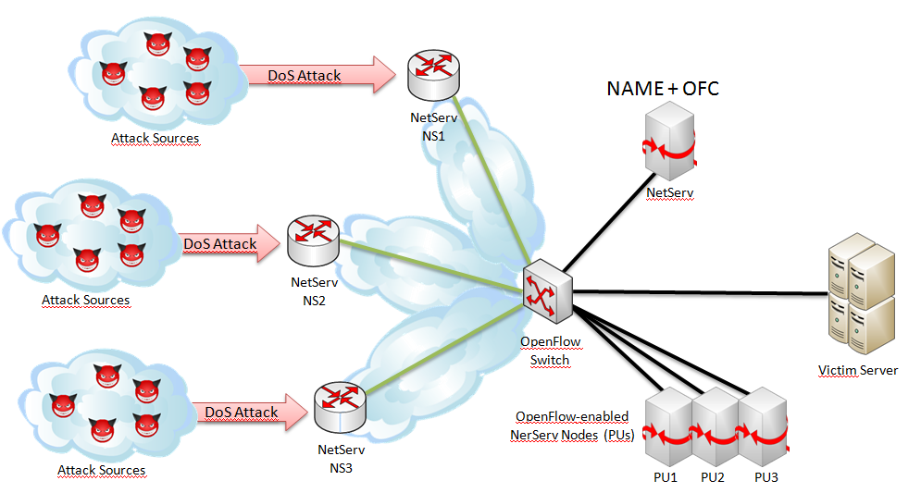
DoS experiment on GENI
Autonomic network management
  Self protecting from a SIP DoS attack (similar to NetServ Overload demo)
  Use of IP flow-based IDS (netmonitor service)
  Use of rate limiter (throttle service)

Slide 42


DoS experiment on GENI
NetServ Node (NS1)
NAME + OFC
SIP messages
OSGi
NetServ Node
Replicated packets
NetServ
Controller
OSGi
DoS Attack
Throttle
NetServ
Controller
OpenFlow
Controller
NAME
Attack Sources
Linux Kernel
Victim Server
DoS Attack
OpenFlow Switch
NetServ NS2
Attack Sources
OpenFlow-enabled NerServ Nodes (PUs)
DoS Attack
NetServ Node
NetServ Node
NetServ Node
OSGi
OSGi
OSGi
NetServ NS3
NetServ
Controller
Net
monitor
NetServ
Controller
Net
monitor
NetServ
Controller
Net
monitor
Throttle
Attack Sources
PU1
PU2
PU3
SIP messages NS1 node OF switch
OF switch SIP server
        PU1 (replicating)

Slide 43
DoS experiment on GENI
NetServ Node (NS1)
NAME + OFC
SIP messages
OSGi
NetServ Node
Replicated packets
NetServ
Controller
OSGi
DoS Attack
Throttle
NetServ
Controller
OpenFlow
Controller
NAME
Attack Sources
Linux Kernel
Victim Server
DoS Attack
OpenFlow Switch
NetServ NS2
Attack Sources
OpenFlow-enabled NerServ Nodes (PUs)
DoS Attack
NetServ Node
NetServ Node
NetServ Node
OSGi
OSGi
OSGi
NetServ NS3
NetServ
Controller
Net
monitor
NetServ
Controller
Net
monitor
NetServ
Controller
Net
monitor
Throttle
Attack Sources
PU1
PU2
PU3
Attack arrives
Net monitor NAME (attack detected) Throttle @ NS1

Slide 44
DoS experiment on GENI
NetServ Node (NS1)
NAME + OFC
SIP messages
OSGi
NetServ Node
Replicated packets
NetServ
Controller
OSGi
DoS Attack
Throttle
NetServ
Controller
OpenFlow
Controller
NAME
Attack Sources
Linux Kernel
Victim Server
Throttle
DoS Attack
OpenFlow Switch
NetServ NS2
Attack Sources
OpenFlow-enabled NerServ Nodes (PUs)
Throttle
DoS Attack
NetServ Node
NetServ Node
NetServ Node
OSGi
OSGi
OSGi
NetServ NS3
NetServ
Controller
Net
monitor
NetServ
Controller
Net
monitor
NetServ
Controller
Net
monitor
Throttle
Attack Sources
PU1
PU2
PU3
Attack increases
NAME (to prevent PU1 overload) Net monitor@PU2-PU3
NAME Throttle@NS2-NS3

Slide 45

OF Controller for the NetServ/OpenFlow Node
Handle multiple Processing Units (WIP)
  Control NetServ nodes attached to an OF switch as PUs (no OFC runs inside of it)
  Parallel packet processing
  Splitting packet flow through several PUs
OpenFlow Switch
Flow Split method:
Not possible with the current OFPv1.1 (will be with v1.2)
Current implementation replicate the flow to all PUs. Every PU drops unwanted packets (using netfilter u32 matching module)
Other networks
Other networks
PU1
OpenFlow Switch
NetServ
PU2
OpenFlow Controller
PU3
OpenFlow-enabled NerServ Nodes (PUs)

Slide 46
NetServ Node
OSGi
NetServ
Controller
OpenFlow Controller
Signaling packets
OpenFlow Switch
First packet of a flow
Subsequent packets
NetServ Node
NetServ Node
NetServ Node
OSGi
OSGi
OSGi
NetServ
Controller
Packet
Processing
Module
NetServ
Controller
Packet
Processing
Module
NetServ
Controller
Packet
Processing
Module

Slide 47
Future improvements
Processing optimized architecture
NetServ Node (NS1)
NAME + OFC
Packets inspected by DPI module deployed in NS1
OSGi
NetServ Node
Packets forwarded only by NS1 and VLAN tagged
NetServ
Controller
OSGi
DoS Attack
DPI
NetServ
Controller
OpenFlow
Controller
NAME
Packets inspected by PU3
Attack Sources
Linux Kernel
Victim Server
DoS Attack
OpenFlow Switch
NetServ NS2
Attack Sources
OpenFlow-enabled NerServ Nodes (PUs)
DoS Attack
OpenFlow Switch
NetServ Node
NetServ Node
NetServ Node
OSGi
OSGi
OSGi
NetServ NS3
NetServ
Controller
Flow
based
IDS
NetServ
Controller
Flow
based
IDS
NetServ
Controller
Flow
based
IDS
DPI
Attack Sources
PU1
PU2
PU3

Slide 48
NetServ applications

Slide 49
Application: ActiveCDN

Slide 50

Application: Media relay
Standard media relay
  Required due to NAT
  Out-of-path
  Inefficient and Costly
NetServ media relay
  Closer to users
  Improved call quality
  Reduced cost for ITSP

Slide 51
Application: Keep-alive responder
NAT Keep-alive responder off
  UA behind NAT must send keep-alive messages
  Major bottleneck for SIP server
NAT Keep-alive responder on
  Module responds on behalf of SIP server
  No traffic to server

Slide 52
Application: Overload control
NetServ Module
Controlled by SIP server
Throttles incoming traffic
Randomized traffic rejection
SIP Server
Installs NetServ module on demand
Controls all NetServ modules
Real-time feedback to modules

Slide 53
ActiveCDN

Slide 54
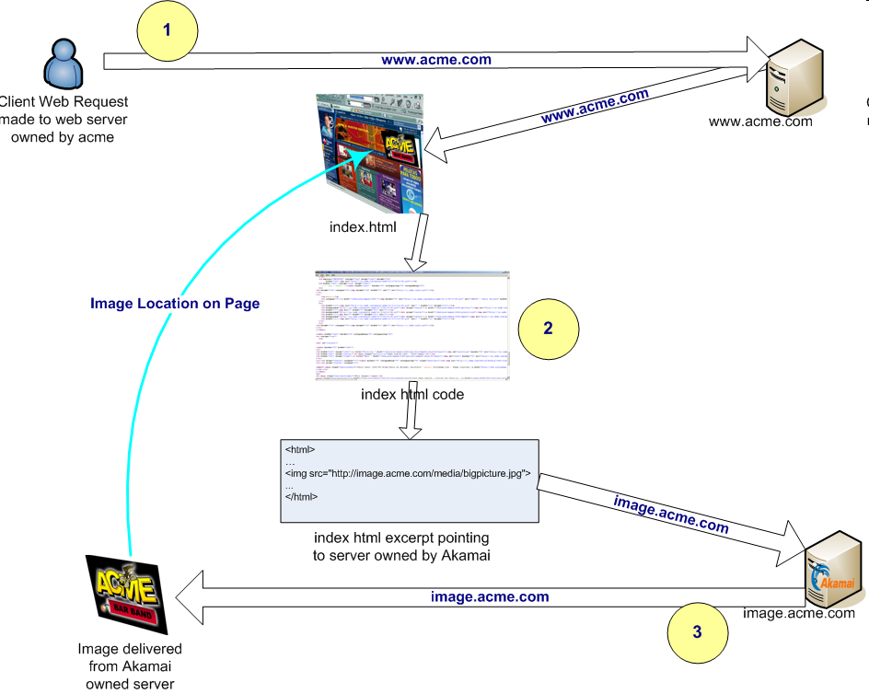
Content Distribution Networks
Distributes content requests from user
  To (hopefully) nearest node in a system of nodes that can serve the content
Preferred method for content providers to host content
  Content provider can build/maintain its own CDN
  More likely: use an ASP’s CDN and host content there
Content requests are re-routed to the nearest server

Slide 55
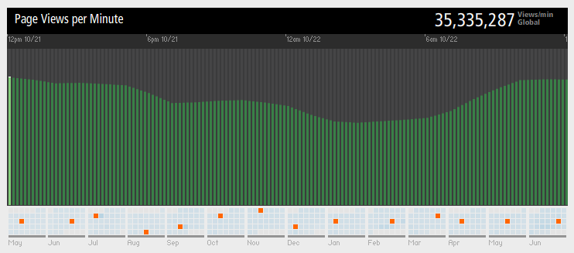
CDN Providers and Research
  CDN service providers
    Established players: Akamai, Edgecast, Amazon CloudFront
    New entrants: service providers (AT&T), web hosting companies (The Planet)
    Self-hosting: YouTube (used Limelight CDN before Google acquisition)
    Commoditized services…
Pageviews/minute handled by Akamai

Slide 56
What do CDNs do today?
Very good at:
  Monitoring network traffic, latency, etc.
    Proprietary systems, maybe tie-up with network service providers
    In 2009: Akamai was sending 5 million traceroute messages on the Internet every 5 minutes to measure latency
  Achieving economies of scale through deploying large, homogenous nodes …
  … at strategic locations around the world
    K-median and Facility Location problems: well studied
  Detecting closest CDN nodes for incoming request
  Re-directing user to that node
    Through name-based redirection (DNS): Akamai, most others
    Message-based redirection (HTTP redirect): Youtube

Slide 57
ActiveCDN and NetServ
Allow content providers to dynamically deploy in-network CDN nodes
  “flow through caching”
Determine optimal placement of nodes dynamically
Deploy custom functionality
  user demographics
  user QoE
→ aggregate node capabilities across wide variety of operators
  → need broker functionality (future work)

Slide 58


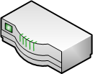
N
N
End user
Regular
router
NetServ
router
NetServ
router
Regular
router
Content
provider
(1) User requests http://youtube.com/getvideo?id=foo
(2) YouTube sends video file
(3) YouTube sends on-path signal to deploy ActiveCDN module
(4) NetServ-enabled routers download the module
(5) NetServ routers notify that the module is active
(6) Another user requests http://youtube.com/getvideo?id=foo
(7) YouTube redirects user to nearest NetServ node running ActiveCDN
(8) User requests http://netserv1.verizon.com/youtube/foo.flv
(9) NetServ router relays the video content, while fetching the file and caching it

Slide 59

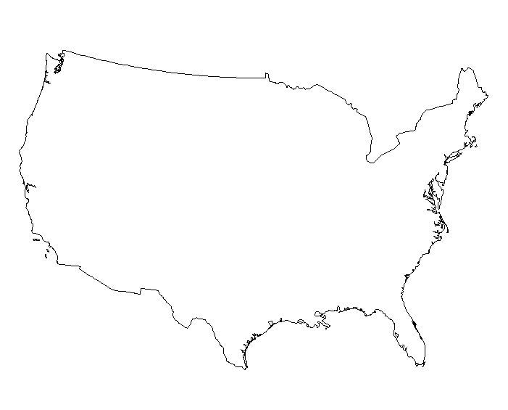
ActiveCDN Demo – watermarking
Screen 1
Screen 2
Screen 3
User 1 downloads and watches video content from provider
Step 1
Content
server
User 1
Content server sends on-path signal to install ActiveCDN module into NetServ router
Content
server
NetServ
node
Step 2
N
User 1
User 2
User 2’s request gets redirected to NetServ router, which serves processed video
Content
server
NetServ
node
Step 3
N
User 1
Watermark

Slide 60
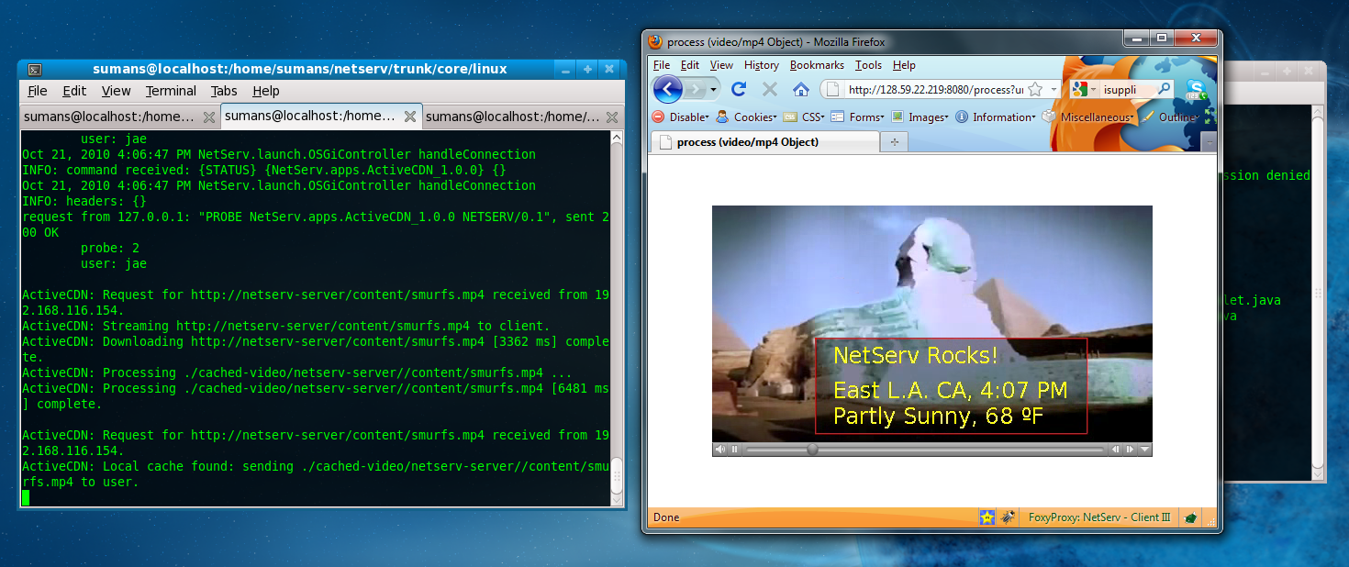
ActiveCDN screenshots
NetServ router:
Installation of module
Stream/download content
Process content
Serve to end user
Client browser
First request: served by content server
Second request: redirected to NetServ node
Third request: processed/cached content

Slide 61
Some background info
Watermarking
  Done using Xuggler: Java library with native hooks into FFMPEG, LAME audio library, etc.
Weather information
  Using XML feed from weather.gov, which takes latitude/longitude info and returns weather information
  Use Java’s XML library and Xpath to get relevant data from feed
  MaxMind GeoIP library which is great for public IP geo-location,
    For GEC9: all IP addresses in demo use private Ips
    Used a “translation table” to map private IPs to real latitude/longitude

Slide 62
ActiveCDN Demo – module migration
Tell:
PlanetLab nodes run scripts fetching small files from the web server
ActiveCDN modules with short TTL keep getting installed and removed
PlanetLab scripts are choreographed to make modules migrate westward!
Step 1
Screen 2:
NetServ nodes popping up
In the eastern region
Screen 3:
Web traffic generated from eastern PlanetLab nodes
Step 2
Idea: that dynamic traffic patterns can be efficiently handled by ActiveCDN
Screen 1:
Web traffic generated from western PlanetLab nodes
Screen 2:
(Flickering) NetServ nodes migrating to the wild west!

Slide 63
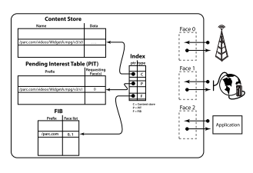
Content-Centric Networking
Concept: we are moving
away from host-centric
networking towards
content-centric
networking
Most prominent work: CCNx from Xerox PARC
Idea: issue Interest packets, get Data responses, content routing handled in network

Slide 64
CCNxServ: Services in CCNx
CCNx is great for static content
  But how about dynamic services?
CCNxServ: services for CCNx
  Runs on top of “pure” CCNx stack
    As opposed to related work (SCN, SoCCeR) that modifies CCNx stack
  Uses dynamic loading (OSGi/NetServ) in combination with CCNx naming scheme
  Service modules retrieved through CCNx

Slide 65
Services in CCNx
CCNx
NetServ
1
Receives service request
4
5
2
Fetches content and services
Installs NetServ
module
Service module invoked
3
Signals netserv-controller
6
Content goes to CCNx space
Returns processed content
7

Slide 66
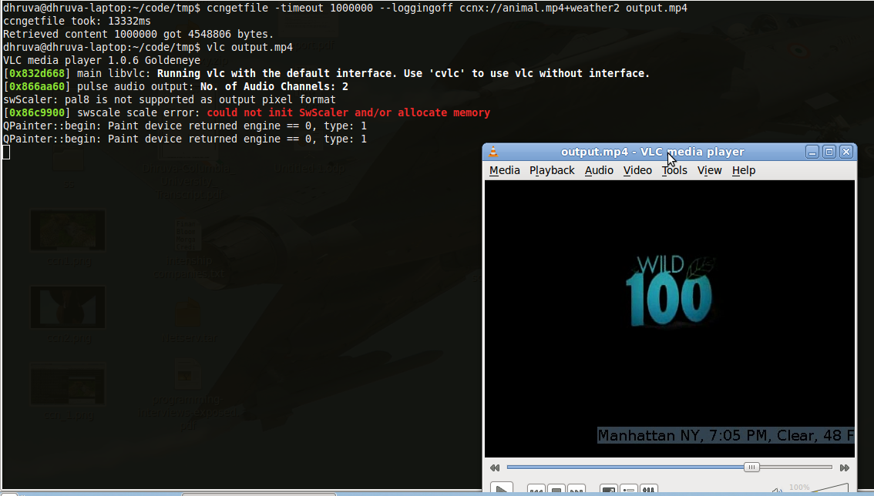
Services in CCNx - II
(Top) ccngetfile getting the CCNx content with service specified, and saving to local folder.
(Right) VLC player playing the resulting video. Note the weather watermark at the bottom right.

Slide 67
Conclusion

Slide 68
Ongoing & future work
NetServ on other devices:
  commercial router (JUNOS)
  home router
  WiMAX base station
Authorization for packet access using RPKI
Create standard APIs for service modules that wants to interact with the data path
  either the linux kernel or an OF switch
Extend NetServ signaling syntax in order to expose OF switch features
Utilize NetFPGA card as hardware processing unit
Internet multicast using NetServ

Slide 69
Conclusion
Universal programmability
  across protocol stack
  across user type
  across modality (read, modify, serve)
  across intensity – from “every packet” to flow or management-only
Integrated approach
  protection & isolation
  software installation & versioning
  http://www.cs.columbia.edu/irt/project/netserv/

Slide 70
Columbia University NetServ team
Salman Baset
Roberto Francescangeli (signaling)
Jan Janak (software engineering assistance)
Michael Kester (measurements)
Eric Liu (measurements)
Jae Woo Lee (architect, infrastructure)
Emanuele Maccherani (OpenFlow)
Wonsang Song
Suman Srinivasan (applications, CDNs, CCNx)
Henning Schulzrinne (PI)

