Slide 1
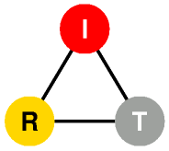
DYSWIS
(Do You See What I See)
Distributed Network Fault Diagnosis System
Kyung Hwa Kim
Henning Schulzrinne
Internet Real-Time Lab
Columbia University
June 2011

Slide 2
Motivation
Today’s Internet
Wide variety of networks
Almost every application relies on Internet connectivity
Applications rely on the proper functioning of many parties
Professional assistance is either unavailable or expensive
Users have no good way to know whom to call or what to try when things go wrong.
Too many possible causes
Fault Symptom: Web access is slow
Possible causes:
high packet loss, an overloaded residential Internet connection, IPv6-to-IPv4 failover, wide-area network problems, a misconguration in the NAT box, or a remote server problem.
Existing approaches
Centralized system: difficult to know exact situation of end-users
End-user software: difficult to know what happens in network core system
We develop “End-user based Collaborative system”
Why collaboration?
To collect diverse information from different parts of the networks and infer the cause of failure.
Notes:
Wide variety of networks from home and office to WiFi hotspots and cellular networks.
Almost every application, from calendars to games, relies on Internet connectivity
Applications often rely on the proper functioning of up to half a dozen parties, from the local wireless network to DNS servers, CDNs and various middleboxes.
For all of these components, professional assistance is either unavailable or expensive, so that most users have to become unwilling network administrators (or rely on their children and technically-savvy friends for support).
The appropriate action differs in each case, ranging from using a third-party DNS server to simply waiting and hoping that the server recovers.

Slide 3
DYSWIS Design Overview
What is DYSWIS?
Distributed network fault detection and diagnosis framework
End-to-End
Collaboration of end-users
Crowdsourcing of diagnosis strategy
Which faults do we detect?
Faults on personal computing machines of end users
How to detect a fault?
Monitor and analyze network raw data
Declare a fault when suspicious behavior is detected
How to diagnose the fault?
Dynamic diagnosis
Self probing
Remote probing
Static diagnosis
Distributed knowledge database

Slide 4
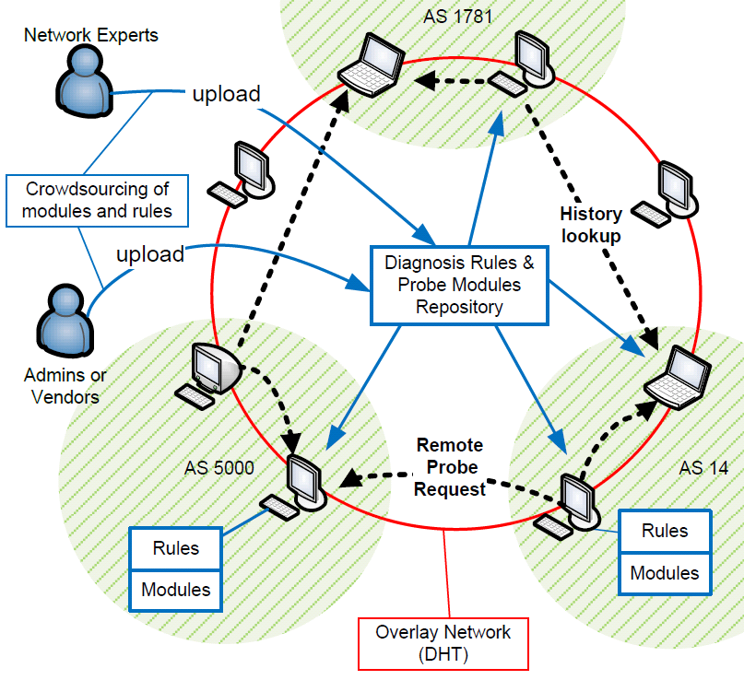
DYSWIS Design Overview
A Complete Framework
End-to-End
Collaboration
Crowdsourcing

Slide 5
Fault Detection
Packet flow data
Session-based
Collect flow of transaction
Create
Session
GET
-------------------
countGet = 1;
RESP
-----------
GET
---------------------
countGet = 1;
GET
-------------------------------
countGet++;
RESP
GET
RESP == 200 && countGet > 1
-------------------------------------------
countGet --;
RESP ==200 && countGet == 1
--------------------------------------------
countGet = 0;
Timeout
RESP !=200
--------------------
Create fault
Timeout
---------------
Create fault
Close
Session
Fault
Timeout
Fault
Sample FSM – HTTP Session

Slide 6
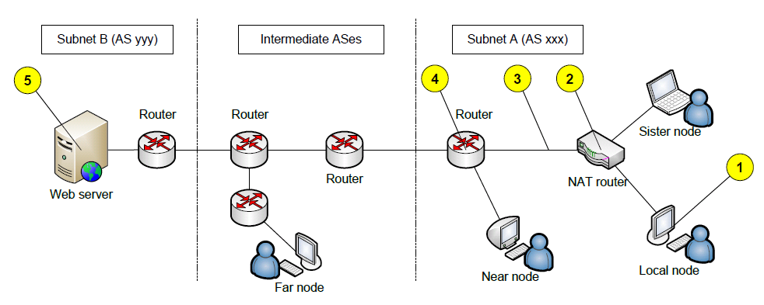
Searching Collaborative Nodes
Local Node
A node currently diagnosing the faults
Sister Node
A node sharing the same NAT device with the local node.
Near Node
A node within the same subnet as the local node
Far Node
A node located in any other subnets.

Slide 7
Searching Nodes
Leveraging Key-Value system of DHT
Key
Network type (e.g. public, NAT)
Location (subnet information)
Value
IP address and port number of the collaborating node

Slide 8
Diagnosis Rule (Decision Tree)
Network connectivity?
No
Yes
Connectivity Problem
Can local nodes
Connect to the
Destination port?
No
Can far nodes
Connect to the
Destination port?
Server Problem
No
Yes
Yes
Go to another flow
Subnet Problem

Slide 9
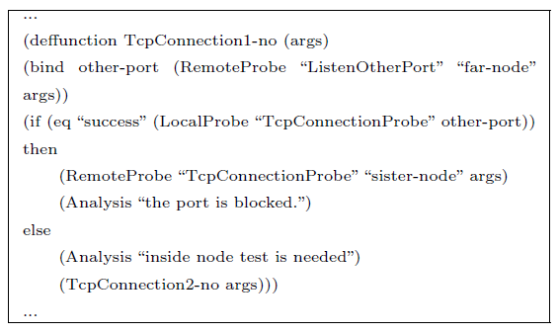
Diagnosis Rule
Using pre-defined ‘rules’ to invoke appropriate probing
Separate the policy from the mechanism
Create and modify diagnosis rules without re-compiling

Slide 10
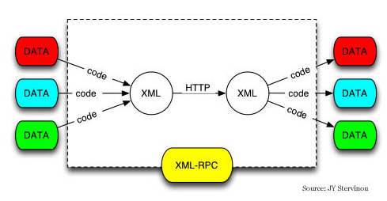
Probing
Active probing
The pre-obtained knowledge can be stale
Once probing is requested, the collaborative peers probe the faults dynamically in real time
Probing request via XML-RPC

Slide 11
Crowdsourcing of diagnosis strategies
Add new functionality
Creating probing modules
Open API
Any software developer can build and distribute a new module that handles new protocol or application
Need compile
Modify or add diagnosis policy
Creating & Modifying Rules
Open Rules
Any user, developer, system administrators can build new customized rules for to diagnose new faults
No compile needed

Slide 12
Crowdsourcing Process
1. Investigate the fault scenario
2. Select probing modules
3. Create a decision tree
4. Write a diagnosis rule
5. Deploy and update

Slide 13
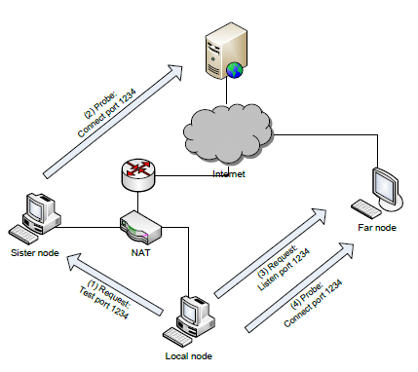
Use Cases
Port Blocking

Slide 14
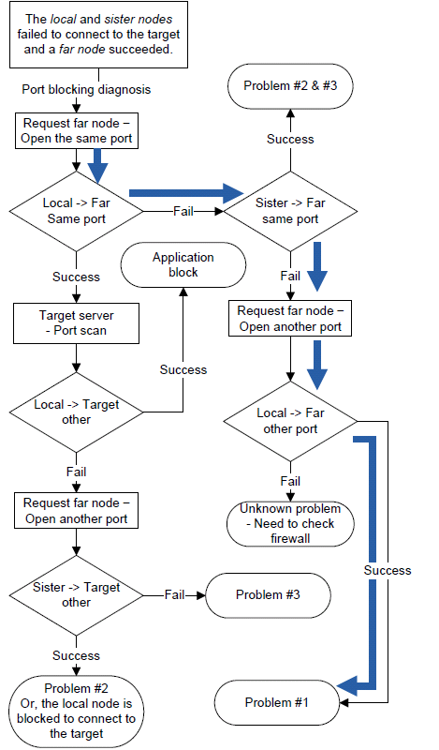
Flow Chart of Port Blocking Diagnosis
#1. Is the outbound port blocked?
#2. Is a local firewall running?
#3. Does the target sever block the local node?
#4. Other problems?

Slide 15
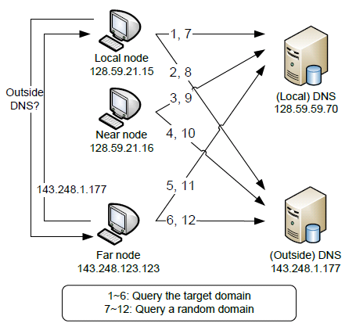
Use Cases
DNS failure

Slide 16
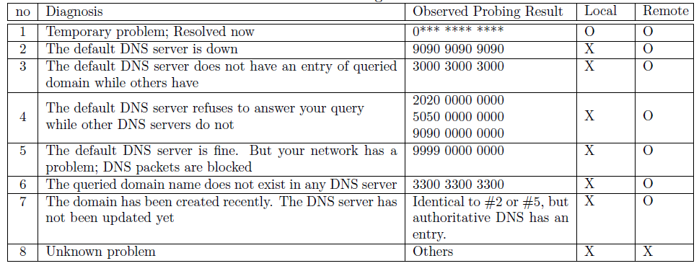
DNS Failure
Diagnosis and Analysis

Slide 17
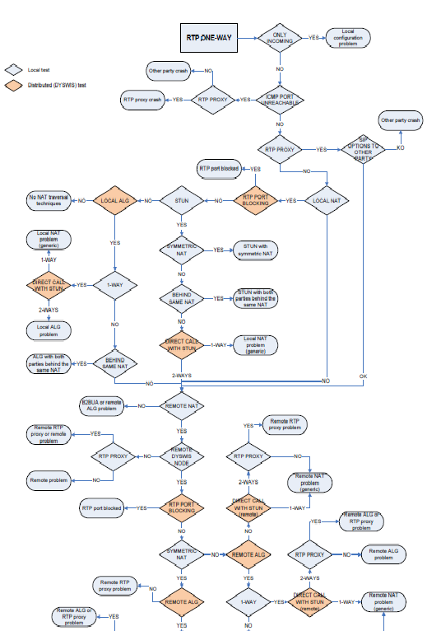
One-way RTP Diagnosis

Slide 18
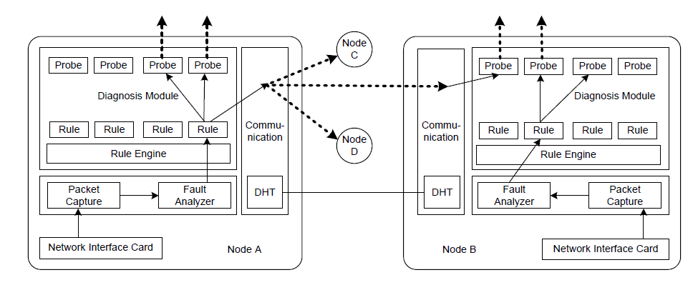
Implementation (Modules)
Java-based framework
Libraries: Jess, AzDHT, Jpcap, etc.

Slide 19
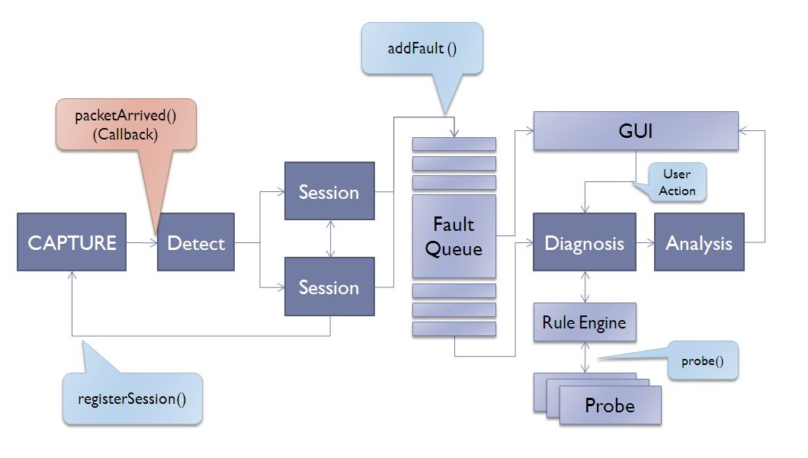
Implementation (Flow)

Slide 20
Modularity
OSGi technology
Dynamic module system for Java
Modules loaded and unloaded at runtime
Bundle: self-contained JAR file with specific structure
Open-source implementations: Apache Felix, Eclipse Equinox
Security and accounting
Security built on Java 2 Security model
Permission-based access control
No fine-grained control or accounting for CPU, storage, bandwidth
Can load native code with appropriate permission
Strict separation of bundles
Classpath set up by Bundle class loader
Inter-bundle communication only through published interfaces
NetServ, [IRT Talk 2009], Jae Woo Lee

Slide 21
OSGi technology
Web Server
End User
DYSWIS
Bundle
Repository
Probing
bundle
Probing
bundle
Probing
bundle
DYSWIS main bundle
Polling
DYSWIS Update bundle
OSGi Felix launcher

Slide 22
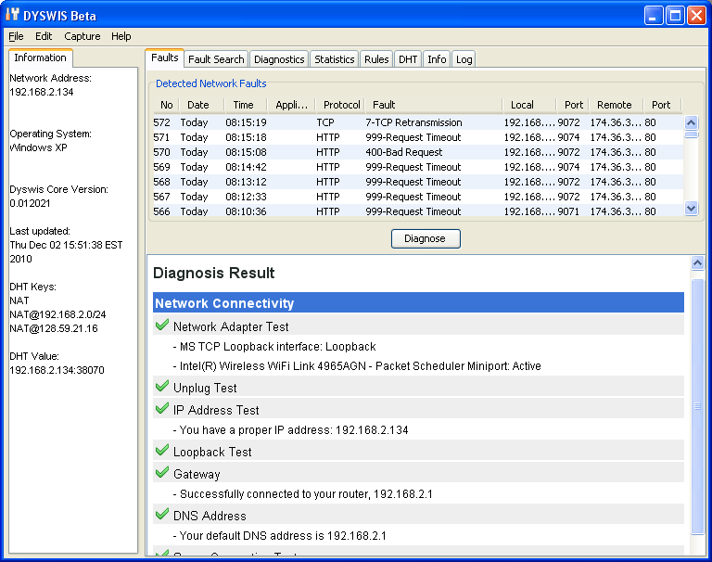
Screenshots

Slide 23
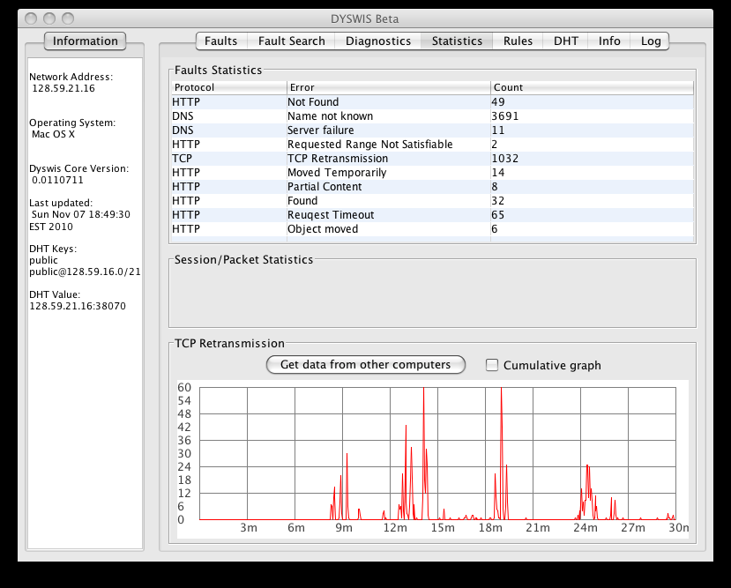
Screenshots

Slide 24
Issues
Main Issues
Overhead of capturing packets
Inconvenient manual development process
How to evaluate?
Security and Privacy
Next steps
DYSWIS with smartphone
Diagnose the Internet problems using mobile network
Secure DYSWIS
DYSWIS on Cloud Computing

Slide 25
Summary
DYSWIS
Distributed network fault detection and diagnosis system
End-to-End
Automatic fault detection and diagnosis
User-friendly interface
Collecting scenarios
Raw data, Survey, Flow data
Implementation Design Factors
Modularity: OSGi technology
Separation: Rule technology
Extensibility: Open API and Rules
Next strategies
Apply to various network fault situations
Cloud computing
Smartphone
Worm, virus, attack
Wireless

