Slide 1
Candidacy Exam
Topic: Privacy in Location Based Services
Wonsang Song
Columbia University

Slide 2
Agenda
Introduction of LBS
Threats to location privacy
Privacy protection techniques
Conclusion

Slide 3
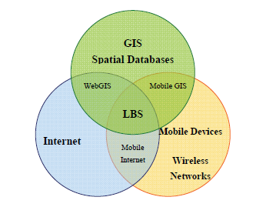
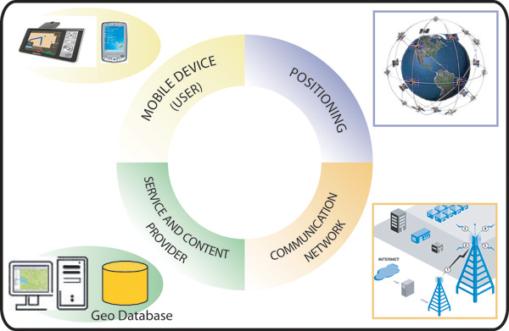
What is LBS?
Location service, location-aware service, location-based service
* A. Brimicombe. GIS – Where are the frontiers now? GIS, 2002.
* S. Steiniger, M. Neun, and A. Edwards. Foundations of Location Based Services. Lecture Notes on LBS, 2006.

Slide 4
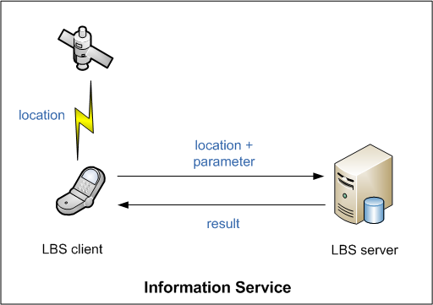
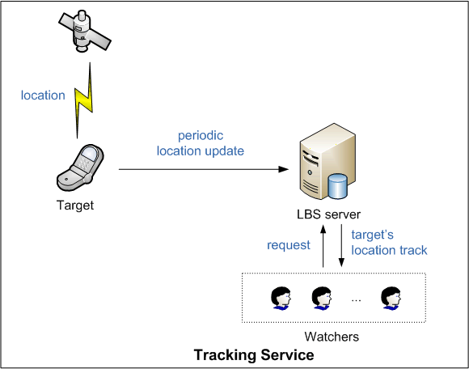
LBS Applications
LBS Applications
Information
Service
Tracking
Service
POI
Advertising
Navigation
Emergency
People / Vehicle Tracking
Tolling
Yellow page
- Restaurant search
SMS alert
- Target marketing
Car navigation
- Geocaching
9-1-1 call
Children monitoring
- Fleet management
Highway tolling (GPS-based)

Slide 5
Location Privacy
Location privacy
  “the ability to prevent other parties from
  learning one’s current or past location” - Beresford and Stajano
Critical in context
  Location + time + identity
Why important?
  Physical security
  Location tells more.

Slide 6
Threats to Location Privacy
Revealing identity
  Pseudonymity is not enough.
  Inference attack¹⁾
Tracking and predicting movement
  Collecting LBS queries to track location
  Data mining²⁾
And more…
  More privacy-sensitive information
  e.g., medical condition, political/religious affiliation
  Linkage attack
1) J. Krumm. Inference Attacks on Location Tracks. Pervasive, 2007.
2) Y. Ye, Y. Zheng, Y. Chen, J. Feng, X. Xie. Mining Individual Life Pattern Based on Location History. MDM, 2009.

Slide 7
Challenges in LBS
Balance between convenience and privacy
To prevent improper or unauthorized use of location
    Gathering location without notice or user’s consent
    Using location beyond the permission
    Reidentification and tracking

Slide 8
Solutions for Location Privacy
Policy-based Solutions
Anonymity-based solutions
PIR-based solutions

Slide 9
Solutions for Location Privacy
Policy-based Solutions
Anonymity-based solutions
PIR-based solutions

Slide 10
W3C Geolocation API
Scripting API for device location
  getCurrentPosition(): “one-shot” location
  watchPosition() / clearWatch(): start/stop repeated position update
Implementations
  Firefox 3.5+, Google Chrome, IE 7 with Google Gears
    Google location service (IP, Wi-Fi fingerprint)
  Mobile Safari in iPhone
    Wi-Fi (Skyhook), cellular, GPS
* Geolocation API Specification. W3C, 2009.
* N. Doty, D. Mulligan, E. Wilde. Privacy Issues of the W3C Geolocation API. UC Berkeley: School of Information. Report 2010-038, 2010.

Slide 11
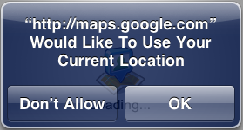
W3C Geolocation Privacy Requirement
User Agents
  Send with permission
    Express permission
    Persistent permission
  Allow revocation
  Allow prearranged trust relationship
    e.g., 9-1-1
Recipients
  Request when necessary
  Use for the task
  Don’t retain without permission
  Don’t retransmit without permission
  Disclose privacy practices
    e.g., purpose, duration, storage security
?
* Geolocation API Specification. W3C, 2009.
* N. Doty, D. Mulligan, E. Wilde. Privacy Issues of the W3C Geolocation API. UC Berkeley: School of Information. Report 2010-038, 2010.

Slide 12
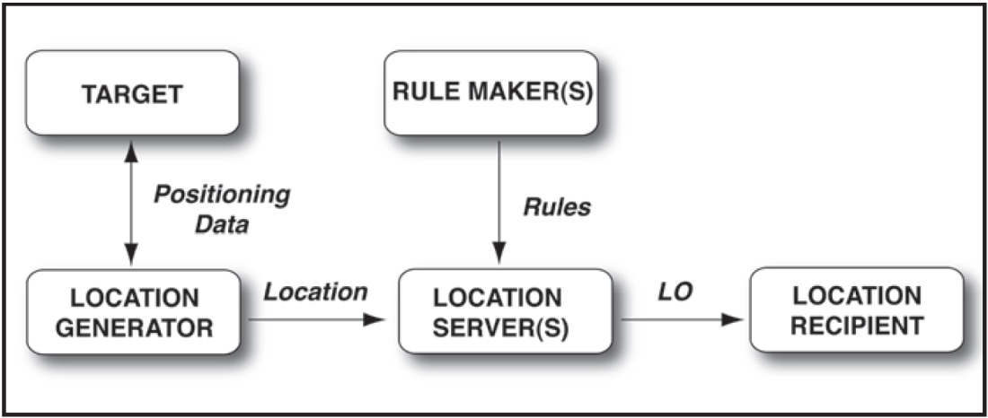
IETF Geopriv Architecture
Providing standard mechanism for
  Transmission of location
  Privacy-preserving
  Protocol independent
Basic architecture
Binding rules to data
LO = location + privacy rule
Conveying user’s preference with location
* R. Barnes, M. Lepinski, A. Cooper, J. Morris, H. Tschofenig, H. Schulzrinne. An Architecture for Location and Location Privacy in Internet Applications. IETF Internet Draft, 2009.

Slide 13
IETF Geopriv Architecture
Privacy rule
  Basic ruleset
    e.g., retransmission-allowed, retention-expiry, …
  Enhanced ruleset
    Rule set = list of rules
    Rule = condition + action + transformation
    Default-deny, adding permission only
Privacy paradigm
  Decision maker: recipient → user
  Non-technical forces can enforce it.
* H. Schulzrinne, H. Tschofenig, J. Morris, J. Cuellar, J. Polk, J. Rosenberg. Common Policy: A Document Format for Expressing Privacy Preferences. RFC 4745, 2007.
* H. Schulzrinne, H. Tschofenig, J. Morris, J. Cuellar, J. Polk. Geolocation Policy: A Document Format for Expressing Privacy Preferences for Location Information. IETF Internet Draft, 2009.

Slide 14
Policy-based solutions
+ | W3C Geolocation | IETF Geopriv
Applicable service | Information / Tracking | Information / Tracking
Target application | Web-based service | Generic service
Creator of privacy policy | Recipients (web sites) | Users
Role of users | Grant permission | Set privacy ruleset
Supporting location type | Geodetic | Civic and Geodetic
Needs trusted 3rd party | No | Yes (location server)
Needs non-technical enforcement | Yes | Yes

Slide 15
Solutions for Location Privacy
Policy-based Solutions
Anonymity-based solutions
PIR-based solutions

Slide 16
Anonymity-based Solutions
Anonymity and anonymity set
  “the state of being not identifiable within a set of subjects, the anonymity set”*
  anonymity set  anonymity
Anonymize data before collection
* A. Pfitzmann, Marit Kohntopp. Anonymity, Unobservability, and Pseudonymity - A Proposal for Terminology. LNCS, 2001.

Slide 17
Mix Zone
Middleware architecture
  Users register/sending location to the proxy.
  Proxy sends/receives queries to/from LBS providers.
Solution
  Mix zone
    Changing pseudonym in the mix zone
    Not sending queries in the mix zone
  Adversary cannot link what are going into and what are coming out.
p₁
p’₂
Mix Zone
p₂
p’₃
p₃
p’₁
* A. Beresford, F. Stajano. Location Privacy in Pervasive Computing. IEEE Pervasive Computing, 2003.

Slide 18
Mix Zone
Limitations
  Need to trust the proxy
  Single point of failure
  Need enough users
    Size of anonymity set = # of users in the mix zone at the time
  Cannot preserve users’ reputation at LBS providers
    Same as services without any pseudonym

Slide 19
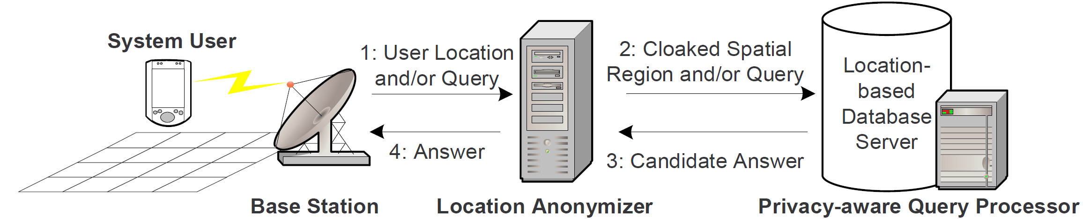
k-anonymity
Location k-anonymity
  Iff location of the subject is indistinguishable from location of at least k - 1 other subjects.
  Pr = 1 / k
Middleware architecture
* M. F. Mokbel, C. Chow, W. G. Aref. The new Casper: query processing for location services without compromising privacy. VLDB, 2006.

Slide 20
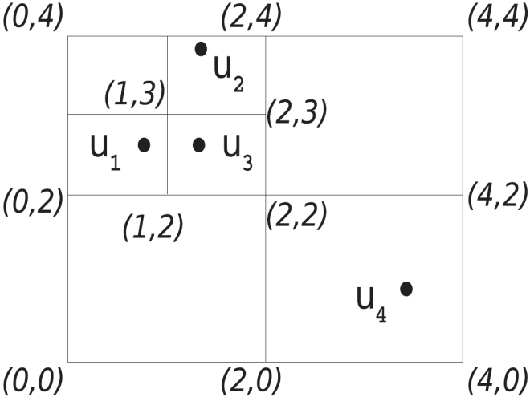
Cloaking algorithm
Input: location of all users
k_{min}: desired minimum anonymity
Output: quadrant containing k users
k_{min} = 3
* M. Gruteser, D. Grunwald. Anonymous Usage of Location-Based Services Through Spatial and Temporal Cloaking. MobiSys, 2003.

Slide 21
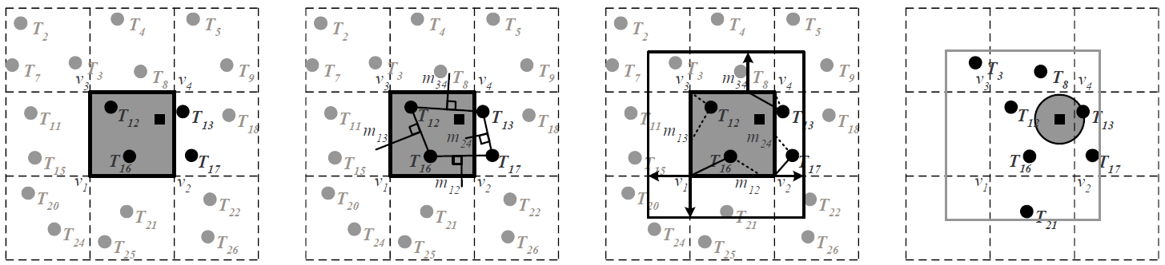
Casper: Query Processing
Privacy-aware query processor
  Embedded in the LBS provider
  Deals with cloaked spatial area
  Input: cloaked spatial region + search parameters
  Output: candidate list
    inclusive and minimal
* M. F. Mokbel, C. Chow, W. G. Aref. The new Casper: query processing for location services without compromising privacy. VLDB, 2006.

Slide 22
Using Dummies
Drawbacks of k-anonymity
  Needs at least k - 1 users nearby
  Needs to trust 3rd party
  → Client sends false location with true location
Dummy generation algorithm
  How realistic? Just random?
  Moving in neighborhood
    Location of dummy = previous loc ± margin
* H. Kido, Y. Yanagisawa, T. Satoh. An anonymous communication technique using dummies for location-based services. ICPS, 2005.

Slide 23
Anonymity-based Solutions
+ | Mix-zone | k-anonymity | Using dummies
Applicable service | Information | Information | Information service with userid
Target of obfuscation | pseudonym | location | location
Possibility of failure | Yes | Yes | No
Necessity of trusted 3rd party | Yes | Yes | No
Security risk | High | High | Low
Waste of resource | No | No | Yes
Privacy risk | Sender address is not revealed. Re-identification is possible but in very limited area. Location tracking is not possible. | Sender address is not revealed. Re-identification is not possible. Location tracking is not possible. | Sender address can be revealed. Re-identification is possible.* Location tracking is not possible.

Slide 24
Solutions for Location Privacy
Policy-based Solutions
Anonymity-based solutions
PIR-based solutions

Slide 25
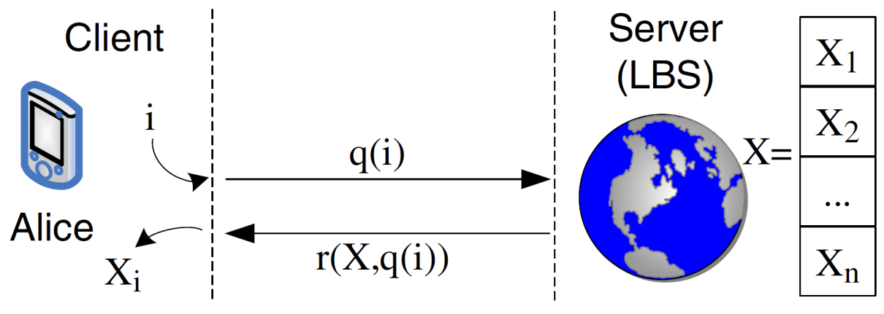
What is Private Information Retrieval?
Problem
  DB: n bits, (X₁, X₂, …, X_{n})
  Client: wants X_{i}
Requirement
  Privacy: Server does not learn i.
  Maybe: Client learns nothing more than X_{i.}
* E. Kushilevitz, R. Ostrovsky. Replication Is Not Needed: Single Database, Computationally-Private Information Retrieval. FOCS, 1997.

Slide 26
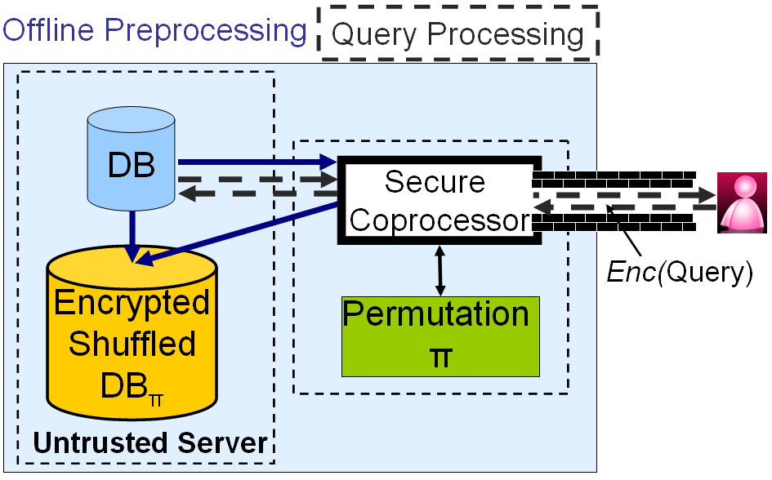
SPIRAL: Hardware-based PIR
Hardware-based PIR
  Secure coprocessor
  Push trusted entity to LBS provider
Preprocessing
  generates π, shuffles DB into DB_{π}, and encrypts DB_{π}
  written back encrypted DB_{π} to the server
Online query processing
  gets encrypted query, and decrypts it
  performs query
  returns encrypted result
DB = {o₁, o₂, o₃}
DB_{π} = {o₃, o₁, o₂}
π = {2, 3, 1}
DB[i] = DB[π[i]]
* A. Khoshgozaran, H. Shirani-Mehr, C. Shahibi. SPIRAL:A Scalable Private Information Retrieval Approach to Location Privacy. PALMS, 2008.

Slide 27
Computational PIR
Quadratic Residuosity Assumption
  x²  a (mod N), for some x, then a is QR mod N
    e.g., 1² = 1  1 (mod 7)
    2² = 4  4 (mod 7)
    3² = 9  2 (mod 7)
    4² = 16  2 (mod 7)
    5² = 25  4 (mod 7)
    6² = 36  1 (mod 7)
  QR predicate Q_{N} (i.e., a function to determine a given number is QR mod N) is assumed to be super-polynomial when N = pq, p and q are two primes.
Procedure of cPIR
  Client sends a random vector y satisfying Q_{N}(y_{i}) = false, Q_{N}(y_{j≠i}) = true.
  Server produces and sends back a vector z out of y and the database x using a matrix operation f:
  z = f (x, y)
  Client can determine x_{i}
  if z_{i}  QR mod N, x_{i} = 0
  z_{i}  QR mod N, x_{i} = 1
* G. Ghinita, P. Kalnis, A. Khoshgozaran, C. Shahabi, K. Tan. Private queries in location based services: anonymizers are not necessary. SIGMOD, 2008.

Slide 28
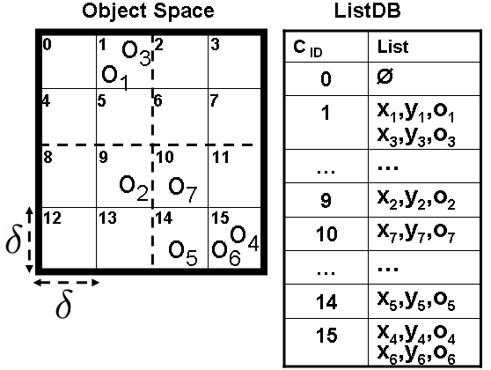
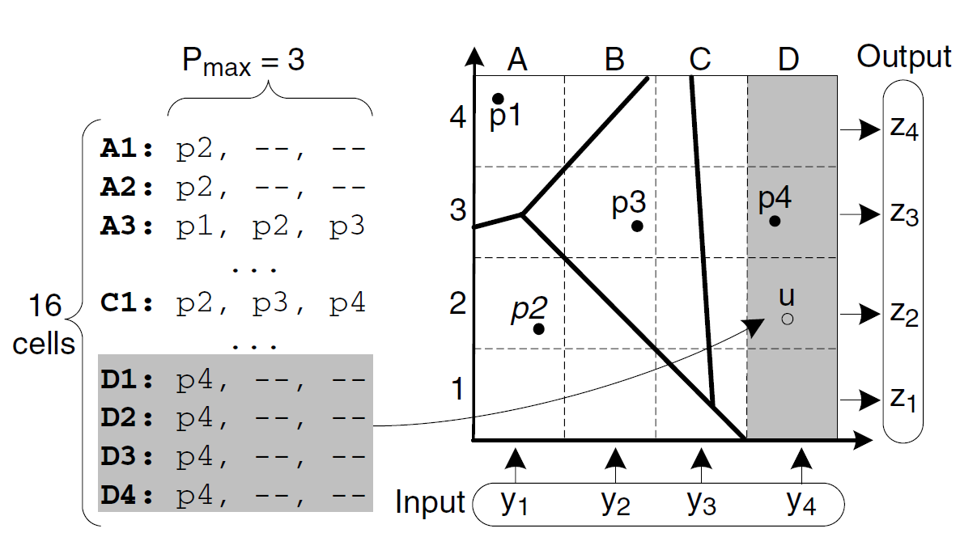
How to apply PIR to LBS?
2D -> 1D
  Converts spatial query to PIR using grid structure.
  Shares grid with users.
* A. Khoshgozaran, H. Shirani-Mehr, C. Shahibi. SPIRAL:A Scalable Private Information Retrieval Approach to Location Privacy. PALMS, 2008.
* G. Ghinita, P. Kalnis, A. Khoshgozaran, C. Shahabi, K. Tan. Private queries in location based services: anonymizers are not necessary. SIGMOD, 2008.

Slide 29
Computational PIR
Pros
  No information is revealed to LBS provider.
  No 3rd party is necessary.
Cons
  Communication cost
    PIR: 2MB (N = 768bits)
    k-anonymity: 8KB (16K users, k = 50)
  Overhead in server CPU
    6sec (N = 768bits, P4 3.0GHz)
* G. Ghinita, P. Kalnis, A. Khoshgozaran, C. Shahabi, K. Tan. Private queries in location based services: anonymizers are not necessary. SIGMOD, 2008.

Slide 30
 | Policy-based | Anonymity-based | PIR-based
Applicable services | Information, Tracking | Information | Information
Requirement for safeguard | High | Low | Low
Needs non-technical enforcement | Yes | No | No
Trusted entity | Service provider | Anonymizer | Hardware maker Cryptography
Privacy guarantee | Low | High | Very high
System overhead | Low | Mid | High

Slide 31
Conclusion
Location privacy threats
  Re-identification
  Tracking and prediction
  Linkage attack
Solutions
  Policy-based solutions
  Anonymity-based solutions
  PIR-based Solutions

Slide 32
Backup Slides

Slide 33
Positioning
GPS
  Radio magnetic wave
  Unidirectional: only satellite to receiver
  Endpoint-based: Privacy protected since device only knows its location
Active Badge (indoors)
  Network-based: Infrastructure knows all users’ location
Cricket (indoors)
  RF + Infra Red
  Endpoint-based: Privacy protected

Slide 34
Inference Attack
Goal: Inferring a person’s identity from location track
Experiment and result
Problems
  Inaccuracy of GPS
  Subject behavior
    Parking location ≠ home
    Multi-unit building
  Inaccuracy of phone book
    33% success with known data
Phase 1
Collecting Location
Phase 2
Finding Home Coordinates
Phase 3
Identifying Subject
GPS receivers on the cars
172 individuals during 2 weeks
Four algorithms
- Last destination
- Dwell time
- Largest cluster
- Best time
Median error: 60.7m
Lookup “phone book” to get the name
Success: 5.2%
* J. Krumm. Inference Attacks on Location Tracks. Pervasive, 2007.

Slide 35
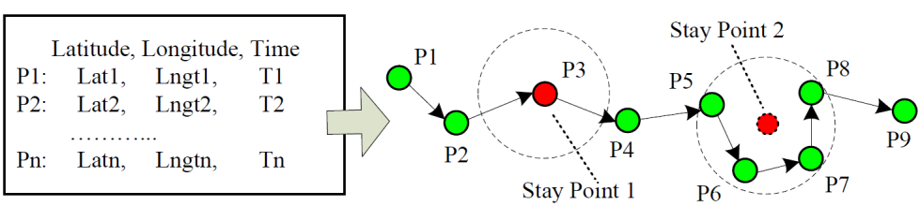
Mining Individual Life Pattern
Goal: Discover one’s general life style and regularity from location history
LP-Mine framework
  Modeling phase
    GPS data → stay point sequence → location history sequence
    Find out significant places while ignoring transition
  Mining phase
    Result: (P, s)
30 min
200 m
* Y. Ye, Y. Zheng, Y. Chen, J. Feng, X. Xie. Mining Individual Life Pattern Based on Location History. MDM, 2009.

Slide 36
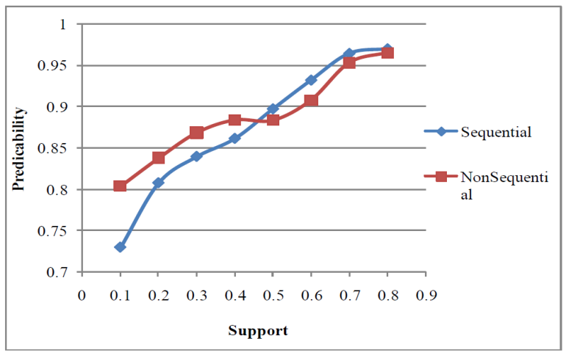
Mining Individual Life Pattern
Objective experiment
  Divides GPS data into two
    One for creating pattern
    The other for applying pattern to predict
Result
* Y. Ye, Y. Zheng, Y. Chen, J. Feng, X. Xie. Mining Individual Life Pattern Based on Location History. MDM, 2009.

Slide 37
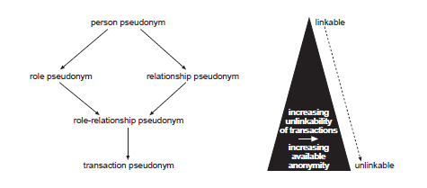
Pseudonym and Anonymity
Anonymity is increased
  Less often pseudonym is used
  More often pseudonym is changed
* A. Pfitzmann, Marit Kohntopp. "Anonymity, Unobservability, and Pseudonymity - A Proposal for Terminology". LNCS, 2001.

Slide 38
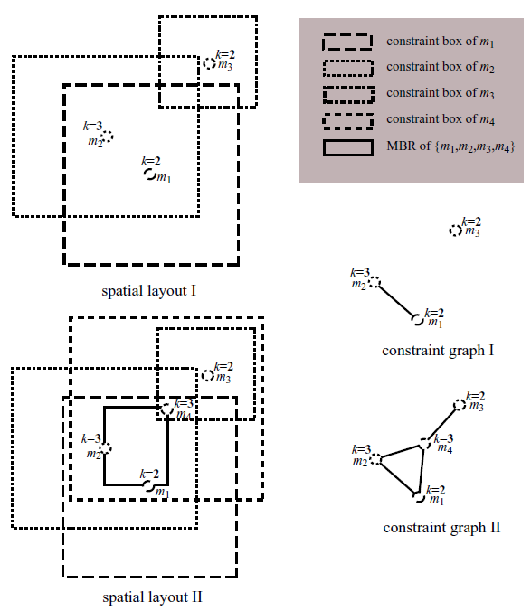
Customizable k-anonymity
Customizable framework
  User can set anonymity constraints in each query.
  Anonymity constraint
  k: desired minimum anonymity
  spatial tolerance
  temporal tolerance
Clique-Cloak algorithm
  Input: anonymity constraints
  Output: smallest cloaking box while satisfying anonymity constraint.
  Data structures
    Constraint graph
    Expiration heap
MBR of {m1, m2, m4}
* B. Gedik, L. Liu. A Customizable k-Anonymity Model for Protecting Location Privacy. ICDCS, 2005.

Slide 39
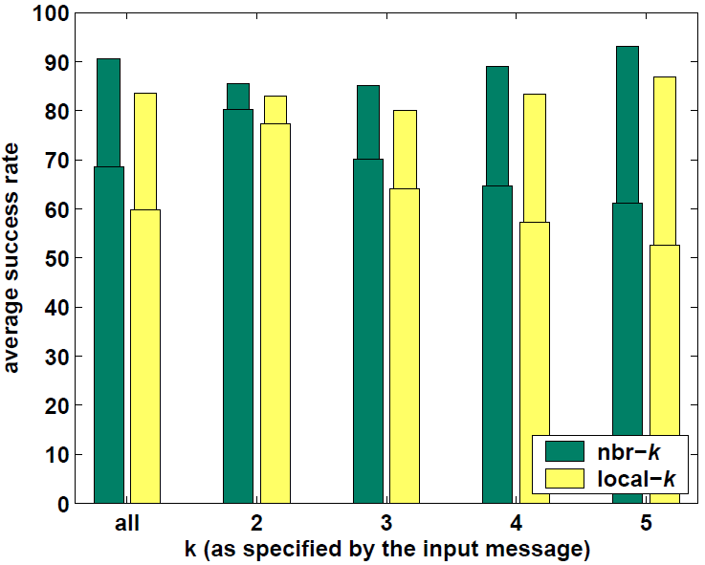
Customizable k-anonymity
Limitations
  Centralized AS
  Can fail even with optimal algorithm.
  NP-complete
  Users are on the border of MBR.
Due to non-optimal algorithm
Failure
Offline computation only
* B. Gedik, L. Liu. A Customizable k-Anonymity Model for Protecting Location Privacy. ICDCS, 2005.

Slide 40
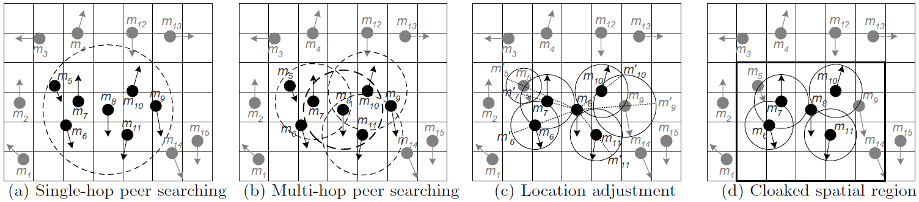
Spatial cloaking using P2P
Drawbacks of centralized architecture
  Bottleneck, single point of failure
  Having entire knowledge is privacy threat when attacked
  Distributed architecture using P2P
Solution
  Each mobile user has:
    Privacy profile (k, A_{min}): A_{min} is anonymous requirement, not the tolerance value.
  Algorithm
    Peer searching phase: use broadcast, multi-hop is allowed, receive other’s location and speed
    Location adjustment phase: consider the movement of peers
    Spatial cloaking phase: determine minimum area covering itself and k -1 others
    Selecting agent, forwarding query, and receiving candidate answers
* C. Chow, M. F. Mokbel, X. Liu. A peer-to-peer spatial cloaking algorithm for anonymous location-based service. GIS, 2006.

Slide 41
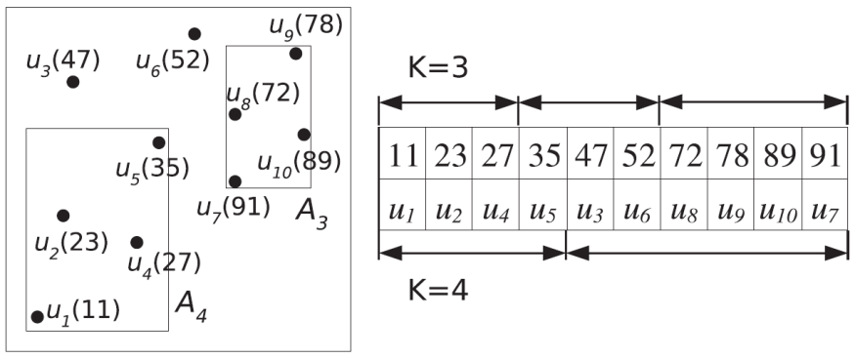
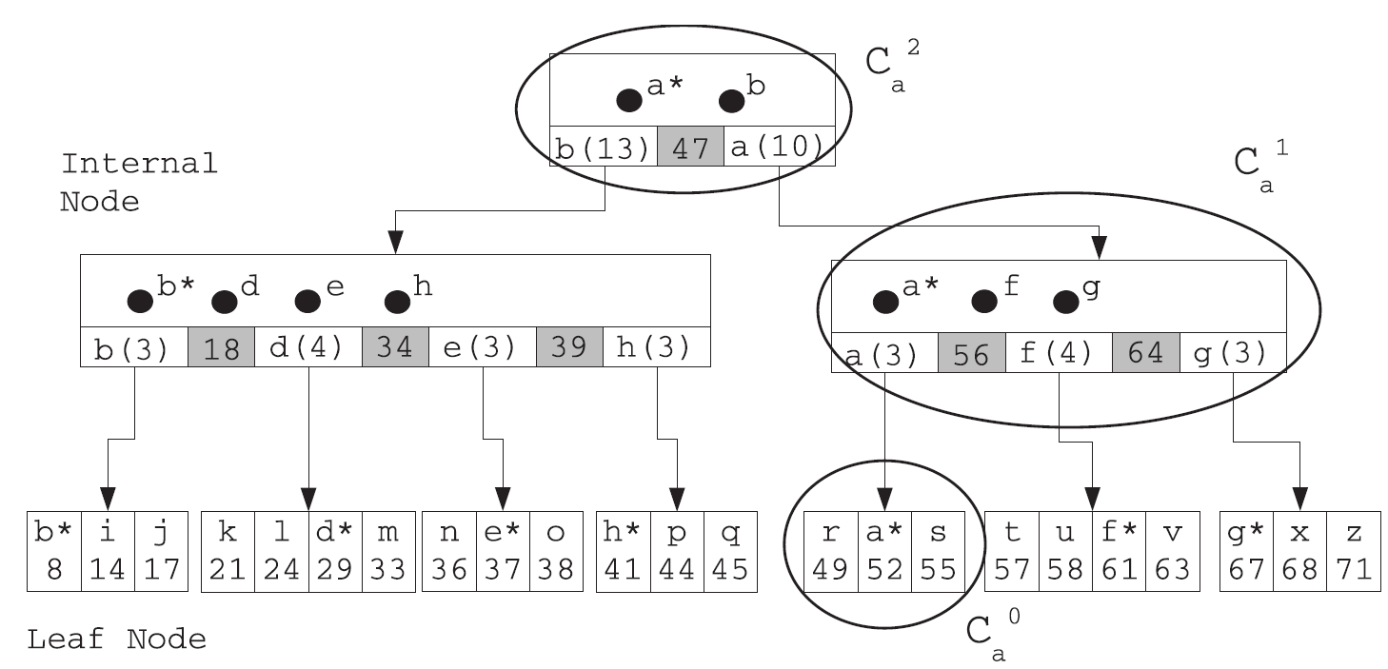
PRIVE: Distributed anonymization
Distributed architecture
  HilbASR
    grouping users into k-buckets using Hilbert value
  B+ tree structure
    index key: Hilbert value of location
    join, departure, relocation, and k-request
Pros and cons
  No single point of failure
  Provides more anonymity
    Cannot determine sender when knowing location of all
  Generates smaller cloaked spatial regions
  Needs to trust others
  Load at root, cluster headers
* G. Ghinita, P. Kalnis, S. Skiadopoulos. PRIVE: anonymous location-based queries in distributed mobile systems. WWW, 2007.

Slide 42
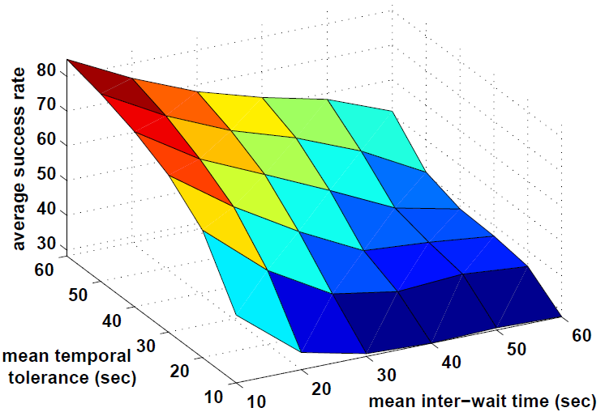
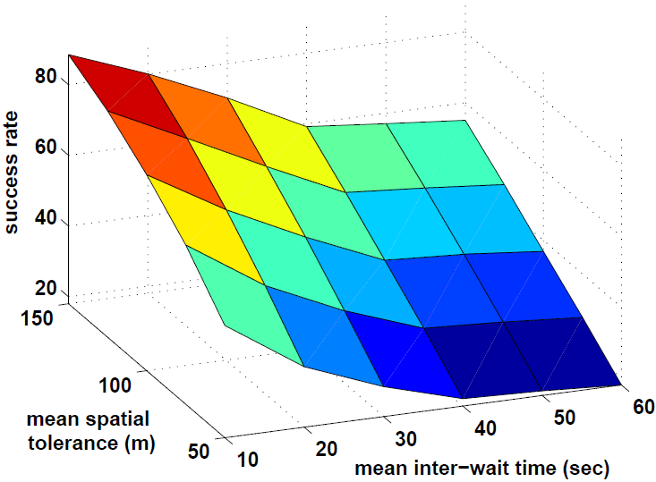
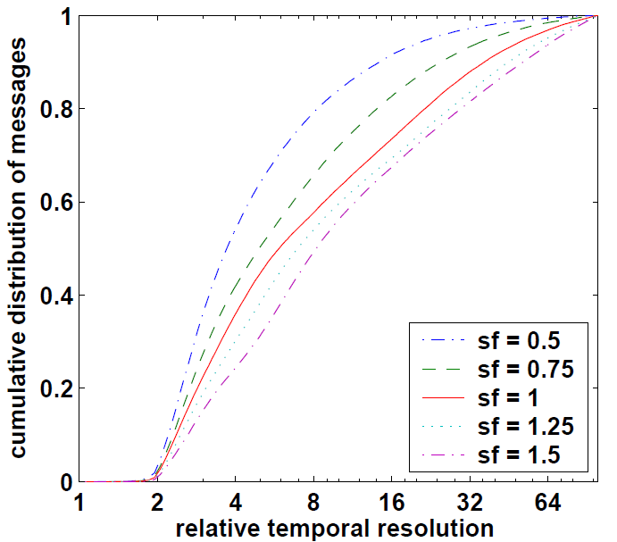
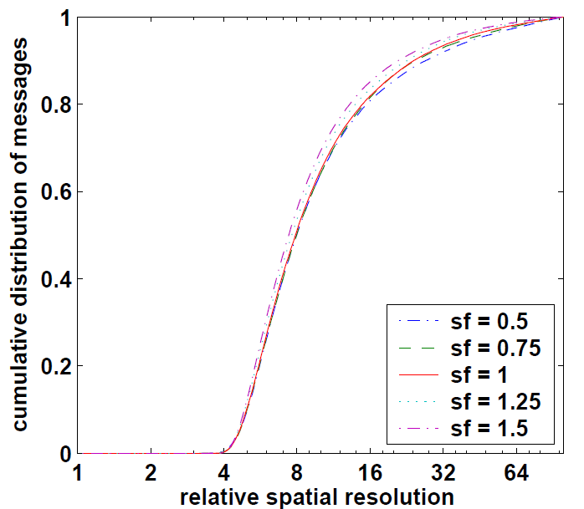
Customizable k-anonymity

Slide 43
k-anonymity
Limitations
  Need to trust AS.
  Algorithm is not optimal.
    Tends to return larger area than necessary.
    → higher processing cost
    Low population density?
  How to decide proper k?
  Might fail to protect privacy.
    In some user distributions

Slide 44
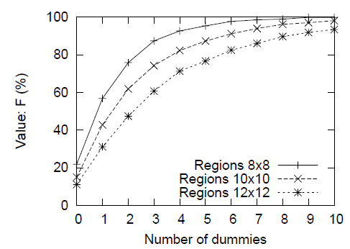
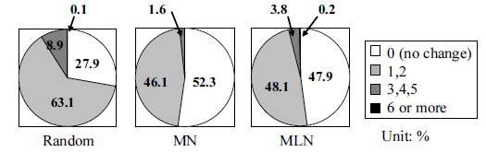

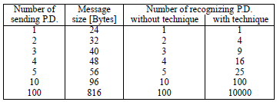
Using Dummies
Evaluation
  Ubiquity F: a scale of all regions where users stay
  Congestion P: number of users in a specific region
  Uniformity Var(P): the variance of P
  Shift(P): difference of P in each region,
  lower Shift(P) means dummies look like real persons
Relationship between dummy generation algorithms and shift(P)
Relationship between dummy generation algorithms and Var(P)
Comparison of location anonymity and number of dummies
Cost comparison for request messages

Slide 45
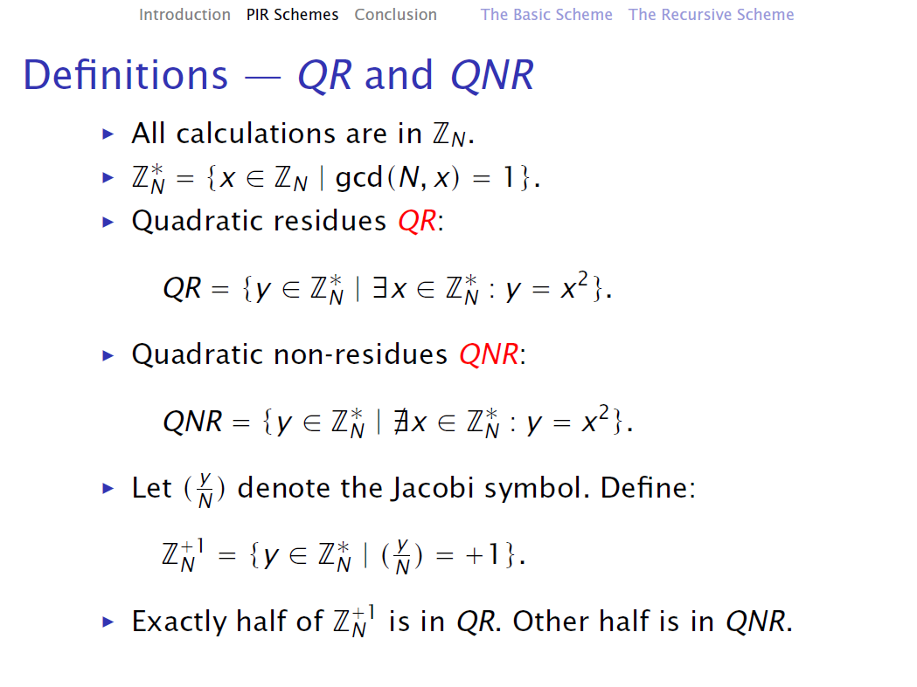
mod N}
mod N}

Slide 46
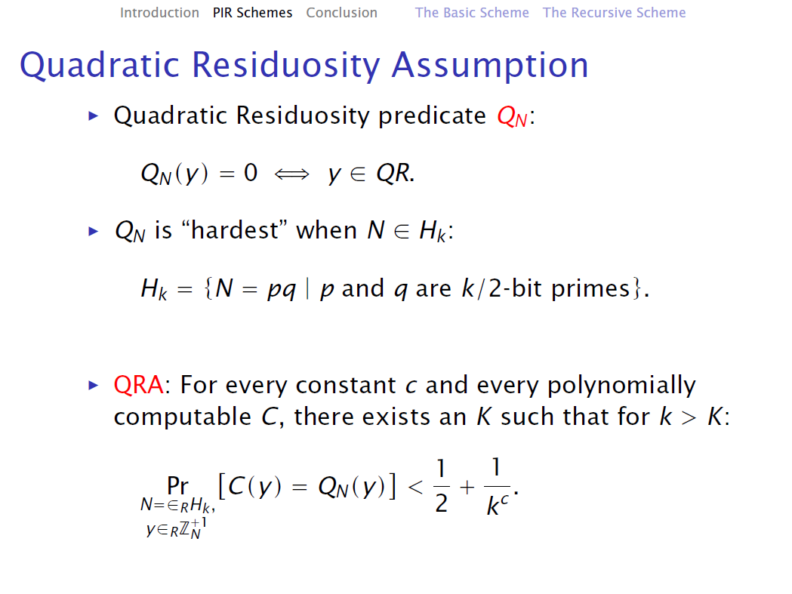

Slide 47
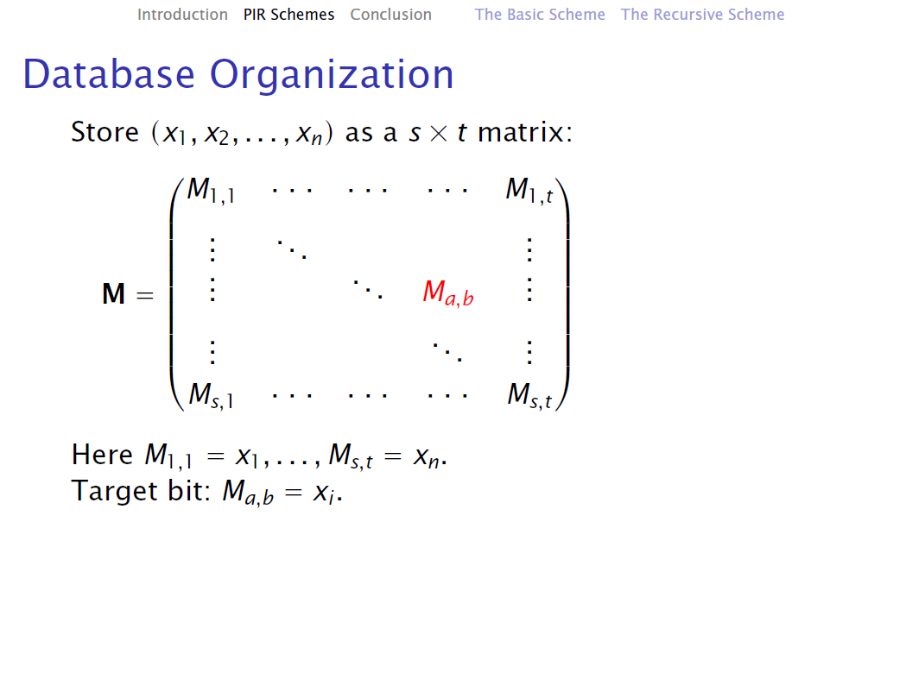

Slide 48
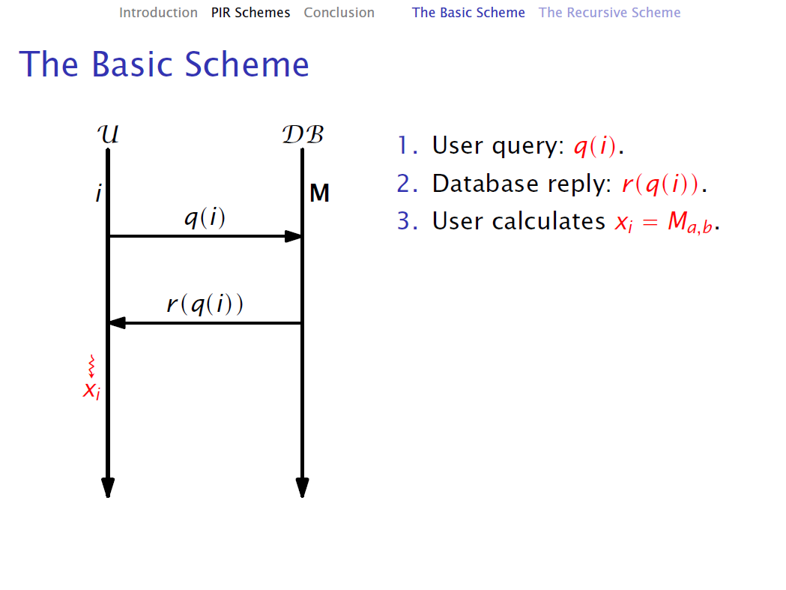

Slide 49
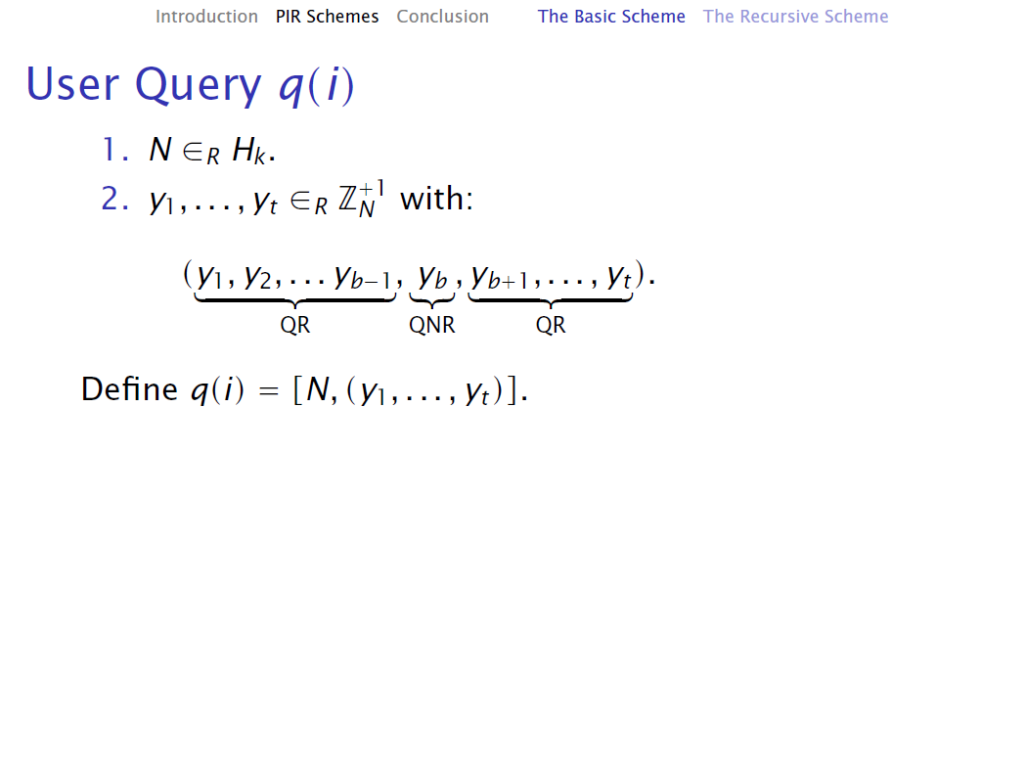

Slide 50
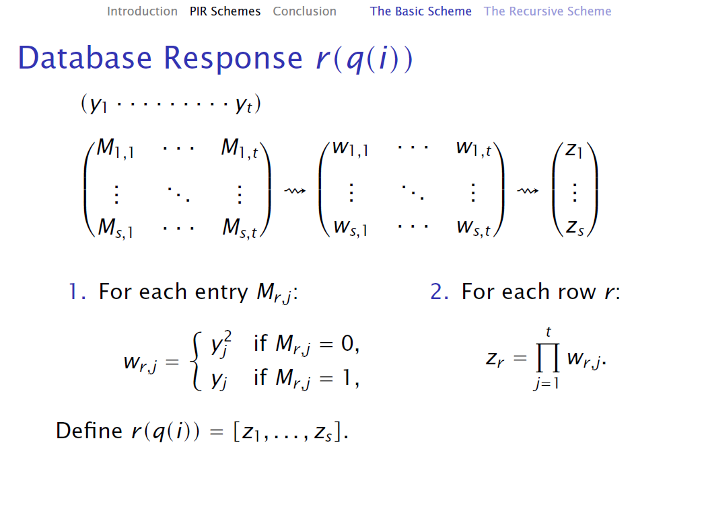

Slide 51
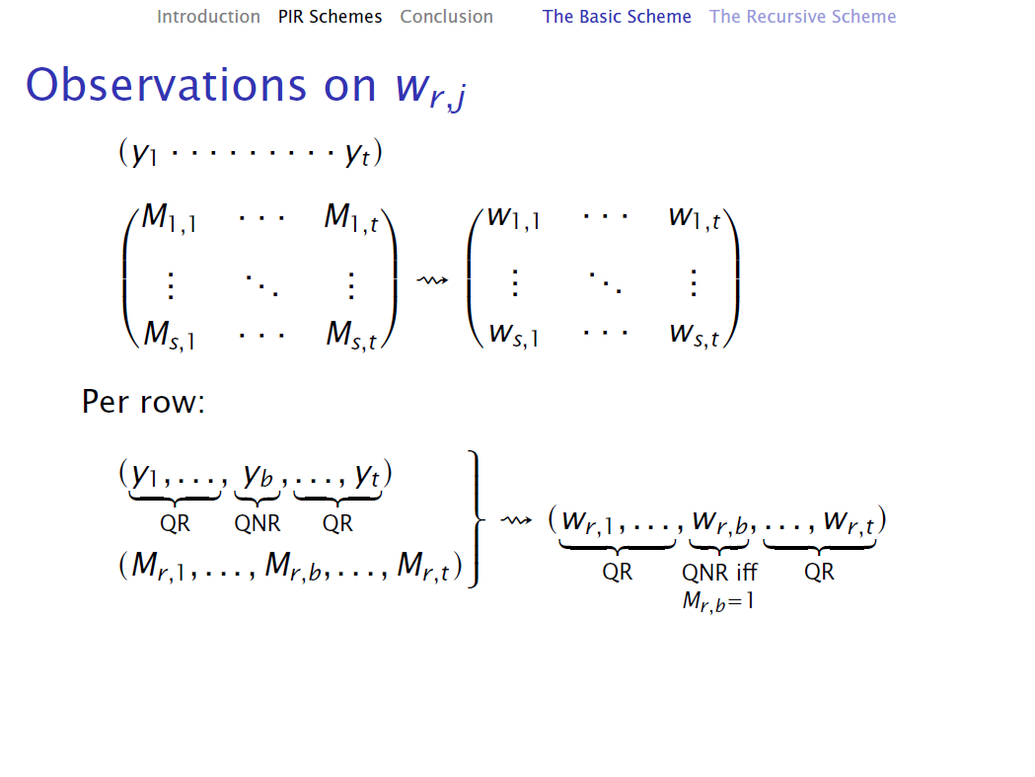

Slide 52
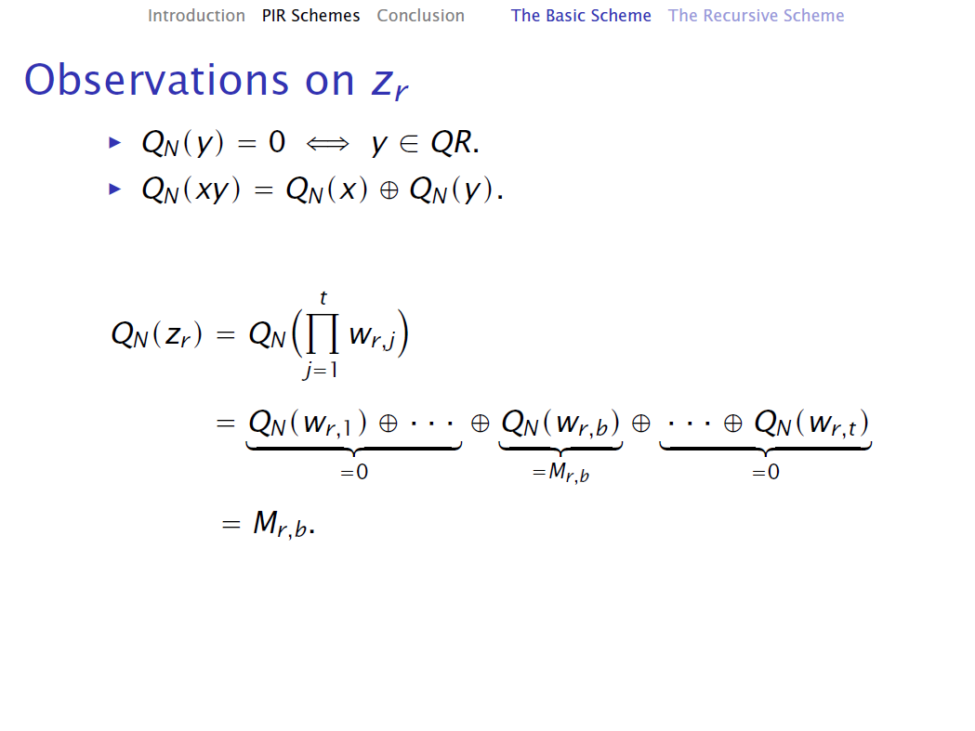

Slide 53
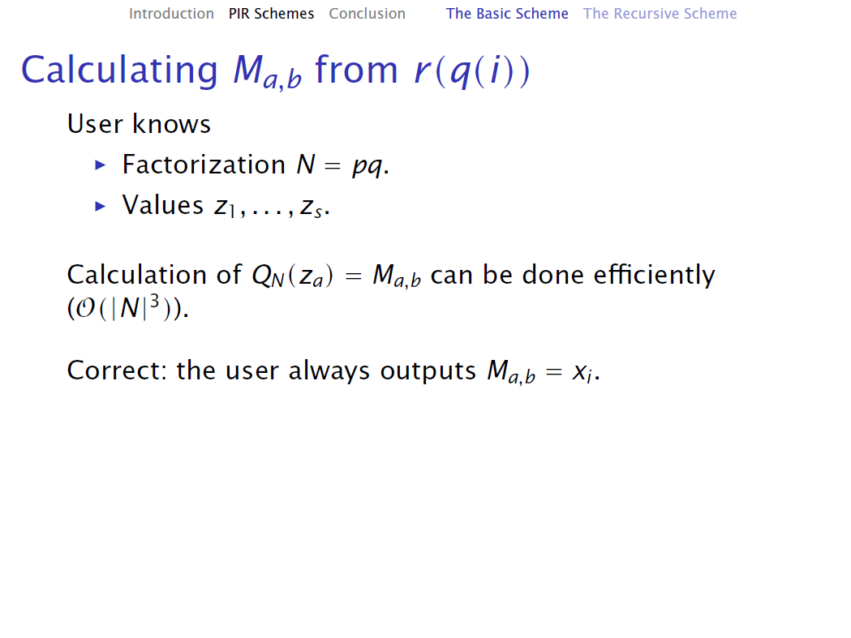

Slide 54



Scope and Assumption
secure channel
anonymity network
LBS user
LBS provider

