Slide 1
Moving Beyond One-Off Ubiquitous Applications
Henning Schulzrinne
Columbia U/U of Oulu

Slide 2
My assumptions
We’re an engineering discipline
“Engineering is the discipline, art and profession of acquiring and applying technical, scientific, and mathematical knowledge to design and implement materials, structures, machines, devices, systems, and processes that safely realize a desired objective or invention.”
Other (good) possibilities:
we train future engineers
we train future researchers

Slide 3
Pasteur’s quadrant
Most networking research
wants to be here
Quest for Fundamental Understanding? | Yes | Pure basic research (Bohr) | Use-inspired basic research (Pasteur)
 | No |  | Pure applied research (Edison)
 |  | No | Yes
 |  | Considerations of Use?
Guessing at problems
(Infocom)
Most networking research
is here
Pasteur’s Quadrant: Basic Science and Technological Innovation, Stokes 1997 (modified)

Slide 4
The $1B question
How big a problem does your proposal solve?
Does it create new ones?
financial, management, …
Can it be integrated into the existing Internet
or a plausible successor?
or 802.11, 802.16, …
… without everybody changing their ways
the secret: nobody is in charge of the Internet
Can it be understood by Cisco CNAs?
see IP multicast, PIM-SM

Slide 5
Useful research outcomes
Standards
unfortunately, rarely cite papers
Get Cisco, Google, Microsoft, … to adopt it
3-4 QoS papers?
Show what doesn’t work
counteract industry shills
e.g., recently web site privacy
Understand the Internet better
but not just your campus network
Prior art in patent disputes
patents don’t have a 90% rejection rate…

Slide 6
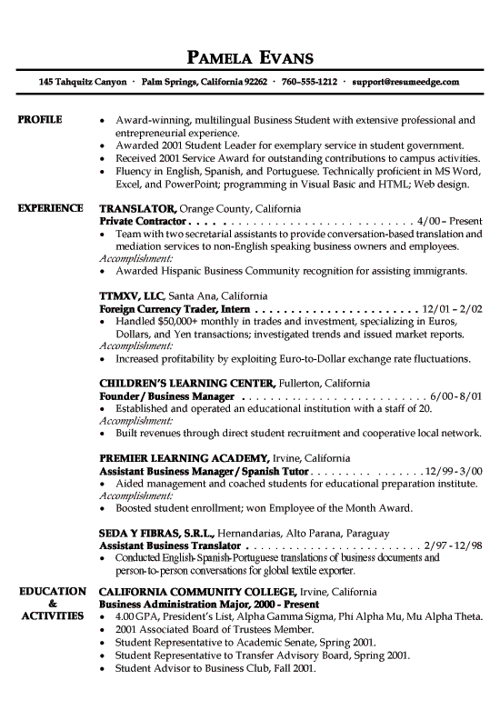
CS research to reality
CS as science
CS as engineering
CS as a soccer league

Slide 7
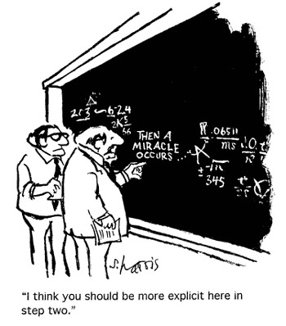
Network tech transfer, mode 1
somebody else just waiting for your
results

Slide 8
Network tech transfer, mode 2

Slide 9
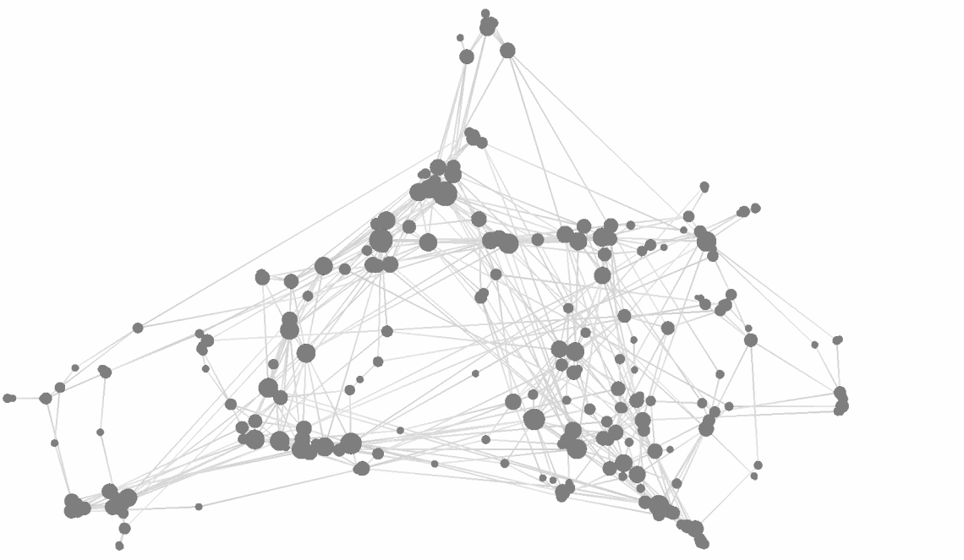
Or just measure citations
be sure to create enough conferences and workshops…

Slide 10
Caricature UbiComp application
Installed on some set of mobile devices or local infrastructure
usually stand-alone
Solves a (minor) problem familiar to the researcher
typically young, technically-focused
social interaction, searching, games, …
Tested with < 10 users
Disappears after the conference paper has been published
and nobody misses it ☺

Slide 11
Why is QoS attractive?
allows for sophisticated math
quality sounds good
extends to web, P2P, sensor networks, ad-hoc networks, 802.x, …
real problem
well-contained problem
can build lab prototypes
next workshop: QoS for social networks

Slide 12
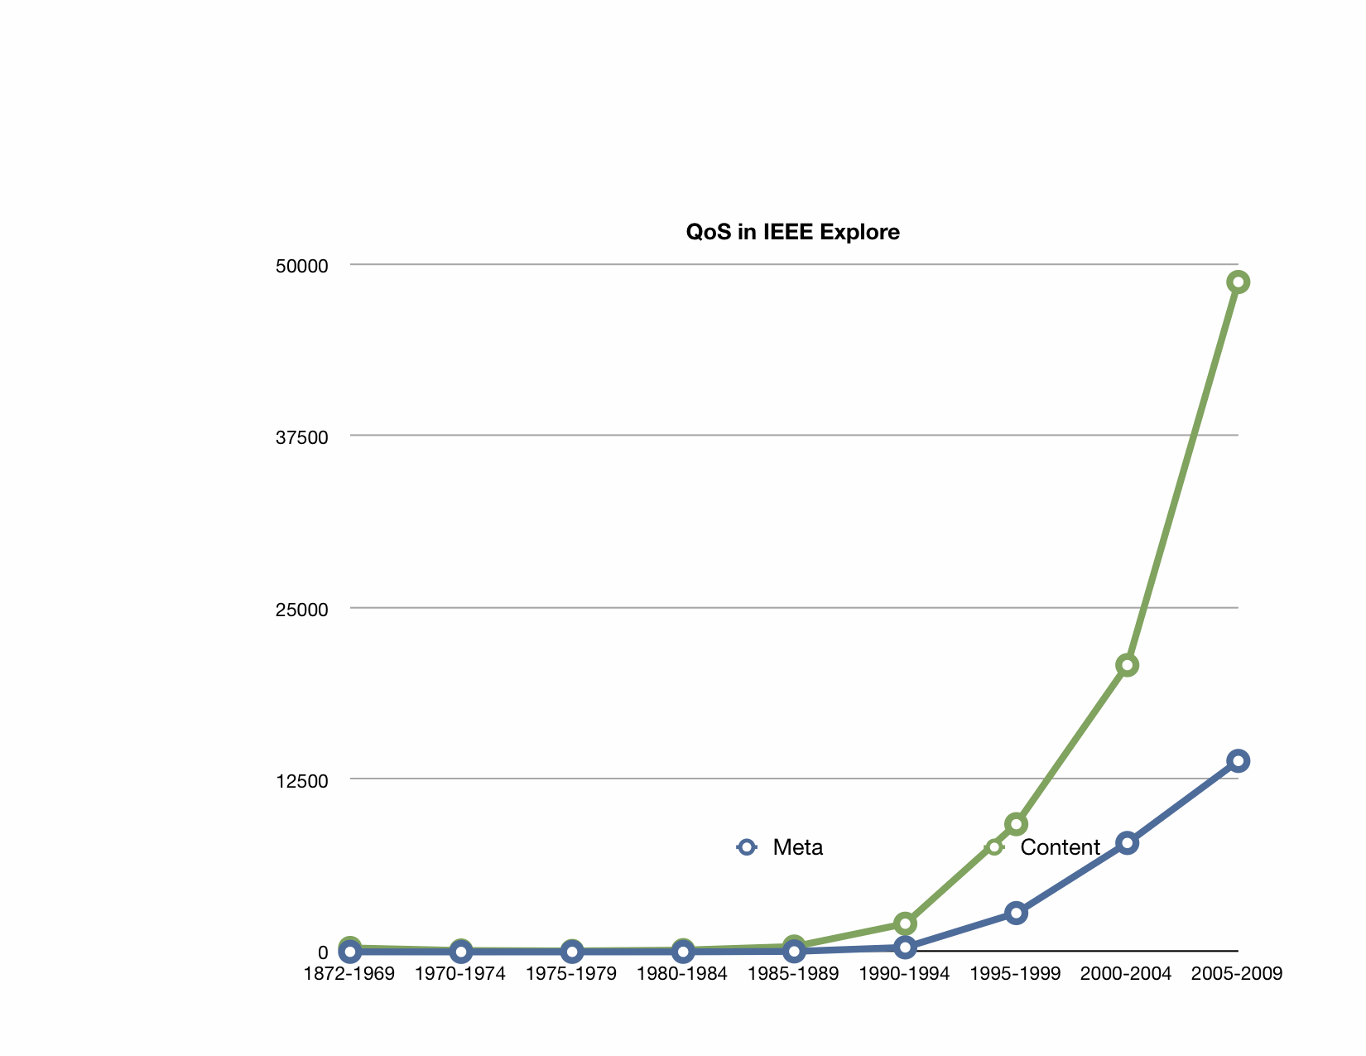
QoS research activity

Slide 13
QoS research
IEEE: 25,583 papers with “QoS” in metadata through 5/2010
84,257 with QoS in meta data or text
2 papers/PhD year
$50,000/PhD year
→ $640M in QoS research

Slide 14
Reflective research needed
Which applications (and tools) from the UbiComp community have had lasting impact?
Some may have inspired other, at-scale applications
But did these applications rely draw on the paper?

Slide 15
Questions
“Just apps”?
leave to professional app developers – scale, refinement, maintenance
but good educational opportunities
student motivation, impact
2008: own web app → 2010: own mobile app
“Cute toys”
need to scale beyond demo
how do good ideas get picked up for scaling?
real value – sustained use?
business model
Infrastructure vs. carry-along
scaling, initial and incremental deployment cost, sustainability

Slide 16
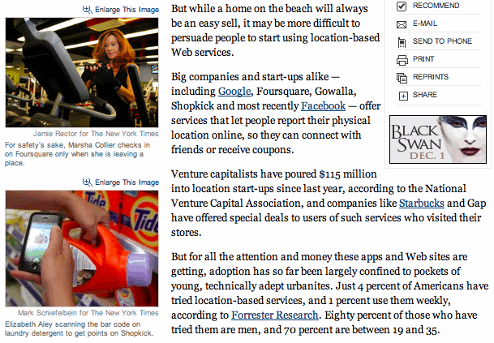
Adoption
NY Times, 8/29/2010

Slide 17
Scaling UbiComp

Slide 18
Content
Little content → little usage
Part of scalable design
Kinds:
self-generated (sensors, derived content)
user-generated
validation, policing, …?
custom-generated

Slide 19
3 broad areas

Slide 20
CS = tool builders
What would make building applications easier, faster, more reliable?
management (cf. PanOulu displays)
image processing?
disruption-prone computing
autonomous scaling to millions of users
?

Slide 21
Grand (?) challenges
What societal problems can UbiComp address?
health care (cost, availability, effectiveness)
educational challenges
safety (vehicles)
social and civic engagement
limited gov’t resources
“emerging economies” problems

