Slide 1
SECE: Sense Everything, Control Everything
Omer Boyaci, Victoria Beltran and Henning Schulzrinne

Slide 2
Overview
SECE allows non-technical users to create services that combine
communication
calendaring
location
devices in the physical world
SECE: event-driven system
uses high-level event languages
to trigger action scripts, written in Tcl
and other languages in the future

Slide 3
Events & actions
Events
Actions
Presence updates
Incoming calls
Email
Calendar entries
Sensor inputs
Location updates
Control the delivery of email
Route phone calls
Update social network status
Control actuators such as lights
Reminders (email, voice call, SMS)
Interact with Internet services

Slide 4
Event language syntax
every sunset {
homelights on;
}
every week on WE at 6:00 PM{
email irt_list “Pizza talk at 6:00 PM today.”;
}
if my stock.google > 14 {
sms me "google stock:"+[stock google];
}

Slide 5
Event Rules: More Examples
Extensible set of small languages
Time
Single on February 16, 2010 at 6:00 PM
Recurring every day at 12:00 until April
Location
Tom within 5 miles of me
Context
if my office.temperature > 80
Communication requests
incoming call

Slide 6
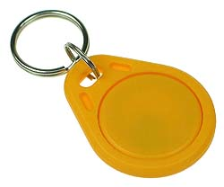
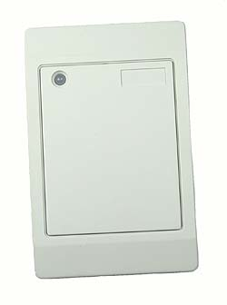
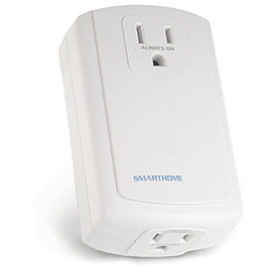
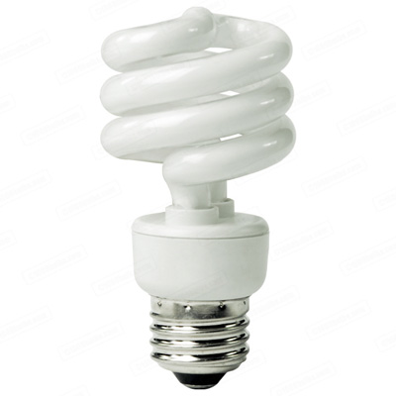
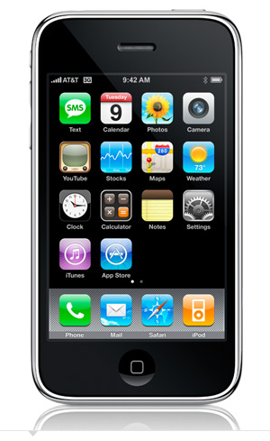
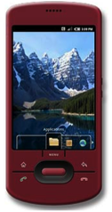
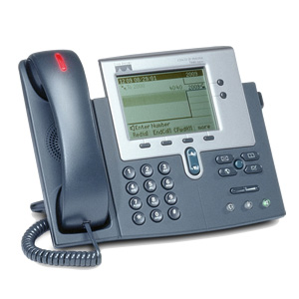
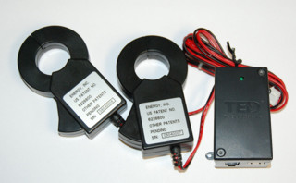
The big picture
GW
next appt.
RFID
Alice → a@b.com,
+1 212 555 1234
control appliances
SECE
GW
PUBLISH
PIDF-LO
SUB/NOT
PIDF-LO, RPID,
others
edit scripts
GW
call state
update SNs, SMS, email
geocoding
travel time
monitor energy
usage
B2BUA

Slide 7
Software architecture

Slide 8
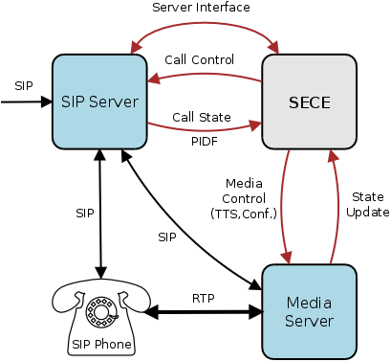
Automated Call Handling
Control: Accept, reject, redirect, forward calls based on variety of SECE signals
Integration: Calendar, address book, PSTN, Google Voice, SMS, location, Text-to-speech, voicemail)
Simplicity: Natural, easy to learn scripting language
Flexibility: Input from a variety of SECE components involved in call handling
Automation: Scripts for recurring tasks (setup a conf. call based on calendar)
“On mom's birthday, call mom when I am home and near phone.”
“Setup a conference call, enter password, invite people, ring desk phone.”
“If driving and incoming call, play “user driving” and redirect to voicemail.”
“If desk phone ringing and not in room, send SMS with caller's number.”

Slide 9
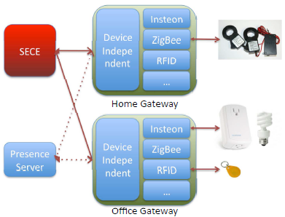
Sensors and Actuators
Sensors: smoke, light, humidity, motion, temperature and RFID readers
Actuators: networked devices and actuators such as lights, cameras, sprinklers, heaters, and air conditioners
if my office.temperature > 80 {
ac on;
}
if my office.smoke equals true {
sprinklers on;
sms me "fire in the office";
call_tts fire-department "fire in the "+[get me.office.address];
electrical-appliances off;
}
if my warehouse.motion equals true {
sms me "person in the warehouse."
}

Slide 10
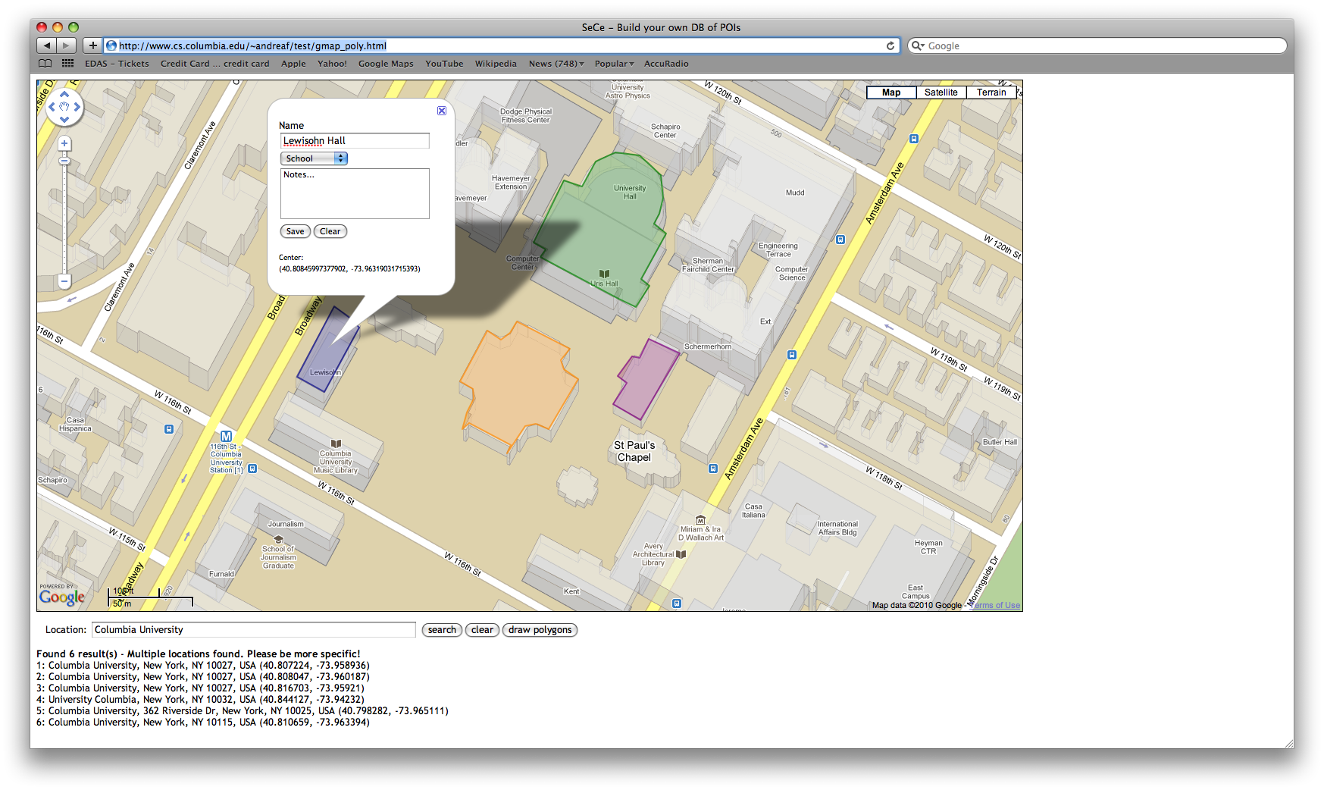
Building a POI database

Slide 11
Handling location updates
User
publishes his/her location periodically (e.g., every 5 min)
Presence server
notifies changes in location to SECE server
SECE server
depending on user’s defined rules, queries LoST server
LoST server
replies with current information on user’s surroundings
SECE server
Takes action based on rules and contextual location information
SECE
Server
LoST
Server
LoST reply
LoST query
NOTIFY
Presence
Server
PUBLISH
SECE User

Slide 12
Conclusion
SECE

Slide 13
Back-up slides

Slide 14
Related Work
Systems | User rules | User actions | Communications | Time | Location | Presence | Sensors | Web services | Actuators
SECE | NL-like rules | Tcl scripts | Call, email, IM | ✔ | User & buddies | ✔ | ✔ | ✔ | ✔
CPL | XML tree | Fixed XML actions | Call | ✖ | ✖ | ✖ | ✖ | ✖ | ✖
LESS | XML tree | XML actions | Call | ✔ | ✖ | ✔ | ✖ | ✖ | X10, vcr
SPL | script | Signaling actions | Call | ✖ | ✖ | ✖ | ✖ | ✖ | ✖
VisuCom | Graphical UI | Signaling actions | Call | ✖ | ✖ | ✖ | ✖ | ✖ | ✖
DiaSpec | Java | Java | ✔✖ | ✖✔ | ✖✔ | ✖✔ | ✖✔ | ✖✔ | ✖✔
CybreMinder | Form based | Reminder | ✖ | ✔ | ✔ | ✖ | ✔ | ✖ | ✖
Task.fm | Time rule | Reminder | ✖ | ✔ | ✖ | ✖ | ✖ | ✖ | ✖

