Slide 1
25 years of quality of service research - where next?
Henning Schulzrinne
Columbia University
(with Omer Boyaci, Andrea Forte, Kyung-Hwa Kim)

Slide 2
Prologue
Most keynotes are prospective – this one is (partially) retrospective
Foil for reflection
  applies just as well to P2P, mobility, multicast, sensor networks, social networks, …
    but they are still (too) active to reflect
How effective is our collective research?
How do we choose and solve problems?
When do we move on?

Slide 3
Preview
What can we learn from 25+ years of QoS research?
Some of my group’s (semi-) QoS research
  how good is industrial practice?
  how can we diagnose QoS (and other problems) in the consumer Internet?
Thoughts on QoS going forward

Slide 4
About (networking) research

Slide 5
My assumptions
We’re an engineering discipline
  “Engineering is the discipline, art and profession of acquiring and applying technical, scientific, and mathematical knowledge to design and implement materials, structures, machines, devices, systems, and processes that safely realize a desired objective or invention.”
Other (good) possibilities:
  we train future engineers
  we train future researchers

Slide 6
Pasteur’s quadrant
Most networking research
wants to be here
Quest for Fundamental Understanding? | Yes | Pure basic research (Bohr) | Use-inspired basic research (Pasteur)
 | No |  | Pure applied research (Edison)
 |  | No | Yes
 |  | Considerations of Use?
Guessing at problems
(Infocom)
Most networking research
is here
Pasteur’s Quadrant: Basic Science and Technological Innovation, Stokes 1997 (modified)

Slide 7
The $1B question
How big a problem does your proposal solve?
  Does it create new ones?
    financial, management, …
Can it be integrated into the existing Internet
  or a plausible successor?
  or 802.11, 802.16, …
… without everybody changing their ways
  the secret: nobody is in charge of the Internet
Can it be understood by Cisco CNAs?
  see IP multicast, PIM-SM

Slide 8
Useful research outcomes
Standards
  unfortunately, rarely cite papers
Get Cisco, Google, Microsoft, … to adopt it
  3-4 QoS papers?
Show what doesn’t work
  counteract industry shills
  e.g., recently web site privacy
Understand the Internet better
  but not just your campus network
Prior art in patent disputes
  patents don’t have a 90% rejection rate…

Slide 9


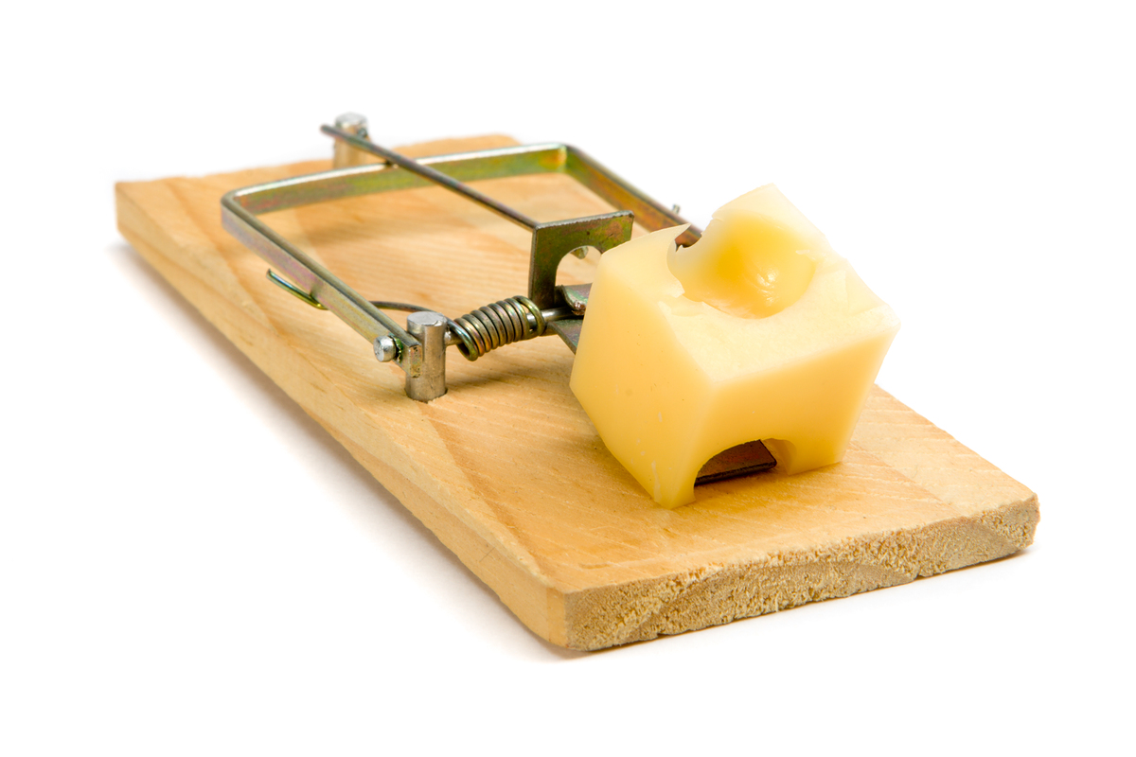
CS research to reality
CS as science
CS as engineering
CS as a soccer league

Slide 10
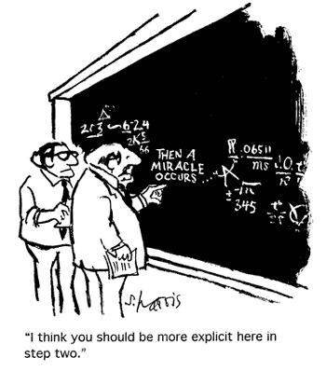


Network tech transfer, mode 1
somebody else just waiting for your
results

Slide 11


Network tech transfer, mode 2

Slide 12
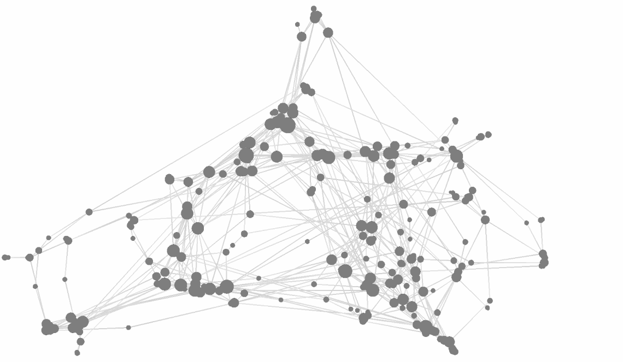
Or just measure citations
be sure to create enough conferences and workshops…

Slide 13
QoS research

Slide 14
Why is QoS attractive?
allows for sophisticated math
quality sounds good
extends to web, P2P, sensor networks, ad-hoc networks, 802.x, …
real problem
well-contained problem
can build lab prototypes
next workshop: QoS for social networks

Slide 15

Old, old joke
research funding,
math, …

Slide 16
Almost 25100 years of QoS
Toll Telephone Traffic
Experiments are described to determine the relationship between telephone circuit loads and the corresponding delay to traffic. The operating methods employed and the number of circuits available determine in general the number of messages per day which can be handled over a single toll circuit. The average delay to traffic obviously depends upon the number of messages per circuit per day, or the circuit loads. With a given load factor, increase in the circuit loads will increase the average delay to traffic. At the same time the revenue per circuit mile will correspondingly increase. The practical limit, however, is approached when the delays to traffic reach a point where the service is unsatisfactory. The results of the experiments described illustrate the fact that increasing circuit loads increase the delay to traffic, and vice versa. The revenue per circuit mile is directly proportional to the product of the circuit load and the toll rate per minute-mile; consequently the relationship between the quality of service and the toll rate is generally obvious, assuming a certain rate of return on the plant investment.
Frank Fowle, Transactions of the American Institute of Electrical Engineers, June 1914

Slide 17
More early QoS work
Second generation computer control procedures for dial-a-ride
Based on operational experience with initial computer control procedures, more sophisticated procedures have been developed designed to provide a greater variety of services simultaneously and to allow the operator more discretion in the quality of service provided. This paper describes these second generation control procedures and analyses their effectiveness in the light of previous operational experience and in a simulation context.
Nigel H. M. Wilson, Decision and Control including the 14th Symposium on Adaptive Processes, 1975

Slide 18
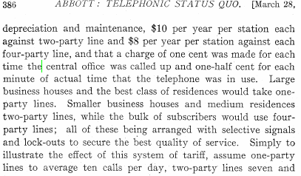
First (?) QoS (+ security) paper
Abbott, Arthur Vaughan, "The Telephonic Status Quo," American Institute of Electrical Engineers, Transactions of the, vol.XIX, pp. 373-388, Jan. 1902

Slide 19
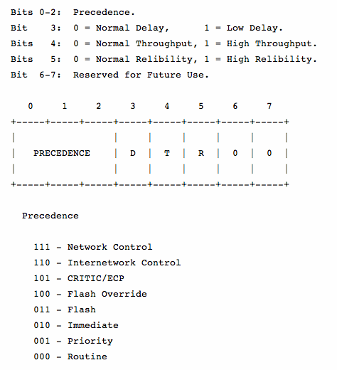
DiffServ v0: IP 791 (1981)

Slide 20
QoS and energy - 1984
Energy Saving the "Record" System
A study is presently being conducted at the French Telecommunications Research Centre (CNET) in order to optimize the power consumption of air conditioning equipment in time-division exchanges. It is conducted within the frame of an "Energy Saving" campaign started by the French Administration. The so-called RECORD system (research for continuous optimal conditions of the air-conditioning system) was developed. This system enables the following functions to be performed: - acceptance and maintenance operations in air conditioning systems, - checking of power consumption, - evaluation of possible energy savings, provided the regulation instructions are modified within limits giving the same quality of service and reliability of the exchange.
Telecommunications Energy Conference, 1984. INTELEC '84.

Slide 21
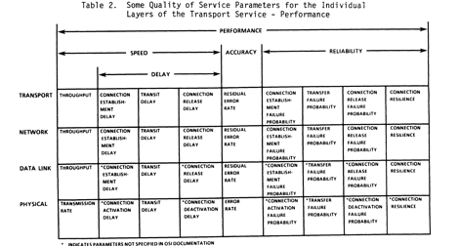
Early packet QoS paper: 1986
This paper first examines quality of service as it applies to the Transport Service of the Open Systems Interconnection (OSI) Reference Model. Quality of service and some of the quality of service parameters applicable to the Transport Service are discussed. Also presented is a new concept concerning the "building-up" of quality of service. These ideas are then used to discuss the concept of robustness.
Pardue, M. D. ; Harvey, J. A. ; Haupt, K. D. ; Orlando, T. A., MILCOM 1985

Slide 22
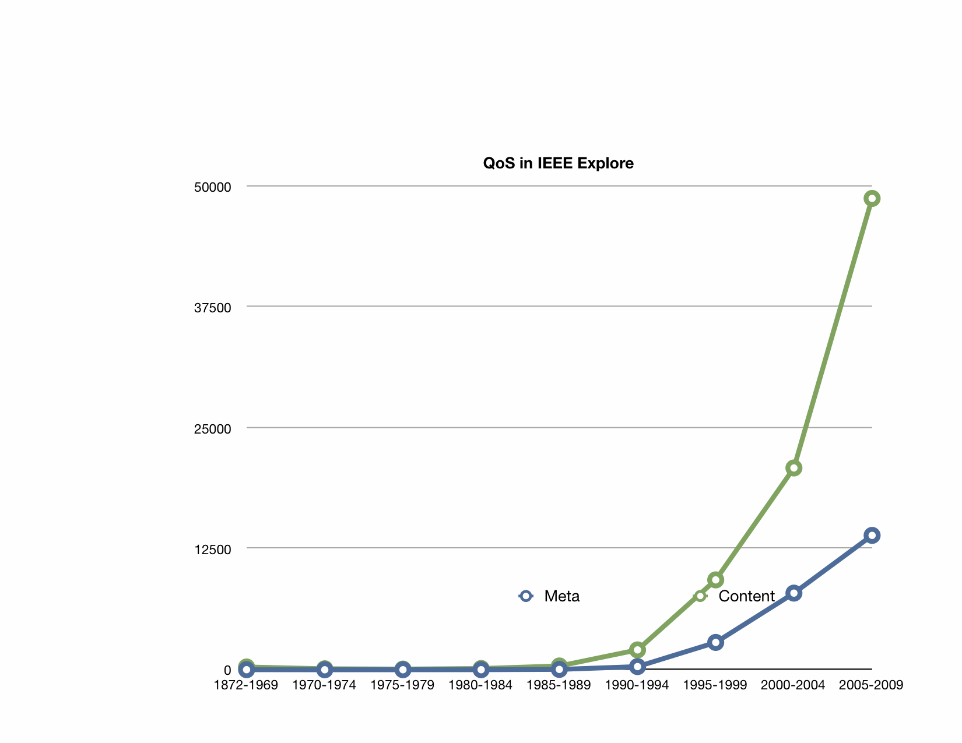
QoS research activity

Slide 23

QoS research
IEEE: 25,583 papers with “QoS” in metadata through 5/2010
  84,257 with QoS in meta data or text
2 papers/PhD year
$50,000/PhD year
→ $640M in QoS research

Slide 24
What might we learn?

Slide 25
Cause of death for the next big thing
 | QoS | multi- cast | mobile IP | active networks | IPsec | IPv6
not manageable across competing domains |  |  |  | 
not configurable by normal users (or apps writers) |  |  |  |  | 
no business model for ISPs |  |  |  |  |  | 
no initial gain |  |  |  |  |  | 
80% solution in existing system |  |  |  |  |  |  (NAT)
increase system vulnerability |  |  |  | 

Slide 26
Why did e2e QoS fail?
Trivial issue: No uniform DiffServ code points
  manual configuration of applications and home gateways
No clearing house or end-to-end identity
No economic model
  flat, peak-rate based charging common
  interesting model: metro pricing
Lots of factors outside carrier control
  home & enterprise network

Slide 27
Users don’t care about QoS
not even QoE
they do care about service reliability:
  consumer grade ~ electricity (99%?)
    99.5% → 43.8 hours outage/year
  commercial grade
    e.g., web server
    Google Apps: 99.9% uptime SLA
    Verizon business DSL SLA: 99%
  critical grade
    e.g., tele-surgery
    typical by redundancy
Notes:
http://www.verizonbusiness.com/terms/ca/sla/dsl.xml

Slide 28
QoS problems are real
… but traditional QoS research unlikely to help

Slide 29

QoS: more than L2 + L3
DNS lookup
IPv6/IPv4
email WWW phone...
SMTP HTTP RTP...
TCP UDP…
IP
ethernet PPP…
CSMA async sonet...
copper fiber radio...
20% of the problem,
80% of the effort

Slide 30
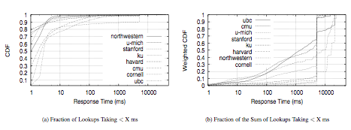
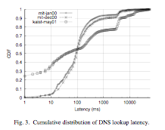
DNS delays
Park, Pai, Peterson, Wang (OSDI04)
Jung et al (ToN 2002)

Slide 31
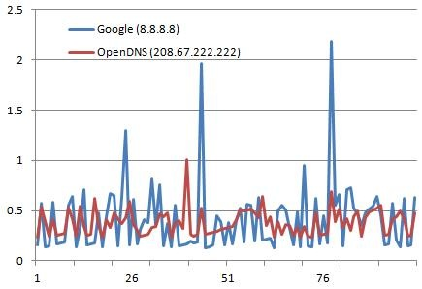
Google vs. OpenDNS
likely exceeds page transfer delay
Dec. 2009 -- http://blog.gadodia.net/performance-comparison-of-opendns-and-google-dns/

Slide 32
What happens to the QoS losers?

Slide 33
Deferring demand
Capacity need is driven by peak demand
  thus, useful to defer peak
Cf. electric utilities
  peak electricity costs >> baseload costs
  but peak bandwidth costs = average costs
Peak deferral
  µs to ms:
    node & router queues
  minutes:
    scheduling VoIP > TCP at home
    Dad’s phone call beats son’s Hulu show
  hours:
    download OS patches
    back-up
    → scavenger service

Slide 34
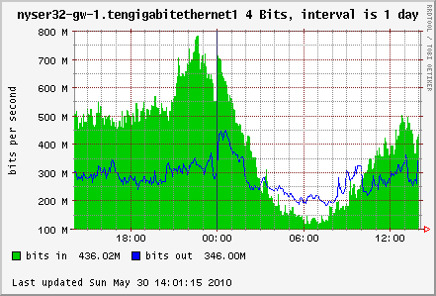
Diurnal variation of traffic demand
peak ≅ 1.7 avg.
Columbia University commercial Internet access (10 GigE), May 30, 2010
Notes:
Sunday, memorial day weekend.

Slide 35
Electric Load Duration Curve
Last 5% (2,500 MW) needed less than 50 hours per year
Last 25% of capacity needed less than 10% of the time
Hours per Year
Source: California Independent System Operator Corporation
Notes:
Note that this does not mean that all charging needs to happen in the middle of the night. This chart shows the load for each hour of the year, sorted from highest load to least load. Significant benefit can be realized by preventing load during only 50 hours per year. Additional benefit is derived from reducing load during only 10% of the hours per year; for this case (California) this corresponds to preventing charging during the hottest 4-6 hours per day during the 3-4 months of summer. It should be noted that this is also a non-optimal time to charge anyway due to battery cooling requirements.
The particular hours change across utilities—some areas are ‘winter peaking’—but the load duration curve shape is very consistent.

Slide 36
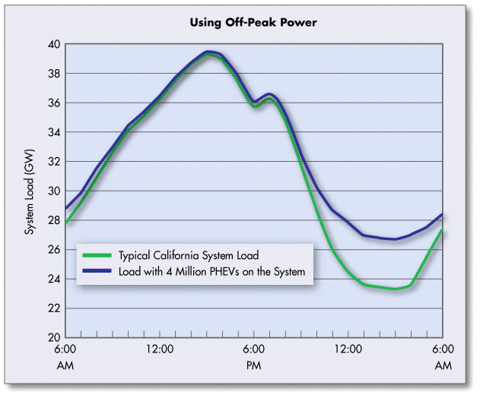
Electricity diurnal demand
about 60%
“Environmental Assessment of Plug-In Hybrid Electric Vehicles (PHEVs)”, June 2009
Notes:
http://web.mit.edu/jjrs/www/AETTPresentations/Knipping-Alexander-MIT-Ford-Shell-2009.ppt

Slide 37
QoS vs. flying business class
economy vs. business class | QoS
always more leg room and better (any) food | only during congestion
flights are mostly full (load factor 80%+) | networks are mostly empty (20-30%)
better food & nicer flight attendants | looks the same
airline doesn’t get blamed for traffic jam on the way to the airport | packet loss at home looks just the same
more frequent flyer miles | there’s an idea…

Slide 38
ITU-T Y.1541 QoS classes
 | 0 | 1 | 2 | 3 | 4 | 5
IPTD (transfer delay) | 100 ms | 400 ms | 100 ms | 400 ms | 1 s | U
IPDV (jitter) | 50 ms |  | Unspecified
IPLR (loss ratio) | 0.1% |  |  |  |  | U
IPER (error rate) | 0.01% |  |  |  |  | U
Usage | Voice |  | Signaling | Interactive Data | Streaming video | Best-effort data
doesn’t provide necessary rate to watch movies

Slide 39
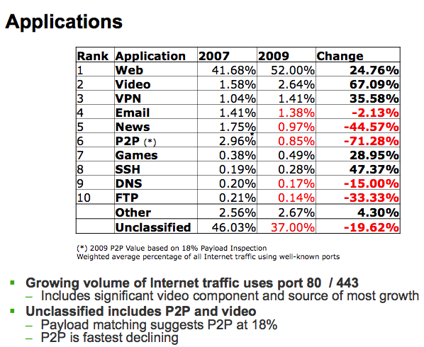
Application changes
probably includes RT traffic
Craig Labovitz, “Internet Traffic and Content Consolidation”, IETF March 2010.

Slide 40
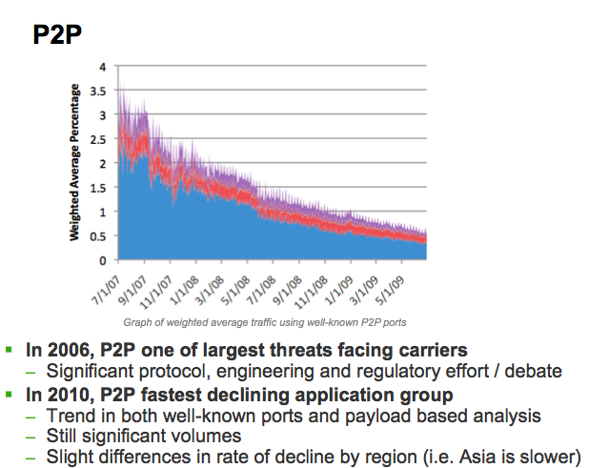
P2P declining
Craig Labovitz, “Internet Traffic and Content Consolidation”, IETF March 2010.
Notes:
Internet Traffic and Content Consolidation by Craig Labovitz, IETF March 2010.

Slide 41
Cisco’s traffic prediction
Ambient video = nannycams, petcams, home security cams, and other persistent video streams
Notes:
http://www.cisco.com/en/US/solutions/collateral/ns341/ns525/ns537/ns705/ns827/white_paper_c11-481360_ns827_Networking_Solutions_White_Paper.html

Slide 42
Cisco traffic prediction

Slide 43


The race against abundance
resource scarcity → QoS
  Soviet model of economic planning: manage scarcity
But turning away paying customers is not good business
Few people will use unpredictable networks
  “sorry, the Internet is sold out today”

Slide 44
What did we end up with?
1997: RFC 2205 (Resource ReSerVation Protocol (RSVP))
1998: RFC 2474 (An Architecture for Differentiated Services)
DiffServ
  typically, priority for VoIP
    access, transport to PSTN gateway
  RSVP for traffic engineering
802.11e
  essentially DiffServ
Volume limits (Comcast = 250 GB/month) or per-MB charges (mobile)
Works well as long as highest priority is small fraction of total

Slide 45
The mantra of TCP fairness
TCP-friendly: non-TCP traffic needs to be TCP-fair
  back off under loss
  RFC XXXX
Problematic:
  RTT-sensitive
    good – may encourage local access
  it’s per session – but one web browser may open 4 connections
  it’s instantaneous only
    what if I haven’t sent for a week and you’ve been downloading 3 GB of YouTube?
  assumes that all bits are worth the same to the user
Bob Briscoe’s work

Slide 46
Some QoS research issues
How can a user tell where things are breaking?
Subscriber-level QoS measurements
  not just in academic networks
What pricing models work for users?
  congestion pricing: too unpredictable
    how many MB are in that web page?
    nice phone call – would you like to continue for $3/minute?
  maybe content provider pays?
  per-minute pricing for VoIP service + QoS
    see Skype Access
  tiered service, capturing 90% of customer group
    see web server pricing
    include some account of priority traffic

Slide 47
Performance of video chat clients under congestion
Residential area networks (DSL and cable)
  Limited uplink speeds (around 1Mbit/s)
  Big queues in the cable/DSL modem(600ms to 6sec)
  Shared more than one user/application
Investigate applications’ behavior under congestion
  Whether they are increasing the overall congestion
  Or trying to maintain a fair share of bandwidth among flows

Slide 48
How good is industrial practice?

Slide 49
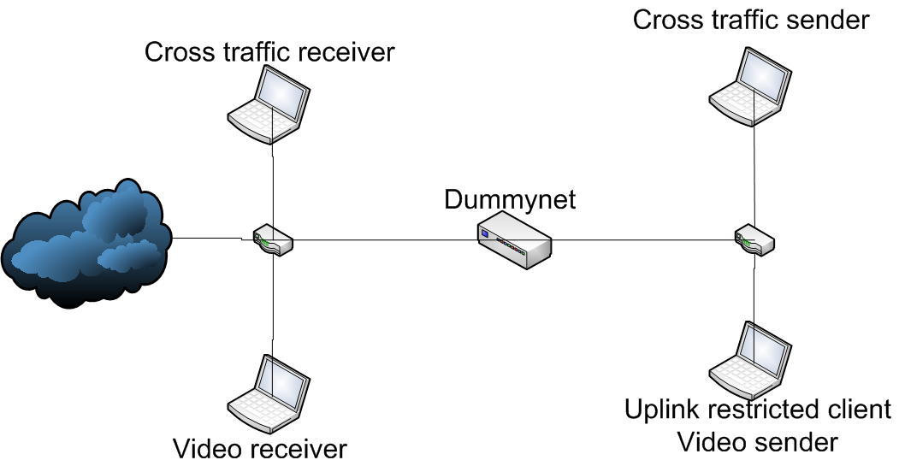
Experimental setup

Slide 50
Step 10 s, 100 kb/s
Skype

Slide 51
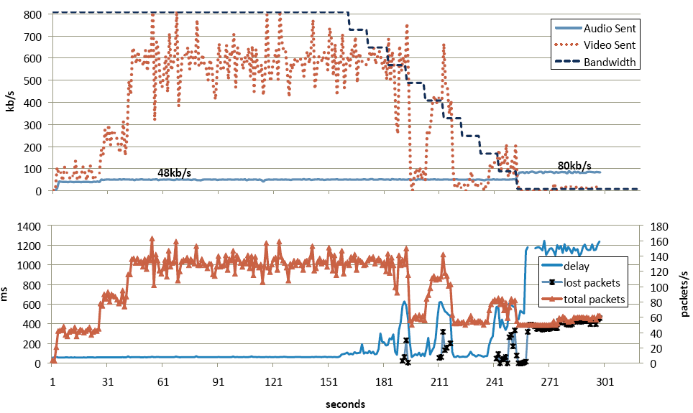
Step 10 s100 kb/s
Live

Slide 52
Step 10 s100 kb/s
X-Lite

Slide 53
File Transfer
Skype

Slide 54
File Transfer
Live

Slide 55
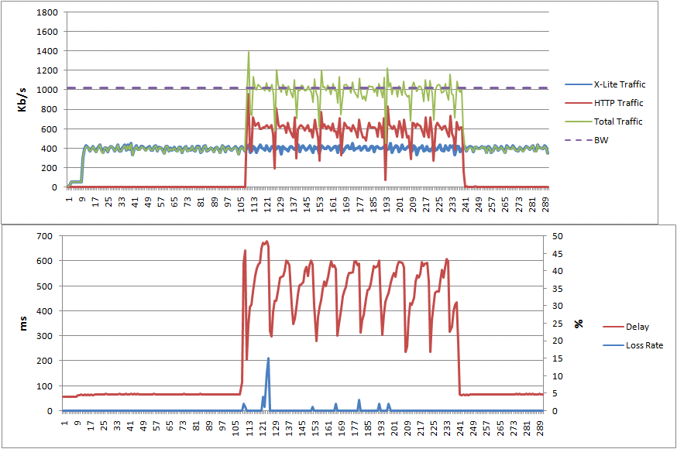
File Transfer
X-Lite

Slide 56
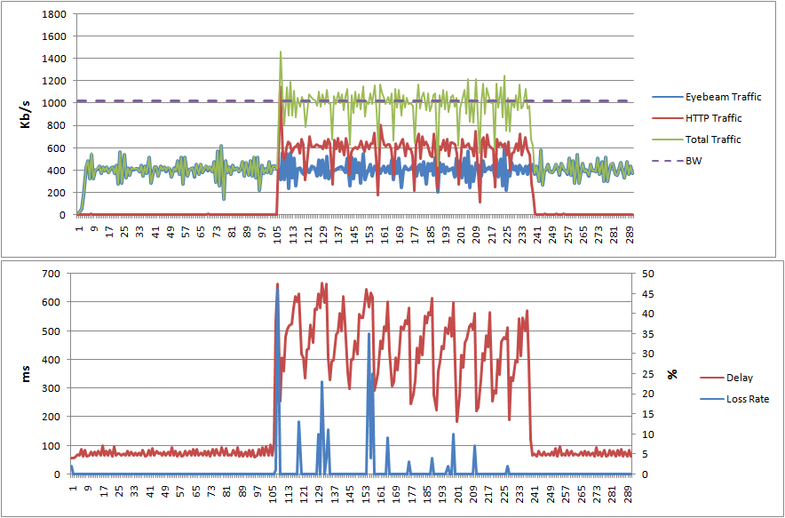
File Transfer
Eyebeam

Slide 57
Bittorrent
Skype

Slide 58
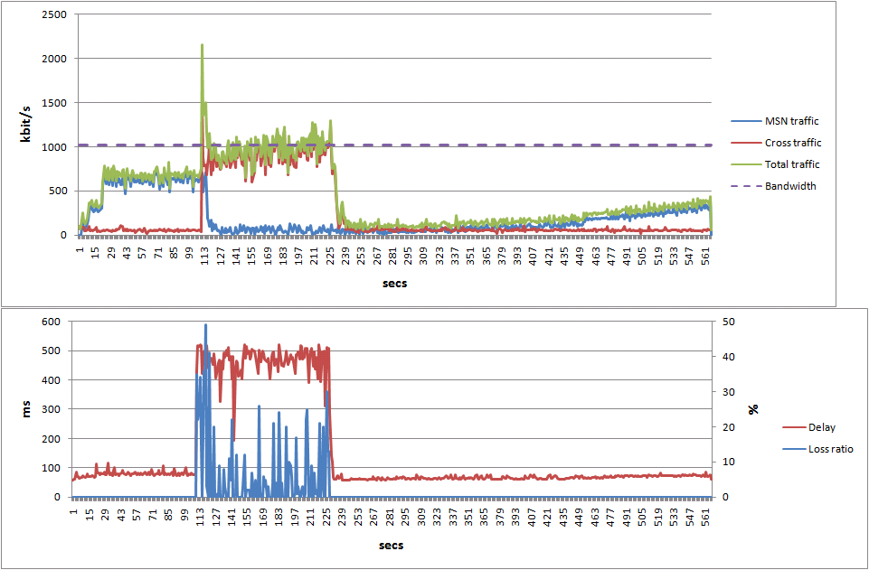
Bittorrent
Live

Slide 59
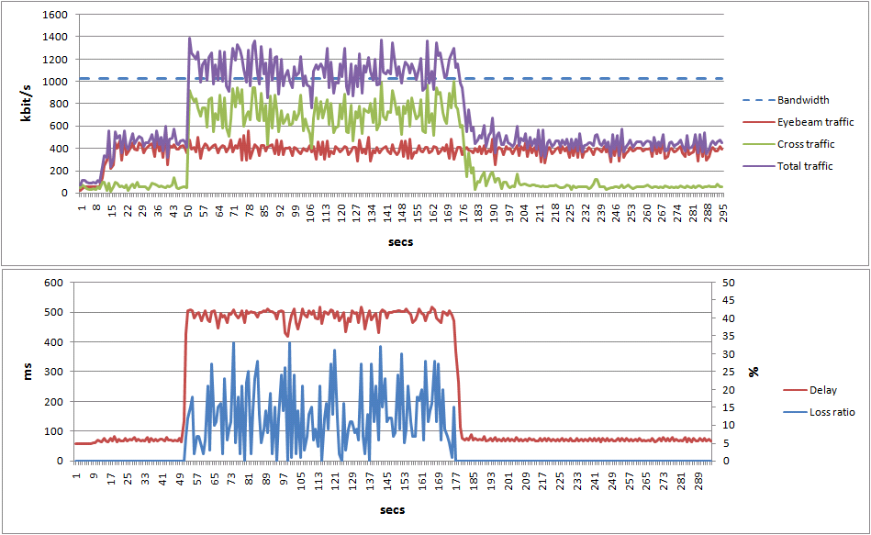
Bittorrent
Eyebeam

Slide 60
Summary of results
Skype, Live Messenger, X-Lite and Eyebeam.
  Skype best:
    by adapting its codec parameters not only on packet loss but also on RTT and jitter.
    follow the changes in bandwidth without causing packet loss
  Eyebeam worst:
    high fluctuations
    poor adaptation to bandwidth fluctuations
Due to limited upstream bandwidth, video clients must have bandwidth adaptation mechanisms and must be able to differentiate between wireless losses and congestion losses

Slide 61
Distributed diagnostics of QoS (and other) problems

Slide 62
Circle of blame
probably packet
loss in your
Internet connection →
reboot your DSL modem
ISP
probably a gateway fault
→ choose us as provider
OS
VSP
must be a
Windows registry
problem → re-install
Windows
app
vendor
must be
your software
→ upgrade

Slide 63

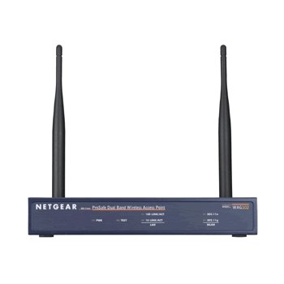
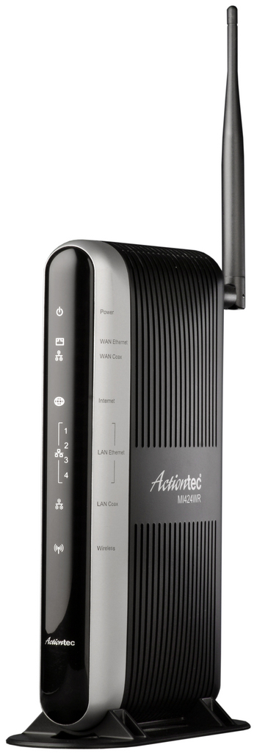
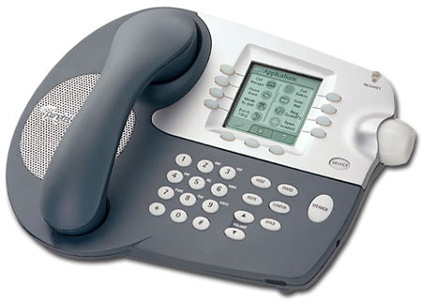
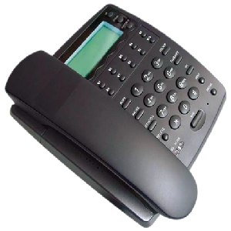

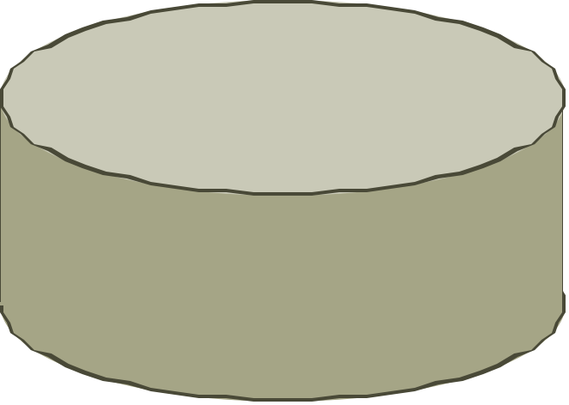

Problems in VoIP systems
NAT drops response
UAS not working
packet loss
NAT
excessive queuing delay
server unreachable
STUN server not available
destination proxy fails or unreachable
outbound proxy fails
DNS
no response from DNS server

Slide 64
DYSWIS
install module if needed
no response
packet loss
no packets sent
rule engine
reachable?
packet loss?
NDIS
pcap
same subnet
same AS
different AS
close to destination
…
indicate likely source of trouble:
application
own device
access link (802.11)
NAT
local ISP
Internet
remote server
DHT to locate probes

Slide 65
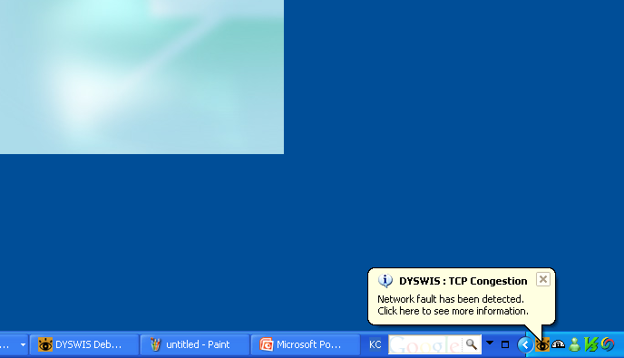
Implementation: system tray

Slide 66
Summary
QoS = our community’s longest running network research topic
  transition of field from classical performance and queuing theory to security and Internet systems
Reflect on research role and outcomes
  are we distilling results or just adding to them?
How can we identify topics that
  matter to real users & operators
    AND
  are amenable to research?

