Slide 1
NSIS based NetServ Signalling Protocol
Design and Implementation
Roberto Francescangeli
Visiting PhD student

Slide 2
NetServ Signaling Protocol
On-Path NSIS based protocol
NetServ protocol runs on top of GIST in C-mode
NetServ protocol will provide
Request validation and authentication
Installation and removal of service modules on path
NetServ network probing features such as
State of on-path nodes (Topology Discovery)
State of services (Service Discovery)
Logs and errors collection for service/node management system or debug

Slide 3
Design of NetServ Protocol 1
3 Request messages
SETUP
REMOVE
PROBE
3 Response messages, one for each request
Messages carry TLV encoded data (GIST-like format)
Probe Response contains a stack of responses
Each node traversed by the probe adds its own data
Initiating node will get the stack and process it
Data can be used by other nodes on the path as well
Authorization for Probe Requests (TBD)

Slide 4
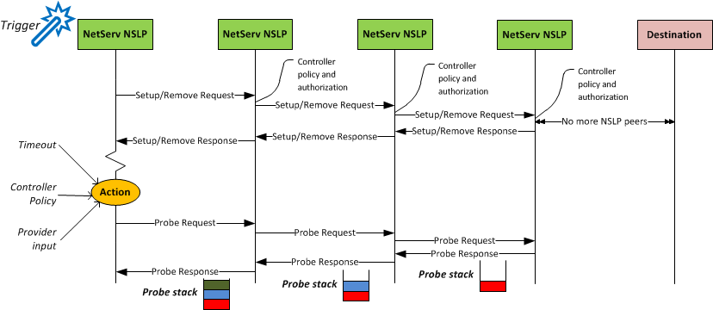
Design of NetServ Protocol 2
Only NSIS nodes with a running NetServ NSLP will process the protocol messages
Other nodes forward the packets transparently

Slide 5
Message and TLV Objects 1
SETUP Request
Data ID
URLs
Lifetime
[Security, NodeIDs, Conditional Install, Additional Info]
REMOVE Request
Data ID
[Security, NodeIDs, Conditional Install, Additional Info]
PROBE Request
Data ID
Probe Ids
Security

Slide 6
Message and TLV Objects 2
SETUP and REMOVE Response
Response (class, code, object of interest)
[Additional Information]
PROBE Response
Node ID
Data ID
Probe Data
Each NODE add its own response
to the message creating a stack

Slide 7
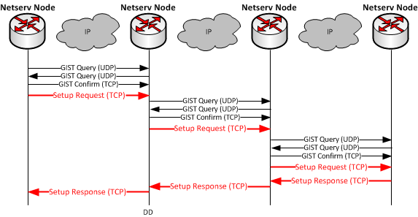
GIST and NetServ Protocol
NetServ Protocol runs on top of GIST
GIST provides hop by hop node discovery, peer association and message transport

Slide 8
Protocol Implementation
Based completely on Open Source technologies
2 free GIST layer implemetations available:
FreeNSIS by University of Göttingen
NSIS-KA by University of Karlsruhe
C++ based
Multi-process or Multi-thread
Timer and Hashtables libraries
Common API between GIST and NSLP makes the two GIST implementations swappable

Slide 9
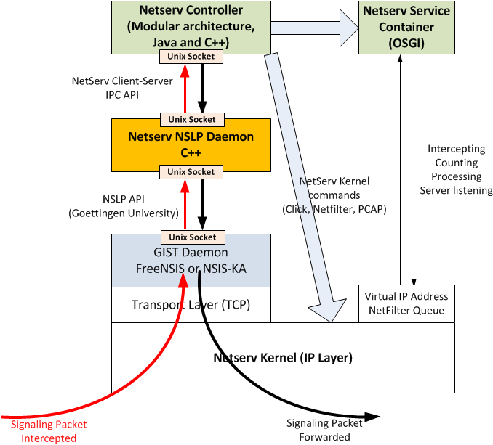
Current Architecture

Slide 10
Implementation Details
Services can trigger NetServ signaling using a command line tool or a C++ Shared Library (.so) that will connect directly to the NSLP daemon
GIST daemon always connected to NSLP daemon
NSLP daemon always connected to NetServ controller
NetServ controller will validate and execute requests
Download, verification, installation of services
Service Container management
NetServ Kernel management
Virtualization of different Service Containers management

