Slide 1
MIA
3/30/10

Slide 2
Core message
Evolutionary rather than ditch-everything/clean-slate
“cleaned slate” rather than clean-slate
overly complex
doesn’t solve everything we want
re-use foundations what worked well
service model = packets (may be optical “dynamic circuits”)
Evolvable
needs to be able to evolve to meet needs for 20-30 years
→ programmability
General & minimal
small set of generalizable abstractions
packet forwarding, lookup, state setup & observation, …
Resilient
emphasize infrastructure security & reliability

Slide 3
Why?
What benefits?
network layer capabilities (e.g., multipath, discovery/hiding)
evolvability (programmability)
trust & value flow (market failure)
lack of resilience
programmer friendliness
What problems?
no incentives to deploy advanced services & lack of mechanisms
useful to society → creates incentives
build in some incentive mechanism
outsource residual risk to third parties
enable useful transactions
network resources
How is this better than the Internet?
earlier active/programmable work

Slide 4
Last time
Small number of general, programmable components (architecture needs to last 20+ years, so need to accommodate unanticipated demands; some of the existing parts of the Internet are straining because they are too special-purpose)
RISC approach to networking
Provide small set of core support services (identifier mapping, economic support [clearing houses? "banks"? bonding?], property assertion [includes location and identity assertion, maybe even bonding]) - we have learned that the core services define what we can do. Having a smaller number of generic mechanisms allows to fix security properties once, rather than for every one of dozens of protocols.
System/infrastructure resilience (more precise than generic "security")We also talked about economic mechanisms that we use to manage large economic systems without a strong central trust anchor, such as insurance, bonding, and rating. Can these economic ideas be leveraged for increase resilience and "security"?

Slide 5
What’s to solve?
Ease of use
Security & trustworthiness
multicast failed couldn’t charge for it
economic support infrastructure
clearing house

Slide 6
Low-level problems
“what’s the killer app?” (AN)
Multihoming
Multipath
only provide destination
no control over routing decisions
e.g., list of k paths, opaque handles for choice
multipath-TCP?
L-I split
Separate signaling plane
Visibility of internals to application/programmer?
observability instead of guessing games
hide things that should be hidden
Tools for establishing trust
identity, location, affiliation, bonding, …

Slide 7
What’s kept and new?
Circuit paradigm
observability (introspection), controllability, time scale separation
better reveal (or hide)
e.g., is there path splitting?
packets ask for information (“ask for directions”)
NOT: router → general purpose computing
ephemeral state processing
interests served (“tussle”?)
why deploy?
mechanisms in forwarding path (fast path)
before session and per-packet

Slide 8
Forwarding mechanisms
4-5 mechanisms in silicon
lookup/filter
longest prefix (set up via routing)
bit mask (filter – set up by policy and signaling)
limited rewriting (transformational)
lookup table (NAT-like?)
packet copying (multicast, DTN, network coding?)
prevent avalanches/amplification – no good mechanism?
storage
storage hierarchy (speed, volume)
economic allocation
use it from the control plane

Slide 9
Locating & naming
Names
fine-grained (services, content)
provable
some ID, some topological
SDSI and SPKI (IETF ten years ago)
tuple-oriented
hierarchy:
allocation
provenance (who owns what)
million vs. billion
resolution deferral (incremental refinement)
business model
policy

Slide 10
Economic support infrastructure
TBD, but important
insurance (see Vishal’s slides)
value flow for computation & storage
provenance idea?
utility model

Slide 11
What’s in and what’s out?
replace IP
ID-locator
redirection – for CDN, anycast, ask for directions
separate control & per-packet
control plane mechanism
TCP
SCTP
not prevent multi-path
BGP (policy routing hammer)
unsatisfactory
DNS – global DHT
opportunity
general global lookup mechanism

Slide 12
Security
DNS
ssh keys
Fine-grained addressing
Strong ID-locator split
Improve privacy
privacy-enhanced addressing
geolocation

Slide 13
Multi-*
Fix TCP assumptions

Slide 14
Optical
Programmable
more flexible access aggregation network
more efficient access provision
program switches at the optical layer
routing & dropping
circuits on a semi-permanent basis + packets
make measurements of the optical layer
Infinera: measure power, OSNR & (intrapacket) BER
drop on a packet-by-packet basis
detect intrusion
routing & reconfiguration
Network on the fly
multicast

Slide 15
Minimal Internet Architecture (MIA)
“Deliver packets from point A to B”
where A and B are globally unique identifiers
libraries
content-based networks
device-centric protocols
human-centered protocols
datagrams
name translation
name translation
MAC & PHY
routing
signaling (path-state mgt.)
routing

Slide 16
MIA node overview
general-purpose CPU
common functionality
modules
(e.g., pub-sub, CDN)
language binding
network API
signaling (install state & code)
internetworking layer
everywhere
fast & low cost
Network elements should offer
communication (everyone)
computation
storage

Slide 17
Assignments
IP (naming/locating/”business model”)
Ken, Volker
low-level primitives?
Extroversion vs. modesty
Dan
Trustworthiness
Dan, Steve
Economic infrastructure
Vishal

Slide 18
Proposal
20 pages
Vision (2-3) → Henning
Architecture (2-3) → everyone
Research agenda
lower layers (optical) → Keren
network support (L3) → Ken, Jim
routing → JI
supporting infrastructure (bindings, lookup, …) → Keith, Volker
introspection & modesty → Dan
security & privacy infrastructure → Steve
economic infrastructure → Vishal
social aspect: network neutrality? economic incentives? policy issues? → Bob Atkinson
Collaboration
Education & Outreach

Slide 19
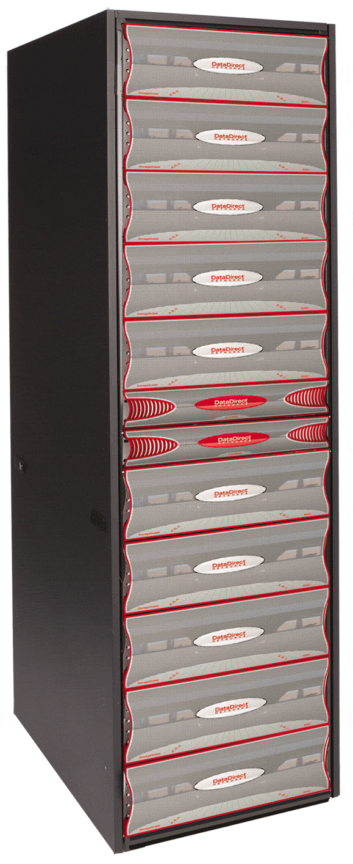
router
switch
CPU
10GigE
storage &
computation
POP

Slide 20
binding service
assurance service
distribute code
gather data
manage nodes
application
application
signaling (control plane)
transport
transport
storage
end node
network
network
network
MAC
router
MAC
MAC
PHY
PHY
PHY

