Slide 1
Vision: Policy-Driven Distributed and Collaborative Demand Response in Multi-Domain Commercial Buildings
Archan Misra (Telcordia)
and
Henning Schulzrinne (Columbia University)
Notes:
1

Slide 2
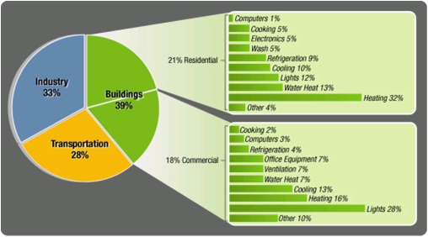
Commercial & residential building energy usage

Slide 3
Demand Response in Commercial Buildings & Campuses
Need to move beyond centralized control of limited “high-load” devices to
Accommodate different policy domains & administrative hierarchies
financial incentives need to be local
avoid annoying users with inflexible policies
e.g., important lab experiments or “need dishes for dinner”
Automated incorporation of devices in the DR paradigm
load management
convenience & comfort (room temperature, boot time) vs. cost
Flexible, pricing-based DR (instead of simple peak load control)
Delegate down objectives and trade-offs (costs), not commands
and provide feedback to device and user

Slide 4
Three Models for Demand Adaptation

Slide 5
Hierarchies of control
real-estate manager
(many tenants)

Slide 6
DR For Commercial Buildings: The Problem Space
Feature | Residential | Commercial | Campus
Typical DER Resources | PVs, CHP | PVs, CHP, micro-turbine | PVs, micro-turbine, capacitor banks
Major loads | HVAC, lighting, fridge, pool, washing machine, dishwasher | HVAC, lighting, office equipment, IT servers, refrigeration | HVAC, lighting, elevators, lab equipment, IT servers
# of DR Loads | O(10) | O(100) | O(1000)
Major Distinguishing Issues |  | Multiple operational domains (different organizations/companies)→ distributed DR; High device heterogeneity | Potentially multiple operational domains (univ. departments); differentiated priority among domains to DER resources

Slide 7
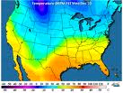
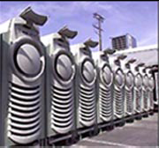
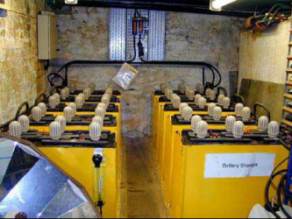
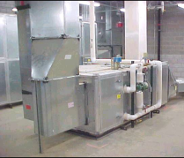
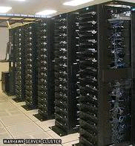
DRACHMA: The Hierarchical DR Model
Weather IT
Information
Wind/Sun
Forecast Data
Distribution Grid/ Utility
Grid Price Signal (t, t+T)
MicroTurbine
Master DR Orchestrator (potentially in EMS)
Device
Production
Profile
Aggregatedd Demand Signal(t, t+T)/
Willingness to Pay (t, t+T)
In-Building Price Signal (t, t+T)
Hierarchical DR Orchestrator
Storage Parameters
(e.g., E(t), discharge
rate)
Hierarchical DR Orchestrator
Battery Storage
Hierarchical DR Orchestrator (+ Policy)
Hierarchical DR Orchestrator (+ Policy)
Device
Profile
Load Device (HVAC)
Load Device
(Server)
LCO

Slide 8
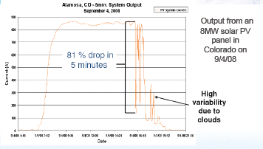
Generation variation

Slide 9
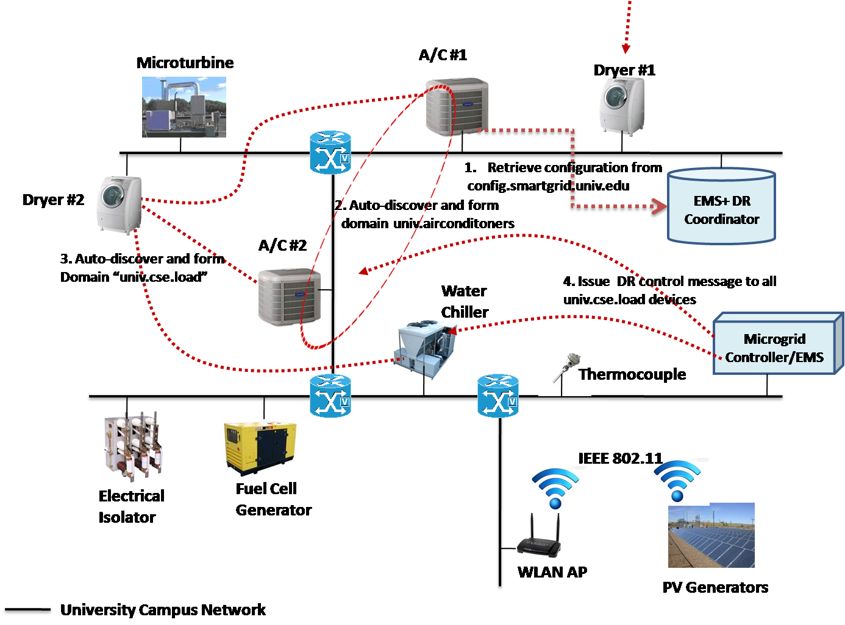
Challenge 1: Device and Domain Autoconfiguration

Slide 10
Challenge 2: Distributed DR Adaptation
Three key technical components
Stochastic Optimization: Express the uncertainty in renewable production & demand as stochastic variables.
Optimal Control: Derive key price-inflexion points for the next few minutes to hours.
Distributed Utility Maximization: Set prices to maximize utility & make the algorithms implementable in a practical building environment
Modified Time-Horizon Optimization
Key Challenges in Building This Distributed Adaptation Framework
Make Framework work without explicitly knowing demand functions (distributed operation)
Incorporate Consumption Constraints (6 Different Load Types)
Factor in underflow/overflow constraints on storage
Conventional Instantaneous Optimization
Maximize user comfort—utility functions
Minimize Energy Price

Slide 11
Challenge 3: Expressing Composite Load/Adaptation Models

Slide 12
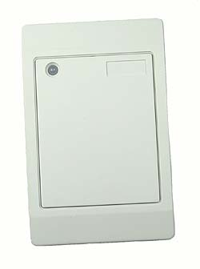
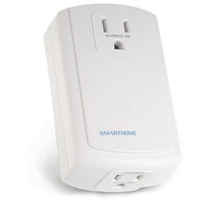
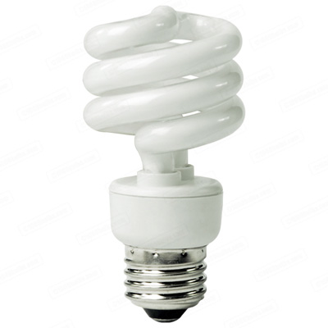
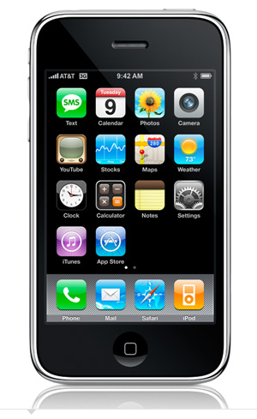
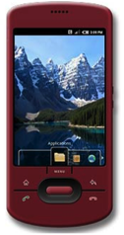
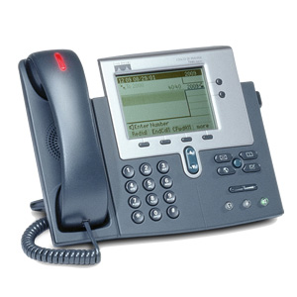
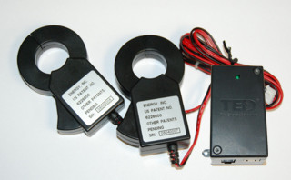
Challenge 4: Automate actions
RFID
next appt.
Alice → a@b.com,
+1 212 555 1234
SECE
GW
control appliances
PUBLISH
PIDF-LO
SUB/NOT
PIDF-LO, RPID,
others
edit scripts
update SNs, SMS, email
call state
geocoding
travel time
monitor energy
usage
B2BUA

Slide 13
Conclusion
Need to decentralize control → reflect local organization
Automate:
local and global objectives → local behavior
avoid manual actions → input from external data sources

