Slide 1
Internet Real Time Laboratory
Department of Computer Science
Columbia University

Slide 2
Overview
PI + 12 PhD students + ~4 visitors + 1 staff researcher
Network infrastructure
PBS: Permission-Based Sending
NetServ for programmable networks
Future Internet architecture
Mobile networks
7DS: opportunistic networks
PetriNet for modeling mobility protocols
Location-based services
Modeling human mobility
Network management & measurement
DYSWIS: distributed fault diagnosis & correction
Vdelay: Video delay measurement tool
Applications & middleware
RELOAD: P2P infrastructure
SIP overload control & cloud services
SPIT prevention
NG911

Slide 3
NetServ - overview
Problem:
Ossification in the Internet
Approach:
Extensible architecture for core network services
Modularity: Building Blocks, Service Modules
Virtual services framework: security, portability
Current results:
Prototype using Click router & Java OSGi framework
Measurements indicating overhead from Java is acceptable
Future Work:
Content Distribution Network (CDN) application
Security and resource control (AAA)
Implementation on a real router

Slide 4
NetServ - prototype
Prototype
Java OSGi on top of Click
Click: Modular router platform
OSGi: dynamic loading and unloading of modules
Measurement
Bare Linux vs. Plain Click
Penalty for kernel-user transition
Plain Click vs. NetServ
Java overhead
2) is small compared to 1)

Slide 5
Circle of blame
probably packet
loss in your
Internet connection →
reboot your DSL modem
ISP
probably a gateway fault
→ choose us as provider
OS
VSP
must be a
Windows registry
problem → re-install
Windows
app
vendor
must be
your software
→ upgrade

Slide 6
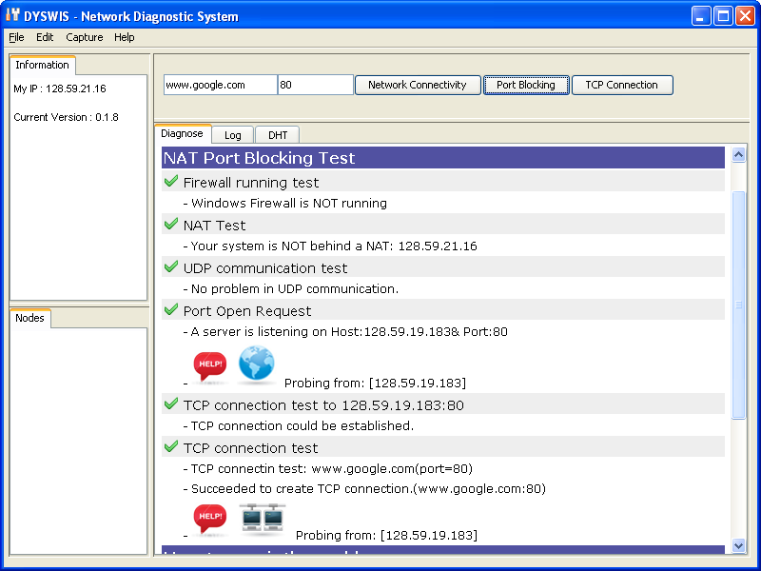
DYSWIS

Slide 7
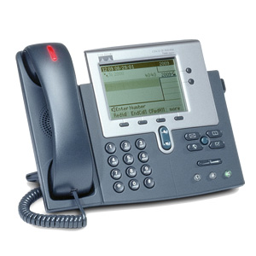
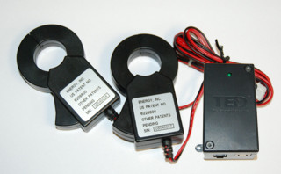
SECE
RFID
next appt.
Alice → a@b.com,
+1 212 555 1234
SECE
GW
control appliances
PUBLISH
PIDF-LO
SUB/NOT
PIDF-LO, RPID,
others
edit scripts
update SNs, SMS, email
call state
geocoding
travel time
monitor energy
usage
B2BUA

