Slide 1
SECE: Sense Everything, Control Everything
Omer Boyaci, Victoria Beltran and Henning Schulzrinne

Slide 2
SECE: Sense Everything, Control Everything
SECE allows users to create services that combine
communication
calendaring
location
devices in the physical world
SECE is an event-driven system
that uses a high-level language
to trigger action scripts, written in Tcl.

Slide 3
SECE: Examples of rules
SECE language syntax
every sunset {
homelights on;
}
every week on WE at 6:00 PM{
email irt_list “Pizza talk at 6:00 PM today.”;
}
if my stock.google > 14 {
sms me "google stock:"+[stock google];
}

Slide 4
SECE: Event-triggered actions
Events
Actions
Presence updates
Incoming calls
Email
Calendar entries
Sensor inputs
Location updates
Controlling the delivery of email
Routing phone calls
Updating social network status
Controlling actuators such as lights
Reminders (email, voice call, SMS)
Interacting with Internet services

Slide 5
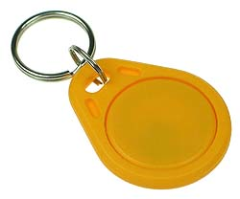
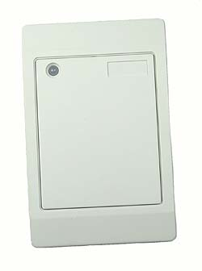
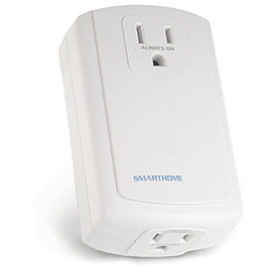
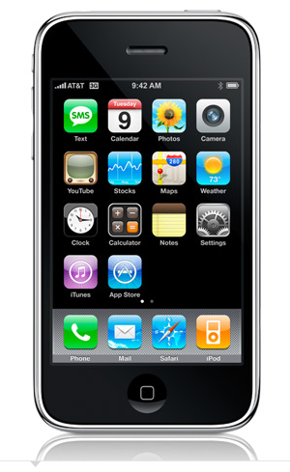
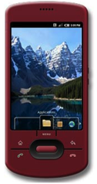
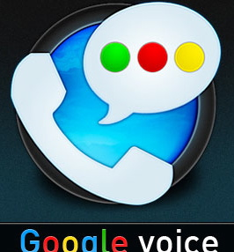
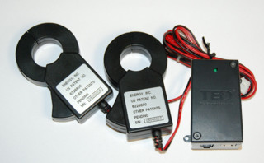
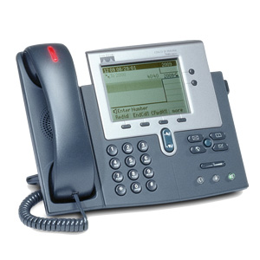
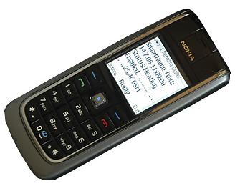
SECE: The glue for Internet applications
GW
next appt.
RFID
Alice → a@b.com,
+1 212 555 1234
control appliances
SECE
GW
PUBLISH
PIDF-LO
SUB/NOT
PIDF-LO, RPID,
others
GW
update SNs, SMS, email
call state
Call events, VM, SMS
geocoding
travel time
monitor energy
usage
B2BUA

Slide 6
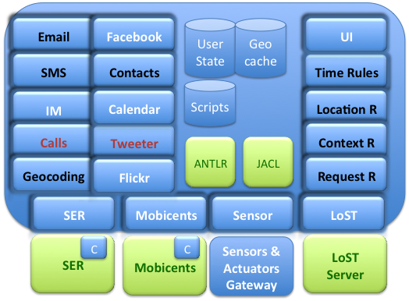
SECE: Software Modules

Slide 7
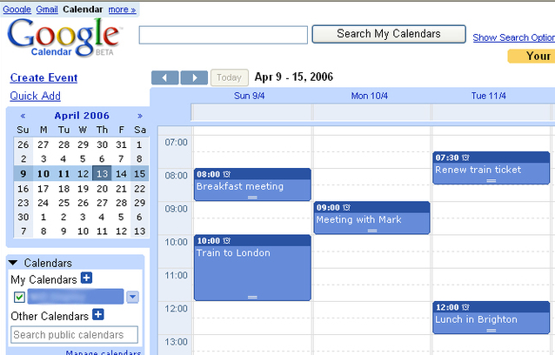
SECE: Time-based rules
Every day at 12:00 from 01/01/2010 until 04/01/2010 {
email employees “lunch time” “Location: 5th floor Dinning Room, Time: 12:30”
}
BEGIN:VCALENDAR
BEGIN:VEVENT
DTSTART;TZID=America/New_York:20100101T120000 RRULE:FREQ=DAILY;BYHOUR=12;
UNTIL=20100401T120000
END:VEVENT
END:VCALENDAR
SECE
Export / Import

Slide 8
SECE: Time-based rules
Non-recurrent rules: A single event
on Anne's birthday at 12:00 am in anne.location{ sms anne "Happy Birthday!!! kisses. John" }
on dateExpr (at timeExpr ) (in timezone) { body }
e.g Europe/Zurich
2011-12-31, 12/31/2011
December 31, 2011
31th day of December, 2011
300th day, 2011
2th MO of May, 2011
May 2th Monday, 2001
Last Sunday in 52th week, 2011
Christmas Day, 2011
Thanksgiving Day, 2011
1 day before Thanksgiving Day, 2011
sunrise
sunset
evening twilight
morning twilight
first working hour
last working hour
lunch break

Slide 9
SECE: Time-based rules
Recurrent rules: multiple events
every sunset { homelights on; } → “every day at sunset”
every year on last Friday of January, March, June at last working hour except August { backup; }
every day at 10 minutes before lunch break from September 1, 2010 until Dec 24, 2010 { sms group-list "Lunch time! Let’s meet in 5 minutes";}
every last monthly day { email me "Reminder: Check the students’ monthly reports”;}
every WE at 6:00 PM from 10/1/09 until May 12, 2010 except 3th WE of Feb, including first day of June, 2010 { email irt-list "reminder: weekly meeting today at 6:00 PM"; }
every freq (on dateExpr) (at timeExpr ) (in timezone) (from dateExpr ) (until dateExpr ) (for num times| timeUnits) (during period) (except dateExprList) (including dateExprList) { body }

Slide 10
SECE: Time-based rules
Recurrent rules: multiple events in particular hours
every hour on 01/01/2011 at 9, 17 hours at 30 minutes at 40, 45 seconds
→ events at 9:30:40, 9:30:45, 17:30:40 and 17:30:45
every hour on first monthly day in working hours until January 1, 2011 except July, August, first day of June, 9:00
every 15 minutes in lunch break
every 30 minutes on MO from 8:00 to 18:00 from 15th day of August until first Monday of September

Slide 11
SECE: Context-based rules
What’s context?
Presence information → IETF SIMPLE specifications
Sensor information
if bob's activity is idle { call bob }
If bob@domain.com’s status equals working { alarm me }
If bob.placetype is home { sms bob “water the plants”; }
if my stock.google > 14 {sms me "google stock:"+[stock google] }
If me.office.temperature < 50 { ac off; }
If anne.location.civic changed { email me “Anne’s civic location:”+[status anne location.civic]
if context operator (value) { body }

Slide 12
SECE: Context-based rules
Tree-like data structure
bob
placeis
status
activity
office
phone
bob.activity
temperature
home
work
video
text
audio
bob.phone.work
bob.placeis.audio

Slide 13
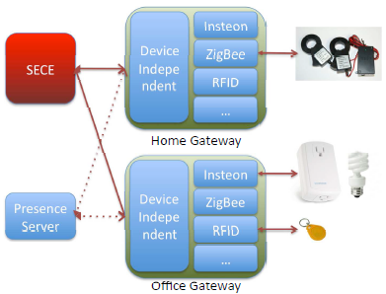
SECE: Sensor and actuators
Sensors : smoke, light, humidity, motion, temperature and RFID Readers
Actuators: networked devices and actuators such as lights, cameras, sprinklers, heaters, and air conditioners.
Sensor description: basic RDF ontology
(Resource Description Framework)
if my warehouse.motion equals true {
sms me "person in the warehouse."
}
if my office.smoke equals true {
sprinklers on;
sms me "fire in the office";
call_tts fire-department "fire in the "+[get me.office.address];
electrical-appliances off;
}

Slide 14
SECE: Location-based rules
bob near "Columbia University”
me near 40.807,-73.963
tom within 5 miles of me
me within 3 miles of ”2960 Broadway, New York, 10027”
tom in “Rockefeller center”
Me outside of “Manhattan”
bob moved 1.5 miles
Place types and user-defined locations:
me near a post office
Anne in a museum
me near my tennis club
user operator location { body }

Slide 15
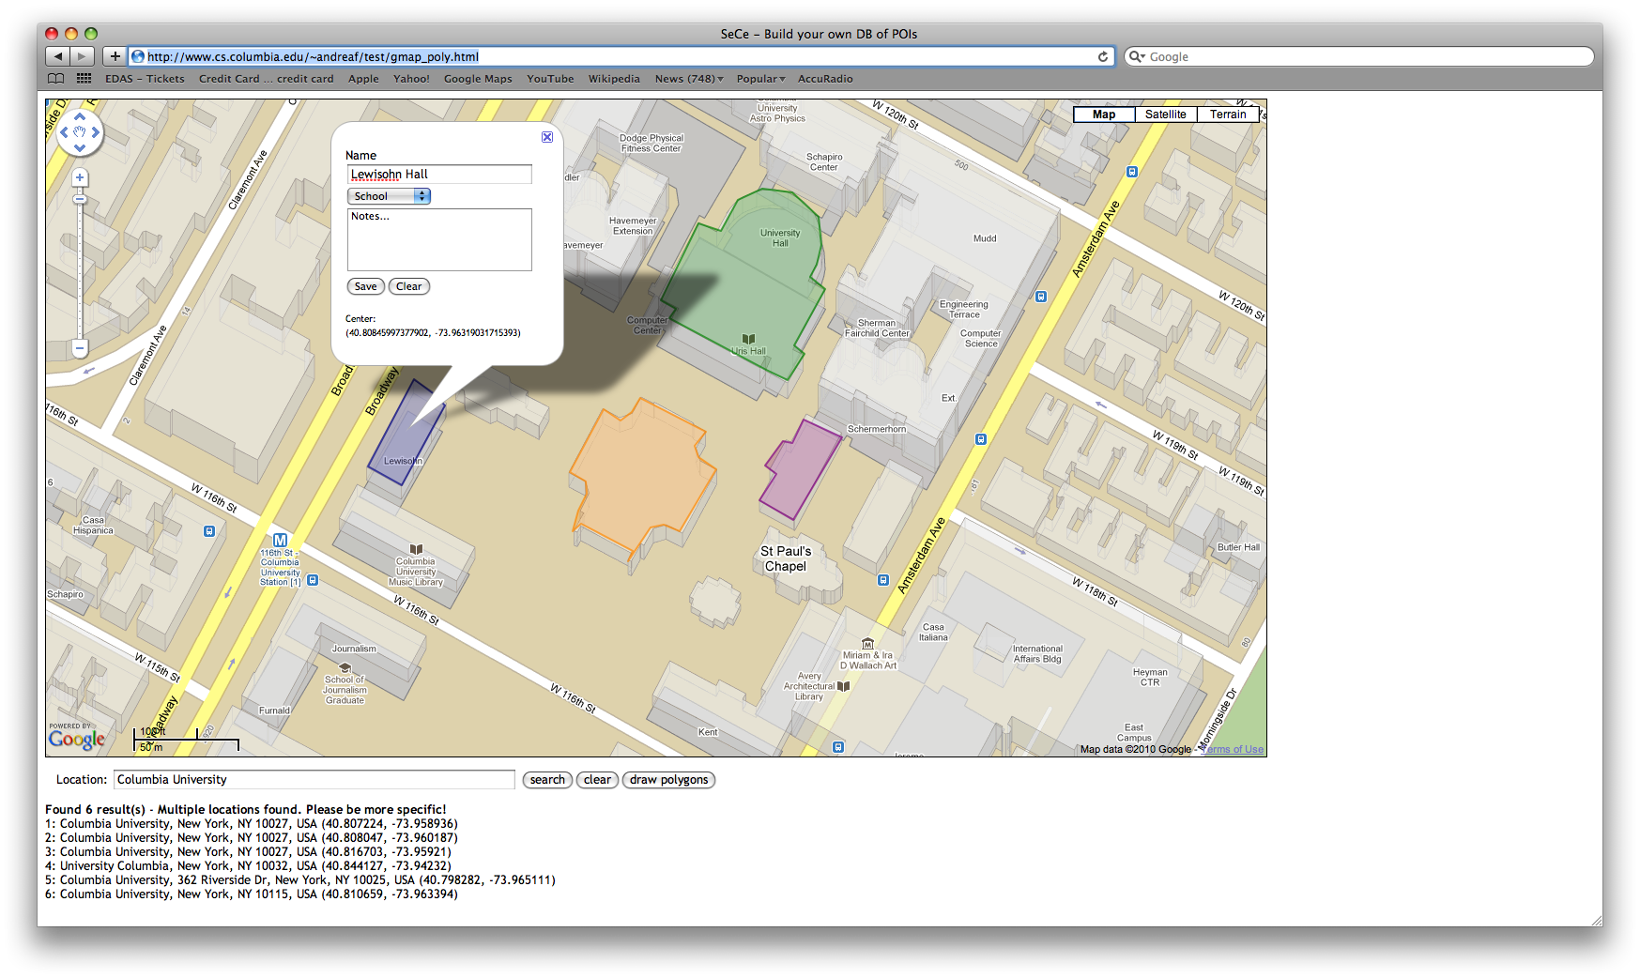
SECE: Location-based rules (Geographical database)

Slide 16
SECE: Location-based rules
(user, op, location)
SECE
Server
LoST
Server
Location rule
LOST REPLY
Geographical
database
LOST QUERY
location=civic info
geo-cache
PUBLISH
Presence
Server
NOTIFY
SECE
Server
LOST REPLY
LoST
Server
LOST QUERY
location=place type
location=user
location=civic info
geo-cache
Presence database
SECE User

Slide 17
SECE: Request-based rules
Event: call, im, sms*, voicemail*, email (*only incoming)
incoming|outgoing event from user|address to address { body }
missed call from user|address to address { body }
received call from user|address to address { body }
incoming call {
if { [my activity] == "on-the-phone"} forward sip:bob@example.com
}
outgoing call {
if {[outgoing destination] == "18003456789"} modify_call destination 12129397054
}
incoming call from Anne {
if {[my location] != "office"} auto_answer audio no_office.au –record
}
incoming im {
sms me [incoming from]+" sent an im:"+[incoming content]
}

Slide 18
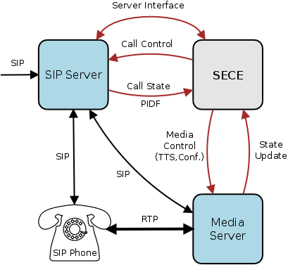
SECE: Request-based rules (SER SIP Server)
Control: Accept, reject, redirect, forward calls based on variety of SECE signals
Integration: Calendar, address book, PSTN, Google Voice, SMS, location, Text-to-speech, Voicemail)
Simplicity: Natural, easy to learn scripting language
Flexibility: Input from a variety of SECE components involved in call handling
Automation: Scripts for recurring tasks (setup a conf. call based on calendar)
“On mom's birthday, call mom when I am home and near phone.”
“Setup a conference call, enter password, invite people, ring desk phone.”
“If driving and incoming call, play “user driving” and redirect to voicemail.”
“If desk phone ringing and not in room, send SMS with caller's number.”

Slide 19
SECE: Next steps…
Integrate SER server
Integrate LoST server and geodatabase
Finish Address Book functionality
Finish request-based incoming rules
Implement request-based outgoing rules
Calendar interface
Facebook interface

