Slide 1
SECE: Making Services Programmable (Again)
Henning Schulzrinne
Omer Boyaci
Victoria Beltran
Jae Woo Lee
Suman Srinivasan
Eric Liu

Slide 2
Overview
Motivation and (brief) history
Programming in-network services → NetServ
Combining web and telecom services → SECE

Slide 3
A Pyramid of programmers
JAIN

Slide 4
Levels of programming

Slide 5
SECE: Sense Everything, Control Everything
Omer Boyaci, Victoria Beltran and Henning Schulzrinne

Slide 6
Overview
SECE allows non-technical users to create services that combine
communication
calendaring
location
devices in the physical world
SECE: event-driven system
uses high-level event languages
to trigger action scripts, written in Tcl
and other languages in the future

Slide 7
Events & actions
Events
Actions
Presence updates
Incoming calls
Email
Calendar entries
Sensor inputs
Location updates
Control the delivery of email
Route phone calls
Update social network status
Control actuators such as lights
Reminders (email, voice call, SMS)
Interact with Internet services

Slide 8
Event language syntax
every sunset {
homelights on;
}
every week on WE at 6:00 PM{
email irt_list “Pizza talk at 6:00 PM today.”;
}
if my stock.google > 14 {
sms me "google stock:"+[stock google];
}

Slide 9
Event rules: more examples
Extensible set of small languages
Time
Single on February 16, 2010 at 6:00 PM
Recurring every day at 12:00 until April
Location
Tom within 5 miles of me
Context
if my office.temperature > 80
Communication requests
incoming call

Slide 10
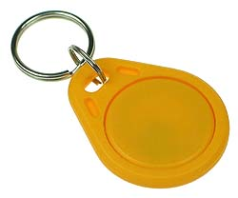
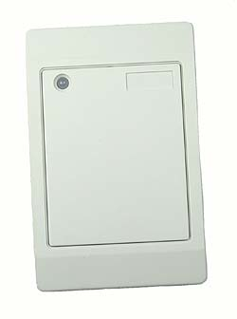
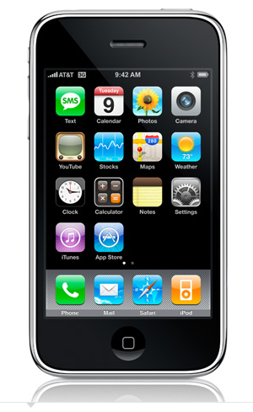
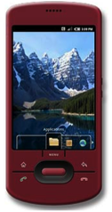
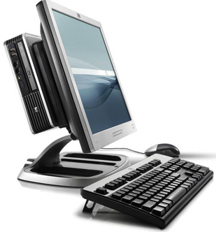
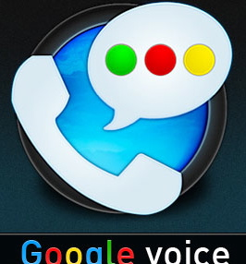
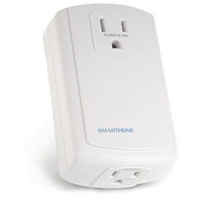
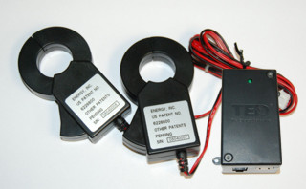
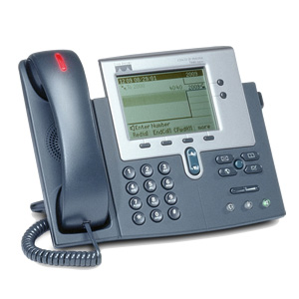
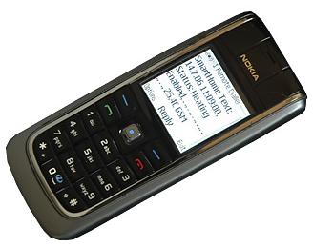
SECE: The glue for Internet applications
GW
next appt.
RFID
Alice → a@b.com,
+1 212 555 1234
geocoding
travel time
SUB/NOT
PIDF-LO, RPID,
others
SECE
PUBLISH
PIDF-LO
update SNs, , email…
GW
GW
call state
Call events, VM, SMS
monitor energy
usage
B2BUA
control appliances

Slide 11
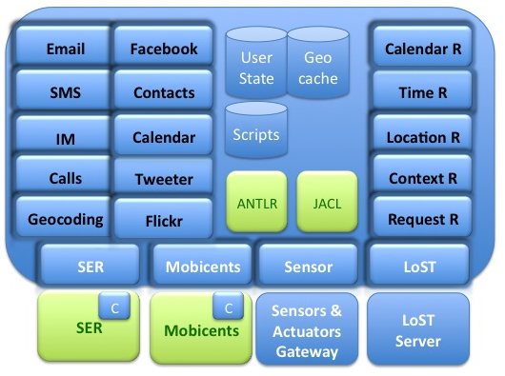
Software Modules

Slide 12
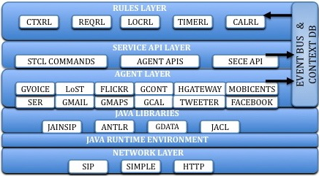
Software architecture

Slide 13
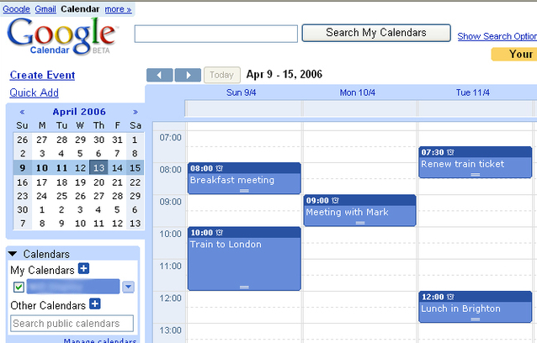
Time-based events
Every day at 12:00 from 01/01/2010 until 04/01/2010 {
email employees “lunch time” “Location: 5th floor Dinning Room, Time: 12:30”
}
BEGIN:VCALENDAR
BEGIN:VEVENT
DTSTART;TZID=America/New_York:20100101T120000 RRULE:FREQ=DAILY;BYHOUR=12;
UNTIL=20100401T120000
END:VEVENT
END:VCALENDAR
SECE
Export / Import

Slide 14
Time: single events
on dateExpr (at timeExpr ) (in timezone) { body }
on Anne's birthday at 12:00 am in anne.location{sms anne "Happy Birthday!"}
2011-12-31, 12/31/2011
December 31, 2011
31th day of December, 2011
300th day, 2011
2th MO of May, 2011
May 2th Monday, 2001
Last Sunday in 52th week, 2011
Christmas Day, 2011
Thanksgiving Day, 2011
1 day before Thanksgiving Day, 2011
e.g Europe/Zurich
sunrise
sunset
evening twilight
morning twilight
first working hour
last working hour
lunch break

Slide 15
Time: recurrences
every freq (on dateExpr) (at timeExpr ) (in timezone) (from dateExpr ) (until dateExpr ) (for num times| timeUnits) (during period) (except dateExprList) (including dateExprList) { body }
every sunset { homelights on; } → “every day at sunset”
every year on last Friday of January, March, June at last working hour except August { backup; }
every day at 10 minutes before lunch break from September 1, 2010 until Dec 24, 2010 { sms group-list "Lunch time! Let’s meet in 5 minutes";}
every last monthly day { email me "Reminder: Check the students’ monthly reports”;}
every WE at 6:00 PM from 10/1/09 until May 12, 2010 except 3th WE of Feb, including first day of June, 2010 { email irt-list "reminder: weekly meeting today at 6:00 PM"; }

Slide 16
Calendar events
when meeting-name begins|finishes { body }
when time time-units before|after meeting-name { body }
when ”weekly meeting” begins {
status activity busy;
sms [event participants] ”Please, switch your cell phone off or set silent mode”;
}
when 30 minutes before ”weekly meeting” {
email [event participants] “”[event title]" “The event [event title] will start is 30 minutes and will last [event duration] minutes. Description: [event description]. Start time: [event start]."
if {me not within 3 miles of campus } {
email [status bob.email] ”I’m away” ”Please, head the conference room and prepare everything for the weekly meeting. Not sure if I will be on time.”;
}
}

Slide 17
Location-based events
bob near "Columbia University”
me near 40.807,-73.963
tom within 5 miles of me
me within 3 miles of ”2960 Broadway, New York, 10027”
tom in “Rockefeller center”
Me outside of “Manhattan”
bob moved 1.5 miles
Place types and user-defined locations:
me near a post office
Anne in a museum
me near my tennis club
user operator location { body }

Slide 18
Location-based events
(user, op, location)
SECE
Server
LoST
Server
Location rule
LOST REPLY
Geographical
database
LOST QUERY
location=civic info
geo-cache
PUBLISH
Presence
Server
NOTIFY
SECE
Server
LOST REPLY
LoST
Server
LOST QUERY
location=place type
location=user
location=civic info
geo-cache
Presence database
SECE User

Slide 19
Handling location updates
User
publishes his/her location periodically (e.g., every 5 min) to a presence server or to a location service such as Google Latitude
Presence server
notifies changes in location to SECE server
Google Latitude (or similar service)
SECE retrieves user’s location periodically
SECE server
depending on user’s defined rules, queries LoST server
LoST server
replies with current information on user’s surroundings
SECE server
Takes action based on rules and contextual location information
SECE
Server
LoST
Server
LoST reply
LoST query
NOTIFY
POLL
Presence
Server
Google
Latitude
PUBLISH
SECE User
IBM Service Science Workshop May 2010

Slide 20
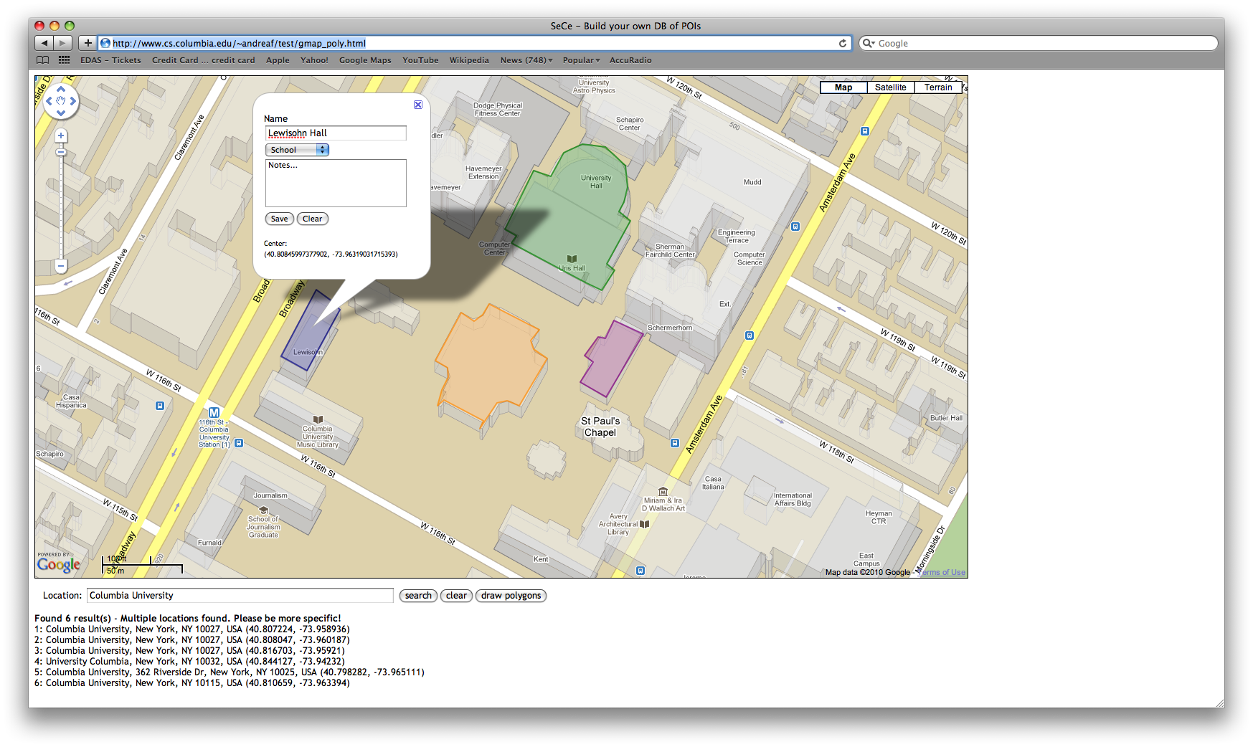
Location-based rules (Geographical database)

Slide 21
Social network events
Incoming social_network message_type
facebook
twitter
linkedin
wallmesssage
newsmessage
direct
social_network status_update
facebook
twitter
linkedin

Slide 22
Context-based rules
What’s context?
Presence information → IETF SIMPLE specifications
Sensor information
if bob's activity is idle { call bob }
If bob@domain.com’s status equals working { alarm me }
If bob.placetype is home { sms bob “water the plants”; }
if my stock.google > 14 {sms me "google stock:"+[stock google] }
If me.office.temperature < 50 { ac off; }
If anne.location.civic changed { email me “Anne’s civic location:”+[status anne location.civic]
if context operator (value) { body }

Slide 23
Context as a tree
bob
placeis
status
activity
office
phone
bob.activity
temperature
home
work
video
text
audio
bob.phone.work
bob.placeis.audio

Slide 24
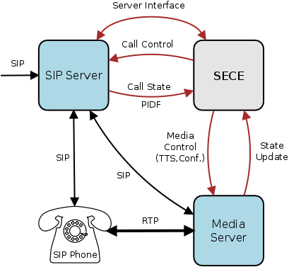
Automated Call Handling
Control: Accept, reject, redirect, forward calls based on variety of SECE signals
Integration: Calendar, address book, PSTN, Google Voice, SMS, location, Text-to-speech, voicemail)
Simplicity: Natural, easy to learn scripting language
Flexibility: Input from a variety of SECE components involved in call handling
Automation: Scripts for recurring tasks (setup a conf. call based on calendar)
“On mom's birthday, call mom when I am home and near phone.”
“Setup a conference call, enter password, invite people, ring desk phone.”
“If driving and incoming call, play “user driving” and redirect to voicemail.”
“If desk phone ringing and not in room, send SMS with caller's number.”

Slide 25
Communication-based events
incoming|outgoing event from user|address to address { body }
missed call from user|address to address { body }
Event: call, im, sms*, voicemail*, email (*only incoming)
received call from user|address to address { body }
incoming call {
if { [my activity] == "on-the-phone"} forward sip:bob@example.com
}
outgoing call {
if {[outgoing destination] == "18003456789"} modify_call destination 12129397054
}
incoming call from Anne {
if {[my location] != "office"} auto_answer audio no_office.au –record
}
incoming im {
sms me [incoming from]+" sent an im:"+[incoming content]
}
incoming call { schedule "call received from [incoming origin]" }

Slide 26
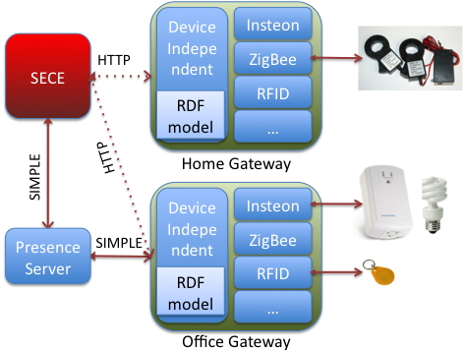
Sensors and actuators
Sensors : smoke, light, humidity, motion, temperature and RFID Readers
Actuators: networked devices and actuators such as lights, cameras, sprinklers, heaters, and air conditioners.
Sensor description: basic RDF ontology
(Resource Description Framework)
if my warehouse.motion equals true {
sms me "person in the warehouse."
}
if my office.smoke equals true {
sprinklers on;
sms me "fire in the office";
call_tts fire-department "fire in the "+[get me.office.address];
electrical-appliances off;
}

Slide 27
Next steps
Functionality:
Integrate SER server
Integrate LoST server and geo database
Finish address book functionality
Finish request-based incoming rules
Implement request-based outgoing rules
Usability:
guided & graphical interface
evaluation: can “normal” users create services?

Slide 28
Conclusion
SECE

