Slide 1
NetSERV: programming NETWORKS (again)
Jae Woo Lee, Jan Janak, Roberto Francescangeli, Suman Srinivasan, Salman A. Baset, Eric W. Liu, Michael S. Kester and Henning Schulzrinne
Internet Real-Time Laboratory, Columbia University
In collaboration with Wolfgang Kellerer and Zoran Despotovic at DOCOMO Euro-Labs,
Volker Hilt at Bell Labs/Alcatel-Lucent and Srini Seetharaman at Deutsche Telekom

Slide 2
What is NetServ?
In-network service container
Java-programmable, signal-driven router
“GENI Lite” – deploy modules, not VMs
  both experimental & production code
Active networking that works ™

Slide 3
Overview
Old world
  (computation, storage) ←→ forwarding
1990s: active networking
  no good isolation infrastructure
  limited applications
Exploring new opportunities
  providing additional services in the current Internet → NetServ
  future Internet architecture

Slide 4
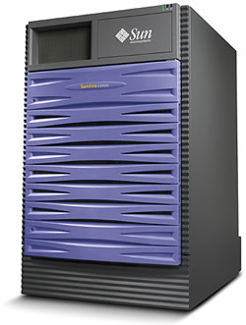
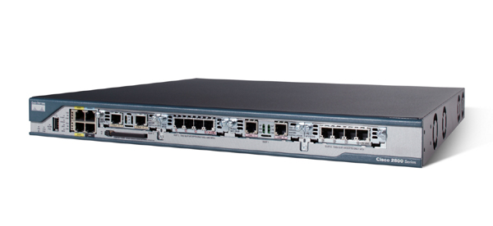
Two worlds
10+ interfaces
0 GB disk
1 low-end processor
1 interface
TB disk
1-32 multi-core processors

Slide 5
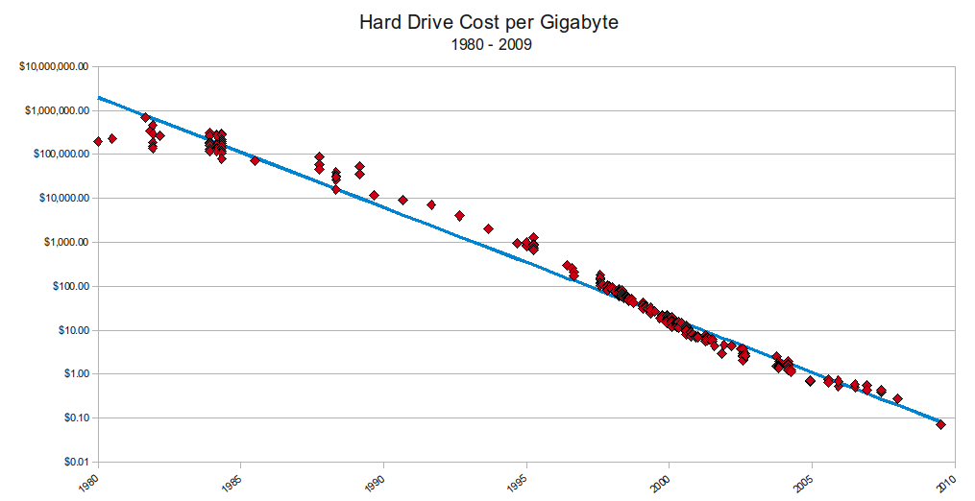
Storage costs
$100/TB
http://www.mkomo.com/cost-per-gigabyte

Slide 6



Bandwidth costs
Amazon EC2
  $100/TB in, $100/TB out
CDN (Internet radio)
  $600/TB (2007)
  $100/TB (Q1 2009 – CDNpricing.com)
NetFlix (7 GB DVD)
  postage $0.70 round-trip → $100/TB
FedEx – 2 lb disk
  5 business days: $6.55
  Standard overnight: $43.68
  Barracuda disk: $91 - $116/TB
Notes:
FedEx and EC2 prices as of 09/15/09
CDN: http://www.mindbranch.com/listing/product/R678-29.html
http://www.cdnpricing.com/

Slide 7
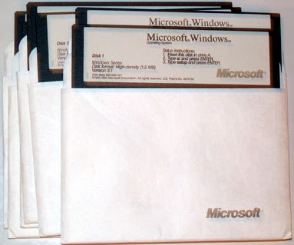
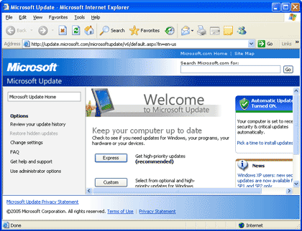

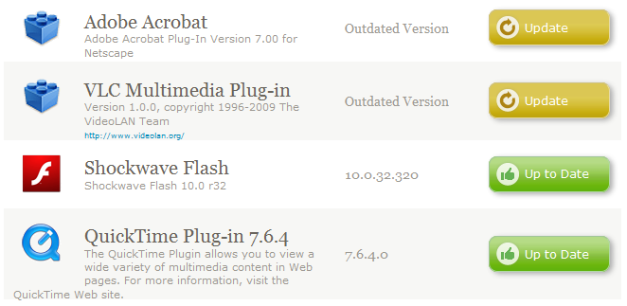
Software: from floppy to autonomous

Slide 8
NetServ overview
Extensible architecture for core network services
  Modularization
  Building Blocks
  Service Modules
  Virtual services framework
  Security
  Portability
  NSF FIND four-year project
  Columbia University
  Bell Labs
  Deutsche Telekom
  DOCOMO Euro-Labs

Slide 9
Architecture overview
Module download
Signaling message
to install module
Signaling message
forwarded to next hop
NetServ controller
Module install
Service modules
Service modules
Service modules
Building block layer
Building block layer
Building block layer
Virtual execution
environment
Virtual execution
environment
Virtual execution
environment
Data packets processed
by service modules
NetServ packet transport

Slide 10
Network node example
RE
storage & computation
PIC
PIC
PE
multiple computation
& storage providers
data center or
POP

Slide 11
Different from active networks?
Active networks
  Example: Packet contains executable code or pre-installed capsules
    Can modify router states and behavior
    Mostly stateless
  Not successful
    Per-packet processing too expensive
    Limited storage (memory expensive)
    Security concerns
    No compelling killer app to warrant such a big shift
  Notable work: ANTS, Janos, Switchware
NetServ
  Virtualized services on current, passive networks
    Service invocation is signaling driven, not packet driven
    Some flows & packets, not all of them
    Emphasis on storage
  Service modules are stand-alone, addressable entities
    Separate from packet forwarding plane
    Extensible plug-in architecture

Slide 12
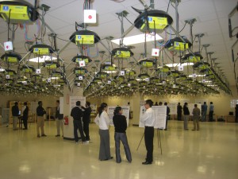
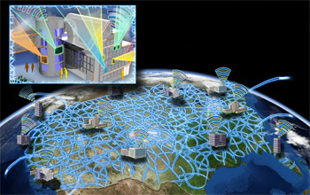
How about GENI?
GENI = global-scale test bed for networking research
  parallel experiments in VMs
➔ long-term, “heavy” services
Demonstrated NetServ on GENI during GEC8

Slide 13
Related work
Cisco’s Programmable Overlay Router
Juniper’s JUNOS SDK
DaVinci project
OpenFlow
ShadowNet (AT&T) – virtual routers
MillionNode GENI (end systems)

Slide 14
NetServ service containers
NetServ service container
  User-level processes
  Embeds a Java Virtual Machine
  Runs OSGi
  Service modules are dynamically installed and removed
NetServ Service Modules
  OSGi-compliant Java code
  Can be stand-alone server (i.e., listens on a port)
  Or can be packet processor
    Packets are first routed from kernel to container using kernel queue (Netfilter queue in Linux and pseudo-device in Click Router)
    Packets are then passed to Java using Java Native Interface (JNI)

Slide 15
Service modules
Full-fledged service implementations
  Use building blocks and other service modules
  Can be implemented across multiple nodes
  Invoked by applications
Examples:
  Routing-related services
    Multicast, anycast, QoS-based routing
  Monitoring services
    Link & system status, network topology
  Identity services
    Naming, security
  Traffic engineering services
    CDN, redundancy elimination, p2p network support

Slide 16
Deployment scenarios
Three actors
  Content publisher (e.g. youtube.com)
  Service provider (e.g. ISP)
  End user
Model 1: Publisher-initiated deployment
  Publisher rents router space from providers (or end users)
Model 2: Provider-initiated deployment
  Publisher writes NetServ module
  Provider sees lots of traffic, fetches and installs module
  Predetermined module location (similar to robots.txt)
Model 3: User-initiated deployment
  User installs NetServ module to own home router or PC
  or on willing routers along the data path

Slide 17
Where does code run?
All (or some?) nodes in a network
  AS, enterprise LAN
Some or all nodes along path
  data path from source to destination
Selected nodes by property
  e.g., one in each AS

Slide 18
How does code get into nodes?
gossip
signaling
All nodes in (enterprise) network

Slide 19
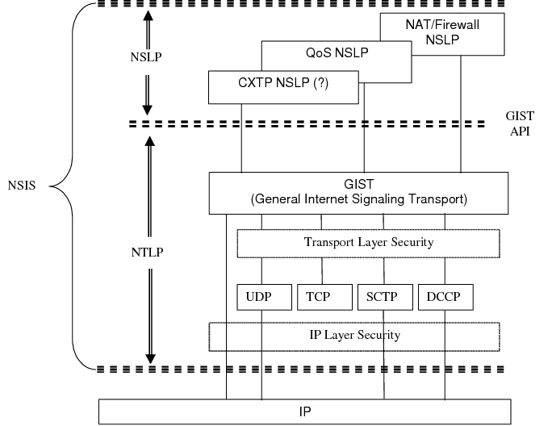
How does code get into nodes?

Slide 20
NSIS
Progress along data path
  with RAO-based discovery
Designed to transport large objects
  supports TCP and UDP
Security mechanisms

Slide 21
NetServ signaling daemons
NetServ signaling daemons
  NSIS (RFC 4080) compliant
  Two layers: Generic GIST and NetServ-specific NSLP
  Receive signaling packets to setup/remove/probe modules
  Command in signal packet handed to NetServ Controller
  Node can be on-path – signal forwarded to next hop
  Currently based on FreeNSIS implementation

Slide 22
Module management: OSGi
“Dynamic module system for Java”
  originally for set top boxes
Why OSGi? Why not just JAR files?
  More than just JAR files
    much richer encapsulation
    metadata in manifest
  Automatic dependency resolution
  Version management
  Provides systems services (logging, configuration, user authentication, device access, …)
  ~ Debian's apt-get or Apple's App Store methods of installation

Slide 23
OSGi features
Dynamic module system for Java
  Modules loaded and unloaded at runtime
  Bundle: self-contained JAR file with specific structure
  Open-source implementations: Apache Felix, Eclipse Equinox
Security and accounting
  Security built on Java 2 Security model
    Permission-based access control
    No fine-grained control or accounting for CPU, storage, bandwidth
    Can load native code with appropriate permission
  Strict separation of bundles
    Classpath set up by Bundle class loader
    Inter-bundle communication only through published interfaces

Slide 24
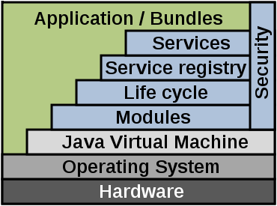
OSGi architecture
Architecture
  Bundles: JAR files with manifest
  Services: Connects bundles
  Services Registry: Management
  of services
  Modules: Import/export interfaces
  for bundles
Possible to “wrap” existing Java apps and JARs
  Add additional manifest info to create OSGi bundle
  E.g.: Jetty web server now ships with OSGi manifest; now extensively used with OSGi containers and custom bundles
  For NetServ, we created a OSGi bundle for the Muffin HTTP proxy server
Image credit: Wikipedia

Slide 25
OSGi implementation
Many core frameworks
  Eclipse Equinox, Apache Felix, Knoplerfish
Real-world examples
  Eclipse IDE uses OSGi for plugin architecture
Mostly finds use in enterprise applications needing plugin functionality
  E.g.: IBM Websphere, SpringSource (now VMWare) dm server, Red Hat's JBoss

Slide 26
Getting packets: Click router
Runs as a Linux kernel module or user-level program
Modules written in C++ (called Elements) are configured in a text file
Elements are arranged in a directed graph, through which packets traverse
Example:
  Click router command:
    sudo click print.click
  Configuration file print.click:
    FromDevice(en0)->CheckIPHeader(14)->IPPrint->Discard;
http://www.read.cs.ucla.edu/click/

Slide 27
1st prototype
Proof-of-concept for dynamic network service deployment
  Open-source Click modular router
  Java OSGi dynamic module system
Promising initial measurement results
  NetServ overhead acceptable compared to other overhead

Slide 28
1st implementation
Implements
PktProcessor
Registers an instance of
PktDispatchingService
NetServ
App
Bundle
dispatcher.addPktProcessor(this);
NetServ
Building Block
Bundle
packet flow
Equinox OSGi framework
NetServ OSGi Launcher
Java Virtual Machine
StaticIPLookup
element
NetServ
element
CheckIPHeader
element
User-level Click router
Single process

Slide 29
Performance evaluation
Initial measurements on the first prototype
  NetServ on user-level Click router
  Maximum Loss Free Forward Rate (MLFFR)
Future work on next-generation prototypes
  NetServ on JUNOS, kernel-mode Click
  Ping latency
  Microbenchmarks
  Throughput for non-trivial services
29
Notes:
29

Slide 30
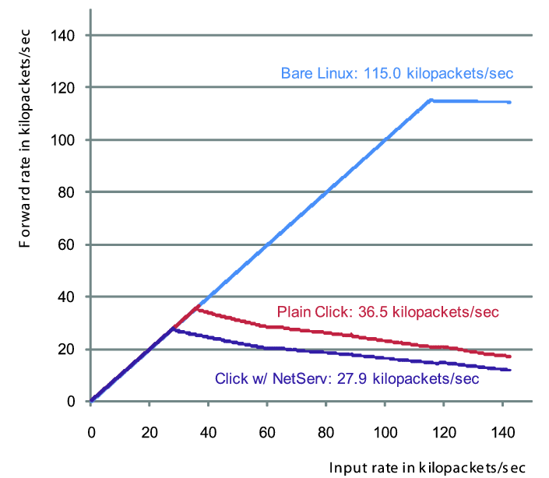
MLFFR comparison
Penalty from kernel-user transition
Penalty from trip to Java layer
For a modular architecture, kernel-user transition is unavoidable since putting a module inside a kernel is not an option

Slide 31
Current NetServ node architecture
Server
modules
Client-
Server
data
packets
NSLP
daemon
OSGi control sockets
OSGi
Service
Container
UNIX
socket
NetServ
Controller
Packet
processing
modules
NetServ Control
Protocol (TCP)
GIST
daemon
Transport layer
OSGi
OSGi
Service
Container
Service
Container
Raw
socket
iptables
command
Forwarded
data packets
Netfilter
NFQUEUE #1
NFQUEUE #2
Signaling
packets
Linux kernel

Slide 32
Next Click architecture
Signaling
NetServ Controller Daemon
Start & stop NetServ Service Container
Module install & removal
Signaling
Service modules for
anonymous users
Service modules for
user #1
Service modules for
user #2
Flow-based multiplexing
layer
Building Blocks
Building Blocks
Building Blocks
OSGi, Java 2 Security
OSGi, Java 2 Security
OSGi, Java 2 Security
OpenVZ container
OpenVZ container
…
OpenVZ container
/dev/fromclick1…N
/dev/toclick1…N
…
…
Kernel-mode Click
PollDevice
element
Other Click
elements
NetServ Packet
Filter
NetServ Packet
Injector
Other Click
elements
ToDevice
element

Slide 33
NetServ controller and kernel
NetServ kernel
  Pass packets to user-level service container processes
  Currently Linux kernel with Netfilter queues
  Click Router version under development
  Juniper Router version planned
NetServ controller
  Coordinates between signaling daemons, kernel, and service container processes
  Receives setup/remove/probe commands from signaling daemons
  Insert/remove packet filters into/from the kernel
  Start/stop service modules in service container processes

Slide 34
Packet intercept
CLICK
  more functionality than needed
pcap
  capture only
iptables with NFQUEUE
  allows filtering of packets into different queues

Slide 35
APIs needed!
Avoid SNMP retrieval problems
  all or nothing (typical)
  hard to do selective triggers
Flow management
  counters, measurement
System information
  like system MIB: geo location, uptime, interface speeds, …
  routing table
  routing table changes (“tell me if route to X changes”)

Slide 36
NetServ service (demo) examples

Slide 37
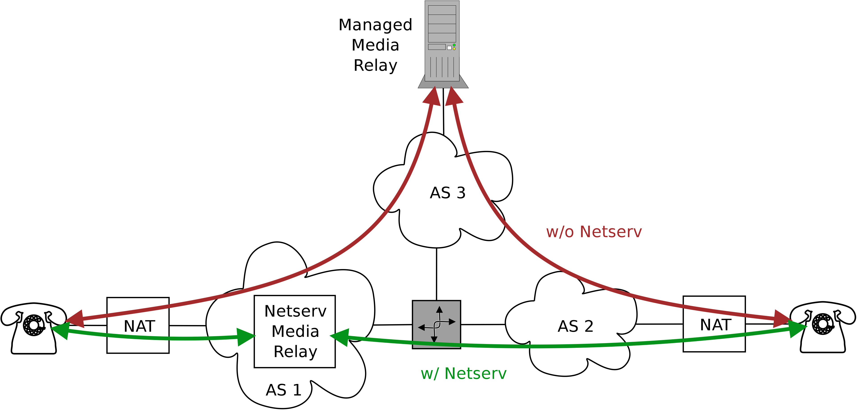
Media relay
Standard media relay
  Required due to NAT
  Out-of-path
  Inefficient and Costly
NetServ media relay
  Closer to users
  Improved call quality
  Reduced cost for ITSP

Slide 38
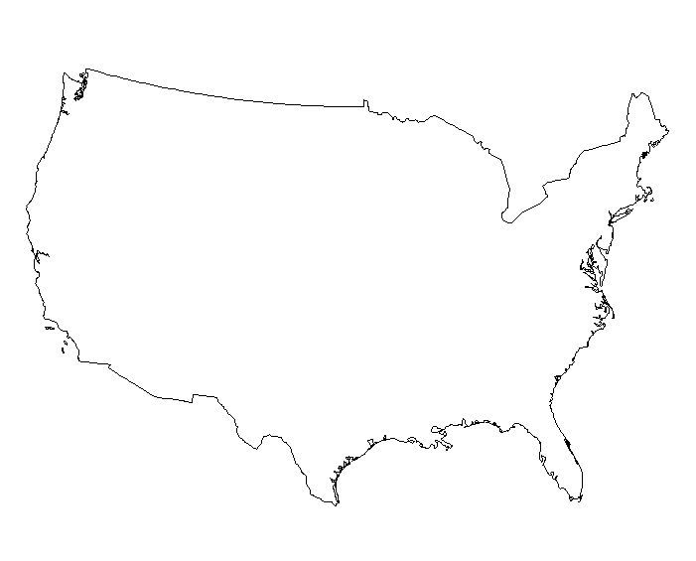
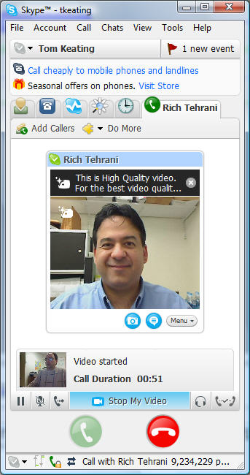
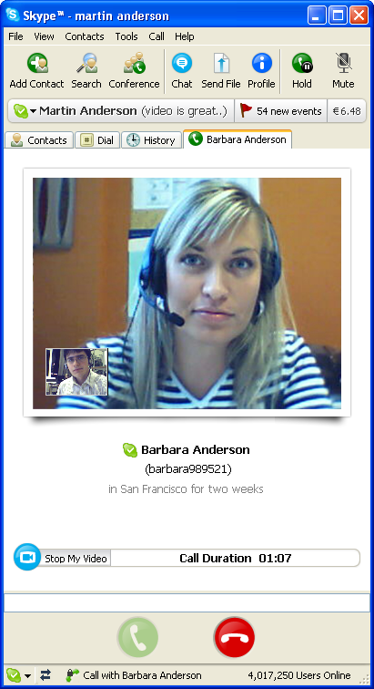



Media relay
Screen 1
Screen 2
Screen 3
SIP server and
Media relay
NAT
End
user
Tell:
How VoIP calls are relayed today
Media relay needed due to NAT
But relays are often out-of-path
Inefficient and high cost for ITSP
Show:
Make a video call between screens 1 & 3
Call flow displayed on screen 2
Bad call quality due to far-away relay

Slide 39
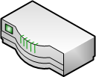

Media relay
Screen 1
Screen 2
Screen 3
N
SIP server
Media relay
on NetServ
NAT
End
user
Tell:
Media relay running in NetServ
Closer to user agents
Higher call quality for users
Reduced cost for ITSP
Show:
SIP server sends signal to install module
Screen 2 displays module being installed (blue arrow)
Make a new video call
Call flow through NetServ relay displayed on screen 2
Screen 1 & 3 show much better video quality

Slide 40
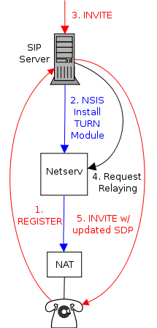
Media relay signaling
UA registers with SIP server
SIP server detects NAT:
  Sends NSIS signal towards UA
  Netserv node close to UA is discovered
  Netserv node installs TURN module
  SIP server remembers to use the TURN module for the UA
An INVITE is received for UA
SIP server sends relaying request to the TURN server
INVITE with updated SDP is sent to UA
NetServ based TURN module is installed at registration time to speed-up processing of INVITE signaling.

Slide 41
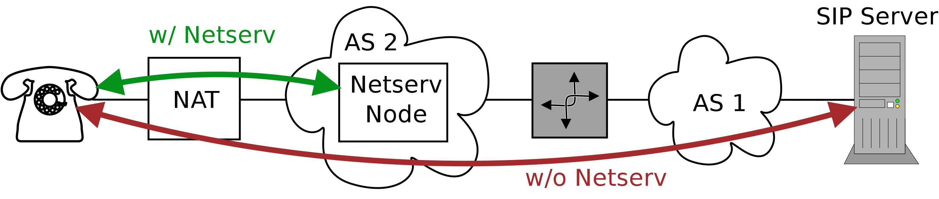
NAT keep-alive responder
NAT Keep-alive responder off
  UA behind NAT must send keep-alive messages
  Major bottleneck for SIP server
NAT Keep-alive responder on
  Module responds on behalf of SIP server
  No traffic to server

Slide 42
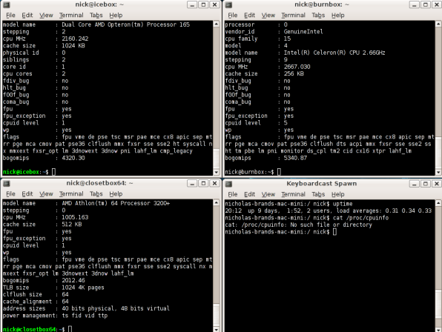

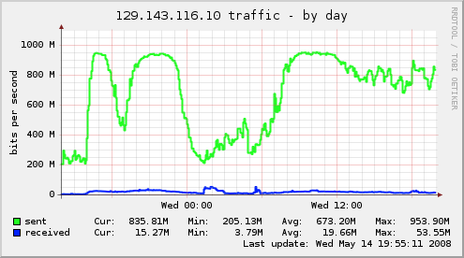

NAT keep-alive responder
Screen 1
Screen 2
Screen 3
NAT
SIP server
High cost for ITSP
Traffic generator
(sipp)
Tell:
UA behind NAT must keep sending keep-alive message
Major bottleneck on SIP server today
Show:
Screen 1: Traffic generators send keep-alive messages to SIP server
Screen 2: Packet flows shown on screen
Screen 3: High traffic volume, thus high cost for ITSP

Slide 43

NAT keep-alive responder
Screen 1
Screen 2
Screen 3
NAT
N
N
N
N
SIP server
No keep-alive traffic
Traffic generator
(sipp)
Tell:
SIP server installs modules into NetServ nodes closer to users
Modules respond to keep-alive messages on behalf of SIP server
Keep-alive messages do not reach SIP server
Show:
Screen 1: Traffic generators keep sending keep-alive messages to the SIP server
Screen 2: Packet flows terminate at NetServ nodes
Screen 3: SIP server sees no keep-alive traffic, thus no keep-alive cost to ITSP

Slide 44


N
N
End user
Regular
router
NetServ
router
NetServ
router
Regular
router
Content
provider
(1) User requests http://youtube.com/getvideo?id=foo
(2) YouTube sends video file
(3) YouTube sends on-path signal to deploy ActiveCDN module
(4) NetServ-enabled routers download the module
(5) NetServ routers notify that the module is active
(6) Another user requests http://youtube.com/getvideo?id=foo
(7) YouTube redirects user to nearest NetServ node running ActiveCDN
(8) User requests http://netserv1.verizon.com/youtube/foo.flv
(9) NetServ router relays the video content, while fetching the file and caching it

Slide 45
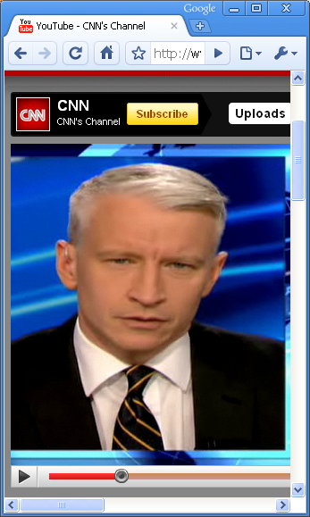
ActiveCDN – watermarking
Screen 1
Screen 2
Screen 3
User 1 downloads and watches video content from provider
Step 1
Content
server
User 1
Content server sends on-path signal to install ActiveCDN module into NetServ router
Content
server
NetServ
node
Step 2
N
User 1
User 2
User 2’s request gets redirected to NetServ router, which serves processed video
Content
server
NetServ
node
Step 3
N
User 1
Watermark

Slide 46
ActiveCDN – module migration
PlanetLab nodes run scripts fetching small files from the web server
ActiveCDN modules with short TTL keep getting installed and removed
PlanetLab scripts are choreographed to make modules migrate westward!
Step 1
Screen 2:
NetServ nodes popping up
In the eastern region
Screen 3:
Web traffic generated from eastern PlanetLab nodes
Step 2
Screen 1:
Web traffic generated from western PlanetLab nodes
Screen 2:
(Flickering) NetServ nodes migrating to the wild west!

Slide 47
Looking ahead

Slide 48
Future: NetServ everywhere
From big to small devices
Real router: Juniper’s JUNOS
Personal computer: Kernel-mode Click
Home router: Linux using iptables
Security and resource control
  Enable various deployment scenarios
  Support different economic incentives

Slide 49
The network services fallacy
We tried adding network services as protocols:
  multicast
  QoS
  mobility
  security
All were, more-or-less, failures
  (or underperformed expectations)
  hard to secure, not quite right
Assumptions, unexamined:
  code changes O(years)
  only written by vendor
  cannot be replaced in field
  but: web browser (JavaScript), Flash, Android, iPhone, …

Slide 50
Thoughts on architecture
Long-term constant: service model
  equivalent of railroad track & road width
Identify core functions we need
  routing
  congestion control
  name lookup
  path state establishment
  …
Learn from history
  why didn’t these get done “right”?

Slide 51
Future Internet architecture?
Really closer to urban design
  zoning, fire codes and infrastructure (rail, water)
    plus oversight (fire marshal & building inspector)
  architecture changes, urban designs stay
    see Washington, DC & Berlin
“Architecture” must be
  expressible in one sentence
  avoid limiting options (unknown unknowns)
  avoid imposing unnecessary costs

Slide 52
Conclusion

