Slide 1
On Scalable, Robust and Secure Signaling for
Next Generation Internet Multimedia Services
Charles Shen Ph.D. Candidate in Electrical Engineering
Advisor: Prof. Henning Schulzrinne
Internet Real-Time Laboratory
Department of Computer Science
Columbia University
April 8th, 2010

Slide 2
Outline
  Introduction
  NSIS, ENUM and SIP-over-TLS
  SIP Server Overload Control
  Conclusions and Contributions

Slide 3












VoIP - A Typical Internet Mulitmedia Service
DNS / ENUM Lookup
SIP Proxying
SIP Registration
Session Creation
Local Location DB
DNS/ENUM Server
SIP Server B
SIP Server C
SIP Server A
SIP Server D
QoS Support
Media Transport
GIST + QoS NSLP
(NSIS)
RTP

Slide 4

VoIP - A Typical Internet Mulitmedia Service
DNS / ENUM Lookup
SIP Proxying
SIP Registration
Session Creation
Local Location DB
DNS/ENUM Server
SIP Server B
SIP Server C
SIP Server A
SIP Server D
QoS Support
Media Transport
GIST + QoS NSLP
(NSIS)
RTP
4/7/2010
4
Notes:
Involve a number of protocols for signaling and media transport.

Slide 5
The Protocol Zoo
Web
Session Management
Session Support:
QoS, NAT/FW …
Session Support: Location Service
Media Transport
Media encap
G.711, H.261
HTTP
SIP
DNS/ENUM
QoS NSLP
NAT NSLP
RTP
GIST
TLS
DTLS
TCP
UDP
IP

Slide 6
The Protocol Zoo
Web
Session Management
Session Support:
QoS, NAT/FW …
Session Support: Location Service
Media Transport
Media encap
G.711, H.261
HTTP
SIP
DNS/ENUM
NSIS
QoS NSLP
NAT NSLP
RTP
GIST
TLS
DTLS
TCP
UDP
IP
Notes:
Next Step in Signaling
Signaling Protocol
different purposes of session support
including QoS reservation

Slide 7
Outline
  Introduction
  NSIS, ENUM and SIP-over-TLS
    NSIS and Routing Dynamics
  SIP Server Overload Control
  Conclusions and Contributions
Notes:
Specific topic

Slide 8

NSIS and Routing Dynamics
Path A (before route change)
NSIS Node
NSIS Node
NSIS Node
Path B (after route change)
Problem
  QoS is only as good as the weakest link in the path
  Internet route changes break path-coupled signaling
Methodology
  Comprehensive Internet routing measurement
  Investigate route change detection mechanisms
Key findings
  TTL monitoring effective but insufficient
  One-way-delay monitoring a good complement
Charles Shen, Henning Schulzrinne et. al., Routing Dynamics Measurement and Detection for Next Step Internet Signaling Protocol, pages 115-126, Proc. IEEE End-to-End Monitoring Techniques and Services Workshop, 2005
Notes:
Path-coupled
Impact of route change on NSIS
path-coupled signaling
QoS control state - data forwarding path
new segments may not have QoS
Problem - QoS judged by weakest link
understanding of the routing infrastructure
Highlights: -> adaptive
Key -> route change detection
Data flow traverses a path different from the one for which NSIS has set up QoS
The poisson nature ensures that the proportion of time our measurement observes a given state is asymptotically equal to the amount of time the Internet spends in that state.
Prevalence: how likely it is that a path at an arbitrary point in time uses a particular route.
Asymmetric - In most cases the prevalence values for the same site as source or destination are similar, but a few cases differ a lot.
Persistence: how long the path will stay in one route
Hop count in route changes: 54% one, 80%-90% <=3 (aft. route merging)
AS path changes: 50%+ Zero, all <=2, 2/3 starting from 2nd or 3rd AS
no strong evidence that the overall routing has either improved or degraded significantly comparing to 1994 and 1999 measurements
paths dominated by a single route good for NSIS
NSIS needs to be aware of significant site-to-site variations
NSIS simple TTL monitoring effective but insufficient
proposed one-way-delay change monitoring mechanism a good complement (e.g. covers 60% TTL-invisible route change in the dataset)

Slide 9
Outline
  Introduction
  NSIS, ENUM and SIP-over-TLS
    NSIS and Routing Dynamics
    NSIS Operation over IP Tunnels
  SIP Server Overload Control
  Conclusions and Contributions

Slide 10

NSIS Operation Over IP Tunnels
Problem
  QoS signaling / data packets unidentifiable in IP tunnels
  E2E QoS breaks
Solution
  Separate tunnel sessions for the tunnel segment
  Tunnel end points map tunnel and E2E sessions
Tunnel IP Header
E2E IP Header
E2E IP Payload
E2E session
IP tunnel
TEntry
TNode
TExit
Tunnel session
Sender
Receiver
Charles Shen, Henning Schulzrinne et. al., NSIS Operation Over IP Tunnels,
draft-ietf-nsis-tunnel-09.txt, IETF NSIS Working Group, Work in Progress. Feb., 2010
Notes:
Widely used - Ipsec

Slide 11
The Protocol Zoo
Web
Session Management
Session Support:
QoS, NAT/FW …
Session Support: Location Service
Media Transport
Media encap
G.711, H.261
HTTP
SIP
DNS/ENUM
QoS NSLP
NAT NSLP
RTP
GIST
TLS
DTLS
TCP
UDP
IP

Slide 12
Outline
  Introduction
  NSIS, ENUM and SIP-over-TLS
    NSIS and Routing Dynamics
    NSIS over IP Tunnels
    ENUM Server Scalability and Performance Evaluation
  SIP Server Overload Control
  Conclusions and Contributions

Slide 13

ENUM: Use Your Existing Telephone Number for Internet Services
ENUM Server
2. Where is
4.3.2.1.5.5.5.2.1.2.1.e164.arpa
3. Call sip:charles@cs.columbia.edu
Caller
Callee
1. Call 212-555-1234
SIP Proxy A
SIP Proxy B
Problem
  Can existing DNS server serve ENUM?
  No comprehensive study found
Methodology
  Experimental evaluation w/ server profiling
Key findings
  BIND is not suitable for ENUM due to scalability reasons
  PDNS is OK for ENUM but much could be improved to match Navitas
Charles Shen, Henning Schulzrinne, Measurement and Evaluation of ENUM Server Performance, pages 1967-1972, Proc. IEEE International Conference on Communications, June 2007
Notes:
total num phone numbers in US 400+ millions
PSTN database query for free phone service in the order of 200 to 350 ms
100 million population, 2calls/busy hour, 50k qps.
Bulk new records adding in (security)

Slide 14
The Protocol Zoo
Web
Session Management
Session Support:
QoS, NAT/FW …
Session Support: Location Service
Media Transport
Media encap
G.711, H.261
HTTP
SIP
DNS/ENUM
QoS NSLP
NAT NSLP
RTP
GIST
TLS
DTLS
TCP
UDP
IP

Slide 15

SIP – Session Initiation Protocol
  Session creation, modify and teardown
  Applications: VoIP, conferencing, instant messaging, presense
  Large scale deployment – ITU-T/ETSI/3GPP -> IMS-based NGN
  Basic entities
    Clients: User Agent (UA)
    Server: Registrar and Proxy
  Core functions:
    Registration
    Proxying
SIP UA
SIP Registrar
Register
401 Unauthorized
Register w/ Cred.
200 OK
Notes:
core signaling in Internet Multimedia Subsystem (IMS) for Next Generation Networks
Next generation networking (NGN) is a broad term to describe some key architectural evolutions in telecommunication core and access networks that will be deployed over the next 5–10 years. he general idea behind NGN is that one network transports all information and services (voice, data, and all sorts of media such as video) by encapsulating these into packets, like it is on the Internet. NGNs are commonly built around the Internet Protocol, and therefore the term "all-IP" is also sometimes used to describe the transformation toward NGN.
The IP Multimedia Subsystem (IMS) is an architectural framework for delivering Internet Protocol (IP) multimedia services. It was originally designed by the wireless standards body 3rd Generation Partnership Project (3GPP), as a part of the vision for evolving mobile networks beyond GSM. Its original formulation (3GPP R5) represented an approach to delivering "Internet services" over GPRS. This vision was later updated by 3GPP, 3GPP2 and TISPAN by requiring support of networks other than GPRS, such as Wireless LAN, CDMA2000 and fixed line.
3GPP defined IMS for GPRS then UMTS
3GPP2 added IMS support for CDMA2000
3GPP added interworking with WLAN
3GPP/TISPAN added added support for fixed networks
TISPAN is an ETSI technical committee. Telecoms & Internet converged Services & Protocols for Advanced Networks

Slide 16
SIP Proxying
SIP UA (Caller)
SIP Proxy
SIP UA (Callee)
INVITE
407 Proxy Auth. Req.
ACK
INVITE w/ Cred.
INVITE
100 Trying
180 Ringing
180 Ringing
200 OK
200 OK
ACK
ACK
Media
BYE
407 Proxy Auth. Req.
BYE
BYE
200 OK
200 OK
Notes:
INVITE three-way handshake because 200 OK message may be delayed
The ACK tells the server that the client is still there

Slide 17
Outline
  Introduction
  NSIS, ENUM and SIP-over-TLS
    ENUM Server Scalability and Performance Evaluation
    NSIS and Routing Dynamics
    NSIS Operation over IP Tunnels
    SIP-over-TLS for VoIP Security
  SIP Server Overload Control
  Conclusions and Contributions

Slide 18
Impact of TLS on SIP Server Performance
Problem
  Man In The Middle (MITM) attacks, e.g. voice pharming
  Securing SIP using TLS – how does it impact performance?
  No comprehensive study found
Methodology
  Identify all typical SIP scenarios over different transports
  Experimental evaluation w/ server profiling
Key findings
  UDP vs. TLS a factor of 2 - 17 (w/ proxy auth and MTLS)
  Derived a measurement-driven cost model to facilitate capacity planning
Charles Shen, Erich Nahum, Henning Schulzrinne, Charles Wright, The Impact of TLS on SIP Server Performance,
Tech Report, CUCS-022-09, Dept. of Computer Science, Columbia University, May 2009 (Submitted for publication)
Notes:
IETF standardized evolution of Secure Socket Layer (SSL) v3
A layer between application and transport
Server and optional client authentication based on certificate
Data confidentiality through hop-by-hop encryption
Data integrity by Message Authentication Code (MAC)
No comprehensive study of SIP-over-TLS exists !

Slide 19
Outline
  Introduction
  NSIS, ENUM and SIP-over-TLS
  SIP Server Overload Control
    Motivations and Overview
  Future Work
  Conclusions and Contributions

Slide 20


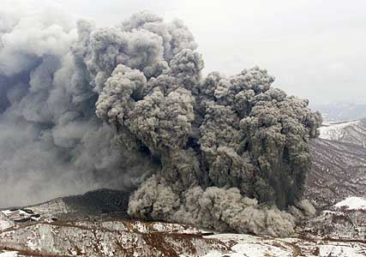


SIP Server Overload: Motivation - When does it happen?
  Legitimate short-term load spike
    Viewer-voting TV shows or ticket giveaways
    Special holidays
    Natural disaster areas
    Manhattan reboot
  Malicious attack
    Denial-of-Service attacks
Notes:
: American Idol
: Thanksgiving, New Year’s Day, and Mother's Day
such as those affected by earthquakes

Slide 21
SIP Server Overload: Real Data
Nation-wide => Kobe
legend
Earthquake of Jan.
17, 1995
regular day
800
about 20 times higher than normal day of average calls in an hour to Kobe from nation-wide
Traffic increased rapidly just after the earthquake at 5:50 and the peak is more than 50 times higher than normal day.
The congestion continued until next Monday
600
Earthquake happened at 5:46am, Jan. 17, 1995
About 20times of normal day
400
200
About 7 times of normal day
Capacity of NTT facility
(max usage of normal days)
4am 8am 12pm 4pm 8pm 12am 4am 8am 12pm 4pm 8pm 12am 4am 8am
Jan 17 Jan 18 Jan 19
Courtesy of Arata Koike, NTT

Slide 22
SIP Server Overload: What Shall We Do?
  Simply dropping requests on overload?
    INVITE hop-by-hop retransmission
    More messages due to retransmission
SIP Proxy A
SIP Proxy B
INVITE
T₁
INVITE
2T₁
INVITE
4T₁
INVITE
Notes:
T1 = 500 ms, increases exponentially
Until total timeout exceeds 32 seconds

Slide 23

SIP Server Overload: Message Rejection or Retry Another Server?
  Rejecting excessive requests upon overload?
  Trying an alternative server?
    may soon be overloaded too-> cascading failure!
SIP UA
SIP Proxy A
SIP Proxy B
SIP Proxy C
INVITE
503 Service Unavailable
a) 500 Server Internal Error
ACK
b) INVITE
Notes:
overall sending rate is not reduced.
rejecting costs comparable CPU cycles with accepting requests!
Client completely shut off during the period specified
Reducing rate with an on/off pattern, may cause oscillation

Slide 24
SIP Server Overload Performance
SIP Proxy A
SIP Proxy B
SIP Proxy D
SIP UAs
SIP Proxy C
SIP UAs
Design Requirements
  approaching ideal performance
  minimizing control parameters
Notes:
high threshold: new INVITE rejected but other messages processed.
Low threshold: new INVITE processing restored

Slide 25
SIP Server Overload: Exsiting Overload Control Layering
Application layer protocol overload control is not new!
For example: HTTP
Transport level
  TCP flow and congestion control
  refuse TCP connections or drop UDP packets
Application level
  HTTP server busy
User level
  user behavior beyond protocol control

Slide 26
SIP Server Overload: Borrow from HTTP Overload Control ?
Similarity
o
Both run over TCP
and
SCTP (rare)
o
Both
have
single
hop
scenario
o
SIP
also runs over UDP
Difference
SIP also has multi
-
o
hop scenario (proxy-to-proxy)
o
SIP has protocol specific retransmission
SIP requests more time
-
o
sensitive (ms vs. sec)
Conclusion
o
SIP presents its own challenges
o
Application layer and transport layer mechanisms
Notes:
TCP: (dominant for HTTP, increasing for SIP)
Single Hop: (client to server for HTTP, UA to registrar/proxy for SIP)

Slide 27
SIP Server Overload Categorized
  Known overload scope
    e.g., Human callee destination limits: TV viewer voting
SIP Proxy A
  Unknown overload scope:
    e.g., holiday greeting spike - global callee scope
    proxy server capacity limits
SIP Proxy B
SIP Proxy D
SIP UAs
SIP Proxy C
SIP UAs
  Avalanche restart
    registration server capacity limits
    local/regional scope
SIP Registrar
SIP UAs
Notes:
Real-life example of avalanche restart: we had a fairly large power outage not to long ago
affecting a fairly wide area of the east of the UK. When the power
was restored, we saw a huge number of REGISTERs hit our platform all
within a second or two - presumably because the same vendor/model
takes the same time to boot up wherever it is - which caused a mini
DoS against our registration servers thanks to the avalanche effect.
Most annoyingly, these devices all retransmitted at exactly the same
time X seconds later, causing a spike followed by plenty of spare
capacity until they all next tried, etc.
Cause of overload, it is always that sources sending too much traffic.
causes of overload:
* reasonable number of sources all sending the traffic to the server (for registration or for a same number) at the same time
More than usual number of users tries to access the system resource
*a) a server to registrar - power failure and recovery
*b) server to a set of designated number - TV commercial
*c) server to a set random numbers - disaster aftermath at the same time because of unexpected event (, ) or
Who are those added (surge) users?
We define the affected population and the associated servers as an Affected Region. The scope of affected region can be local, e.g., in a) the area that a registrar server covers; the affected region can be global, e.g. in b) or c). In essence, the difference of the local surge vs. global surge is a known population size vs. unknown population size.

Slide 28
SIP Server Overload: The Family Tree
SIP Server Overload
Proxy Server Overload
Registrar Server Overload
Proxy to Proxy Overload
UA to Registrar Overload
Known Overload Source/Destination Scope
Unknown Overload Source/Destination Scope
Notes:
Similarity
Inherient randamization unless it is an attack

Slide 29
SIP Server Overload: The Family Tree
SIP Server Overload
Proxy Server Overload
Registrar Server Overload
Proxy to Proxy Overload
UA to Registrar Overload
Known Overload Source/Destination Scope
Unknown Overload Source/Destination Scope
Notes:
Similarity
Inherient randamization unless it is an attack

Slide 30
Outline
  Introduction
  NSIS, ENUM and SIP-over-TLS
  SIP Server Overload Control
    Motivations and Overview
    Filter-based SIP Overload Control
  Conclusions and Contributions

Slide 31
SIP Server Overload: Filter-based Control – Push Control to the Edge
Filter Spec
ID: To: +1-212-555-1234
Time: 9am-10am 2009-1-1
Act: accept rate=N_{EPA}
Filter Spec
ID: To: +1-212-555-1234
Time: 9am-10am 2009-1-1
Act: accept rate=N_{SPA}
Filter Spec
ID: To: +1-212-555-1234
Time: 9am-10am 2009-1-1
Act: accept rate= N_{max}
Enterprise Network A
Hotline Callee
212-555-1234
9am-10am,
2009-1-1
Service Provider A
Filter Spec
ID: To: +1-212-555-1234
Time: 9am-10am 2009-1-1
Act: accept rate=N_{SPB}
Enterprise Network B
Service Provider B
Charles Shen, Henning Schulzrinne, Arata Koike, A Session Initiation Protocol (SIP) Load Control Event Package, draft-shen-sipping-load-control-event-package-03.txt, IETF SIPPING Working Group, Work in Progress. Oct., 2009
Notes:
SIP Event SUBSCRIBE and NOTIFY mechanisms

Slide 32
SIP Server Overload: The Family Tree
SIP Server Overload
Proxy Server Overload
Registrar Server Overload
Proxy to Proxy Overload
UA to Registrar Overload
Known Overload Source/Destination Scope
Unknown Overload Source/Destination Scope
UDP-based
Application Layer Filter-based SIP Overload Control
Notes:
UDP does not have transport flow control -> application layer feedback-based mechanism
Similarity
Inherient randamization unless it is an attack

Slide 33
Outline
  Introduction
  NSIS, ENUM and SIP-over-TLS
  SIP Server Overload Control
    Motivations and Overview
    Filter-based SIP Server Overload Control
    Application Layer Feedback-based Overload Control
  Conclusions and Contributions

Slide 34

Feedback-based SIP Overload Control
Feedback Channel
(In-band or out-of-band)
Feedback Enforcement
Feedback Algorithm
Incoming Load
Regulated Load
Output Load
Throttled Load
Sending Entity (SE)
Receiving Entity (RE)
Volker Hilt, Eric Noel, Charles Shen, Ahmed Abdelal, Design Considerations for Session Initiation Protocol (SIP) Overload Control, draft-ietf-sipping-overload-design-02.txt, IETF SIPPING Working Group, work in progress, July 2009
Notes:
Overloaded server as a receiving entity
Upstream server as sending entities
Executes an Algorithm, produce a control variable
Convey the control to the sending entity
Enforce the control parameter

Slide 35
Absolute Rate Feedback
Feedback Channel
(In-band or out-of-band)
Feedback Enforcement
Feedback Algorithm
λ’
λ
λ’
μ = λ’
λ - λ’
Sending Entity (SE)
Receiving Entity (RE)
Volker Hilt, Eric Noel, Charles Shen, Ahmed Abdelal, Design Considerations for Session Initiation Protocol (SIP) Overload Control, draft-ietf-sipping-overload-design-02.txt, IETF SIPPING Working Group, work in progress, July 2009

Slide 36
Relative Rate Feedback
Feedback Channel
(In-band or out-of-band)
Feedback Enforcement
Feedback Algorithm
p
λ
(1-p)λ
μ=(1-p)λ
pλ
Sending Entity (SE)
Receiving Entity (RE)
Volker Hilt, Eric Noel, Charles Shen, Ahmed Abdelal, Design Considerations for Session Initiation Protocol (SIP) Overload Control, draft-ietf-sipping-overload-design-02.txt, IETF SIPPING Working Group, work in progress, July 2009

Slide 37
Window Feedback
Feedback Channel
(In-band or out-of-band)
Feedback Enforcement
Feedback Algorithm
win
λ
λ’
μ = λ’
if (win > 0)
if (win < 0)
λ - λ’
Sending Entity (SE)
Receiving Entity (RE)
Volker Hilt, Eric Noel, Charles Shen, Ahmed Abdelal, Design Considerations for Session Initiation Protocol (SIP) Overload Control, draft-ietf-sipping-overload-design-02.txt, IETF SIPPING Working Group, work in progress, July 2009

Slide 38
Window-based Feedback Control Algorithm Design
 | Win-disc | Win-cont | Win-auto
Window size decrement | upon receiving session request (INVITE)
Window size adjustment algorithm | update acceptable # of sessions every control interval | update current # of available session slots every message arrival | window size increment after processing NEW INVITE request
Tunable parameters | budget queuing delay control Interval measurement interval | budget queuing delay measurement Interval | N/A
Notes:
Win-disc is a time-driven algorithm – make sure the existing backlogged sessions and new sessions accepted during the next control interval will all be handled with a budget queueing delay.
Win-cont is an event-driven algorithm – make sure that until the next event time, the number of sessions presented in the system will not exceeded the number that the server can handle, given a queueing delay budget.
Win-auto accepts a new session after it finishes processing a new request.
Evaluate # new sessions acceptable in the next control interval
Delay for existing and upcoming sessions are bounded
Bound the # sessions at any time

Slide 39
Rate-based Feedback Control Algorithms
 | Rate-abs | Rate-occ
Rate adjustment algorithm | update acceptable rate every control interval | update request acceptance ratio every control interval
Tunable parameters | budget queuing delay control interval measurement interval | budget CPU occupancy control interval measurement interval OCC tuning parameters

Slide 40
Feedback based SIP Overload Control:
Best Performance Comparison across Algorithms
All except rate-occ reaches unit goodput
  no retransmission ever
  server always busy processing messages
  each message part of successful session
rate-occ does not operate at unit goodput
  Occupancy coarser than queue length
  extremely small CI improves performance at heavy load but with many problems
SE1
SE2
RE
SIP UAs
SE3
SIP UAs

Slide 41
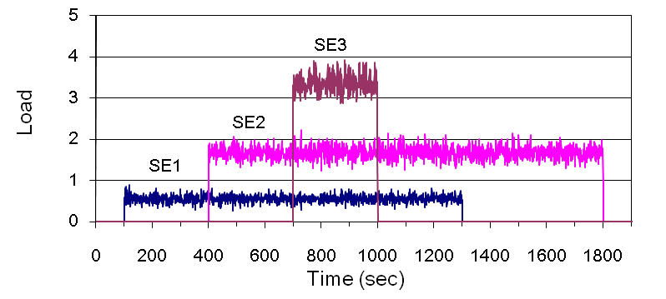
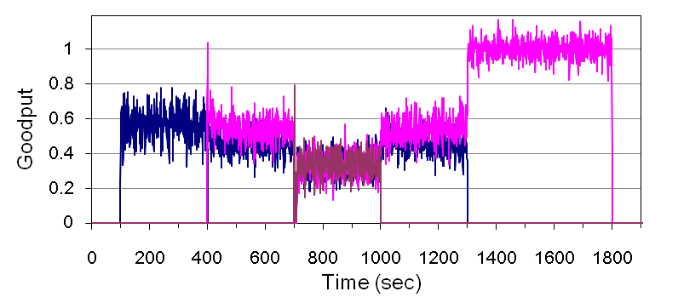
Performance under Dynamic Load w/ Provider-centric Fairness
  Short periods of bulk loads w/ source arrivals/departures
  Example result of rate-abs algorithm
  Fast dynamic transition
  Each upstream SE share equal prop. of RE capacity
  Provider-centric fairness
Notes:
Realistic proxy to proxy overload likely short periods of bulk loads w/ source arrivals/departures.

Slide 42
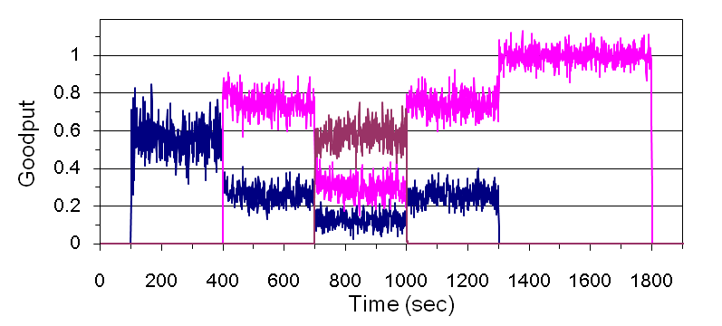
Performance under Dynamic Load w/ User-centric Fairness
  User-centric fairness
  SEs share proportional to original incoming load
  Bi-directional feedback
  Example result of
  win-cont algorithm

Slide 43
Feedback based SIP Overload Control: Conclusions
 | Win-disc | Win-cont | Win-auto | Rate-abs | Rate-occ
Optimal Steady state performance | ✓ | ✓ | ✓ | ✓ | ✗
Optimal Dynamic performance | ✓ | ✓ | ✗ | ✓ | ✓
User-centric Fairness | ✓(w/ bi- dir. feedback) | ✓(w/ bi- dir. feedback) | ✗ | ✓(w/ bi-dir. feedback) | ✓
Provider-centric fairness | ✓ | ✓ | ✗ | ✓ | ✓
# of tunable parameters | 3 | 2 | 0 | 3 | 5
Charles Shen, Henning Schulzrinne, Erich Nahum, SIP Server Overload Control: Design and Evaluation,
IPTComm 2008, Principles, Systems and Applications of IP Telecommunications Services and Security for
Next Generation Networks.
Notes:
Win-auto has the least number of tunable parameters, offers good steady performance. But we don’t have much control on its dynamic performance or fairness.
Rate-occ has the largest number of tunable parameters, is good at dynamic load and fairness but not under steady performance.

Slide 44
SIP Server Overload: The Family Tree
SIP Server Overload
Proxy Server Overload
Registrar Server Overload
Proxy to Proxy Overload
UA to Registrar Overload
Known Overload Source/Destination Scope
Unknown Overload Source/Destination Scope
Application Layer Filter-based SIP Overload Control
UDP-based
TCP-based
Application Layer Feedback-based SIP Overload Control
Notes:
Similarity
Inherient randamization unless it is an attack

Slide 45
Outline
  Introduction
  NSIS, ENUM and SIP-over-TLS
  SIP Server Overload Control
    Motivations and Overview
    Filter-based SIP Server Overload Control
    Application Layer Feedback-based Overload Control
    Transport Layer TCP-based Overload Control
  Conclusions and Contributions

Slide 46
SIP-over-TCP
  Why SIP-over-TCP ?
    Security - TLS over TCP
    NAT/Firewall traversal
    Larger message sizes
    Better overload control?
  Main differences from SIP-over-UDP
    No hop-by-hop retransmission
    But E2E retransmission remains, e.g., 200 OK (for INVITE)
    Inherent transport flow control
SIP Proxy
SIP UA
200 OK
200 OK
200 OK
T₁
200 OK
2T₁
200 OK
200 OK
4T₁
200 OK
200 OK
ACK
ACK
Notes:
T1 = 500 ms, increases exponentially
Until total timeout exceeds 32 seconds
Some existing NATs and firewalls bock UDP traffic all together.
Outbound TCP connections blocked less frequently
the state to let UDP go through usually deleted if the flow becomes idle for some time

Slide 47
TCP Flow Control: Preventing Receiver Overflow
Receiver Application
Sender Application
Application
Buffer
Sender sends no more than the size of the receiver available buffer space
Write
Read
LastByteWritten
TCP
TCP
LastByteRead
Send
Buffer
■ ■ ■
Receive
Buffer
LastByteSent
LastByteAcked
LastByteRcvd
EffectiveWindow = AdvertisedWindow –
(LastByteSent – LastByteAcked)
AdvertisedWindow = MaxRcvBuffer -
(LastByteRcvd - LastByteRead)

Slide 48

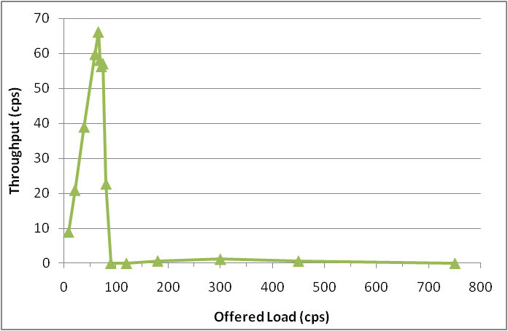
SIP-over-TCP: Default Performance
UAs
SE
RE
UAs
Clear congestion collapse after overload

Slide 49
SIP-over-TCP Overload Control: Observations and Solutions
Non-atomic application session load
  INVITE much more expensive than other messages
  In-session messages from different connections at different time
Long queueing delays
  Large default system buffer size
SIP UA (Caller)
SIP Proxy
SIP UA (Callee)
Solution ➔ split the connections
INVITE
INVITE
100 Trying
180 Ringing
180 Ringing
200 OK
200 OK
Solution ➔ minimize the buffers
ACK
ACK
Media
BYE
BYE
200 OK
200 OK
Notes:
16KB send buffer
64KB receive buffer
64KB application buffer

Slide 50
SIP-over-TCP Overload Control Mechanism: ECS+BM
Minimized TCP socket
send buffer
Minimized TCP socket
receive buffer +
minimized SIP server
application buffer
Explicit
Connection
Split
Session start
INVITE requests
Sending
Entity
Port 5059
Receiving
Entity
Other in-session
requests (ACK etc.)
Port 5060
Default TCP socket
send buffer
Default TCP socket
Receive buffer + default
SIP server application buffer
Explicit Connection Split with
Buffer Minimization (ECS+BM)
Notes:
Send buffer 2K
Receive buffer 680x2 effective 680x1.5
Application buffer 1020

Slide 51
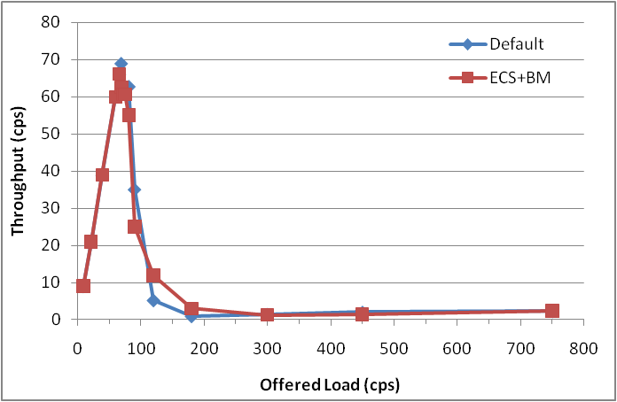
Performance of SIP-over-TCP Overload Control Mechanism: ECS+BM
Pressure merely shifted to SE
Ultimately blocking UAC to SE !
Solution ➔ smart forwarding
UAs
SE
RE
UAs

Slide 52
SE Smart Forwarding for ECS
Start
A simple parameter-free smart forwarding algorithm
Implementation just an easy Linux ioctl function call to test buffer emptiness
N
INVITE arrival?
Y
Reject INVITE
N
INVITE connection
send buffer empty?
Y
Forward INVITE

Slide 53
SIP-over-TCP Overload Control Mechanism: ECS+BM+SF
Minimized TCP socket
send buffer
Minimized TCP socket
receive buffer +
minimized SIP server
application buffer
Explicit
Connection
Split
Smart
forwarding
Session start
INVITE requests
Sending
Entity
Port 5059
Receiving
Entity
Other in-session
requests (ACK etc.)
Port 5060
Default TCP socket
send buffer
Default TCP socket
Receive buffer + default
SIP server application buffer
Explicit Connection Split + Buffer Minimization and Smart Forwarding (ECS+BM+SF)

Slide 54
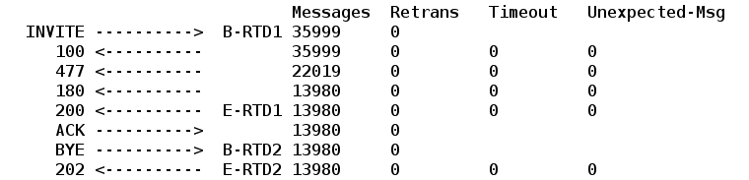
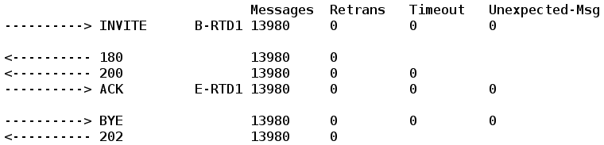
ECS+BM+SF: Throughput
Among 35999 INVITEs generated, 22019 rejected, all the rest 13980 go successful, no retransmissions
RE CPU utilization is full ➔ achieving full capacity without waste
Callers
Callees
Case study L=150 C=65

Slide 55
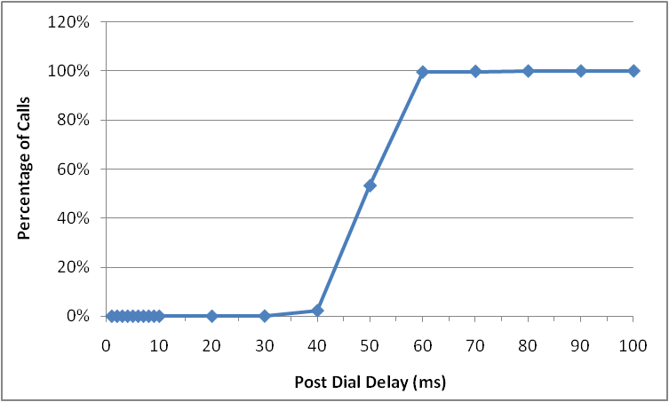
ECS+BM+SF: Post Dial Delay (INVITE – 200 OK)
99% delay smaller than 60ms
No delay exceeds 70ms

Slide 56
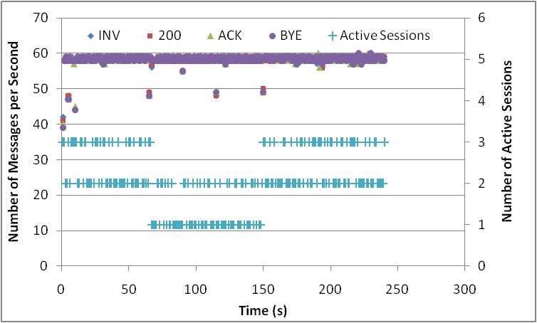
SIP-over-TCP Overload Control Mechanism: ECS+BM+SF Revisited
Minimized TCP socket
send buffer
Minimized TCP socket
receive buffer +
minimized SIP server
application buffer
Explicit
Connection
Split
Smart
forwarding
Session start
INVITE requests
Sending
Entity
Port 5059
Receiving
Entity
Other in-session
requests (ACK etc.)
Port 5060
Default TCP socket
send buffer
Default TCP socket
Receive buffer + default
SIP server application buffer

Slide 57
SIP-over-TCP Overload Control Mechanism: ICS+BM+SF
Minimized TCP socket
send buffer
Minimized TCP socket
receive buffer +
minimized SIP server
application buffer
Smart Forwarding
Implicit
connection
split
Sending
Entity
All Requests
Receiving
Entity
Implicit Connection Split with Buffer Minimization and Smart Forwarding (ICS+BM+SF)

Slide 58
Smart forwarding for Implicit Connection Split
Start
N
message arrival?
Y
N
Is an INVITE?
Y
N
Reject
send buffer empty?
Y
Forward INVITE only if send buffer is empty
Always forward non-INVITE
Forward

Slide 59
SIP-over-TCP Overload Control Mechanism: ICS+BM+SF Revisited
Minimized TCP socket
send buffer
Minimized TCP socket
receive buffer +
minimized SIP server
application buffer
Smart Forwarding
Implicit
connection
split
Sending
Entity
All Requests
Receiving
Entity
Implicit Connection Split with Buffer Minimization and Smart Forwarding (ICS+BM+SF)

Slide 60
SIP-over-TCP Overload Control Mechanism: ICS+RBM+SF
Minimized TCP socket
receive buffer
Smart Forwarding
Implicit
connection
split
Sending
Entity
All Requests
Receiving
Entity
Implicit Connection Split with Receive Buffer Minimization and Smart Forwarding (ICS+RBM+SF)

Slide 61
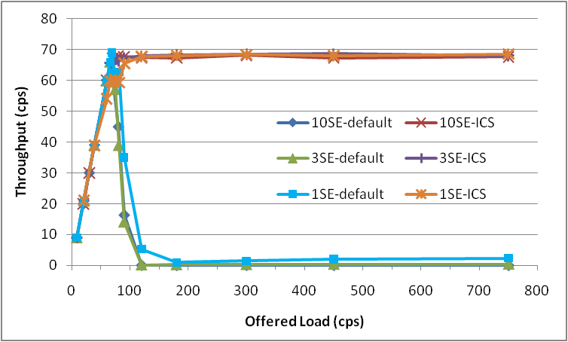
Overall Performance ICS+RBM+SF: Using 1SE / 3SE / 10SE
receive buffer size = 2KB

Slide 62
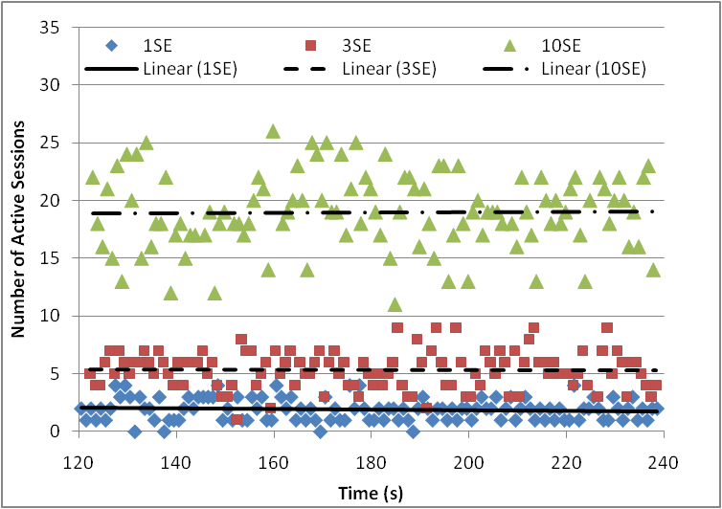
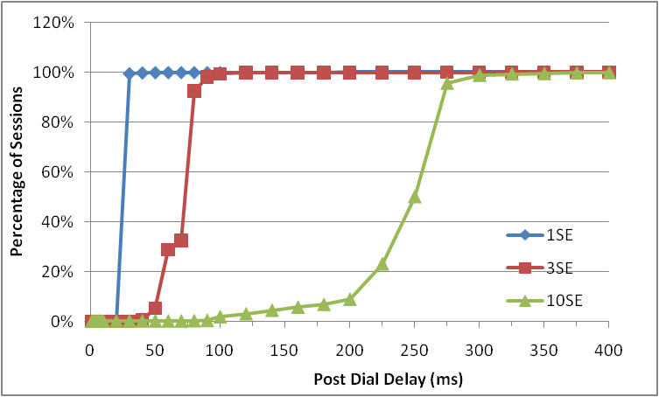
ICS+MRB+SF: Comparing 1SE, 3SE and 10SE
Number of active sessions and Post Dial Delay increase roughly proportionally due to total buffer size increase
Most applicable for networks where an RE connects to a moderate number of SEs

Slide 63
Insights from Our SIP-over-TCP Overload Control Study
TCP flow control alone cannot prevent SIP congestion collapse
Causes: session-based load with time-sensitive constraints
Key solution components
  Connection split ➔ app. layer awareness to transport layer
  Upstream smart forwarding ➔ release pressure in advance
  Minimized buffer ➔ avoid job accumulation to minimize delay
Charles Shen, Henning Schulzrinne, On TCP-based SIP Server Overload Control, Tech Report, CUCS-048-09, Dept. of Computer Science, Columbia University, October 2009 (Submitted for publication)

Slide 64
SIP Server Overload: The Family Tree
SIP Server Overload
Proxy Server Overload
Registrar Server Overload
Proxy to Proxy Overload
UA to Registrar Overload
Known Overload Source/Destination Scope
Unknown Overload Source/Destination Scope
Application Layer Filter-based SIP Overload Control
UDP-based
TCP-based
Application Layer Feedback-based SIP Overload Control
TCP feedback w/ Conn. Split + Buffer Min. + Smart Fw.
Notes:
Similarity
Inherient randamization unless it is an attack

Slide 65
Outline
  Introduction
  NSIS, ENUM and SIP-over-TLS
  SIP Server Overload Control
    Motivations and Overview
    Filter-based SIP Server Overload Control
    Application Layer Feedback-based Overload Control
    Transport Layer TCP-based Overload Control
    Avalanche Restart Overload Control
  Conclusions and Contributions

Slide 66
Outline
  Introduction
  NSIS, ENUM and SIP-over-TLS
  SIP Server Overload Control
    Motivations and Overview
    Filter-based SIP Server Overload Control
    Application Layer Feedback-based Overload Control
    Transport Layer TCP-based Overload Control
    Avalanche Restart Overload Control
  Conclusions and Contributions

Slide 67
SIP Server Avalanche Restart Overload Control
  Key: an appropriate backoff time after reboot
  Registrar decides/conveys it during normal operation
SIP Registrar
SIP UAs
REGISTER
SIP UA
SIP Registrar
SIP/2.0 200 OK
Restart-Backoff: 300
Charles Shen, Henning Schulzrinne, Arata Koike, A Mechanism for Session Initiation Protocol (SIP) Avalanche Restart Overload Control, draft-shen-sipping-avalanche-restart-overload-00, work in progress, Nov. 2009
Notes:
Restart-Backoff Timer Interval (RBIT) = RBTI = ( R / C ) * ( 1 + k )
where R = number of registered clients at the Registrar
C = Registrar estimated server capacity
k = redundancy coefficient (e.g., 0.1)

Slide 68
SIP Server Overload: The Family Tree
SIP Server Overload
Proxy Server Overload
Registrar Server Overload
Proxy to Proxy Overload
UA to Registrar Overload
Known Overload Source/Destination Scope
Unknown Overload Source/Destination Scope
Server-assisted
random backoff
Application Layer Filter-based SIP Overload Control
UDP-based
TCP-based
Application Layer Feedback-based SIP Overload Control
TCP feedback w/ Conn. Split + Buffer Min. + Smart Fw.
Notes:
Similarity
Inherient randamization unless it is an attack

Slide 69
Outline
  Introduction
  NSIS, ENUM and SIP-over-TLS
  SIP Server Overload Control
  Conclusions and Contributions

Slide 70
Conclusions and contributions – questions answered (1/4)
Routing – How does Internet routing dynamics look like ?
  Conducted a large scale Internet routing measurement
  Evaluated routing pathologies, infrastructure availability, route/AS change, route/AS path prevalence & persistence.
NSIS – How can NSIS work better with route changes, given real routing data?
  Proposed and evaluated new route change detection method
  Made recommendations on NSIS deployment models
Notes:
NSIS: (under IETF standadization)

Slide 71
Conclusions and contributions – questions answered (2/4)
ENUM – Are common open source DNS servers capable of serving ENUM?
  Conducted the first comprehensive ENUM performance evaluation
  Found some (e.g., PDNS) works, the most popular one (BIND) does not
  Identified areas of improvements of open source servers for ENUM
SIP security – How does securing SIP with TLS impact SIP performance?
  Conducted the first comprehensive performance study of SIP-over-TLS
  Quantified performance difference - costly but not unaffordable
  Established a new measurement-driven cost model for capacity planning
Notes:
NSIS: (under IETF standadization)

Slide 72
Conclusions and contributions – questions answered (3/4)
What are the typical types of SIP overload?
  Proposed a taxonomy on SIP server overload: proxy-based, registrar-based
How to deal with proxy-to-proxy overload?
  How to deal with proxy-to-proxy overload w/ add. context (e.g., time, scope)?
    Proposed a new application level filter-based SIP overload control mechanism
  How to deal with general proxy-to-proxy overload w/o transport layer support?
    Proposed three new window-based SIP overload control algorithms
    Conducted the first comprehensive study of SIP app. layer feedback overload control
  How to deal with general proxy-to-proxy overload w/ transport layer support?
    Conducted the first systematic study on applicability overload control for SIP-over-TCP
    Proposed and evaluated new algorithms for TCP-based SIP overload control
How to solve the famous avalanche restart problem?
  Proposed a new mechanism based on server-assisted random backoff
Notes:
used to plug-in existing algorithms for SIP overload overload
accepted by the IETF design team

Slide 73
Conclusions and contributions – questions answered (4/4)
SIP server overload
UA-to-Registrar (avalanche restart)
Proxy-to-Proxy
Involved
entities?
Timing
and scope
unknown
Server-assisted random backoff
known
UDP
TCP
Transport
Event filter-based control
Transport feedback w/ connection-split
buffer-minimization smart-forwarding
Application layer rate/window feedback
Notes:
Similarity
Inherient randamization unless it is an attack

Slide 74
Thank you!

