Slide 1
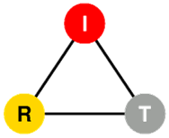
NetServ: Enabling In-Network Services On The Next Generation Internet
GENI Alpha Demonstration
Jae Woo Lee, Jan Janak, Roberto Francescangeli, Suman Srinivasan, Eric Liu, Michael Kester, Salman Baset, Wonsang Song
and Henning Schulzrinne
Internet Real-Time Lab, Columbia University
In collaboration with
Wolfgang Kellerer and Zoran Despotovic at DOCOMO Euro-Labs
Volker Hilt at Bell Labs/Alcatel-Lucent
Srini Seetharaman at Deutsche Telekom
Presented by Jae Woo Lee

Slide 2
NetServ
NSF FIND project
Led by Internet Real-Time Lab (IRT) at Columbia University
Framework for deploying in-network services in the next generation Internet
Common API for routers and end systems

Slide 3
What is NetServ?
In-network service container
Java-programmable, signal-driven router
Active networking 2.0

Slide 4
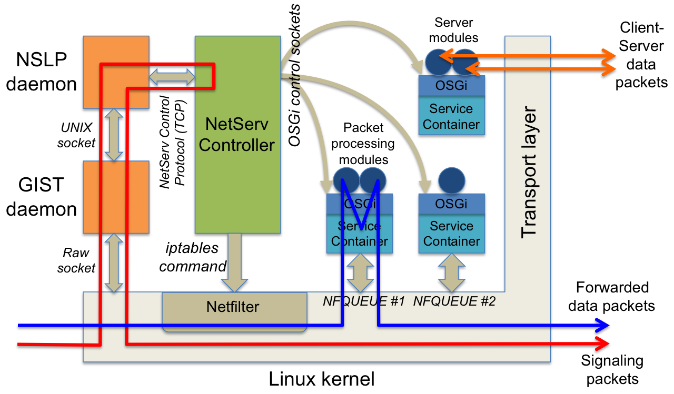
NetServ Node Architecture

Slide 5
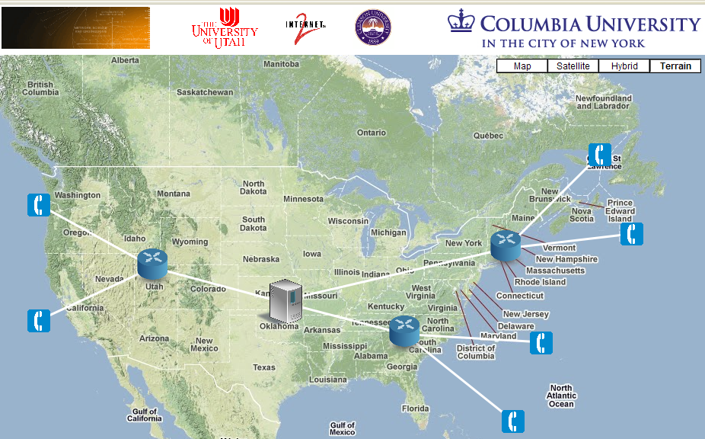
Demo 1: ActiveCDN
ActiveCDN
ActiveCDN
GPO
Utah
Kansas
Clemson
Benefits of ActiveCDN:
Dynamic deployment based on load
Localized services such as weather, ads and news

Slide 6
Demo 2: VoIP Overload Control
Real-time Control
Traffic Overload
Manageable Traffic
NetServ Node
SIP Server
NetServ Module
SIP Server
Controlled by SIP server
Throttles incoming traffic
Randomized traffic rejection
Installs NetServ module on demand
Controls all NetServ modules
Real-time feedback to modules

Slide 7
NetServ on GENI
Topology setup for this demo
Setup using the Common API
4 sites across the US continent
ProtoGENI, PlanetLab, OpenFlow, Internet2
What GENI does for NetServ
Provides at-scale testbed
Capable of supporting router experiments
What NetServ can do for GENI
Alternate way to use GENI: deploy modules, not VMs
“GENI Lite!”

