Slide 1
The Future of Wireless: Reaching the Unreachable and Adaptive Wireless Networks
Henning Schulzrinne
(with Arezu Moghadam, Suman Srinivasan, Jae Woo Lee and others)
Columbia University

Slide 2
Challenges for years 20...39
Changing usage: H2H → M2M
More than just first-mile access
User-focused design
Interconnecting mobile service
Covering the white spots

Slide 3

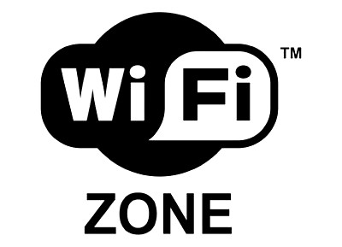

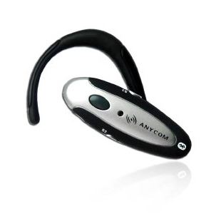
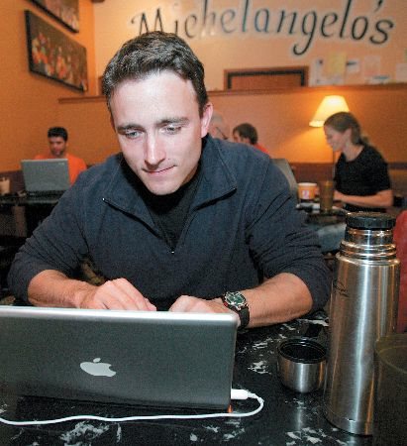
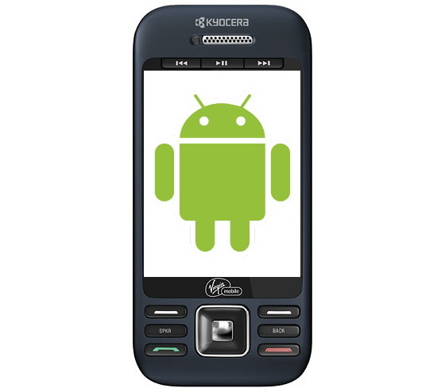
Wireless networks now

Slide 4
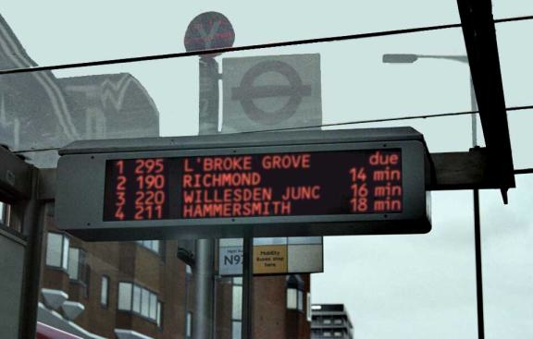
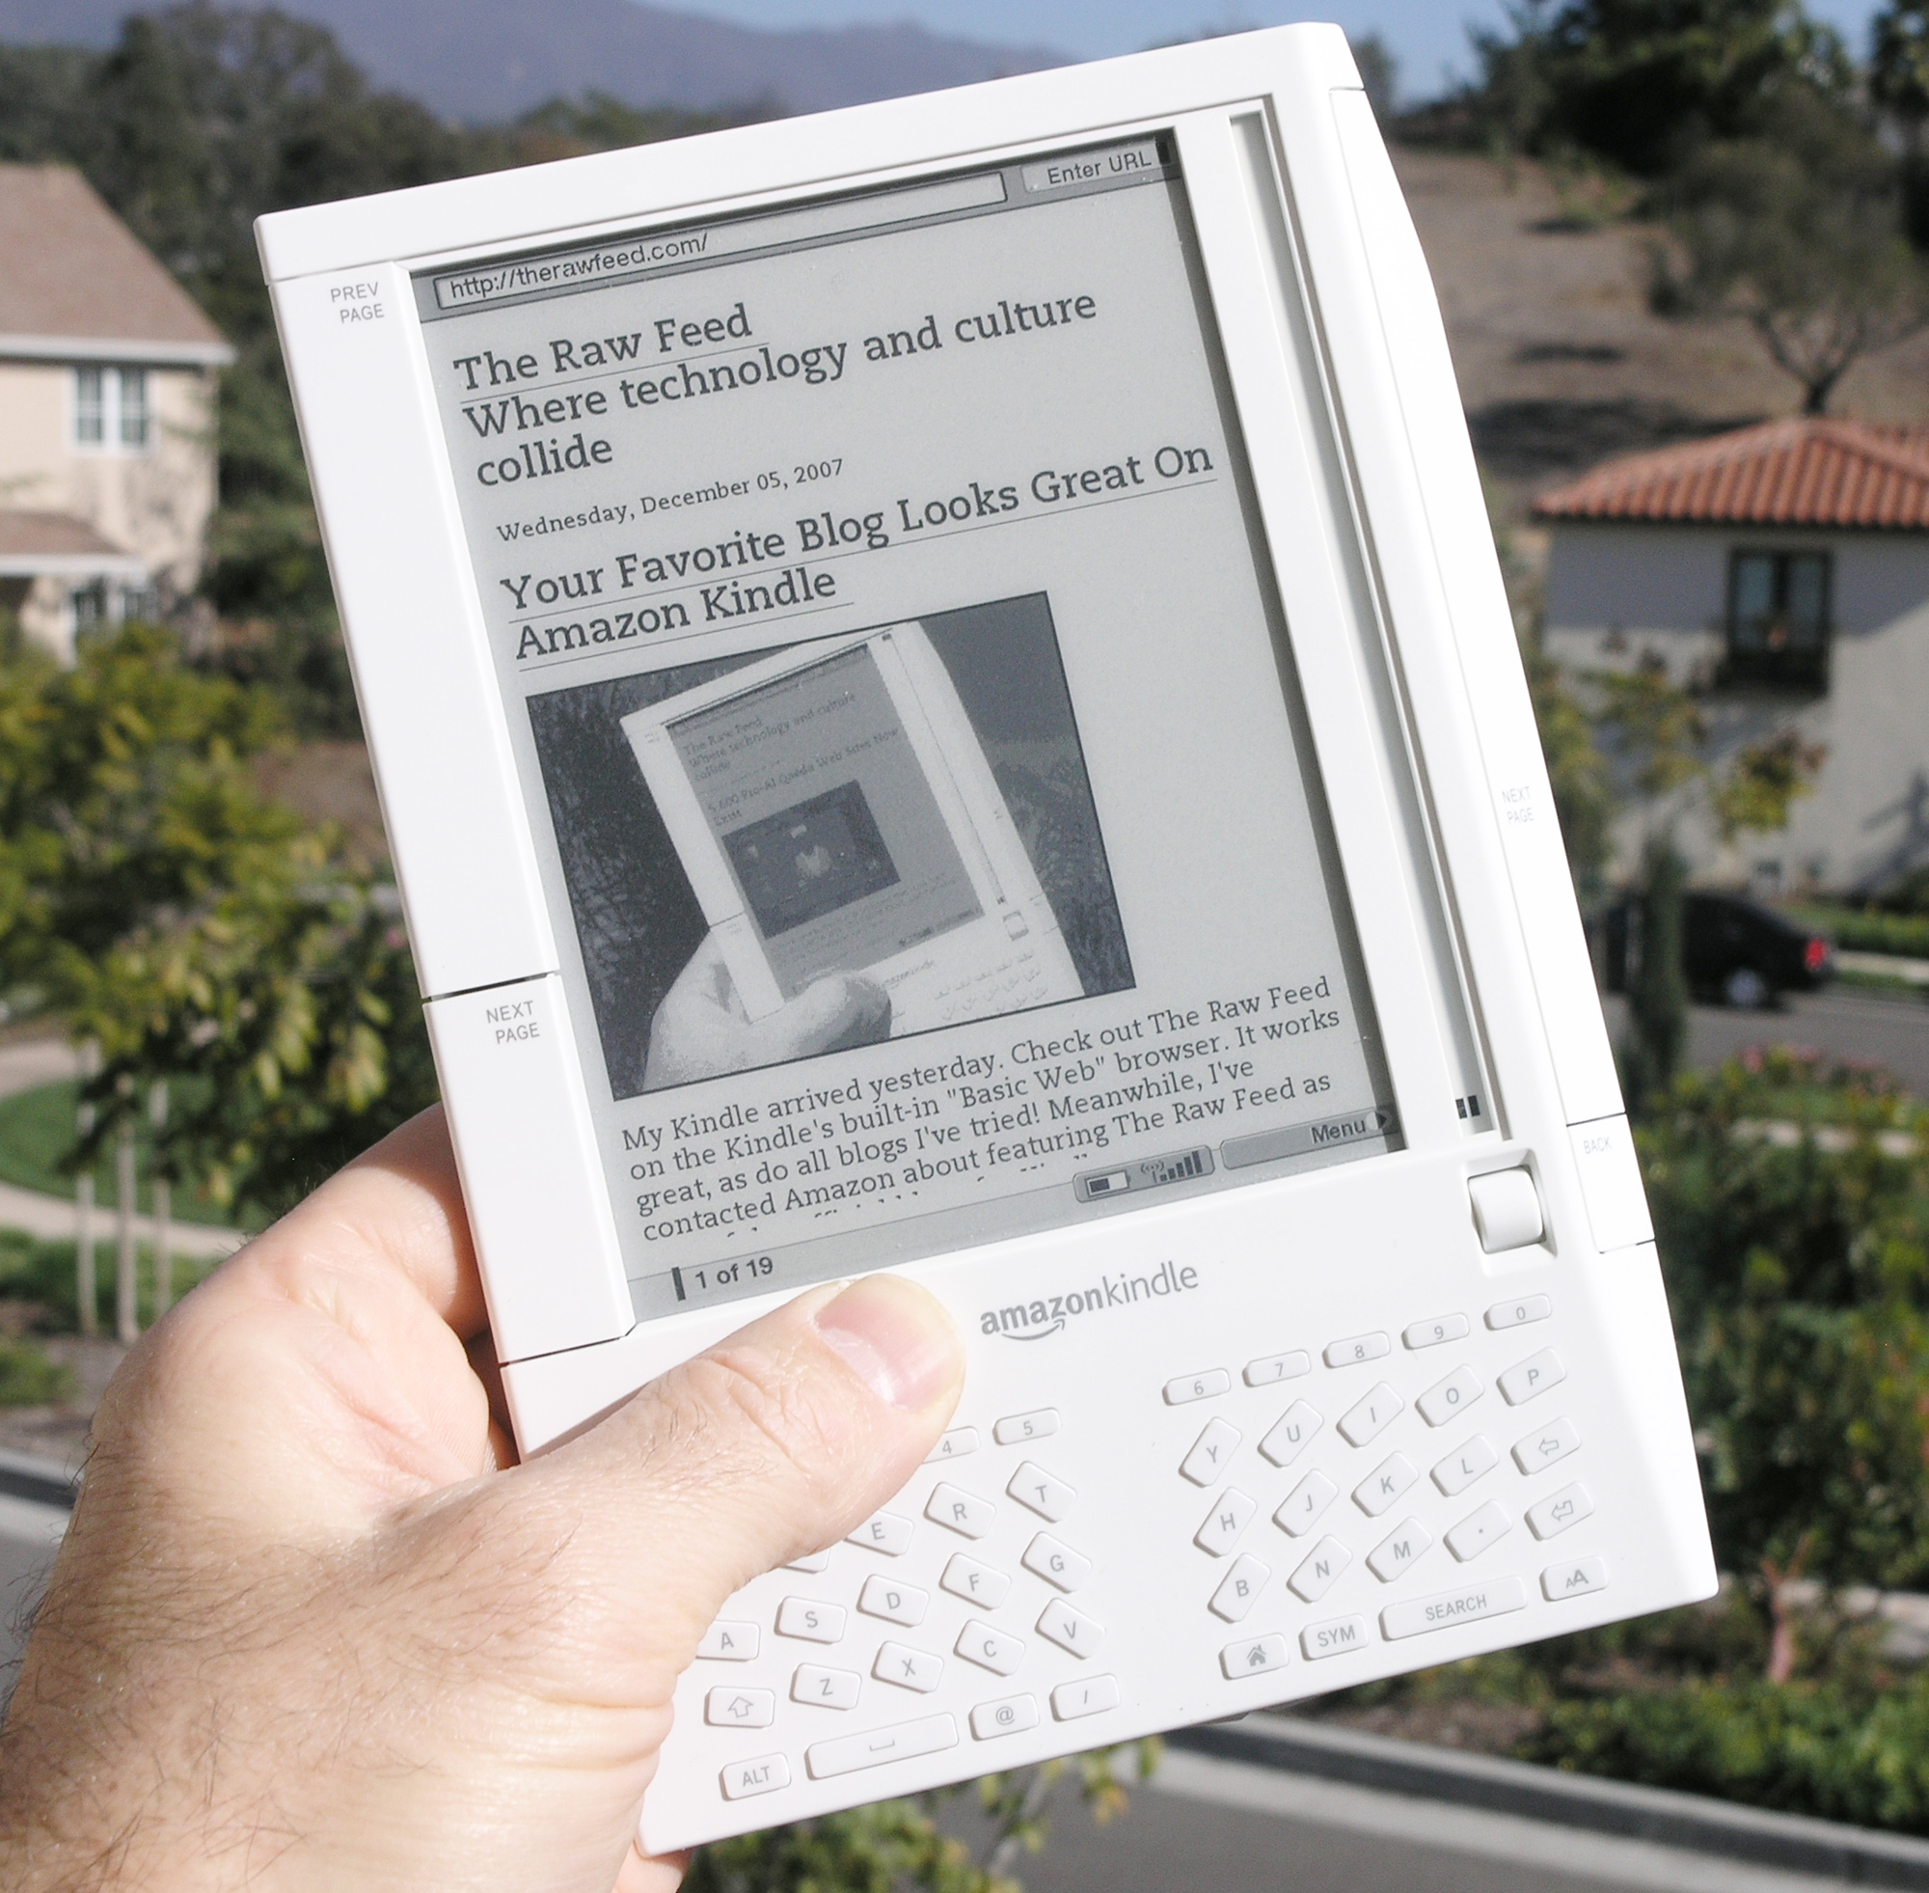
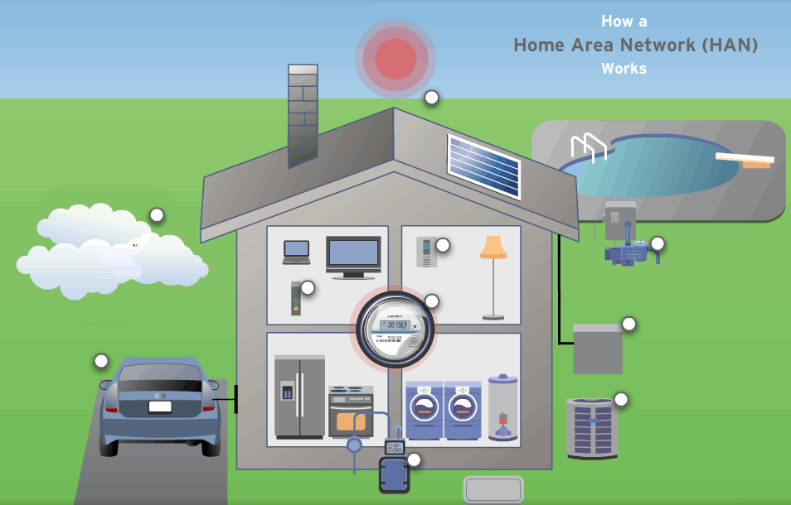
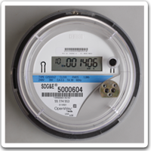
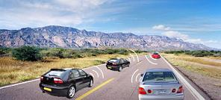
Emerging wireless applications

Slide 5
Changing usage
voice
web
M2M

Slide 6
More than just Internet Classic
Network | wireless | mobility | path stability | data units
Internet “classic” | last hop | end systems | > hours | IP datagrams
mesh networks | all links | end systems | > hours
mobile ad-hoc | all links | all nodes, random | minutes
opportunistic | typical | single node | ≈ minute
delay-tolerant | all links | some predictable | some predictable | bundles
store-carry-forward | all nodes | all nodes | no path | application data units

Slide 7
Reaching the unreachable

Slide 8
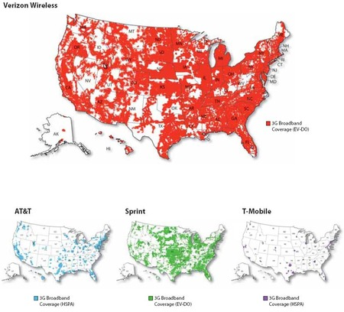
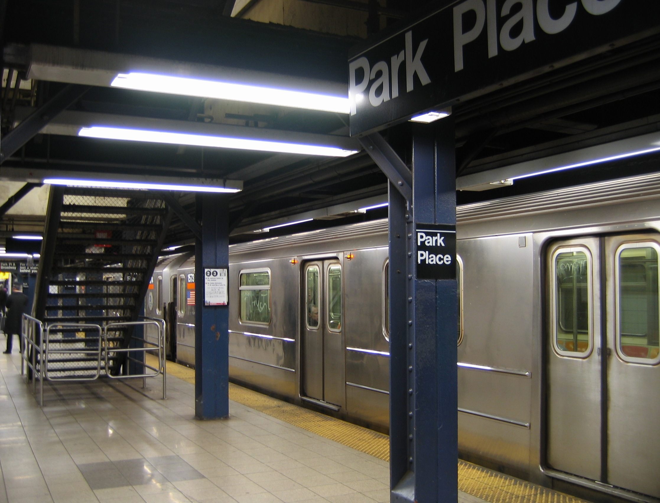
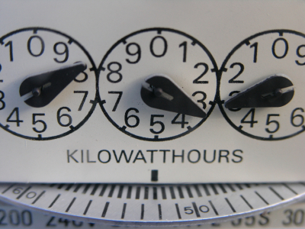
White spaces (real world)
$60 for 5 GB → $12/GB

Slide 9

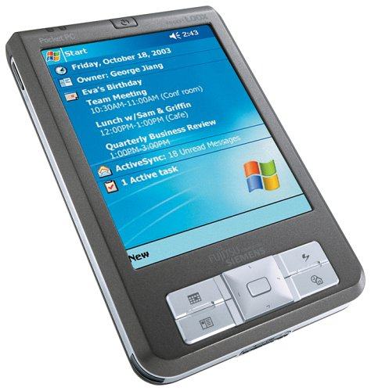
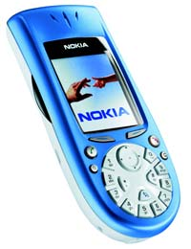
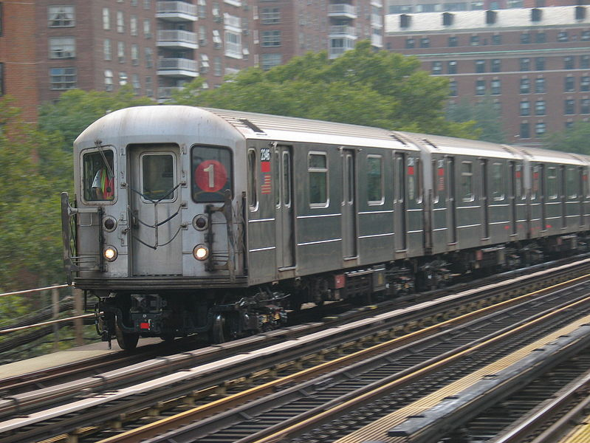
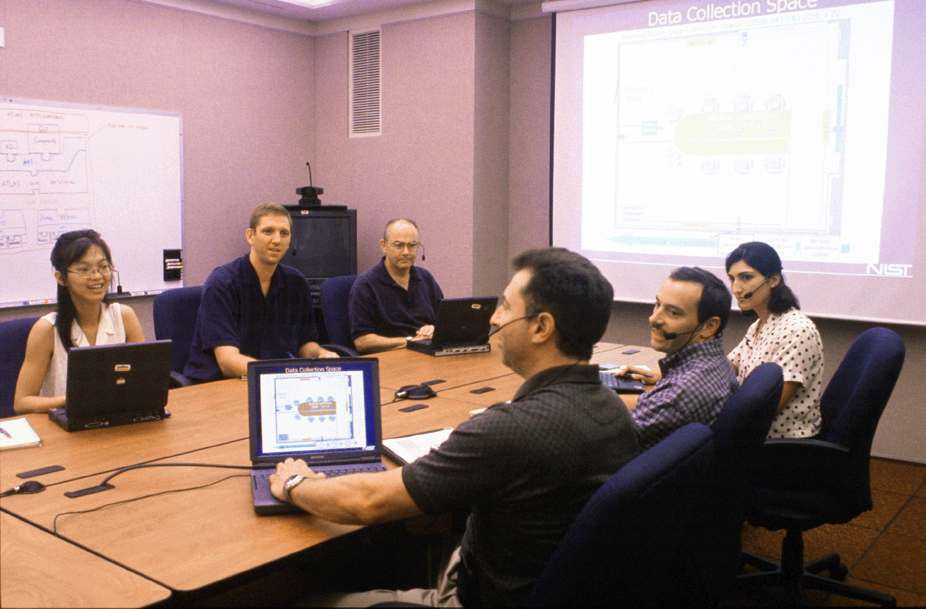
Contacts are
opportunistic
intermittent
Internet
?
?
D
802.11 ad-hoc mode
BlueTooth
Notes:
Therefore these networks have unique characteristics and introduce new challenges from the networking basics to the applications
THERE IS NO END-TO-END PATH.

Slide 10
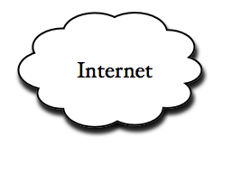
Web Delivery Model
7DS core functionality: Emulation of web content access and e-mail delivery

Slide 11
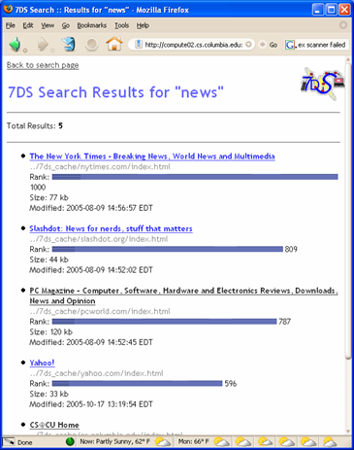
Search Engine
Provides ability to query locally for results
  Searches the cache index using Swish-e library
Stores query for future contacts

Slide 12
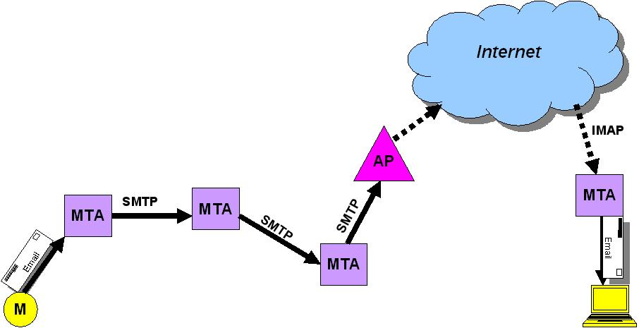
Email exchange

Slide 13

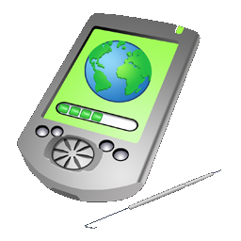
BonAHA framework
key11 = value11
key12 = value12
key13 = value13
key14 = value14
[1] node1.register()
Node 1
[2] node1.get(key13)
key21 = value21
key22 = value22
key23 = value23
key24 = value24
[3] data =
node1.fileGet(
value13);
BonAHA
[CCNC 2009]
Node 2

Slide 14

Generic service model?
Application
Opportunistic Network Framework – get(), set(), put(), rm()
ZigBee
BlueTooth
mDNS/
DNS-SD
DHTs?
Gnutella?

Slide 15
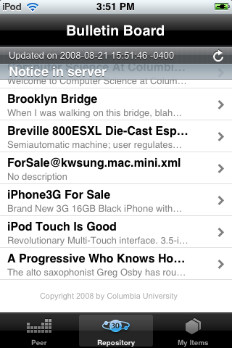
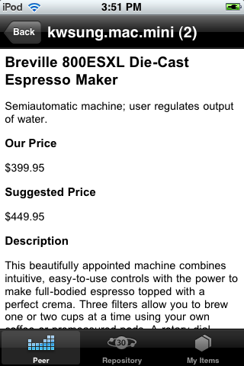
Bulletin Board System
Written in Objective-C, for iPod Touch

Slide 16
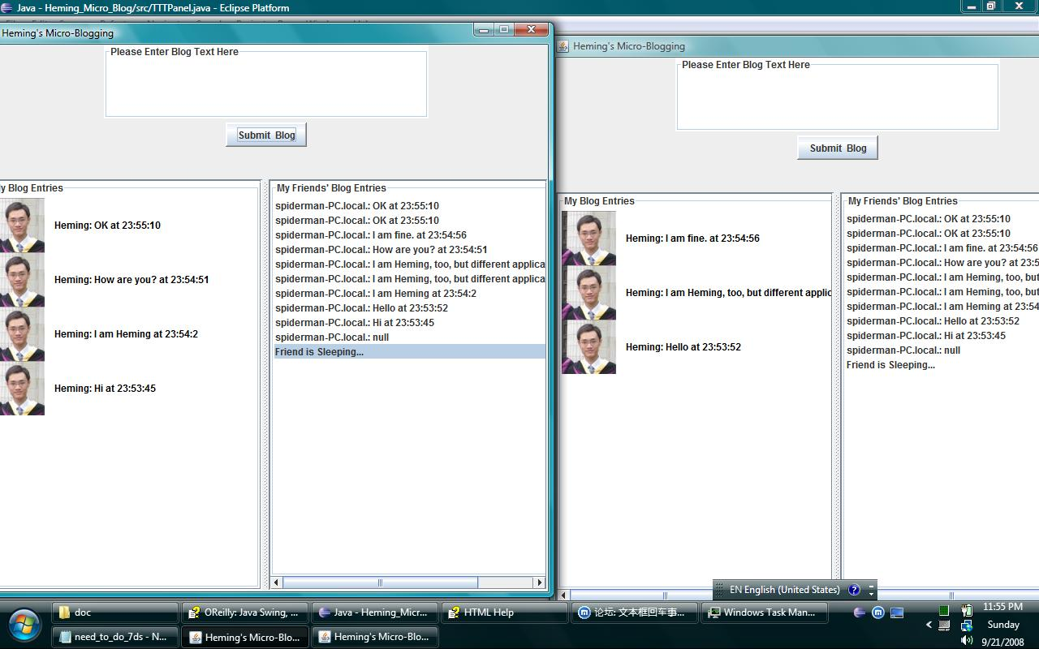
Local Microblogging

Slide 17
Problem – lack of group communication model for mobile DiTNs?
Any cast communication model
  Emergencies
  Traffic congestion notifications
  Severe weather alerts
Traditional multicast as a group communication model → Fails!
  No knowledge of the topology
  No infrastructure to track group memberships
Communication with communities of interest → Even a harder problem!
  Market news, sport events
  Scientific articles
  Advertisement about particular products
Epidemic routing
Notes:
Proposed models for
multicasting in mobile DTNs try to extend the classical multicast
model to disruption-tolerant networks. They define
new multicast semantics to overcome the intrinsic network
partitioning in mobile DTNs. However, these proposed
architectures require a global knowledge of the multicast
group memberships of nodes and the network topology.

Slide 18








Interest-aware Communication
Jazz
Jazz
Rock
Rock
Jazz
Communication with communities of interest
  Interest-aware music sharing application

Slide 19
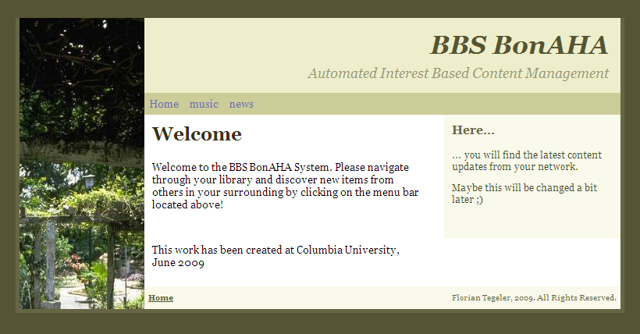
UI of Interest-Aware Music and News Sharing Application for 7DS

Slide 20
Problem 1 of interest-aware: Greedy!
h
D
Y
5
a
d
X
X
3
1
D
D
e
D
2
b
4
S
Y
Y
1
3
3
f
1
4
X
c
3
X
g
D
Y
wireless contact
data transfer

Slide 21
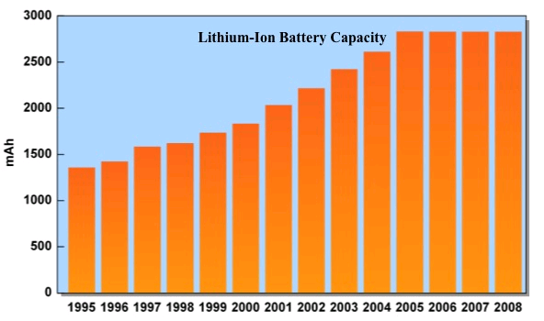
Energy issues
Interest-aware algorithms transmit until end of contact
Battery life remains a problem for mobile devices!
Source: TIAX, portable power conference
Notes:
Improvements in battery capacity simply haven't kept pace with ever-more-powerful processors.
Battery capacity improvement has stalled!

Slide 22
Solution – PEEP
Still interest-aware
  Interest vectors; binary
  Learning interests: feedback from user, # data items of each category, play times for music files, or LSA
Transmit-budget
  Amount of data items allowed for transmission at each connection
  How to divide the transmit budget?
Popularity
  Should be estimated
1 | 0 | 0 | 1 | 1 | 1 | 0
Items of interest?
Others?
1
2

Slide 23
Criteria to assign budget?
Only interest-aware
  Might waste budget
Interest-aware + randomly selected
Interest-aware + popularity estimation
  Ideal case: we know the global popularity
Budget designation (e.g., 50%)
Items of interest
1
2
Items of interest
random
1
2
Items of interest
popular
1
2
interests
popular
1
2

Slide 24
Popularity estimation
1 | 0 | 1 | 0 | 0 | 1
Contact window N
  History of the users’ interests
  Average or weighted average
  Example: C=6, N=8
  Replace the oldest
1 | 0 | 0 | 1 | 1 | 1
0 | 1 | 0 | 0 | 0 | 0
1 | 0 | 0 | 1 | 0 | 0
0 | 0 | 1 | 0 | 0 | 0
0 | 1 | 0 | 0 | 0 | 0
1 | 1 | 0 | 0 | 0 | 0
1 | 0 | 1 | 0 | 0 | 0
.62 | .37 | .37 | .25 | .12 | .25

Slide 25
Evaluation of PEEP

Slide 26
Adaptive networks

Slide 27
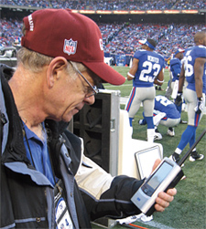
Spectrum management
What happens at field level makes the spectrum even tighter. "Stop and consider," said Mendelsohn, "that each coach on the field has a beltpack with four frequencies per pack, with about 10 coaches per team. Then the quarterbacks have two per pack. That's 42 frequencies for each team right there; so with two teams, that's about 84 frequencies." But that's hardly all. "Then add another 15 frequencies for the referees, the chain gang and security frequencies. That's 99 — before counting the TV broadcasters, which require 40 frequencies each, minimum," he said. "Then there are another 15 for home and away radio, and 20 more for various broadcasters doing stand-ups before and after the game. "And what most people forget about is," Mendelsohn said, "that all of this RF is basically contained within and around just 100 yards."
Steve Mendelsohn, game day frequency coordinator for the NFL.
http://www.tvtechnology.com/article/90772

Slide 28
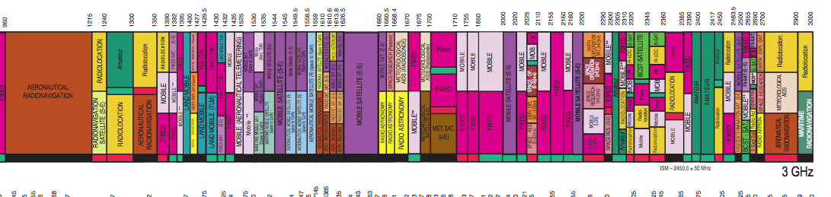

Spectrum
http://www.ntia.doc.gov/osmhome/allochrt.pdf

Slide 29
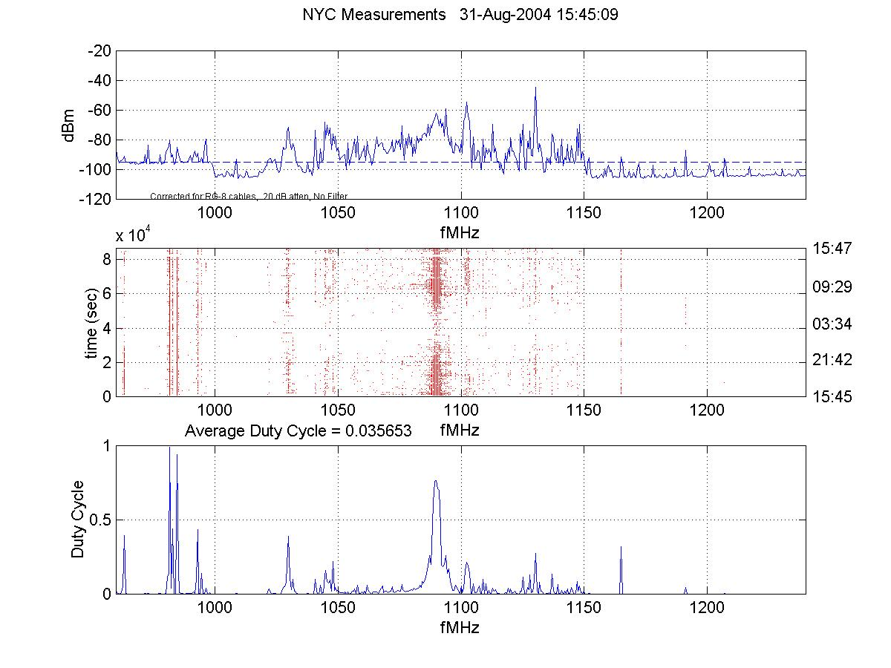
But often lightly used
http://www.sharedspectrum.com/measurements/
NYC, August 2004
Notes:
www.fcc.gov/sptf

Slide 30
Cognitive radio is insufficient
Solution: Cognitive radio! → ?
Doesn’t help with dense applications
  long time scales (hours → days)
    (geographic database solution seems most likely)
  each frequency still inefficiently used
→ automated sharing on shorter time scales

Slide 31
Mobile applications

Slide 32
Mobile why’s
Why does each mobile device need its own power supply?
Why do I have to adjust the clock on my camera each time I travel?
Why do I have to know what my IMAP server is and whether it uses TLS or SSL?
Why do I have to “synchronize” my iPhone?
Why do I have to manually update software?
Why do we use USB memory sticks when all laptops have 802.11b?

Slide 33




Context-aware communication
context = “the interrelated conditions in which something exists or occurs”
anything known about the participants in the (potential) communication relationship
time | at current location of destination
capabilities | audio, video, text, …
location | location-based call routing location events
activity/availability | rich presence automotive safety
sensor data (mood, physiometric) | medical monitoring

Slide 34
Examples of “invisible” behavior

Slide 35
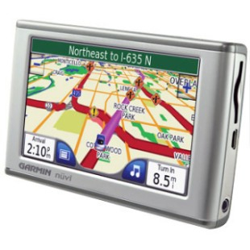
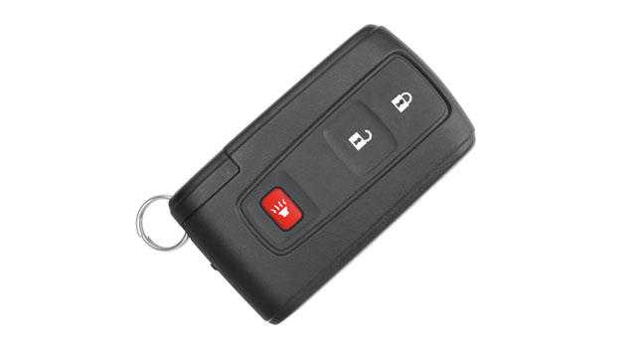
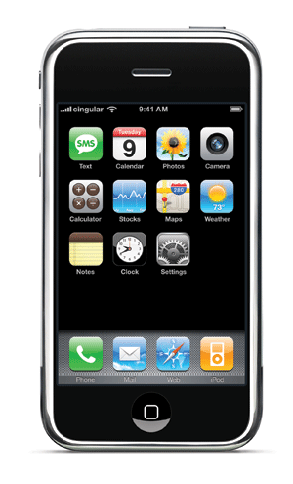
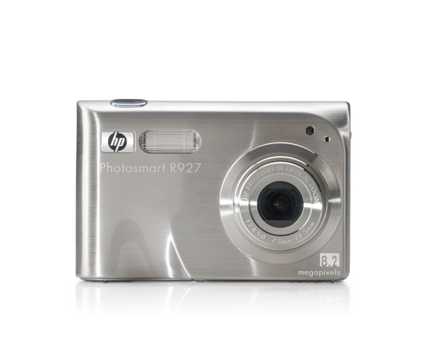
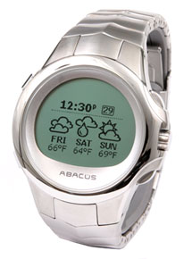
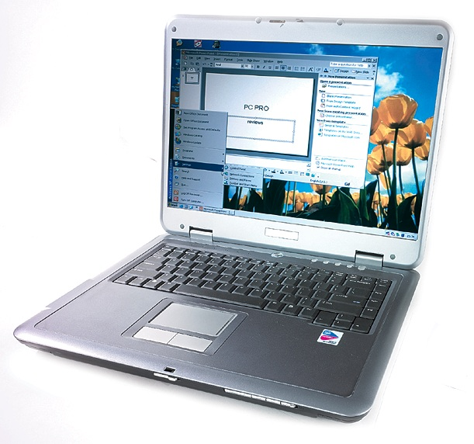
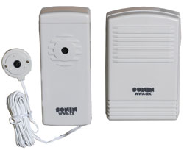
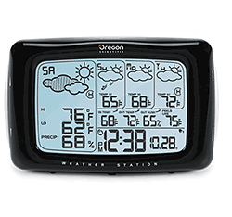
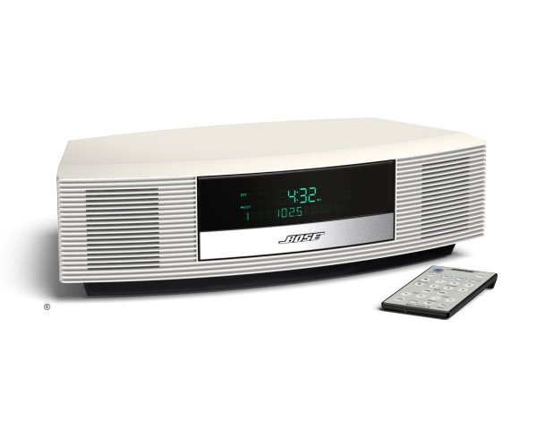
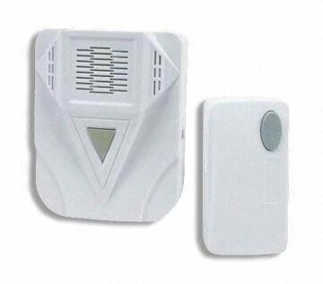
Usability: Interconnected devices
opens (home, car, office) doors
generates TAN
updates location
incoming call
time, location
address book
alert, events
any weather service
school closings
acoustic alerts

Slide 36
Conclusion
Focus shifting: speed to diversity, functionality, autonomic behavior
Applications beyond voice and web
  more than “Internet of things” & sensor networks
Seamless user experience across cellular, WLAN & disruption-tolerant networks

Slide 37
Backup slides

Slide 38
Deploying services
NetServ
Cloud
computing
Shared
hosting
Dedicated
hosting
Colocation
Own
data center
Unit | Java task | VM | /html | server | rack | 100s of racks
Provided | computation storage network power AC | computation network power AC | web server network power AC | computation storage network power AC | network power AC
setup time | seconds | minutes | hours | day | week | years
cost | ? | $1/hour $0.10/GB $0.10/GB-month | $20/month | $100/month | $550+/rack | $10M/year
Notes:
http://www.hostventures.com/colocationprices.html
http://aws.amazon.com/ec2/#pricing
http://gigaom.com/2008/09/03/where-to-get-the-cheapest-mobile-data-plans/
http://searchdatacenter.techtarget.com/news/article/0,289142,sid80_gci1204203,00.html

Slide 39
Networks beyond the Internet
Network model | route stability | motion of data routers
Internet | minutes | unlikely
mobile ad-hoc | 3 τ | disruptive
store-carry-forward | < 3 τ | helpful

Slide 40
Destination/delivery mode
Destination/delivery mode
Unicast
Multicast
Anycast
Any node that meets
conditions
e.g., any AP or
infostation to upload
Messages
7DS message delivery
Person
Location-driven
Interest-driven
Location-driven
EBR
MaxProp
Prophet
Spray and wait
BUBBLE
SimBet
Geographic
routing
GeOpps
GeoDTN+Nav
Oracle-based
Community-
based routing
Interest-aware
communication
Geographic routing
GeOpps

Slide 41
Depth and breadth
Depth and breadth
One-hop
Two-hops / Source routing
More than two hops /
Per-hop routing
Direct delivery
between a sender and a receiver
Single link
Multiple links
Single copy
Multiple copies
Flooding
Shortest path
Oracle-based
Several possible paths
Oracle-based
GeOpps
GeoDTN+Nav
Prophet
SimBet
Spray and wait
EBR
BUBBLE
Epidemic routing,
MaxProp

Slide 42
Knowledge
Knowledge
Zero knowledge
Deterministic information
Probabilistic information
randomized routing
Epidemic routing
Spray and wait
7DS message delivery
Temporal information
Spatial information
Mobility pattern
Popularity/centrality
Personal relationship
Route/destination location varying
Prophet
MobySpace
EBR
BUBBLE
SimBet
MaxProp
Prophet
Time-invariant
Time-varying, dynamics are known
Satellite
Oracle-based
Route-varying,
Destination- invariant
Bus, train
Oracle-based
Route/destination-invariant
Satellite
GeOpps
GeoDTN+Nav
Oracle-based
Navigation system
GeoDTN+Nav

