Slide 1
SIP Server Overload Control
Henning Schulzrinne & Charles Shen
Columbia University

Slide 2
Outline
  Introduction to SIP
  SIP Overload Control Motivation and Overview
  Filter-based SIP Overload Control
  Overload Control for SIP over UDP
  Overload Control for SIP over TCP
  Summary

Slide 3

The Protocol Zoo
Web
Session Management
Session Support:
QoS, NAT/FW …
Session Support: Location Service
Media Transport
Media encap
G.711, H.261
HTTP
SIP
DNS/ENUM
QoS NSLP
NAT NSLP
RTP
GIST
TLS
DTLS
TCP
UDP
IP

Slide 4
The Protocol Zoo
Web
Session Management
Session Support:
QoS, NAT/FW …
Session Support: Location Service
Media Transport
Media encap
G.711, H.261
HTTP
SIP
DNS/ENUM
QoS NSLP
NAT NSLP
RTP
GIST
TLS
DTLS
TCP
UDP
IP

Slide 5


SIP – Session Initiation Protocol
  Session creation, modify and teardown
  Large scale deployment - NGN
  Applications: VoIP, conferencing, instant messaging, presense
  Core functions: registration and proxying
SIP Registrar
Register
200 OK
Notes:
- core signaling in Internet Multimedia Subsystem (IMS) for Next Generation Networks

Slide 6


SIP Proxying
Caller
SIP Proxy A
SIP Proxy B
Callee
INVITE
INVITE
INVITE
100 Trying
100 Trying
100 Trying
180 Ringing
180 Ringing
180 Ringing
200 OK
200 OK
200 OK
ACK
ACK
ACK
Media
BYE
BYE
BYE
200 OK
200 OK
200 OK

Slide 7


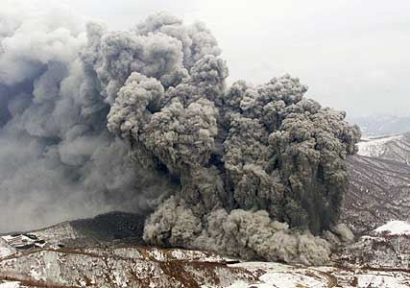


SIP Server Overload: Motivation - When does it happen?
  Legitimate short-term load spike
    Viewer-voting TV shows or ticket giveaways
    Special holidays
    Natural disaster areas
    Mass phone reboot after power failure and recovery
  Malicious attack caused overload
    Denial-of-Service attacks
Notes:
: American Idol
: Thanksgiving, New Year’s Day, and Mother's Day
such as those affected by earthquakes

Slide 8
SIP Server Overload: Real Data
Nation-wide => Kobe
legend
Earthquake of Jan.
17, 1995
regular day
800
about 20 times higher than normal day of average calls in an hour to Kobe from nation-wide
Traffic increased rapidly just after the earthquake at 5:50 and the peak is more than 50 times higher than normal day.
The congestion continued until next Monday
600
Earthquake happened at 5:46am, Jan. 17, 1995
About 20times of normal day
400
200
About 7 times of normal day
Capacity of NTT facility
(max usage of normal days)
4am 8am 12pm 4pm 8pm 12am 4am 8am 12pm 4pm 8pm 12am 4am 8am
Jan 17 Jan 18 Jan 19
Courtesy of NTT

Slide 9
SIP Server Overload Categorized - Proxy to Proxy Overload
  Known overload caller/callee scope
    human callee destination limits: ticket give-away
    malicious caller injecting traffic
SIP Proxy A
SIP Proxy B
SIP Proxy D
SIP Proxy C
  Unknown overload caller/callee scope:
    proxy server capacity limits
    disaster aftermath - regional callee scope
    holiday greetings - global callee scope
Notes:
Real-life example of avalanche restart: we had a fairly large power outage not to long ago
affecting a fairly wide area of the east of the UK. When the power
was restored, we saw a huge number of REGISTERs hit our platform all
within a second or two - presumably because the same vendor/model
takes the same time to boot up wherever it is - which caused a mini
DoS against our registration servers thanks to the avalanche effect.
Most annoyingly, these devices all retransmitted at exactly the same
time X seconds later, causing a spike followed by plenty of spare
capacity until they all next tried, etc.
Cause of overload, it is always that sources sending too much traffic.
causes of overload:
* reasonable number of sources all sending the traffic to the server (for registration or for a same number) at the same time
More than usual number of users tries to access the system resource
*a) a server to registrar - power failure and recovery
*b) server to a set of designated number - TV commercial
*c) server to a set random numbers - disaster aftermath at the same time because of unexpected event (, ) or
Who are those added (surge) users?
We define the affected population and the associated servers as an Affected Region. The scope of affected region can be local, e.g., in a) the area that a registrar server covers; the affected region can be global, e.g. in b) or c). In essence, the difference of the local surge vs. global surge is a known population size vs. unknown population size.

Slide 10
SIP Server Overload Categorized – UA to Registrar Overload
SIP Registrar
  Avalanche restart after sudden power failure and recovery
    registration server capacity limits
    usually affecting local/regional registerant scope
    real-life example recently in a fairly wide area the east of UK
  Different scenarios call for different approaches
Notes:
Real-life example of avalanche restart: we had a fairly large power outage not to long ago
affecting a fairly wide area of the east of the UK. When the power
was restored, we saw a huge number of REGISTERs hit our platform all
within a second or two - presumably because the same vendor/model
takes the same time to boot up wherever it is - which caused a mini
DoS against our registration servers thanks to the avalanche effect.
Most annoyingly, these devices all retransmitted at exactly the same
time X seconds later, causing a spike followed by plenty of spare
capacity until they all next tried, etc.
Cause of overload, it is always that sources sending too much traffic.
causes of overload:
* reasonable number of sources all sending the traffic to the server (for registration or for a same number) at the same time
More than usual number of users tries to access the system resource
*a) a server to registrar - power failure and recovery
*b) server to a set of designated number - TV commercial
*c) server to a set random numbers - disaster aftermath at the same time because of unexpected event (, ) or
Who are those added (surge) users?
We define the affected population and the associated servers as an Affected Region. The scope of affected region can be local, e.g., in a) the area that a registrar server covers; the affected region can be global, e.g. in b) or c). In essence, the difference of the local surge vs. global surge is a known population size vs. unknown population size.

Slide 11
SIP Server Overload: Existing Overload Control Layering
Application layer protocol overload control is NOT new! E.g., HTTP
User level
  user is given a busy signal
  delayed response reduces usage
  reduced functionality (e.g., no images)
  user behavior beyond protocol control
Application protocol level
  HTTP/SIP server busy indications
  protocol specific
Transport or lower layers
  TCP flow control
  TCP congestion control
  refuse TCP connections or UDP packets
  cross-layer, specific to the lower layer protocols

Slide 12
SIP Server Overload: Borrow from HTTP Overload Control?
both run over TCP and SCTP (rarely)
both often have a single server hop
Similarity
Differences
SIP also runs over UDP
SIP has multiple hops (proxies)
SIP has protocol-specific retransmission
SIP requests more time sensitive (ms vs. seconds)
Conclusion
sufficiently different to require different solutions
Notes:
TCP: (dominant for HTTP, increasing for SIP)
Single Hop: (client to server for HTTP, UA to registrar/proxy for SIP)

Slide 13
SIP Server Overload: Transport Layer Overload Control for SIP?
TCP flow control
avoid receiver buffer overflow
TCP congestion control
avoid link congestion
Refuse TCP connections
o
May
be good
for UA to registrar/proxy scenario
o
Not preferable for proxy to proxy
connection
Drop UDP packets
o
SIP
retransmission
may cause adverse effect
Conclusion
o
Different
transport layer overload control
options
o
A
pplication
layer SIP
overload control
Notes:
TCP flow control aims at avoiding buffer overflow for a specific sender to receiver connection
TCP congestion control aims at avoiding IP layer congestion-induced packet loss globally
SIP overload concerns about many senders to many receivers through series of intermediate proxies
Helpful but not sure whether sufficient
May be helpful for UA to registrar/proxy scenario
Not preferable for proxy to proxy connection that contains multi-user request aggregate
SIP protocol retransmission may cause adverse effect
Different transport layer overload control options need to be investigated for SIP overload
May need to look at application layer SIP overload control

Slide 14
SIP Server Overload: The Family Tree
SIP server overload
proxy server overload
registrar server overload
proxy to proxy overload
UA to proxy overload
UA to Registrar overload
known overload source/destination
diffuse overload source/destination
UDP-based
TCP-based
Notes:
Similarity
Inherient randamization unless it is an attack

Slide 15
SIP Server Overload: The Family Tree
SIP server overload
proxy server overload
registrar server overload
proxy to proxy overload
UA to proxy overload
UA to registrar overload
known overload source/destination
diffuse overload source/destination
UDP-based
TCP-based
application layer filter-based SIP overload control
Notes:
Similarity
Inherient randamization unless it is an attack

Slide 16



SIP Server Overload: Filter-based Control – Push Control to the Edge
Filter Spec
ID: To: +1-212-555-1234
Time: 9am-10am 2009-1-1
Act: accept rate=N_{EPA}
Filter Spec
ID: To: +1-212-555-1234
Time: 9am-10am 2009-1-1
Act: accept rate=N_{SPA}
Filter Spec
ID: To: +1-212-555-1234
Time: 9am-10am 2009-1-1
Act: accept rate= N_{max}
Enterprise Network A
Hotline Callee
212-555-1234
9am-10am,
2009-1-1
Service Provider A
Filter Spec
ID: To: +1-212-555-1234
Time: 9am-10am 2009-1-1
Act: accept rate=N_{SPB}
Enterprise Network B
Service Provider B
Charles Shen, Henning Schulzrinne, Arata Koike, A Session Initiation Protocol (SIP) Load Control Event Package, draft-shen-sipping-load-control-event-package-01.txt, IETF SIPPING Working Group, Work in Progress. Nov 3, 2008

Slide 17
SIP Server Overload: The Family Tree
SIP Server Overload
Proxy Server Overload
Registrar Server Overload
Proxy to Proxy Overload
UA to Proxy Overload
UA to Registrar Overload
Known Overload Source/Destination Scope
Unknown Overload Source/Destination Scope
Application Layer Filter-based SIP Overload Control
UDP-based
TCP-based
Notes:
Similarity
Inherient randamization unless it is an attack

Slide 18
SIP Server Overload: The Family Tree
SIP Server Overload
Proxy Server Overload
Registrar Server Overload
Proxy to Proxy Overload
UA to Proxy Overload
UA to Registrar Overload
Known Overload Source/Destination Scope
Unknown Overload Source/Destination Scope
Application Layer Filter-based SIP Overload Control
UDP-based
TCP-based
Application Layer Feedback-based SIP Overload Control
Notes:
Similarity
Inherient randamization unless it is an attack

Slide 19
SIP over UDP: Simple Dropping upon overload?
  SIP over UDP is dominant in current practice
  Simply dropping requests on overload?
    more messages due to retransmission
    e.g., Timer A for INVITE retransmission
SIP Proxy A
SIP Proxy B
INVITE
T₁
INVITE
2T₁
INVITE
4T₁
INVITE
Notes:
T1 = 500 ms, increases exponentially
Until total timeout exceeds 32 seconds

Slide 20

SIP over UDP: Message Rejection upon Overload?
  Rejecting excessive requests upon overload?
    SIP 503 (Service Unavailable) response code to reject individual request
  Trying an alternative server?
    may soon be overloaded too-> cascading failure!
Caller
SIP Proxy A
SIP Proxy B
SIP Proxy C
INVITE
503 Service Unavailable
a) 500 Server Internal Error
ACK
b) INVITE
Notes:
overall sending rate is not reduced.
rejecting costs comparable CPU cycles with accepting requests!
Client completely shut off during the period specified
Reducing rate with an on/off pattern, may cause oscillation

Slide 21

Feedback-based SIP Overload Control
Feedback Channel
(In-band or out-of-band)
Feedback Enforcement
Feedback Algorithm
Feedback Info.
Incoming Load
Regulated Load
Output Load
Throttled Load
Sending Entity (SE)
Receiving Entity (RE)

Slide 22
Absolute Rate Feedback
Feedback Channel
(In-band or out-of-band)
Feedback Enforcement
Feedback Algorithm
λ’
λ
λ’
μ = λ’
λ - λ’
Sending Entity (SE)
Receiving Entity (RE)

Slide 23
Relative Rate Feedback
Feedback Channel
(In-band or out-of-band)
Feedback Enforcement
Feedback Algorithm
p
λ
(1-p)λ
μ =(1-p)λ
pλ
Sending Entity (SE)
Receiving Entity (RE)

Slide 24
Window Feedback
Feedback Channel
(In-band or out-of-band)
Feedback Enforcement
Feedback Algorithm
win
λ
λ’
μ = λ’
if (win > 0)
if (win < 0)
λ - λ’
Sending Entity (SE)
Receiving Entity (RE)

Slide 25
Feedback-based SIP Overload Control: Design Requirements
Requirements
  approaching ideal performance*
  minimizing control parameters
Performance Metrics
  Througput + Response time -> Goodput
  INVITE -> ACK (INVITE) delivered <= 10 s
  Fairness
INVITE
100 Trying
180 Ringing
200 OK
ACK
BYE
200 OK
* All load and goodput values normalized over server capacity in this presentation

Slide 26
Window-based Feedback Control Algorithms
 | Win-disc | Win-cont | Win-auto
Window size decrement | upon receiving session request (INVITE)
Window size adjustment algorithm | update acceptable # of sessions every control interval | update current # of available session slots every message arrival | window size increment after processing NEW INVITE request
Tuning parameters | budget queuing delay control Interval measurement interval | budget queuing delay measurement Interval | N/A

Slide 27
Rate-based Feedback Control Algorithms
 | Rate-abs | Rate-occ
Rate adjustment algorithm | update acceptable rate every control interval | update request acceptance ratio every control interval
Tuning parameters | budget queuing delay control interval measurement interval | budget CPU occupancy control interval measurement interval OCC tuning parameters

Slide 28
Simulation Assumptions and Metrics
  Simulator: RFC3261 compatible simulator built on OPNET
  Call model: exponential inter-arrival w/ standard seven-message call flow
  RE service capacity: 72 cps, rejecting rate: 3000 cps
  UAs and SEs have infinite capacity
  UDP transport, no link delay and loss
  Piggyback feedback method
SIP Proxy A
SIP Proxy B
SIP Proxy D
SIP Proxy C

Slide 29
SIP Overload Performance without any Feedback Control
Simple Drop scenario
  message dropped when queue full
Threshold Rejection scenario
  queue length configured with a high and a low threshold value.
Similar congestion collapse but different reasons:
  Simple Drop
    one third of INVITE arriving at the callee
    all 180 RINGING and most of the 200 OK also dropped due to queue overflow
    Ghost ring!
  Threshold Rejection
    no INVITE reaches the callee, RE is only sending rejection messages
Notes:
high threshold: new INVITE rejected but other messages processed.
Low threshold: new INVITE processing restored

Slide 30
Feedback based SIP Overload Control:
Best Performance Comparison across Algorithms
All except rate-occ reaches unit goodput
  no retransmission ever
  server always busy processing messages
  each single message part of a successful session
rate-occ does not operate at unit goodput
  not simply due to artificial 85% CPU limit
  inherently occupancy not as direct a metric as needed
  extremely small CI improves performance at heavy load but with many problems

Slide 31
SIP Overload Control: Fairness
Basic fairness assuming sources of equal importance
User-centric fairness:
  equal success probability for each individual user
  implementation: div. RE capacity proportionally to original SE load arrivals
  applicability example: “Free ticket to the third caller”
Provider-centric fairness:
  each provider (SE) gets the same aggregate share of total RE capacity
  implementation: divide RE capacity equally among SEs
  applicability example: equal-share SLA
Customized fairness: assuming sources of different importance
  any allocation as pre-specified by SLA etc.
  penalizing the specific sources in deny of service attacks

Slide 32
Dynamic Load Performance w/ Provider Centric Fairness
  short periods of bulk loads w/ source arrivals/departures.
  Example result using rate-abs algorithm
  Each upstream SE share close to equal RE capacity
  Fast dynamic transition
Notes:
Realistic proxy to proxy overload likely short periods of bulk loads w/ source arrivals/departures.

Slide 33
Dynamic Load Performance w/ User Centric Fairness
  Double feed architecture
  Example using win-cont algorithm
  Upstream SEs share RE capacity proportionally
  Fast dynamic transition

Slide 34
Feedback based SIP Overload Control: Conclusions
 | Win-disc | Win-cont | Win-auto | Rate-abs | Rate-occ
Optimal Steady state performance | ✓ | ✓ | ✓ | ✓ | ✗
Optimal Dynamic performance | ✓ | ✓ | ✗ | ✓ | ✓
User-centric Fairness | ✓(with double-feed) | ✓ (with double-feed) | ✗ | ✓ (with double-feed) | ✓
Provider-centric fairness | ✓ | ✓ | ✗ | ✓ | ✓
# of tuning parameters | 3 | 2 | 0 | 3 | 5
Charles Shen, Henning Schulzrinne, Erich Nahum, SIP Server Overload Control: Design and Evaluation,
pages 149-173, Volume 5310/2008, Principles, Systems and Applications of IP Telecommunications.
Services and Security for Next Generation Networks.

Slide 35
SIP Server Overload: The Family Tree
SIP Server Overload
Proxy Server Overload
Registrar Server Overload
Proxy to Proxy Overload
UA to Proxy Overload
Known Overload Source/Destination Scope
Unknown Overload Source/Destination Scope
Application Layer Filter-based SIP Overload Control
UDP-based
TCP-based
Application Layer Feedback-based SIP Overload Control
Notes:
Similarity
Inherient randamization unless it is an attack

Slide 36
SIP Server Overload: The Family Tree
SIP Server Overload
Proxy Server Overload
Registrar Server Overload
Proxy to Proxy Overload
UA to Proxy Overload
Known Overload Source/Destination Scope
Unknown Overload Source/Destination Scope
Application Layer Filter-based SIP Overload Control
UDP-based
TCP-based
Application Layer Feedback-based SIP Overload Control
Does TCP w/ small Sndbuffer
solve the overload problem?
How about fairness?
Notes:
Similarity
Inherient randamization unless it is an attack

Slide 37
SIP over TCP
  Why?
    Security - TLS over TCP
    NAT/Firewall traversal
    Larger message sizes especially in NGN
    Flow/congestion control?
  Main differences
    Much fewer but still have retransmission timer, e.g., for 200 OK
    Transport level flow control
SIP Proxy
Callee
200 OK
200 OK
T₁
2T₁
200 OK
4T₁
200 OK
ACK
Notes:
T1 = 500 ms, increases exponentially
Until total timeout exceeds 32 seconds

Slide 38
TCP Flow Control: Preventing Receiver Overflow
Receiver Application
Sender Application
Application
Buffer
Sender sends no more than the size of the receiver available buffer space
Write
Read
LastByteWritten
TCP
TCP
LastByteRead
Send
Buffer
■ ■ ■
Receive
Buffer
LastByteSent
LastByteAcked
LastByteRcvd
EffectiveWindow = AdvertisedWindow –
(LastByteSent – LastByteAcked)
AdvertisedWindow = MaxRcvBuffer -
(LastByteRcvd - LastByteRead)

Slide 39

SIP Over TCP Testbed
SIPOL benchmarking suite
  automates running experiments and analyzing results
  extensible and reproducible
OpenSIPS (Formerly OPEN SIP Express Router)
  open source standard of SIP proxies
SIPp
  open source standard of SIP workload generator
Hardware testbed
  Up to 22 Intel Pentium 4 or Xeon or 3GHz machines with 1G/2G memory (for SE/RE/UAC/UAS)
  Lightly loaded 100M or 1Gbps LAN
  Linux kernel 2.6.24
Workload
  Standard 7-message signaling flow
SIP Receiving Entities
SIP Sending Entities

Slide 40
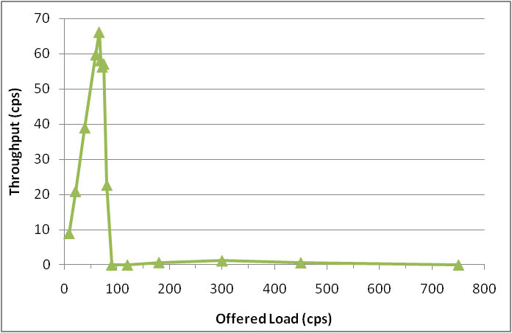
SIP over TCP: Default Performance
UAC
SE
RE
UAS
Clear congestion collapse after overload

Slide 41
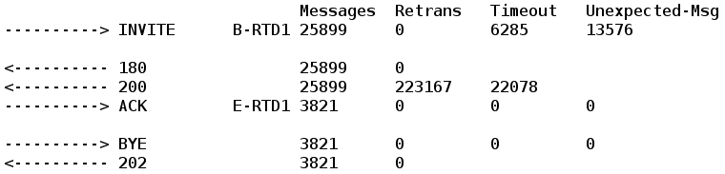
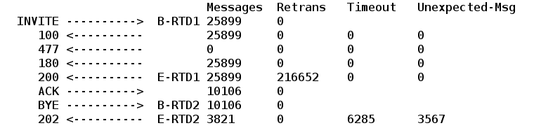
Default SIP over TCP Internals: Final Screen Log
UAS
UAS: only 3821 of the 25899 INV receives ACK, all the rest timed out
UAC: sends 10106 ACKs but 6285 of them too late when arrived at UAS
UAC
Case study L=150 C=65

Slide 42
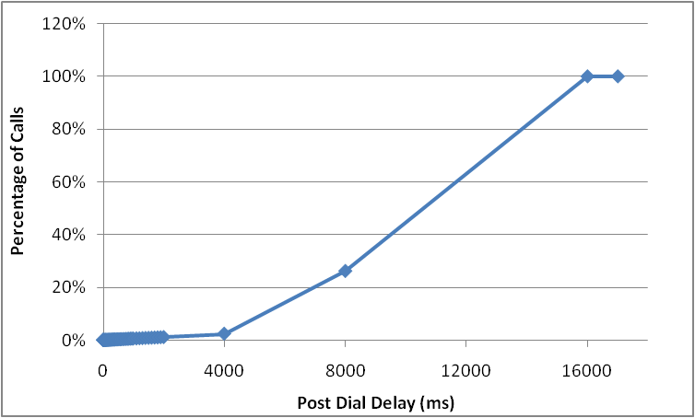
Default SIP over TCP Internals: Post Dial Delay
Delay between INVITE sent and 180/200 received
Even without considering whether ACK is delivered successfully
  73% PDD between 8 ~ 16 s
  24% PDD between 4 ~ 8 s
Case study L=150 C=65

Slide 43
SIP over TCP Overload Control: Observations and Solutions
Non-atomic application session load makes default transport level flow admission control ineffective
  INVITE much more expensive than other messages
  In-session messages from different connections at different time
Default system buffer leads to unacceptable delays
  SE socket send buffer
  RE socket receive buffer
  RE server application buffer
INVITE carries different “weight” from other messages
Default system buffer lead to unacceptable delay
Solution ➔ split the connections
Solution ➔ minimize the buffers

Slide 44
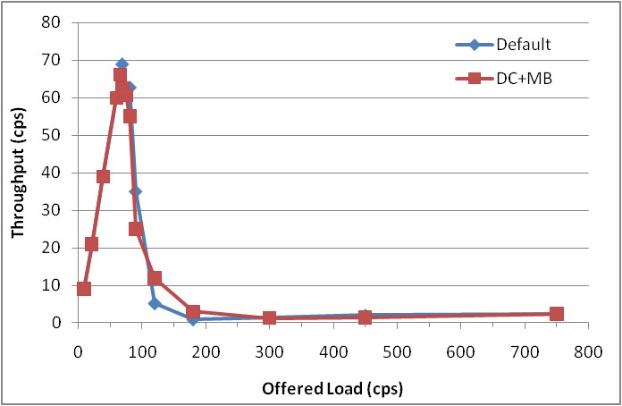
SIP Over TCP Overload Control Mechanism: DC+MB
Minimized TCP socket
sending buffer
Minimized TCP socket
receiving buffer +
minimized SIP server
application buffer
Physical
Connection
Split
Session start
INVITE requests
Sending
Entity
Port 5059
Receiving
Entity
Other in-session
requests (ACK etc.)
Port 5060
Default TCP socket
sending buffer
Default TCP socket
Receiving buffer + default
SIP server application buffer
Dual Connection with Minimized Buffer
(DC+MB)
Notes:
Send buffer 2K
Receive buffer 680x2 effective 680x1.5
Application buffer 1020

Slide 45
Why does DC+MB still fail and how to fix it?
Pressure merely shifted to SE
Ultimately blocking UAC to SE !
Solution ➔ smart forwarding
Start
N
INVITE arrival?
Y
Reject INVITE
N
INVITE connection
send buffer empty?
A simple parameter-free smart forwarding algorithm
Implementation just an easy Linux ioctl function call to test buffer emptiness
Y
Forward INVITE

Slide 46
SIP Over TCP Overload Control Mechanism: DC+MB+SF
Minimized TCP socket
sending buffer
Minimized TCP socket
receiving buffer +
minimized SIP server
application buffer
Physical
Connection
Split
Smart
forwarding
Session start
INVITE requests
Sending
Entity
Port 5059
Receiving
Entity
Other in-session
requests (ACK etc.)
Port 5060
Default TCP socket
sending buffer
Default TCP socket
Receiving buffer + default
SIP server application buffer
Dual Connection with Minimized Buffer and Smart Forwarding (DC+MB+SF)
Slide 46
10/28/09

Slide 47
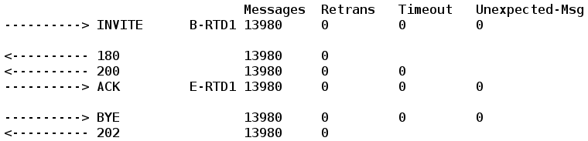
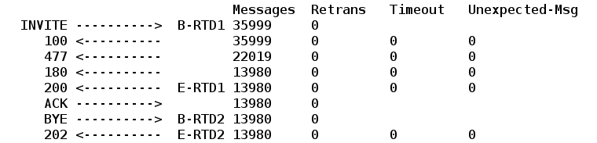
DC+MB+SF: Throughput
UAS
Among 35999 INVITEs generated, 22019 rejected, all the rest 13980 go successful, no retransmissions
RE CPU utilization is full ➔ achieving full capacity without waste
UAC
Case study L=150 C=65

Slide 48
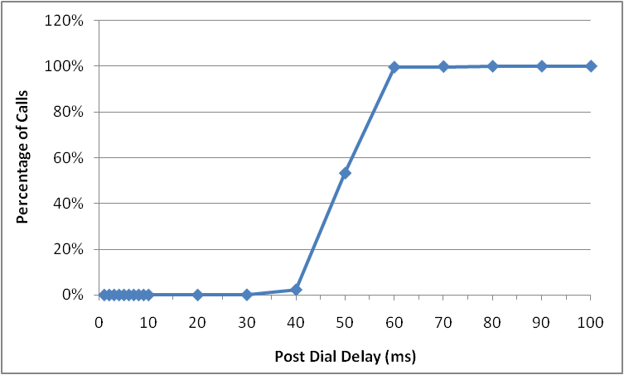
DC+MB+SF: Post Dial Delay
99% delay smaller than 60ms
No delay exceeds 70ms

Slide 49
SIP Over TCP Overload Control Mechanism: VDC+MB
Minimized TCP socket
sending buffer
Minimized TCP socket
receiving buffer +
minimized SIP server
application buffer
Smart Forwarding
Virtual
connection
split
Sending
Entity
All Requests
Receiving
Entity
Default TCP socket
sending buffer
Default TCP socket
Receiving buffer + default
SIP server application buffer
Virtual Dual Connection with Minimized Buffer and Smart Forwarding (VDC+MB+SF)

Slide 50
Smart forwarding for Virtual Dual Connection
Start
N
message arrival?
Y
N
Is an INVITE?
Y
N
Reject
send buffer empty?
Y
Forward INVITE only if send buffer is empty
Always forward non-INVITE
Forward

Slide 51
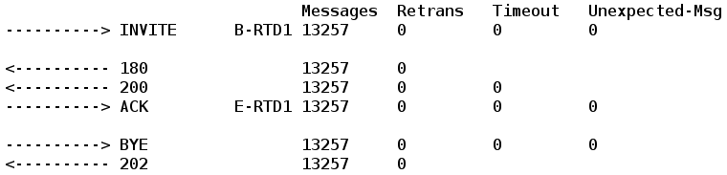
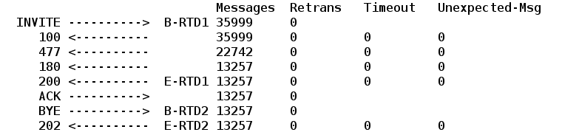
VDC+MB+SF: Throughput
UAS
Among 35999 INVITEs generated, 22742 rejected, all the rest 13257 go successful (comparing to 13980 in DC+MB+SF), no retransmissions
RE CPU utilization is full ➔ achieving full capacity without waste
UAC
Case study L=150 C=65

Slide 52
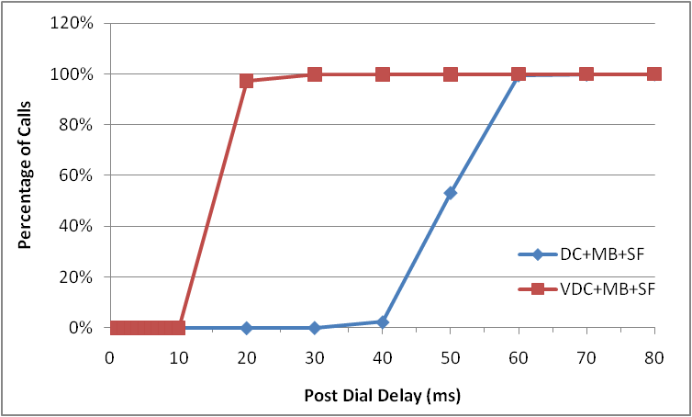
VDC+MB+SF: Post Dial Delay Comparing with DC+MB+SF
99.8% delay smaller than 30ms
Overall better than DC+MB+SF
Slide 52
10/28/09

Slide 53
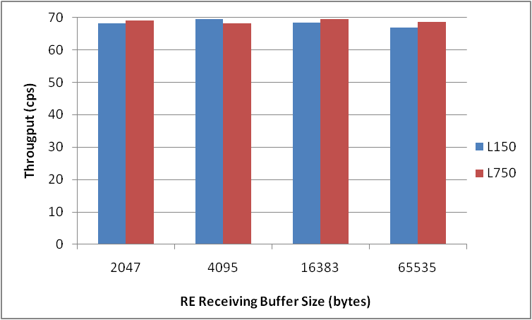
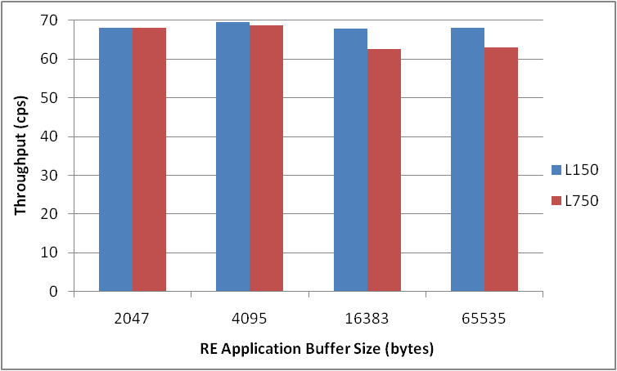
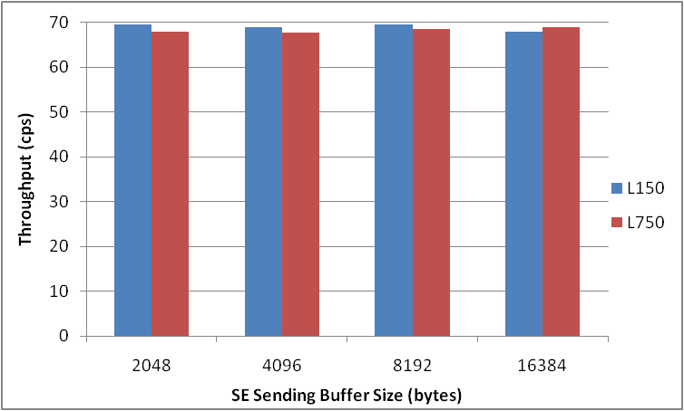
VDC+MB+SF: Buffer tuning
w/ default application buffer
Conclusion:
Send buffer size insignificant
Receive buffer more effective than application buffer
only needs to tune receive buffer!
MB ➔ MRB (Minimized Receive Buffer)
w/ default receive buffer

Slide 54
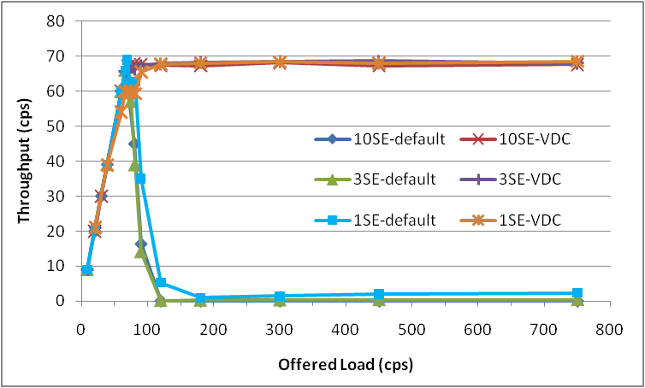
Overall Performance VDC+MRB+SF: Using 1SE / 3SE / 10SE
receive buffer 2K

Slide 55
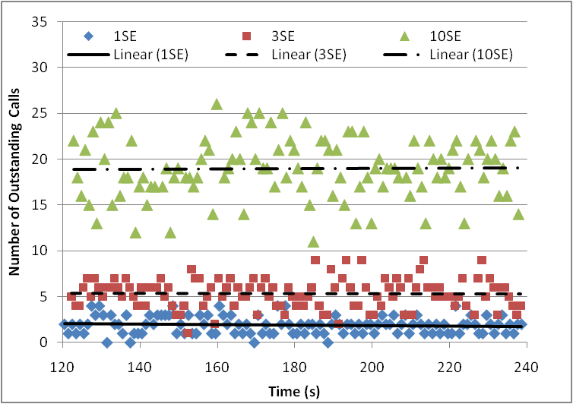
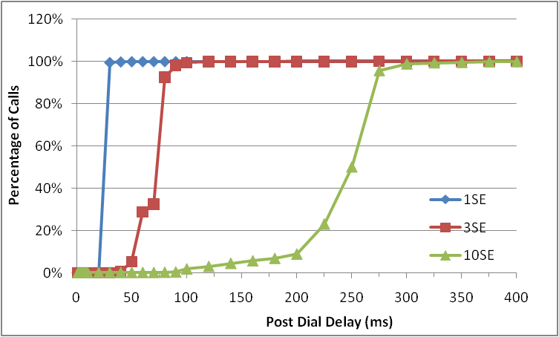
VDC+MRB+SF: Comparing 1SE, 3SE and 10SE
Number of outstanding calls and PDD increase roughly proportionally due to total buffer size increase

Slide 56
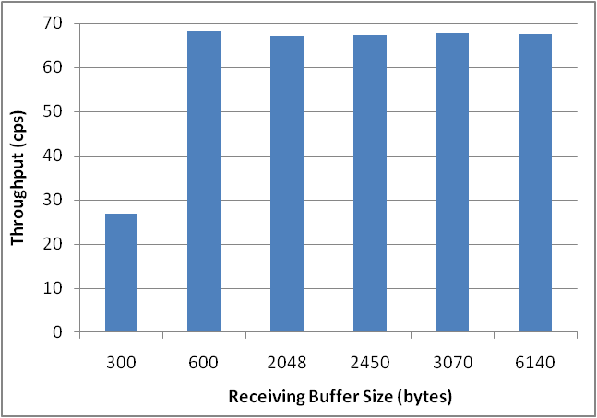
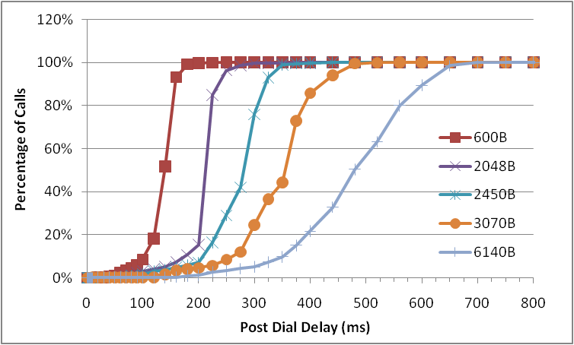
VDC+MRB+SF: Receiving Buffer Impact 10 SE w/ 11 Times Overload
Throughput fine as long as receive buffer not too small
Delay obviously affected
Recommended value is no more than one or two INVITE size (e.g., 1 ~ 2K)

Slide 57
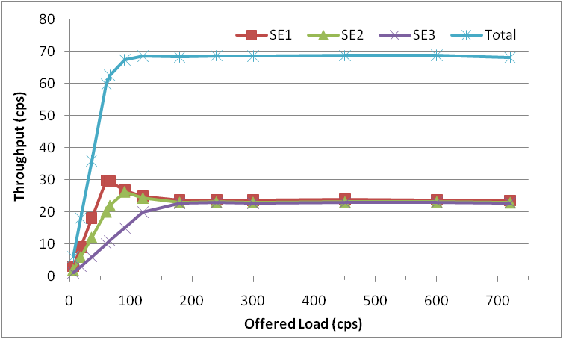
VDC+MRB+SF: Fairness
Three SEs with incoming load ratio 3:2:1
When total load is below capacity, capacity proportionally divided
At light to moderate overload, division approaches equality
At heavy overload, share the same portion of capacity

Slide 58
Insights from Our SIP over TCP Overload Control Study
Traditional TCP flow control cannot preventing SIP congestion collapse
Causes: special SIP load characteristics
  Multiple-message, session-based, non-atomic job unit distributed in different connections
  Start of the session message a commitment for the rest of the messages
  Real-time requirement - job fails if not finished within delay threshold
The results generalize to whole application space with similar load characteristics, e.g., SQL
Key solution components:
  Connection split ➔ for the unequal and distributed messaging problem
  Upstream smart forwarding ➔ release pressure in advance
  Self-minimized buffer ➔ avoid job accumulation to minimize delay
Limitation:
  Solution does not address the SIP overload scenario with numerous SEs overloading a single RE, which is a separate problem

Slide 59
SIP Server Overload: The Family Tree
SIP Server Overload
Proxy Server Overload
Registrar Server Overload
Proxy to Proxy Overload
UA to Proxy Overload
UA to Registrar Overload
Known Overload Source/Destination Scope
Unknown Overload Source/Destination Scope
Application Layer Filter-based SIP Overload Control
UDP-based
TCP-based
Application Layer Feedback-based SIP Overload Control
Connection Split + Minimized Buffer + Smart Forwarding
Notes:
Similarity
Inherient randamization unless it is an attack

Slide 60
SIP Server Overload: Conclusion
SIP Server Overload
Proxy Server Overload
Registrar Server Overload
Proxy to Proxy Overload
UA to Proxy Overload
UA to Registrar Overload
Known Overload Source/Destination Scope
Unknown Overload Source/Destination Scope
Random backoff?
Offline feedback?
Application Layer Filter-based SIP Overload Control
UDP-based
TCP-based
Application Layer Feedback-based SIP Overload Control
Connection Split + Minimized Buffer + Smart Forwarding
Notes:
Similarity
Inherient randamization unless it is an attack

Slide 61
End

Slide 62
Backup slides – VoIP basics

Slide 63


VoIP - A Typical Internet Mulitmedia Service
Local Location DB
DNS/ENUM Server
SIP Server C
SIP Server B
SIP Server A
SIP Server D

Slide 64





VoIP - A Typical Internet Mulitmedia Service
DNS / ENUM Lookup
SIP Proxying
SIP Registration
Session Creation
Local Location DB
DNS/ENUM Server
SIP Server B
SIP Server C
SIP Server A
SIP Server D
QoS Support
Media Transport
GIST + QoS NSLP
(NSIS)
RTP

Slide 65
VoIP - A Typical Internet Mulitmedia Service
DNS / ENUM Lookup
SIP Proxying
SIP Registration
Session Creation
Local Location DB
DNS/ENUM Server
SIP Server B
SIP Server C
SIP Server A
SIP Server D
QoS Support
Media Transport
GIST + QoS NSLP
(NSIS)
RTP
10/28/09
65

Slide 66
Backup slides – SIP Overload over UDP

Slide 67
Feedback-based SIP Overload Control: Design Decisions
  SIP session as a basic control unit
    Different message carry different weights, e.g. INVITE vs. non-INVITE
  Characterizing SIP session
    check number of INVITEs accepted
  Active source estimation
    directly tracking each current active SE sending incoming load
  Dynamic session backlog estimation
    count both INVITEs and non-INVITEs for current session backlog

Slide 68
Feedback based SIP Overload Control:
Sensitivity of Budget Queuing Delay and Control Interval
  Small queuing delay (< ½ T1 timer) avoids timeout and gives best results
  Example results for win-disc
  Similar results for win-cont and rate-abs
  Sensitivity of control interval
    the smaller CI, the better.
  Example results for win-disc,
    at D_{B} =200 ms CI <= 200 ms sufficient to archive unit goodput in our scenario
Notes:
Example results for win-disc
Unit goodput w/ Delay Budget (D_{B}) <= 200 ms, Control Interval (CI) = 200 ms
Goodput degraded by 25% D_{B} = 500 ms
Sensitivity of control interval
the smaller CI, the better.
Example results for win-disc,
at D_{B} =200 ms CI <= 200 ms sufficient to archive unit goodput in our scenario

Slide 69
Backup slides – SIP Overload over UDP

Slide 70
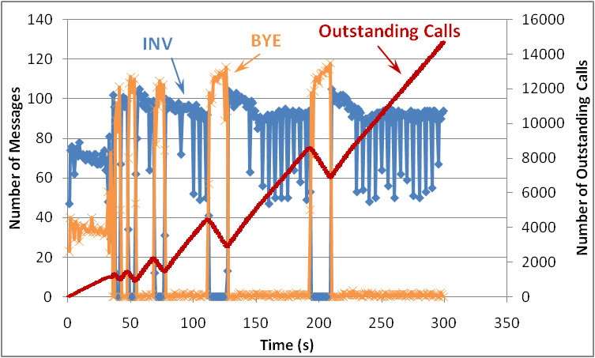
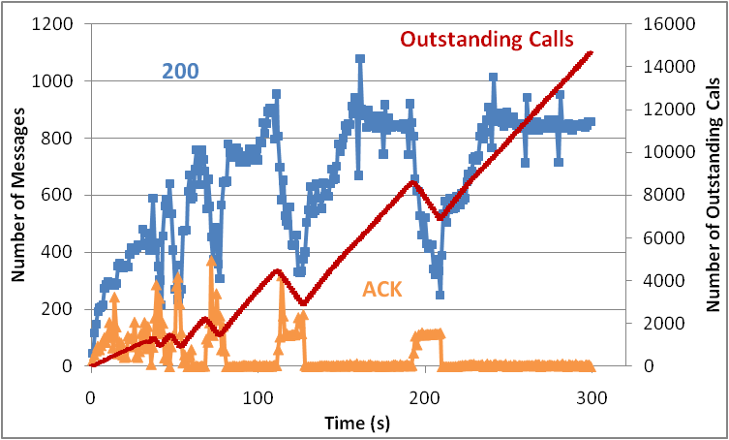
Default SIP over TCP Internals: RE Average Message Processing Rate
  200 retransmission immediately => RTD > 500ms
  Loads not atomic => INV/BYE processing alternates; too many INVs admitted, BYEs lag behind;
  Increasing number of outstanding calls => even longer delay
  Default RE buffer holds up to 150 INVITEs at a time, about 5 times of allowed maximum calls in the system based on delay budget
Case study L=150 C=65
Notes:
Not shown: number of 180 and number of 200; actually, num of 180 follows num of INVs, num of 200 OK to BYEs follows num of BYEs both because UAS is not overloaded.
Maximum number of allowed outstanding calls:
Capacity 65cps -> each call 15.4 ms
To avoid 200 retransmission timer, one way delay < 250 ms -> 16 calls maximum
But many of the calls are partially in the system at a time, consider half of the messages are in the system
Then the effective maximum number doubled at 32 calls.
Default buffer is 85K receiving buffer +64K socket buffer, consider an INVITE as 1K , about 150 INVITEs

Slide 71
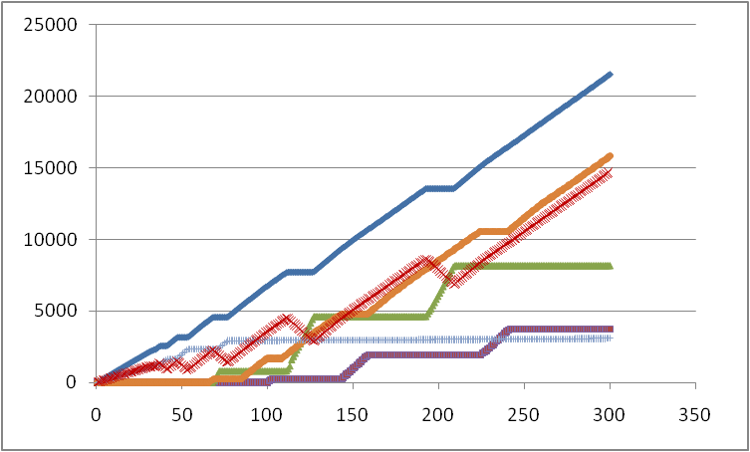
Default SIP over TCP Internals: UAS Total Messages Processed
INV Recv
200 Timeout
Outstanding
Calls
INV Unexpected
ACK Recv
INV Timeout
0 – 38s: number of outstanding calls equal to number of ACKs received
After 38s: outstanding calls increase with INV and decrease with ACK/BYE processing
After 69s: INV unexpected: actually ACK and BYE messages arrived after call timeout
After 101s: call states established by unexpected ACK and BYE messages timeout
Timely received num of ACKs virtually stopped growing after 77s -> Zero throughput
Case study L=150 C=65
Notes:
Number of 180 and initial 200 (not 200 retransmissions) are the same because both generated by UAS immediately upon receiving INV
Number of ACK,BYE and 200 to BYEs are the same because ACK and BYE are generated at the same time at the UAC and 200 OK to BYE is immediately generated upon receiving BYE at the UAS

Slide 72
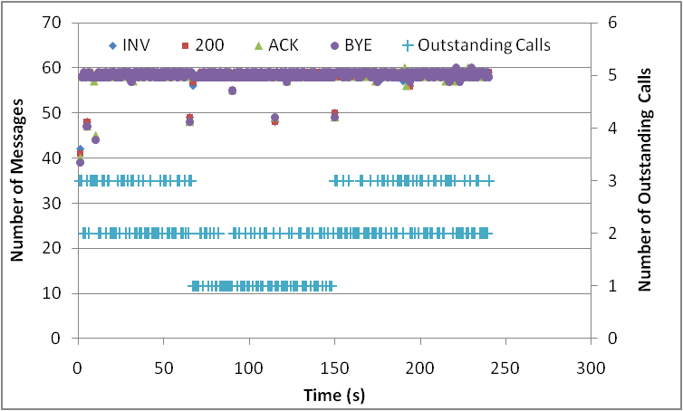
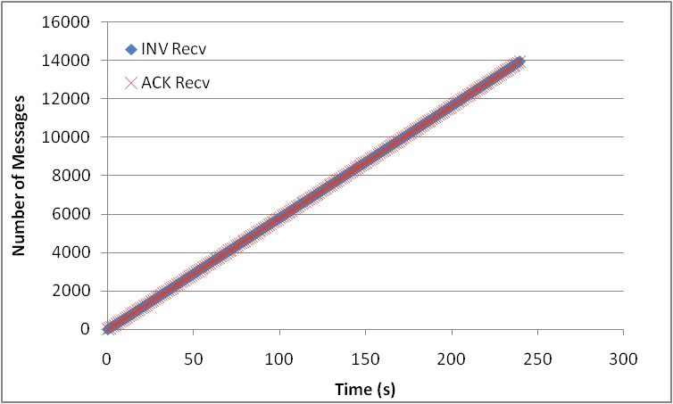
DC+MB+SF: RE Average Message Processing
All messages handled in time
# outstanding calls bt. 1 and 3 !
UAS total message processing
Each INVITE matches ACK
Case study L=150 C=65

Slide 73
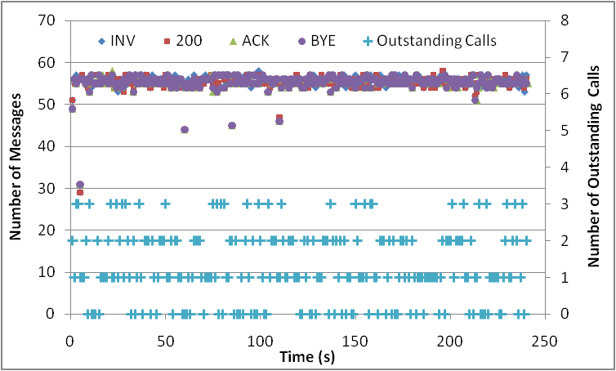
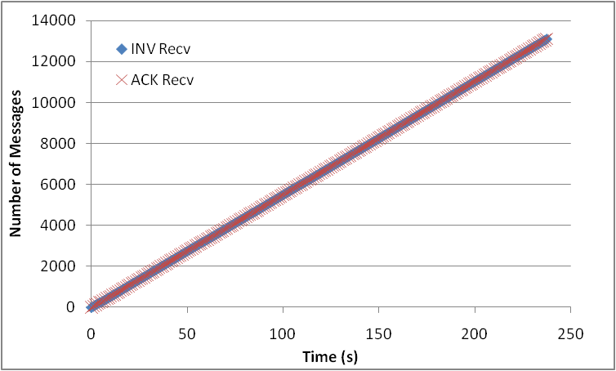
VDC+MB+SF: RE and UAS Message Processing
RE average message processing rate
All messages handled in time
# outstanding calls bt. 0 and 3
comparing to bt. 1 and 3 in DC
UAS total message processing
Each INVITE matches ACK
Slide 73
Case study L=150 C=65
10/28/09

Slide 74
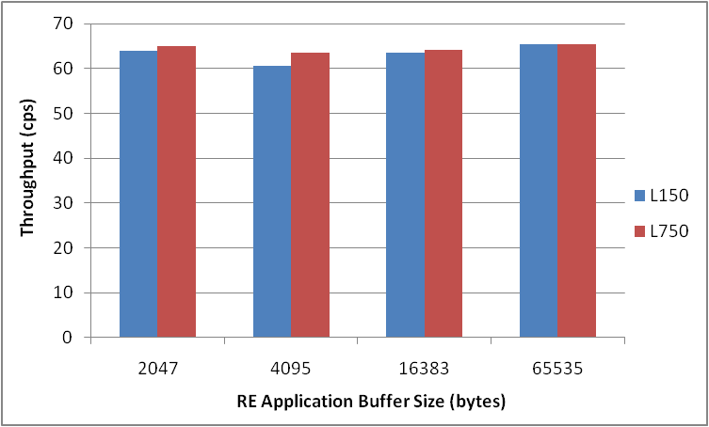
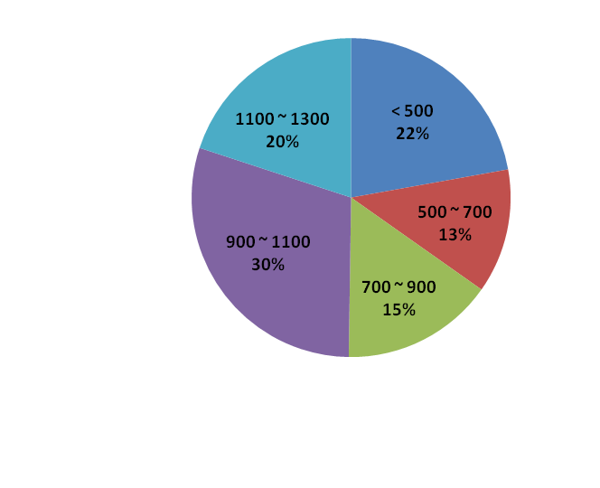
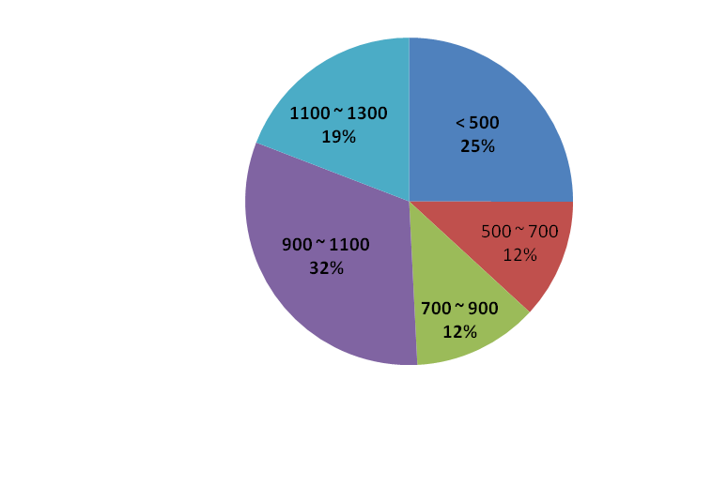
VDC+MB+SF: Relaxing the Application Buffer
Throughput roughly the same
Number of bytes read from the socket each time virtually unaffected by the App. buffer size
L150 w/ default App. buffer
L750 w/ default App. buffer
Notes:
Send buffer 2K
Receive Buffer 1K

Slide 75
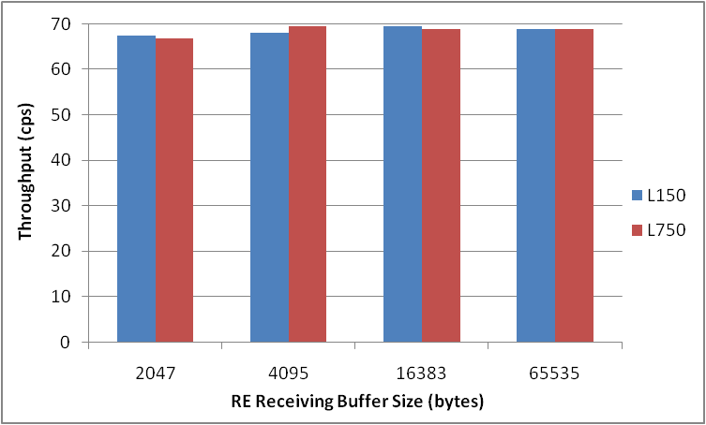
Relaxing Receive Buffer and Application buffer
Min application buffer 1300B
Default application buffer 64K
Default receive buffer 64K
Notes:
Send buffer always 2K

Slide 76
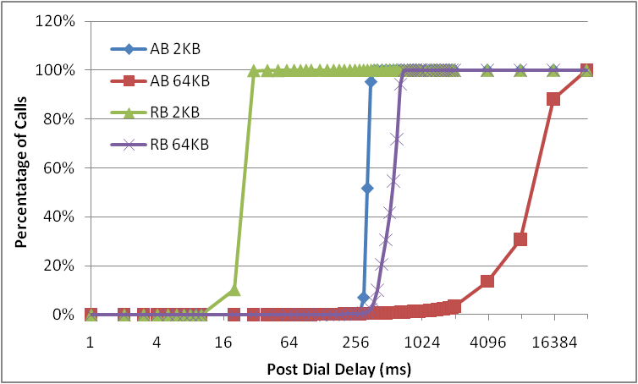
Relaxing both Receive and Application Buffer: Post Dial Delay
Though throughputs are similar, limiting receiving buffer is significantly more effective in reducing delay and thus preventing retransmission

Slide 77
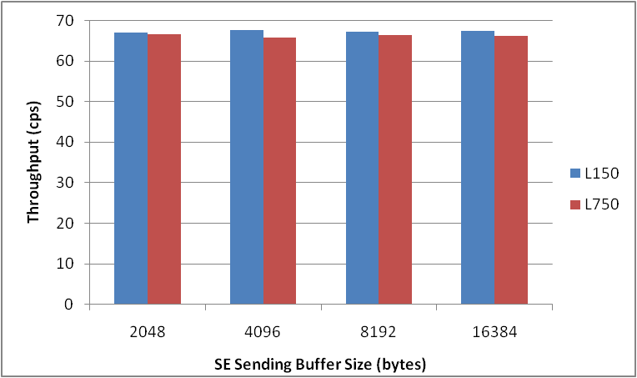
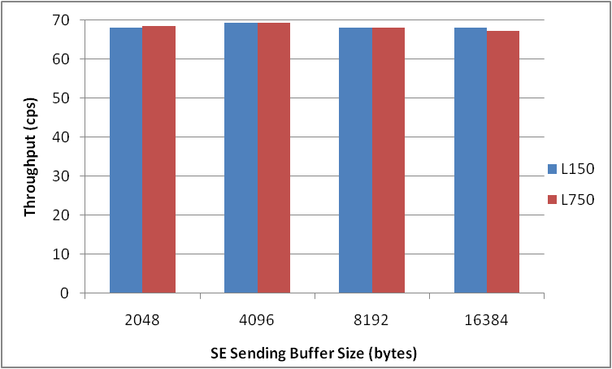
Relaxing Send Buffer
Throughput under receive buffer 2K, min application buffer 1300B
Throughput under receive buffer 2K, default application buffer 64K

Slide 78
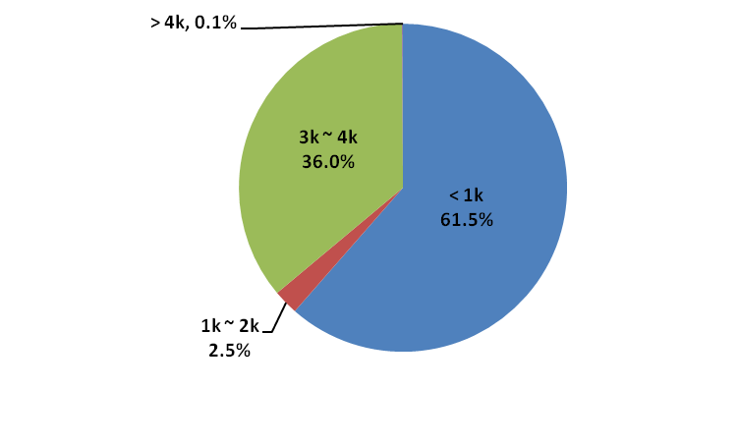
Relaxing Send Buffer
Throughput under default receive buffer 64K, Min. application buffer 1300
Send buffer size seen under load 750, default send buffer 16K, default application buffer 64K, receive buffer 2K
With a minimized number of active calls in the system, send buffer size does not matter
Conclusion:
only needs to tune the receive buffer!
MB ➔ MRB (Minimized Receive Buffer)

Slide 79
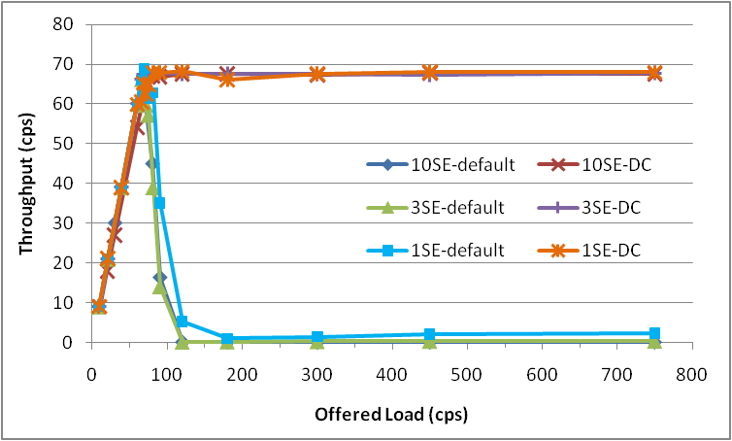
Overall Performance DC+MRB+SF vs. VDC+MRB+SF
Using 1SE, 3SE and 10SE, receive buffer 2K
Overall overload throughput very similar
DC underload performance slightly better than VDC in single SE case
However, VDC delay smaller than DC
  E.g., 200 retransmission seen in 10SE L750 scenario
  for DC but not for VDC

