Slide 1
vDelay: A tool to measure capture-to-display latency and frame rate
Omer Boyaci, Andrea Forte, Salman Abdulbaset and Henning Schulzrinne
August 10,2009

Slide 2
Introduction
  Measures capture-to-display latency and frame rate of a video chat session
  Do not require access to source code or network stream
  No modifications to the executables
  Sender and receiver side vDelay applications are written in Java so it is platform independent.

Slide 3
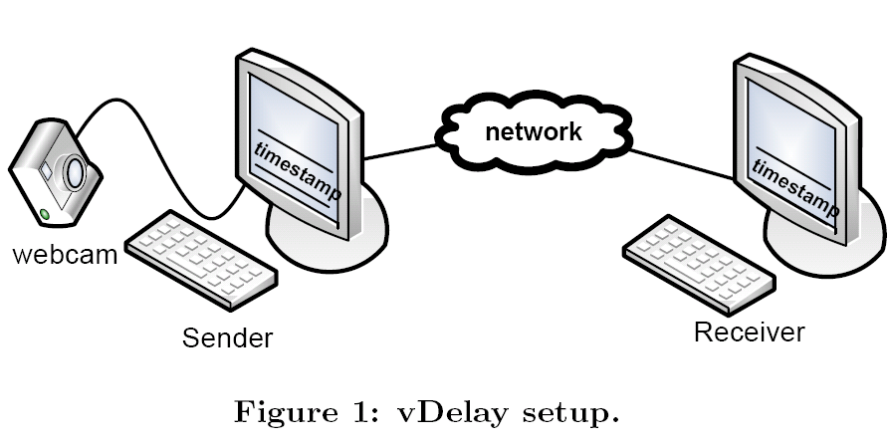
vDelay

Slide 4
vDelay
  Sender side
Application Layer (Java)
Renders the timestamp
Operating System (Frame Buffer)
  Receiver side
Display
(LCD)
Application Layer
(Java)
Captures the timestamp
Display
(LCD)
Webcam
Operating System (Frame Buffer)
Video Chat App
(Encoding)
Frame
Video Chat App
(Decoding)

Slide 5
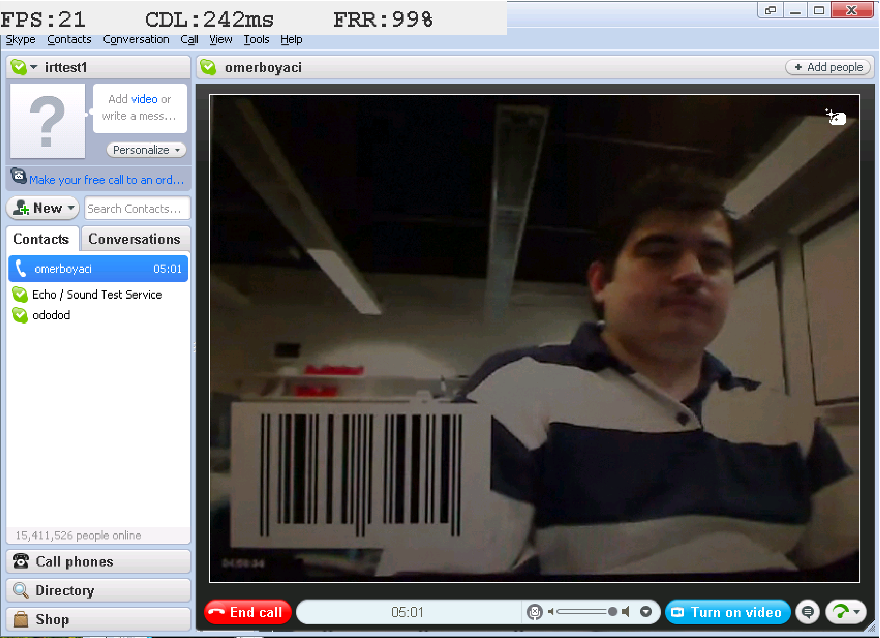
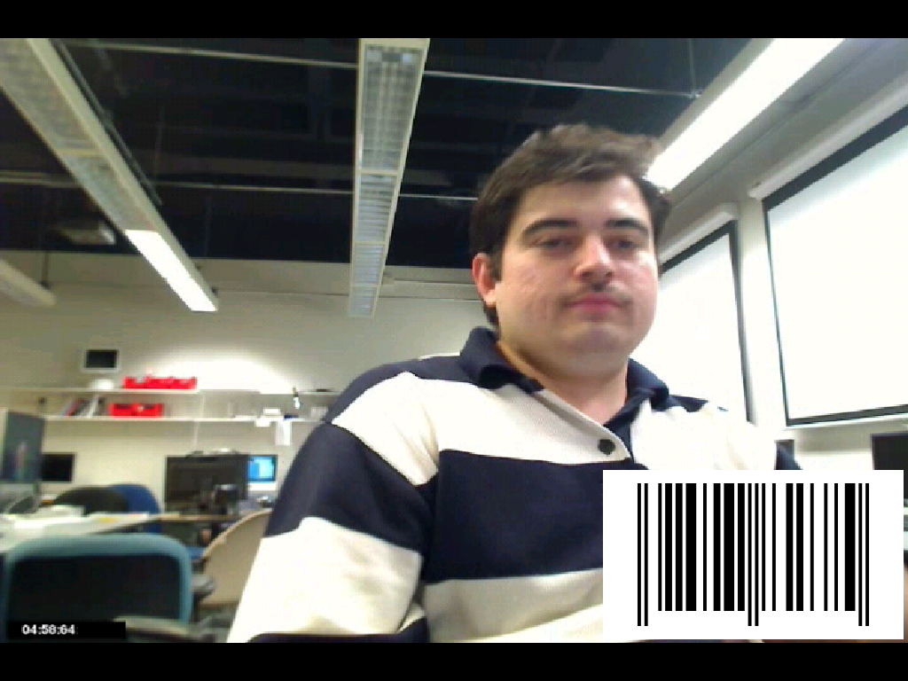
vDelay
Demo
Rendering Barcode
  Screenshot of the receiver side vDelay application.
  FPS, CDL, and FRR statistics are shown at the top of the image.
  The barcode received from the caller agent is also visible.

Slide 6
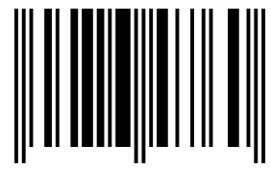
vDelay (Tools)
  Sender side
  Receiver side
Application Layer (Java)
Renders the timestamp
Application Layer
(Java)
Captures the timestamp
EAN-8 barcodes
Barcode4J library (10000 barcodes)
Screen Capture (Java)(Aero)
Checks whether new frame or not
If new ->Zxing library (Google Code)
Reports
  Frame per second
  Capture-to-display latency

Slide 7
vDelay: Important factors
Shutter speed of the webcam
  Lower is better (1ms worked for us)
Gain (Aperture)
  Should be set to maximum to decrease shutter speed
LCD vertical refresh rate
  Higher is better (60Hz in our case)
LCD latency
  Lower is better (5ms in our case)
Video quality
  Reading barcodes are easier for HQ video

Slide 8
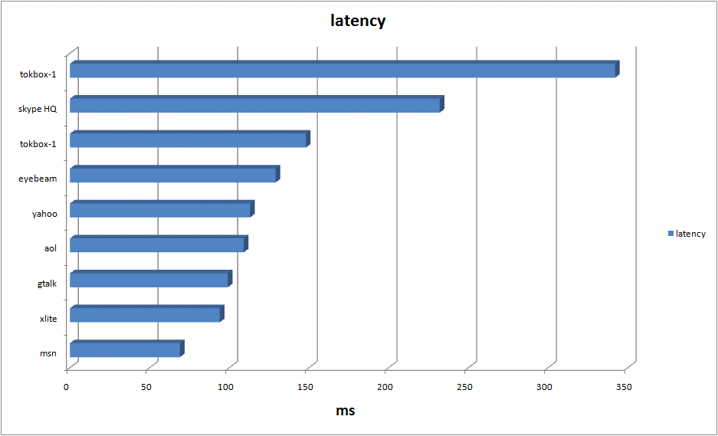
vDelay: Results (Latency)

Slide 9
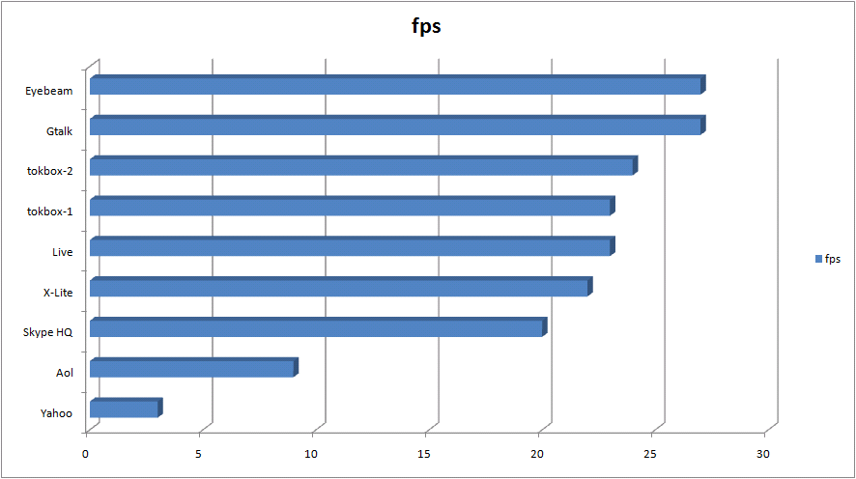
vDelay: Results (Frame per sec)

Slide 10
Conclusion
Video chat applications have very different congestion control mechanism.
Big DSL/cable modem buffers increase network latency in case of congestions.
Capture-to-display latency of video chat applications varies from 70ms to 300ms.

