Slide 1
Internet protocols for the SmartGrid – architectural considerations
Henning Schulzrinne
Columbia University

Slide 2
Internet protocols >> IP
application
application
ARP
DNS
LDAP
time sync
(NTP)
upper-layer protocol
(HTTP, SMTP, SIP)
upper-layer protocol
TCP, UDP
(SCTP)
TCP, UDP
(SCTP)
IP
IP
IP
link layer
link layer
link layer

Slide 3
First rule of protocol design: Don’t
avoid custom protocol stacks
except maybe in small, high-value niches (1000s)
only a few patterns → RPC, event notification, discovery, directories, …
use by home routers, DSL modems, set-top boxes, electronic picture frames, …
SmartGrid is not a stand-alone application
integration with security, entertainment
allow use of existing libraries & stacks
more testing
better security coverage
less likely to be abandoned
IPR issues less likely

Slide 4
IETF model
Core expertise in Internet protocol design
heavy emphasis on security, manageability, scalability
Open participation (as individuals, not organizations)
WG mailing lists + 3 annual meetings
public, no-cost access to
mailing list archives
drafts (I-Ds and RFCs)
“Rough consensus, running code”
International
typically, about 50% US participation

Slide 5
Requirements: Avoid optimization
Avoid (early) optimization
light-weight vs. heavy-weight debates
“binary is faster than text!”
often based on superstition, not engineering
small message volume
e.g., “cannot handle XML” → every smartphone has a web browser (with a built-in language interpreter, too!)

Slide 6
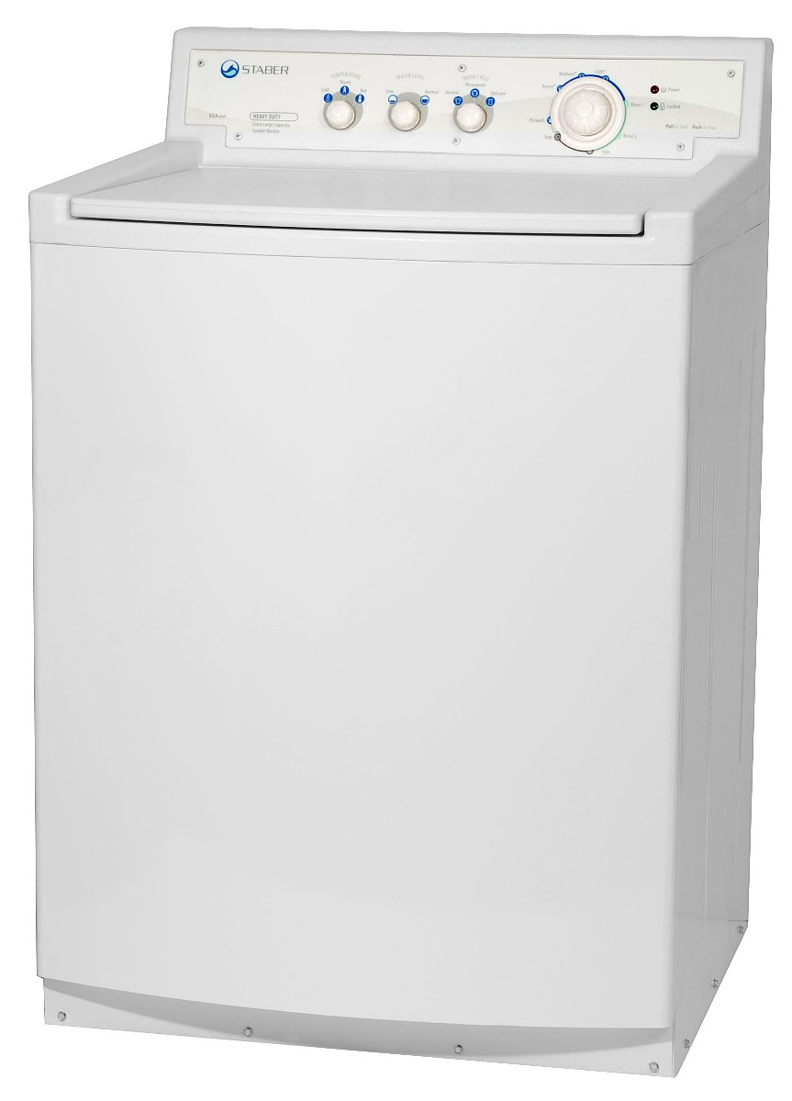
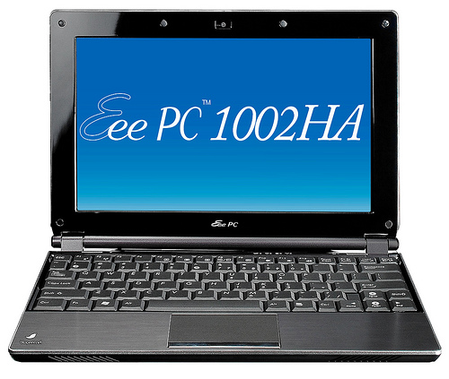
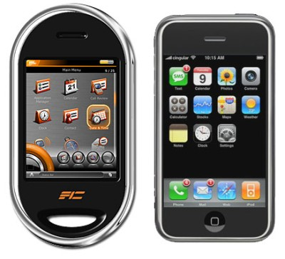
Requirements: UI
Please enter password?
Wide range of user interface
from PC touch screen to washer
difficult initial configuration
literally, must be “plug-and-play”
need laptop to connect dish washer
protocols must be self-configuring (or not require configuration)
authentication particularly challenging
credential entry
status indication
rely on existing UI-equipped devices

Slide 7
Requirements: Extensibility
device lifetimes measured in decades
manufacturer may disappear or abandon product
some may not be upgraded
but software upgrades must be designed in
small (“narrow”) interfaces preferred
backwards-compatibility types:
ignore new information elements
indicate level of support (“support version 1.2”)
fail gracefully (“sorry, not supported”)

Slide 8
Requirements: no profiles
Profiles =
define subset of functionality of spec → bad
interoperability problems
define list of RFCs that everybody needs to implement to get sticker
maybe elevate SHOULDs to MUSTs

Slide 9
Requirements: naming
You can’t manage what you can’t name
Customers, households, devices, …
deal transparently with moves
Avoid manual assignment
duplication, UI issues
Who certifies name ownership?
TLS certificate scaling
hierarchical model
e.g., one per company, with local authentication

Slide 10
Requirements: diagnostics
All protocols must support diagnostics
reachability (“ping”)
liveness (e.g., HTTP options)
middle box discovery (“traceroute”)
including transformations (see “SIP History”)
discovery of client and server properties
extensive failure indications
not just a status code

Slide 11
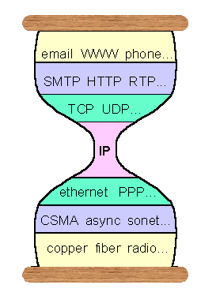
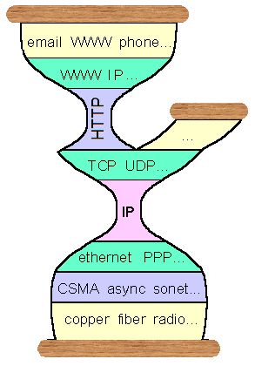
The two-port Internet
Many public access systems only allow port 80 (HTTP) and maybe 25 (SMTP)
related NAT issues
Everything tunneled over outbound HTTP
Web-based email
Flash video delivery (e.g., YouTube)
HTTP CONNECT for remote login
Dave Thaler

Slide 12
Internet services – the missing entry
Service/delivery | synchronous | asynchronous
push | instant messaging presence event notification session setup media-on-demand | messaging
pull | data retrieval file download remote procedure call | peer-to-peer file sharing

Slide 13
Filling in the protocol gap
Service/delivery | synchronous | asynchronous
push | SIP, RTSP (control) RTP (media, measurements) | SMTP
pull | HTTP (→ SOAP, REST) | (not yet standardized)

Slide 14
Left to do: event notification
notify (small) group of users when something of interest happens
presence = change of communications state
email, voicemail alerts
environmental conditions
vehicle status
emergency alerts
kludges
HTTP with pending response
inverse HTTP --> doesn’t work with NATs
Lots of research (e.g., SIENA)
IETF efforts starting
SIP-based
XMPP

Slide 15
Summary
Some profiling helpful, but limited
What design patterns are needed?
Are there commodity application protocols that fit the pattern?
lookup, remote invocation
event notification
asynchronous delivery
directories
Avoid amateur protocol design
and protocol design without domain knowledge…

Slide 16
IETF RECIPE: Reducing Energy Consumption through Protocols Exploration

Slide 17
IETF effort: RECIPE bar-bof
First meeting at IETF 74 (San Francisco)
Focus on communication within households and enterprises
Not just metering
Two efforts:
announce or retrieve grid properties
control devices
Privacy-sensitive
Security focus

Slide 18
Use cases
Energy time management
Plug-in hybrid is notified when it should charge
Dishwasher, water heater run after midnight
“when can I get 100 kW?”
Utility requests load reduction
“please reduce load by 1 MW”
Energy management
“Dear fridge, how many kWh have you used?”

Slide 19
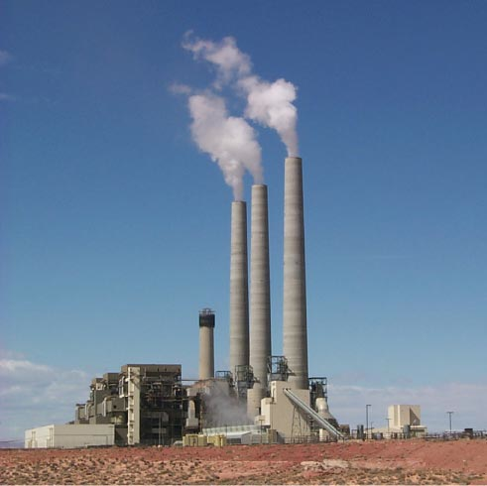
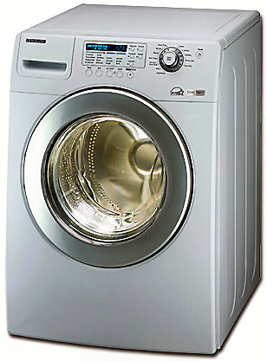
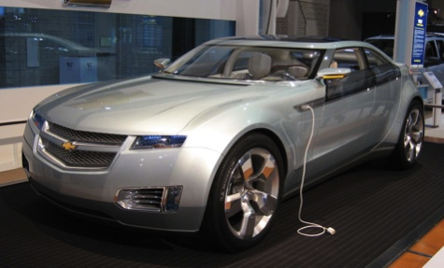
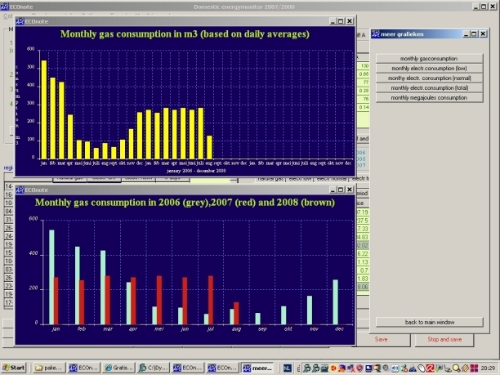
Architecture
Discover controllers and elements
Utility (gas, electric)
Local controllers
Authenticate
Prices and actions may depend on customer contract
Control
Information
“charge at 2300”
“wash at 1900”
“what’s the projected cost of a kWh at 1500?”

