Slide 1
RECIPE: Reducing Energy Consumption through Protocols Exploration
Henning Schulzrinne
Columbia University

Slide 2
Use cases
Energy time management
Plug-in hybrid is notified when it should charge
Dishwasher, water heater run after midnight
“when can I get 100 kW?”
Utility requests load reduction
“please reduce load by 1 MW”
Energy management
“Dear fridge, how many kWh have you used?”

Slide 3
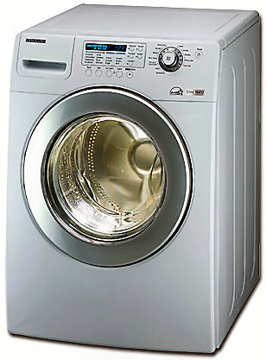
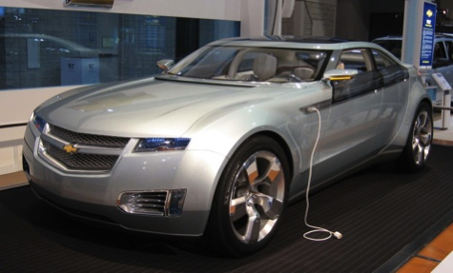
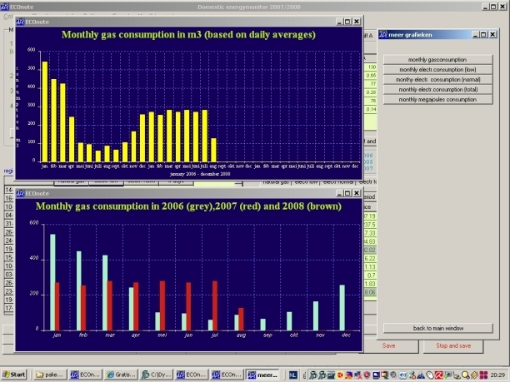
Architecture
Discover controllers and elements
Utility (gas, electric)
Local controllers
Authenticate
Prices and actions may depend on customer contract
Control
Information
“charge at 2300”
“wash at 1900”
“what’s the projected cost of a kWh at 1500?”

