Slide 1
Networking challenges
Henning Schulzrinne
Dept. of Computer Science
Columbia University
New York, NY

Slide 2
Networks beyond the Internet, cont’d
Network model | route stability | motion of data routers
Internet | minutes | unlikely
mobile ad-hoc | 3 τ | disruptive
store-carry-forward | < 3 τ | helpful

Slide 3
More than just Internet Classic
Network | wireless | mobility | path stability | data units
Internet “classic” | last hop | end systems | > hours | IP datagrams
mesh networks | all links | end systems | > hours
mobile ad-hoc | all links | all nodes, random | minutes
opportunistic | typical | single node | ≈ minute
delay-tolerant | all links | some predictable | some predictable | bundles
store-carry-forward | all nodes | all nodes | no path | application data units

Slide 4


Myth #1: Addresses are global & constant
also: identifier-locator split
10.0.1.1
1.2.3.4
192.168.0.1
128.59.16.14
10.0.1.2
DHCP
tunnel
?
128.59.16.28
STUN

Slide 5

Myth #2: Connectivity commutes, associates
Referals, call-backs, redirects
Assumptions:
  A connects to B → B can connect to A
  A connects to B, B to C → C can connect to A
May be time-dependent
200 ms

Slide 6
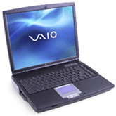
Myth #2a: Bidirectional connectivity

Slide 7
Myth #3: End-to-end delay of 1st packet typical
1st packet may have additional latency
  ARP, flow-based routers
MIPv6, PIM-SM, MSDP: fixed path during initial data burst
→ Choice of server may be suboptimal
  higher delay, lower throughput, inefficient network usage

Slide 8
Challenges

Slide 9
User challenges vs. research challenges
Are we addressing real user needs?
  Engineering vs. sports
My guesses
ease of use
no manual
reliability
no re-entry
no duplication
integration
phishing
data loss
cost
limited risk

Slide 10
Cause of death for the next big thing
 | QoS | multi- cast | mobile IP | active networks | IPsec | IPv6
not manageable across competing domains |  |  |  | 
not configurable by normal users (or apps writers) |  |  |  |  | 
no business model for ISPs |  |  |  |  |  | 
no initial gain |  |  |  |  |  | 
80% solution in existing system |  |  |  |  |  |  (NAT)
increase system vulnerability |  |  |  | 

Slide 11
Which Internet are you connected to?
port 80 + 25
IPv4
NAT
multicast
QoS
IPv4
DHCP
IPv6
IPv4
PIA

Slide 12
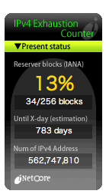
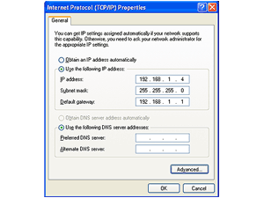
Network challenges
multi-homing
routing table
explosion
+2 years
+5 years
+8 years
99.9 → 99.999%
zero configuration
Notes:
http://www.cs.ucl.ac.uk/staff/M.Handley/papers/only-just-works.pdf

Slide 13
Challenges
Pervasive multihoming

Slide 14
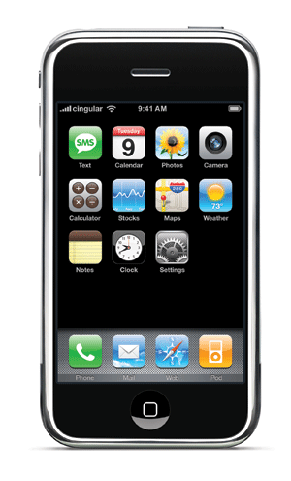

Network of the (near) future
MSO
Telco
Homes passed by multiple networks →
increase reliability by connecting to all
(“reliable system out of unreliable components”)
3G, 4G, WiMax

Slide 15
Multihoming (& mobility)
Current IPv4 address ➔
  identifier = unique host or interface
  locator = network that serves host (provider)
One system, multiple addresses:
  multihoming: at the same time
  mobility: sequentially
Multihoming:
  connections need to be aware of network path
  socket interface makes it hard to program
Solutions:
  HIP: cryptographic host identifier
  SHIM6
  LISP: two network addresses
  DNS: SRV, NAPTR

Slide 16
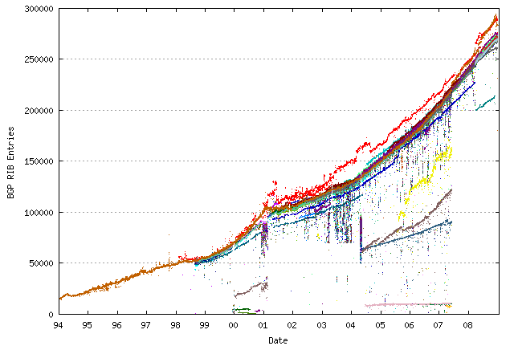
Example: BGP growth
http://bgp.potaroo.net/

Slide 17
Challenges
Security

Slide 18
Network security issues

Slide 19
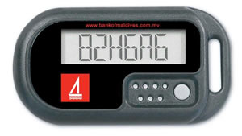

What about security?
passwords →certs + crypto token
9: Political
8: Financial
Application
Presentation
Session
Transport
Network
Link
Physical
secure DNS
usable
security
configuration
secure BGP
Technologies (mostly) available, but use & deployment hard

Slide 20
What about security?
“The future Internet must be secure”
Most security-related problems are not network problems
  spam: identity and access, not SMTP
  web: (mostly) not TLS, but distinguishing real bank from fake one
  web: cross-domain scripting, code injection
  browser vulnerabilities & keyboard sniffers
Restrict generality
Black list → white list
  virus checker → app store
Automated tools
  better languages, taint tracking, automated input checking, stack protection, memory randomization, …
Probably need more trust mediation

Slide 21
Ad-hoc networks
Definition: (all/most) nodes relay data
  “every node a router”
  unlike P2P: layer 2/3
  like P2P: grow organically, no central administration
Classical problems:
  routing problems with unstable links
    pro-active and reactive
    geographic routing
  energy usage
    for non-vehicular networks
  location determination

Slide 22
Ad-hoc, sensor and mesh networks
mesh
(nodes as routers)
vehicular
(single-hop?)
mobile ad-hoc
(links vanish, energy)
sensor
(processing, energy)

Slide 23
Ad-hoc networks
Thousands of papers
  routing, security, transport, PHY, …
Unclear applicability
  niche applications in industrial and home control
  ZigBee
  cellular backhaul?
  others mostly single-hop
  bandwidth constraints of mesh networks

Slide 24
Mobility
IETF work
  proxy mobile IPv6
  now: NETEXT
  NETLMN (local mobility)
Other:
  lots of stages → optimizing hand-off (see Dutta et al.)
  application-layer hand-off
    most applications don’t need address stability
  use of multiple interfaces?
  interaction with cognitive radio?

Slide 25
7DS and opportunistic networks: exploring networks beyond the Internet
with Suman Srinivasan, Arezu Moghadam

Slide 26
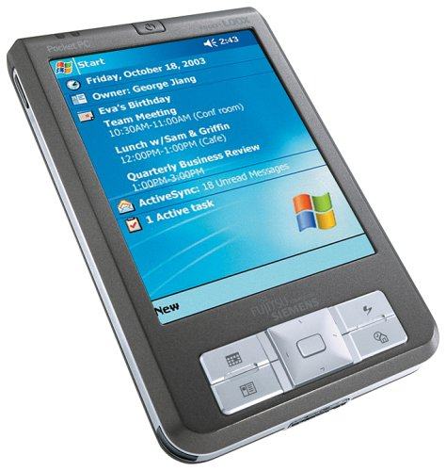
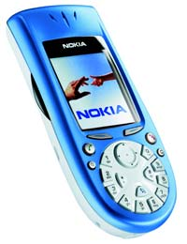
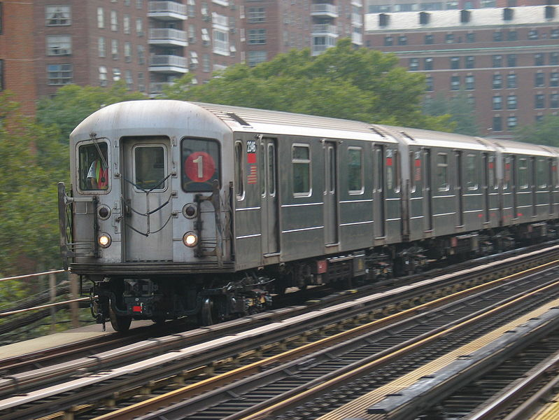
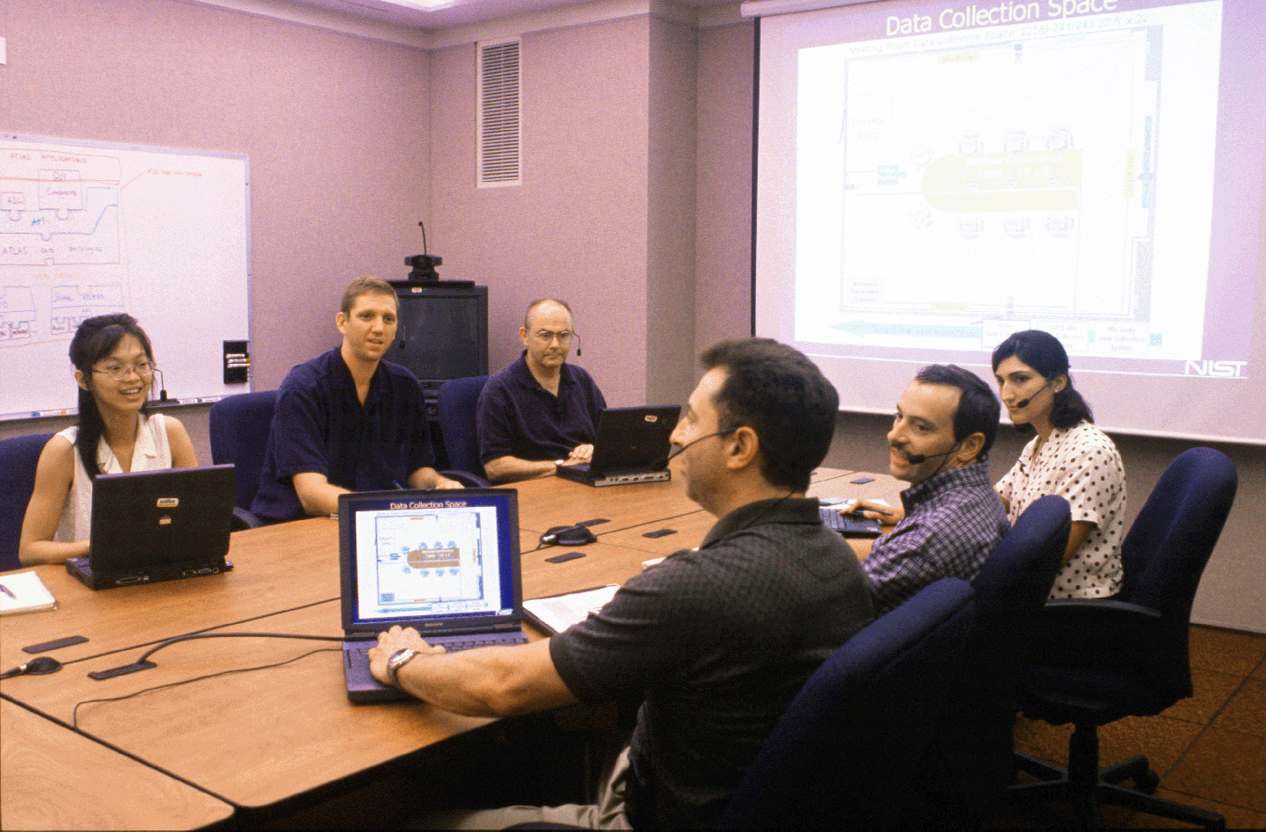
Contacts are
opportunistic
intermittent
Internet
?
?
D
802.11 ad-hoc mode
BlueTooth
Notes:
Therefore these networks have unique characteristics and introduce new challenges from the networking basics to the applications
THERE IS NO END-TO-END PATH.

Slide 27
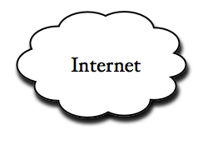
Web Delivery Model
7DS core functionality: Emulation of web content access and e-mail delivery

Slide 28
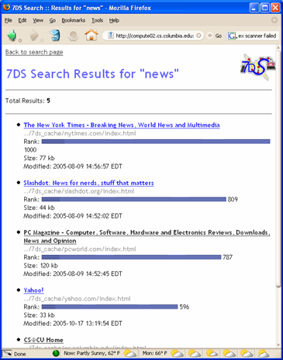
Search Engine
Provides ability to query self for results
Searches the cache index using Swish-e library
Presents results in any of three formats: HTML, XML and plain text
Similar in concept to Google Desktop

Slide 29
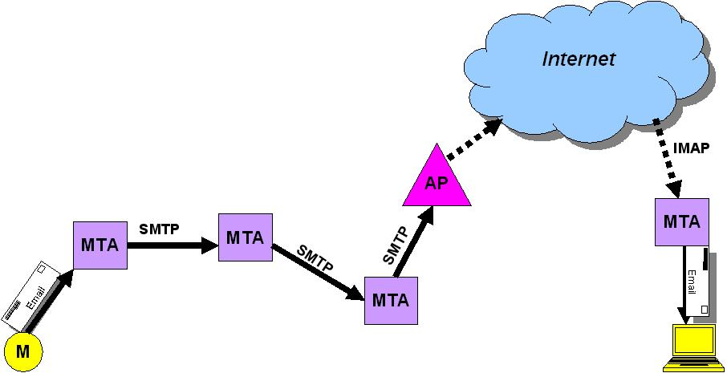
Email exchange

Slide 30


BonAHA framework
key11 = value11
key12 = value12
key13 = value13
key14 = value14
[1] node1.register()
Node 1
[2] node1.get(key13)
key21 = value21
key22 = value22
key23 = value23
key24 = value24
[3] data =
node1.fileGet(
value13);
BonAHA
[CCNC 2009]
Node 2

Slide 31
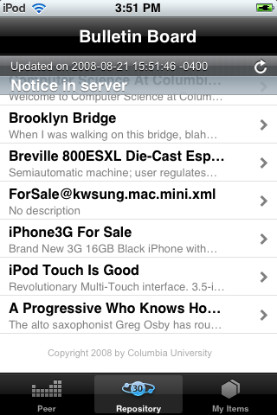
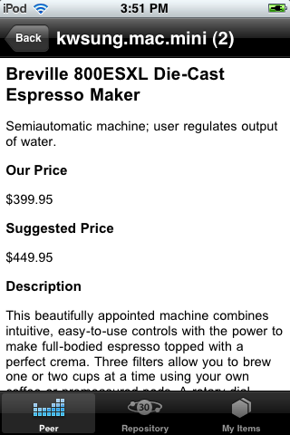
Bulletin Board System
Written in Objective-C, for iPod Touch

