Slide 1
VoIP in Wireless Networks
Henning Schulzrinne
Andrea G. Forte, Sangho Shin
Department of Computer Science
Columbia University

Slide 2
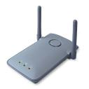







VoIP and IEEE 802.11
Architecture
Internet
Router
Router
PBX
160.38.x.x
128.59.x.x
AP
AP
Wireless client

Slide 3
VoIP and IEEE 802.11
Problems
Support for real-time multimedia
  Handoff
    L2 handoff
      Scanning delay
    Authentication
      802.11i, WPA, WEP
    L3 handoff
      Subnet change detection
      IP address acquisition time
    SIP session update
      SIP re-INVITE
  Low capacity
    Large overhead
    Limited bandwidth
    Unfair resource distribution between uplink and downlink
  Call Admission control
    Difficult to predict the impact of new calls

Slide 4
VoIP and IEEE 802.11
Solutions
Support for real-time multimedia
  Handoff
    Fast L2 handoff
    Fast L3 handoff
    Passive DAD (pDAD)
    Cooperative Roaming (CR)
  Low capacity
    Dynamic PCF (DPCF)
    Adaptive Priority Control (APC)
  Call admission control
    Queue size Prediction using Computation of Additional Transmissions (QP-CAT)
    Distributed Delay Estimation (DDE) and Call Admission Control (CAC) using Interval Between Idle Times (IBIT)

Slide 5
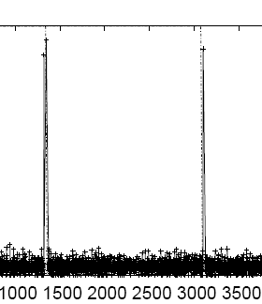
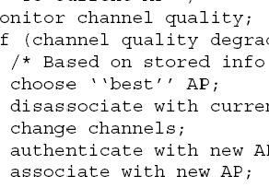
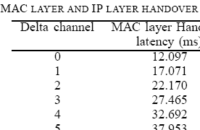
Reducing MAC Layer Handoff in IEEE 802.11 Networks

Slide 6
Fast Layer 2 Handoff
Layer 2 Handoff delay
APs available on all channels
Mobile Node
Probe Request (broadcast)
Probe Response(s)
Discovery Phase
Probe Delay
New AP
Authentication Request
Open Authentication Delay
Authentication Response
Association Request
Authentication Phase
Open Association Delay
Association Response

Slide 7
Fast Layer 2 Handoff
Overview
Problems
  Handoff latency is too big for VoIP
    Seamless VoIP requires less than 90ms latency
    Handoff delay is from 200ms to 400ms
  The biggest component of handoff latency is probing (over 90%)
Solutions
  Selective scanning
  Caching

Slide 8
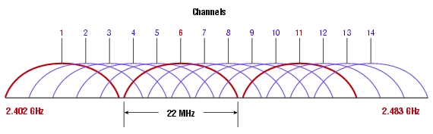
Fast Layer 2 Handoff
Selective Scanning
  In most of the environments (802.11b & 802.11g), only channel 1, 6, 11 are used for APs
  Two APs that have the same channel are not adjacent (Co-Channel interference)
  Scan 1, 6, 11 first and give lower priority to other
  channels that are currently used

Slide 9
Fast Layer 2 Handoff
Caching
Background
  Spatial locality (Office, school, campus…)
Algorithm
  After scanning, store the candidate AP info into cache (key=current AP).
  Use the AP info in cache for association without scanning when handoff happens.
 | Key | AP1 | AP2
1 | Current AP | Next best AP | Second best AP
 | …. | …. | ….
N

Slide 10
Fast Layer 2 Handoff
Measurement Results – Handoff time

Slide 11
Fast Layer 2 Handoff
Conclusions
Fast MAC layer handoff using selective scanning and caching
Selective scanning : 100-130 ms
Caching : 3-5 ms
Low power consumption (PDAs)
Don’t need to modify AP, infrastructure, or standard. Just need to modify the wireless card driver!

Slide 12
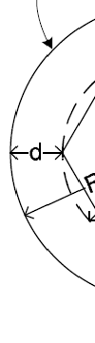
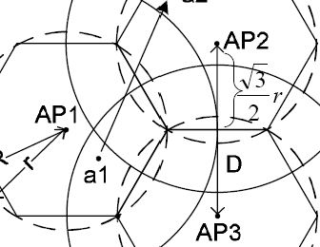
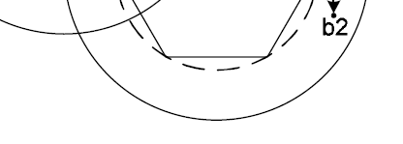
Layer 3 Handoff

Slide 13
L3 Handoff
Motivation
Problem
  When performing a L3 handoff, acquiring a new IP address using DHCP takes on the order of one second
The L3 handoff delay too big for real-time
multimedia sessions
Solution
  Fast L3 handoff
  Passive Duplicate Address Detection (pDAD)

Slide 14
Fast L3 Handoff
Overview
MN
DHCP Server
L2 Handoff
Complete
DHCP DISCOVER
DAD
DHCP OFFER
DHCP REQUEST
DHCP ACK
We optimize the layer 3 handoff time as follows:
  Subnet discover
  IP address acquisition

Slide 15
Fast Layer 3 Handoff
Subnet Discovery (1/2)
Current solutions
  Router advertisements
    Usually with a frequency on the order of several minutes
  DNA working group (IETF)
    Detecting network attachments in IPv6 networks only
No solution in IPv4 networks for detecting a subnet change in a timely manner

Slide 16
Fast Layer 3 Handoff
Subnet Discovery (2/2)
Our approach
  After performing a L2 handoff, send a bogus DHCP_REQUEST (using loopback address)
  DHCP server responds with a DHCP_NAK which is relayed by the relay agent
  From the NAK we can extract subnet information such as default router IP address (IP address of the relay agent)
  The client saves the default router IP address in cache
  If old AP and new AP have different default router, the subnet has changed

Slide 17
Fast Layer 3 Handoff
Fast Address Acquisition
IP address acquisition
This is the most time consuming part of the L3 handoff process → DAD takes most of the time
We optimize the IP address acquisition time as follows:
  Checking DHCP client lease file for a valid IP
  Temporary IP (“Lease miss”) → The client “picks” a candidate IP using particular heuristics
  SIP re-INVITE → The CN will update its session with the TEMP_IP
  Normal DHCP procedure to acquire the final IP
  SIP re-INVITE → The CN will update its session with the final IP
While acquiring a new IP address via DHCP, we do not have any disruption regardless of how long the DHCP procedure will be.
We can use the TEMP_IP as a valid IP for that subnet until the DHCP procedure ends.

Slide 18
Fast Layer 3 Handoff
TEMP_IP Selection
Roaming to a new subnet
  Select random IP address starting from the router’s IP address (first in the pool). MN sends 10 ARP requests in parallel starting from the random IP selected before.
Roaming to a known subnet (expired lease)
  MN starts to send ARP requests to 10 IP addresses in parallel, starting from the IP it last used in that subnet.
Critical factor: time to wait for an ARP response.
  Too small → higher probability for a duplicate IP
  Too big → increases total handoff time
TEMP_IP: for ongoing sessions only
Only MN and CN are aware of the TEMP_IP

Slide 19
Fast Layer 3 Handoff
Measurement Results (1/2)
MN
DHCPd
Router
CN
L2 handoff
complete
DHCP Req.
Detecting subnet change
NAK
22 ms
ARP Req.
Waiting time
138 ms
IP acquisition
ARP Req.
ARP Resp.
4 ms
4 ms
Processing overhead
SIP INVITE
SIP OK
29 ms
SIP signaling
RTP packets (TEMP_IP)
SIP ACK

Slide 20
Fast Layer 3 Handoff
Measurement Results (2/2)
Scenario 1
  The MN enters in a new subnet for the first time ever
Scenario 2
  The MN enters in a new subnet it has been before and it has an expired lease for that subnet
Scenario 3
  The MN enters in a new subnet it has been before and still has a valid lease for that subnet

Slide 21
Fast Layer 3 Handoff
Conclusions
Modifications in client side only (requirement)
  Forced us to introduce some limitations in our approach Works today, in any network
Much faster than DHCP although not always fast enough for real-time media (scenarios 1 and 2)
Scenario 3 obvious but … Windows XP
ARP timeout → critical factor → SIP presence
SIP presence approach (Network support)
  Other stations in the new subnet can send ARP requests on behalf of the MN and see if an IP address is used or not. The MN can wait for an ARP response as long as needed since it is still in the old subnet.

Slide 22


Passive DAD
Overview
DHCP server
Address Usage Collector (AUC)
TCP Connection
IP
MAC
Expire
Client ID
MAC
IP1
MAC1
570
DUID1
MAC1
IP2
MAC2
580
DUID2
MAC2
Flag
IP
Client ID
IP3
MAC3
590
DUID3
MAC3
Broadcast-ARP-DHCP
Router/Relay Agent
SUBNET
AUC builds DUID:MAC pair table (DHCP traffic only)
AUC builds IP:MAC pair table (broadcast and ARP traffic)
The AUC sends a packet to the DHCP server when:
  a new pair IP:MAC is added to the table
  a potential duplicate address has been detected
  a potential unauthorized IP has been detected
DHCP server checks if the pair is correct or not and it records the IP address as in use. (DHCP has the final decision!)

Slide 23
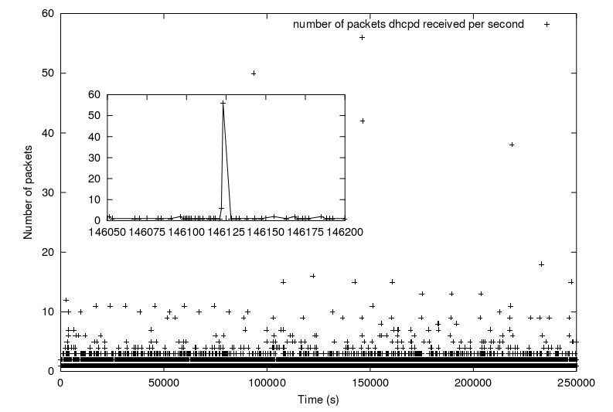
Passive DAD
Traffic load – AUC and DHCP

Slide 24
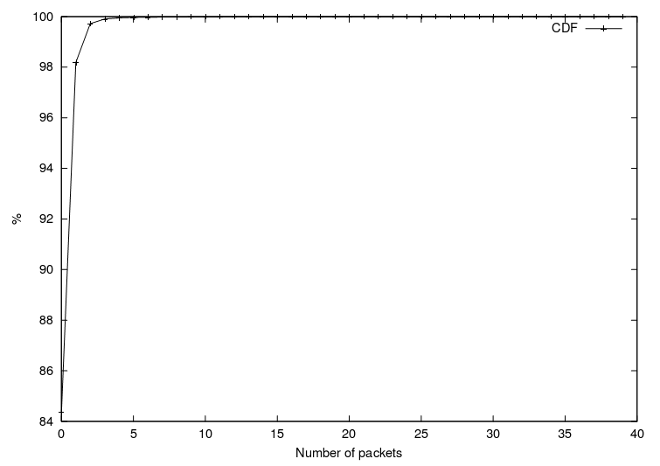
Passive DAD
Packets/sec received by DHCP

Slide 25
Passive DAD
Conclusions
pDAD is not performed during IP address acquisition
  Low delay for mobile devices
Much more reliable than current DAD
  Current DAD is based on ICMP echo request/response
    not adequate for real-time traffic (seconds - too slow!)
    most firewalls today block incoming echo requests by default
  A duplicate address can be discovered in real-time and not only if a station requests that particular IP address
  A duplicate address can be resolved (i.e. FORCE_RENEW)
Intrusion detection …
  Unauthorized IPs are easily detected

Slide 26



Cooperation Between Stations in Wireless Networks
Internet

Slide 27
Cooperative Roaming
Goals and Solution
Fast handoff for real-time multimedia in any network
  Different administrative domains
  Various authentication mechanisms
  No changes to protocol and infrastructure
  Fast handoff at all the layers relevant to mobility
    Link layer
    Network layer
    Application layer
New protocol → Cooperative Roaming
  Complete solution to mobility for real-time traffic in wireless networks
  Working implementation available

Slide 28
Cooperative Roaming
Why Cooperation ?
Same tasks
  Layer 2 handoff
  Layer 3 handoff
  Authentication
  Multimedia session update
Same information
  Topology (failover)
  DNS
  Geo-Location
  Services
Same goals
  Low latency
  QoS
  Load balancing
  Admission and congestion control
  Service discovery

Slide 29
Cooperative Roaming
Overview
Stations can cooperate and share information about the network (topology, services)
Stations can cooperate and help each other in common tasks such as IP address acquisition
Stations can help each other during the authentication process without sharing sensitive information, maintaining privacy and security
Stations can also cooperate for application-layer mobility and load balancing

Slide 30
Cooperative Roaming
Layer 2 Cooperation
R-MN
Stations
NET_INFO_REQ
NET_INFO_RESP
Random waiting time
  Stations will not send the same information and will not send all at the same time
The information exchanged in the NET_INFO multicast frames is:
APs {BSSID, Channel}
SUBNET IDs

Slide 31
Cooperative Roaming
Layer 3 Cooperation
Subnet detection
  Information exchanged in NET_INFO frames (Subnet ID)
IP address acquisition time
  Other stations (STAs) can cooperate with us and acquire a new IP address for the new subnet on our behalf while we are still in the OLD subnet
  → Not delay sensitive!

Slide 32
Cooperative Roaming
Cooperative Authentication (1/2)
Cooperation in the authentication process itself is not possible as sensitive information such as certificates and keys are exchanged.
STAs can still cooperate in a mobile scenario to achieve a seamless L2 and L3 handoff regardless of the particular authentication mechanism used.
  In IEEE 802.11 networks the medium is “shared”.
    Each STA can hear the traffic of other STAs if on the same channel.
  Packets sent by the non-authenticated STA will be dropped by the infrastructure but will be heard by the other STAs on the same channel/AP.

Slide 33
Cooperative Roaming
Cooperative Authentication (2/2)
AP
RN data packets
+
relayed data packets
802.11i authentication packets
Relayed Data Packets
RN
R-MN
One selected STA (RN) can relay packets to and from the R-MN for the amount of time required by the R-MN to complete the authentication process.

Slide 34
Cooperative Roaming
Measurement Results (1/2)
Handoff without authentication
1400
1210.0
1200
1000
867.0
800
L2
ms
L3
600
Total
400
343.0
200
4.2
11.4
15.6
0
CR
IEEE 802.11 Handoff

Slide 35
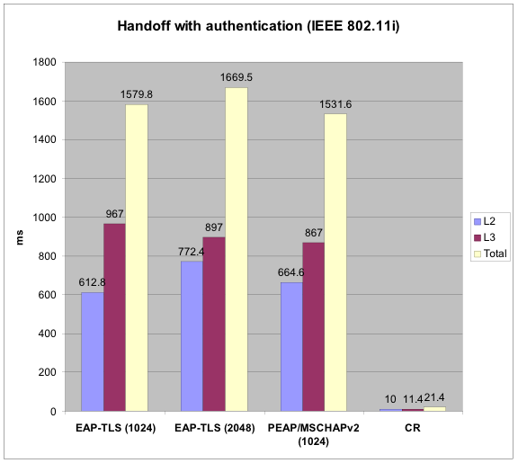
Cooperative Roaming
Measurement Results (2/2)

Slide 36
Cooperative Roaming
Application Layer Handoff - Problems
SIP handshake
  INVITE → 200 OK → ACK
  (Few hundred milliseconds)
User’s direction (next AP/subnet)
  Not known before a L2 handoff
  MN not moving after all

Slide 37
Cooperative Roaming
Application Layer Handoff - Solution
MN builds a list of {RNs, IP addresses}, one per each possible next subnet/AP
RFC 3388
  Send same media stream to multiple clients
  All clients have to support the same codec
Update multimedia session
  Before L2 handoff
    Media stream is sent to all RNs in the list and to MN (at the same time) using a re-INVITE with SDP as in RFC 3388
    RNs do not play such streams (virtually support any codec)
  After L2 handoff
    Tell CN which RN to use, if any (re-INVITE)
    After successful L2 authentication tell CN to send directly without any RN (re-INVITE)
No buffering necessary
  Handoff time: 15ms (open), 21ms (802.11i)
  Packet loss negligible

Slide 38
Cooperative Roaming
Other Applications
In a multi-domain environment Cooperative Roaming (CR) can help with choosing AP/domain according to roaming agreements, billing, etc.
CR can help for admission control and load balancing, by redirecting MNs to different APs and/or different networks. (Based on real throughput)
CR can help in discovering services (encryption, authentication, bit-rate, Bluetooth, UWB, 3G)
CR can provide adaptation to changes in the network topology (common with IEEE 802.11h equipment)
CR can help in the interaction between nodes in infrastructure and ad-hoc/mesh networks

Slide 39
Cooperative Roaming
Conclusions
Cooperation among stations allows seamless L2 and L3 handoffs for real-time applications (10-15 ms HO)
Completely independent from the authentication mechanism used
It does not require any changes in either the infrastructure or the protocol
It does require many STAs supporting the protocol and a sufficient degree of mobility
Suitable for indoor and outdoor environments
Sharing information → Power efficient

Slide 40
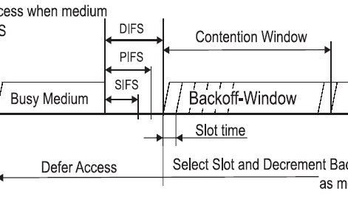
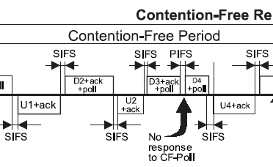
Improving Capacity of VoIP in IEEE 802.11 Networks using Dynamic PCF (DPCF)

Slide 41
Dynamic PCF (DPCF)
MAC Protocol in IEEE 802.11
Distributed Coordination Function (DCF)
  Default MAC protocol
CSMA/CA
Contention Window
DIFS
DIFS
Backoff
Next frame
Busy Medium
Defer Access
Slot
Point Coordination Function (PCF)
  Supports rudimentary QoS, not implemented
Contention Free Repetition Interval (Super Frame)
Contention Free Period (CFP)
Contention Period (CP)
PIFS
SIFS
SIFS
SIFS
SIFS
SIFS
SIFS
DCF
Beacon
D1+poll
D2+Ack
+poll
poll
CF-End
U1+ACK
U2+ACK
Null

Slide 42
Dynamic PCF (DPCF)
Problems of PCF
Waste of polls
  VoIP traffic with silence suppression
  Synchronization between polls and VoIP packets
Talking Period
Mutual Silence Period
Listening Period
poll
poll
poll
poll
poll
poll
1
1
1
1
1
1
Data
Data
Data
ACK
ACK
ACK
Wasted polls
App
CFP
CP
poll
poll
poll
poll
poll
MAC
Null
Null
failed

Slide 43
Dynamic PCF (DPCF)
Overview
Classification of traffic
  Real-time traffic (VoIP) uses CFP, also CP
  Best effort traffic uses only CP
  Give higher priority to real-time traffic
Dynamic polling list
  Store only “active” nodes
Dynamic CFP interval and More data field
  Use the biggest packetization interval as a CFP interval
  STAs set “more data field” (a control field in MAC header) of uplink VoIP packets when there are more than two packets to send → AP polls the STA again
  Solution to the various packetization intervals problem
Solution to the synchronization problem
  Allow VoIP packets to be sent in CP only when there are more than two VoIP packets in queue

Slide 44
Dynamic PCF (DPCF)
Simulation Results (1/2)
Capacity for VoIP in IEEE 802.11b
45
40
37
DPCF
35
32%
PCF
30
28
30
28
Number of VoIP Flows
24
DCF
25
23
20
15
14
13
10
7
7
DCF
5
PCF
DPCF
0
0
1
2
3
4
5
6
7
8
9
10
11
12
Transmission Rate (M b/s)

Slide 45
Dynamic PCF (DPCF)
Simulation Results (2/2)
Delay and throughput of 28 VoIP traffic and data traffic
3000
544.8
600
FTP Throughput
VoIP Throughput
487.4
2500
VoIP Delay (90%)
500
400.0
2000
400
Throughput (kb/s)
311.5
End-to-End Delay (ms)
1500
300
1000
182.5
200
500
67.4
100
24.8
17.8
10.6
21.9
26.1
29.2
0
DCF
PCF
DPCF
DCF
PCF
DPCF
DCF
PCF
DPCF
DCF
PCF
DPCF
0
0
1
2
3
Number of Data Sessions

Slide 46

Balancing Uplink and Downlink Delay of VoIP Traffic in 802.11 WLANs using Adaptive Priority Control (APC)

Slide 47
Adaptive Priority Control (APC) Motivation
Big difference between uplink and downlink delay when channel is congested
AP has more data, but the same chance to transmit them than nodes
600
Uplink (90th%tile)
500
Downlink (90th%tile)
Uplink (AVG)
Downlink (AVG)
400
Downlink
Downlink
End-to-end delay (ms)
300
200
Solution?
AP needs have higher priority than nodes
What is the optimal priority and how the priority is applied to the packet scheduling?
100
Uplink
0
26
27
28
29
30
31
32
33
34
Number of VoIP sources
20 ms packetization interval (64kb/s)

Slide 48
Adaptive Priority Control (APC) Overview
Number of packets in queue of AP
Optimal priority (P) = Q_{AP}/Q_{STA}
  Simple
  Adaptive to change of number of active STAs
  Adaptive to change of uplink/downlink traffic volume
Contention free transmission
  Transmit P packets contention free
  Precise priority control
    P → Priority
    Transmitting three frames contention free → three times higher priority than other STAs.
  No overhead
  Can be implemented with 802.11e CFB feature
Average number of packets in queue of STAs

Slide 49
Adaptive Priority Control (APC) Simulation Results
450
400
Uplink (90th%tile)
600
Downlink (90th%tile)
Uplink (90th%tile)
350
Uplink (AVG)
500
Downlink (90th%tile)
Downlink (AVG)
Uplink (AVG)
300
Downlink (AVG)
400
250
End-to-end delay (ms)
Downlink
End-to-end delay (ms)
300
200
200
150
100
100
Uplink
0
50
26
27
28
29
30
31
32
33
34
Number of VoIP sources
Capacity
0
30
31
32
33
34
35
36
37
25% Improvement
Capacity
Number of VoIP sources
20 ms packetization interval (64kb/s)

Slide 50
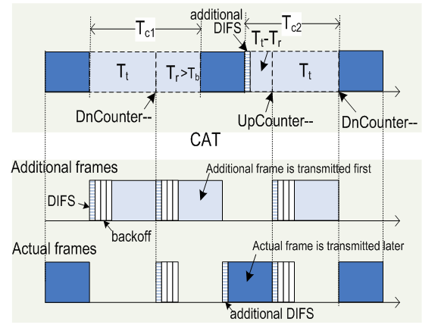
Call Admission Control using QP-CAT

Slide 51
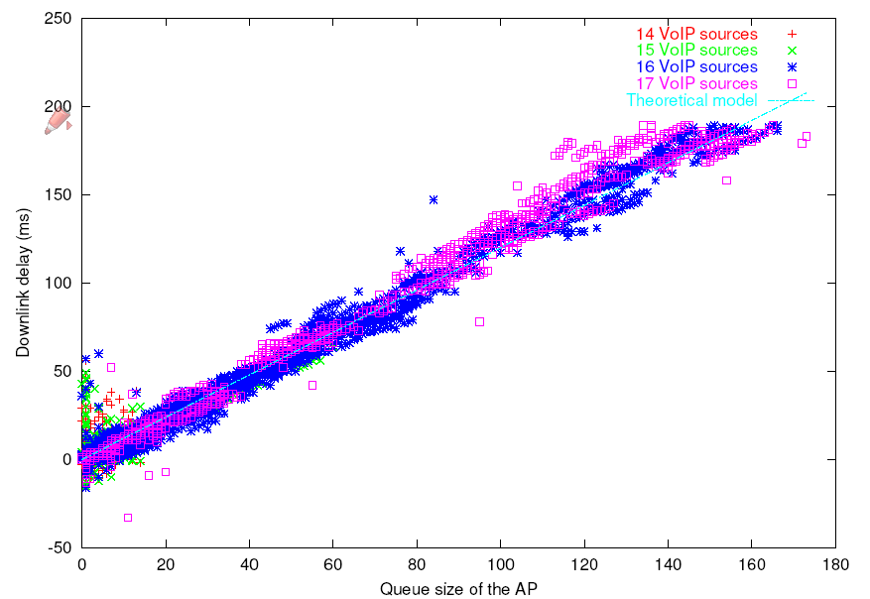
Admission Control using QP-CAT
Introduction
QP-CAT
  Metric: Queue size of the AP
    Strong correlation between the queue size of the AP and delay
  Key idea: predict the queue size increase of the AP due to new VoIP flows, by monitoring the current packet transmissions
Correlation between queue size of the AP and delay
(Experimental results with 64kb/s VoIP calls)

Slide 52
QP-CAT
Basic flow of QP-CAT
Emulate new
VoIP traffic
Compute Additional
Transmission
Decrease
the queue size
Predict the future
queue size
Additional transmission
+
Packets from
a virtual
new flow
channel
Actual packets
additional
packets
current
packets

Slide 53
QP-CAT
Computation of Additional Transmission
  Virtual Collision
  Deferrals of virtual packets

Slide 54
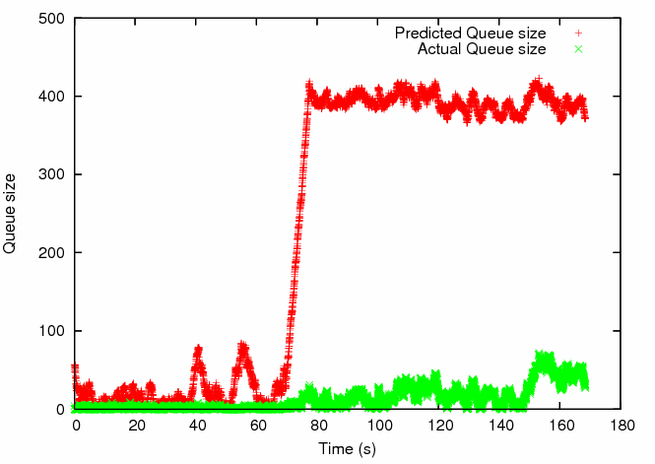
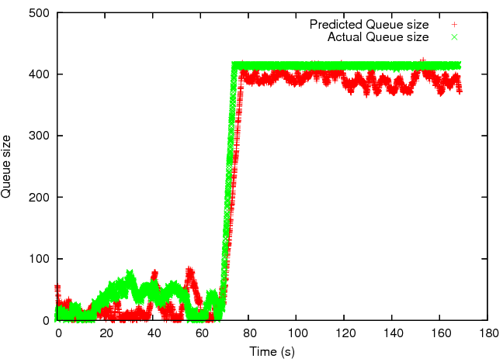
QP-CAT
Simulation results
18 calls (actual)
16 calls + 1 virtual call
(predicted by QP-CAT)
17 calls + 1 virtual call
(predicted by QP-CAT)
16 calls + 1 virtual call
(predicted by QP-CAT)
17 calls + 1 virtual call
(predicted by QP-CAT)
17th call is admitted
17 calls (actual)
18th call starts
16 calls (actual)
17 calls (actual)
VoIP traffic with 34kb/s 20ms Packetization Interval

Slide 55
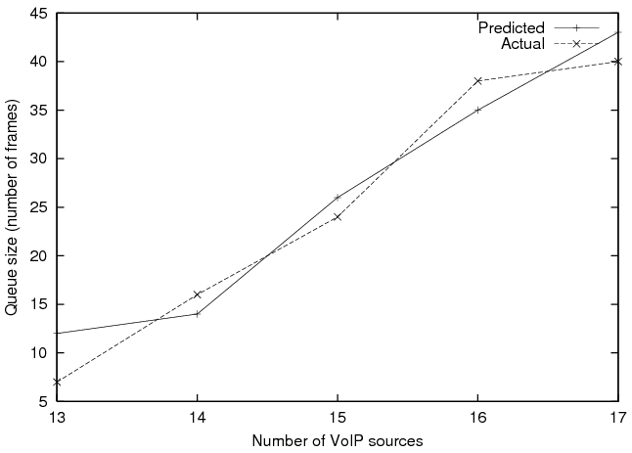
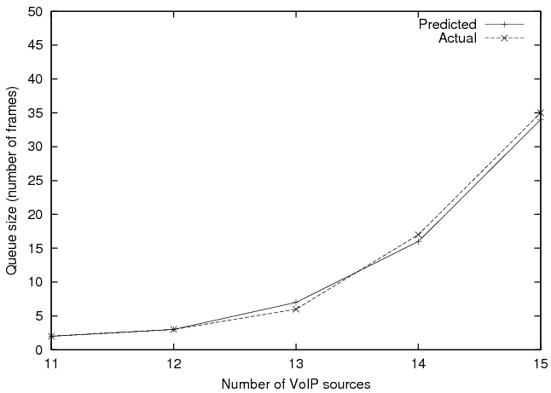
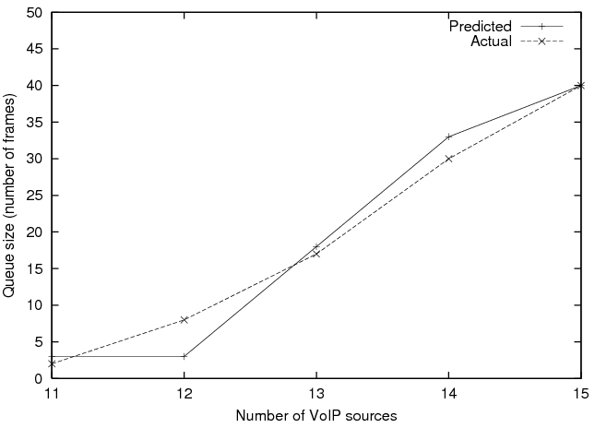
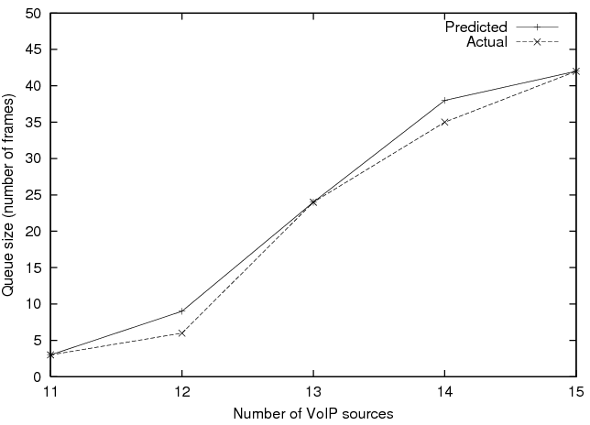
QP-CAT
Experimental results
11Mb/s
1 node - 2Mb/s
2 nodes - 2Mb/s
3 nodes - 2Mb/s
VoIP traffic with 64kb/s 20ms Packetization Interval

Slide 56
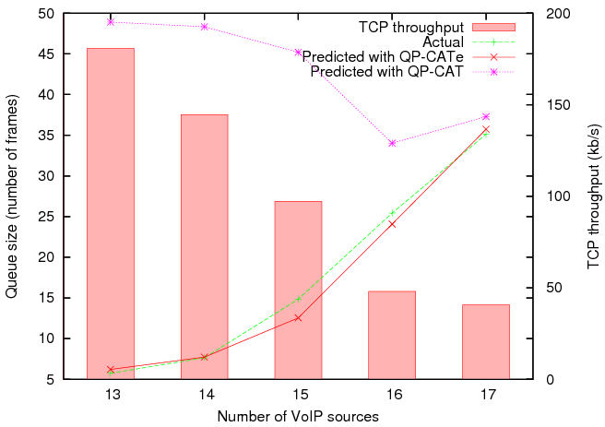
QP-CAT
Modification for IEEE 802.11e
QP-CATe
  QP-CAT with 802.11e
  Emulate the transmission during TXOP
TXOP
D
D
D
TCP
T_{c}
TXOP
D
D
D
D
D
D
TCP
T_{c}

Slide 57
QP-CAT
Conclusions
What we have addressed
  Fast handoff
    Handoffs transparent to real-time traffic
  Fairness between AP and STAs
    Fully balanced uplink and downlink delay
  Capacity improvement for VoIP traffic
    A 32% improvement of the overall capacity
  802.11 networks in congested environments
    Inefficient algorithms in wireless card drivers
  Call Admission Control
    Accurate prediction of impacts of new VoIP calls
Other problems
  Handoff between heterogeneous networks

Slide 58
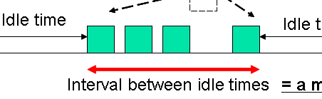
Distributed Delay Estimation (DDE) and Call Admission Control (CAC) using Interval between Idle Times*
*Joint work with Kenta Yasukawa, Tokyo Institute of Technology, Japan

Slide 59
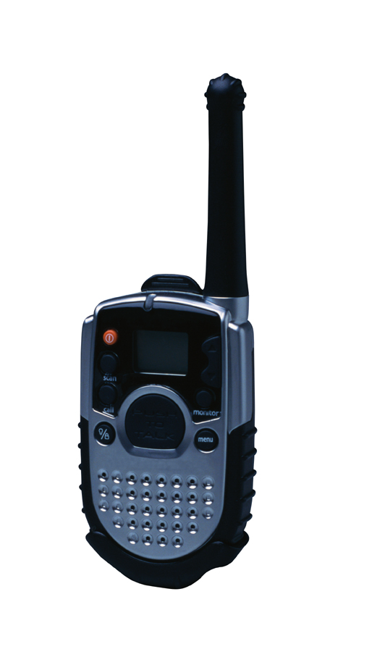
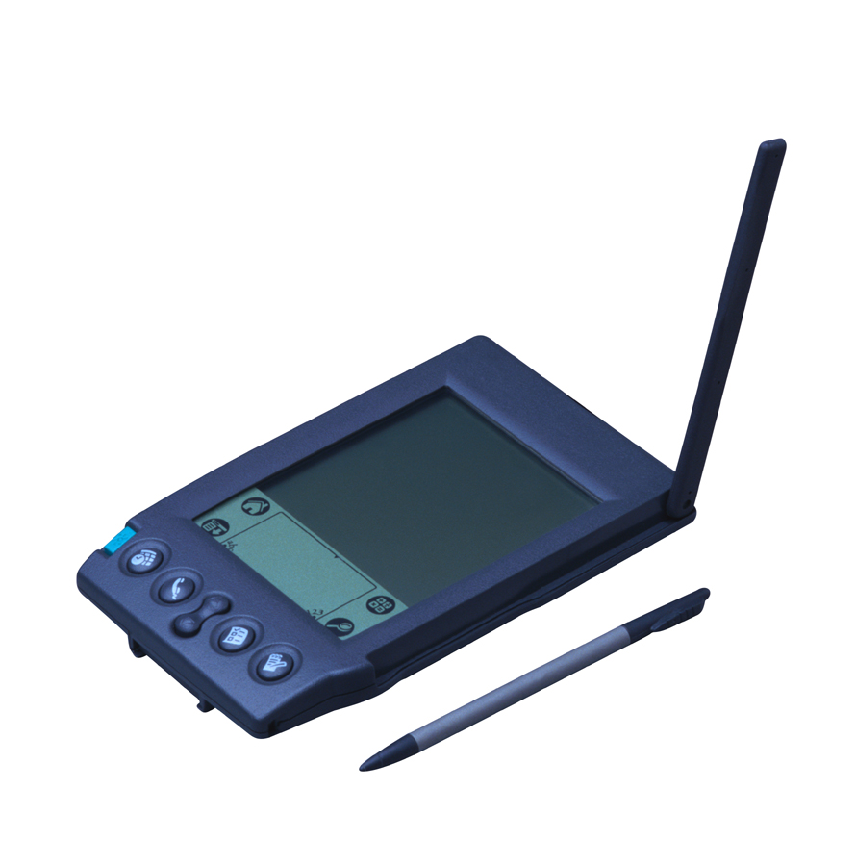



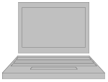
DDE and CAC using IBIT
Network capacity and CAC decisions
APs tend to be a bottleneck
IEEE 802.11 DCF networks
Queuing delay at AP significantly increases under congestion; It determines the capacity
However, AP doesn’t tell:
How congested it is
Queuing delay
VoIP nodes
Basic Service Set (BSS)
Need a method to enable clients estimate the delays in 802.11 networks

Slide 60
DDE and CAC using IBIT
Queuing Delay Estimation
Nodes can sense others’ transmissions in 802.11 networks
Can we get any useful information by listening the medium?
Idle time
Idle time
Down link
Interval between idle times
= a measure for delay!
Up link
This duration should be the maximum queuing delay for an extra packet
If so, delay estimation would be possible:
  without sending any additional traffic
  by any node at anywhere in BSS
  (Can hear ACKs from AP even for hidden nodes)
Clients can determine how long packets are delayed

Slide 61
DDE and CAC using IBIT
How to know when the AP is idle
Every channel idle period doesn’t necessarily mean the AP is idle (Because of Backoff)
CSMA/CA
DIFS
SIFS
. . .
Data Frame
ACK
Channel
Random Backoff Slots [0, CW]
Idle Time Threshold:
Enables to ignore small idle times that don’t necessarily mean the AP is idle
DIFS = SIFS + SlotTime x 2
SIFS = 10 us
SlotTime = 20 us
CWMin = 31
Idle Time Threshold t = DIFS + SlotTime x CWMin
e.g., t = 670 us in 802.11b
How the method works:
Find idle times longer than t
Measure the intervals between found idle times
Calculate the average of the found intervals (to reduce noise)
Output the average interval of idle times as the estimated delay

Slide 62
DDE and CAC using IBIT
Simulations using NS-2
1 AP and N VoIP nodes
IEEE 802.11b
VoIP traffic can be:
  G.711 CBR / VBR*
    Payload: 160 bytes
    Packetization Interval:20ms
    (Packet rate: 50 pps)
  G.723.1 CBR / VBR*
    Payload: 20 bytes
    Packetization Interval:30ms
    (Packet rate: 33 pps)
* For VBR, ITU-T P.59 talk spurt model was used
Observing
node
VoIP nodes

Slide 63
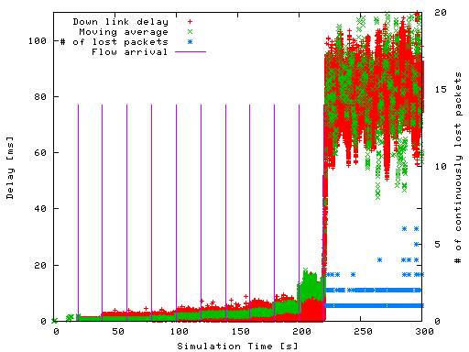
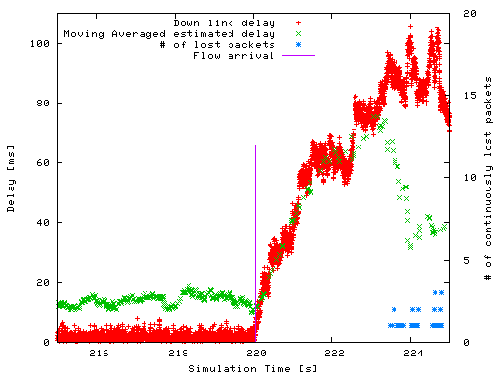
DDE and CAC using IBIT
Delay Estimation - CBR
802.11b G.711 CBR
Zoomed into 210 – 230 [s]
Zoomed →
The estimated delay follows the actual one well

Slide 64
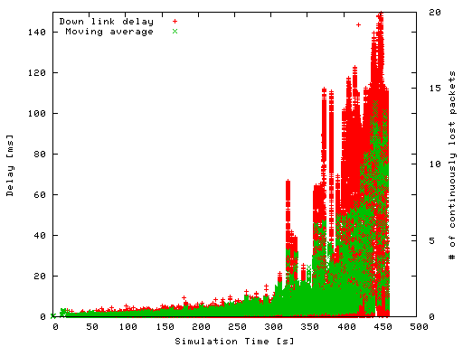
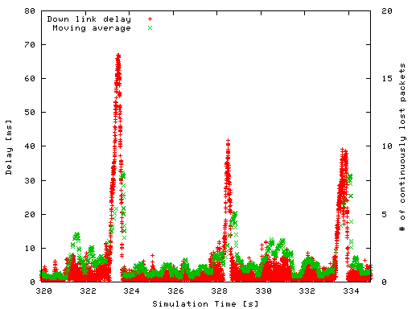
DDE and CAC using IBIT
Delay Estimation - VBR
802.11b G.711 VBR
Zoomed into 320—335 [s]
Zoomed →
VBR traffic was generated based on ITU-T P.59

Slide 65
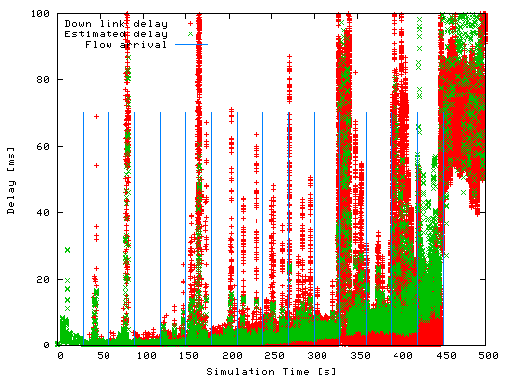
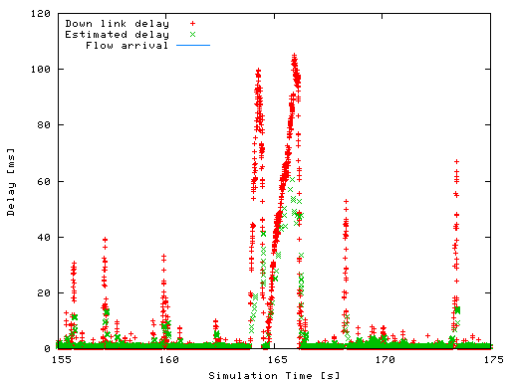
DDE and CAC using IBIT
Delay Estimation - CBR with HTTP traffic
802.11b G.711 CBR w/ Background traffic
(HTTP 5 connections per second)
Zoomed into 155-175 [s]
Zoomed →
Web traffic was generated by Packmime http://dirt.cs.unc.edu/packmime/

Slide 66
DDE and CAC using IBIT
Call Admission Control using IBIT
Idle time can be considered as a “service opportunity” for an extra packet
And, the frequency of idle times means that of service opportunities (μ)
A new flow
Packet size: s
Packet rate: λ
1/λ
TxTime(s) = Time taken to finish sending a packet which has size of s
including all overheads
Ifμ > λ, the new flow won’t cause congestion!
Idle time longer
than TxTime(s)
(= Service opportunity)
Channel
Interval between idle times = 1/μ
By checking ifλ < μ CAC would be achieved!

Slide 67
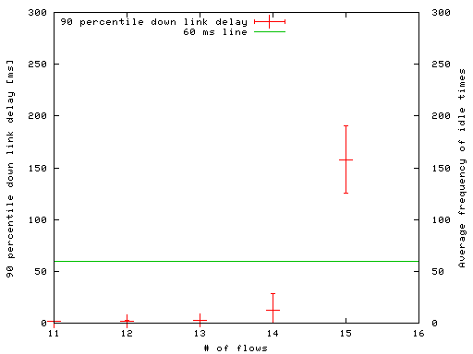
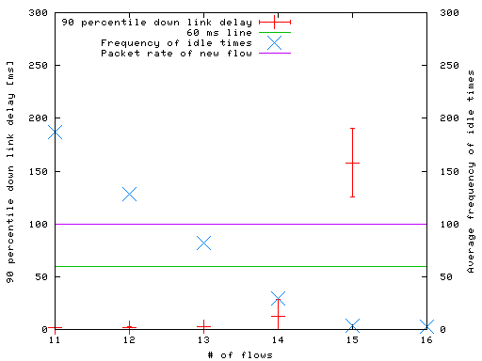
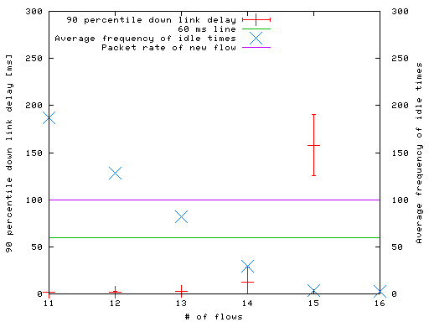
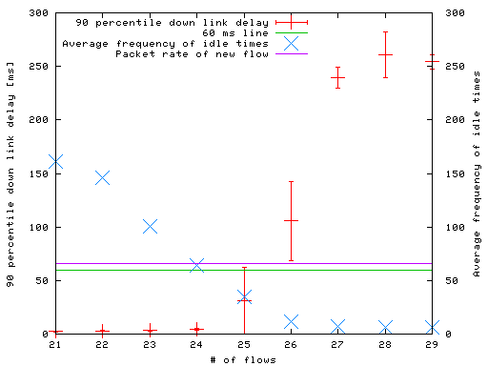
DDE and CAC using IBIT
CAC Evaluation - Same codecs (1/2)
90 percentile delays vs. # of calls
  CBR case
Unacceptable
Unacceptable
Unacceptable
Stop here!
802.11b G.711 CBR
Packet rate: 50 pps (One way)
TxTime(200B) = 780 us (802.11b, short preamble)
802.11b G.723.1 CBR
Packet rate: 33 pps (One way)
TxTime(20B) = 680 us
(802.11b, short preamble)

Slide 68
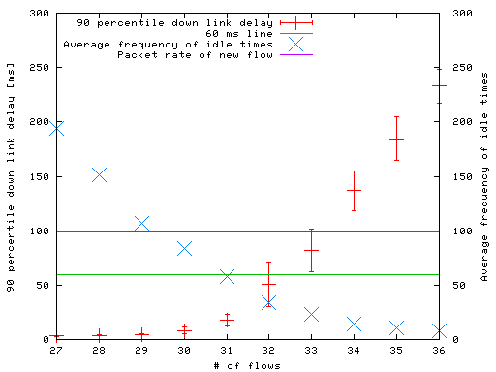
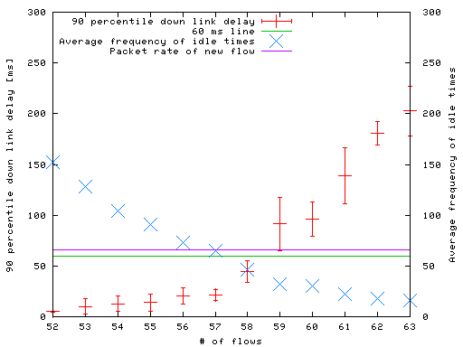
DDE and CAC using IBIT
CAC Evaluation - Same codecs (2/2)
90 percentile delays vs. # of calls
  VBR case
Unacceptable
Unacceptable
802.11b G.711 VBR
Packet rate: 50 pps (One way)
TxTime(200B) = 780 us (802.11b, short preamble)
802.11b G.723.1 VBR
Packet rate: 33 pps (One way)
TxTime(20B) = 680 us
(802.11b, short preamble)

Slide 69
DDE and CAC using IBIT
CAC Evaluation - Different codecs
  G.711 CBR + G.723.1 CBR
    (Different packet size and packetization interval)
Contour of 90 percentile delays (ms)
Unacceptable

Slide 70
DDE and CAC using IBIT
Conclusions
Checking interval between idle times will enable wireless clients to:
  estimate delay
  perform call admission control
  → QoS control without modifying AP or Infrastructure
  → Application to cooperative model
Results
  IBIT allows accurate delay estimation and CAC decisions for both CBR and VBR traffic
  Actual implementation confirmed simulation results

Slide 71
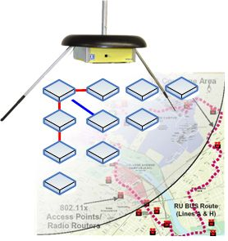
Experimental Capacity Measurement in the ORBIT Testbed

Slide 72
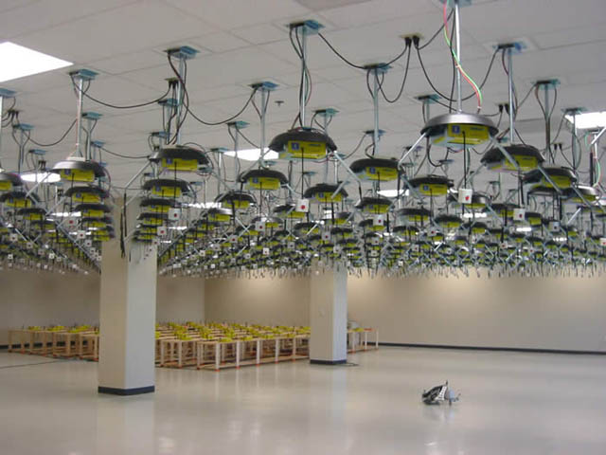
Capacity Measurement
ORBIT test-bed
Open access research test-bed for next generation wireless networks
WINLab in Rutgers University in NJ

Slide 73
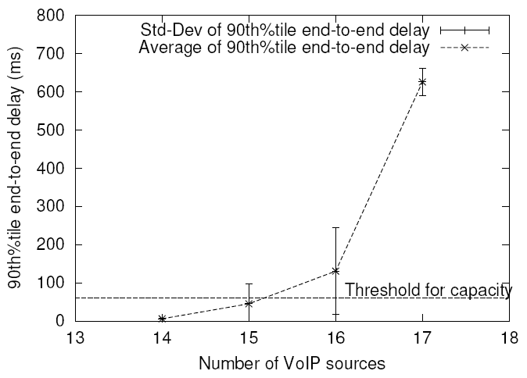
Capacity Measurement
Experimental Results - Capacity of CBR VoIP traffic
64 kb/s, 20 ms packetization interval

Slide 74
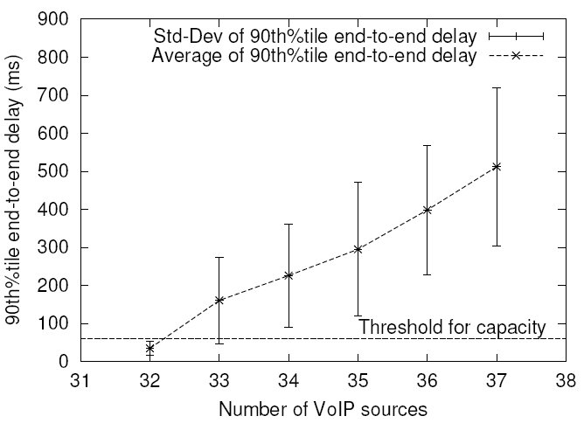
Capacity Measurement
Experimental Results - Capacity of VBR VoIP traffic
0.39 Activity ratio

Slide 75
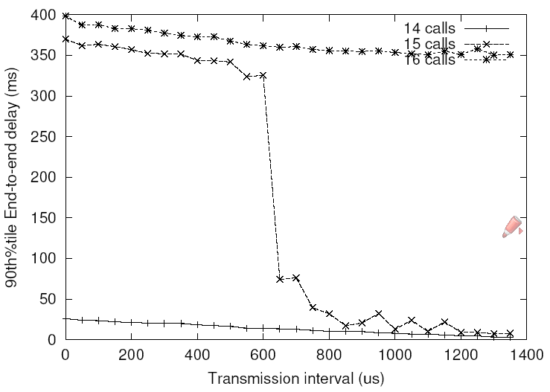
Capacity Measurement
Factors that affects the capacity
Auto Rate Fallback (ARF) algorithms
  13 calls (ARF)→ 15 calls (No ARF)
  Because reducing Tx rate does not help in alleviating congestion
Preamble size
  12 calls (long) → 15 calls (short)
  Short one is used in wireless cards
Packet generation intervals among VoIP sources
  14 calls → 15 calls
  In simulation, random intervals needs to be used

Slide 76
Capacity Measurement
Other factors
Scanning APs
  Nodes start to scan APs after experiencing many frame losses
  Probe request and response frames could congest channels
Retry limit
  Retry limit is not standardized and vendors and simulation tools use different values
  Can affect retry rate and delay
Network buffer size in the AP
  Bigger buffer → lower packet loss, but long delay

Slide 77

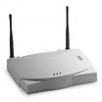

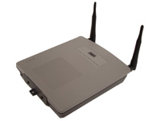


IEEE 802.11 in the Large: Observations at an IETF Meeting

Slide 78
Observations at the IETF Meeting Introduction
65th IETF meeting
  Dallas, TX (March 2006)
  Hilton Anatole hotel
  1,200 attendees
Data collection
  21st - 23rd for three days
  25GB data, 80 millions frames
Wireless network environment
  Many hotel 802.11b APs, 91 additional APs in 802.11a/b by IETF
  The largest indoor wireless network measured so far
We observed:
  Bad load balancing
  Too many useless handoffs
  Overhead of having too many APs

Slide 79
Observations at the IETF Meeting
Load balancing
Throughput per client
  No load balancing feature was used
  Client distribution is decided by the relative proximity from the APs
  Big difference in throughput among channels
Average throughput per client
in 802.11a/b

Slide 80
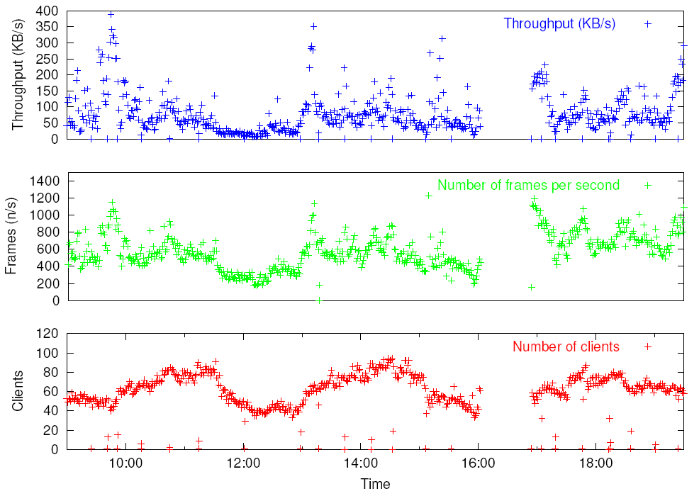
Observations at the IETF Meeting
Load balancing
Number of clients vs. Throughput
  Clear correlation between the number of clients and throughput
  The number of clients can be used for load balancing with low complexity of implementation, in large scale wireless networks
Capacity in the channel
Capacity in the channel

Slide 81
Observations at the IETF Meeting Handoff behavior
Too many handoffs are performed due to congestion
  Distribution of session time : time (x) between handoffs
    0< x < 1 min : 23%
    1< x < 5 min : 33%
  Handoff related frames took 10% of total frames.
Too many inefficient handoffs
  Handoff to the same channel : 72%
  Handoff to the same AP : 55%
The number of handoff per hour
in each IETF session

Slide 82
Observations at the IETF Meeting Overhead of having multiple APs
Overhead from replicated multicast and broadcast frames
  All broadcast and multicast frames are replicated by all APs → increase traffic
  DHCP request (broadcast) frames are replicated and sent back to each channel
  Multicast and broadcast frames: 10%
Router
Router
A channel
A channel

Slide 83
Deploying dense 802.11 networks – conventional wisdom meets measurements
Andrea G. Forte and Henning Schulzrinne

Slide 84
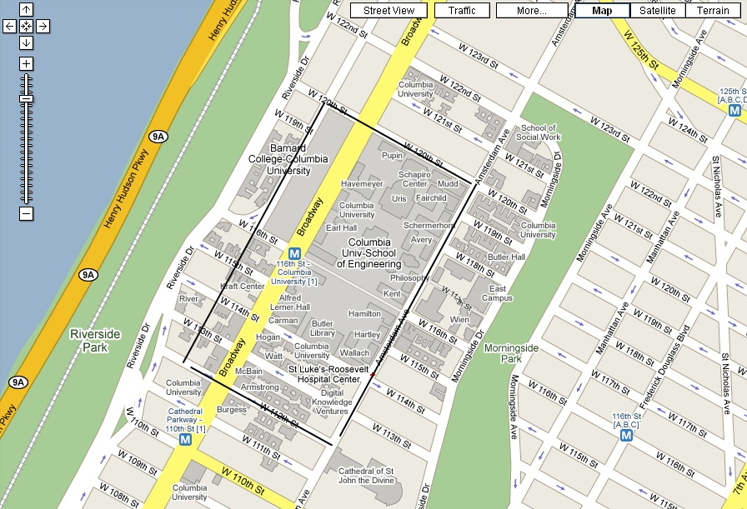
Site Survey – Columbia University
Google Map!

Slide 85
Site Survey – Columbia University
Found a total of 668 APs
  338 open APs (49%)
  350 secure APs (51%)
  Best signal: -54 dBm
  Worst signal: -98 dBm
Found 365 unique wireless networks
  “private” wireless networks (single AP): 340
  “public” networks (not necessarily open): 25
    Columbia University: 143 APs
    PubWiFi (Teachers College): 33 APs
    COWSECURE: 12 APs
    Columbia University – Law: 11 APs
    Barnard College: 10 APs

Slide 86

Experiment 1
Experimental setup
Sniffer
AP
Client
Surrounding APs
Surrounding APs

Slide 87
Using non-overlapping channels
Throughput and retry rate with no interference
→ Same for any channel
Throughput and retry rate with interference on channel 1

Slide 88
Overlapping channels
Throughput and retry rate with interference on channel 4
→ Better than channel 6
Throughput and retry rate with interference on channel 8
→ Better than channel 6

Slide 89
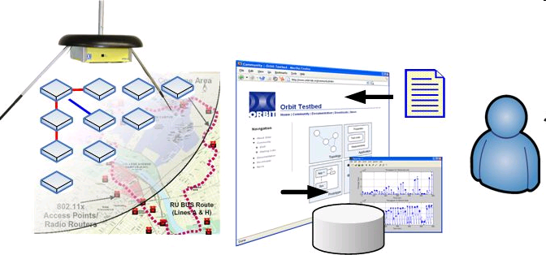
Experiment 2
Experimental setup
ORBIT wireless test-bed
  Grid of 20x20 wireless nodes
  Used only maximum bit-rate of 11 Mb/s (no ARF)
  G.711 CBR
  Number of clients always exceeding the network capacity (CBR @ 11Mb/s → 10 concurrent calls)

Slide 90
Non-overlapping channels
AP1: channel 1
AP2: channel 6
43 clients
AP1 and AP2 use channel 1
43 clients

Slide 91
Overlapping channels
AP1: channel 1
AP2: channel 4
67 clients
AP1 and AP2 use ch. 4
67 clients

Slide 92
Results
When using two APs on the same channel
  Throughput decreases drastically
  Physical-error rate and retry rate increase
Using two APs on two overlapping channels performs much better than using the same non-overlapping channel
  Do not deploy multiple APs on the same non-overlapping channels
  USE OVERLAPPING CHANNELS!

Slide 93
Channel selection algorithm
Using overlapping channels does not reduce performance
  Use at least channels 1, 4, 8 and 11
Do not deploy multiple APs on the same non-overlapping channels
Using two APs on the same channel worse than using a single AP!
  Just increasing the number of APs does not help
Impact on automated channel assignment mechanisms

Slide 94
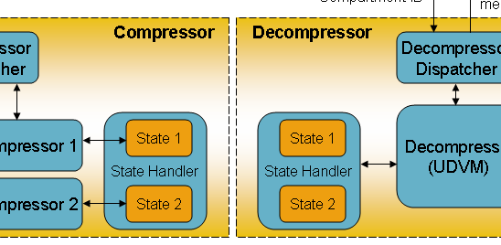
Signaling Compression for Push-to-talk over Cellular (PoC)

Slide 95
Template-based Compression
Why compression?
SIP
  Chosen as signaling protocol for IMS
  text-based protocol
    Average SIP INVITE as large as 1200 bytes
IP Multimedia Subsystem (IMS)
  Low bit-rate links
  Long call set-up delay
    Not suitable for push-to-talk over cellular (PoC)
Delay
  GSM: ~ 2 sec one-way delay (SS7)
  PoC: ~ 1 sec requirement
Notes:
95

Slide 96
Template-based Compression SigComp – Pros and Cons
Advantages
  Already standardized by IETF
  Mandatory in IMS rel 5 and above
  Implementations already available
    Open SigComp (Deflate)
Disadvantages
  Complex and heavy
  LZ-based compression not good enough for PoC and IMS
  Overhead
    UDVM bytecode, feedback item, state identifier, etc.
Notes:
96

Slide 97
Template-based Compression
Our approach
Templates
  Send only variable parameters of SIP messages
Shared Dictionary (SD)
  Association between URIs and index in SD
    Headers affected: From, To, Contact, etc.
  Association between codecs and indexes in SD
    Lines affected: m= lines, rtpmap lines, fmtp lines, etc.
Other
  Header Stripping
    Some SIP headers and SDP lines are irrelevant to the receiver (Via, Max-Forwards, Record Route, etc.)
  Compression
    Various compression techniques are used (integer encoding, bit-mask encoding, etc.)
  Packet Optimization
    The compressed packet is structured so to minimize its size and the order of the compressed values in the packet is fixed
Notes:
97

Slide 98
Template-based Compression Incoming INVITE – Contributions
New heuristic is added to the previous one | Original Size | Stripped Headers | Templates | Various (bit-masks, string2int) | SD + Public IDs | Packet Optimization
Size (Bytes) | 1182 | 1008 | 343 | 196 | 137 | 81
Savings (Bytes) | - | 174 | 665 | 147 | 59 | 56
Savings (%) | - | 14.72 | 56.26 | 12.43 | 5.0 | 4.73

Slide 99
Template-based Compression Incoming INVITE – Compression
 | Original size | SigComp only | Template only | Template + SigComp | Template + SD | Template + SD + SigComp
Full Flow (Bytes) | 1182 | 592 | 149 | 115 | 81 | 87
Optimized Flow (Bytes) | 1182 | 658 | 149 | 122 | 81 | 87
SigComp makes things worst !
Notes:
99

Slide 100
Template-based Compression
Conclusions
Why compression
  SIP rich text protocol
    Good for high bandwidth
  IMS and cellular
    low bandwidth
  Long call set-up delay
SigComp
  Advantages
    Already RFC
    Mandatory in IMS release 5 and above
    Implementations already available (Open SigComp - deflate)
  Disadvantages
    Not good enough for PoC and IMS
    Complex and heavy
Template based compression (TBC)
  Templates
  Shared dictionary
  Performances
    Below 113 bytes for downlink direction
    About 30-40 bytes for uplink direction
    Satisfies delay requirements for PoC in IMS

Slide 101
Conclusions
VoIP requires multi-faceted re-engineering of 802.11
  Hand-off
    focused on local, client-based approaches
    need systematic comparison with infrastructure approaches
      pro-active probably most promising
      needs discovery, L3 remoting of AA operations
  QoS
    About 20% utilization - but most WLANs will carry mixed traffic
    Admission control remains challenging - need NSIS or similar

Slide 102
More information & papers
  http://www.cs.columbia.edu/IRT/wireless
  http://www.cs.columbia.edu/~andreaf
  http://www.cs.columbia.edu/~ss202

