Slide 1
P2P Distributed Fault Diagnosis for SIP Services
Henning Schulzrinne, Kyung-Hwa Kim
Dept. of Computer Science, Columbia University, New York, NY
Kai Miao
Intel Corporation
an update

Slide 2
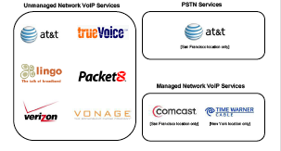
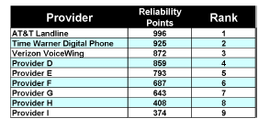
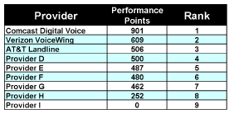
VoIP quality still lagging
Keynote study published November 2008
http://www.keynote.com/docs/kcr/Voice_W6_CIStudy.pdf

Slide 3
Circle of blame
probably packet
loss in your
Internet connection →
reboot your DSL modem
ISP
probably a gateway fault
→ choose us as provider
OS
VSP
must be a
Windows registry
problem → re-install
Windows
app
vendor
must be
your software
→ upgrade

Slide 4
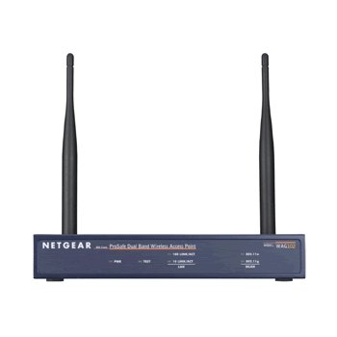
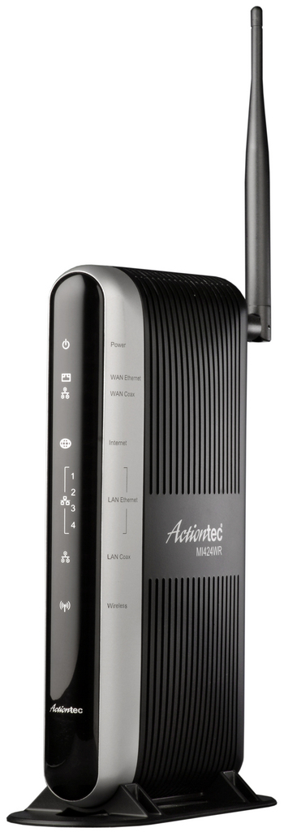






Problems in VoIP systems
NAT drops response
UAS not working
packet loss
NAT
excessive queuing delay
server unreachable
STUN server not available
destination proxy fails or unreachable
outbound proxy fails
DNS
no response from DNS server

Slide 5





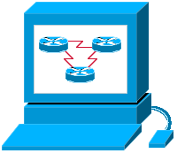

Traditional network management model
X
SNMP
“management from the center”

Slide 6
Old assumptions, now wrong
Single provider (enterprise, carrier)
  has access to most path elements
  professionally managed
Problems are hard failures & elements operate correctly
  element failures (“link dead”)
  substantial packet loss
Mostly L2 and L3 elements
  switches, routers
  rarely 802.11 APs
Problems are specific to a protocol
  “IP is not working”
Indirect detection
  MIB variable vs. actual protocol performance
End systems don’t need management
  DMI & SNMP never succeeded
  each application does its own updates

Slide 7
What’s different about VoIP?
Consumer application
  no technical knowledge
  no sys admin
High reliability expectations
  “My old $10 phone always just worked”
Low margins
  one call center call → lose margins for a year
Difficulty of remote debugging
  Tech support can’t see network conditions or NAT
QoS sensitive
  my 802.11 has 10% packet loss if the TV is on…
NAT sensitive

Slide 8

Managing the whole protocol stack
media
echo
gain problems
VAD action
protocol problem
authorization
asymmetric conn (NAT)
RTP
protocol problem
playout errors
SIP
UDP/TCP
TCP neg. failure
NAT time-out
firewall policy
IP
no route
packet loss
DNS
DHCP
STUN
interference
collisions
802.11

Slide 9
Types of failures
Hard failures
  connection attempt fails
  no media connection
  NAT time-out
Soft failures (degradation)
  packet loss (bursts)
    access network? backbone? remote access?
  delay (bursts)
    OS? access networks?
  acoustic problems (microphone gain, echo)
  a software bug (poor voice quality)
    protocol stack? Codec? Software framework?

Slide 10
DYSWIS = Do You See What I See?
Do you see what I see?
Internet
End user
End user
End user

Slide 11
DYSWIS
no response
packet loss
no packets sent
rule engine
reachable?
packet loss?
NDIS
pcap
same subnet
same AS
different AS
close to destination
…
indicate likely source of trouble:
application
own device
access link (802.11)
NAT
local ISP
Internet
remote server

Slide 12
DYSWIS overview
Detect
Diagnosis
Probe
Detect
Diagnosis
Detect
Probe
Diagnosis
Probe
Detect
DHT
for looking for remote node
XMLRPC
For Remote Function call
Diagnosis
Probe
Detect
Diagnosis
Detect
Probe
Diagnosis
Probe
Detect
Detect
Diagnosis
Diagnosis
Probe
Probe
Detect
Detect
Diagnosis
Diagnosis
Probe
Probe
Detect
Detect
Diagnosis
Diagnosis
Probe
Probe
Internet

Slide 13
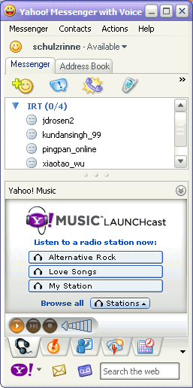


Architecture
Sensor node
“not working”
(notification)
Diagnosis node
orchestrate tests
contact others
request diagnostics
inspect protocol requests
(DNS, HTTP, RTCP, …)
ping 127.0.0.1
can buddy reach our resolver?
“DNS failure for 15m”
notify admin
(email, IM, SIP events, …)

Slide 14
Example rule
Rule Example
(load-function ExMyUpcase)
(load-function SelfDiagnosis)
(load-function DnsConnection)
(load-function ProxyServer)
(load-function SipResult)
(defrule MAIN::SIP
(declare (auto-focus TRUE))
=>
(process-sip void)
)
(deffunction process-sip (?args)
"test dns and proxy server for sip"
(bind ?result "NA")
(bind ?result (self-diagnosis void))
if (eq ?result "ok") then
(bind ?result (dns-connection other))
if (eq ?result "ok") then
(bind ?result (proxy-connection void))
(sip-result ?result)
)
(deffunction process-dns (?args)
"test dns server"
(bind ?result "NA")
(bind ?result (dns-connection void))
if (eq ?result "ok") then
(bind ?result (dns-resolution other))
(sip-result ?result)
)

Slide 15
Peer selection
DHT or database
  Register myself to DHT network
    AS number, subnet, first hop address, access point
  Search probing nodes
    Nodes on LAN and beyond
You can contact to B. His IP address is 218.59.21.16 and port number is 9090
I need some nodes who can help me.
Who is in same subnet with me?
A
B
DHT

Slide 16
Peer selection - DHT (key, value)
<key>
<type>node</type>
<asn>14<asn>
<subnet>128.59.0.0/16</subnet>
</key>
<value>
<type>node</type>
<ip>128.59.21.15</ip>
<port>9090</port>
<protocol>udp</protocol>
</value>
I need some nodes who can help me.
Who is in same subnet with me?
<key>
<type>node</type>
<asn>9880<asn>
<subnet>45.45.45.0/24</subnet>
<firewall>no</firewall>
<nat>no</nat>
</key>
<value>
<type>node</type>
<ip>128.59.21.15</ip>
<hostname>kkh.cs.columbia.edu</hostname>
<port>9090</port>
<protocol>tcp</protocol>
</value>
A
B
DHT

Slide 17
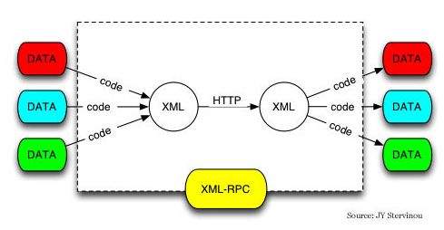
Remote probing
Distributing modules
  Detecting and probing modules should be added and updated
  Dynamic class loading
  Dynamic module distributing
    Modules can be created and updated separately.
XMLRPC
Notes:
by using XMLRPC, we can use another machine’s modules as like our own functions

Slide 18
Probing Scenarios
HTTP
  Causes: Dead web-server, page moved, low bandwidth, …
    Check DNS query
    TCP connection
    Ask other node to try same query
    Check TCP congestion (packet loss)
    …
DNS
  Causes: Dead DNS server, resolution failed, UDP is not working, …
    Check other DNS server
    Ask other node to try to connect my DNS server
    Ask other node to query same host to another DNS server
SIP/RTP
  Causes: NAT, DNS, proxy server, authentication, …
    Proxy connectivity test (SIP OPTION)
    Ask other node to try same action
    …

Slide 19
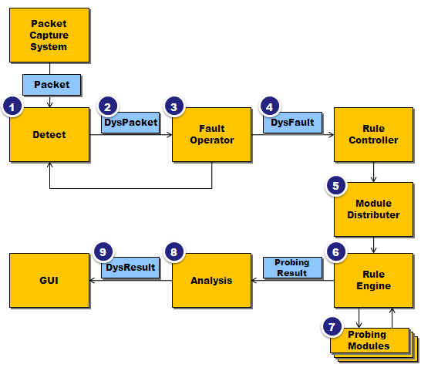
Implementation
http://wiki.cs.columbia.edu/display/res/DYSWIS
Notes:
Autoupdate

Slide 20



Implementation using Felix
Need to update polling and other functions
Update polling bundle
poll
DYSWIS Main Bundle
Felix launcher
Probing bundle 1
“dynamic service deployment framework amenable to remote management”
Probing bundle 2
Probing bundle 3

Slide 21
Summary
Problems in VoIP applications particularly hard to diagnose
  cost-sensitive consumer application
  multiple interlocking protocols
  NATs and firewalls
  QoS-sensitive
Existing management systems not useful
DYSWIS – distributed diagnostics using peers
  generic infrastructure: probes & rules
Applications should assist in debugging
  “hey, DYSWIS, I got a problem!”

