Slide 1
SIGCOMM Community feedback Meeting
2009

Slide 2
Agenda
Intro & Thanks
Status and Future of SIGCOMM
Communication among the SIGCOMM Community
SIGCOMM Technical Steering Committee Proposal
Survey on SIGCOMM 2009 author experience
Discussion on double submissions
Open Discussion

Slide 3
Thanks to outgoing EC members
Past Chair (now past-past chair): Jen Rexford
Awards Chair: John Byers
Chair:
Mark Crovella (stays on EC as past chair)
Notes:
So bd replaces jrex

Slide 4
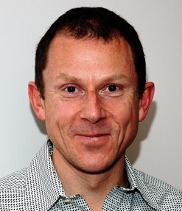
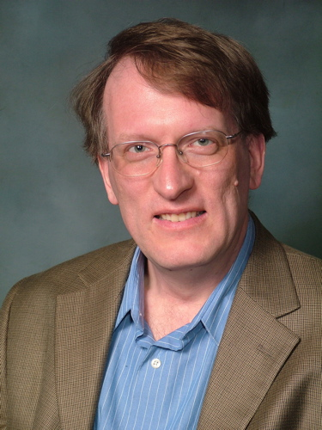
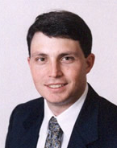
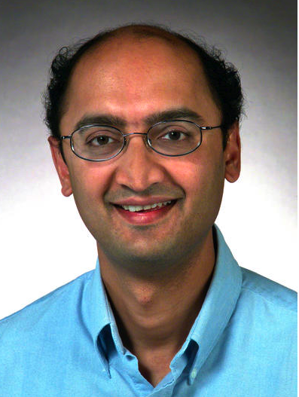
SIG Officers
Bruce Davie
Chair
Henning Schulzrinne
Vice-Chair
Tilman Wolf
Secretary/Treasurer
Ramesh Govindan
Awards Chair
S. Keshav
EIC, CCR

Slide 5
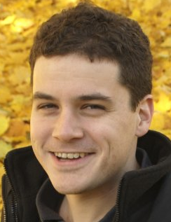
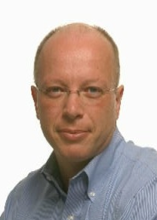
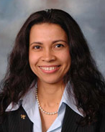
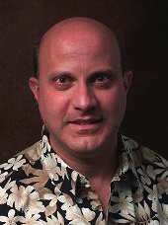
Neil Spring
Information Director
Mark Crovella
Past Chair
Joe Touch
Conference Coordinator
Emeritus
Jau de Oliveira
Conference Coordinator

Slide 6
SIG Finances
ACM Guidelines
Maintain a minimum fund balance, as a fraction of expected expenses for the year
The SIG’s budget is healthy
Within our fund-balance requirements
This year’s events broke even or had a small profit
We use those profits for SIG activities such as awards, geodiversity grants, LANC support, etc.

Slide 7
SIGCOMM Sponsored Conferences
CoNEXT
SIGCOMM sponsored; European roots, broad scope
Dec 1-4, 2009, Rome, Italy
Internet Measurement Conference
SIGCOMM, in cooperation with USENIX and SIGMETRICS
November 4-6, 2009, Chicago, IL, USA
HotNets Workshop
Emphasis on emerging research directions
October 22-23, 2009, New York, NY, USA
Architectures for Networking and Communication Systems
Joint with SIGARCH, IEEE
October 19-20, 2009, Princeton, NJ, USA
Networked Sensor Systems (SenSys)
Joint with SIGMOBILE, SIGARCH, SIGOPS, SIGMETRICS, SIGBED and NSF
November 4-6, 2009, Berkeley, CA, USA

Slide 8
Connecting with the Global Community
AINTEC: Asian Internet Engineering Conf.
SIGCOMM is in cooperation & provides some $$
November 18-20, 2009, Bangkok, Thailand
LANC: Latin American Networking Conf.
SIGCOMM is in cooperation & provides some $$
September 24-25, 2009, Pelotas, Brazil
Travel grants to SIGCOMM-sponsored events
Student travel grants
SIGCOMM’09 geodiversity travel grants

Slide 9
Conferences “In Co-operation”
Networked Systems Design & Implementation (NSDI)
USENIX, in cooperation with SIGCOMM & SIGOPS
April 28-20, 2010, San Jose, CA, USA
Multimedia Systems Conference
Sponsored by SIGMM
February 22-23, 2010, Scottsdale, AZ, USA
NetGames Workshop
in cooperation with SIGCOMM and SIGMM
November 23-24, 2009, Paris, France
IPTComm: Principles, Systems and Applications of IP Telecommunications
July 7-8, 2009, Atlanta, GA, USA
SIMPLEX: 1st Annual Workshop on Simplifying Complex Network for Practitioners
In cooperation with SIGMOBILE
July 1, 2009, Venice, Italy
NOSSDAV
SIGMM, in cooperation with SIGCOMM & SIGOPS
June 3-5, 2009, Williamsburg, VA, USA

Slide 10
SIGCOMM Conference Locations
Now on three-year cycle: North America, Europe, and “Wild Card”
Future SIGCOMM Locations
2010: New Delhi, India
2011: North America
Currently seeking 1-page site proposals: due October 31
See www.sigcomm.org
2012: Europe
SIGCOMM conference dates
One week between mid August & first Monday in Sept
Rotating dates to avoid scheduling collisions

Slide 11
Awards
SIGCOMM
Test of Time
SIGCOMM Best Paper
Best Student Paper (2009 the first time both awards given)
SIGCOMM Rising Star
Continuation of CoNEXT’s Rising Star Award
“recognizing a young researcher - generally, an individual who has completed a PhD roughly within the past seven years - who has made outstanding research contributions during this early part of their career.”
First award to Dina Papagiannaki in 2008

Slide 12
Information Services
Redesign and Reimplementation of SIGCOMM Web Site in 2008
Still some room for improvement (navigation, consistency)
Thanks to Neil Spring
Feedback Solicited!
infodir_sigcomm@acm.org

Slide 13
SIG Total Membership: 1657
Trend common to majority of SIGs
SIGCOMM membership included in conf. reg this year (as in 2007, but not 2008)
Notes:
1994 – bsd joins – also big push from SIG (see annual report)
1995 – Netscape IPO, cover of Time etc etc

Slide 14
SIGCOMM FUTURE VISION

Slide 15
SIGCOMM as a community
Not just a set of conferences
For example, members of the community view SIGCOMM as a place to find collaborators
Community members help each other develop compelling research agendas
Foster new workshops, publications, etc
Place where industry comes to connect with researchers
Educating the next generation of networking folks
Notes:
Refer to CCR “making the world a different place”

Slide 16
Industry-Academic Collaboration
A focus of mine for c. 20 years
Aim: improve information flow in both directions
Industry has lots of interesting problems that would benefit from academic research
Academics have lots of ideas/projects likely to be of value to industry
Proposals:
Host a website that enables industrial folks to disseminate research topics of interest and provide contact points for researchers
Create a session at SIGCOMM (other conferences?) for information exchange between industry and academia

Slide 17
Communication
Desire for “transparency” of EC clearly expressed
Attempting to address that through all communication means at our disposal
CCR, print and online
My first article in next issue
All members can submit articles (inc. opinion pieces), comment online
blog.sigcomm.org
www.sigcomm.org/news/RSS
Email discussion: sigcomm@postel.org
SIGCOMM members mailing list: SIGCOMM-MEMBERS@LISTSERV.ACM.ORG
Facebook (SIGCOMM, not to be confused with SIGCOMM 2009)
Not yet on twitter (can we pay off Signy Roberts?)

Slide 18
Conference Issues
The SIGCOMM conference is highly selective, and prestigious (duh)
Inevitably, many unhappy authors of rejected papers
We must make the paper selection process as good as we can
Documenting that process very helpful (thanks Dina and Luigi!)
Lots of thinking on how to do better
Technical Steering Committee proposal
Fostering additional high-quality venues
E.g. CoNEXT, etc.
Reviewer diligence is essential

Slide 19
Education
SIGCOMM also has the potential to affect how Computer Networking is taught
Education director position has been open since Jim Kurose stepped down
We could (for example)
Run workshops on this topic
Provide forum for exchange of ideas/experience among instructors
Filling the Education Director position should be a priority

Slide 20
Technical Steering Committee Proposal

Slide 21
TSC Proposal: Motivation
Currently, SIGCOMM EC serves as steering committee for SIGCOMM Conference
All other SIG-sponsored conferences have steering committees
Want to make the PC composition and review process the best we can
The EC may not be elected for their expertise in these areas
A Technical Steering Committee composed of individuals with strong PC expertise can provide store of institutional knowledge

Slide 22
TSC Proposal Outline
NOTE: We’re looking for feedback
TSC has clear set of responsibilities around the Technical aspects of the SIGCOMM Conference
No overlap with EC responsibilities
PC Chairs retain autonomy
EC continues to deal with budget and logistical aspects
EC will ultimately have to deal with budget anyway
Starting with a small change rather than full-blown SC

Slide 23
TSC Composition
6 members, appointed by SIGCOMM Chair
Three year term
Three former PC chairs (one from each of last 3 conferences)
Three other members with suitable expertise
Aiming to increase “openness”
In steady state, 2 members replaced each year

Slide 24
TSC Responsibilities
Select PC Chairs
Maintain records on what has/hasn’t worked
Maintain dialog with the SIGCOMM Community
Advise PC Chairs on PC composition
Advise PC Chairs on review process issues
Set policies/guidelines as needed related to technical program (e.g. double submission, etc.)

Slide 25
SIGCOMM 2009 AUTHOR SURVEY

Slide 26
2009 author survey
Attempt to gather feedback from authors
review quality
possibilities for changes (length, review process, …)
About 130 responded (SurveyMonkey)
Absolute numbers less important than trends
selection bias, sour grapes, …
but tried to phrase questions positively

Slide 27
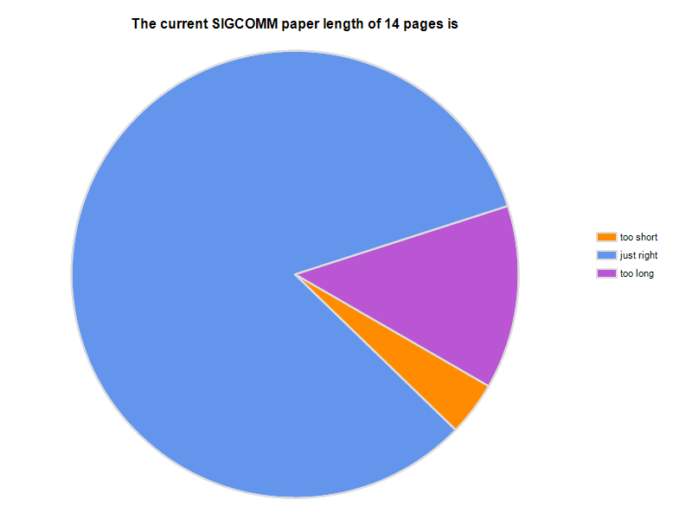
Paper length

Slide 28
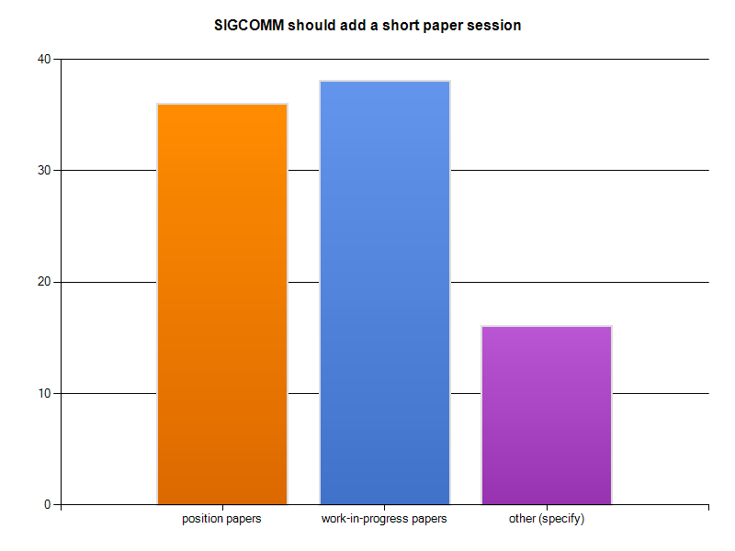
Short paper session?

Slide 29
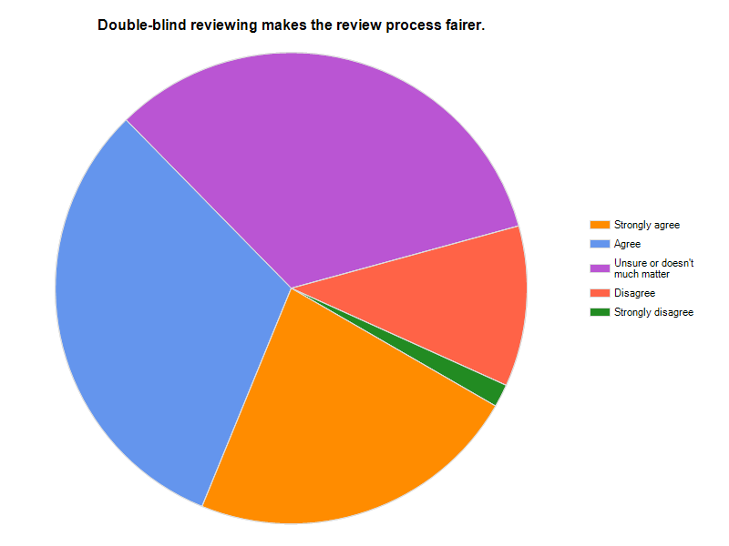
Double-blind matters?

Slide 30
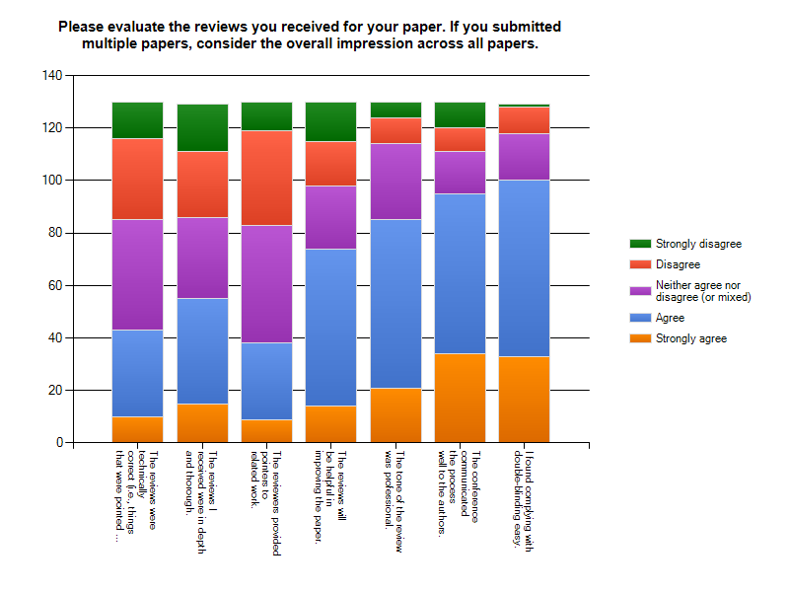
Review quality
thorough
related work
technically correct
double-blinding easy?
process communication?
helpful
professional tone?

Slide 31
Review suggestions
Ensure >= 3 reviews for all papers
seen as mark of “good” conference
Rebuttal
effect unclear – no clear evidence of effectiveness
maybe for borderline papers?
OSDI/SOSP model: ~9 reviews/paper

Slide 32
Interesting comments
“Think about why theory people don't submit their papers to Sigcomm any longer.”
“The SIGCOMM conference should narrow its scope to reflect the competence areas of the program committee members. The reviews this year and papers published in the last couple of years on wireless networking illustrate the lack of knowledge in the area.”
This is my first time to submit SIGCOM. I found that the review quality is so bad. the reviewers really do not understand the paper.
I received much more helpful and more thorough reviews from NSDI.
Many of the reviews, including the PC summary, seemed of the form "Nice idea. But what about X?" where X is some relatively minor case.
We worked on this piece, succeeded, added it to the paper, resubmitted this year, and... got two "1"s, with completely random and minor criticism, completely inconsistent to the previous year reviews -- very frustrating experience.
It's kind of difficult explaining to your grad students why a reviewer for a "top conference" is suggesting we switch to a less-scalable algorithm than what we'd used in the paper.

Slide 33
Conference topics
No consensus (surprise!), but some themes
openness to all networking areas
hardware & theory underrepresented
less wireless (since covered by other events)
“likely to generate discussion” vs. “well-founded” vs. “likely to matter”

Slide 34
General comments
Strive for best-possible review process, but perfection unlikely
unclear metrics, noise (see shadow PC experiments)
non-repeatability (year N changes != year N+1 changes)
top 10 papers clear, rest less so
Limited effectiveness of tweaking
large number of good, but incomplete (or limited), papers
Consider “next-generation” publishing
general CS debate (see CACM)
what do we want to accomplish? resources available?
almost all of the good rejects will appear somewhere else (and in the DL!)

Slide 35
DOUBLE SUBMISSION

Slide 36
Need for policy
Agreement: “double submission bad-bad-bad”
But:
unclear policy on details
who makes determination?
e.g., “almost” the same
traditional remedy: withdraw from both events
but what happens if paper replicas already published?
mark in online program? withdraw from DL?
cross-society issues?
notify academic supervisor/lab director?
Interest in “CS publishing 101” seminar for young researchers?
ethics, good reviewing, common mistakes

