Slide 1
SIP - standards and technologies
A snapshot
Henning Schulzrinne
Dept. of Computer Science, Columbia University, New York
hgs@cs.columbia.edu
Joint Techs VoIP Workshop
Texas A&M University
February 2009

Slide 2
Outline
Scaling SIP to the real world: emergency calling
Scaling SIP to very large deployments
  some measurements for designing large servers
  congestion control and dealing with avalanche restart
  P2P SIP
  failure discovery
The state of SIP standardization, year 11
  developments in 2006 & upcoming highlights
  trouble in standards land

Slide 3
IETF VoIP efforts
ECRIT
(emergency calling)
ENUM
(E.164 translation)
SIMPLE
(presence)
uses
SPEERMINT
(peering)
uses
GEOPRIV
(geo + privacy)
XCON
(conf. control)
may use
uses
SIPPING
(usage, requirements)
SIP
(protocol)
uses
provides
IPTEL
(tel URL)
BLISS
(common services)
SPEECHSC
(speech services)
usually
used with
AVT
(RTP, SRTP, media)
P2PSIP
(peer-to-pper)
MMUSIC
(SDP, RTSP, ICE)
SIGTRAN
(signaling transport)
IETF RAI area

Slide 4
SIP, SIPPING & SIMPLE –00 drafts
includes draft-ietf-*-00 and draft-personal-*-00

Slide 5
RFC publication

Slide 6
IETF WG: SIP in 2006 & 2007
~ 44 SIP-related RFCs published in 2006
  BFCP, conferencing
  SDP revision
  rich presence
Activities:
  hitchhiker’s guide
  infrastructure:
    GRUUs (random identifiers)
    URI lists
    XCAP configuration
    SIP MIB
  services:
    rejecting anonymous requests
    consent framework
    location conveyance
    session policy
  security:
    end-to-middle security
    certificates
    SAML
    sips clarification
  NAT:
    connection re-use
    SIP outbound
    ICE (in MMUSIC)
see http://tools.ietf.org/wg/sip’/

Slide 7
IETF WG: SIP in 2008
~ 7 RFCs published
  conference lists
  multiple-recipient MESSAGEs
  consent-based communications
  answer mode
  DOS due to forking
activities
  connection reuse
  SIP outbound (NATs)
  session policies
  location conveyance
  199 (early dialog terminated)
  certs
  anonymity for UAs

Slide 8
IETF WG: SIPPING
31 RFCs published in 2006, 1 in 2007, 12 in 2008
Policy
  media policy
  SBC functions
Services
  service examples
  call transfer
  configuration framework
  spam and spit
  text-over-IP
  transcoding
Testing and operations
  IPv6 transition
  race condition examples
  IPv6 torture tests
  SIP offer-answer examples
  overload requirements
  configuration
  voice quality reporting

Slide 9
SIPPING status

Slide 10
Open issues: Configuration
Ideally, should only need a user name and some credential
  password, USB key, host identity (MAC address), …
More than DHCP: device needs to get
  SIP-level information (outbound proxy, timers)
  policy information (“sorry, no video”)
Multiple sources of configuration information
  local network (hotel proxy)
  voice service provider (off-network)
Configuration information may change
Needs to allow no-touch deployment of thousands of devices
SIP configuration framework
  has been languishing for years
  currently being rewritten to reduce complexity
  SIP Forum effort – convergence?

Slide 11



Interoperability
Generally no interoperability problems for basic SIP functionality
  basic call, digest registration, call transfer, voice mail
Weaker in advanced scenarios and backward compatibility
  handling TCP, TLS
  NAT support (symmetric RTP, ICE, STUN, ...)
  multipart bodies
  SIP torture tests
  call transfer, call pick-up
  video and voice codec interoperability (H.264, anything beyond G.711)
SIPit useful, but no equivalent of WiFi certification
  most implementations still single-vendor (enterprise, carrier) or vendor-supplied (VSP)
  SFTF (test framework) still limited
Need profiles to guide implementers
Notes:
https://lists.cs.columbia.edu/pipermail/sip-implementors/2006-October/014489.html
http://www.sipfoundry.org/sip-forum-test-framework/sip-forum-test-framework-sftf.html

Slide 12
Trouble in Standards Land
Proliferation of transition standards: 2.5G, 2.6G, 3.5G, …
  true even for emergency calling…
Splintering of standardization efforts across SDOs
  primary:
    IEEE, IETF, W3C, OASIS, ISO
  architectural:
    PacketCable, ETSI, 3GPP, 3GPP2, OMA, UMA, ATIS, …
  specialized:
    NENA
  operational, marketing:
    SIP Forum, IPCC, …
OASIS
data
formats
W3C
ISO (MPEG)
data
exchange
IETF
L2.5-L7
protocols
IEEE
L1-L2
PacketCable
3GPP

Slide 13
IETF issues
SIP WGs: small number (dozen?) of core authors (80/20)
  some now becoming managers…
  or moving to other topics
IETF: research → engineering → maintenance
  many groups are essentially maintaining standards written a decade (or two) ago
    DNS, IPv4, IPv6, BGP, DHCP; RTP, SIP, RTSP
    constrained by design choices made long ago
  often dealing with transition to hostile & “random” network
  network ossification
Stale IETF leadership
  often from core equipment vendors, not software vendors or carriers
fair amount of not-invented-here syndrome
    late to recognize wide usage of XML and web standards
    late to deal with NATs
    security tends to be per-protocol (silo)
      some efforts such as SAML and SASL
tendency to re-invent the wheel in each group

Slide 14
IETF issue: timeliness
Most drafts spend lots of time in 90%-complete state
  lack of energy (moved on to new -00)
  optimizers vs. satisfiers
    multiple choices that have non-commensurate trade-offs
Notorious examples:
  SIP request history: Feb. 2002 – May 2005 (RFC 4244)
  Session timers: Feb. 1999 – May 2005 (RFC 4028)
  Resource priority: Feb. 2001 – Feb 2006 (RFC 4412)
New framework/requirements phase adds 1-2 years of delay
Three bursts of activity/year, with silence in-between
  occasional interim meetings
IETF meetings are often not productive
  most topics gets 5-10 minutes → lack context, focus on minutiae
  no background → same people as on mailing list
  5 people discuss, 195 people read email
No formal issue tracking
  some WGs use tools, haphazardly
Gets worse over time:
  dependencies increase, sometimes undiscovered
  backwards compatibility issues
  more background needed to contribute

Slide 15
IETF issues: timeliness
WG chairs run meetings, but are not managing WG progress
  very little control of deadlines
    e.g., all SIMPLE deadlines are probably a year behind
  little push to come to working group last call (WGLC)
  limited timeliness accountability of authors and editors
  chairs often provide limited editorial feedback
IESG review can get stuck in long feedback loop
  author – AD – WG chairs
  sometimes lack of accountability (AD-authored documents)
RFC editor often takes 6+ months to process document
  dependencies; IANA; editor queue; author delays
  e.g., session timer: Aug. 2004 – May 2005

Slide 16
SIP Server Overload Control: Design and Evaluation
Charles Shen and Henning Schulzrinne
Columbia University
Erich Nahum
IBM T.J. Watson Research Center

Slide 17
Session Initiation Protocol (SIP)
  Application layer signaling protocol for managing sessions in the Internet
  Run on top of the transport layer e.g. UDP, TCP and SCTP
  Typical usage: voice over IP call setup, instant messaging, presence, conferencing

Slide 18
SIP Server Overload Problem
  Many causes to excessive number of messages overwhelming the server
    Natural disaster and emergency-induced call volume: earthquake,
    Predictable special events: Mother’s Day
    Flash Crowds: American Idol, “Free tickets to the third caller”
    Denial of service attacks
  Simply dropping requests on overload?
    SIP has retransmission timers for message loss, especially over UDP
    E.g., Timer A for INVITE retransmission
      T1 = 500 ms, increases exponentially until total timeout period exceeds 32 s
    Simple message dropping induces more messages due to retransmission!

Slide 19

SIP server overload
overloaded
Springsteen tickets!!
earthquake
vote for your favorite…
INVITE
503
overloaded
overloaded
Proxies will return 503 --> retry elsewhere
Just adds more load
Retransmissions exacerbate the problem

Slide 20
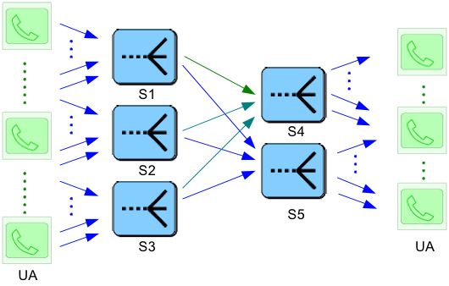
Overload control
Current discussion in design team
Feedback control: rate-based or window-based
Avoid congestion collapse
Deal with multiple upstream sources
goodput
capacity
offered load

Slide 21
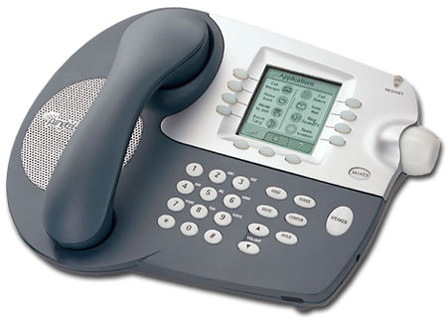

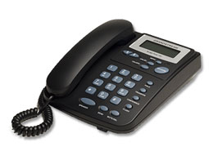
Avalanche restart
Large number of terminals all start at once
Typically, after power outage
Overwhelms registrar
Possible loss of registrations due to retransmission time-out
#1
REGISTER
#300,000
reboot after
power outage

Slide 22
SIP Server Overload Problem (Cont.)
  Rejecting excessive requests upon overload?
    SIP 503 (Service Unavailable) response code used to reject individual request
      Individual sessions are rejected but overall sending rate is not reduced.
      Even worse: rejecting requests takes comparable CPU cycles with accepting requests!
    503 (Service Unavailable) with Retry-After?
      Client completly shut off during the period specified
      Reducing rate with an on/off pattern, may cause oscillation
  Trying an alternative server?
    Alternative server may soon be overloaded too-> cascading failure!
  Feedback-based SIP overload control
    Sender is instructed by the receiver not to send more requests than the receiver can accept in the first place!

Slide 23
Feedback-based SIP Overload Control
  Absolute rate feedback
    RE estimates and feedbacks to SEs target controlled load (λ’)
    SE throttles offered load P_{b} = (1-λ’/λ) so actual load to RE conforms to target load
    Key is accurate controlled load estimation
  Relative rate feedback (loss-based feedback)
    RE estimates and feedbacks to SEs a load throttle percentage P_{b} based on a target metric (e.g. CPU utilization, queue length)
    SE throttles offered load by P_{b} to conform to the target controlled load.
    Key is the target metric and the throttle percentage adjustment algorithm
  Window feedback
    RE estimates and feedbacks to SEs a window size indicates current acceptable num of new calls
    SE throttles any new call arrivals while no window slot available, thus limiting offered load (λ) to the target controlled load.
    Key is the maximum window setup and dynamic window adjustment algorithm

Slide 24
Win-disc Window Control Algorithm
  Principle: estimate and adjust the number of acceptable sessions every control interval
  Decrease window upon new session arrival
  Adjust window every control interval T_{c}
    new available window (W) is the total allowed number of session in the next interval minus existing backlog
    W = μT_{c} + μD_{B} - N_{sess}
      μ: current session service rate
      D_{B:} budget queuing delay (should be smaller than the INVITE timer)
      N_{sess} = N_{inv} + (N_{noninv} / (L_{sess}-1) ) is current num of sessions in the system
  Initial window: suggested W₀ = μ_{eng}T_{c} where μ_{eng} is the engineered server capacity.

Slide 25
Win-cont Window Control Algorithm
  Principle: continuously keep the estimated number of existing sessions in the system below a target number
  Decrease window size upon new session arrival (enqueueing INVITE)
  Increase available window size (W) when currently estimated existing num of sessions is smaller than maximum allowed num of jobs
  W = μD_{B} – N_{sess}
      μD_{B} is equal to maximum allowed num of sessions in the system (max window size)
      N_{sess} = N_{inv} + (N_{noninv} / (L_{sess}-1) ) is current num of sessions in the system
  Initial window: suggested W₀ = μ_{eng}T_{c} where μ_{eng} is the engineered server capacity.

Slide 26
rate-abs Absolute Rate Based Control
  During every control interval Tc, the RE notifies the SE of the new target load λ
λ = μ [1- (d_{q} - D_{B} ) / T_{c}] *
μ: the current estimated service rate
d_{q} = N_{sess} ∕ μ : queuing delay at the last measurement interval where
N_{sess} is current num of sessions in the server obtained using our Dynamic
Session Estimation Algorithm
  The SE does percentage throttle to limit offered load to RE within the feedback assignment for each control interval
* Algorithm proposed by Hosein etc.

Slide 27
Simulation Assumptions and Metrics
  Simulator: RFC3261 compatible simulator built on OPNET
  Node model:
    Each UA represents infinite number of callers/callees
    UAs and SEs have infinite capacity
    RE server configuration: service capacity: 72 cps, rejecting rate: 3000 cps
  Traffic model:
    Calls from callers on the left to callees on the right
    Exponential interarrival times and call holding time
    Standard seven-message call flow
  Transport and network model
    UDP transport-> all SIP timers active
    No link delay and loss is assumed
  Feedback method: piggybacked in the next available message to the particular next hop.
  Metrics:
    Goodput: success of all five setup messages from INVITE to ACK below 10 s
    Delay: from the INVITE sent to the ACK to 200 OK received

Slide 28
SIP Overload Performance without Any Feedback Control
“Simple Drop” scenario
  message dropped when queue full
“Threshold Rejection” scenario
  queue length configured with a high and a low threshold value.
  when queue length high threshold
    new INVITE requests are rejected but other messages are still processed.
  when queue length falls below low threshold
    INVITE processing restored
Similar congestion collapse but DIFFERENT reasons:
  “Simple Drop”:
    one third of INVITE arriving at the callee
    all 180 RINGING and most of the 200 OK also dropped due to queue overflow.
  “Threshold Rejection” :
    no INVITE reaches the callee
    RE is only sending rejection messages

Slide 29
Summary and Comparison of Feedback Algorithm Parameters
Algorithm | Binding | Control Interval | Measurement Interval | Additional Parameters
Rate-abs | D_{B} | T_{C} | T_{m}
Rate-occ | ρ_{B} | T_{C} | T_{m} | f_{min} and ɸ
Win-disc | D_{B} | T_{C} | T_{m}
Win-cont | D_{B} * | N/A | T_{m}
Win-auto | N/A | N/A | N/A
  Most algorithms have a binding parameter
    three use budget queuing delay D_{B}
    one uses budget CPU occupancy ρ_{B}
  All three discrete time control algorithms need T_{c}
  T_{m} used by four of the five algorithms for service rate and CPU occupancy, where applicable
  Tm = min(100 ms,Tc) found to be a reasonable choice
  Queue length is measured instantly
D_{B:} budget queuing delay
ρ_{B}: CPU occupancy
T_{c}: discrete time feedback control interval
T_{m}: discrete time measurement interval for selected server metric; T_{m} ≤ T_{c}
f_{min}: minimal acceptance fraction
ϕ: multiplicative factor
* D_{B} recommended for robustness, although a fixed binding window size can also be used
† Optionally D_{B} may be applied for corner cases

Slide 30
Sensitivity of Budget Queuing Delay and Control Interval
  Sensitivity of budget queuing delay
    Small queuing delay (< ½ T1 timer) avoids timeout and gives best results
  Example results for win-disc *
    Unit goodput when DB <= 200 ms and Tc = 200 ms
    Goodput degraded by 25% DB = 500 ms
  Results for win-cont and rate-abs show similar shape, with slightly different sensitivity.
  In general, a positive DB value centered at around 200 ms sufficient for all
  Sensitivity of control interval
    the smaller the Tc the better.
  Example results for win-disc,
    at D =200 ms Tc <= 200 ms sufficient to archive unit goodput in our scenario
* All load and goodput values normalized over server capacity

Slide 31
Fairness for SIP Overload Control
User-centric fairness:
  In its basic form it ensures equal success rate for each individual user
  Implementation by assigning the capacity of the overloaded server proportionally to the upstream servers according to the original load arrival
  Applicability example: “Third caller receives a free gift”
Provider-centric fairness:
  Assuming each upstream server represents a provider, in its basic form it ensures each provider gets the same aggregate share of total capacity
  Implementation by dividing the capacity equally among upstream servers
  Applicability example: equal-share SLA
Customized fairness
  Any allocation as pre-specified by SLA etc.
  Deny of Service attacks, penalizing the specific sources

Slide 32
Dynamic Load Performance w/ Provider Centric Fairness
  Realistic server to server overload situations
    more likely short periods of bulk loads
    possibly accompanied by new source arrivals or departures.
  Example result using rate-abs algorithm
  Each upstream SE share close to equal RE capacity
  Fast dynamic transition

Slide 33
Dynamic Load Performance w/ User Centric Fairness
  Double feed architecture
    With load feedforward to assist receiver capacity allocation
  Example using win-cont algorithm
  Upstream SEs share to RE capacity proportional to their offered load
  Fast dynamic transition

Slide 34
Dynamic Load Performance of win-auto Algorithm
  Source arrival transition time could be noticeably longer
  Capacity split not easy to predict
    hard to enforce explicit fairness
    basically no processing intervention
  Still achieves aggregate unit goodput

Slide 35
Conclusions and Future Work
  SIP overload problem is special because of the high rejection cost and drop retransmission
  SIP overload control goal is to maximize number of timely completed call
    Approach is to have SE send only the appropriate number of calls RE can timely handle
  Presented and compared five algorithms under both steady and dynamic load
    Win-disc/win-cont/win-auto/rate-abs/rate-occ
    All but rate-occ are able to achieve unit goodput
      Algorithms binding on queue metrics is preferred over occupancy-based heuristic
    All but win-auto adapts to dynamic load and source departure/arrival well
    All but win-auto can achieve both user-centric and provider centric fairness
      Win-disc/win-cont/rate-abs requires double feedback architecture for user-centric fairness
    win-auto is still extremely simple with close to unit steady state aggregate goodput
  Future work:
    More realistic network configuration including link delay and loss, node failure model
    Feedback enforcement algorithms other than percentage throttle and window throttle

Slide 36
Scaling servers & TCP
Need TCP
  TLS support: customer privacy, theft of service, …
    particularly for WiFi
  many SIP messages now exceed reasonable UDP size (fragmentation)
    e.g., INVITE for IMS: 1182 bytes
Concern: UA support
  improving: 82% of systems at recent SIPit’19 had TCP support
  only 45% support TLS
Concern: TCP (and TLS) much less efficient than UDP
  running series of tests to identify differences
  difference mainly in
    connection setup cost
    message splitting (may need pre-parsing or incremental parsers)
    thread count (one per socket?)
Our model:
  300,000 customers/servers
    0.1 Erlang, 180 sec/call
  600,000 BHCA --> 167 req/sec
  300,000 registrations --> 83 req/sec
  $0.001/subscriber

Slide 37
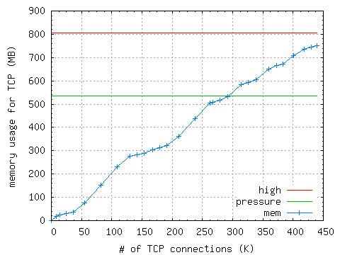
Performance evaluation results
Pentium 4 server, 3 GHz
  4 GB memory
  Linux 2.6.16
echo server
Kumiko Ono

Slide 38
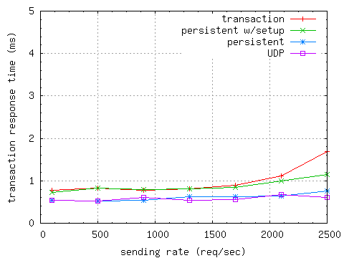
SIP server measurements
TCP
Initial INVITE measurements
  OpenSER
  400 calls/sec for TCP
  roughly 260 calls/sec for TLS
sipd REGISTER test
Kumiko Ono, Charles Shen, Erich Nahum

Slide 39
IETF P2P efforts & Testbeds
Salman Abdul Baset, Gaurav Gupta, Jae Woo Lee and Henning Schulzrinne
Columbia University

Slide 40
Outline
What is a peer-to-peer VoIP and IM system?
P2P in a LAN → mDNS
Why P2P?
  Why not Skype or OpenDHT?
Design challenges
P2PP
OpenVoIP architecture and design
RELOAD

Slide 41




P2P SIP
Why?
  no infrastructure available: emergency coordination
  don’t want to set up infrastructure: small companies
  Skype envy :-)
P2P technology for
  user location
    only modest impact on expenses
    but makes signaling encryption cheap
  NAT traversal
    matters for relaying
  services (conferencing, …)
    how prevalent?
New IETF working group just formed
  likely, multiple DHTs
  common control and look-up protocol?
generic DHT service
p2p network
P2P provider B
DNS
P2P provider A
traditional provider
zeroconf
LAN

Slide 42

P2P SIP -- components
Multicast-DNS (zeroconf) SIP enhancements for LAN
  announce UAs and their capabilities
Client-P2P protocol
  GET, PUT mappings
  mapping: proxy or UA
P2P protocol
  get routing table, join, leave, …
  independent of DHT?
  replaces DNS for SIP, not proxy

Slide 43
A Peer-to-Peer VoIP and IM System
{
Establish media session
In the presence of NATs
Directory service
P2P
Presence
P2P for all of these?
Monitoring
PSTN connectivity

Slide 44
Why P2P?
Cost
Scale
  14 million Skype online users (Nov 19, 2008)
  23 million MSN online users (comscore)
Media session load
  100,000 calls per minute (1,666 calls per second)
  106 Mb/s (64 kb/s voice) 426 Mb/s (256 kb/s video)
Presence load
  1000 notifications per second (500B per notification)
  4 Mb/s
Monitoring load
  Call minutes
  Number of online users

Slide 45



Three kinds of P2P systems
structured
P2P system
(DHT)
unstructured
P2P system
mDNS
network
size
Fortune
500
Skype
dentist office
SME
ad-hoc
802.11
network

Slide 46
DNS-SD/mDNS overview
Subnet (LAN, e.g., wireless APs in hotel)
DNS-Based Service Discovery (DNS-SD) adds a level of indirection to SRV using PTR:
  _daap._tcp.local. PTR Tom’s Music._daap._tcp.local.
  _daap._tcp.local. PTR Joe’s Music._daap._tcp.local.
  Tom’s Music._daap._tcp.local. SRV
  0 0 3689 Toms-machine.local.
  Tom’s Music._daap._tcp.local. TXT
  "Version=196613" "iTSh Version=196608"
  "Machine ID=6070CABB0585" "Password=true”
  Toms-machine.local. A 160.39.225.12
Multicast DNS (mDNS)
  Run by every host in a local link
  Queries & answers are sent via multicast
  All record names end in “.local.”
1:n mapping

Slide 47

SIP URI Advertisement Format
Service instance name: Instance.Service.Domain
  Instance = ( SIP-URI / SIPS-URI ) [ SP description ]
  Service = “_sipuri._udp” / “_sipuri._tcp” / “_sipuri._sctp”
  E.g.: sip:bob@example.com - PDA._sipuri._udp.local.
Contact TXT record attribute
  Similar to Contact SIP header except:
    It contains only a single URI
    Non-SIP URIs are not allowed
  UA capabilities advertised via field parameters (RFC3840)
Code to appear in SIP Communicator

Slide 48
Why not Skype?
Median call latency through a relay 96 ms (~6K calls)
  Two machines behind NAT in our lab (ping<1ms)
Call success rate
  7.3 % when host cache deleted, call peers behind NAT
    4.5K call attempts (March-July, 2007)
  74% when traffic blocked between call peers
    11K call attempts (March-July, 2007)
User annoyance
  relays calls through a machine whose user needs bw!
  shut down the application resulting in call drop
Closed and proprietary solution
  plug P2P in existing SIP phones
IP1:p1
IP2:p2
IP3:p3
.
.
Notes:
Hard to obtain statistics for this user annoyance though.

Slide 49

Why not OpenDHT?
“publicly accessible distributed hash table (DHT) service”
NAT traversal
Non-OpenDHT nodes cannot fully participate in the overlay
Actively maintained?
  73 nodes as of January 22, 2009
Notes:
http://www.opendht.org/servers.txt

Slide 50
Design Challenges
the usual list…
#1 Scalability
#2 Reliablity
#3 Robustness
#4 Bootstrap
#5 NAT traversal
#6 Security
  data, storage, routing (hard)
#7 Management (monitoring)
#8 Debugging
}
at bounded bw, CPU, mem / node
(< 500 B/s)
}
must have for any commercial p2p network

Slide 51
Design Challenges
the not so usual list…
#1 Scalability but how?
  Planet Lab has ~500 online machines online
    ~400 in August
  beyond Planet Lab
  which DHT or unstructured? any?
#2 Robustness?
  a realistic churn model?
    at best Skype, p2p traces
#3 Maintenance?
  OpenDHT only running on 22 nodes (Sep 7, 2008 [1])
#4 NAT traversal
  Nodes behind NAT fully participating in the overlay
    May be, but at what cost?
[1] http://opendht.org/servers.txt
Notes:
Planet Lab alive nodes
http://summer.cs.princeton.edu/status/tabulator.cgi?table=table_nodeviewshort&select=%27resptime%20%3E%200%27

Slide 52
IETF efforts
OpenVoIP
mDNS

Slide 53
OpenVoIP
Design goals
  meet the challenges
  distributed directory service
    Chord, Kademlia, Pastry, Gia
      protocol vs. algorithm
    common protocol / encoding mechanisms
  establish media session between peers [behind NAT]
    STUN / TURN / ICE
  use of peers as relays
  distributed monitoring / statistics gathering
Implementation goals
  multiplatform
  pluggable with open source SIP phones
  ease of debugging
Performance goals
  relay selection and performance monitoring mechanisms
  beat Skype!

Slide 54
OpenVoIP architecture
[ Bootstrap / authentication ]
[ monitoring server / Google Maps ]
Overlay2
SIP
NAT
Overlay1
P2P
STUN
TLS / SSL
Protocol stack of
a peer
bob@example.com
alice@domain.com
NAT
A peer in P2PSIP
A client

Slide 55
Peer-to-Peer Protocol (P2PP)
A binary protocol
Geared towards IP telephony but equally applicable to file sharing and streaming
Multiple DHT and unstructured p2p protocol support
Application API
NAT traversal
  using STUN, TURN and ICE
Request routing
  recursive, iterative, parallel
Supports hierarchy (super nodes [peers], ordinary nodes [clients])
Multiple hash function support
  SHA1, SHA256, MD4, MD5, ...
TCP or UDP
Notes:
Session Traversal Utilities for (NAT)
Interactive connectivity establishment (ICE)
Security mechanisms in progress

Slide 56
Peer-to-Peer Protocol (P2PP)
Reliable or unreliable transport (TCP/TLS or UDP/DTLS)
Security
  DTLS, TLS, storage security
Multiple hash function support
  SHA1, SHA256, MD4, MD5
Monitoring
  ewma_bytes_sent [rcvd], CPU utilization, routing table

Slide 57
Peer-to-Peer Protocol (P2PP)
A binary protocol
Geared towards IP telephony but equally applicable to file sharing, streaming, and p2p-VoD
Multiple DHT and unstructured p2p protocol support
Application API
NAT traversal
  using STUN, TURN and ICE
Request routing
  recursive, iterative, parallel
  per message
Supports hierarchy (super nodes [peers], ordinary nodes [clients])
Central entities (e.g., authentication server)

Slide 58
Implementation design
}
app. pluggability
insert (key, value, callback)
{
callback (resp)
lookup (key, callback)
Bootstrap
Client
KadPeer
BambooPeer
OtherPeer
Node
Distance
Routing table
Parser / encoder
BigInt
Neighbor table
Transactions
{
multiplatform
Sys
Transport / timers
DTLS
TLS
UDP
TCP

Slide 59
OpenVoIP features
Kademlia, Bamboo, Chord
SHA1, SHA256, MD5, MD4
Hash base: multiple of 2
Recursive and iterative routing
Windows XP / Vista, Linux
Integrated with OpenWengo (Qutecom)
Can connect to OpenWengo and P2PP network
Buddy lists and IM
1000 node Planet lab network on ~300 machines
Integrated with Google maps
Demo video: http://youtube.com/?v=g-3_p3sp2MY

Slide 60
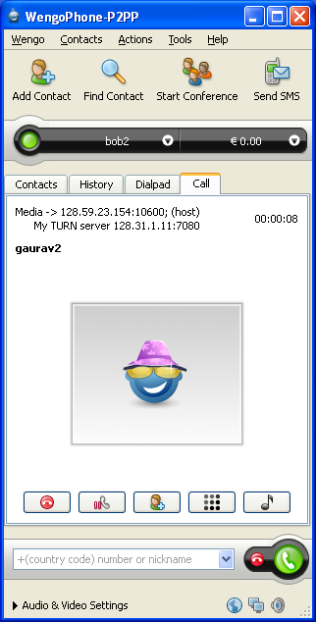
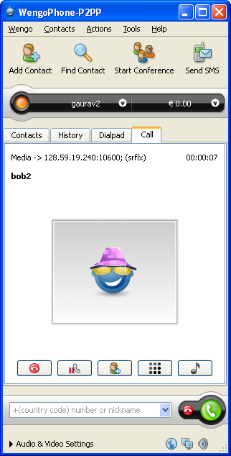
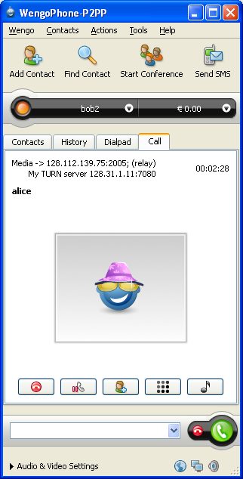
OpenVoIP snapshots
direct
call through a NAT
call through a relay

Slide 61
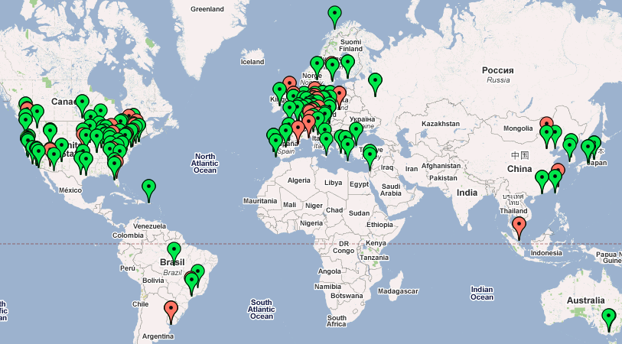
OpenVoIP snapshots
Google Map interface

Slide 62
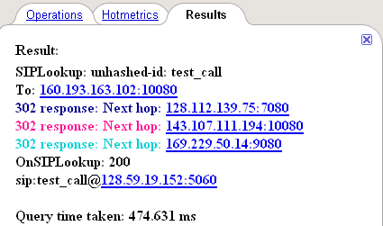
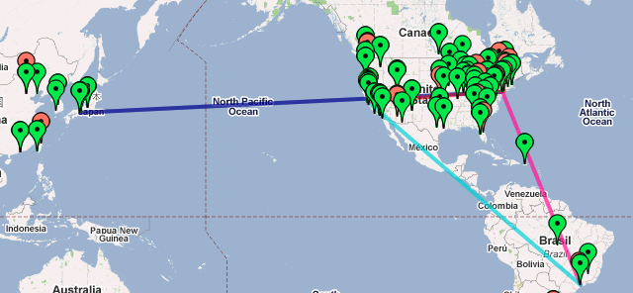
OpenVoIP snapshots
Tracing lookup request on Google Maps

Slide 63
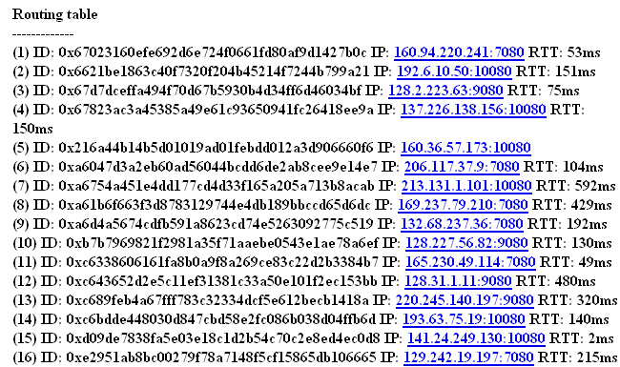
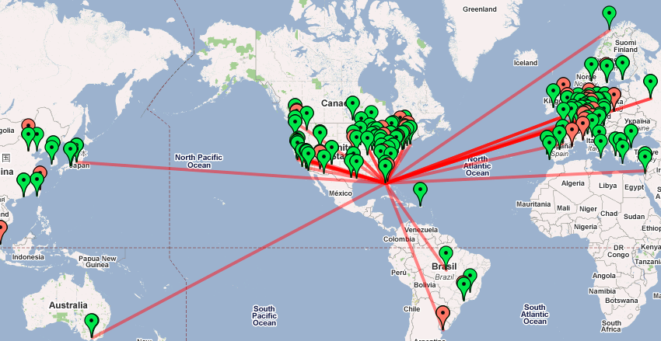
OpenVoIP snapshots

Slide 64
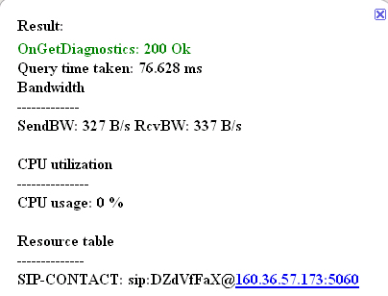
OpenVoIP snapshots
Resource consumption of a node

Slide 65
Relay selection
User annoyance
Use heuristics that operate on a routing table of a node
  random
  minimum delay
  maximum spare bandwidth
  minimum number of jobs
  threshold based (<200ms, maximum spare, longest uptime)

Slide 66
Why calls may fail in OpenVoIP?
Cannot find a user
  user is online, but p2p cannot find it.
NAT and firewall issues
  SIP messages
  call succeeds but media?
  relay
Relay
  failure in finding a suitable relay
  relay fails during call
    2-3 relays
System reliability
  (user search + NAT traversal + relay)

Slide 67
Facts of Peer-to-Peer Life
Routing loops happen
Byzantine failures arise
Nodes become disconnected
System does not always scale!
Automated maintenance does not always work
Planet Lab quirks
  cleans the directory
  DoS attacks on open ports
Bootstrap server is attacked
Notes:
Someone trying their own protocol with our bootstrap server, probably to create a buffer overflow.

Slide 68
OpenVoIP: Key techniques
Randomization is our best friend!
  send the maintenance messages within a bounded random time
Churn recovery
  is on demand and periodic
Insert a new entry in routing table after checking liveness
Periodically republish SIP records
  not feasible for large records
Avoid overly complex mechanisms
  can backfire!

Slide 69
OpenVoIP: Debugging
Black-box
  Lookup request for a random key
State acquisition
  Remotely obtain the resource and storage utilization of a node
Set and Unset a data-value on a node
  such as BW, CPU utilization
  to test a relay selection algorithm
Remotely enable and disable logging
Control log size
Find a faulty node
  hard
  centralized vs. distributed approach

Slide 70
OpenVoIP – releasing an update
Three step process
  Check in a local network (10-15 nodes)
  Deploy the update on a managed node that fully participates in the overlay
    test its functionality
  Release the update
Planet Lab deployment
  churn one quarter of the network
  deploy the update
  continue until done

Slide 71
RELOAD
A binary protocol
Pluggable overlay algorithms
  potentially any DHT or unstructured algorithm
  base DHT
Two tier architecture
  peers and clients
Security
Data storage
Message routing
Usages

Slide 72
P2P conclusions
P2P systems as tool, not miracle cure
  will not fix broken business model
  software more complicated than client-server
  trust issues much harder
Use as autonomic self-adaptive server scaling mechanism
  with server virtualization
  fully self-deploying infrastructure
IETF efforts in progress
  not SIP specific
  see DYSWIS for other uses

Slide 73
Conclusion
Moving from lab and trials to large-scale deployments
Planning horizon includes turning off circuit-switched phones
  in large enterprises
  in some carriers
From emphasis on features to global scale:
  interoperation
  configuration
  peer-to-peer systems
  emergency services
  overload behavior
  failure detection across networks and protocol layers
Integration of advanced features (IM, presence, video, programmable services) still lacking
Current standardization processes slow and complexity-inducing

