Slide 1
IRT Research Overview
Fall 2009

Slide 2
Overview
PI + 12 PhD students + ~4 visitors + 1 staff researcher
Network infrastructure
  PBS: Permission-Based Sending
  NetServ for programmable networks
Mobile networks
  7DS
  PetriNet for modeling mobility protocols
  Location-based services
  Modeling human mobility
Network management & measurement
  DYSWIS: distributed fault diagnosis & correction
  Vdelay: Video delay measurement tool
Applications & middleware
  RELOAD: P2P infrastructure
  SIP overload control
  SPIT prevention
  NG911

Slide 3
Selected other recent projects
Mobile networks
  fast 802.11 hand-off
  802.11 MAC layers for VoIP
  802.11 measurement-based admission control
  cooperative wireless nodes
  LoST: location + service → URL + area
Transport layer
  TCP for multimedia applications
Applications & middleware
  DNS performance
  DotSlash: self-scaling LAMP infrastructure

Slide 4
Network infrastructure

Slide 5
Permission-based sending (PBS)
Objective
  Preventing DoS attacks and other forms of unauthorized traffic.
Network traffic authorization
  Permission is granted by the intended receiver.
  Permission represents the authority to send data.
Deny-by-default
  Unauthorized traffic without permission is dropped at the first router by default.
Hybrid approach
  Proactive approach
    Explicit permission by on-path signaling
    NSIS protocol suites (GIST and PBS NSLP)
  Reactive approach
    Monitoring traffics using periodic signaling
    PBS detection algorithm (PDA)
Secure mechanism
  Secure permission state setup using public key cryptography
  Protect the authentication of data packets using IPsec
SeGi Hong

Slide 6

Permission-based sending (PBS)
Sender
R1
R2
Receiver
Auth verification success
Q (FID,PKey,Auth)
Q ( FID,Pkey,Auth)
Q (FID,Pkey,Auth)
P (10MB, FID, Pkey, Skey, Auth)
P (10MB, FID,Pkey, Skey, Auth)
P (10MB, FID, Pkey, Skey, Auth)
Data flow (size = 1MB) / IPsec
Data flow (size = 1MB) / IPsec
Data flow (size = 1MB) / IPsec
T
IPsec verification failed
IPsec verification success
Auth verification success
Install permission state
RV = Total 1MB
Attack flow
(w/o IPsec)
Q (FID,PKey,Auth, V=1MB)
Q (FID,PKey,Auth, V=1MB)
Q (FID,PKey,Auth, V=1MB)
P (10MB, FID, Pkey, Skey, Auth)
P (10MB, FID,Pkey, Skey, Auth)
P (10MB, FID, Pkey, Skey, Auth)
Monitoring traffic (RV=V=1 MB)
FID: 5-tuple based flow identification
TTL: permission state time limit for the flow
T: Soft-state period
V: total volume of data that the sender has sent
Pkey: public key
Auth: authentication field for
the signaling message
Skey: shared key for IPsec

Slide 7
NetServ: programming network elements
Problem:
  Ossification in the Internet
Approach:
  Extensible architecture for core network services
    Modularity: Building Blocks, Service Modules
    Virtual services framework: security, portability
Current results:
  Prototype using Click router & Java OSGi framework
  Measurements indicating overhead from Java is acceptable
Future Work:
  Content Distribution Network (CDN) application
  Security and resource control (AAA)
  Implementation on a real router
Jae Woo Lee &
Suman Srinivasan

Slide 8
NetServ - prototype
Prototype
Java OSGi on top of Click
Click: Modular router platform
OSGi: dynamic loading and unloading of modules
Measurement
Bare Linux vs. Plain Click
  Penalty for kernel-user transition
Plain Click vs. NetServ
  Java overhead
2) is small compared to 1)

Slide 9
AAA on virtualized environment
Problem
  Traditional
    user access to one service
    theory model consider access to centralized resource only
  Now and future
    Application integration: mashup
    Cloud computing
    NetServ: may need many building blocks to build a service
Approach and result
  Establish theory model
  Special problems to be solved
    performance
    authoritative model
  Secure AAA protocol
user
resource
Traditional
user
resource
  Now and future
Notes:
Traditional: although AAA server and user database may be distributed, but the access model is user authorized access to one service ( resource)
Now and future: may need to be authorized by several organization, access to several resource.
Performance: such as delay
Authoritative model including:
1)Decision mechanism: with resource R1, R2, R3, access may allowed only when R1 and R2 and R3, or maybe R1 and (R2 or R3).
2)Trust model

Slide 10
Mobile networks & applications

Slide 11
Mobility systems modeling using Timed Petri net
Problem
Mechanisms and design principles for optimized handover are poorly understood
Lack of formal methodology to systematically discover or evaluate mobility optimizations
Approach
Identification of the fundamental properties that are rebound during a handover operation
Systematic analysis of the primitive operations during handover
Modeling of the handover processes that allows performance predictions to be made for both an un-optimized handover and for specific optimization techniques under systems resource constraints
Results
Timed Petri net-based mobility models for handoff processes using MATLAB and Time Net tools
Ability to predict systems behavior such as deadlocks
Verification of optimization techniques
Prediction of handover performance under specific resource constraints (e.g., battery, CPU and network bandwidth)
Ashutosh Dutta

Slide 12
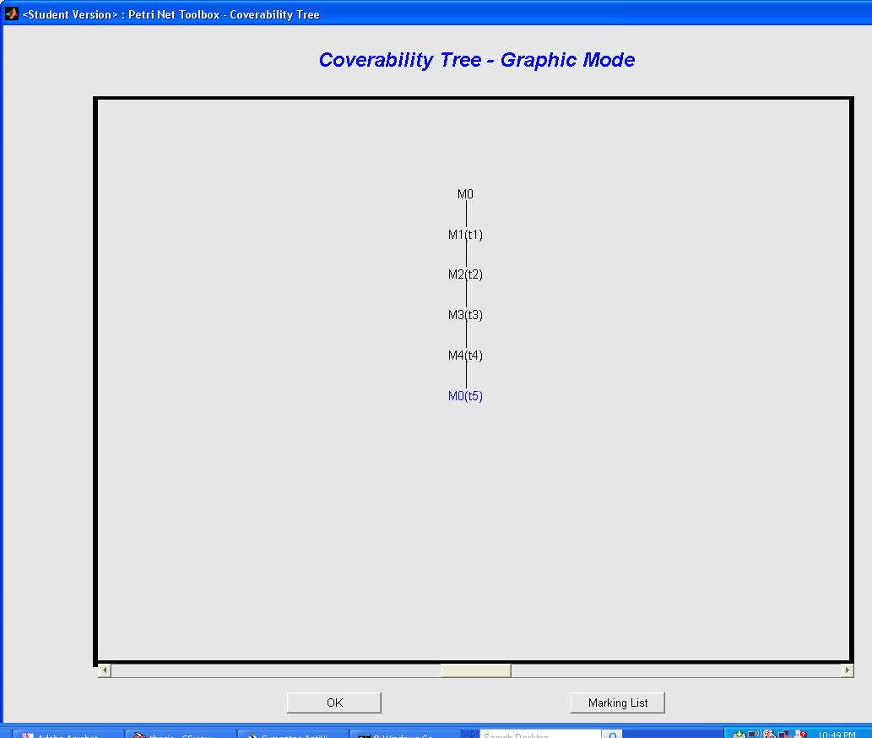
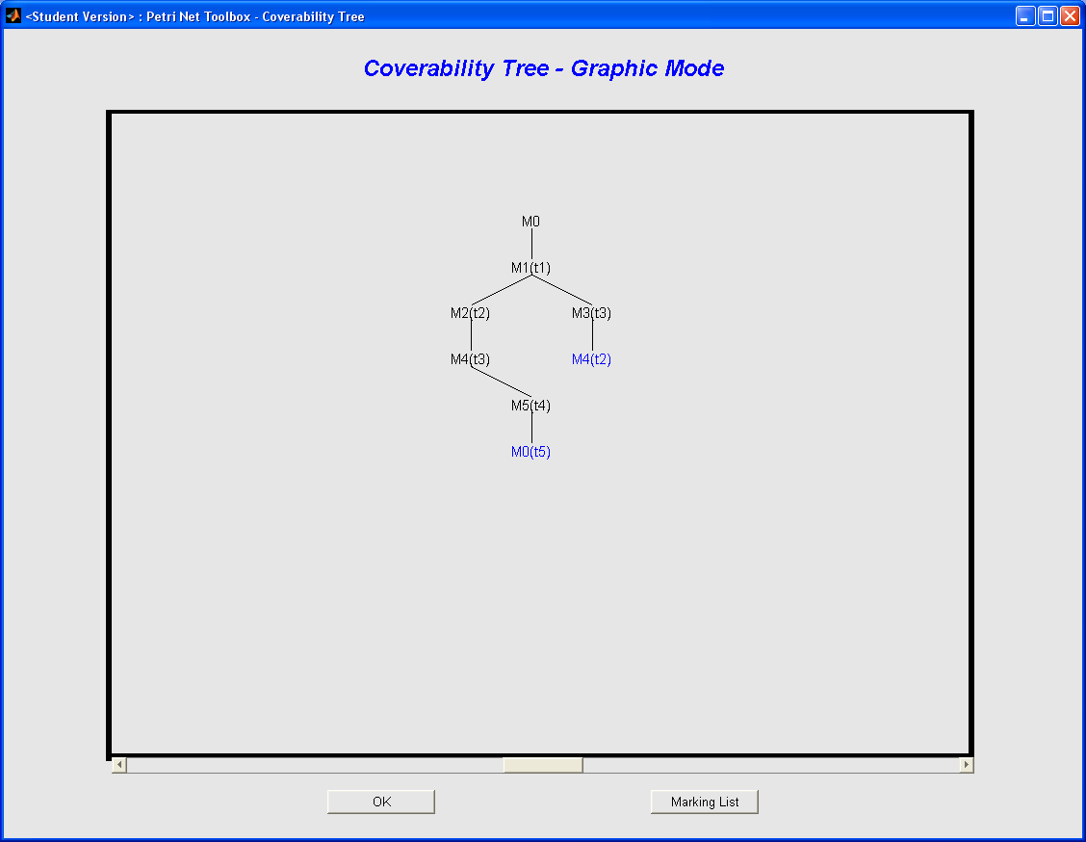
Petri net modeling results
Figure 1: Timed Petri net modeling for handoff
Figure 2: Sequential handoff operations
(a)
(b)
Figure 3: Concurrent handoff operations
Figure 4: Coverability tree a) sequential, b) concurrent

Slide 13



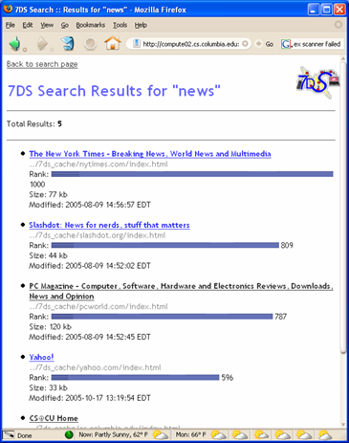

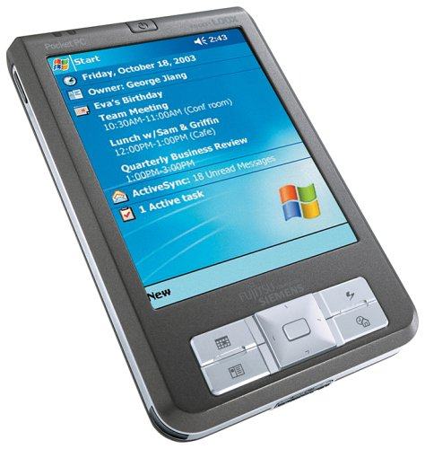
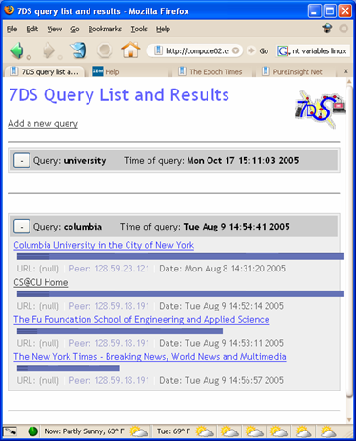
7DS – Disruption-tolerant networks
Concept
7DS application suite
Search engine
Query self for results
Searches the cache index using:
Swish-e library
Presents results in three formats: HTML, XML and plain text
Similar concept to Google Desktop
Internet
In the absence of the Internet:
nodes can exchange information amongst themselves
Local P2P wireless networks to exchange information
Get information they do not have from another peer
Uses
  Getting web pages from peers
  Sending e-mails
Query multicast engine
Exchange information among peers
Requesting peer broadcasts query to network
Responding peers reply if they have information
  Send encoded string with list of matching items
Requesting peer retrieves suitable information
Interesting problem:
Service discovery protocols don’t work well in opportunistic networks
We looked at different ways of solving this problem
Suman Srinivasan

Slide 14
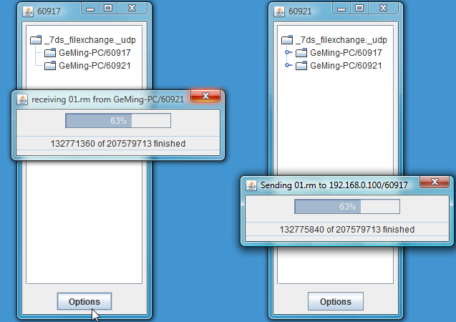

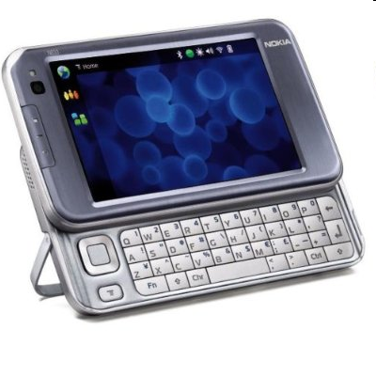
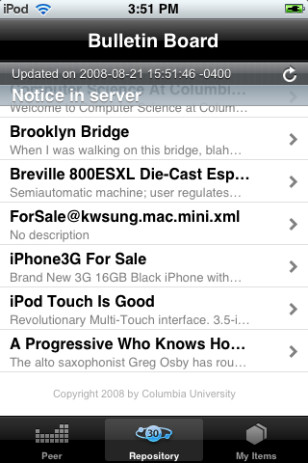
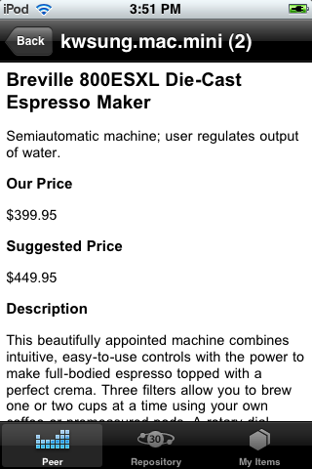

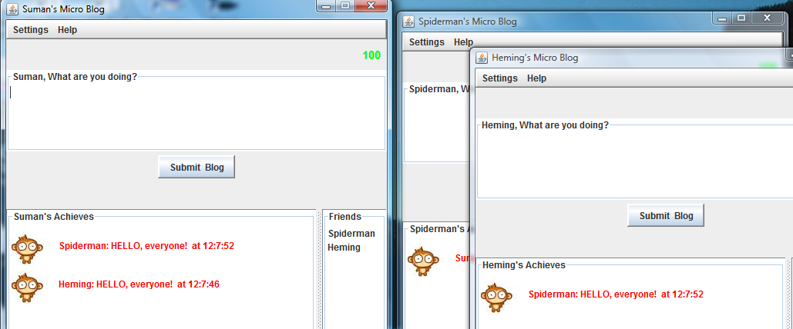
BonAHA framework for opportunistic networks
Opportunistic Networks
Applications written using BonAHA
Mobile nodes; highly mobile networks
  No infrastructure
OLPC; mesh networks
  “Ad-hoc applications”/ “Mobile P2P applications”
Applications need to
  Be aware of network transitions
  State/metadata of nodes in the network
BBS application
Runs on iPod/iPhone
Allows users to upload “posts”
Other users can pick up “posts” and
share their own
Information on events, etc that they
are interested in sharing
BonAHA framework
Group Chat
Really localized applications
  Work in “cloud” or “opportunistic” networks
Examples
  File synchronization
  Bulletin Board system
We have a framework for this: BonAHA
  And applications built using it
Allows users to discover peers
in local network and chat
Rooms can be set up for private
chats
File Sharing
BonAHA API
Users can share files with each
other by dragging and dropping
files onto peers’ computers
Handles peers entering and
leaving network
For registration
  service = new BService(“loc", "tcp");
  service.set("Latitude", lat);
  service.register();
  service.setListener(this);
For network transitions
  nodeUpdated()
  nodeExited()
Papers published: CCNC 2009, NGMAST 2008,
CoNEXT student workshop 2007

Slide 15
Mobility behavior
What are mobility models good for?
  Disruption-tolerant (store-move-forward) networks
  QoS in cellular networks
Problem: Current synthetic and trace-based mobility models inadequate
We are using Sense Network’s traces
  GPS traces of a wide-spectrum of mobile users
  Citysense application
Arezu Moghadam

Slide 16
Periodic Model to Predict User’s next Location
Learning probability distribution of a user’s movement from the training set up to time T
Learning user’s pattern by mapping timestamps to hourly timeslots of the week
For example timestamp t > T maps to timeslot j
User k
timestamp i
0
1
2
3
4
5
6
7
8
j
j+1
168
Week
t

Slide 17
Network management & measurement

Slide 18




DYSWIS: What’s wrong with the network?
Traditional Diagnostics Tools
  End-user diagnostics: Difficult to obtain information about what is happening beyond the local network
  Centralized management: Hard to determine failure causes because it does not know end-user’s personal environment such as network device, wireless router, and firewall.
  New Approach
    DYSWIS : Distributed, End-to-end, and Intelligent
?
?
Why I cannot send an email?
ZZZzzz....
Traditional tools: Neither end-users nor central tools can detect misbehavior of a router.
Kyung Hwa Kim

Slide 19
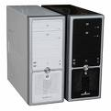



DYSWIS
What happened to the web server?
Probe
Probe
DYSWIS
DHT
Network
Request
DYSWIS = automatic network fault diagnosis system
  Distributed: ask other nodes what they see & remote probing.
  End-to-end: end-user knows his situation best.
  Users collaborate with others to collect information
  Security: Continuously monitor network packets.
  Auto-detection: Detect faults automatically and start to diagnose.
Current implementation status
  DYSWIS framework and protocol developed
  Several probing modules (NAT, Firewall, SIP, RTP, and DNS)

Slide 20
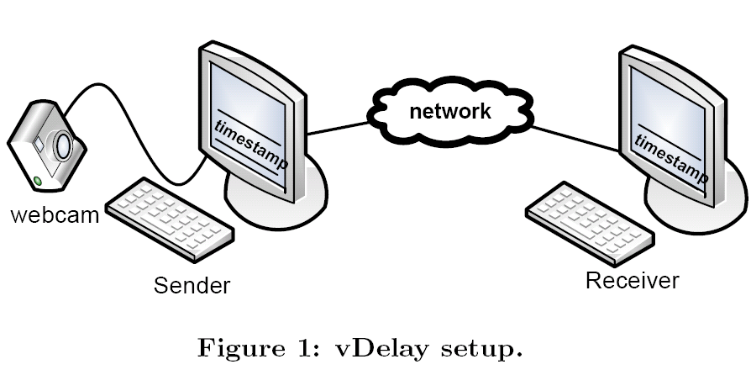
vDelay: Measuring capture-to-display latency and frame rate
  Measures capture-to-display latency and frame rate of a video chat session
  Does not require access to source code or network stream
  Java-based → platform independent

Slide 21
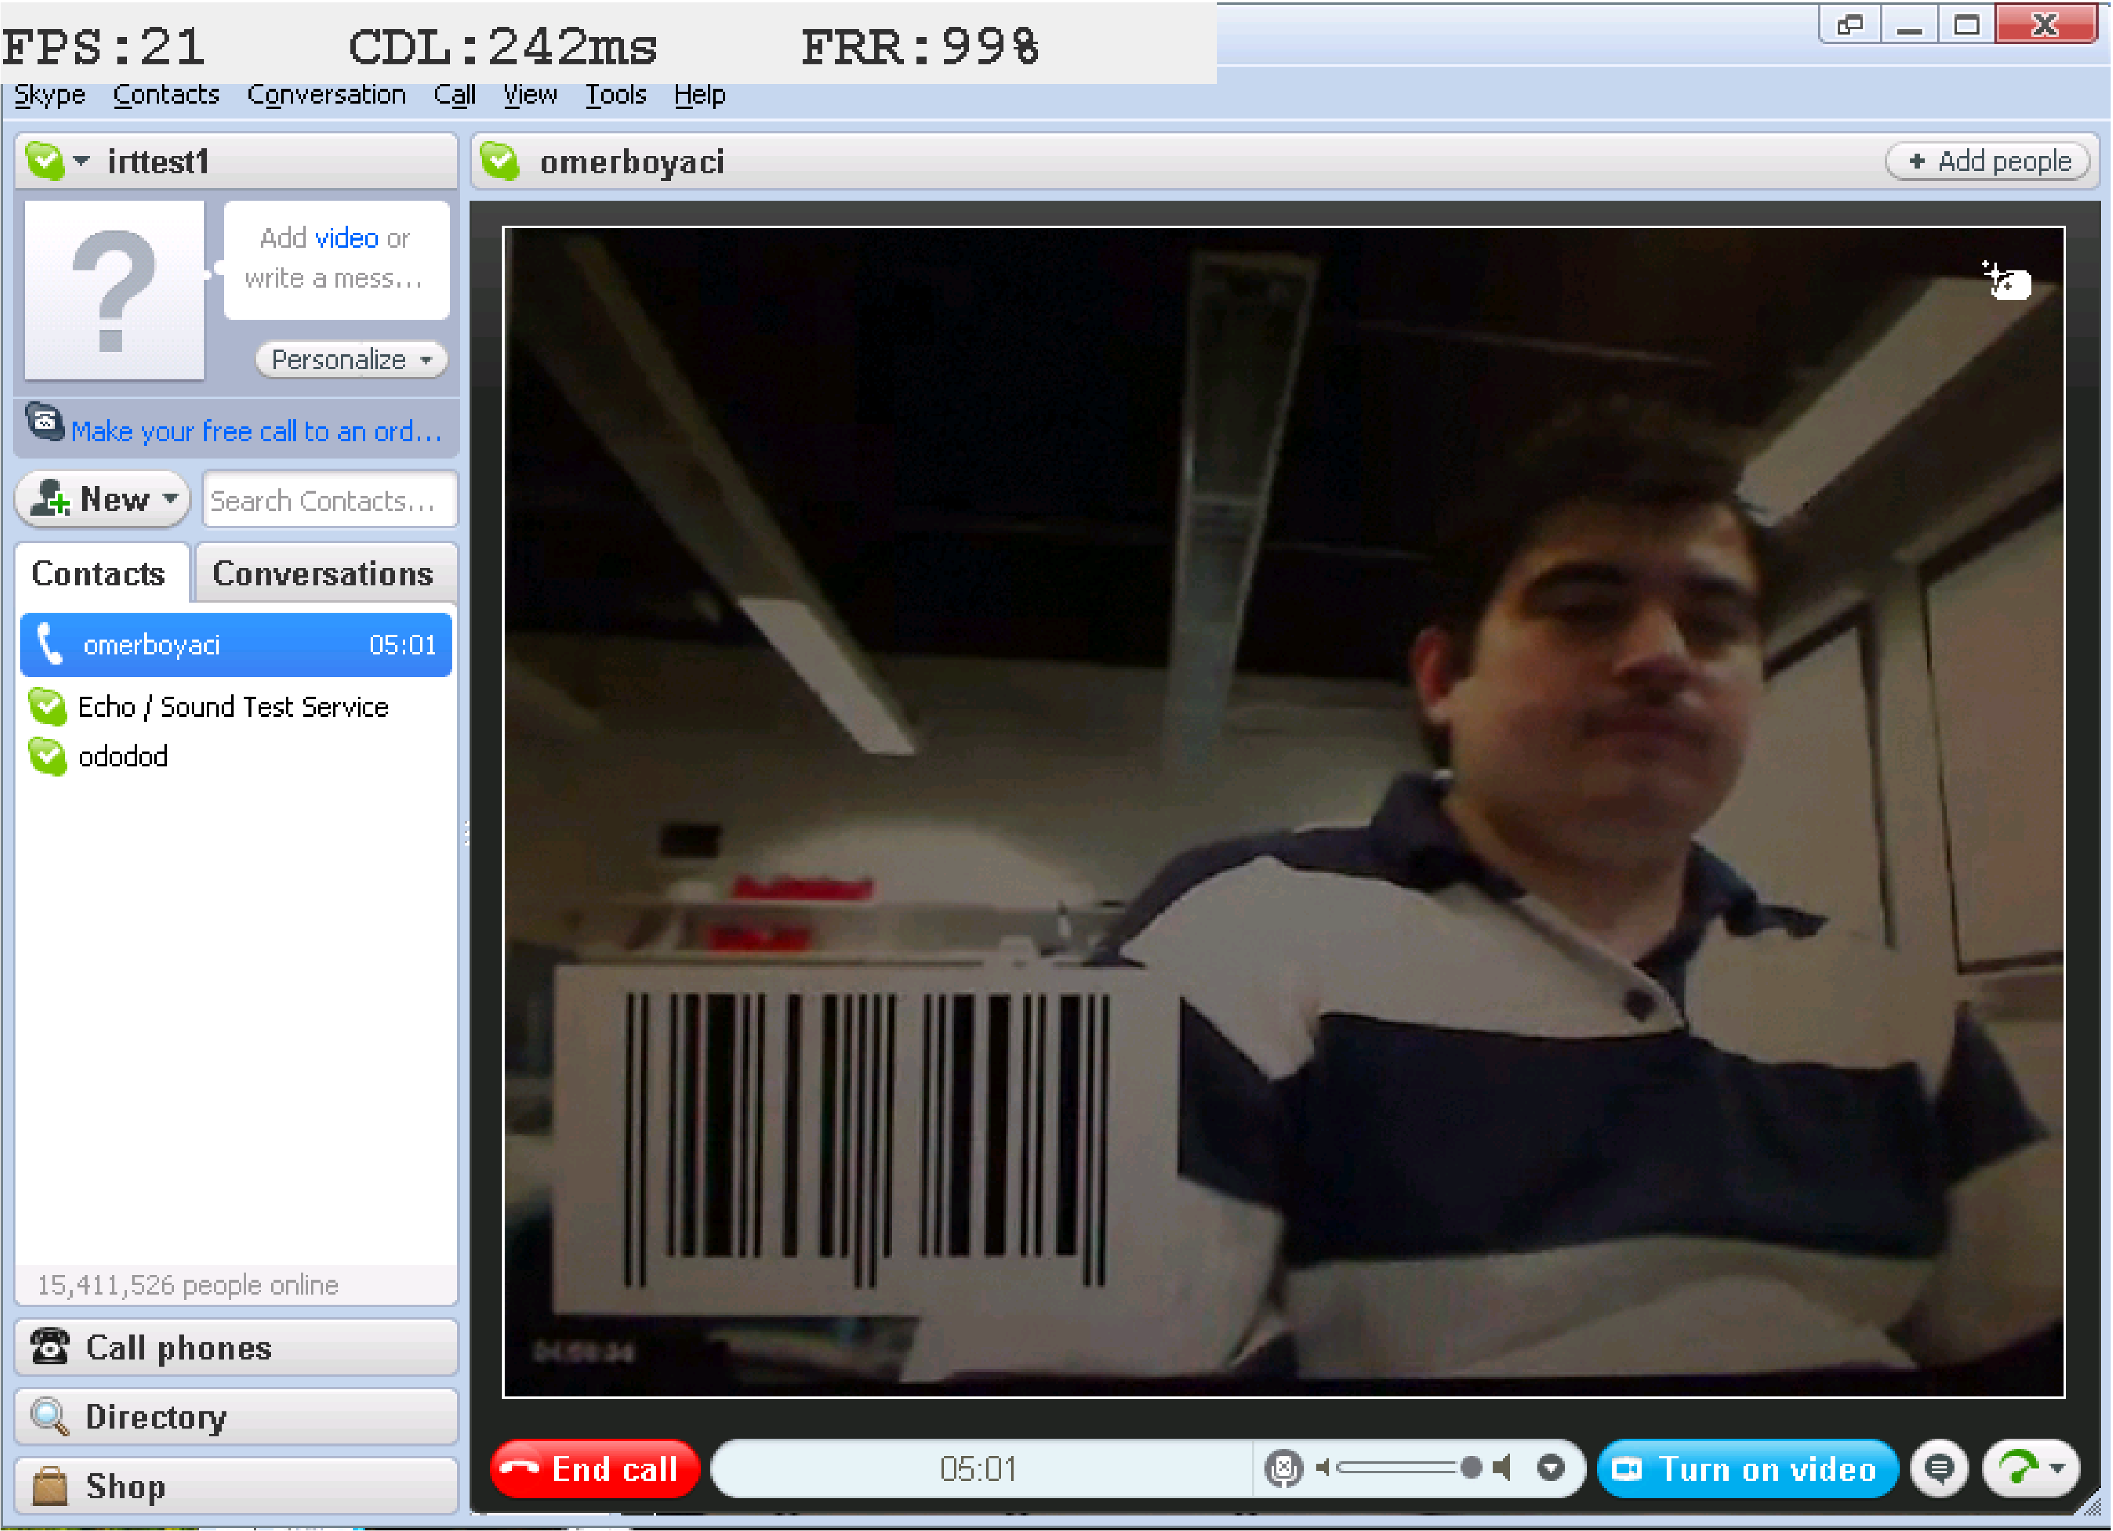
vDelay

Slide 22
Performance of video chat applications under congestion

Slide 23
Performance of video chat under congestion
Performance of video chat applications under congestion
  Residential area networks (DSL and cable)
    Limited uplink speeds (around 1Mbit/s)
    Big queues in the cable/DSL modem(600ms to 6sec)
    Shared more than one user/application
Investigate applications’ behavior under congestion
  Whether they are increasing the overall congestion
  Or trying to maintain a fair share of bandwidth among flows

Slide 24
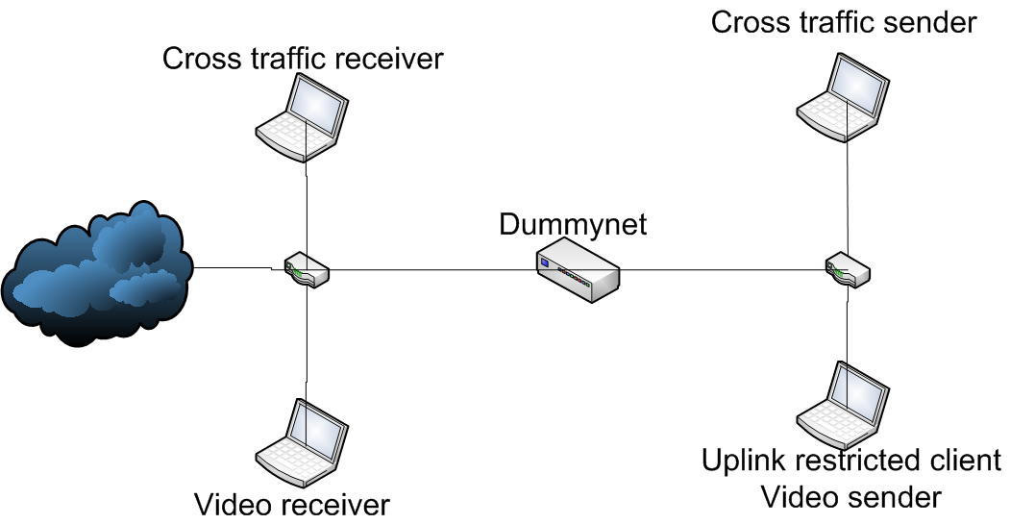
Experimental Setup

Slide 25
Results: X-Lite
X-Lite with 10kb-10sec step function

Slide 26
Video chat
Analyzed Skype, Live Messenger, X-Lite and Eyebeam
  Skype behaved the best by adapting its codec parameters based not only on packet loss but also on RTT and jitter. This allowed Skype to closely follow the changes in bandwidth without causing any packet loss.
  Eyebeam performed the worst with high fluctuations in the transmission speed of its video traffic and with poor adaptation to bandwidth fluctuations.
Due to limited upstream bandwidth, video clients must have bandwidth adaptation mechanisms and must be able to differentiate between wireless losses and congestion losses.

Slide 27
Applications & middleware

Slide 28
Peer-to-peer communication systems
media relay
(or relay)
node A
node E
NAT
media
Call
P2P-SIP / PSTN
gateway
Firewall
node B
network address
of node E?
What is distributed?
directory service
call signaling
media session and
conferencing
presence
Call
node C
node D
Salman Baset

Slide 29
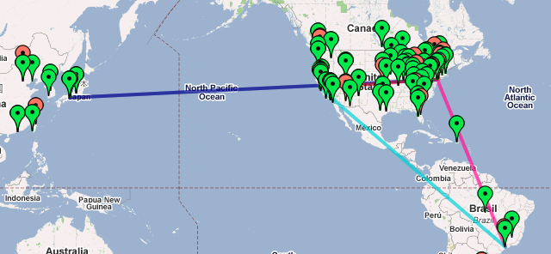
Peer-to-peer communication systems
Reliability
Session quality
Video
conferencing
Challenges
Protocol and
system design
Measurement
Approach
  Analytical modeling
  Simulations
  Building system
  Measurement

Slide 30


CURESPIT: Controlling Unsolicited Requests against SPIT
Black/white-list SPIT filtering incurs false positives
The more convenient communications we have, the more vulnerable to unsolicited bulk communications we are. It is crucial to differentiate incoming requests from those with “weak social ties” from SPIT.
Strong social ties
INVITE
From: <friend_callerID>
Accept
Address book:
List of caller IDs of those with strong ties
- family
- friends
- colleagues etc.
Weak social ties
INVITE
From: <unknown_callerID#1>
?
Callee
Callers
INVITE
From: <unknown_callerID#2>
No social ties
?
Kumiko Ono

Slide 31
CURESPIT: Controlling Unsolicited Requests against SPIT
→ Label incoming requests using cross-media relations from earlier communications
1. An outgoing message via HTTP, email or SIP
2. Store cross-media relations
as references to prior comm.
Cross-media relations:
- Message-ID of emails
- Call-ID of dialogs
- email on web page
3.
INVITE
From: <unknown_callerID#1>
with reference to prior comm.
Callers with weak social ties
Callee
4. Labeling by referencing prior comm.

Slide 32



SIP Server Overload Control (I)
Problem statement:
  SIP server overload during emergency, call-in TV programs, etc.
  Default TCP configurations cause performance collapse
Approach:
  Virtually split the TCP connection into two
  Upstream server conducts smart forwarding to release pressure
Smart INVITE
request forwarding
Special connection for
INVITE requests
SE
UAC
RE
Normal connection for
non-INVITE requests
UAS

Slide 33
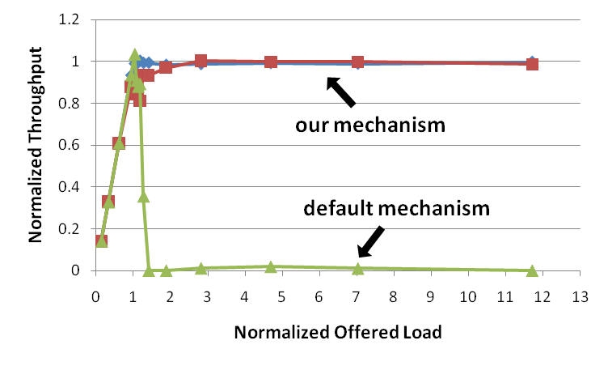
SIP Server Overload Control (II)
Results:
  Under our mechanism, the throughput under heavy overload remains close to the capacity

Slide 34
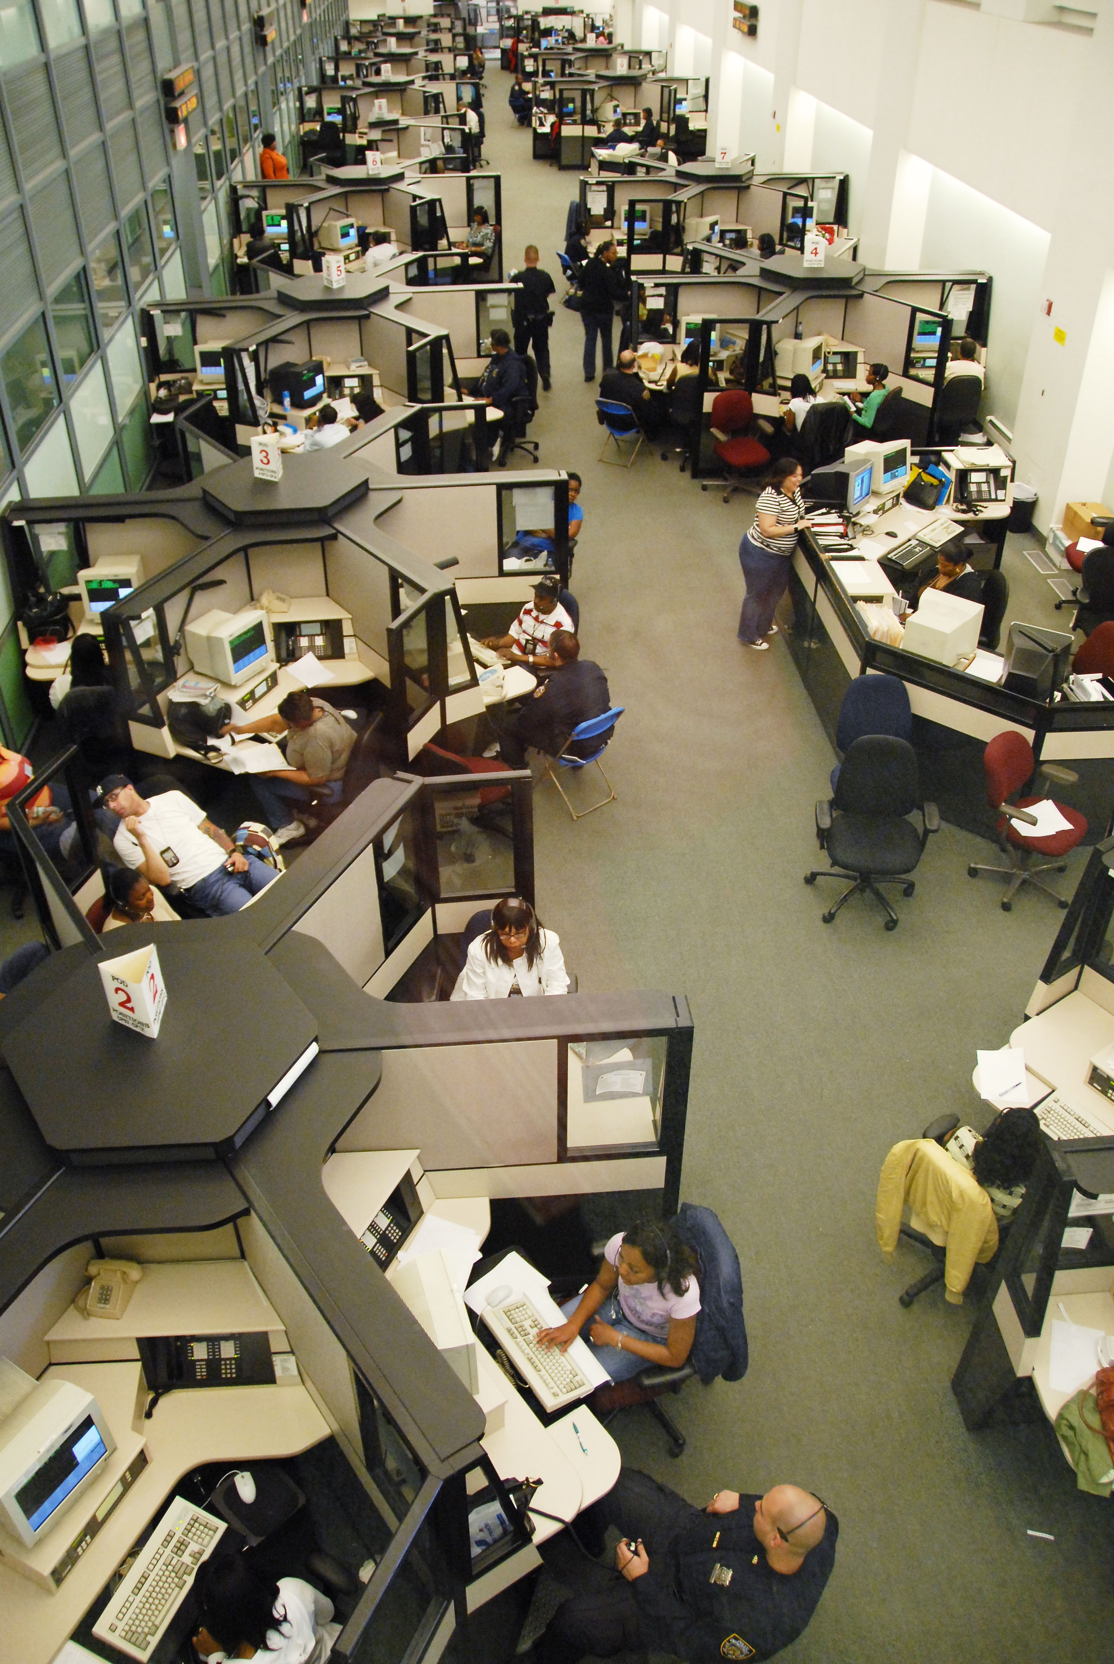
NG911: Emergency calling using IP
Problem
  Is it possible to offer emergency calling services on an all-IP network?
Benefits of an all-IP network
  Multimedia
  Data integration
  Flexible routing during massive disasters
Challenges
  How to determine the location of the calling device?
  How to route calls based on location information?
  How to use multimedia and add data to call?
* Figure: NYC PSAP in Brooklyn

Slide 35
NG911
A SIP-based emergency calling infrastructure
IP-based PSAPs
for
multimedia
and
data
Location determination
at the call source
Location-based routing
using LoST

Slide 36
Location-based services
Location-based services: services bound to a user physical location (gas stations, restaurants, indoor directions, …)
Location determination
  GPS, cellular triangulation
Location delivery
  HELD, PIDF-LO
Service type representation
  Service URNs (draft-forte-ecrit-service-classification-02)
Service discovery
  LoST, LoST extensions (draft-forte-ecrit-lost-extensions-02)

Slide 37
LoST Extensions
LoST: particular attention given to emergency service requirements
We define two new queries
  Within distance X
    New use of circular shape used in <findService> queries
  N closest
    New attribute ‘limit’ to <findService> element

Slide 38
Service URNs
How to describe services?
  List of service URNs
    (draft-forte-ecrit-service-classification-02)
  How to define new top-level service labels?
    Non standard action
    (draft-forte-ecrit-service-urn-policy-00)
EXAMPLE:
urn:service:cultural
  cultural.art-gallery
  cultural.library
  cultural.monument
  cultural.museum
  cultural.theater
urn:service:education
  education.classroom
  education.day-care-center
  education.nursery
  education.school

Slide 39
Presence-enabled rule language
The future Fixed Mobile Convergence will provide ubiquitous always-on communication services
User personalization is a key factor in the success of FMC services → Presence information: preferences on communications, device capabilities, privacy rules, calendar information, location information
IETF SIP for Instant Messaging and Presence Leveraging Extensions (SIMPLE ) framework:
  Users publish their presence documents to a Presence Server (PS)
  The PS notifies the proper presence information to the users’ watchers
Our objective: The design of a rule-based language enhanced with presence information and the implementation of a prototype.

Slide 40
Presence-enabled rule language
The language allows users to set rules based on their presence information → just some examples….
  “Accept only calls from my boss when I am working”
  “Send me an instant message when my son get home”
  “Reject any call from a friend when I am in a meeting, and send him or her the message ‘I am busy, I will call you back later’”
The language allows to save memory and processing resources on the client devices and bandwidth
  “If I am connected to my self phone, send me any presence notification as an email but don’t notify me”
  “If my memory resources are scarce, save only the most important presence information about my work mates”
  “If the bandwidth is limited, publish only my activity and status information”
Other functions are also possible: filtering information, privacy filtering, remote control of applications….

Slide 41
Backup slides

Slide 42
DoS attacks
The largest DDoS attack size:
      40 Gb/sec, 2007
    Cyberweapons
      Political and military conflicts
      Political fight between
      Estonia and Russia, 2007
      Georgian-Russian war, 2008
      “Internet Attacks Grow
      More Potent”, NY Times,
      Nov 9, 2008
  From 40,000 sensors monitoring networks in over 180 countries through Symantec products and services and third-party sources.

Slide 43
PBS implementation structure
On-path signaling
Authorization
State table: permission state, IPsec state
(Hashtable)
PBS NSLP
Processing
(OpenSSL)
Traffic management
Userspace IPsec module
(netfilter queue module, libiptc, OpenSSL)
NTLP (GIST)
Processing
User level
Kernel level
Network
device
Netfilter IP packet filtering
(iptables)
Linux kernel
routing table
(route)
Network
device
Signal flow
Data flow
Control and configuration
43

Slide 44
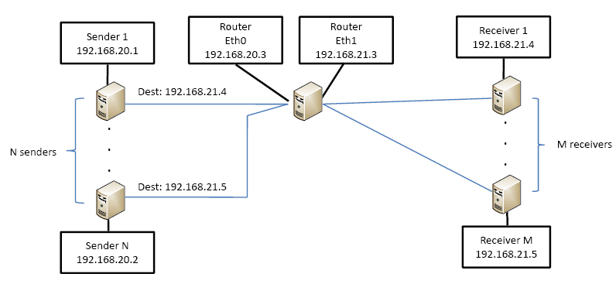
Testbed
AMD Opteron 2.2GHz CPU and 2GB RAM
Linux kernel version 2.6.23

Slide 45
DoS attack
Internet
  Any one can inject any IP packets into the network
  Resource are shared by all users
  Denial-of-Service (DoS) attacks are possible
DoS attacks
  Aim to disrupt the service provided by a network or server
  Attacker might spoof the source address
  Botnets: The attacker controls the compromised computer by IRC channel
Botnet
  The attacker controls the compromised computer by IRC (Internet Relay Chat) channel
  SYN flood, ICMP flood and HTTP flood
Attack
Attack
Attack
DATA
Attack
Attack
Attack
DATA

Slide 46
CPU usage for signaling
Number of concurrent sessions that can be handled
600 (Q, P) messages /sec
→ 36,000 concurrent flows with 60 sec refresh period with fair queue

