Slide 1
VoIP – not your grandmother’s phone any more
Henning Schulzrinne
Columbia University

Slide 2
Overview
VoIP as black phone replacement → interactive communications enabler
Presence as a service enabler
Peer-to-peer VoIP
Integrating VoIP with cellular
Fax-over-IP

Slide 3
Outline
VoIP maturing: vision vs. reality
  overview of protocol zoo
  presence and location-based services
  user-programmable services
New VoIP challenges
  emergency calling
  peer-to-peer systems
The state of SIP standardization
  trouble in standards land
  interoperability

Slide 4
The three Cs of Internet applications
grossly simplified...
communications
commerce
community
what users care about
research
focus
what users care about

Slide 5
Killer Application
Carriers looking for killer application
  justify huge infrastructure investment
  “video conferencing” (*1950 – †2000)
  ?
“There is no killer application”
  Network television block buster → YouTube hit
  “Army of one”
  Users create their own custom applications that are important to them
  Little historical evidence that carriers (or equipment vendors) will find that application if it exists
Killer app = application that kills the carrier

Slide 6
Collaboration in transition
inter-organization
multiple technology generations
diverse end points
intra-organization;
small number of systems (meeting rooms)
standards-based solutions
proprietary (single-vendor) systems

Slide 7
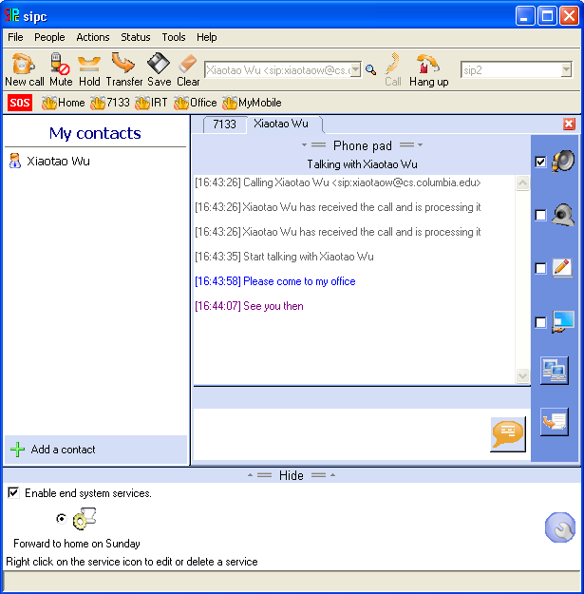
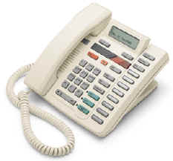

Evolution of VoIP
“Can it really replace the phone system?”
“How can I make it stop ringing?”
long-distance calling,
ca. 1930
“does it do
call transfer?”
replacing the
global phone system
“amazing – the phone rings”
going beyond
the black phone
catching up
with the digital PBX
1996-2000
2000-2003
2004-2005
2006-

Slide 8
IETF VoIP & presence efforts
XMPP
(presence)
P2PSIP
(DHT protocol)
ECRIT
(emergency calling)
SIMPLE
(presence)
ENUM
(E.164 translation)
uses
GEOPRIV
(geo + privacy)
uses
SPEERMINT
(peering)
XCON
(conf. control)
may use
uses
SIPCORE
(protocol)
DISPATCH
(spin off mini-WGs)
uses
BLISS
(services)
DRINKS
(registry)
usually
used with
AVT
(RTP, SRTP, media)
MMUSIC
(SDP, RTSP, ICE)
MEDIACTRL
(media servers)
SPEECHSC
(speech services)
IETF RAI area

Slide 9


Old vs. new
 | old reality | new idea | new reality
service provider | ILEC, CLEC | email-like, run by enterprise, homes | E.164-driven; MSOs, some ILECs, Skype, European SIP providers, Vonage, SunRocket
media | 4 kHz audio | wideband audio, video, IM, shared apps, … | 4 kHz audio
services | CLASS (CLID, call forwarding, 3-way calling, ...) | user-created services (web model) presence | still CLASS
user IDs | E.164 | email-like | E.164 IM handles

Slide 10
SIP overview

Slide 11
Internet services – the missing entry
Service/delivery | synchronous | asynchronous
push | instant messaging presence event notification session setup media-on-demand | messaging
pull | data retrieval file download remote procedure call | peer-to-peer file sharing

Slide 12
Filling in the protocol gap
Service/delivery | synchronous | asynchronous
push | SIP RTSP, RTP | SMTP
pull | HTTP ftp SunRPC, Corba, SOAP | (not yet standardized)

Slide 13
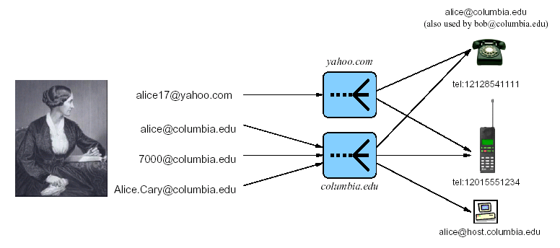

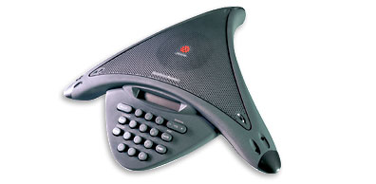
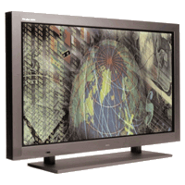
SIP as service enabler
Rendezvous protocol
  lets users find each other by only knowing a permanent identifier
Mobility enabler:
  personal mobility
    one person, multiple terminals
  terminal mobility
    one terminal, multiple IP addresses
  session mobility
    one user, multiple terminals in sequence or in parallel
  service mobility
    services move with user

Slide 14

What is SIP?
Session Initiation Protocol → protocol that establishes, manages (multimedia) sessions
  also used for IM, presence & event notification
  uses SDP to describe multimedia sessions
Developed at Columbia U. (with others)
Standardized by
  IETF (RFC 3261-3265 et al)
  3GPP (for 3G wireless)
  PacketCable
About 100 companies produce SIP products
Microsoft’s Windows Messenger (≥4.7) includes SIP

Slide 15
Philosophy
Session establishment & event notification
Any session type, from audio to circuit emulation
Provides application-layer anycast service
Provides terminal and session mobility
Based on HTTP in syntax, but different in protocol operation
Peer-to-peer system, with optional support by proxies
  even stateful proxies only keep transaction state, not call (session, dialogue) state
  transaction: single request + retransmissions
  proxies can be completely stateless

Slide 16
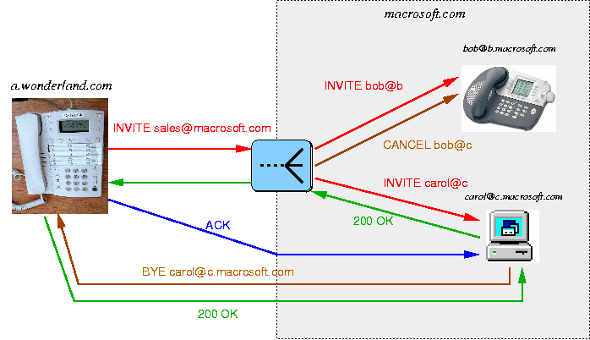
Basic SIP message flow

Slide 17

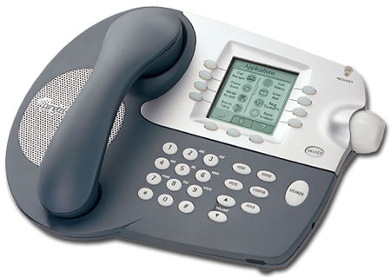
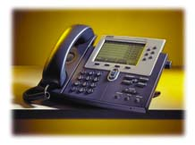
SIP trapezoid
outbound proxy
destination proxy
(identified by SIP URI domain)
1st request
SIP trapezoid
2nd, 3rd, … request
a@foo.com: 128.59.16.1
registrar
voice traffic
RTP

Slide 18
SIP message format
request
response
request line
INVITE sip:bob@there.com SIP/2.0
SIP/2.0 200 OK
Via: SIP/2.0/UDP here.com:5060
From: Alice <sip:alice@here.com>
To: Bob <sip:bob@there.com>
Call-ID: 1234@here.com
CSeq: 1 INVITE
Subject: just testing
Contact: sip:alice@pc.here.com
Content-Type: application/sdp
Content-Length: 147
Via: SIP/2.0/UDP here.com:5060
From: Alice <sip:alice@here.com>
To: Bob <sip:bob@there.com>
Call-ID: 1234@here.com
CSeq: 1 INVITE
Subject: just testing
Contact: sip:alice@pc.here.com
Content-Type: application/sdp
Content-Length: 134
header fields
v=0
o=alice 2890844526 2890844526 IN IP4 here.com
s=Session SDP
c=IN IP4 100.101.102.103
t=0 0
m=audio 49172 RTP/AVP 0
a=rtpmap:0 PCMU/8000
v=0
o=bob 2890844527 2890844527 IN IP4 there.com
s=Session SDP
c=IN IP4 110.111.112.113
t=0 0
m=audio 3456 RTP/AVP 0
a=rtpmap:0 PCMU/8000
message body
SDP

Slide 19



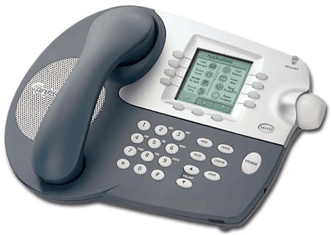
PSTN vs. Internet Telephony
PSTN:
Signaling & Media
Signaling & Media
Internet
telephony:
China
Signaling
Signaling
Media
Belgian customer,
currently visiting US
Australia
Notes:
With a few exceptions, in Internet telephony, end systems are the only entities where signaling and media flows converge. Thus, any service that requires interaction with user media is likely to be easier to implement in the end systems.
More seperately

Slide 20

SIP addressing
Users identified by SIP or tel URIs
  sip:alice@example.com
tel: URIs describe E.164 number, not dialed digits (RFC 2806bis)
tel URIs → SIP URIs by outbound proxy
A person can have any number of SIP URIs
The same SIP URI can reach many different phones, in different networks
  sequential & parallel forking
SIP URIs can be created dynamically:
  GRUUs
  conferences
  device identifiers (sip:foo@128.59.16.15)
Registration binds SIP URIs (e.g., device addresses) to SIP “address-of-record” (AOR)
tel:110
sip:sos@domain
domain →
128.59.16.17
via NAPTR + SRV

Slide 21

3G Architecture (Registration)
mobility management
signaling
serving
interrogating
interrogating
CSCF
proxy
home IM domain
registration signaling (SIP)_
visited IM domain

Slide 22
Presence & events

Slide 23

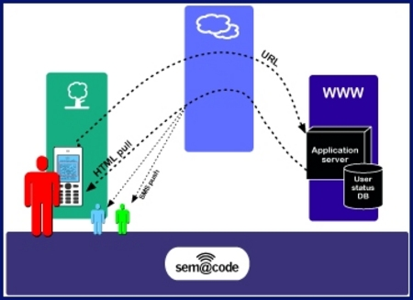
We need glue!
Lots of devices and services
  cars
  household
  environment
Generally, stand-alone
  e.g., GPS can’t talk to camera
Home
  home control networks have generally failed
    cost, complexity
Environment
  “Internet of things”
  tag bus stops, buildings, cars, ...

Slide 24
Left to do: event notification
notify (small) group of users when something of interest happens
  presence = change of communications state
  email, voicemail alerts
  environmental conditions
  vehicle status
  emergency alerts
kludges
  HTTP with pending response
  inverse HTTP --> doesn’t work with NATs
Lots of research (e.g., SIENA)
IETF efforts starting
  SIP-based
  XMPP

Slide 25




Context-aware communication
context = “the interrelated conditions in which something exists or occurs”
anything known about the participants in the (potential) communication relationship
both at caller and callee
time | CPL
capabilities | caller preferences
location | location-based call routing location events
activity/availability | presence
sensor data (mood, bio) | privacy issues similar to location data

Slide 26
The role of presence
Guess-and-ring
  high probability of failure:
    “telephone tag”
    inappropriate time (call during meeting)
    inappropriate media (audio in public place)
  current solutions:
    voice mail → tedious, doesn’t scale, hard to search and catalogue, no indication of when call might be returned
    automated call back → rarely used, too inflexible
  → most successful calls are now scheduled by email
Presence-based
  facilitates unscheduled communications
  provide recipient-specific information
  only contact in real-time if destination is willing and able
  appropriately use synchronous vs. asynchronous communication
  guide media use (text vs. audio)
  predict availability in the near future (timed presence)
Prediction: almost all (professional) communication will be presence-initiated or pre-scheduled

Slide 27


GEOPRIV and SIMPLE architectures
rule
maker
DHCP
XCAP
(rules)
target
publication
interface
location
server
notification
interface
location
recipient
GEOPRIV
presentity
presence
agent
SUBSCRIBE
watcher
SIP
presence
PUBLISH
NOTIFY
caller
callee
SIP
call
INVITE
INVITE

Slide 28

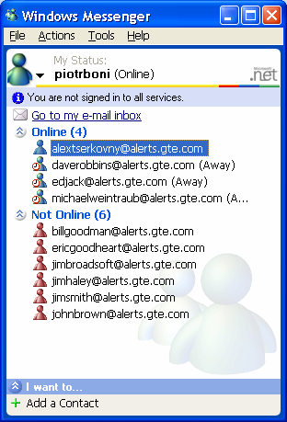





Presentity and Watchers
Bob’s
Presentity
Presence
Server
(PS)
Watchers
SUBSCRIBE
Watchers
Watchers
PUBLISH
NOTIFY
Bob’s status, location
Available, Busy, Somewhat available, Invisible
Bob’s Filters (Rules), PIDF *)
wife
PUBLISH
son
R u there ?
*) - PIDF = Presence Information Data Format
BUZZ
friend
Cell
Phone
PC-IM Client
Bob’s play station
Bob’s Presence User Agents (PUA)
external
world

Slide 29
Basic presence
Role of presence
    initially: “can I send an instant message and expect a response?”
    now: “should I use voice or IM? is my call going to interrupt a meeting? is the callee awake?”
Yahoo, MSN, Skype presence services:
    on-line & off-line
      useful in modem days – but many people are (technically) on-line 24x7
      thus, need to provide more context
    + simple status (“not at my desk”)
    entered manually → rarely correct
    does not provide enough context for directing interactive communications

Slide 30

Presence data architecture
presence sources
PUBLISH
raw
presence
document
create
view
(compose)
privacy
filtering
depends on watcher
XCAP
select best source
resolve contradictions
XCAP
composition
policy
privacy
policy
(not defined yet)
draft-ietf-simple-presence-data-model

Slide 31

Presence data architecture
candidate
presence
document
raw
presence
document
post-processing
composition
(merging)
watcher
filter
remove data not of
interest
SUBSCRIBE
difference
to previous notification
final
presence
document
watcher
NOTIFY

Slide 32
Rich presence
Provide watchers with better information about the what, where, how of presentities
facilitate appropriate communications:
  “wait until end of meeting”
  “use text messaging instead of phone call”
  “make quick call before flight takes off”
designed to be derivable from calendar information
  or provided by sensors in the environment
allow filtering by “sphere” – the parts of our life
  don’t show recreation details to colleagues

Slide 33
Rich presence
automatically derived from
  sensors: physical presence, movement
  electronic activity: calendars
Contains:
  multiple contacts per presentity
    device (cell, PDA, phone, …)
    service (“audio”)
  activities, current and planned
  surroundings (noise, privacy, vehicle, …)
  contact information
  composing (typing, recording audio/video IM, …)

Slide 34


The role of presence for call routing
PUBLISH
Two modes:
  watcher uses presence information to select suitable contacts
    advisory – caller may not adhere to suggestions and still call when you’re in a meeting
  user call routing policy informed by presence
    likely less flexible – machine intelligence
    “if activities indicate meeting, route to tuple indicating assistant”
    “try most-recently-active contact first” (seq. forking)
PA
translate
RPID
NOTIFY
CPL
LESS
INVITE

Slide 35
Presence and privacy
All presence data, particularly location, is highly sensitive
Basic location object (PIDF-LO) describes
  distribution (binary)
  retention duration
Policy rules for more detailed access control
  who can subscribe to my presence
  who can see what when
<tuple id="sg89ae">
<status>
<gp:geopriv>
<gp:location-info>
<gml:location>
<gml:Point gml:id="point1“
srsName="epsg:4326">
<gml:coordinates>37:46:30N 122:25:10W
</gml:coordinates>
</gml:Point>
</gml:location>
</gp:location-info>
<gp:usage-rules>
<gp:retransmission-allowed>no
</gp:retransmission-allowed>
<gp:retention-expiry>2003-06-23T04:57:29Z
</gp:retention-expiry>
</gp:usage-rules>
</gp:geopriv>
</status>
<timestamp>2003-06-22T20:57:29Z</timestamp>
</tuple>

Slide 36


Privacy rules
Conditions
  identity, sphere
  time of day
  current location
  identity as <uri> or <domain> + <except>
Actions
  watcher confirmation
Transformations
  include information
  reduced accuracy
User gets maximum of permissions across all matching rules
  privacy-safe composition: removal of a rule can only reduce privileges
Extendable to new presence data
  rich presence
  biological sensors
  mood sensors

Slide 37
Example rules document
<rule id=1>
<conditions>
<identity><id>user@example.com</id></identity>
<actions>
<sub-handling>allow</sub-handling>
<provide-services>
<service-uri-scheme>sip</service-uri-scheme>
<service-uri-scheme>mailto</service-uri-scheme>
</provide-services>
<provide-person>true</provide-person>
<provide-activities>true</provide-activities>
<provide-user-input>bare</provide-user-input>
<ruleset>
<transformations>

Slide 38
Location-based services

Slide 39
Location-based services

Slide 40
Location-based SIP services
Location-aware inbound routing
  do not forward call if time at callee location is [11 pm, 8 am]
  only forward time-for-lunch if destination is on campus
  do not ring phone if I’m in a theater
outbound call routing
  contact nearest emergency call center
  send delivery@pizza.com to nearest branch
location-based events
  subscribe to locations, not people
  Alice has entered the meeting room
  subscriber may be device in room → our lab stereo changes CDs for each person that enters the room

Slide 41
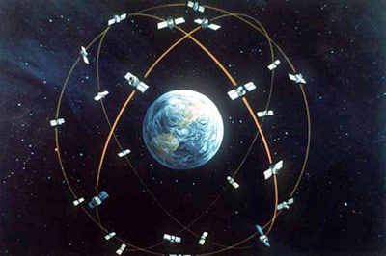
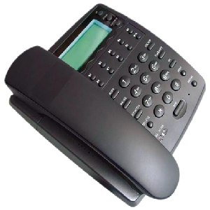
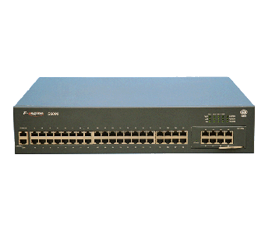
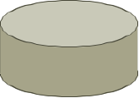

Location delivery
GPS
HELD
HTTP
wire
map
DHCP
LLDP-MED

Slide 42
Location determination options
Method | CDP or LLDP-MED | DHCP | HELD | GPS | manual entry
Layer | L2 | L3 | L7 (HTTP) | - | user
advantages | simple to implement built into switch direct port/room mapping | simple to implement network locality | traverses NATs can be operated by L2 provider | accurate mobile devices no carrier cooperation | no infrastructure changes no carrier cooperation
problems | may be hard to automate for large enterprises | mapping MAC address to location? | mapping IP address to switch port? | indoor coverage acquisition time | fails for mobile devices unreliable for nomadic
Use | Ethernet LANs | Enterprise LANs Some ISPs | DSL, cable | mobile devices | fall back

Slide 43
Program location-based services

Slide 44
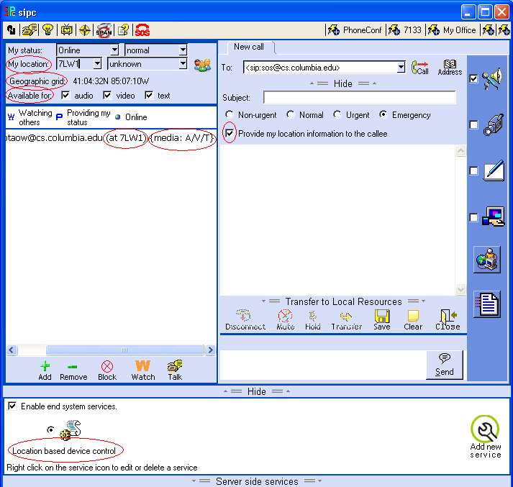

Slide 45
Emergency calling

Slide 46





Modes of emergency communications
emergency call
information
“I-am-alive”
emergency alert
(“inverse 911”)
dispatch
civic coordination

Slide 47
Background on 9-1-1
Established in Feb. 1968
  1970s: selective call routing
  late 1990s: 93% of population/96% of area covered by 9-1-1
  95% of 9-1-1 is Enhanced 9-1-1
  US and Canada
Roughly 200 mio. calls a year (6 calls/second)
  1/3 wireless
6146 PSAPs in 3135 counties
  most are small (2-6 call takers)
  83.1% of population have some Phase II (April 2007)
“12-15 million households will be using VoIP as either primary or secondary line by end of 2008” (NENA)
http://www.nena.org/

Slide 48
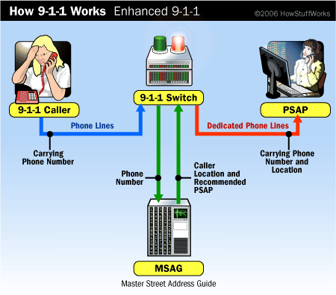
Local Switch
Automatic
Number
Identification
Automatic
Location
Identification
Collaboration between
local phone providers and
local public safety agencies

Slide 49
What makes VoIP 112/911 hard?
POTS | PSTN-emulation VoIP | end-to-end VoIP
(landline) phone number limited to limited area | landline phone number anywhere in US (cf. German 180) | no phone number or phone number anywhere around the world
regional carrier | national or continent-wide carrier | enterprise “carrier” or anybody with a peer-to-peer device
voice provider = line provider (~ business relationship) | voice provider ≠ ISP | voice provider ≠ ISP
national protocols and call routing | probably North America + EU | international protocols and routing
location = line location | mostly residential or small business | stationary, nomadic, wireless

Slide 50
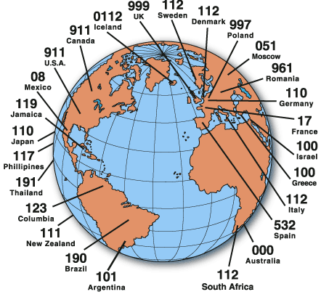
Emergency numbers
Each country and region has their own
  subject to change
Want to enable
  traveler to use familiar home number
  good samaritan to pick up cell phone
Some 3/4-digit numbers are used for non-emergency purposes (e.g., directory assistance)
Emergency number

Slide 51
Service URN
Idea: Identifiers to denote emergency calls
  and other generic (communication) services
Described in IETF ECRIT RFC 5031
Emergency service identifiers:
  sos General emergency services
  sos.animal-control Animal control
  sos.fire Fire service
  sos.gas Gas leaks and gas emergencies
  sos.marine Maritime search and rescue
  sos.mountain Mountain rescue
  sos.physician Physician referral service
  sos.poison Poison control center
  sos.police Police, law enforcement

Slide 52

LoST: Location-to-URL Mapping
VSP₁
cluster serving VSP₁
replicate
root information
cluster
serves VSP₂
123 Broad Ave
Leonia
Bergen County
NJ US
LoST
NJ
US
NY
US
root
nodes
sip:psap@leonianj.gov
search
referral
Bergen County
NJ US
Leonia
NJ US

Slide 53
Cellular
LoST
9-
9-1-
9-1-1
9-1-1
SIP
RTP
Access Network

Slide 54
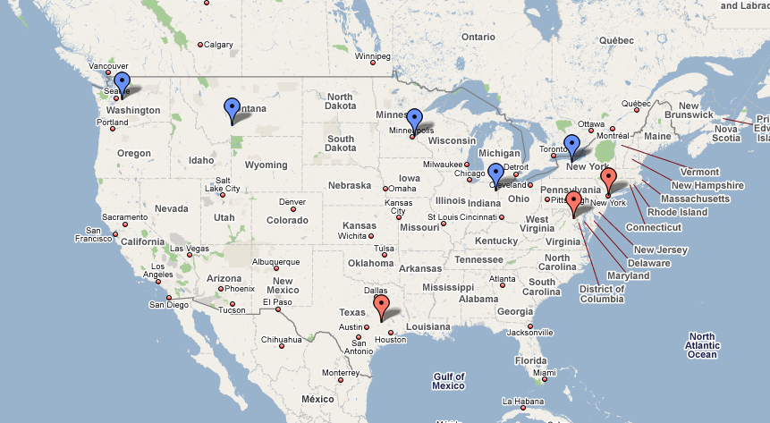
The POC system is deployed in 5 real PSAPs and 3 labs across the USA.
PSAP: Public Safety Answering Point (=Emergency call center)
King County, WA
Bozeman, MT
St. Paul, MN
Rochester, NY
Columbia Univ. Lab
Fort Wayne, IN
BAH Lab
TAMU Lab

Slide 55
P2P

Slide 56
Defining peer-to-peer systems
1 & 2 are not sufficient:
DNS resolvers provide services to others
Web proxies are both clients and servers
SIP B2BUAs are both clients and servers

Slide 57



P2P systems are …
P2P
NETWORK ENGINEER’S WARNING
P2P systems may be
inefficient
slow
unreliable
based on faulty and short-term economics
mainly used to route around copyright laws
vs.

Slide 58
Motivation for peer-to-peer systems
Saves money for those offering services
  addresses market failures
Scales up automatically with service demand
More reliable than client-server (no single point of failure)
No central point of control
  mostly plausible deniability
Networks without infrastructure (or system manager)
New services that can’t be deployed in the ossified Internet
  e.g., RON, ALM

Slide 59
P2P traffic is not devouring the Internet…
steady percentage

Slide 60
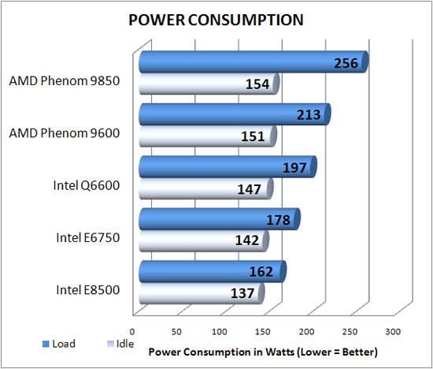
Energy consumption
Monthly cost =
$37
@ $0.20/kWh
http://www.legitreviews.com/article/682/
Notes:
http://www.legitreviews.com/images/reviews/682/power_consumption.jpg

Slide 61
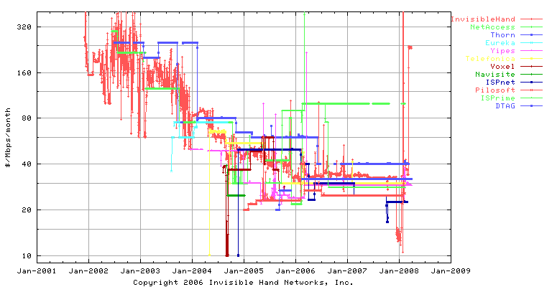
Bandwidth costs
Transit bandwidth: $40 Mb/s/month ~ $0.125/GB
US colocation providers charge $0.30 to $1.75/GB
  e.g., Amazon EC2 $0.17/GB (outbound)
  CDNs: $0.08 to $0.19/GB

Slide 62
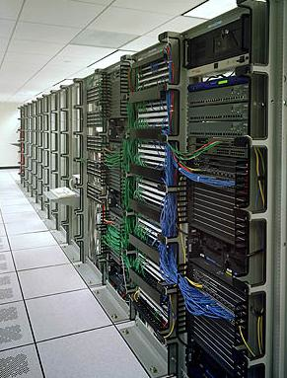
Economics of P2P
Service provider view
  save $150/month for single rented server in colo, with 2 TB bandwidth
  but can handle 100,000 VoIP users
But ignores externalities
  home PCs can’t hibernate → energy usage
    about $37/month
  less efficient network usage
  bandwidth caps and charges for consumers
    common in the UK
    Australia: US$3.20/GB
Home PCs may become rare
  see Japan & Korea
charge ($)
bandwidth
Notes:
http://www.primus.com.au/PrimusWeb/HomeSolutions/AdditionalServices/Broadband+TopUps.htm

Slide 63
Which is greener – P2P vs. server?
Typically, P2P hosts only lightly used
  energy efficiency/computation highest at full load
  → dynamic server pool most efficient
  better for distributed computation (SETI@home)
But:
  CPU heat in home may lower heating bill in winter
    but much less efficient than natural gas (< 60%)
  Data center CPUs always consume cooling energy
    AC energy ≈ server electricity consumption
Thus,
  deploy P2P systems in Scandinavia and Alaska

Slide 64
Reliability
Some of you may be having problems logging into Skype. Our engineering team has determined that it’s a software issue. We expect this to be resolved within 12 to 24 hours. (Skype, 8/12/07)
CW: “P2P systems are more reliable”
Catastrophic failure vs. partial failure
  single data item vs. whole system
  assumption of uncorrelated failures wrong
Node reliability
  correlated failures of servers (power, access, DOS)
  lots of very unreliable servers (95%?)
Natural vs. induced replication of data items

Slide 65
Security & privacy
Security much harder
  user authentication and credentialing
    usually now centralized
  sybil attacks
  byzantine failures
Privacy
  storing user data on somebody else’s machine
Distributed nature doesn’t help much
  same software → one attack likely to work everywhere
CALEA?

Slide 66
OA&M
P2P systems are hard to debug
No real peer-to-peer management systems
  system loading (CPU, bandwidth)
    automatic splitting of hot spots
  user experience (signaling delay, data path)
  call failures
Later: P2PP & RELOAD add mechanisms to query nodes for characteristics
Who gathers and evaluates the overall system health?

Slide 67
P2P for VoIP

Slide 68

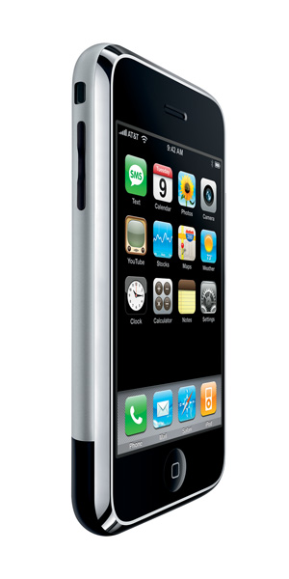
The role of SIP proxies
tel:1-212-555-1234
REGISTER
sip:alice@example.com
sip:line1@128.59.16.1
Translation may depend on caller, time of day, busy status, …
sip:6461234567@mobile.com

Slide 69



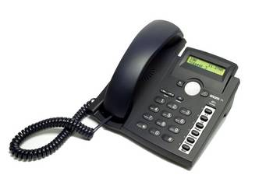
P2P SIP
Why?
  no infrastructure available: emergency coordination
  don’t want to set up infrastructure: small companies
  Skype envy :-)
P2P technology for
  user location
    only modest impact on expenses
    but makes signaling encryption cheap
  NAT traversal
    matters for relaying
  services (conferencing, transcoding, …)
    how prevalent?
New IETF working group formed
  multiple DHTs
  common control and look-up protocol?
generic DHT service
p2p network
P2P provider B
DNS
P2P provider A
traditional provider
zeroconf
LAN

Slide 70
More than a DHT algorithm
Finger table
Tree
Routing-table stabilization
Periodic recovery
Lookup correctness
Prefix-match
Modulo addition
Routing-table size
Parallel requests
Recursive routing
Bootstrapping
Updating routing-table from lookup requests
Leaf-set
XOR
Proximity neighbor selection
Lookup performance
Reactive recovery
Successor
Hybrid
Proximity route selection
Strict vs. surrogate routing
Routing-table exploration
Notes:
Slide: This slide shows many different DHT-independent and DHT-specific design choices
Different names for similar concepts (finger, routing-table).
Mixing of DHT-independent and DHT-specific issues in original papers.

Slide 71

P2P SIP -- components
Multicast-DNS (zeroconf) SIP enhancements for LAN
  announce UAs and their capabilities
Client-P2P protocol
  GET, PUT mappings
  mapping: proxy or UA
P2P protocol
  get routing table, join, leave, …
  independent of DHT
  replaces DNS for SIP and basic proxy

Slide 72
P2PSIP architecture
Bootstrap & authentication server
alice@example.com
Overlay 2
SIP
NAT
bob@example.com → 128.59.16.1
P2P
STUN
INVITE bob@128.59.16.1
TLS / SSL
NAT
peer in P2PSIP
bob@example.com
Overlay 1
client
Notes:
STUN=session traversal utilities
Optional bootstrap authentication server

Slide 73
IETF peer-to-peer efforts
Originally, effort to perform SIP lookups in p2p network
Initial proposals based on SIP itself
  use SIP messages to query and update entries
  required minor header additions
P2PSIP working group formed
  now SIP just one usage
Several protocol proposals (ASP, RELOAD, P2PP) merged
  still in “squishy” stage – most details can change

Slide 74
RELOAD
Generic overlay lookup (store & fetch) mechanism
  any DHT + unstructured
Routed based on node identifiers, not IP addresses
Multiple instances of one DHT, identified by DNS name
Multiple overlays on one node
Structured data in each node
  without prior definition of data types
  PHP-like: scalar, array, dictionary
  protected by creator public key
  with policy limits (size, count, privileges)
Maybe: tunneling other protocol messages

Slide 75
Typical residential access
Sasu Tarkoma, Oct. 2007

Slide 76
NAT traversal
get public IP address
media
P2P
peer

Slide 77
ICE (Interactive Connectivity Establishment)

Slide 78
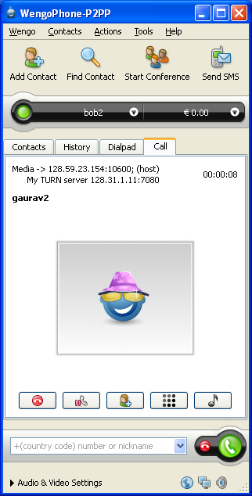
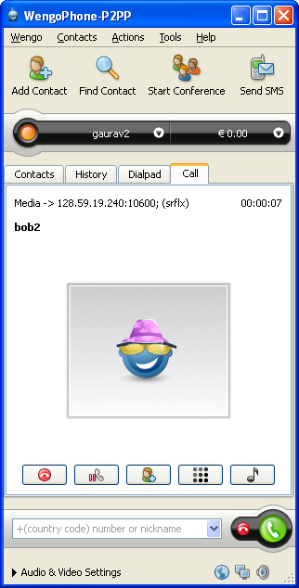
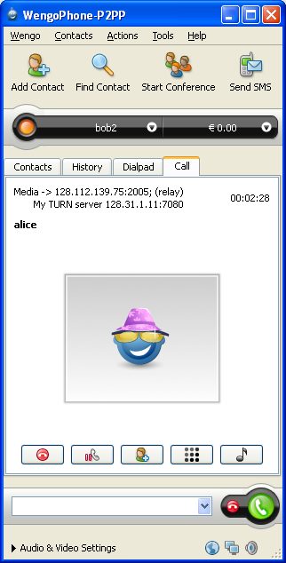
OpenVoIP snapshots
direct
call through a NAT
call through a relay

Slide 79
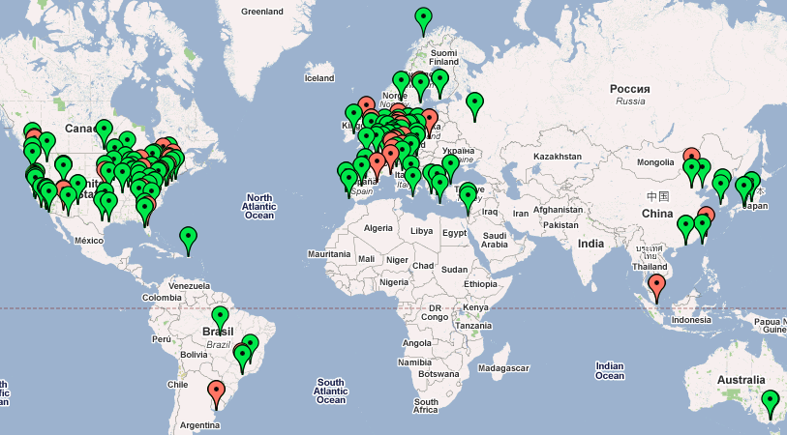
OpenVoIP snapshots
Google Map interface

Slide 80
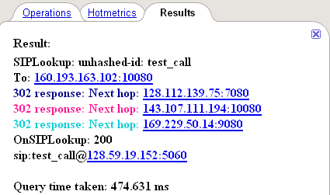
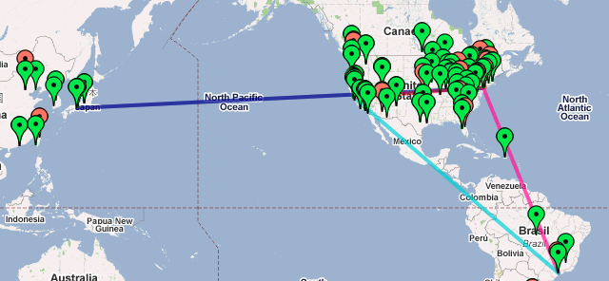
OpenVoIP snapshots
Tracing lookup request on Google Maps

Slide 81
Integrating cellular and 802.11

Slide 82
Integrating VoIP and Cellular

Slide 83



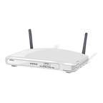
VoIP+GSM testbed
T1 Line
Cell-phone Tower
ISDN Gateway/SIP Conference
Server/SIP Proxy Server
GSM Network
WiFi Network
User B
(dual-mode handset)
User A
Access Point
Dual-mode handset
  IP interface: X-Lite client
  GSM interface: Nokia cellphone

Slide 84
Experiments
Total Call Setup Delay
A calls B
Call Forward
Calling B
User A
User B’s base station
Asterisk
User B
Forwarding Delay
Type of call (A → B) | Forwarding delay | Call-setup delay
Cell-to-cell * | 6.7 s | 9.6 s
Cell-to-IP ** | 3.1 s | 6.2 s

Slide 85
Fax-over-IP

Slide 86
Fax-over-IP

Slide 87
Fax pass-through
Uses G.711 over RTP
  fax signaling events (RFC 3665)
  other codecs may not reproduce modem tones
May be sensitive to packet-specific distortions
  bit errors → packet loss bursts
  jitter → delay adaptation gaps
Fixes:
  PLC in terminal adapter
  FEC in RTP stream
  T.38 in gateway?

Slide 88
Standards & interoperability

Slide 89



Interoperability
Generally no interoperability problems for basic SIP functionality
  basic call, digest registration (mostly...), call transfer, voice mail
Weaker in advanced scenarios and backward compatibility
  handling TCP, TLS
  NAT support (symmetric RTP, ICE, STUN, ...)
  multipart bodies
  SIP torture tests
  call transfer, call pick-up
  video and voice codec interoperability (H.264, anything beyond G.711)
SIPit useful, but no equivalent of WiFi certification
  most implementations still single-vendor (enterprise, carrier) or vendor-supplied (VSP)
  SFTF (test framework) still limited
Need profiles to guide implementers
A role for public shaming?
Notes:
https://lists.cs.columbia.edu/pipermail/sip-implementors/2006-October/014489.html
http://www.sipfoundry.org/sip-forum-test-framework/sip-forum-test-framework-sftf.html

Slide 90
Trouble in Standards Land
Proliferation of transition standards: 2.5G, 2.6G, 3.5G, …
  true even for emergency calling…
Splintering of standardization efforts across SDOs
  primary:
    IEEE, IETF, W3C, OASIS, ISO
  architectural:
    PacketCable, ETSI, 3GPP, 3GPP2, OMA, UMA, ATIS, …
  specialized:
    NENA
  operational, marketing:
    SIP Forum, IPCC, …
OASIS
data
formats
W3C
ISO (MPEG)
data
exchange
IETF
L2.5-L7
protocols
IEEE
L1-L2
PacketCable
3GPP

Slide 91
IETF issues
SIP WGs: small number (dozen?) of core authors (80/20)
  some now becoming managers…
  or moving to other topics
IETF: research → engineering → maintenance
  many groups are essentially maintaining standards written a decade (or two) ago
    DNS, IPv4, IPv6, BGP, DHCP; RTP, SIP, RTSP
    constrained by design choices made long ago
  often dealing with transition to hostile & “random” network
  network ossification
Stale IETF leadership
  often from core equipment vendors, not software vendors or carriers
fair amount of not-invented-here syndrome
    late to recognize wide usage of XML and web standards
    late to deal with NATs
    security tends to be per-protocol (silo)
      some efforts such as SAML and SASL
tendency to re-invent the wheel in each group

Slide 92
Conclusion
Even after 10+ years, VoIP mostly still “cheaper calls”
New services and models:
  (rich) presence
  location-based services
  user-programmable services
  P2P SIP
Scaling to carrier-scale and under duress
Current standardization processes slow and complexity-inducing

