Slide 1
VoIP intro
Henning Schulzrinne

Slide 2
Name confusion
Commonly used interchangeably:
  Voice-over-IP (VoIP) – but includes video
  Internet telephony – but may not run over Internet
  IP telephony (IPtel)
Also: VoP (any of ATM, IP, MPLS)
Some reserve Internet telephony for transmission across the (public) Internet
Transmission of telephone services over IP-based packet switched networks
Also includes video and other media, not just voice

Slide 3
A bit of history
1876 invention of telephone
1915 first transcontinental telephone (NY–SF)
1920’s first automatic switches
1956 TAT-1 transatlantic cable (35 lines)
1962 digital transmission (T1)
1965 1ESS analog switch
1974 Internet packet voice (2.4 kb/s LPC)
1977 4ESS digital switch
1980s Signaling System #7 (out-of-band)
1990s Advanced Intelligent Network (AIN)
1992 Mbone packet audio (RTP)
1996 early commercial VoIP implementations (Vocaltec); PC-to-PC calling

Slide 4

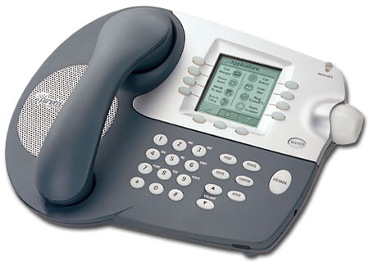
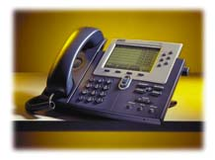
System model
to.com
registrar
outbound proxy
a@foo.com: 128.59.16.1
signaling
SIP trapezoid
media

Slide 5
Functions needed
Signaling
  Find destination user (vs. host)
    Using registration (“binding”)
  Negotiate media and their parameters
  Authenticate caller
  Implement services and policies
    Call vs. media services
Media
  Deliver media streams
    Right order, right codec, right timing
    Provide QoS feedback

Slide 6

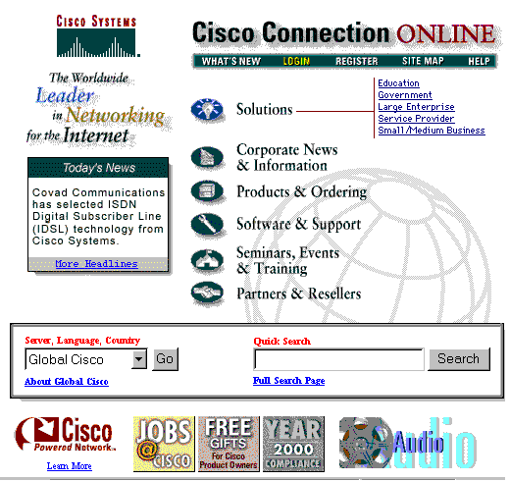
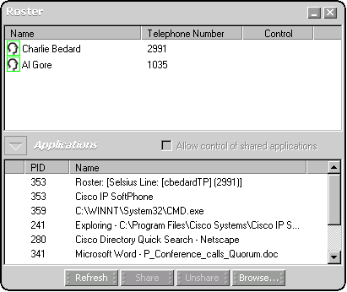



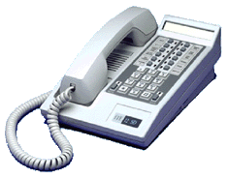


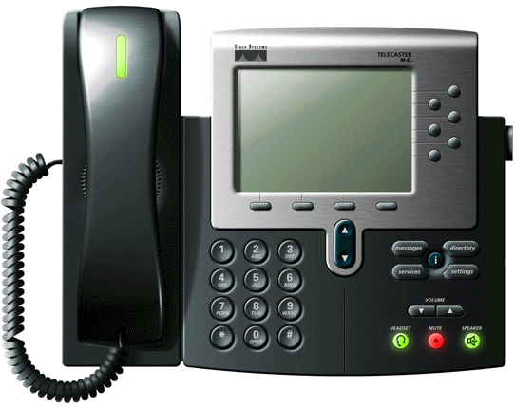
AVVID Architecture -
Open Packet Telephony
Collaboration
IP IVR, IP AA
Apps Engine
Intelligent
Contact
Manager
ICM
Applications
Cisco Unity
Voice Mail, UMS
Video
Voice Portal
Call Processing
Call
Processing
GK
Directory
PSTN
PSTN gateways
Analog phone support
DSP farms
IP
Network
Infrastructure
Clients
IP SoftPhone
The World Is Now Global—
All Apps Must Travel Time and Distance
Brian Gracely, Cisco, 2001

Slide 7
PBX features
boss/admin features
call waiting/multiple calls | RFC 3261
hold | RFC 3264
transfer | RFC 3515/Replaces
conference | RFC 3261/callee caps
message waiting | message summary package
call forward | RFC 3261
call park | RFC 3515/Replaces
call pickup | Replaces
do not disturb | RFC 3261
call coverage | RFC 3261
simultaneous ringing | RFC 3261
basic shared lines | dialog/reg. package
barge-in | Join
“Take” | Replaces
Shared-line “privacy” | dialog package
divert to admin | RFC 3261
intercom | URI convention
auto attendant | RFC 3261/2833
attendant console | dialog package
night service | RFC 3261
centrex-style features
attendant features
from Rohan Mahy’s VON Fall 2003 talk

Slide 8
Legacy (PSTN) issues
Map between E.164 numbers and URLs
Locate PSTN gateways
PSTN services
  Shared lines & key systems
  Early media (pre-pick up)
  Emergency calling
  Dumb end systems (elevator phones)

