Slide 1

Identity, Spheres and Privacy Rules
Henning Schulzrinne
(with Hannes Tschofenig and Richard Barnes)
Workshop on Identity, Information and Context October 21 - 22, 2008

Slide 2
The GEOPRIV Working Group
First BoF on Spatial Location held at 48th IETF (July 2000)
  IETF community had concerns that privacy was not sufficiently addressed
GEOPRIV WG formed, met for the first time at 50th IETF (August 2001)
  Strong user privacy mandate in WG charter
  Location determination methods are out of scope
  Scope is on protecting the transmission of location information over the public Internet
2008: A number of RFCs associated already available.
Vendors, operators, standards professionals, policy experts, and academia
More information:
http://www.ietf.org/html.charters/geopriv-charter.html

Slide 3
Privacy Concerns
Location
  Many entities know your location today
  In many cases, YOU do not control the systems that determines and stores your location
  Example: NetGeo database (see RFC 1876)
In many cases, location is only one data element in the larger presence context. Distribution of these other attributes also deserves privacy protection.
To understand the work in GEOPRIV the presence work has to be considered.

Slide 4
Overview of Presence
Presence emerged as a component of instant messaging applications
Foremost, provides binary availability data
  Online or offline?
Closely tied to the concept of a friends list
  Based on subscription, a persistent relationship
Modern presence systems also provide a disposition towards communication
  Not just am I online, but am I busy, away, etc
Capability information
  What kinds of communication can I accommodate with my endpoint?
Customized responses – context dependent
  Give different answers to different subscribers

Slide 5

Basic Presence Model
Notification
(4) PUBLISH
(3) SUBSCRIBE
Publication
Presence
Server
(5) NOTIFY
Presentity
Watcher
(2) XCAP
Policy
Simplified SIP
exchanges
Rule Maker

Slide 6
Basic GEOPRIV Architecture
Publication
Notification
Location
Server
Location
Generator
Location
Recipient
Policy
Rules
Rule
Maker
Shows only the network
agents, not the human actors

Slide 7
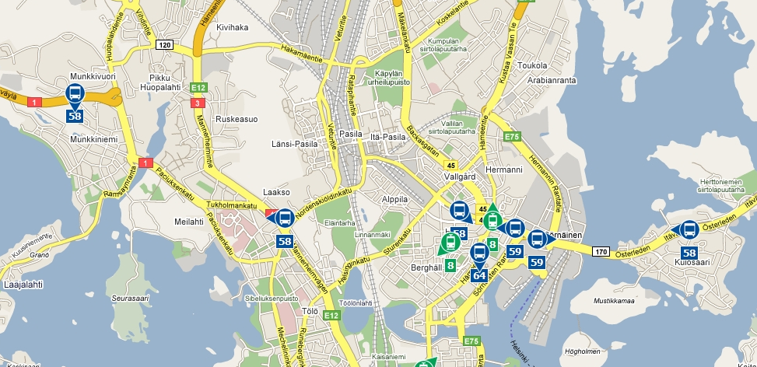
Example: Vehicle Tracking
http://transport.wspgroup.fi/hklkartta/

Slide 8
PIDF-LO: RFC 4119
Basic Ruleset = Usage Restriction
MUST always be attached to a PIDF-LO document
    Retention expires (how long are you allowed to keep the object)
    Policy for retransmission of location information (Yes/No)
    Reference to an external ruleset (optional)
    A “note well” of free text, human readable privacy policy
Specified in RFC 4119

Slide 9
Authorization for Presence and Location Information
Authorization Framework
Basic Ruleset
Extended Ruleset
Common
Policy
PIDF-LO
Geopriv Policy
Presence Policy
RFC 4745 – Common Policy
RFC 5020 -- Presence Authorization Policy
draft-ietf-geopriv-policy-14.txt – Geolocation Policy

Slide 10
Extended Ruleset
Common Policy
Design Goals:
  Permit only
  Additive permissions (“Minimal Disclosure”)
  Upgradeable/Extensibility
  Capability/Versioning support
  No false assurance
  Efficient implementation (no regular expressions)
  Protocol-independent
Supports pluralism of contexts
Two Usage Models:
  Attached (per-value or per-reference) to PIDF-LO document
  Available at the Location/Presence Server
Identity information needs to be instantiated based on the specific conveyance protocol

Slide 11
Extended Ruleset
Common Policy
Rule consists of:
  conditions part
  actions parts
  transformations part
Conditions:
  Identity Conditions
    Matching One Entity
    Matching Multiple Entities
    Matching Any Authenticated Identity
    Matching Any Authenticated Identity Excepting Enumerated Domains/Identities
  Sphere
  Validity
No actions & no transformations specified

Slide 12
Common Policy
Example
<?xml version="1.0" encoding="UTF-8"?>
<ruleset xmlns="urn:ietf:params:xml:ns:common-policy">
<rule id="f3g44r1">
<conditions>
<identity>
<one id="sip:alice@example.com"/>
<one id="tel:+1-212-555-1234" />
<one id="mailto:bob@example.net" />
<many domain="example.com"/>
</identity>
<sphere value="work"/>
<validity>
<from>2003-12-24T17:00:00+01:00</from>
<until>2003-12-24T19:00:00+01:00</until>
</validity>
</conditions>
<actions/>
<transformations/>
</rule>
</ruleset>

Slide 13
Identity Handling
Identity information depends on the selected conveyance protocol.
Specification needs to indicate how the identity fields of Common Policy are populated.
Functionality about identity management and privacy inherited from conveyance protocol (e.g., SIP)
Examples in the SIP context:
  P-Asserted ID (RFC 3325)
  SIP Identity (RFC 4474) / Authenticated Identity Body (RFC 3893)
  SIP SAML (draft-ietf-sip-saml-03.txt)
  SIP CERTS (draft-ietf-sip-certs-05.txt)
  Privacy in SIP: RFC 3323

Slide 14
Geopriv Policy
Adds location-based authorization policies to the Common Policy framework
Conditions:
  IF **I am in the following area** THEN
Transformations:
  SET usage policies
  REDUCE granularity of provided location information

Slide 15
Policy
Example (1/2)
<rule id="BB56A19">
<conditions>
<gp:location-condition>
<gp:location
profile="geodetic-condition">
<gs:Circle
srsName="urn:ogc:def:crs:EPSG::4326">
<gml:pos>
-34.410649 150.87651
</gml:pos>
<gs:radius
uom="urn:ogc:def:uom:EPSG::9001">
1500
</gs:radius>
</gs:Circle>
</gp:location>
</gp:location-condition>
</conditions>
<transformations/>
</rule>
<cp:rule id="AA56i09">
<cp:conditions>
<gp:civic-loc-condition>
<country>DE</country>
<A1>Bavaria</A1>
<A3>Munich</A3>
<A4>Perlach</A4>
<A6>Otto-Hahn-Ring</A6>
<HNO>6</HNO>
</gp:civic-loc-condition>
</cp:conditions>

Slide 16
Challenge: User Interface
More work is necessary to develop user-friendly interfaces.
Particularly important since authorization policies are an integral part of the solution
A lot of today’s communication is still done without any policy handling.
Paradigm change since we see user in the role of changing the privacy policies (“user control and consent”).

Slide 17
Outlook
Increased usage of PUB/SUB usage and richer presence usage expected
As deployment increases the problems with data retention and privacy will increase too
GEOPRIV architecture unique among the standardization solutions.
More implementation work is needed to determine better and extended policy handling

