Slide 1
VoIP beyond calling grandma: 3 projects
Henning Schulzrinne
Dept. of Computer Science, Columbia University, New York
hgs@cs.columbia.edu
(with Jong Yul Kim, Wonsng Song, Omer Boyaci, Supreeth Subramanya and others)
VoIP Conference & Expo 2008
October 24, 2008

Slide 2
Overview
FAA training: beyond phone numbers
NG911 prototype: integrating data
BASS application sharing: beyond voice and video

Slide 3
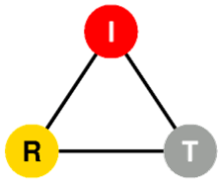

VoIP Systems at FAA
Anurag Chakravarthi, Venkata Malladi, Prakash G S,
Henning Schulzrinne, Supreeth Subramanya, Xiaotao Wu
Department of Computer Science
Columbia University
Date: May 1, 2007

Slide 4
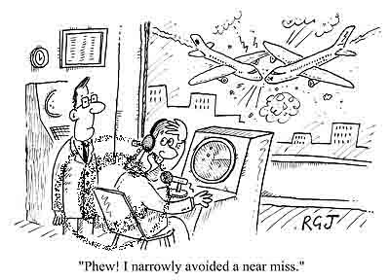
Air Traffic Controller
A person who operates the air traffic control system to expedite and maintain a safe and orderly flow of the air traffic and help prevent mid-air collisions.
Cartoon from - http://www.cartoonstock.com/lowres/rjo0363l.jpg

Slide 5
FAA training
Federal Aviation Administration (FAA)
An agency of the U.S. Department of Transportation with authority to regulate and oversee all aspects of civil aviation in the U.S.
FAA Academy
The education and training division of FAA
Provides training to all personnel of aviation community
We’re working with a group responsible for training the Air Traffic Controllers (ATC)

Slide 6
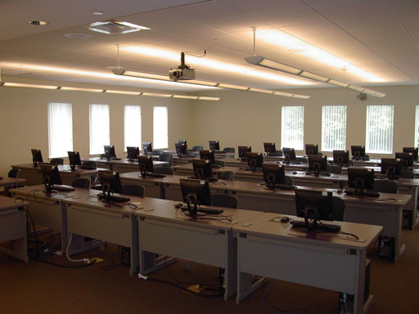

FAA training
ATC Training levels
Low fidelity – instructional games, individual training
Medium fidelity – real time interactive training
Full fidelity – complex interactions, real hardware
Photos - http://www.cba.uri.edu/classrooms/pictures/computerlab.jpg & http://www.lockheedmartin.com/data/assets/10307.jpg

Slide 7
Before & after
FAA Academy Communication System
Three parallel networks in every classroom and lab
Data Network (Fast or Gigabit Ethernet)
Voice Network (Analog, hardwired point-to-point connections)
Video Network (Graphical simulations)
Disadvantages
Difficult to add new training scenarios
Uses obsolete equipments, no longer available without custom manufacture
Solution – convergence of Data and Voice networks
Digital vs. analog
Better utilization of bandwidth
Reconfigurability in connections
I’m in

Slide 8
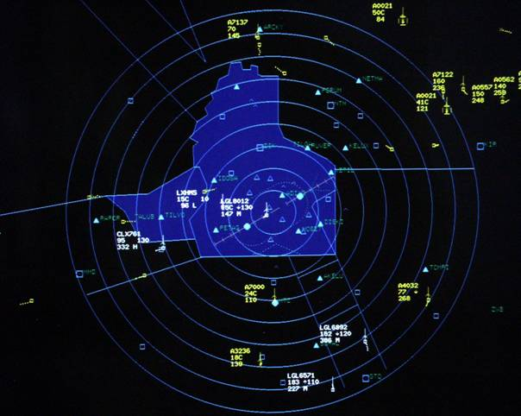
The Bigger Picture
What are the ATCs trained on?
Learning to use air traffic control devices & displays
Communicating and coordinating with Pilots / ATCs
Many more aspects
  Learning the air traffic rules
  Developing a mental picture of
  air-space and air-timing
Why should we care?
We are designing the communication system
We’ll have to use air traffic control devices and displays for input/output
Photo - http://www.aeroport.public.lu/pictures/en/administration/atc/atc_003.jpg

Slide 9
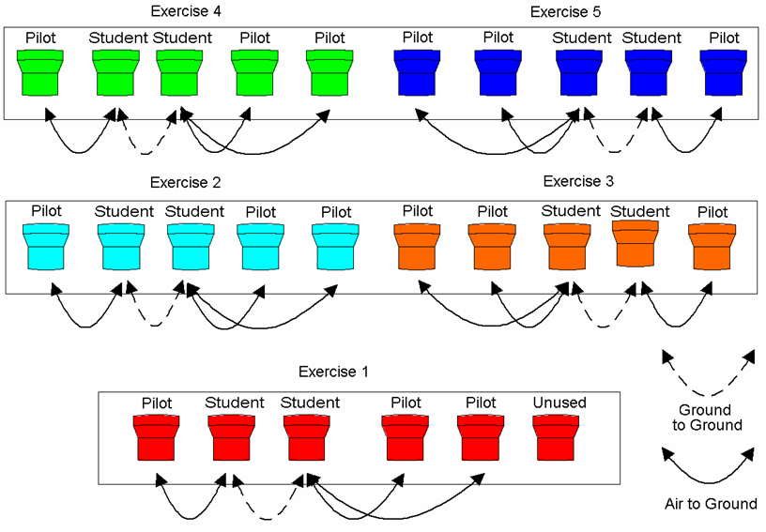
The Classroom VoIP System
Overview
Consists of up to 26 Students (ATC, Pilot) and 1 instructor
Students and instructor use computer and push-to-talk (PTT) device
Instructor loads a flight scenario and teaches/tests the students
Dual Sector
Scenario

Slide 10
The Classroom VoIP System
Four Communication scenarios
ATC communicates with the pilots in his sector (radio broadcast)
ATC communicates with neighboring ATCs during pilot handoff (point-to-point)
Instructor may monitor students (i.e. listen to what they hear/talk)
Instructor may record the training sessions
SIP perspective
Signaling – Student UA, Instructor UA and SIP proxy
Voice communication – RTP stack, Audio/speech codec library
System information – Database (MySQL)

Slide 11
The Classroom VoIP System
1. Radio (or Frequency) Communication
Communication amongst ATC and all the pilots in his sector → Multicast
The flight scenario loaded by the instructor defines the communication rules
SIP perspective
Every radio channel is given a permanent SIP address (sip:freq_120@faa.gov)
There’s no destination for a radio call – the caller needs to join a multicast session
Generation and management of multicast address
  Multicast Address Provider UA (MAP UA)
Define the rules for allowing a student to participate in a radio channel communication
  Configurations and roles defined in database (by the Instructor)
Logic for processing the communication request
  SIP-CGI

Slide 12
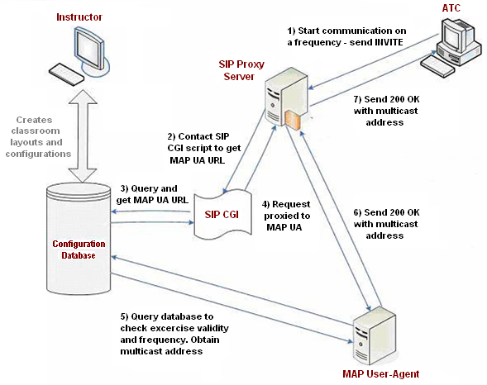
The Classroom VoIP System
Radio
Communication
Design

Slide 13
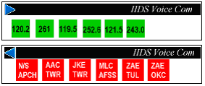
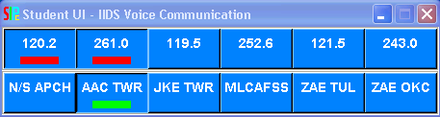
The Classroom VoIP System
User Interfaces and I/O Devices
Student UI
Buttons for each radio and landline channels
Audio visual cues to describe the state – Unselected, Selected, Active or Ringing
Dynamic creation of the UI based on a configuration file
Hardwired
System UI
VoIP System UI
Push-To-Talk (PTT)
A USB device with a headphone, a microphone and a binary switch
Used as a selector for the voice transmission channel
  Reception on radio and landline can be simultaneous, but transmission is mutually exclusive

Slide 14
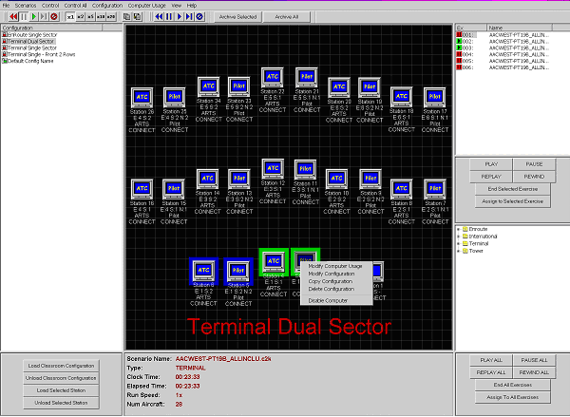
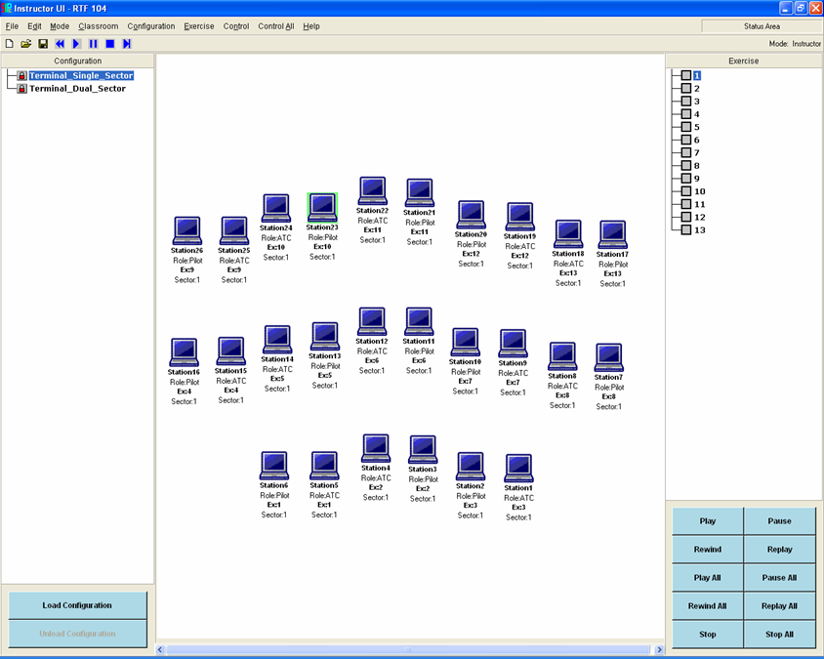
The Classroom VoIP System
User Interfaces and I/O Devices
Instructor UI
Create configurations/rules and load/unload exercises
Monitor students and record/replay voice communications
Visual representation of the classroom
Hardwired System UI
VoIP System UI

Slide 15
The Classroom VoIP System
Implementation and Packaging
Everything’s in Tcl/Tk
RTP and audio/speech library is in C++
Student, instructor machines are Windows and VoIP server is Linux
  Freewrap - to package all the Tcl/Tk files into a single windows executable
  Installshield - to put the executables, configuration files
  Linux RPM - sipd, rtspd, sip-cgi, mapua, MySQL

Slide 16
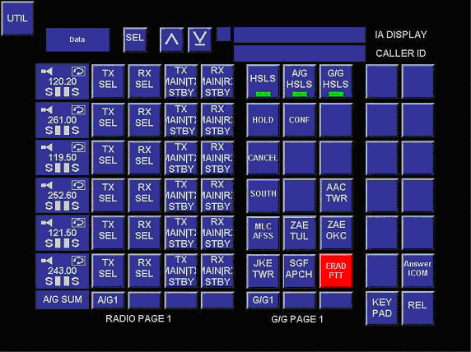
The Lab VoIP System
Unified, configurable GUI for ATC and Position Instructors

Slide 17
FAA systems: lessons learned
Key insights
Map real-world communication scenarios to SIP/RTP/RTSP flows
Put together SIP components, leading to a VoIP architecture
Importance of an extensible design with well-defined interfaces
  VoIP system migration from classrooms to the labs
Need for robust error/warning handling
Progress so far
Classroom VoIP is operational in 5 training rooms
Lab VoIP to be deployed by June ‘07

Slide 18






The Next Generation 9-1-1
Proof-of-Concept System

Slide 19
About the project
“EMERGENCY HELP. Anytime, anywhere, any device.”™
National Emergency Number Association (NENA)
IETF ECRIT Working Group
IETF GEOPRIV Working Group
NENA
High level requirements
Use of multimedia
Data delivery and sharing
Recording and incident details
Call taker user interface
Technical standards
System architecture
Behavior of components
Format of location objects
Technical standards
IETF ECRIT Working Group
IETF GEOPRIV Working Group
The NG9-1-1 POC System

Slide 20
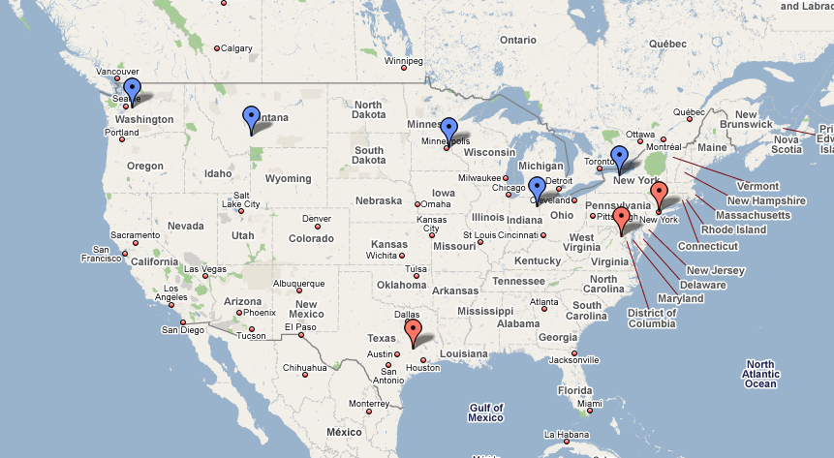
The POC system is deployed in 5 real PSAPs and 3 labs across the USA.
PSAP: Public Safety Answering Point (=Emergency call center)
King County, WA
Bozeman, MT
St. Paul, MN
Rochester, NY
Columbia Univ. Lab
Fort Wayne, IN
BAH Lab
TAMU Lab

Slide 21
POC system is divided into two networks
Emergency Services Network (ESN)
9-1-1
SIP-based network of PSAPs
managed by the emergency authorities
Access Network
Network used by emergency caller to ask for help
Examples: PSTN, Cellular, Residential VoIP
Role
1. Determine location of caller
2. Route call to ESN

Slide 22

①
③
Why is location important?
Send help to the site of emergency
Route call to the correct destination
How do I send my location?
Sent along with SIP INVITE
Formatted as PIDF-LO XML object
GPS
②
LLDP-MED
DHCP
Cell Tower
Manual Entry
Skyhook Wireless

Slide 23
VoIP
LoST
9-
9-1-
9-1-1
9-1-1
SIP
RTP
Access Network

Slide 24
VoIP
LoST
9-1-1
SIP
RTP
“All call takers are busy…”
Access Network

Slide 25
Cellular
LoST
9-
9-1-
9-1-1
9-1-1
SIP
RTP
Access Network

Slide 26
SMS
LoST
9-
9-1-
9-1-1
9-1-1
“Bank robbery!”
SIP
S
Access Network

Slide 27
Telematics
LoST
9-
9-1-
9-1-1
9-1-1
SIP
RTP
Access Network
Crash Data

Slide 28
Comments
We are beginning to understand what an emergency response system should look like
There are lots of interesting network problems in emergency communication systems
  Location of network devices
  “Call setup time (dialing of last digit to ring at the PSAP), under expected peak load shall be less than 2 seconds.”
  Reliable communications in large scale disasters

Slide 29
BASS Application Sharing System
Omer Boyaci
www.cs.columbia.edu/~boyaci/appshare

Slide 30
Application Sharing
Sharing an application with multiple users
There is only one copy of the application
Participants do not need application itself
Briefly, participants
  receive screen updates
  send keyboard and mouse events
Desktop sharing is also supported.

Slide 31
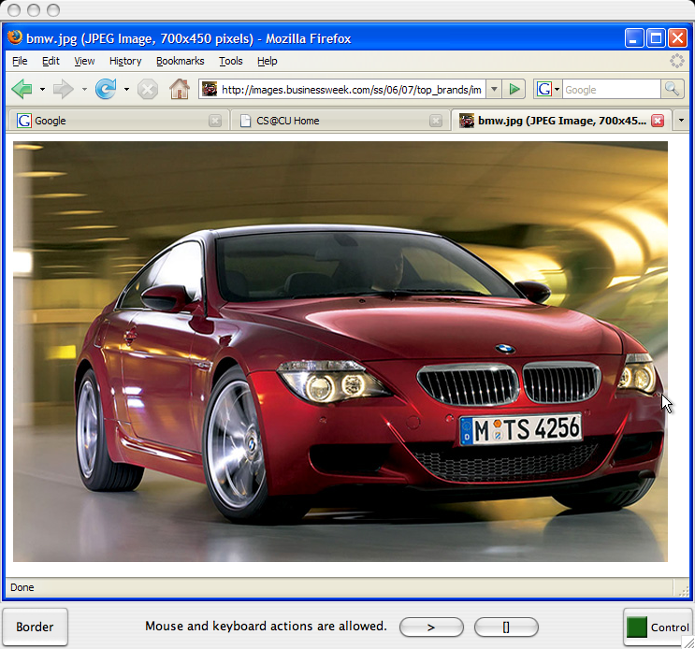
Screenshot

Slide 32
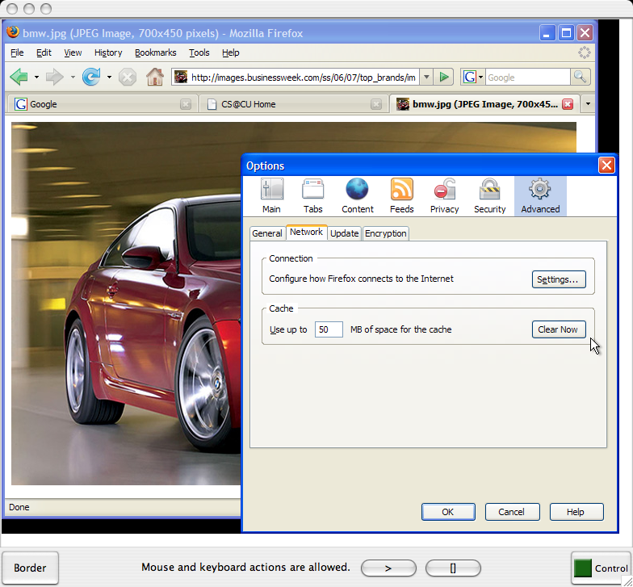
Screenshot (2)

Slide 33
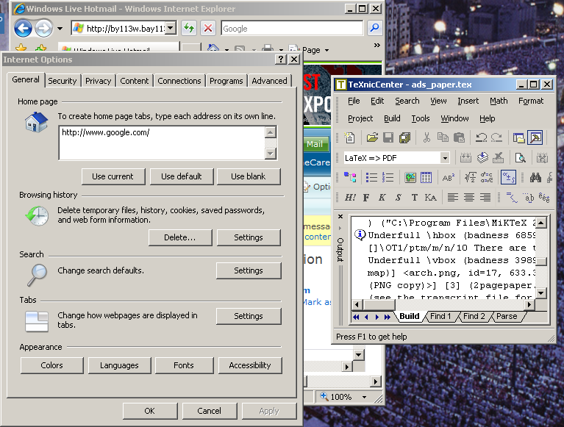
Screenshot (Overlapped Windows)
1
4
2
3

Slide 34
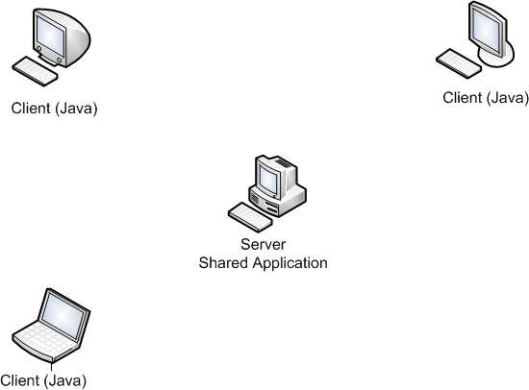
System Architecture
Client/Server Software Architecture
Screen Updates

Slide 35
System Architecture
Client/Server Software Architecture
Keyboard Mouse Events

Slide 36
Client (Viewer) Architecture
Client receives these commands
  Open new window
  Window size changed
  Pixel update
  Close window
Client sends
  BFCP (Binary Floor Control Protocol) commands
  Keyboard and mouse events

Slide 37
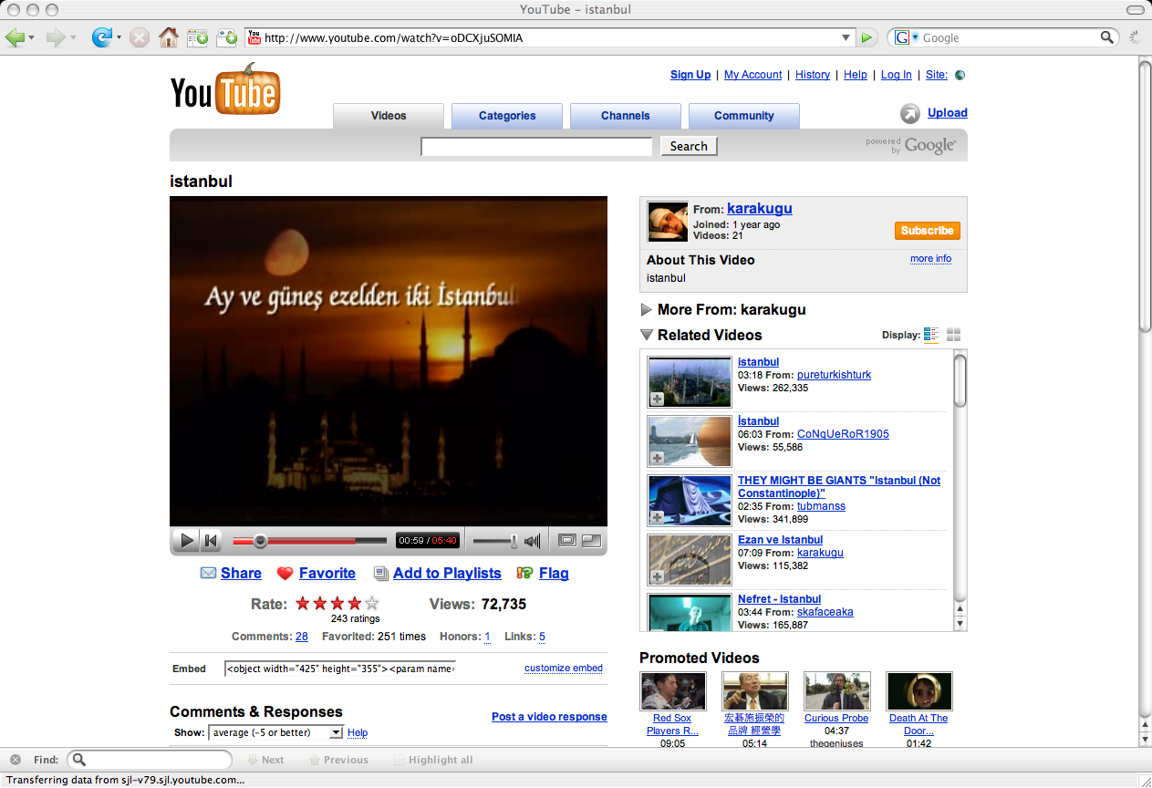
Multimedia Support (Movies)

Slide 38
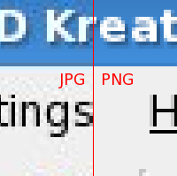
Multimedia Support (Movies)
Composite image comparing JPEG and PNG: notice artifacts in JPEG versus solid PNG background.

Slide 39
Multimedia Support (PNG vs JPG)
Ethernet (60Mb/s)

Slide 40
PNG/JPG Detection Algorithm
Region>
40,000px
?
-1,0,1
coordinates
PNG Size
counter
YES
Time Stamp
New
Region
?
Create a record
&
Start Checking
Region record
YES
NO
Continue
Checking
Detected
?
Use Detected
Format
NO
YES

Slide 41
Conclusion
Application sharing allows users to share a single application with multiple participants.
Participants don't need the application.
It is not specific to a single application.
Extra features like recording is added.

Slide 42
Lessons learned
More than just voice and video
  integrate other session types (text, applications, …)
More than point-to-point sessions
  multicast and multi-unicast
More than person URLs
  groups representing rooms, frequencies, …
Integrated with external data
  maps, telematics, …

