Slide 1
Engineering peer-to-peer systems
Henning Schulzrinne
Dept. of Computer Science, Columbia University, New York
hgs@cs.columbia.edu
(with Salman Baset, Jae Woo Lee, Gaurav Gupta, Cullen Jennings, Bruce Lowekamp, Erich Rescorla)
P2P 2008
September 9, 2008

Slide 2



Overview
Engineering = technology + economics
“Right tool for the right job”
The economics of peer-to-peer systems
P2PSIP – standardizing P2P for VoIP and more
OpenVoIP – a large-scale P2P VoIP system

Slide 3
Defining peer-to-peer systems
1 & 2 are not sufficient:
DNS resolvers provide services to others
Web proxies are both clients and servers
SIP B2BUAs are both clients and servers

Slide 4

P2P systems are …
P2P
NETWORK ENGINEER’S WARNING
P2P systems may be
inefficient
slow
unreliable
based on faulty and short-term economics
mainly used to route around copyright laws

Slide 5
Peer-to-peer systems
Service discovery
data size
data size
High
replication
Performance impact / requirement
Medium
replication
Low
NAT
replication
File sharing
VoIP
Streaming & VoD
Notes:
NAT: In filesharing, there are multiple copies of a file. If a peer cannot download a file from a peer behind a NAT, it can possibly consult other peers, and thus NAT issues have a relatively low impact on filesharing than VoIP. Not so in bit-torrent style systems.
Replication: Implicit replication for popular content in file-sharing. No implicit replication in VoIP. P2P protocol should actively replicate for availability.

Slide 6
Motivation for peer-to-peer systems
Saves money for those offering services
  addresses market failures
Scales up automatically with service demand
More reliable than client-server (no single point of failure)
No central point of control
  mostly plausible deniability
Networks without infrastructure (or system manager)
New services that can’t be deployed in the ossified Internet
  e.g., RON, ALM
Publish papers & visit Aachen

Slide 7
P2P traffic is not devouring the Internet…
steady percentage

Slide 8
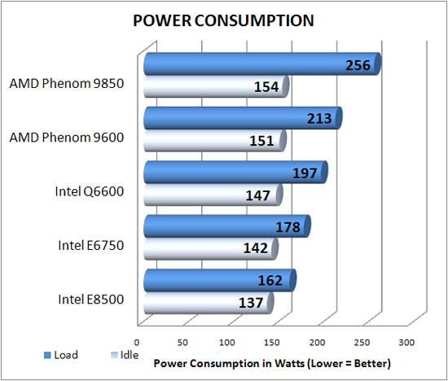
Energy consumption
Monthly cost =
$37
@ $0.20/kWh
http://www.legitreviews.com/article/682/
Notes:
http://www.legitreviews.com/images/reviews/682/power_consumption.jpg

Slide 9
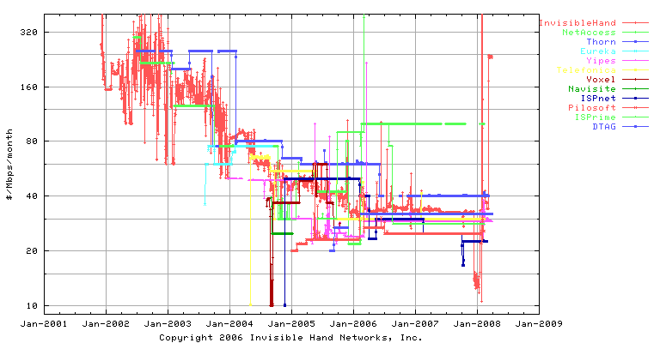
Bandwidth costs
Transit bandwidth: $40 Mb/s/month ~ $0.125/GB
US colocation providers charge $0.30 to $1.75/GB
  e.g., Amazon EC2 $0.17/GB (outbound)
  CDNs: $0.08 to $0.19/GB

Slide 10
Bandwidth costs
Thus, 7 GB DVD → $1.05
  Netflix postage cost: $0.70
HDTV viewing
  4 hours of TV / day @ 18 Mb/s ➔972 GB/month
  $120/month (if unicast)
Bandwidth cost for consumer ISP
  local: amortization of infrastructure, peak-sized
  wide area: volume-based (e.g., 250 GB → $50) for non-tier 1 providers
  may differ between upstream and downstream
Universities are currently net bandwidth providers
  Columbia U: 350 MB/hour = 252 GB/month (cf. Comcast!)

Slide 11
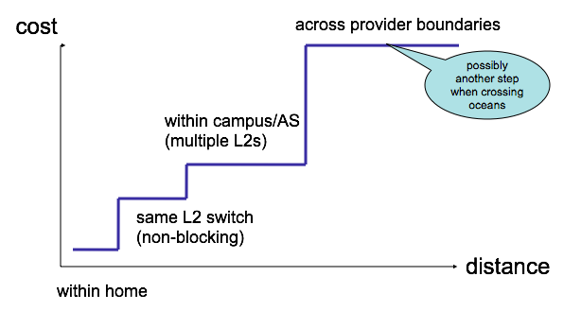
Bandwidth vs. distance

Slide 12
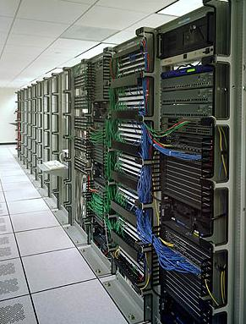
Economics of P2P
Service provider view
  save $150/month for single rented server in colo, with 2 TB bandwidth
  but can handle 100,000 VoIP users
But ignores externalities
  home PCs can’t hibernate → energy usage
    about $37/month
  less efficient network usage
  bandwidth caps and charges for consumers
    common in the UK
    Australia: US$3.20/GB
Home PCs may become rare
  see Japan & Korea
charge ($)
bandwidth
Notes:
http://www.primus.com.au/PrimusWeb/HomeSolutions/AdditionalServices/Broadband+TopUps.htm

Slide 13
Which is greener – P2P vs. server?
Typically, P2P hosts only lightly used
  energy efficiency/computation highest at full load
  → dynamic server pool most efficient
  better for distributed computation (SETI@home)
But:
  CPU heat in home may lower heating bill in winter
    but much less efficient than natural gas (< 60%)
  Data center CPUs always consume cooling energy
    AC energy ≈ server electricity consumption
Thus,
  deploy P2P systems in Scandinavia and Alaska

Slide 14





The computation & storage grid
measurement of storage easy
computation harder

Slide 15
Mobility
Mobile nodes are poor peer candidates
  power consumption
  puny CPUs
  unreliable and slow links
  asymmetric links
But no problem as clients → lack of peers
Thus, only useful for infrastructure-challenged applications
  e.g., disruption-tolerant networks

Slide 16
Reliability
Some of you may be having problems logging into Skype. Our engineering team has determined that it’s a software issue. We expect this to be resolved within 12 to 24 hours. (Skype, 8/12/07)
CW: “P2P systems are more reliable”
Catastrophic failure vs. partial failure
  single data item vs. whole system
  assumption of uncorrelated failures wrong
Node reliability
  correlated failures of servers (power, access, DOS)
  lots of very unreliable servers (95%?)
Natural vs. induced replication of data items

Slide 17
Security & privacy
Security much harder
  user authentication and credentialing
    usually now centralized
  sybil attacks
  byzantine failures
Privacy
  storing user data on somebody else’s machine
Distributed nature doesn’t help much
  same software → one attack likely to work everywhere
CALEA?

Slide 18
OA&M
P2P systems are hard to debug
No real peer-to-peer management systems
  system loading (CPU, bandwidth)
    automatic splitting of hot spots
  user experience (signaling delay, data path)
  call failures
Later: P2PP & RELOAD add mechanisms to query nodes for characteristics
Who gathers and evaluates the overall system health?

Slide 19
Locality
Most P2P systems location-agnostic
  each “hop” half-way across the globe
Locality matters
  media servers, STUN servers, relays, ...
Working on location-aware systems
  keep successors in close proximity
  AS-local STUN servers

Slide 20

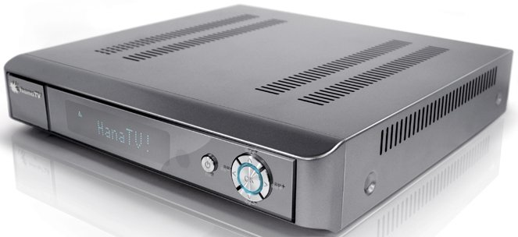
P2P video may not scale
(Almost) everybody watching TV at 9 pm → individual upstream bandwidth > per-channel bandwidth
  for HDTV, 8.5 (uVerse) to 14 Mb/s (full-rate)
  for SDTV, 2-6 Mb/s
→ need minimum upstream bandwidth of ~10 Mb/s
  Verizon FiOS: 15 Mb/s
  T-Kom DSL 2000: 192 kb/s upstream
Act only according to that maxim whereby you can at the same time will that it should become a universal law. (Kant)

Slide 21
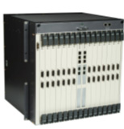
Long-term evolution of P2P networks
Resource-aware P2P networks
  stay within resource bounds
    hard to predict at beginning of month…
  cooperate with PC and mobile power control
    e.g., don’t choose idle PCs
    only choose plugged-in mobiles
Managed P2P networks
  e.g., in Broadband Remote Access Server (BRAS)
  or resizable compute platforms
    Amazon EC2

Slide 22
P2P for Voice-over-IP

Slide 23




The role of SIP proxies
tel:1-212-555-1234
REGISTER
sip:alice@example.com
sip:line1@128.59.16.1
Translation may depend on caller, time of day, busy status, …
sip:6461234567@mobile.com

Slide 24




P2P SIP
Why?
  no infrastructure available: emergency coordination
  don’t want to set up infrastructure: small companies
  Skype envy :-)
P2P technology for
  user location
    only modest impact on expenses
    but makes signaling encryption cheap
  NAT traversal
    matters for relaying
  services (conferencing, transcoding, …)
    how prevalent?
New IETF working group formed
  multiple DHTs
  common control and look-up protocol?
generic DHT service
p2p network
P2P provider B
DNS
P2P provider A
traditional provider
zeroconf
LAN

Slide 25
More than a DHT algorithm
Finger table
Tree
Routing-table stabilization
Periodic recovery
Lookup correctness
Prefix-match
Modulo addition
Routing-table size
Parallel requests
Recursive routing
Bootstrapping
Updating routing-table from lookup requests
Leaf-set
XOR
Proximity neighbor selection
Lookup performance
Successor
Reactive recovery
Hybrid
Strict vs. surrogate routing
Proximity route selection
Routing-table exploration
Notes:
Slide: This slide shows many different DHT-independent and DHT-specific design choices
Different names for similar concepts (finger, routing-table).
Mixing of DHT-independent and DHT-specific issues in original papers.

Slide 26

P2P SIP -- components
Multicast-DNS (zeroconf) SIP enhancements for LAN
  announce UAs and their capabilities
Client-P2P protocol
  GET, PUT mappings
  mapping: proxy or UA
P2P protocol
  get routing table, join, leave, …
  independent of DHT
  replaces DNS for SIP and basic proxy

Slide 27

P2PSIP architecture
Bootstrap & authentication server
alice@example.com
Overlay 2
SIP
NAT
bob@example.com → 128.59.16.1
P2P
STUN
INVITE bob@128.59.16.1
TLS / SSL
NAT
peer in P2PSIP
bob@example.com
Overlay 1
client
Notes:
STUN=session traversal utilities
Optional bootstrap authentication server

Slide 28
IETF peer-to-peer efforts
Originally, effort to perform SIP lookups in p2p network
Initial proposals based on SIP itself
  use SIP messages to query and update entries
  required minor header additions
P2PSIP working group formed
  now SIP just one usage
Several protocol proposals (ASP, RELOAD, P2PP) merged
  still in “squishy” stage – most details can change

Slide 29
RELOAD
Generic overlay lookup (store & fetch) mechanism
  any DHT + unstructured
Routed based on node identifiers, not IP addresses
Multiple instances of one DHT, identified by DNS name
Multiple overlays on one node
Structured data in each node
  without prior definition of data types
  PHP-like: scalar, array, dictionary
  protected by creator public key
  with policy limits (size, count, privileges)
Maybe: tunneling other protocol messages

Slide 30
Typical residential access
Sasu Tarkoma, Oct. 2007

Slide 31
NAT traversal
get public IP address
media
P2P
peer

Slide 32
ICE (Interactive Connectivity Establishment)

Slide 33
OpenVoIP
An Open Peer-to-Peer VoIP and IM System
Salman Abdul Baset, Gaurav Gupta, and Henning Schulzrinne
Columbia University

Slide 34
Overview
What is a peer-to-peer VoIP and IM system?
Why P2P?
Why not Skype or OpenDHT?
Design challenges
OpenVoIP architecture and design
Implementation issues
Demo system

Slide 35
A Peer-to-Peer VoIP and IM System
{
Establish media session
In the presence of NATs
Directory service
P2P
Presence
P2P for all of these?
Monitoring
PSTN connectivity

Slide 36
Why P2P?
Cost
Scale
  10 million Skype online users (comscore)
  23 million MSN online users (comscore)
Media session load
  100,000 calls per minute (1,666 calls per second)
  106 Mb/s (64 kb/s voice); 426 Mb/s (256 kb/s video)
Presence load
  1000 notifications per second (500B per notification)
  4 Mb/s
Monitoring load
  Call minutes
  Number of online users

Slide 37
Why not Skype?
Median call latency through a relay 96 ms (~6K calls)
  Two machines behind NAT in our lab (ping<1ms)
Call success rate
  7.3 % when host cache deleted, call peers behind NAT
    4.5K call attempts
  74% when traffic blocked between call peers
    11K call attempts
User annoyance
  relays calls through a machine whose user needs bandwidth!
  Shut down the application resulting in call drop
Closed and proprietary solution
  use P2P for existing SIP phones
Notes:
Hard to obtain statistics for this user annoyance though.

Slide 38
Why not OpenDHT?
Actively maintained?
  22 nodes as of Sep 7, 2008 [1]
NAT traversal
Non-OpenDHT nodes cannot fully participate in the overlay
[1] http://opendht.org/servers.txt

Slide 39
Design Challenges
the usual list…
#1 Scalability
#2 Reliability
#3 Robustness
#4 Bootstrap
#5 NAT traversal
#6 Security
  data, storage, routing (hard)
#7 Management (monitoring)
#8 Debugging
}
at bounded bw, cpu, mem / node
(<500 B/s)
}
must for any commercial p2p network

Slide 40
Design Challenges
the not so usual list…
#1 Scalability but how?
  Planet Lab has ~500 online machines online
    ~400 in August
  beyond Planet Lab
  which DHT or unstructured? any?
#2 Robustness?
  a realistic churn model?
    at best Skype, p2p traces
#3 Maintenance?
  OpenDHT only running on 22 nodes (Sep 7, 2008 [1])
#4 NAT traversal
  Nodes behind NAT fully participating in the overlay
    May be, but at what cost?
[1] http://opendht.org/servers.txt
Notes:
Planet Lab alive nodes
http://summer.cs.princeton.edu/status/tabulator.cgi?table=table_nodeviewshort&select=%27resptime%20%3E%200%27

Slide 41
OpenVoIP
Design goals
  meet the challenges
  distributed directory service
    Chord, Kademlia, Pastry, Gia
      protocol vs. algorithm
    common protocol / encoding mechanisms
  establish media session between peers [behind NAT]
    STUN / TURN / ICE
  use of peers as relays
  distributed monitoring / statistics gathering
Implementation goals
  multiplatform
  pluggable with open source SIP phones
  ease of debugging
Performance goals
  relay selection and performance monitoring mechanisms
  beat Skype!

Slide 42
OpenVoIP architecture
[ Bootstrap / authentication ]
[ monitoring server / Google Maps ]
Overlay2
SIP
NAT
Overlay1
P2P
STUN
TLS / SSL
Protocol stack of
a peer
bob@example.com
alice@domain.com
NAT
A peer in P2PSIP
A client

Slide 43
Peer-to-Peer Protocol (P2PP)
A binary protocol – early contribution to P2PSIP WG
Geared towards IP telephony but equally applicable to file sharing, streaming, and p2p-VoD
Multiple DHT and unstructured p2p protocol support
Application API
NAT traversal
  using STUN, TURN and ICE
Request routing
  recursive, iterative, parallel
  per message
Supports hierarchy (super nodes [peers], ordinary nodes [clients])
Central entities (e.g., authentication server)

Slide 44
Peer-to-Peer Protocol (P2PP)
Reliable or unreliable transport (TCP/TLS or UDP/DTLS)
Security
  DTLS, TLS, storage security
Multiple hash function support
  SHA1, SHA256, MD4, MD5
Monitoring
  ewma_bytes_sent [rcvd], CPU utilization, routing table

Slide 45
OpenVoIP features
Kademlia, Bamboo, Chord
SHA1, SHA256, MD5, MD4
Hash base: multiple of 2
Recursive and iterative routing
Windows XP / Vista, Linux
Integrated with OpenWengo
Can connect to OpenWengo and P2PP network
Buddy lists and IM
1000 node Planet lab network on ~300 machines
Integrated with Google maps
Demo video: http://youtube.com/?v=g-3_p3sp2MY

Slide 46
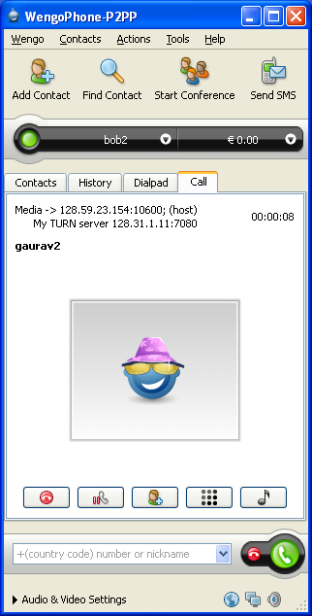
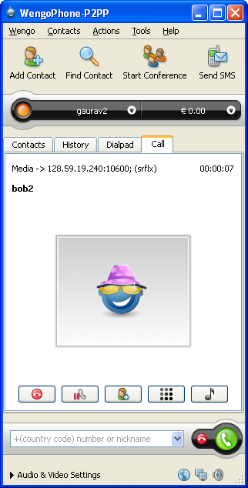
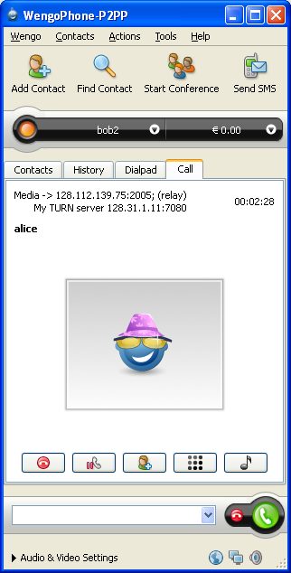
OpenVoIP snapshots
direct
call through a NAT
call through a relay

Slide 47
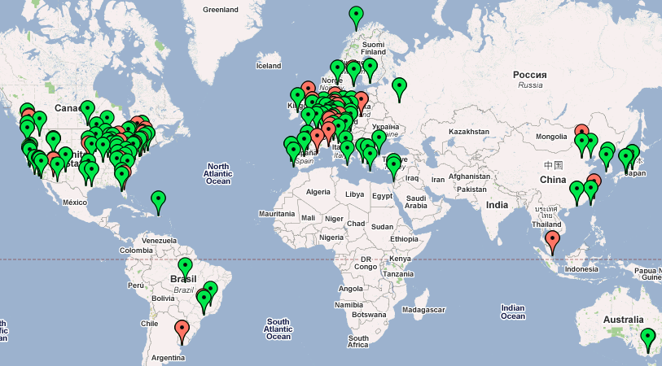
OpenVoIP snapshots
Google Map interface

Slide 48
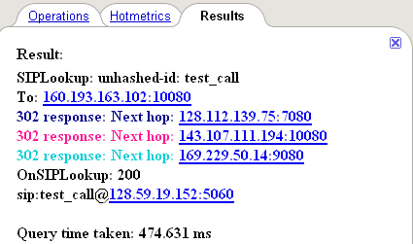
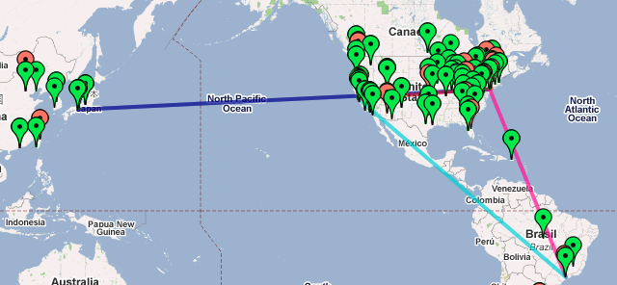
OpenVoIP snapshots
Tracing lookup request on Google Maps

Slide 49
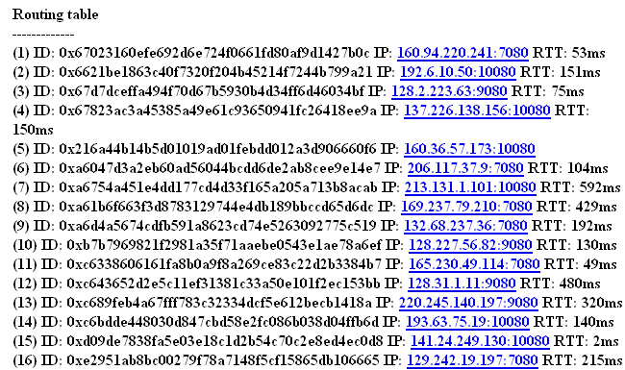
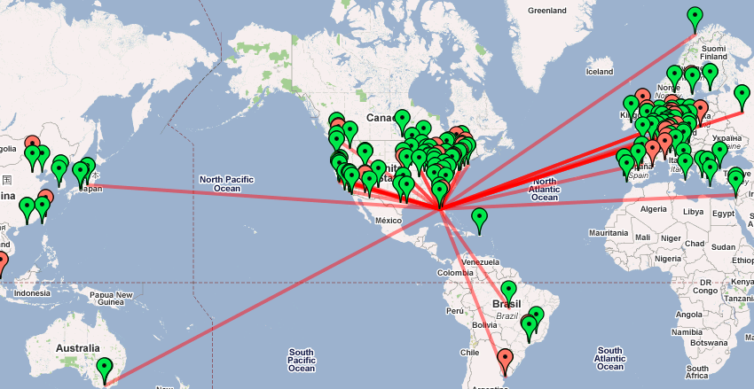
OpenVoIP snapshots

Slide 50
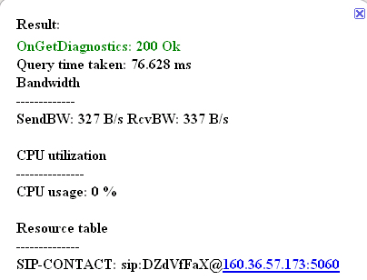
OpenVoIP snapshots
Resource consumption of a node

Slide 51
Why calls may fail in OpenVoIP?
Cannot find a user
  user is online, but p2p cannot find it
  NAT and firewall issues
  SIP messages
  call succeeds but media?
  relay
Relay is shutdown
System reliability
  (search + NAT traversal + relay)

Slide 52
Facts of Peer-to-Peer Life
Routing loops happen
Byzantine failures arise
Nodes become disconnected
System does not always scale!
Automated maintenance does not always work
Planet Lab quirks
  cleans the directory
  DoS attacks on open ports
Bootstrap server is attacked
Notes:
Someone trying their own protocol with our bootstrap server, probably to create a buffer overflow.

Slide 53
OpenVoIP: Key techniques
Randomization is our best friend!
  send the maintenance messages within a bounded random time
Churn recovery
  is on demand and periodic
Insert a new entry in routing table after checking liveness
Periodically republish SIP records
  not feasible for large records
Avoid overly complex mechanisms
  can backfire!

Slide 54
OpenVoIP: Debugging
Black-box
  Lookup request for a random key
State acquisition
  Remotely obtain the resource and storage utilization of a node
Set and Unset a data-value on a node
  such as BW, CPU utilization
  to test a relay selection algorithm
Remotely enable and disable logging
Control log size
Find a faulty node
  hard
  centralized vs. distributed approach

Slide 55
Implementation issues
Diagnostics
  protocol
  command-line
    showrt, shownt, showro, showcp,
    insert [key] [value], rlookup, ulookup
    getrt getnt getro [IPaddr] [port]
  graphical
Platform independence
  thread: 3 functions
    createthread, waitforthread [pthread_join],
  sys: 3 functions
    strcasecmp, getopt, gettimeofday (GetSystemTimeAsFileTime)
  net: 4 functions
    close [closesocket], inet_aton [inet_addr], select timer, getsockopt

Slide 56
Combining Bonjour/mDNS and peer-to-peer systems

Slide 57
Four stages of dynamic p2p systems
Bootstrapping
  Formation of small private p2p islands
Interconnection
  Connectivity and service discovery between the p2p islands (each represented by a leader)
Structure formation
  DHT construction among the leaders
Growth
  Merger of multiple such DHTs

Slide 58
Zeroconf: solution for bootstrapping
Three requirements for zero configuration networks:
  IP address assignment without a DHCP server
  Host name resolution without a DNS server
  Local service discovery without any rendezvous server
Solutions and implementations:
  RFC3927: Link-local addressing standard for 1)
  DNS-SD/mDNS: Apple’s protocol for 2) & 3)
  Bonjour: DNS-SD/mDNS implementation by Apple
  Avahi: DNS-SD/mDNS implementation for Linux and BSD

Slide 59
DNS-SD/mDNS overview
DNS-Based Service Discovery (DNS-SD) adds a level of indirection to SRV using PTR:
  _daap._tcp.local. PTR Tom’s Music._daap._tcp.local.
  _daap._tcp.local. PTR Joe’s Music._daap._tcp.local.
  Tom’s Music._daap._tcp.local. SRV
  0 0 3689 Toms-machine.local.
  Tom’s Music._daap._tcp.local. TXT
  "Version=196613" "iTSh Version=196608"
  "Machine ID=6070CABB0585" "Password=true”
  Toms-machine.local. A 160.39.225.12
Multicast DNS (mDNS)
  Run by every host in a local link
  Queries & answers are sent via multicast
  All record names end in “.local.”
1:n mapping

Slide 60
z2z: Zeroconf-to-Zeroconf interconnection
rendezvous point - OpenDHT
Import/export
services
Import/export
services
z2z
z2z
Zeroconf subnet A
Zeroconf subnet B

Slide 61
Demo: global iTunes sharing
Exporting iTunes shares under key “columbia”:
  $ z2z --export:opendht _daap._tcp --key “columbia”
Importing services stored under key “columbia”:
  $ z2z --import:opendht --key “columbia”

Slide 62
How z2z works (exporting)
OpenDHT
1)
Send browse request (i.e., PTR query) for service type: _daap._tcp
put:
key=
z2z._daap._tcp.columbia
value=
Tom’s Music
160.39.225.12:3689
Password=true
……
2)
Send resolve request (i.e., SRV, A, and TXT query) for each service
z2z
3)
Export them by putting into OpenDHT
Tom’s Music.
_daap._tcp.local
Joe’s Music.
_daap._tcp.local
160.39.225.12
Tom’s Computer
Password=true
……
160.39.225.13
Joe’s Computer
Password=false
……
Notes:
Gagaga

Slide 63
How z2z works (importing)
OpenDHT
1)
Issue get call into OpenDHT
get:
key=z2z._daap._tcp.columbia
value=Tom’s Music
160.39.225.12:3689
……
value=Joe’s Music
……
“A” record for 160.39.225.12
2)
Add “A” record into mDNS
z2z
mDNS
3)
Import services by registering them
(i.e., add PTR, SRV, TXT records to the local mDNS)
Tom’s Music._daap._tcp.local
_remote-160.39.225.12.local
……

Slide 64
z2z implementation
C++ Prototype using xmlrpc-c for OpenDHT access
  Proof of concept
  Porting problem due to Bonjour and Cygwin incompatibility
z2z v1.0 released
  Rewritten in Java from scratch
  Open-source (BSD license)
  Available in SourceForge (https://sourceforge.net/projects/z2z)
Paper describing design and implementation detail
  z2z: Discovering Zeroconf Services Beyond Local Link
    Lee, Schulzrinne, Kellerer, and Despotovic
  Submitted to IEEE Globecom’07 Workshop on Service Discovery

Slide 65
Conclusion
P2P provides new design tool, not miracle cure
  general notion of self-scaling and autonomic systems
  TANSTAFL: assumptions of “free” resource may no longer hold
  may move to rentable resources
Moving from tweaking algorithms to engineering protocols
  reliable, diagnosable, scalable, secure, NAT-friendly, …
  DHT-agnostic
Need more work on diagnostics and management

Slide 66
Join
JP
BS
P5
P7
P9
1. Query
2. 200
P5, P30, P2P-Options
3+. STUN (ICE candidate gathering)
4. Join
5. Join
6. 200
JP
(P10)
7. 200
N(P9, P15)
N(P9, P15)
8. Join
9. 200
10. Transfer
11. 200
Notes:
P2P-Options=P2P algorithm, hash algorithm, logarithm base
1) Joining peer (JP) first sends a query message to the bootstrap server to discover P2P-Options and other peers in the network.
2) It then discovers its NAT type and gathers ICE candidates.
3) Sends a join request which is recursively forwarded.
4) JP will be inserted between P7 and P9.
5) P9 is responsible for all objects between [P7, P9]. It transfers the relevant objects to JP.
6) JPs gathered candidates are sent in the Peer-Info TLV.

Slide 67
Call establishment
P1
P3
P5
P7
1. Lookup-Peer (P7)
2. Lookup-Peer (P7)
3. Lookup-Peer (P7)
4. 200 (P7 Peer-Info)
5. 200 (P7 Peer-Info)
6. 200 (P7 Peer-Info)
7. INVITE
8. 200 Ok
9. ACK
Media

