Slide 1
Faculty & their research
Department of Computer Science
Columbia University

Slide 2
Theory
Rocco Servedio | Computational complexity of machine learning problems; computationally efficient algorithms for various important and natural learning problems such as learning decision trees, learning logical formulas, and learning geometrically defined concepts such as intersections of halfspaces or polynomial surfaces
Jonathan Gross | Graph theory
Tal Malkin | Expanding the foundations of cryptography to more realistic settings, proving security against strong active attacks.
Joe Traub | Exponential decrease in qubit complexity for computing path integrals on a quantum computer by using randomization
Henryk Wozniakowski | Computational complexity of continuous problems
Mihalis Yannakakis | Algorithms and complexity theory for games, equilibria, and other fixed points; approximation algorithms and multi-objective optimization.

Slide 3
Systems
Al Aho | How to make reliable software reliably
Steve Bellovin | Treat port numbers as part of the IP address for routing, to get ubiquitous firewall policy enforcement
Gail Kaiser | Software engineering
Angelos Keromytis | Network security
Vishal Misra | Internet economics, network neutrality and fair and efficient pricing schemes for the Internet.
Jason Nieh | Distributed systems
Dan Rubenstein | Network protocols for ultra low-power, energy-harvesting devices; network protocols for maintaining connectivity in mobile-robot networks

Slide 4
Systems
Henning Schulzrinne | Location-aware and programmable multimedia applications; programmable Internet architectures; network fault discovery; disruption-tolerant networks
Sal Stolfo | Insider threat: characterize desirable properties of decoys guiding the implementation and generation of "decoy documents" for a trap-based defense system and implement a web page for distributing user-generated decoy documents with embedded "beacons" to identify insider break-ins and attempts to exfiltrate sensitive information.
Junfeng Yang | Effective, scalable techniques for detecting, debugging, and fixing software errors.
Yechiam Yemini | A layer 2.5 approach to network virtual machines & clouds.

Slide 5
Making Sense of Data
Luis Gravano | Databases and information retrieval, interpreted broadly and across unstructured, semi-structured, and structured data
Tony Jebara | Machine Learning using graphs and matching with applications in social networks, spatiotemporal data, web data and image data.
Itsik Pe’er | Computational methods for modeling DNA-sequence variation within species and populations
Ken Ross | Designing database systems to take advantage of modern multicore hardware.

Slide 6
Interacting with Humans
Steve Feiner | Human-computer interaction in 2D and 3D: augmented reality, mobile and wearable, multimodal.
Julia Hirschberg | Natural language processing.
Kathy McKeown | Natural language processing.

Slide 7
Interacting with the Physical World (Vision, Graphics & Robotics)
Peter Allen | Graspit Simulator: Real-Time robotic grasping simulator that can be interfaced with robotic and prosthetic hands Fully Insertable Surgical Imaging Device with pan/tilt/lighting for minimally invasive surgery Large Scale Automated 3D Site Modeling
Peter Belhumeur | First face search engine, allowing users to search through millions of images based on the appearance of the faces within.
Steve Feiner | Human-computer interaction in 2D and 3D: augmented reality, mobile and wearable, multimodal
Eitan Grinspun | Algorithms for simulating thin flexible surfaces and curves

Slide 8
Interacting with the Physical World (Vision, Graphics & Robotics)
Tony Jebara | Machine learning with applications in vision and spatio-temporal modeling
John Kender | Created first multimedia browser to search over a library of long unstructured videos using visual, audio, and textual cues, and verified its high effectiveness via user studies.
Shree Nayar | Computational camera
Ravi Ramamoorthi | Theoretical foundations, mathematical representations and computational models for the visual appearance of objects, digitally recreating or rendering the complexity of natural appearance.

Slide 9
Designing Digital Systems
(Computer Engineering)
Luca Carloni | Communication-based design of multi-core systems-on-chip and distributed embedded systems.
Steve Edwards | Languages and compilers for embedded system applications
Steve Nowick | Design and CAD tools for asynchronous and mixed-timing digital design, providing scalable and low-power methodologies for assembling complex systems.
Simha Sethumadhavan | Parallelizing legacy binaries for multi/many core machines

Slide 10
How to Make Reliable Software Reliably
Al Aho
Do Crosscutting Concerns Cause Software Defects?
  We created metrics and developed experimental platforms that allowed usto do the first empirical studies of open-source software systems. We showed a statistically significant correlation between the degree of scattering and the number of defects that had been reported in these systems.
Tracing Requirements to Source Code
  The concern-location problem is to identify within a program all of the source code related to the features, requirements, and other concerns of the program. This problem is central to program development and maintenance. We developed a new technique called prune-dependency analysis that combined with existing techniques improves the accuracy of concern location by over 100%.

Slide 11
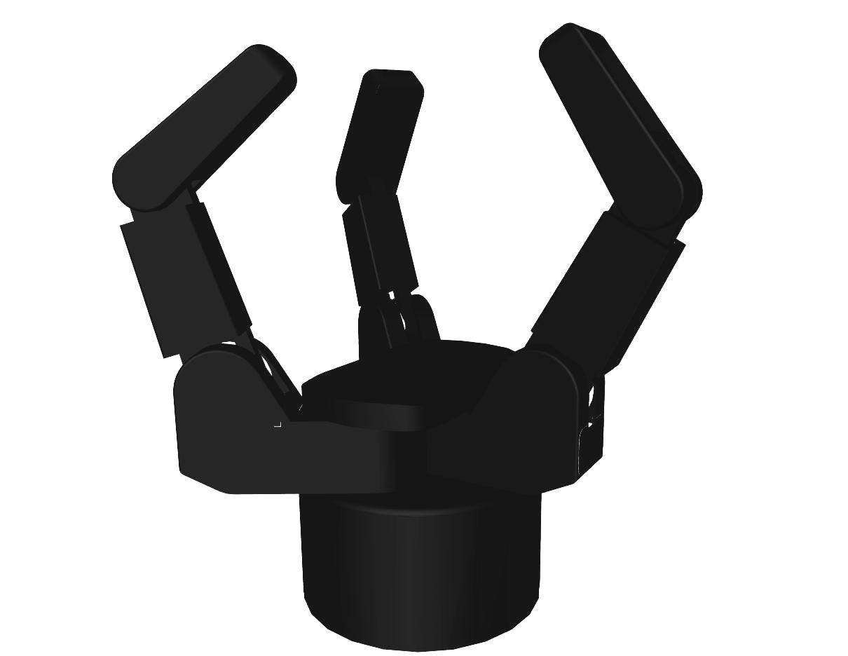
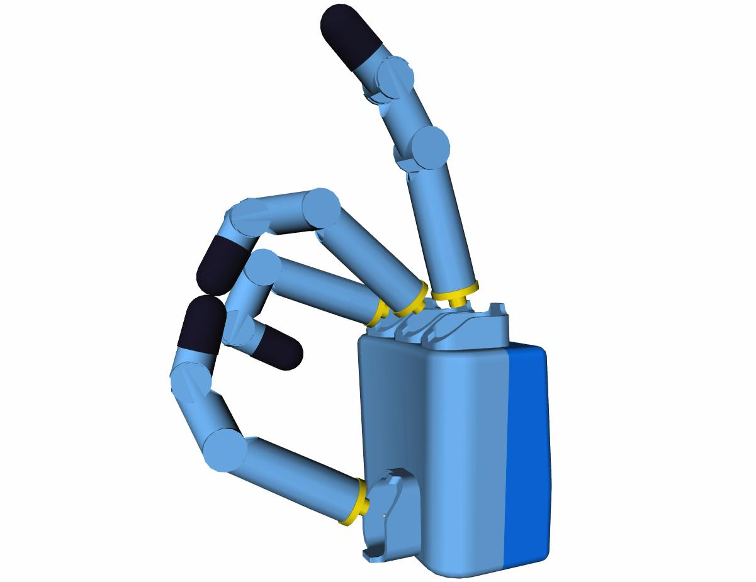
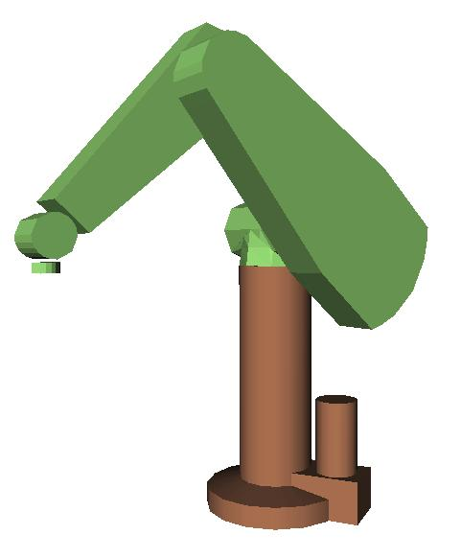
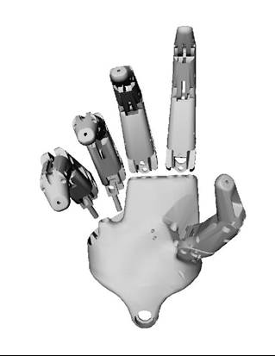
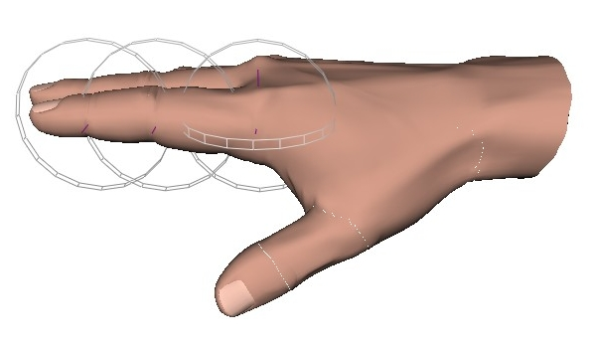
GraspIt! Simulator
Peter Allen
Integrated grasp analysis: Grasp quality, weak points, force optimization
Visualize grasp from all angles
Includes dynamics, friction, materials
Perform many grasps quickly
Faster than using a real arm and hand
Build a library of saved grasps
  Recall grasp when object is encountered again
  Can be used in online grasping
Can be applied to library of robotic hands, manipulators, human hand

Slide 12
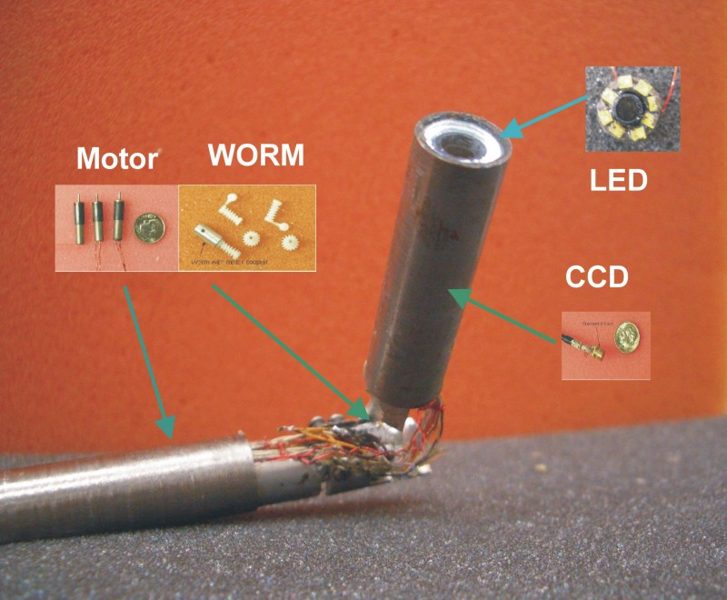

Peter Allen
Insertable Surgical Imaging Device
with Pan, Tilt, Zoom, and Lighting
with Dennis L. Fowler
Surgery, Columbia University
Fully insertable in-vivo imaging device for minimally invasive, single port surgery
Modular camera/lens system
Integrated LED lighting
3 DOF: Pan, Tilt, Zoom
Mono and Stereo Camera versions
Experimentally tested on animals
Easier to use than standard laparoscope
Joystick controlled
Figure caption is optional,
use Arial Narrow 20pt

Slide 13
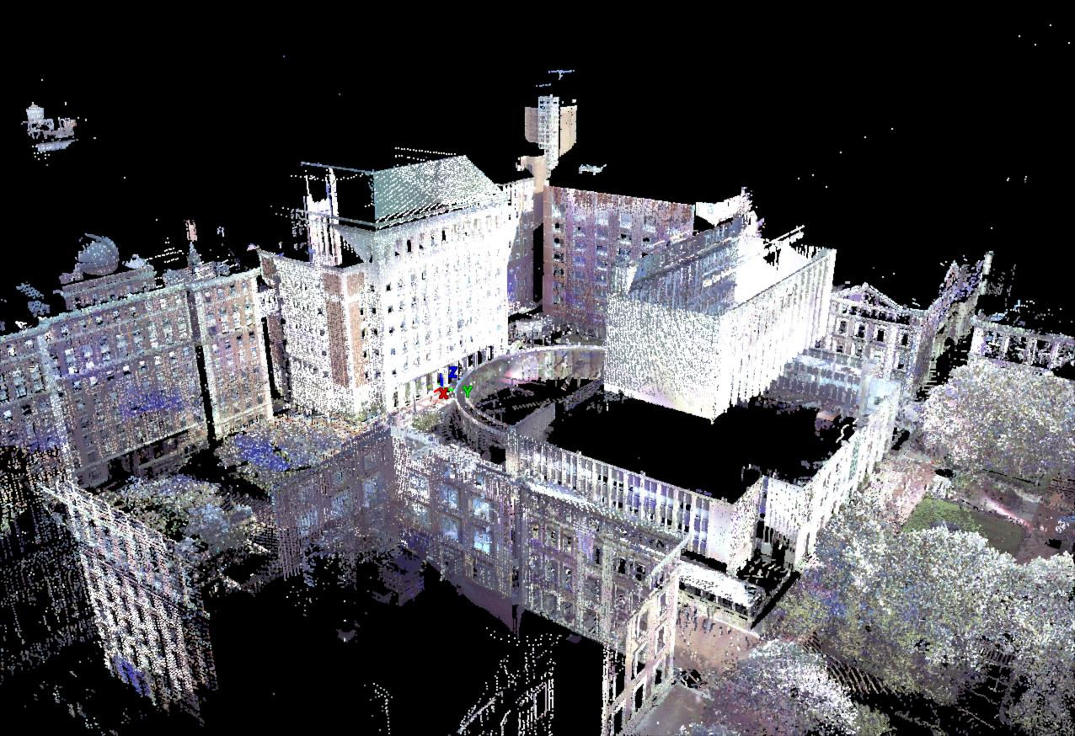
Large Scale 3D Site Modeling
Peter Allen
2D – 3D registration
Visualization: adding context to models.
View planning for data acquisition
Illumination coherent texture mapping
Mobile robot data acquisition
The Columbia University Campus
Notes:
13

Slide 14
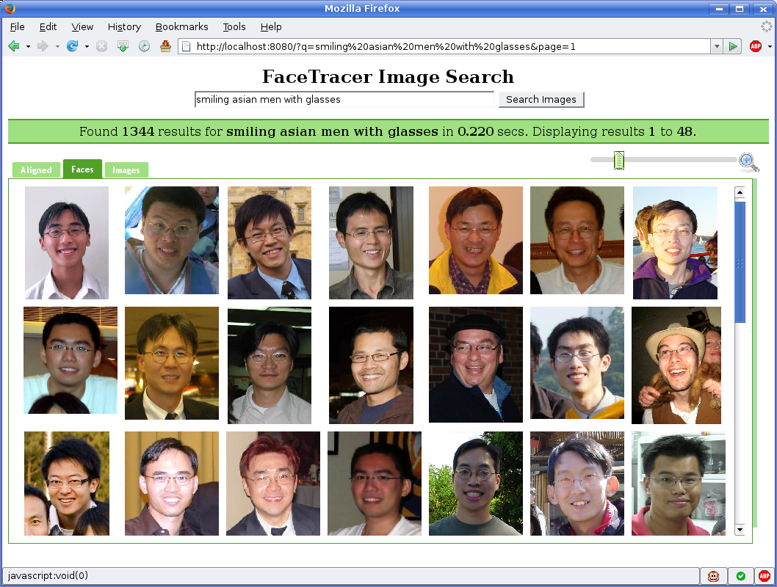
A Search Engine for Images with Faces
Peter Belhumeur
FaceTracer: “smiling Asian men with glasses”

Slide 15
Routing as the Firewall Layer
Steve Bellovin
Concatenate the port number to the IP address and route on all 48 bits
Only advertise routes for services you run
Selectively advertise some routes – services – on some interfaces or paths but not others, for controlled, limited access
Every router along the way enforces the security policy; no border firewall box to bypass
Especially good for MANETs: drop unwanted packets early and save battery power and spectrum

Slide 16
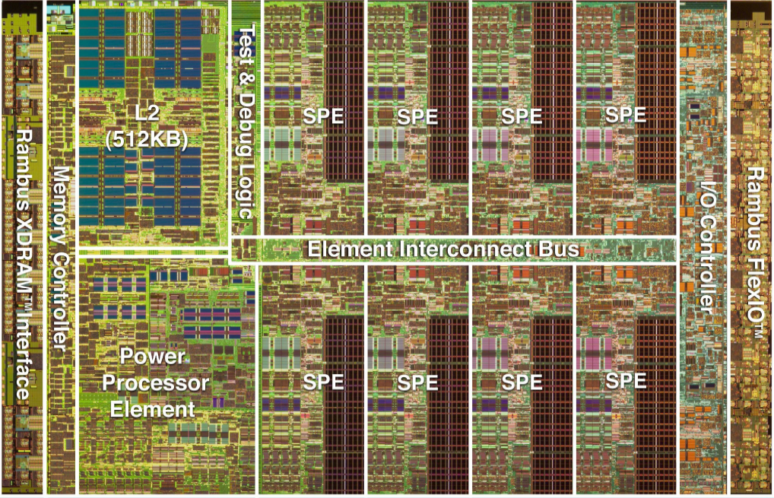
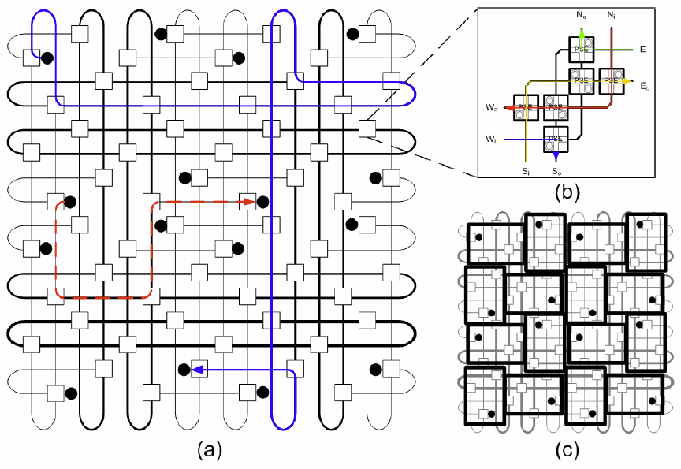
Distributed Embedded Systems
Luca Carloni
Design Technologies
for Distributed
Embedded Systems
On-Chip Communication Synthesis for Multi-Core Systems-on-Chip
Nanophotonic Interconnection Networks
for High-Performance Embedded Computing
Notes:
"Communication-Based Design of Multi-Core Systems-on-Chip and Distributed Embedded Systems”

Slide 17
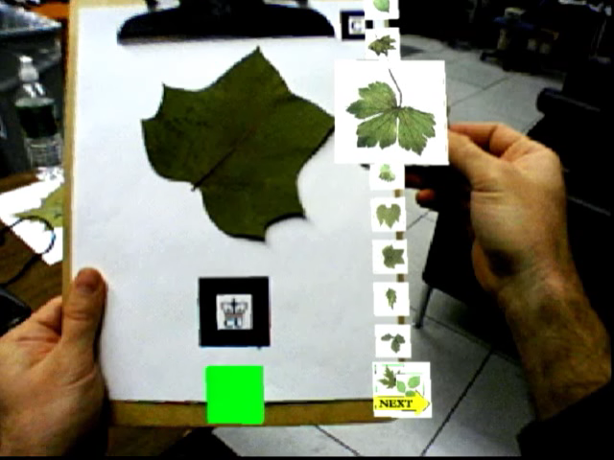
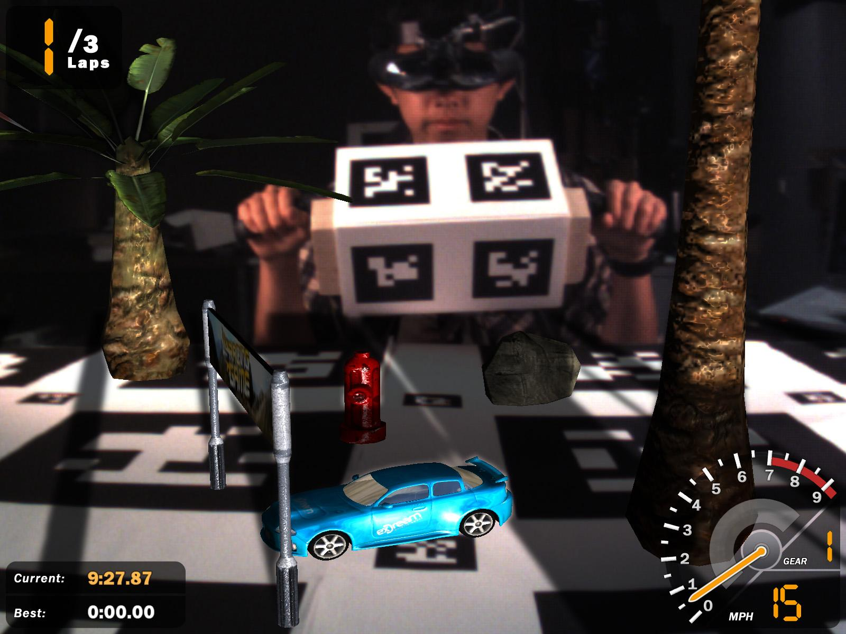
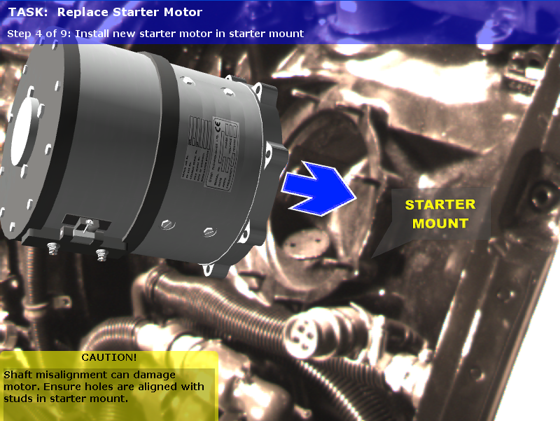
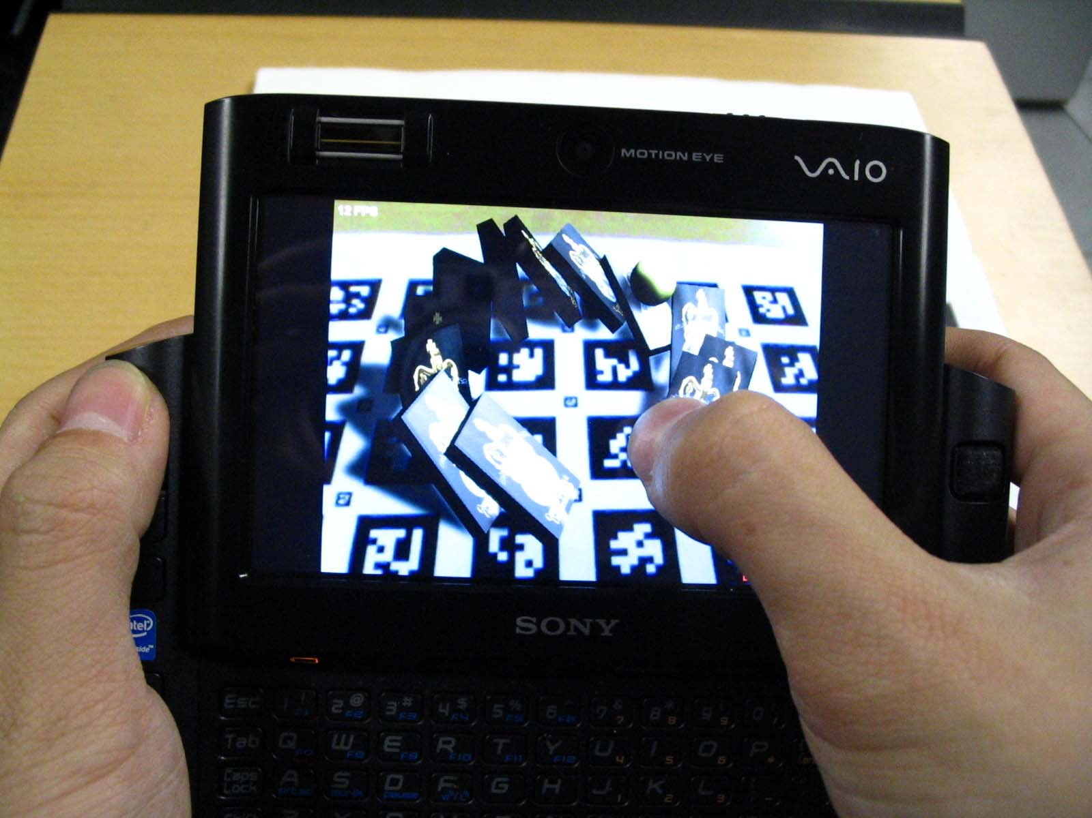
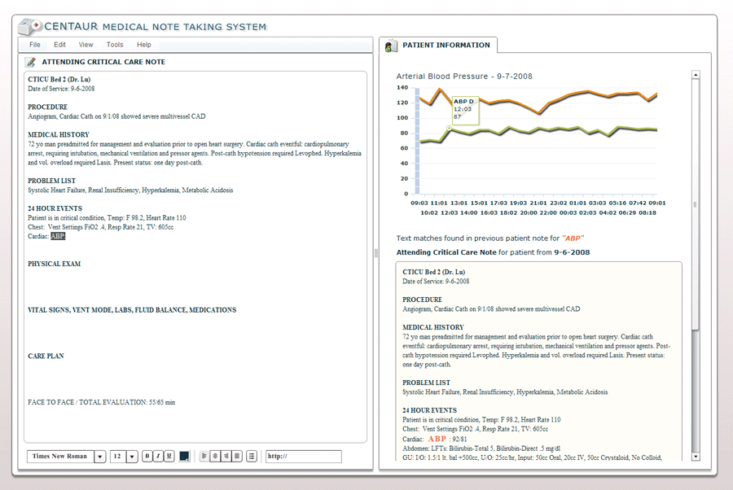
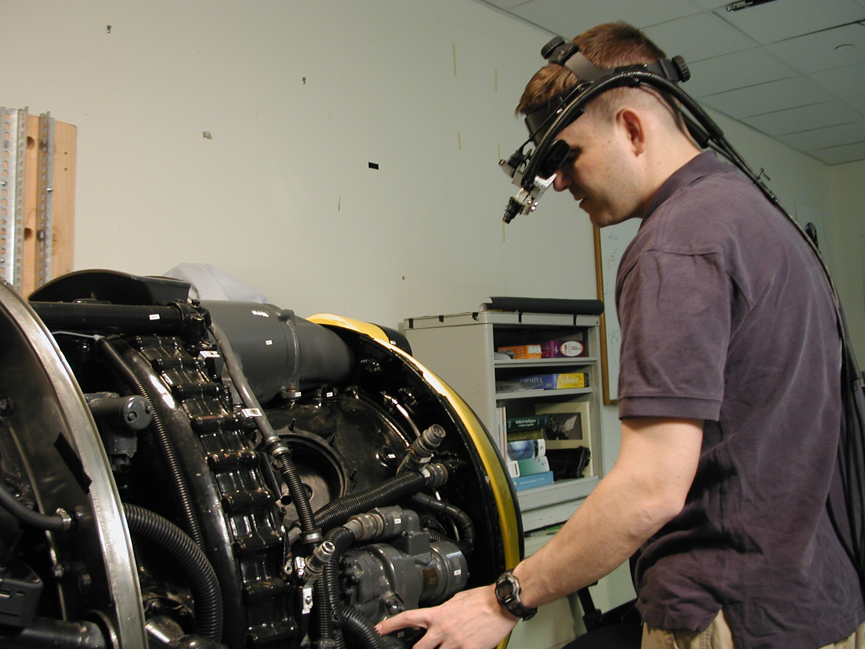
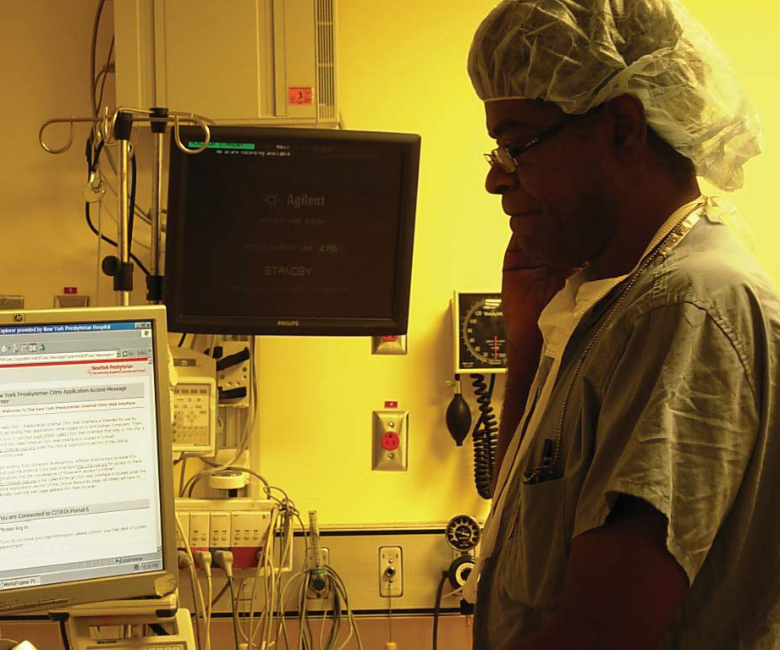
Human-computer interaction in 2D and 3D: augmented reality, mobile and wearable, multimodal
Steve Feiner

Slide 18
Databases, information retrieval, web search, information extraction, data mining
Luis Gravano
Time-sensitive information retrieval
Keyword search over relational databases
Information extraction
SQOUT: Structured querying of text databases, via information extraction

Slide 19

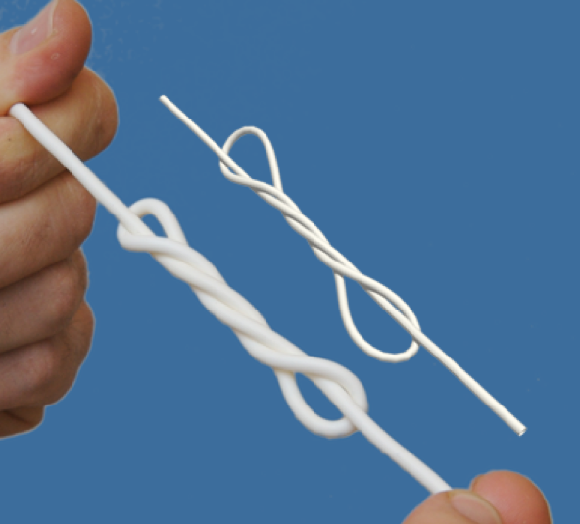
Simulation of surfaces and curves
Eitan Grinspun
Study of knots and cables
Applications to medicine (sutures),
civil engineering (cables), and
biology (hair, fur, proteins)
CAD tools for garment industry
Animation tools for feature films

Slide 20
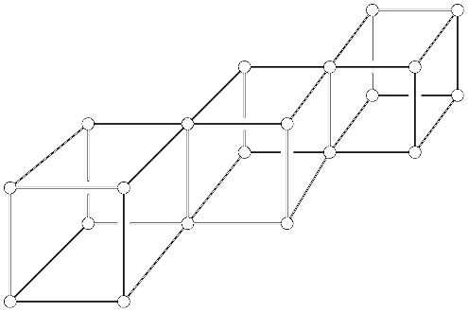
Enumerating Network Layouts
Jonathan Gross
Methods for constructing a surface-by-surface inventory of the number of topologically distinct ways that a graph can be placed without any edge-crossings on a surface.

Slide 21
Eternal Testing of Software Systems
Gail Kaiser
Problem: Infeasible to exhaustively test software systems in the lab and impossible to test under all future deployment conditions
Solution: Never-ending testing in the field (“in situ”) and in the internal states achieved during production operation (“in vivo”) - while ensuring that the testing is invisible to end-users with at most modest performance degradation, together with a new methodology for defining test suites analogous to unit/integration testing, invoked at the method call level but in the context of the complete system and allowing for arbitrary (and potentially corrupted) system state
Prototype implementation for Java using AspectJ to insert instrumentation:
Forks a copy of the Java process to run the corresponding method-specific test suite N% of the times that an instrumented method happens to be invoked, for a per-method configurable N
An extension supports distribution of the testing burden over an “application community” to reduce participant overhead, as well as rearrange testing assignments when certain methods aren’t invoked often enough by previous assignees
We have indeed found defects in open source systems (OSCache, Apache JCS) that are not detected by the test suites distributed with those systems

Slide 22
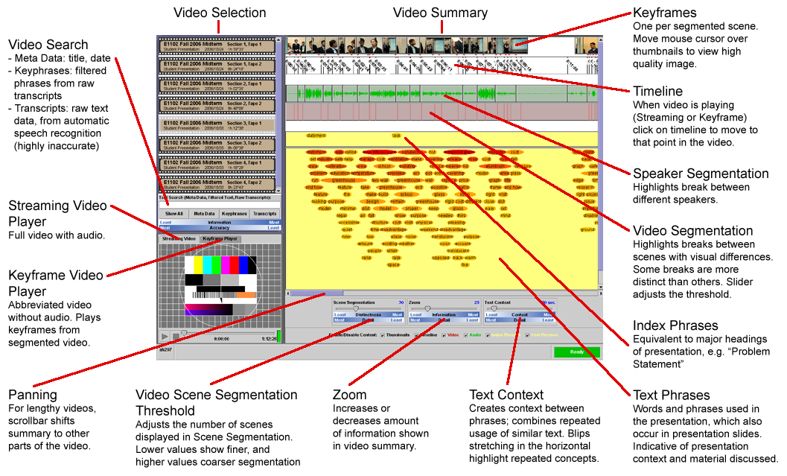
John Kender
Video Summarization

Slide 23
Foundations of Cryptography: The Next Generation
Tal Malkin
Tal Malkin
Traditional Cryptography achieves provable security of protocols, but assumes a clean, controlled model.
  This is not sufficient for the way crypto is used today: there are new environments, new applications, new types of attacks.
  E.g., over the Internet, concurrently with many other protocols, or on small portable devices (smartcard, PDA).
  Key exposure or manipulation is a major cause of security breaches, much more so than cryptanalysis.
Our Work: expand theoretical foundations to capture provable security against strong, realistic attackers, including:
  Security when attacker can read the secret key (key exposure)
  Security when attacker can modify the secret key (tampering)
  Security against side channel attacks (power, timing analysis)
  Security in an Internet-like setting (when attacker can coordinate across several, unaware of each other, protocols).

Slide 24
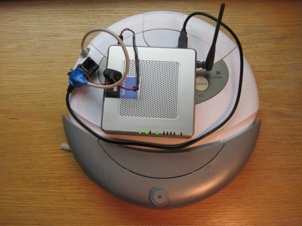

Spreadable Connected Autonomous Networks
Vishal Misra & Dan Rubenstein
Roombas are mobile robots with wireless network connectivity, form an ad-hoc network
Objective: Allow Roombas to move freely as long movement does not partition the network
Sample Applications: search-n-rescue, wireless mesh backbone

Slide 25
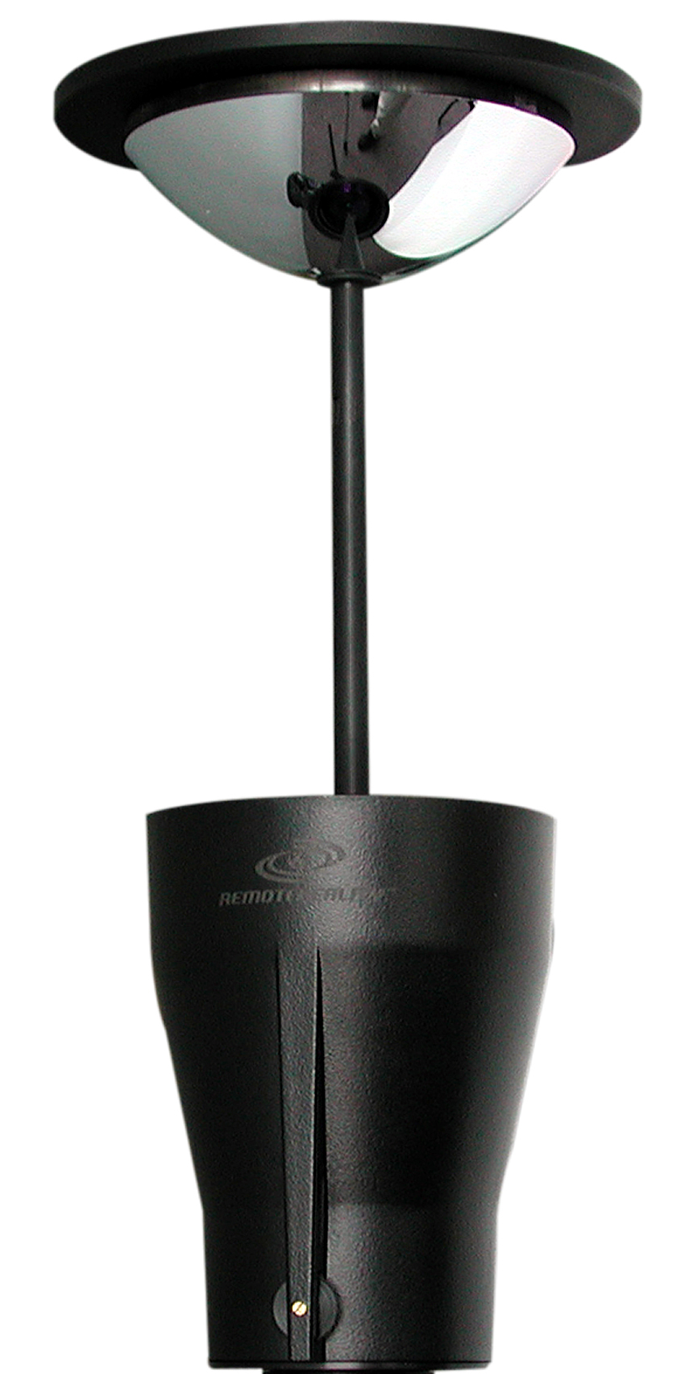
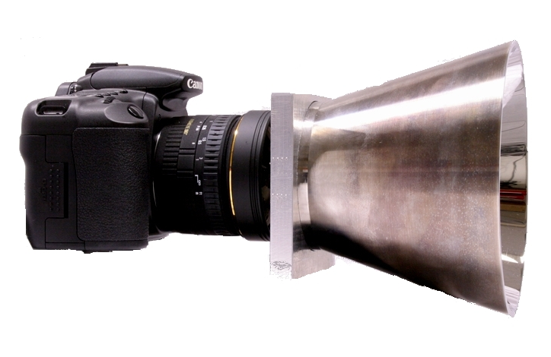
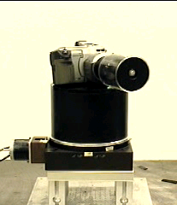
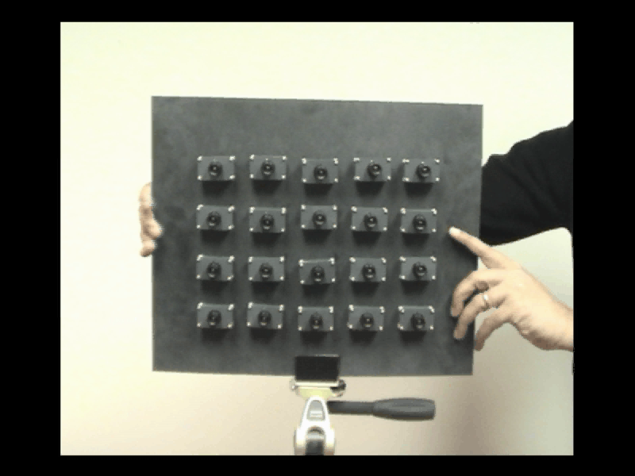
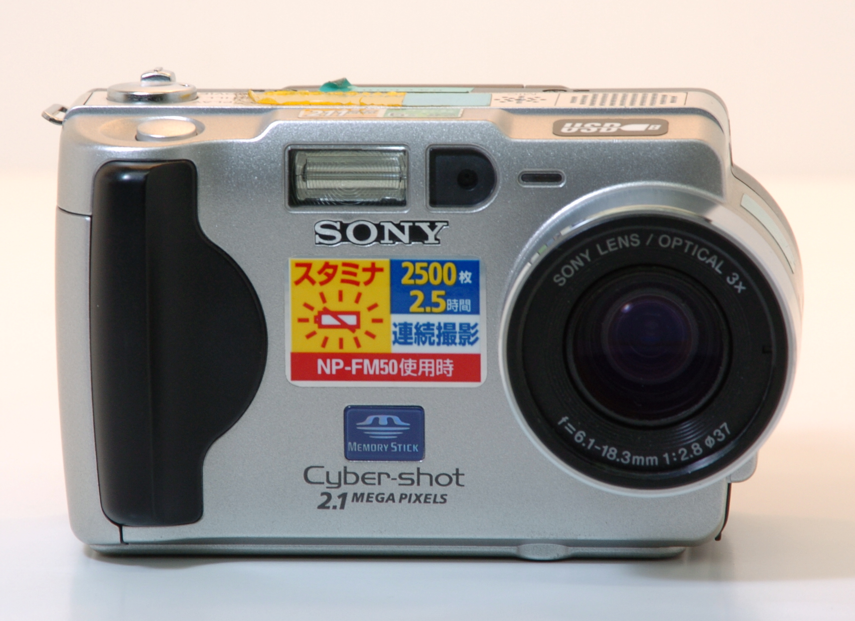
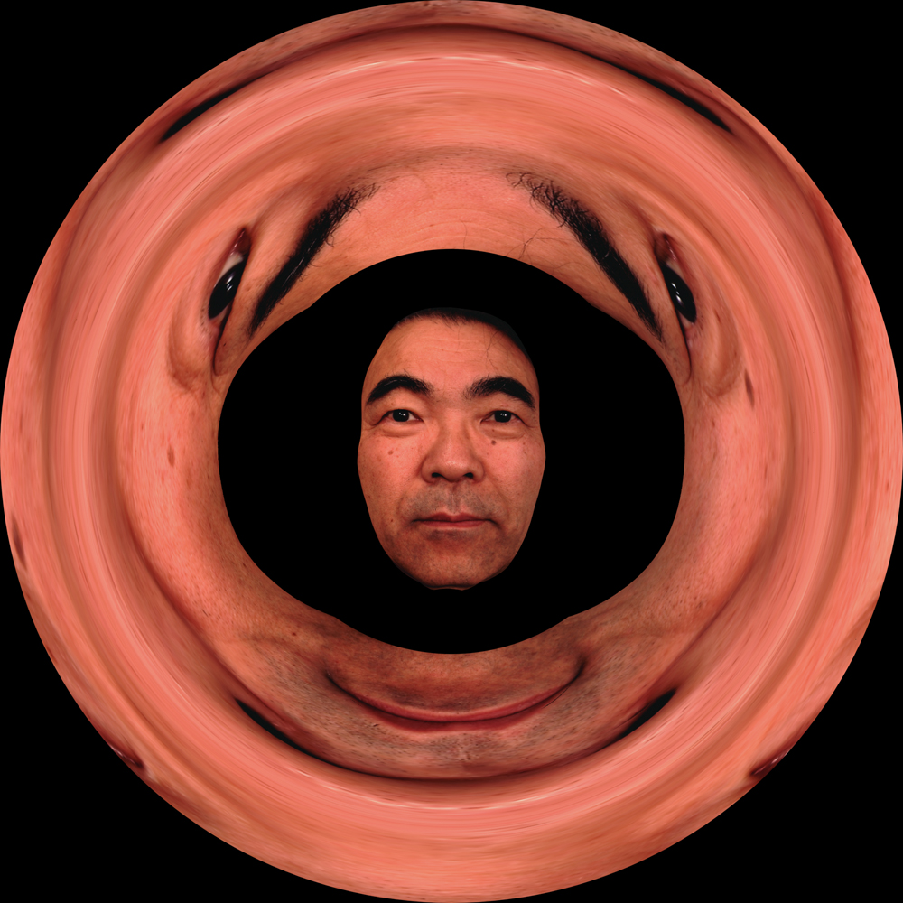
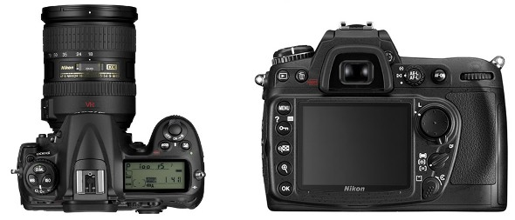
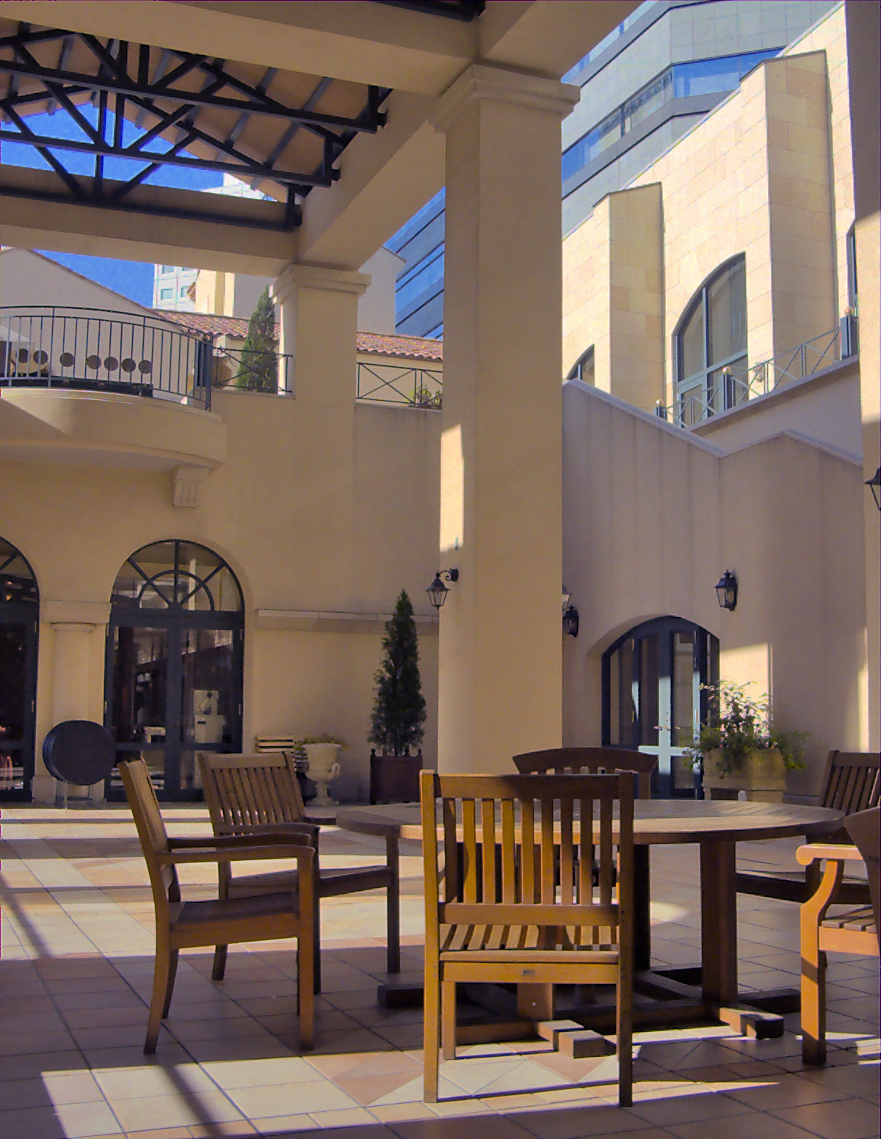
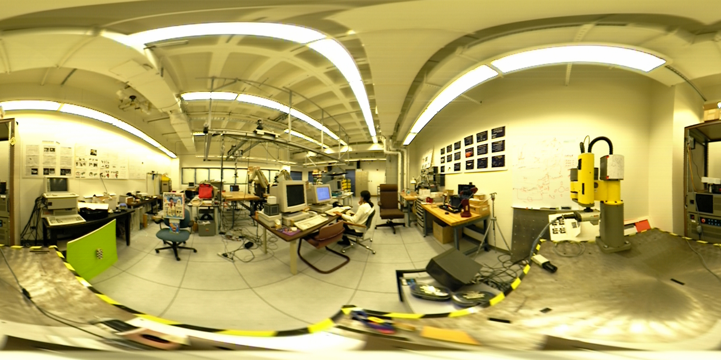
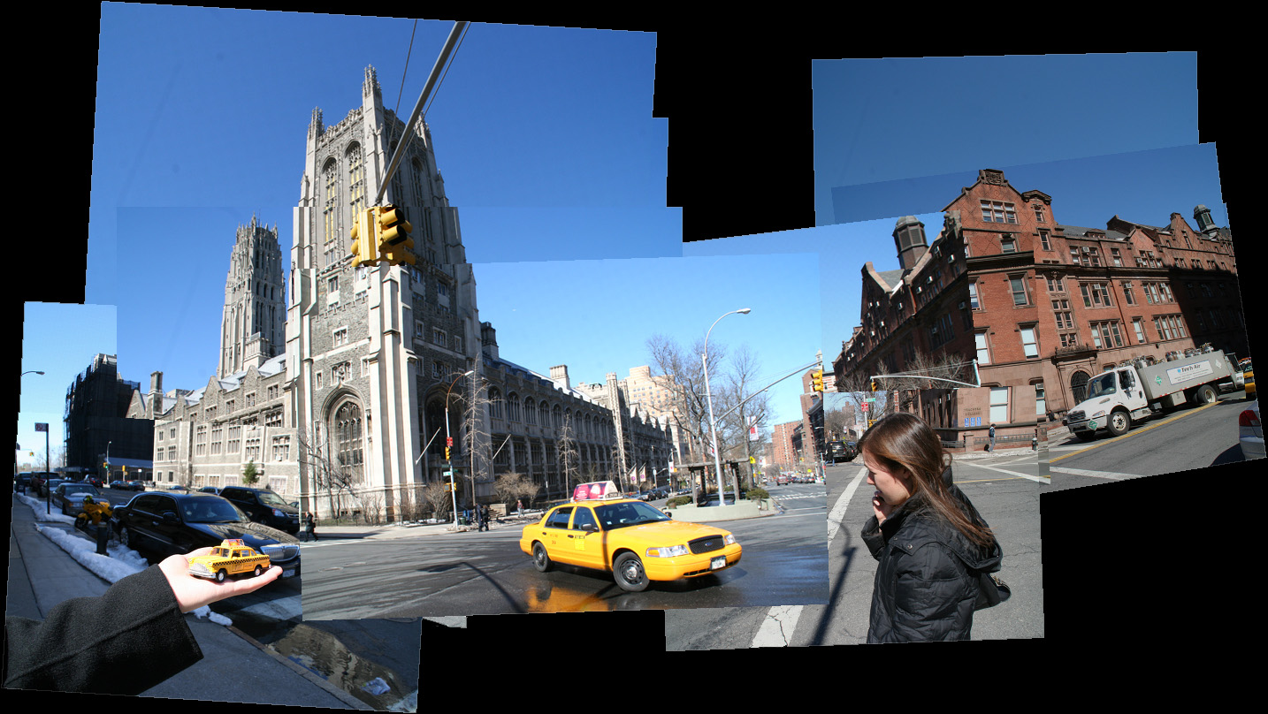
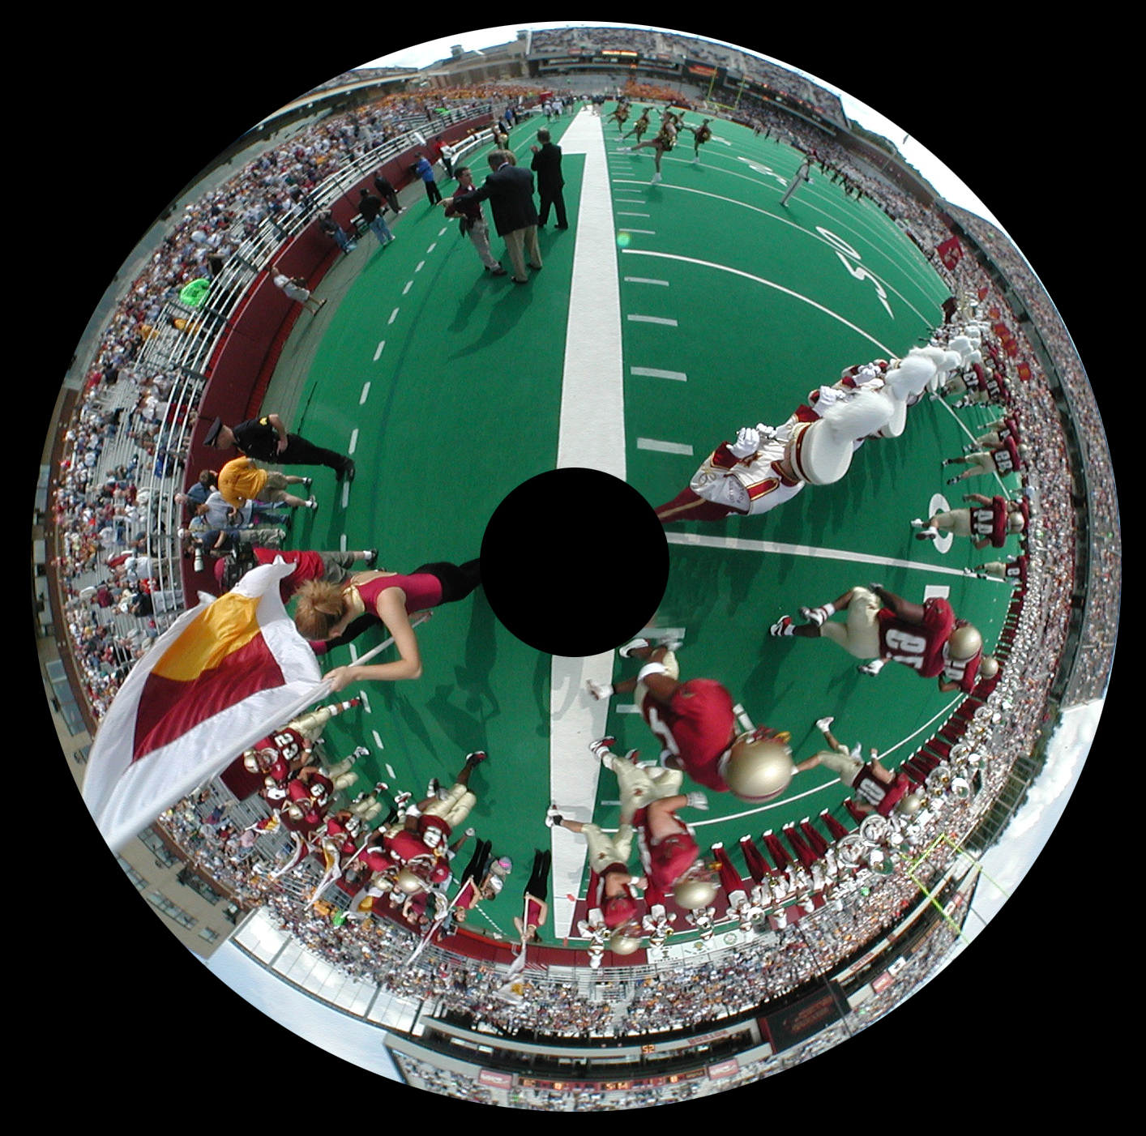
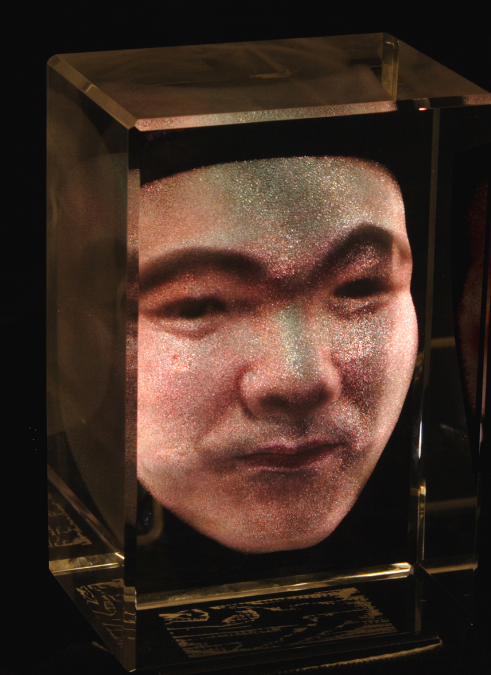
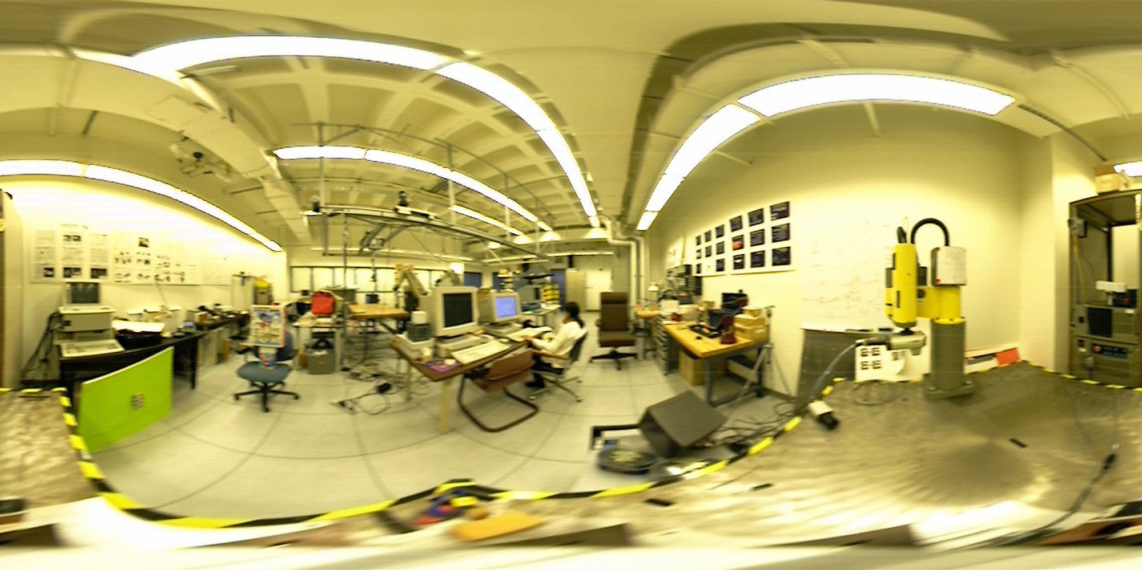
Shree Nayar
Computer Vision Laboratory
Computational cameras that produce new forms of visual information
Panoramic
Camera
Radial Depth
Camera
Spherical Stereo
Camera
Flexible
Camera Array
High Dynamic
Range Camera

Slide 26
Jason Nieh
DejaView
Provides a Tivo-like experience for the user's desktop
  record display
    to playback, browse, fast-forward, rewind
  record text and context
    to use as index to search the display record
  record execution state
    to revive and manipulate previous sessions

Slide 27
Design and CAD tools for asynchronous and mixed-timing digital systems
Steve Nowick
Project #1: low-power clockless chip for laser space measurement (joint with NASA Goddard)
Joint design of prototype space measurement chip with NASA Goddard manager (2006-2008), avoiding any sampling clock, and exhibiting lower area and power, and higher performance and flexibility, than their existing synchronous designs. Uses my circuit design methods and tools. Has generated interest at NASA, with potential for use in future space missions.
Project #2: high-speed flexible asynchronous interconnect mesh for shared memory parallel processors - (joint with U. of Maryland)
Designing a flexible robust asynchronous mesh for shared-memory parallel processors, to connect synchronous cores and memories. Unlike synchronous meshes, allows easy intgration of several clock speeds, avoids high-speed clock distribution, and supports easy scalability.

Slide 28
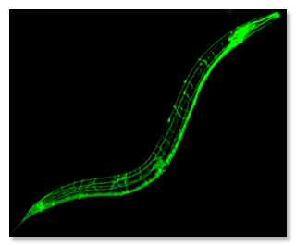
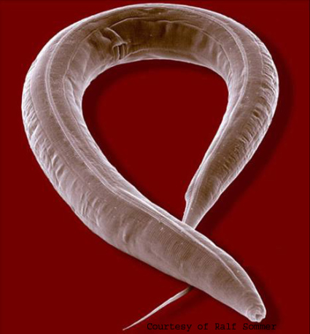
The $ Genome
Itsik Pe’er
Our lab recently lead analysis of the first whole-genome sequencing of a mutant animal
We sequenced a mutant worm with novel, high throughput, cost-effective technology
We developed novel probabilistic models for sequence data, with Γ-distributed coverage
Gene and mutation causing two right-side “brains” were discovered
Nature Methods, ePub 08/08

Slide 29
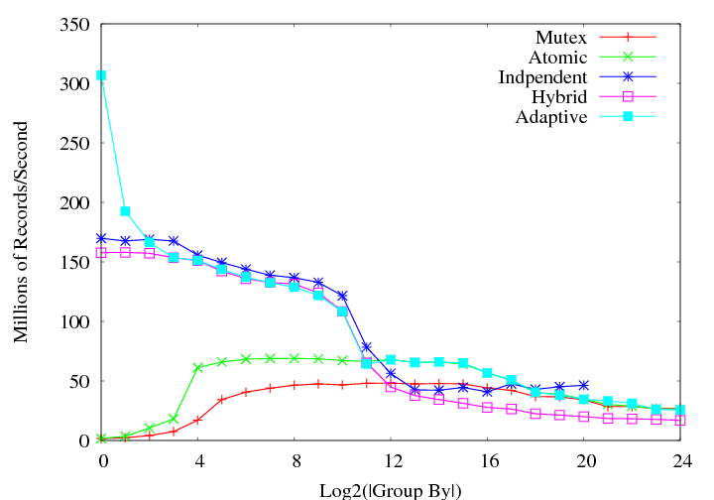
Ken Ross
Aggregation Performance on a 32-way Multicore machine
Lightweight sampling, choosing aggregation algorithm with best performance characteristics for the distribution (good locality, no contention, take advantage of runs if present)
Runs
Throughput
L2 Cache Size
(locality)
Contention

Slide 30
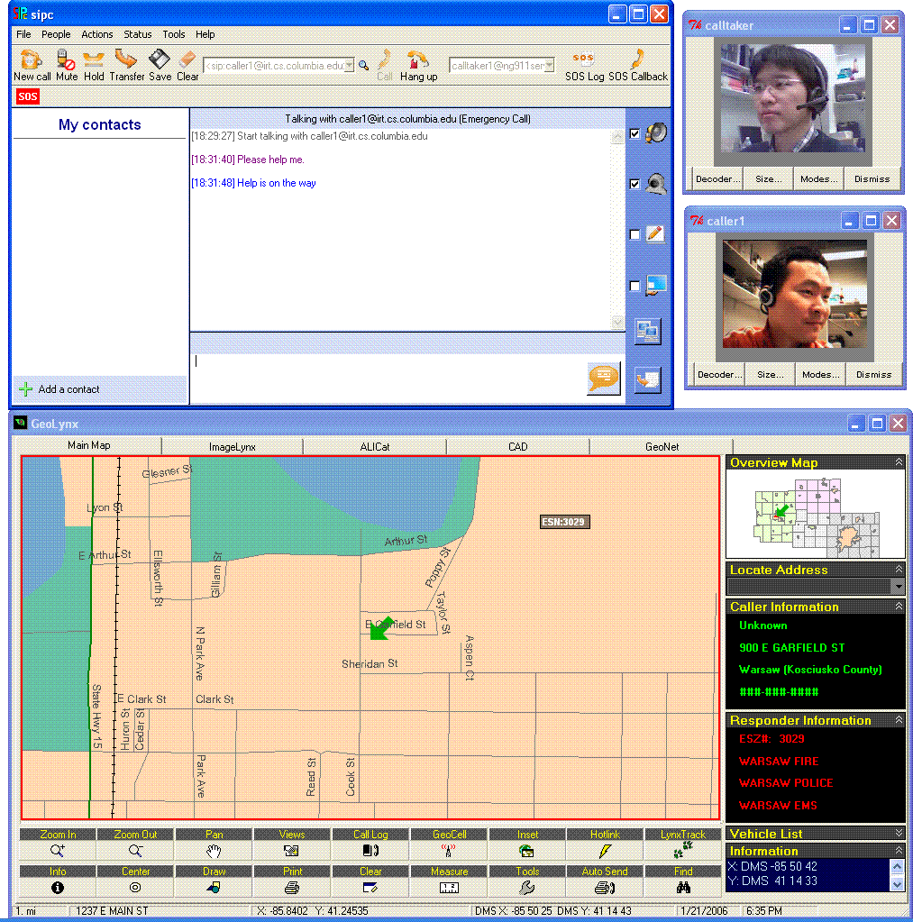
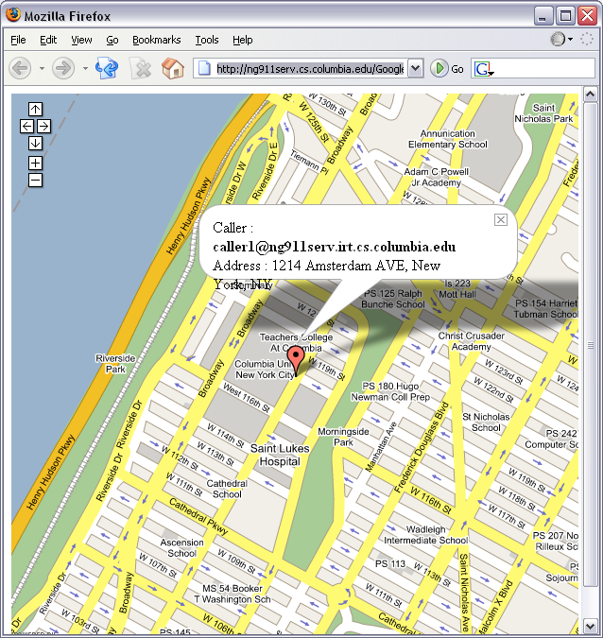
Next-Generation 911 network
Henning Schulzrinne
Design protocols and systems for next-generation 9-1-1 network
  Location-based services protocol (LoST)
Deployed in 5 PSAPs with DOT support
Architecture to be standard for new national emergency calling infrastructure

Slide 31
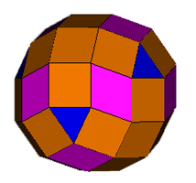
Rocco Servedio
Provably correct and efficient learning algorithms for interesting and important classes of functions in natural learning models
Optimal algorithms for learning high-dimensional convex sets
[FOCS ’08]
First adaptive provably noise-tolerant boosting algorithms
[NIPS ’08]
Optimal cryptographic hardness results for learning monotone functions [ICALP ’08]
h_{0,0}
h_{0,1}
h_{1,1}
h_{0,2}
h_{1,2}
h_{2,2}
h_{0,3}
h_{1,3}

Slide 32
Legacy Code Parallelization
Simha Sethumadhavan
Legacy binaries cannot easily take advantage of multi/many cores. Difficulties:
  Converting ILP to hardware threads profitably
  Limited parallelization experience, time constraints
New semi-automatic parallelization leverages:
  Advances in memory disambiguation techniques and hardware memory dependence predictors
  Ease of sharing knowledge on the Internet: An open system for accumulating users parallelization experiences
  Advances in recommender systems: Recommendations for code parallelization based on accumulated parallelization experiences
System design
  User and compiler provide best-effort parallelization based on hints available from the recommendation system
  Hardware uses speculative execution to fill in performance goals

Slide 33
Insider Threat Detection:
Host and Network Monitoring Techniques
Salvatore J. Stolfo
We study two approaches to detect malicious insider actions:
  Anomaly detection and profiling techniques to detect masqueraders by learning the user’s intent of their “normal” actions and
  Trap-based decoy techniques to detect traitors by generating and planting bogus but realistic data and traffic hard to distinguish from the real thing
http://www.cs.columbia.edu/ids/RUU/Dcubed

Slide 34
Complexity of Equilibria and Fixed points
Mihalis Yannakakis
How hard is it to compute
  Equilibria of games (Nash)
  Market equilibria (Arrow-Debreu)
  Optimal strategies in Stochastic games (Shapley)
  Extinction probabilities in Branching processes (Kolmogorov)
  Language probabilities for Stochastic context-free grammars
Basic models in different areas
Open whether they can be solved in polynomial time
Common theme: All can be cast as fixed point problems: Compute a vector x that satisfies x=F(x) for a suitable Brouwer function F
New complexity class FIXP: fixed points of functions F with standard algebraic operations
Nash equilibrium problem for games with 3 (or more) players is FIXP-complete: if we can solve it in polynomial time then we can solve also all the other problems

Slide 35
Techniques for Detecting, Debugging, and Fixing
Software Errors
Junfeng Yang
Recent projects
  EXPLODE: a storage system model checker
    Invented a checking architecture that reduces the manual overhead of model checking by several orders of magnitude
    Result: 70+ serious bugs (e.g. loss of all user data) in well-tested, widely-used storage systems (e.g. Linux file systems); many led to immediate patches
  Detecting security holes using static analysis and symbolic execution
    Result: 40+ Linux security holes; many led to immediate patches
Current projects
  Model checking large distributed systems
    Initial result: 28 bugs in a Microsoft production system running on top of 100K machines
  Repairing software by avoiding buggy executions

Slide 36
How To Network Virtual Machines & Clouds
Yechiam Yemini
(Some of) The Problems:
  VMs are mobile ➔ How do we handle mobile servers?
    E.g., IP addressing; DNS resolution; security; maintaining sessions..
  VMs share physical LAN NIC ➔ How do we manage QoS?
  VMs increase stack inefficiencies ➔ How do we minimize stack processing?
Approach: extend layer-2.5 to the VM/Cloud
  Resolve the problems at layer-2.5 and protect the IP layer & stack above
  Mobility: use label-switching for mobile paths to virtual IP addresses
  Bandwidth sharing: manage QoS of layer 2.5 paths
  Stack efficiency: offload stack processing & route directly to applications

