Slide 1
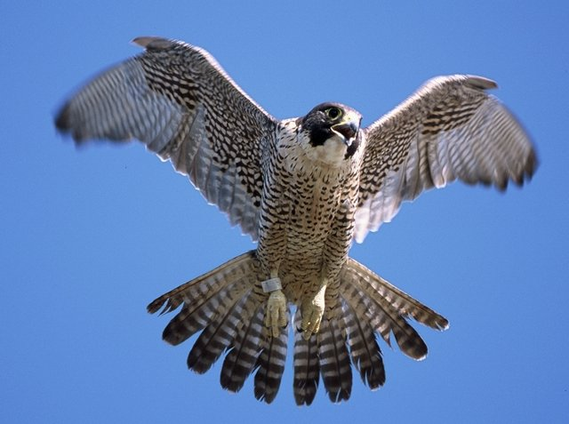
PEREGRINE:
Efficient Deterministic Multithreading through Schedule Relaxation
Heming Cui,
Jingyue Wu,
John Gallagher,
Huayang Guo,
Junfeng Yang
Software Systems Lab
Columbia University

Slide 2

Nondeterminism in Multithreading
Different runs ➔ different behaviors, depending on thread schedules
Complicates a lot of things
  Understanding
  Testing
  Debugging
  …

Slide 3
Nondeterministic Synchronization
Thread 0
Thread 1
Thread 0
Thread 1
mutex_lock(M)
*obj = …
mutex_unlock(M)
mutex_lock(M)
free(obj)
mutex_unlock(M)
mutex_lock(M)
free(obj)
mutex_unlock(M)
mutex_lock(M)
*obj = …
mutex_unlock(M)
Apache Bug #21287
Data Race
Thread 0
Thread 1
Thread 0
Thread 1
……
barrier_wait(B)
print(result)
……
barrier_wait(B)
result += …
……
barrier_wait(B)
print(result)
……
barrier_wait(B)
result += …
FFT in SPLASH2

Slide 4
Deterministic Multithreading (DMT)
Same input → same schedule
  Addresses many problems due to nondeterminism
Existing DMT systems enforce either of
  Sync-schedule: deterministic total order of synch operations (e.g., lock()/unlock())
  Mem-schedule: deterministic order of shared memory accesses (e.g., load/store)

Slide 5
Sync-schedule
[TERN OSDI '10], [Kendo ASPLOS '09], etc
Pros: efficient (16% overhead in Kendo)
Cons: deterministic only when no races
  Many programs contain races [Lu ASPLOS '08]
Thread 0
Thread 1
Thread 0
Thread 1
mutex_lock(M)
*obj = …
mutex_unlock(M)
mutex_lock(M)
free(obj)
mutex_unlock(M)
Thread 0
Thread 1
Thread 0
Thread 1
……
barrier_wait(B)
print(result)
……
barrier_wait(B)
result += …
……
barrier_wait(B)
print(result)
……
barrier_wait(B)
result += …
mutex_lock(M)
free(obj)
mutex_unlock(M)
mutex_lock(M)
*obj = …
mutex_unlock(M)
FFT in SPLASH2
Apache Bug #21287

Slide 6
Mem-schedule
[COREDET ASPLOS '10], [dOS OSDI '10], etc
Pros: deterministic despite of data races
Cons: high overhead (e.g., 1.2~10.1X slowdown in dOS)
Thread 0
Thread 1
Thread 0
Thread 1
……
barrier_wait(B)
print(result)
……
barrier_wait(B)
result += …
……
barrier_wait(B)
print(result)
……
barrier_wait(B)
result += …
FFT in SPLASH2

Slide 7
Open Challenge [WODET '11]
Either determinism or efficiency, but not both
Type of Schedule | Determinism | Efficiency
Sync | ☹ | ☺
Mem | ☺ | ☹
Can we get both?

Slide 8
Yes, we can!
Type of Schedule | Determinism | Efficiency
Sync | ☹ | ☺
Mem | ☺ | ☹
PEREGRINE | ☺ | ☺

Slide 9
PEREGRINE Insight
Races rarely occur
  Intuitively, many races ➔ already detected
  Empirically, six real apps ➔ up to 10 races occured
Hybrid schedule
  Sync-schedule in race-free portion (major)
  Mem-schedule in racy portion (minor)

Slide 10
PEREGRINE: Efficient DMT
Schedule Relaxation
  Record execution trace for new input
  Relax trace into hybrid schedule
  Reuse on many inputs: deterministic + efficient
    Reuse rate is high (e.g., 90.3% for Apache, [TERN OSDI '10])
    Automatic using new program analysis techniques
Run in Linux, user space
Handle Pthread synchronization operations
Work with server programs [TERN OSDI '10]

Slide 11
Summary of Results
Evaluated on a diverse set of 18 programs
  4 real applications: Apache, PBZip2, aget, pfscan
  13 scientific programs (10 from SPLASH2, 3 from PARSEC)
  Racey (popular stress testing tool for DMT)
Deterministically resolve all races
Efficient: 54% faster to 49% slower
Stable: frequently reuse schedules for 9 programs
  Many benefits: e.g., reuse good schedules [TERN OSDI '10]

Slide 12
Outline
PEREGRINE overview
An example
Evaluation
Conclusion

Slide 13
PEREGRINE Overview
Program Source
Instrumentor
INPUT
LLVM
Miss
Hit
INPUT
Match?
INPUT, Si
<Ci, Si>
Program
Execution
Traces
<C1, S1>
…
<Cn, Sn>
Program
Recorder
Analyzer
<C,S>
Replayer
OS
OS
Schedule Cache

Slide 14
Outline
PEREGRINE overview
An example
Evaluation
Conclusion

Slide 15
An Example
main(argc, char *argv[]) {
nthread = atoi(argv[1]);
size = atoi(argv[2]);
for(i=1; i<nthread; ++i)
pthread_create(worker);
worker();
if ((flag=atoi(argv[3]))==1)
result += …;
printf(“%d\n”, result);
}
worker() {
char *data;
data = malloc(size/nthread);
for(i=0; i<size/nthread; ++i)
data[i] = myRead(i);
pthread_mutex_lock(&mutex);
result += …;
pthread_mutex_unlock(&mutex);
}
// Read input.
// Create children threads.
// Work.
// Missing pthread_join()
// if “flag” is 1, update “result”.
// Read from “result”.
// Allocate data with “size/nthread”.
// Read data from disk and compute.
// Grab mutex.
// Write to “result”.

Slide 16
Instrumentor
main(argc, char *argv[]) {
nthread = atoi(argv[1]);
size = atoi(argv[2]);
for(i=1; i<nthread; ++i)
pthread_create(worker);
worker();
// Missing pthread_join()
if ((flag=atoi(argv[3]))==1)
result += …;
printf(“%d\n”, result);
}
worker() {
char *data;
data = malloc(size/nthread);
for(i=0; i<size/nthread; ++i)
data[i] = myRead(i);
pthread_mutex_lock(&mutex);
result += …;
pthread_mutex_unlock(&mutex);
}
// Instrument command line arguments.
// Instrument read() function within myRead().

Slide 17
Instrumentor
main(argc, char *argv[]) {
nthread = atoi(argv[1]);
size = atoi(argv[2]);
for(i=1; i<nthread; ++i)
pthread_create(worker);
worker();
// Missing pthread_join()
if ((flag=atoi(argv[3]))==1)
result += …;
printf(“%d\n”, result);
}
worker() {
char *data;
data = malloc(size/nthread);
for(i=0; i<size/nthread; ++i)
data[i] = myRead(i);
pthread_mutex_lock(&mutex);
result += …;
pthread_mutex_unlock(&mutex);
}
// Instrument command line arguments.
// Instrument synchronization operation.
// Instrument read() function.
// Instrument synchronization operation.
// Instrument synchronization operation.

Slide 18
$./a.out 2 2 0 Recorder
main(argc, char *argv[]) {
nthread = atoi(argv[1]);
size = atoi(argv[2]);
for(i=1; i<nthread; ++i)
pthread_create(worker);
worker();
// Missing pthread_join()
if ((flag=atoi(argv[3]))==1)
result += …;
printf(“%d\n”, result);
}
worker() {
char *data;
data = malloc(size/nthread);
for(i=0; i<size/nthread; ++i)
data[i] = myRead(i);
pthread_mutex_lock(&mutex);
result += …;
pthread_mutex_unlock(&mutex);
}
Thread 0
Thread 1
main()
nthread=atoi()
size=atoi()
(1<nthread)==1
pthread_create()
(2<nthread)==0
worker()
worker()
data=malloc()
data=malloc()
(0<size/nthread)==1
(0<size/nthread)==1
data[i]=myRead()
data[i]=myRead()
(1<size/nthread)==0
(1<size/nthread)==0
lock()
result+=…;
unlock()
lock()
result+=…;
unlock()
(flag==1)==0
printf(…,result)

Slide 19
$./a.out 2 2 0 Recorder
Thread 0
Thread 1
main()
nthread=atoi()
size=atoi()
(1<nthread)==1
pthread_create()
(2<nthread)==0
worker()
worker()
data=malloc()
data=malloc()
(0<size/nthread)==1
(0<size/nthread)==1
data[i]=myRead()
data[i]=myRead()
(1<size/nthread)==0
(1<size/nthread)==0
lock()
result+=…;
unlock()
lock()
result+=…;
unlock()
(flag==1)==0
printf(…,result)

Slide 20
Analyzer: Hybrid Schedule
Thread 0
Thread 0
Thread 1
Thread 1
main()
nthread=atoi()
size=atoi()
(1<nthread)==1
pthread_create()
pthread_create()
(2<nthread)==0
worker()
worker()
data=malloc()
data=malloc()
(0<size/nthread)==1
(0<size/nthread)==1
data[i]=myRead()
data[i]=myRead()
(1<size/nthread)==0
(1<size/nthread)==0
lock()
lock()
result+=…;
unlock()
unlock()
lock()
lock()
result+=…;
unlock()
unlock()
(flag==1)==0
printf(…,result)

Slide 21
Analyzer: Hybrid Schedule
Thread 0
Thread 1
Thread 0
Thread 1
main()
nthread=atoi()
size=atoi()
(1<nthread)==1
pthread_create()
pthread_create()
(2<nthread)==0
worker()
worker()
data=malloc()
data=malloc()
(0<size/nthread)==1
(0<size/nthread)==1
data[i]=myRead()
data[i]=myRead()
(1<size/nthread)==0
(1<size/nthread)==0
lock()
lock()
result+=…;
result+=…;
unlock()
unlock()
lock()
lock()
result+=…;
result+=…;
unlock()
unlock()
(flag==1)==0
printf(…,result)

Slide 22
Analyzer: Hybrid Schedule
Thread 0
Thread 1
Thread 0
Thread 1
main()
nthread=atoi()
size=atoi()
(1<nthread)==1
pthread_create()
pthread_create()
(2<nthread)==0
worker()
worker()
data=malloc()
data=malloc()
(0<size/nthread)==1
(0<size/nthread)==1
data[i]=myRead()
data[i]=myRead()
(1<size/nthread)==0
(1<size/nthread)==0
lock()
lock()
result+=…;
unlock()
unlock()
lock()
lock()
result+=…;
result+=…;
unlock()
unlock()
(flag==1)==0
printf(…,result)
printf(…,result)

Slide 23
Analyzer: Hybrid Schedule
Thread 0
Thread 1
Thread 0
Thread 1
main()
nthread=atoi()
size=atoi()
(1<nthread)==1
pthread_create()
pthread_create()
(2<nthread)==0
worker()
worker()
data=malloc()
data=malloc()
(0<size/nthread)==1
(0<size/nthread)==1
data[i]=myRead()
data[i]=myRead()
(1<size/nthread)==0
(1<size/nthread)==0
lock()
lock()
result+=…;
unlock()
unlock()
lock()
lock()
result+=…;
result+=…;
unlock()
unlock()
(flag==1)==0
printf(…,result)
printf(…,result)

Slide 24
./a.out 2 2 0
Analyzer: Precondition
Thread 0
Thread 1
Challenges
  Ensure schedule is feasible
  Ensure no new races
main()
nthread=atoi()
main(argc, char *argv[]) {
nthread = atoi(argv[1]);
size = atoi(argv[2]);
for(i=1; i<nthread; ++i)
pthread_create(worker);
worker();
// Missing pthread_join()
if ((flag=atoi(argv[3]))==1)
result += …;
printf(“%d\n”, result);
}
……
size=atoi()
(1<nthread)==1
pthread_create()
(2<nthread)==0
worker()
worker()
data=malloc()
data=malloc()
(0<size/nthread)==1
(0<size/nthread)==1
data[i]=myRead()
data[i]=myRead()
Hybrid Schedule
(1<size/nthread)==0
(1<size/nthread)==0
lock()
result+=…;
Thread 0
Thread 1
unlock()
pthread_create()
lock()
lock()
result+=…;
unlock()
unlock()
lock()
result+=…;
(flag==1)==0
unlock()
printf(…,result)
printf(…,result)

Slide 25
Naïve Approach to Computing Preconditions
Thread 0
Thread 1
nthread==2
main()
size==2
nthread=atoi()
flag!=1
size=atoi()
(1<nthread)==1
(1<nthread)==1
pthread_create()
(2<nthread)==0
(2<nthread)==0
worker()
worker()
data=malloc()
data=malloc()
(0<size/nthread)==1
(0<size/nthread)==1
(0<size/nthread)==1
(0<size/nthread)==1
data[i]=myRead()
data[i]=myRead()
(1<size/nthread)==0
(1<size/nthread)==0
(1<size/nthread)==0
(1<size/nthread)==0
lock()
result+=…;
unlock()
lock()
result+=…;
unlock()
(flag==1)==0
(flag==1)==0
printf(…,result)

Slide 26
Analyzer: Preconditions (a Naïve Way)
Thread 0
Thread 1
nthread==2
main()
size==2
nthread=atoi()
flag!=1
size=atoi()
(1<nthread)==1
pthread_create()
(2<nthread)==0
worker()
worker()
Problem: over-constraining!
  size must be 2 to reuse
Absorbed most of our brain power in this paper!
Solution: two new program analysis techniques; see paper
data=malloc()
data=malloc()
(0<size/nthread)==1
(0<size/nthread)==1
data[i]=myRead()
data[i]=myRead()
(1<size/nthread)==0
(1<size/nthread)==0
lock()
result+=…;
unlock()
lock()
result+=…;
unlock()
(flag==1)==0
printf(…,result)

Slide 27
Analyzer: Preconditions
Thread 0
Thread 1
nthread==2
main()
nthread=atoi()
size=atoi()
flag!=1
(1<nthread)==1
(1<nthread)==1
pthread_create()
(2<nthread)==0
(2<nthread)==0
worker()
worker()
data=malloc()
data=malloc()
(0<size/nthread)==1
(0<size/nthread)==1
data[i]=myRead()
data[i]=myRead()
(1<size/nthread)==0
(1<size/nthread)==0
lock()
result+=…;
unlock()
lock()
result+=…;
unlock()
(flag==1)==0
(flag==1)==0
printf(…,result)

Slide 28
./a.out 2 1000 3 Replayer
Thread 0
Thread 1
main()
Preconditions
nthread=atoi()
size=atoi()
nthread==2
(1<nthread)==1
pthread_create()
flag!=1
(2<nthread)==0
worker()
worker()
data=malloc()
data=malloc()
(0<size/nthread)==1
(0<size/nthread)==1
data[i]=myRead()
data[i]=myRead()
Hybrid Schedule
(1<size/nthread)==0
(1<size/nthread)==0
lock()
result+=…;
Thread 0
Thread 1
unlock()
pthread_create()
lock()
lock()
result+=…;
unlock()
unlock()
lock()
result+=…;
(flag==1)==0
unlock()
printf(…,result)
printf(…,result)

Slide 29
Benefits of PEREGRINE
Thread 0
Thread 1
main()
Deterministic: resolve race on result; no new data races
Efficient: loops on data[] run in parallel
Stable [TERN OSDI '10]: can reuse on any data size or contents
Other applications possible; talk to us!
nthread=atoi()
size=atoi()
(1<nthread)==1
(1<nthread)==1
pthread_create()
(2<nthread)==0
(2<nthread)==0
worker()
worker()
data=malloc()
data=malloc()
(0<size/nthread)==1
(0<size/nthread)==1
data[i]=myRead()
data[i]=myRead()
(1<size/nthread)==0
(1<size/nthread)==0
lock()
result+=…;
unlock()
lock()
result+=…;
unlock()
(flag==1)==0
printf(…,result)

Slide 30
Outline
PEREGRINE overview
An example
Evaluation
Conclusion

Slide 31
General Experiment Setup
Program-workload
  Apache: download a 100KB html page using ApacheBench
  PBZip2: compress a 10MB file
  Aget: download linux-3.0.1.tar.bz2, 77MB.
  Pfscan: scan keyword “return” 100 files from gcc project
  13 scientific benchmarks (10 from SPLASH2, 3 from PARSEC): run for 1-100 ms
  Racey: default workload
Machine: 2.67GHz dual-socket quad-core Intel Xeon machine (eight cores) with 24GB memory
Concurrency: eight threads for all experiments

Slide 32
Determinism
Program | # Races | Sync-schedule | Hybrid schedule
Apache | 0 | ☺ | ☺
PBZip2 | 4 | ☹ | ☺
barnes | 5 | ☹ | ☺
fft | 10 | ☹ | ☺
lu-non-contig | 10 | ☹ | ☺
streamcluster | 0 | ☺ | ☺
racey | 167974 | ☹ | ☺

Slide 33
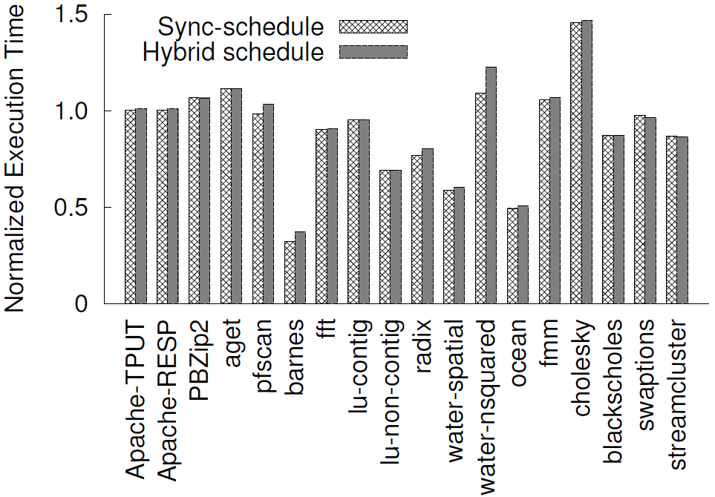
Overhead in Reusing Schedules

Slide 34
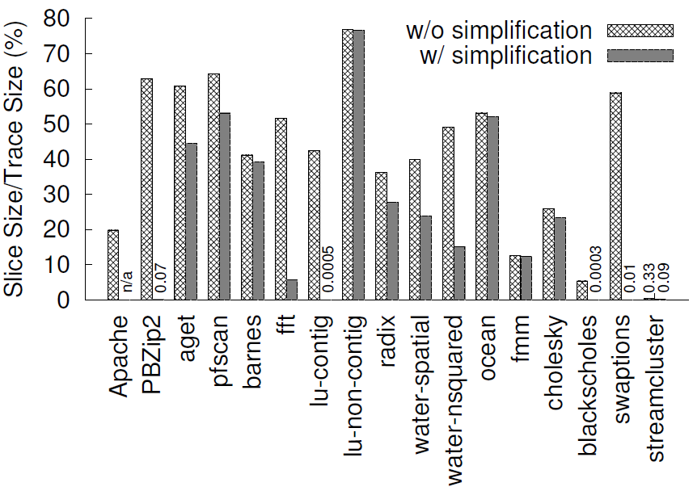
% of Instructions Left in the Trace

Slide 35
Conclusion
Hybrid schedule: combine the best of both sync-schedule and mem-schedules
PEREGRINE
  Schedule relaxation to compute hybrid schedules
  Deterministic (make all 7 racy programs deterministic)
  Efficient (54% faster to 49% slower)
  Stable (frequently reuse schedule for 9 out of 17)
Have broad applications

Slide 36
Thank you!
Questions?

