Slide 1
Detecting foodborne disease outbreaks using social media
Luis Gravano, Mohip Jorder, Fotis Psallidas, Alden Quimby, Henri Stern, and Vipul Rajeha
@Columbia University
Sharon Balter, Cassandra Harrison, Kenya Murray, and Vasudha Reddy
@Department of Health and Mental Hygiene

Slide 2
BACKGROUND
Food Poisoning Deaths: 3,000 per year in U.S. [CDC, 2014]
Foodborne Illness Factors: Incubation period, number of people affected
Government Process: NYC Dept. of Health and Mental Hygiene relies on complaints to initiate restaurant investigations
Problem: People rarely file official complaints (~50 per week as of 2014)
YELP
Twitter

Slide 3
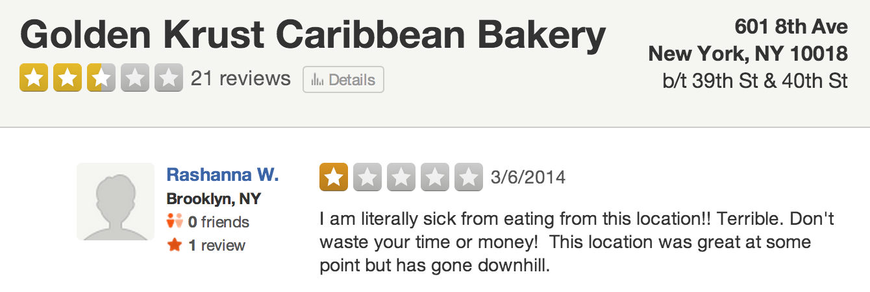
EXAMPLES
Key Word
Assumed Sick Date
Data
Integration
Restaurant
Chain
Location
Reference
Temporal Statement
Key Word
Key Word
Assumed Sick Date
Slang

Slide 4
desiderata
Integrate heterogeneous social media sources
Extract needles from high volume and rate streams of haystacks.
Entity-Centric: Aggregate relevant social media documents by entities
Overall goal: Present precise actionable information in real-time

Slide 5
Desiderata DetectING disease outbreaks
Integrate heterogeneous social media sources
Yelp, Twitter, and NYC 311 Complaints
Extract needles from high volume and rate streams of haystacks
Feature extraction (e.g., keywords, conversations, restaurant chains, and temporal statements)
Document classification
Entity-Centric: Aggregate relevant social media documents
Aggregate positive social documents (Yelp Reviews, Tweets, NYC 311 Complaints) by restaurants
Overall goal: Present precise actionable information in real-time
Ranking of potential restaurant to investigate
Human in the loop

Slide 6
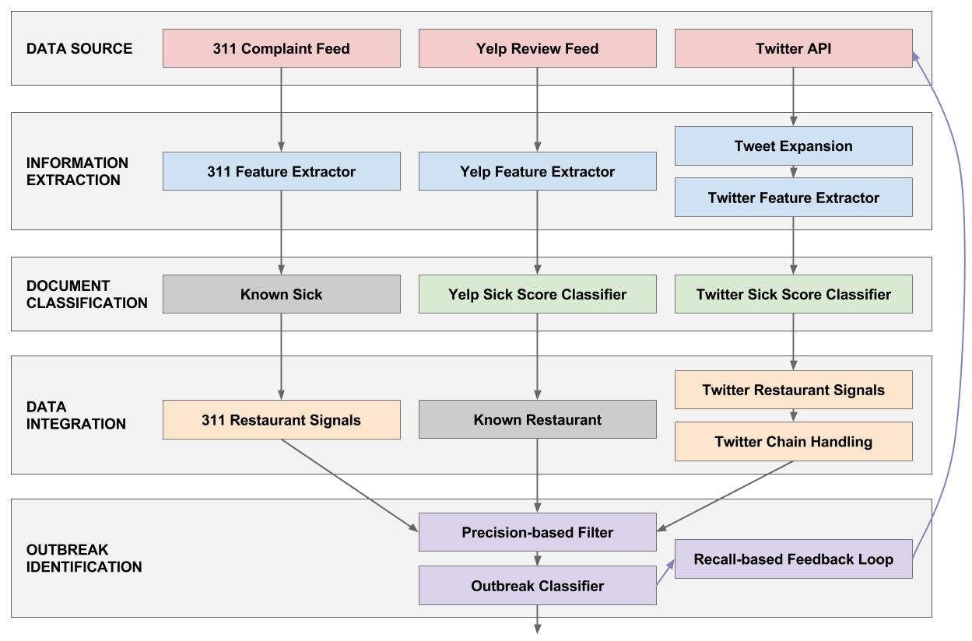
Proposed approach End-to-end
Main idea:
Signals from each social media source in isolation.
Collectively, combine the signals to strengthen the decision.

Slide 7
Yelp windbreak
Yelp Review Feed
Daily provided by YELP (Many Thanks)
Contains reviews about restaurants from the NY City
37,100 restaurants
320 types of restaurants (e.g., Etnic Food, Spanish, Gelato)
2,019,737 reviews
* Statistics as of 10/02/2014
Feature Extractor
Yelp Sick Score Classifier

Slide 8
Yelp windbreak
Yelp Review Feed
Tokenization (N-gram/Word Tokenization) of text for number of people affected and incubation period
Doc length normalization, no stopwords
Feature Extractor
Yelp Sick Score Classifier

Slide 9
Yelp windbreak
Combination of three classifiers
YelpSick (SimpleCart):
Sickness-related keywords
YelpIncubation (ADtree)
Temporal statements in keyword form
YelpPeople (Part):
Multiple people affected
Yelp Review Feed
Feature Extractor
Yelp Sick Score Classifier
YelpSick | YelpIncubation | YelpPeople
sick | morning | friends and I
food poisoning | days | me and my
stomach | week | party

Slide 10
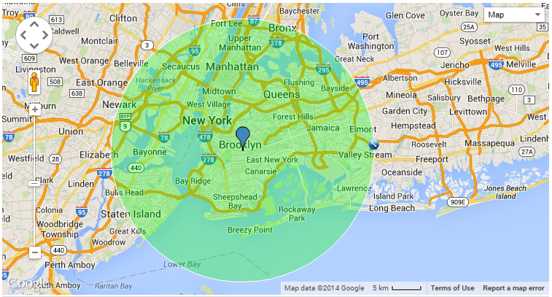
Twitter windbreak
Twitter API
Accessed through public API
Spatial
Latitude = 40.67
Longitude = -73.94
Radius = 13
Keywords (OR-semantics)
#foodpoisoning
#stomache
“food poison”
“food poisoning”
stomach
vomit
puke
diarrhea
“the runs”
Temporal
Since last downloaded tweet id
Feature Extractor
Twitter Sick Score Classifier

Slide 11
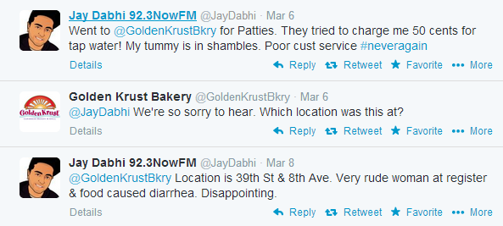
Twitter windbreak
Tweet Expansion
Track conversations.
Expand user timeline 4 days back/forward
Scrape restaurant websites for twitter accounts
Note: tweets already contain the keywords we searched for.
Twitter API
Feature Extractor
Twitter Sick Score Classifier

Slide 12
Twitter windbreak
Training Data
DOPH of Chicago (Many thanks)
DOHMH of NY
Built C4.5 Decision Tree classifier
Twitter API
Feature Extractor
TwitterSick
food poisoning
stomachache
nausea
Twitter Sick Score Classifier

Slide 13
AGGREGATOR – THE CHAIN PROBLEM
Given the positive Yelp reviews, Twitter messages, and NYC 311 Complaints aggregate them by restaurant.
Yelp
Known restaurant
Twitter
Scrapping of websites
Reverse geocode expanded tweets days back//Incubation period
Bad results for chains (e.g., StarBucks only a few meters away)
Request Twitter users additional information (Twitter form)
NYC 311 Complaints
Use Bing to reverse geocode the location and match to the Yelp restaurant catalog
Chains appear with multiple names. Use string matching

Slide 14
results
Identified 7 outbreaks since 2013
Only 50-75 outbreaks per year in New York State
~30 in NYC
Real Outbreak: Yelp review flagged on Dec 18, 2012
Information extracted: Possible salmonella, incident occurred on Dec 8, incubation period 1 day, 7 of 9 people affected.
DOHMH investigation: Determined attendees were sick for 4 days with diarrhea, vomiting, nausea, and stomach cramps.

Slide 15
DEMO

