Slide 1
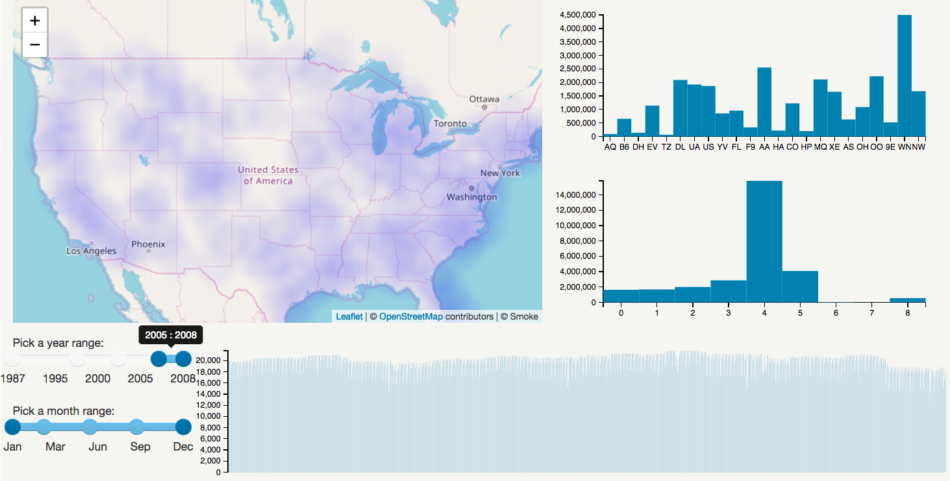
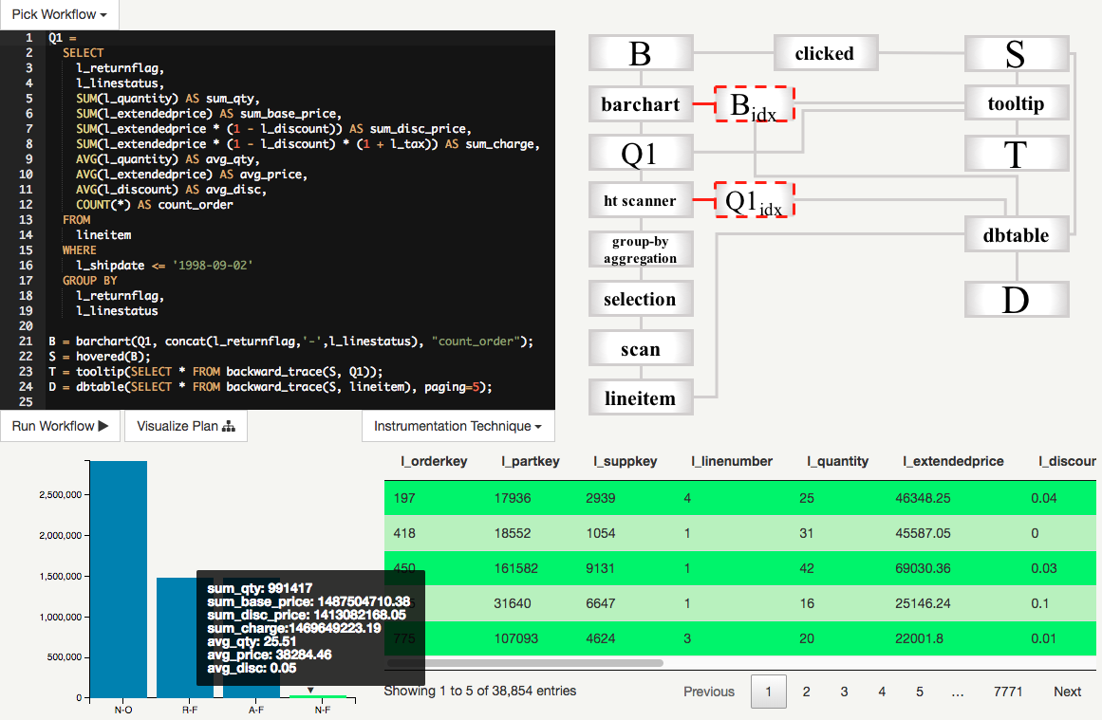
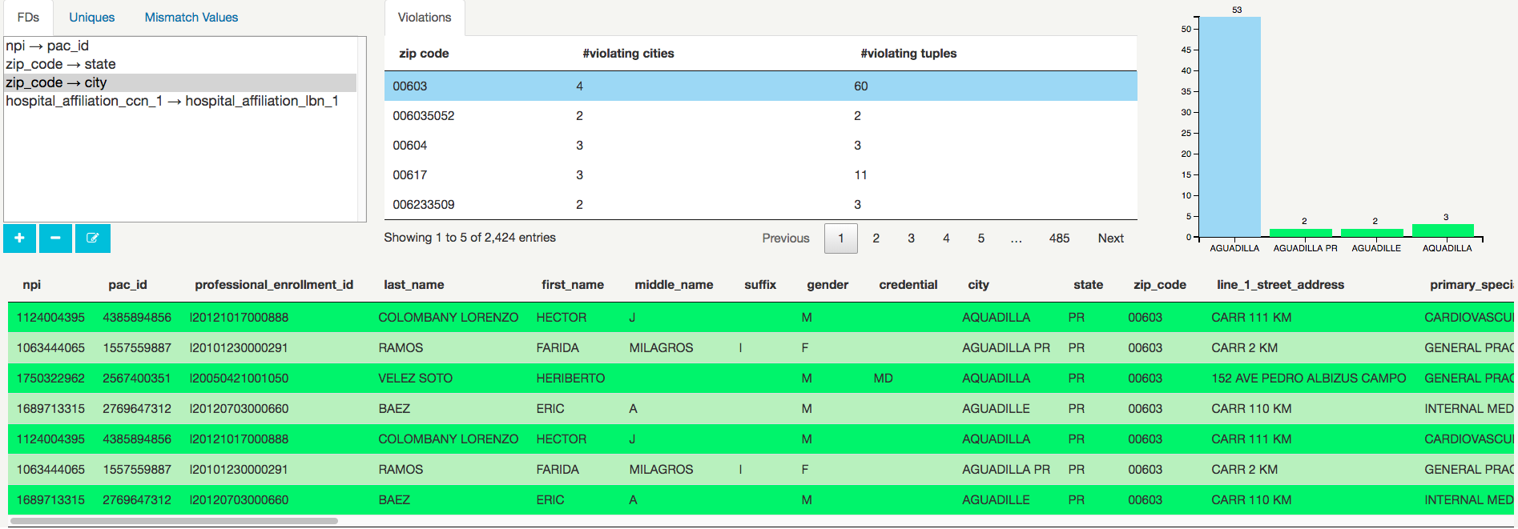
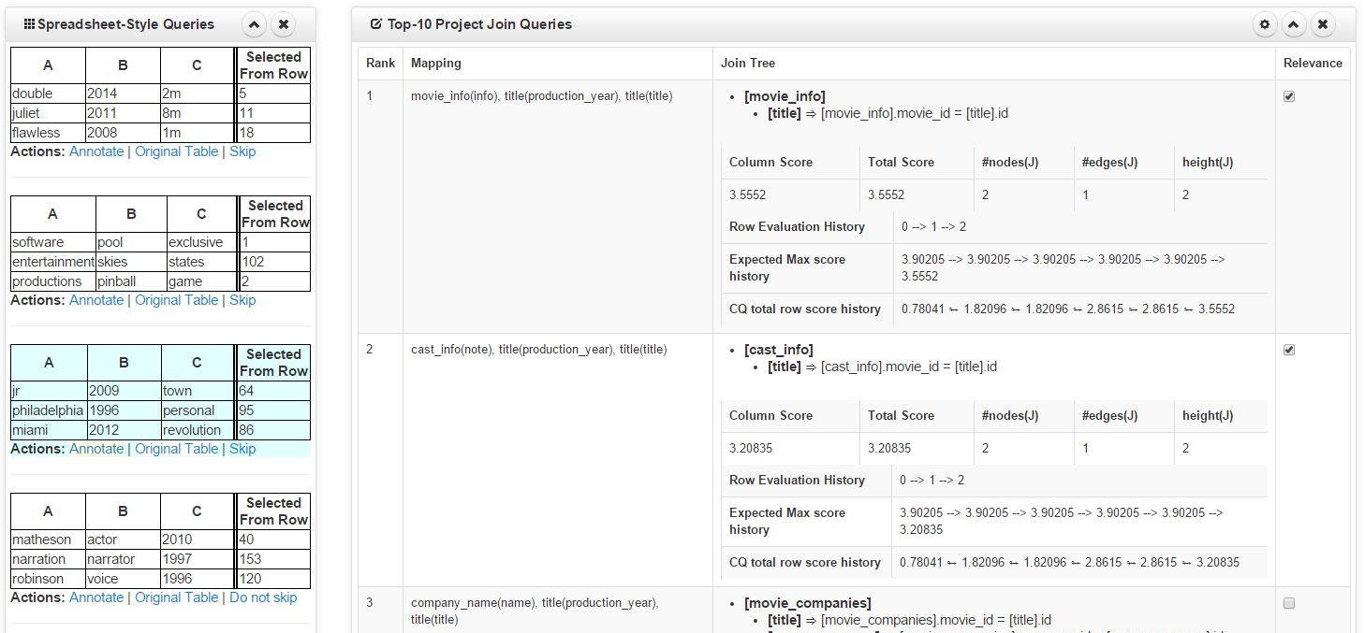
SMOKE: Fine-Grained Provenance Capture
at Interactive Speed
Fotis Psallidas
fotis@cs.columbia.edu
Eugene Wu
ewu@cs.columbia.edu

Slide 2


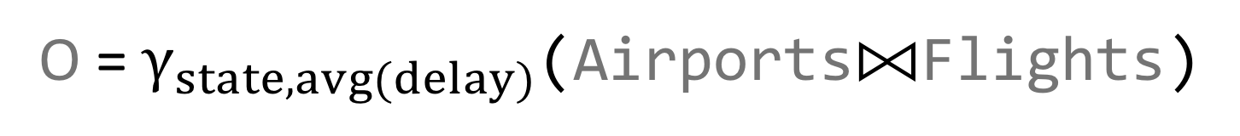
Fine-Grained Provenance Primer
O = $γ_{state, avg(delay)}$(Airports⨝Flights)
name = from
Airports
 | name | state
a₁ | LGA | NY
a₂ | JFK | NY
a₃ | MIA | FL
O
 | state | avg(delay)
o₁ | NY | 40
o₂ | FL | 60
 | from | delay | state
j₁ | LGA | 30 | NY
j₂ | LGA | 40 | NY
j₃ | JFK | 50 | NY
j₄ | MIA | 60 | FL
⨝
γ
Flights
 | from | delay
f₁ | LGA | 30
f₂ | LGA | 40
f₃ | JFK | 50
f₄ | MIA | 60

Slide 3
Fine-Grained Provenance Primer
Airports
 | name | state
a₁ | LGA | NY
a₂ | JFK | NY
a₃ | MIA | FL
O
 | state | avg(delay)
o₁ | NY | 40
o₂ | FL | 60
 | from | delay | state
j₁ | LGA | 30 | NY
j₂ | LGA | 40 | NY
j₃ | JFK | 50 | NY
j₄ | MIA | 60 | FL
Flights
 | from | delay
f₁ | LGA | 30
f₂ | LGA | 40
f₃ | JFK | 50
f₄ | MIA | 60
{f₄} = backward_trace({o₂}, Flights)

Slide 4
Fine-Grained Provenance Primer
Airports
 | name | state
a₁ | LGA | NY
a₂ | JFK | NY
a₃ | MIA | FL
O
 | state | avg(delay)
o₁ | NY | 40
o₂ | FL | 60
 | from | delay | state
j₁ | LGA | 30 | NY
j₂ | LGA | 40 | NY
j₃ | JFK | 50 | NY
j₄ | MIA | 60 | FL
Flights
 | from | delay
f₁ | LGA | 30
f₂ | LGA | 40
f₃ | JFK | 50
f₄ | MIA | 60
{o₂} = forward_trace({f₄}, O)

Slide 5
Fine-Grained Provenance Primer
Airports
 | name | state
a₁ | LGA | NY
a₂ | JFK | NY
a₃ | MIA | FL
O
 | state | avg(delay)
o₁ | NY | 40
o₂ | FL | 60
 | from | delay | state
j₁ | LGA | 30 | NY
j₂ | LGA | 40 | NY
j₃ | JFK | 50 | NY
j₄ | MIA | 60 | FL
Flights
 | from | delay
f₁ | LGA | 30
f₂ | LGA | 40
f₃ | JFK | 50
f₄ | MIA | 60

Slide 6
Fine-Grained Provenance Primer
Navigation of the input-output connections
  {records} = backward_trace(…)
  {records} = forward_trace(…)
Provenance consuming queries
  SQL(backward_trace(…))
  SQL(forward_trace(…))

Slide 7


Fine-Grained Provenance Capture
Optimizing Provenance Constructs $⇒$ Fine Grained Provenance Capture Problem
A
 | name | state
a₁ | LGA | NY
a₂ | JFK | NY
a₃ | MIA | FL
O
 | state | avg(delay)
o₁ | NY | 40
o₂ | FL | 60
 | from | delay | state
j₁ | LGA | 30 | NY
j₂ | LGA | 40 | NY
j₃ | JFK | 50 | NY
j₄ | MIA | 60 | FL
F
 | from | delay
f₁ | LGA | 30
f₂ | LGA | 40
f₃ | JFK | 50
f₄ | MIA | 60
Fine-grained Provenance Capture Problem
Capture provenance graph w/ low-overhead
to answer provenance queries efficiently

Slide 8
Previous Work
LAZY [Cui et al. and Ikeda et al.]
Do not materialize the provenance graph
Provenance query evaluation by rewriting to SQL queries
EAGER [Subzero, NewT, Ramp, Clothia et al., Titian, Trio, Perm, GProm, ProQL and DBNotes]
Materialize the provenance graph
  Logical: In the relational model
  Physical: In a separate provenance subsystem
Provenance query evaluation using the materialized graph

Slide 9
Previous Work – Provenance Capture
Main Problems
Physical
Expensive virtual function calls
Write-inefficient provenance storage
No physical plan co-optimizations
Logical
Storing graph under relational model
Hard to optimize queries
Expensive joins
Physical
183x
Logical
16.9x
Smoke-D
Smoke-I
No Capture
Lazy
10
100
1K
10K
Capture Latency (ms, log)

Slide 10
Previous Work – Provenance Query
Main Problems
Lazy Approaches
Equivalent SQL queries are slow
Physical Approaches
Read-inefficient provenance storage
Logical Approaches
Need extra indexing steps
Lazy
Physical
Logical
Logical Indexed
w/ Smoke Indexes
10
100
1000
10000
100000
Cum. Latency (ms, log) over
5000 backward trace queries

Slide 11
Design Principles for Fast Provenance Systems
4 Design Principles
P1. Tight Integration
Integrate provenance capture within query plans
Index provenance in read- and write-efficient indexes
P2. Reuse work
  Provenance indexes in hash tables
  Intra-plan hash table reuse
P3. Apriori Knowledge
Don’t capture if not used
P4. Provenance Consumption
Push computation into provenance capture

Slide 12
SMOKE Overview
Result 1
Result 2
In-Memory Query Compiled Engine
Eager physical approach
Write and read-efficient provenance indexes
Two capture paradigms: Defer and Inject

Slide 13
Provenance Index Representations
input
output
rid index
rid array
R
O
1-to-N
1-to-1
r₁
r₁
r₂
r₁
r₁
o₁
r₂
r₄
r₇
r₄
r₂
Op
r₂
o₂
r₃
r₅
r₈
r₉
r₂
r₃
r₃
o₃
…
r₄
r₃
r₁
o₄

Slide 14


Two Capture Paradigms
o₁
j₁
j₂
j₃
o₂
j₄
⋈
 | state | avg(delay)
o₁ | NY | 40
o₂ | FL | 60
 | state | avg(delay)
o₁ | NY | 40
o₂ | FL | 60
 | from | delay | state
j₁ | LGA | 30 | NY
j₂ | LGA | 40 | NY
j₃ | JFK | 50 | NY
j₄ | MIA | 60 | FL
j₁
j₂
j₃
j₄
$$γ$$
$$γ$$
 | from | delay | state
j₁ | LGA | 30 | NY
j₂ | LGA | 40 | NY
j₃ | JFK | 50 | NY
j₄ | MIA | 60 | FL
 | from | delay | state
j₁ | LGA | 30 | NY
j₂ | LGA | 40 | NY
j₃ | JFK | 50 | NY
j₄ | MIA | 60 | FL
Inject
Defer

Slide 15
Physical Algebra
Both paradigms for every relational operator
Avoid materializing intermediate provenance indexes for multi-operator plans

Slide 16
Experimental Setup
Provenance Capture and Querying
  Comparison with state-of-the-art Physical, Logical, and Lazy approaches
  Single operator performance: microbenchmarks using zipfians
  Multi-operator performance: TPC-H
Real-World Applications
  Comparison with state-of-the-art, hand-tuned implementations
  Interactive Visualizations:
    Overview first then details on demand
    Crossfilter
  Data Profiling: Functional Dependency Checks

Slide 17

Main Results - Provenance Capture
GB --- 10M Tuples, 100 groups, $θ=1$
Physical
183x
Smoke outperforms alternatives by embodying the design principles
Negligible overhead over fast query engines
Can do better with opts (.8x →.4x)
Logical
16.9x
Smoke-D
1.4x
Smoke-I
0.8x
No Capture
10
100
1K
10K
Capture Latency (ms, log)

Slide 18
Main Results - CROSSFILTER
Provenance can express important application logic
Example: Show the distribution of #flights per carrier only for selected states
backward_trace( ,flights)
airports
View V₁
flights
airlines
View V₂
#flights
selective_refresh(V2, flights )
FL
OO
AA
DL
HA
UA
WN
NW
CO

Slide 19
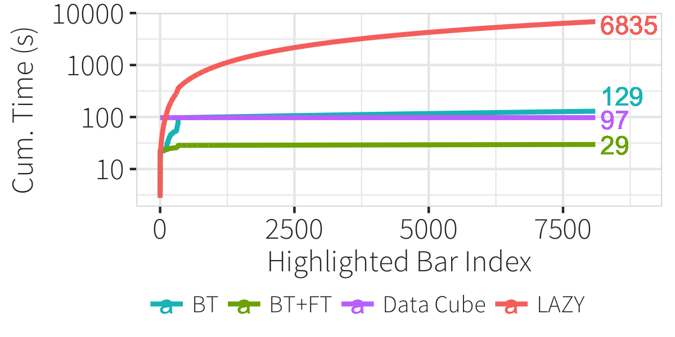
Main Results - CROSSFILTER
Crossfilter on Ontime dataset: 5 initial views over 125 million delayed flights
Data cubes: Immens > 1 hour , Nanocubes > 30 minutes, Hashedcubes > 4 minutes

Slide 20
Takeaway
Interactive Visualizations
Interactive
Data Profiling
Multi-Application
Linking
Interactive Query Specification
What-if Provisioning
Query
Explanations
Why-not Analytics
Iterative Analytics
Viz Workflow Debugging
Interactive
Data Cleaning
Interaction Debugging
ML
Interpretability
Visualization
Deconstruction and Restyling
Interaction
By Example
Application Design Search
Collaborative Communication
Action Recovery
Sense-Making
Meta-Analysis
Replication and Reproducibility
Data Integration
Debugging
Network Diagnostics
Dataset
Versioning
Auditing
…
Provenance for Interactive Visualizations [HILDA ‘18]

Slide 21
Thank you
// Q
Smoke: Fine-Grained Lineage At Interactive Speed
A Deep breath of Data-Intensive Lineage Applications
Provenance for Interactive Visualizations
Combining Design and Performance in a DVMS
[VLDB18]
[SIGMOD18]
[HILDA18]
[CIDR17]

