Slide 1
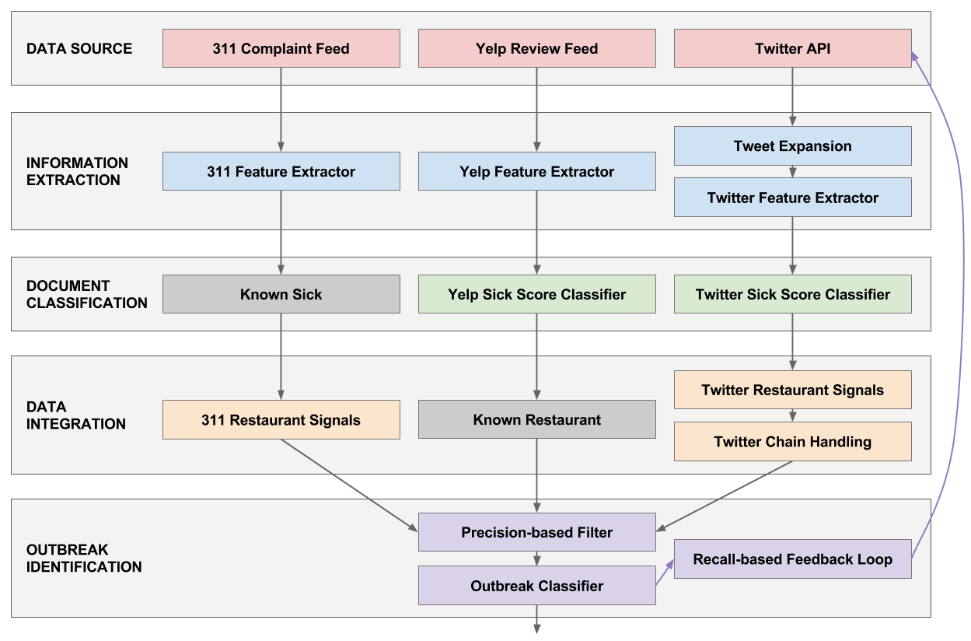
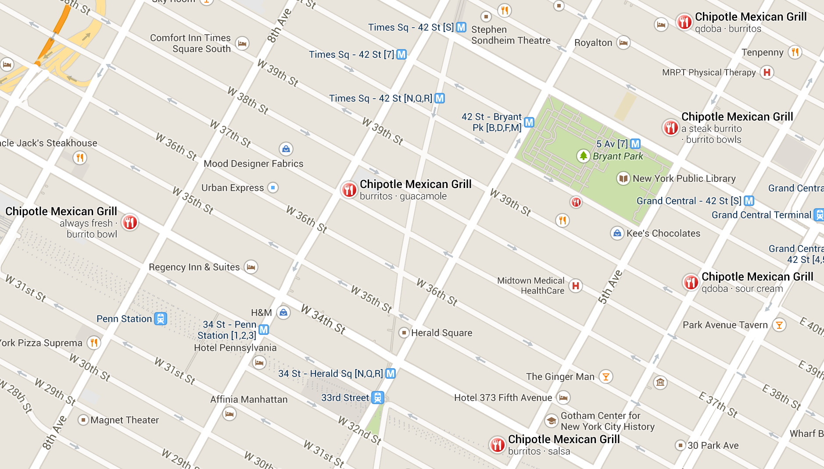
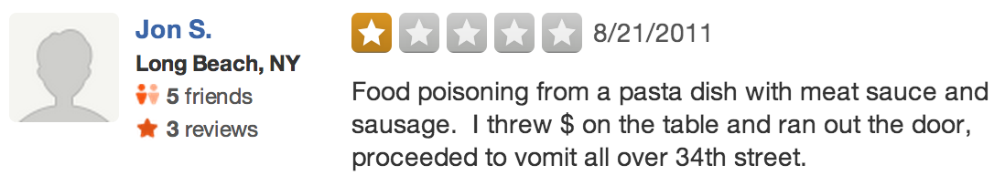
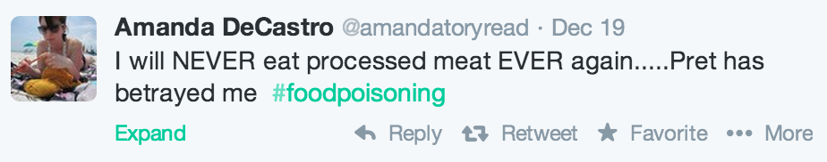
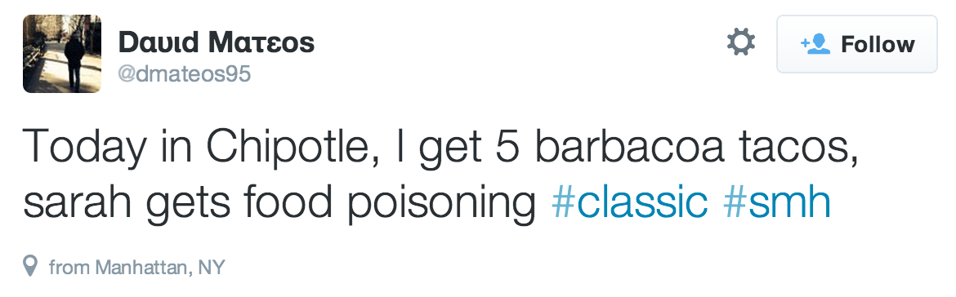
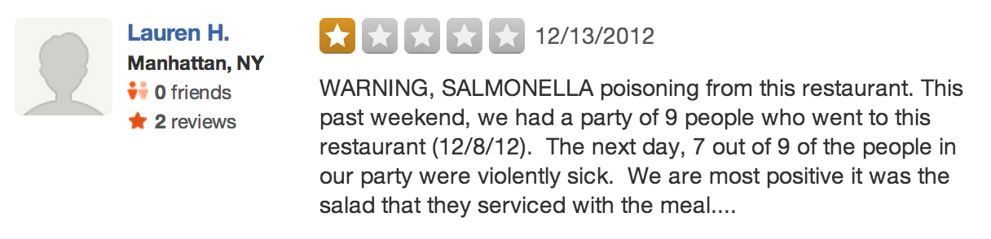
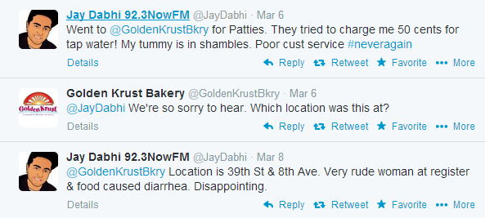
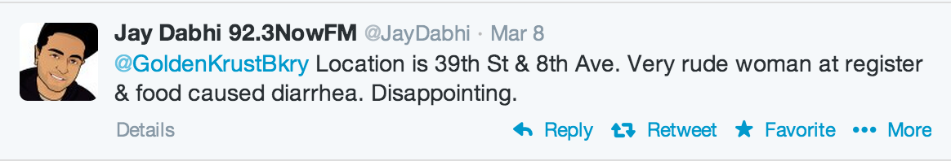
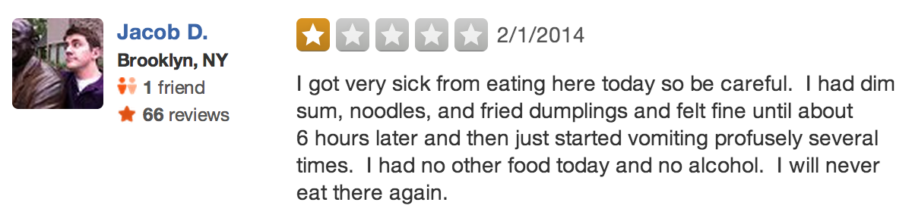
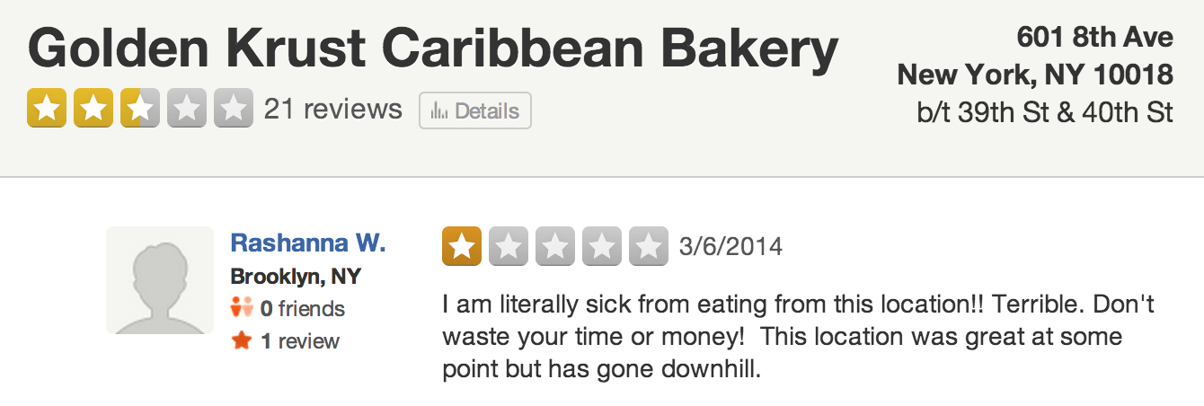
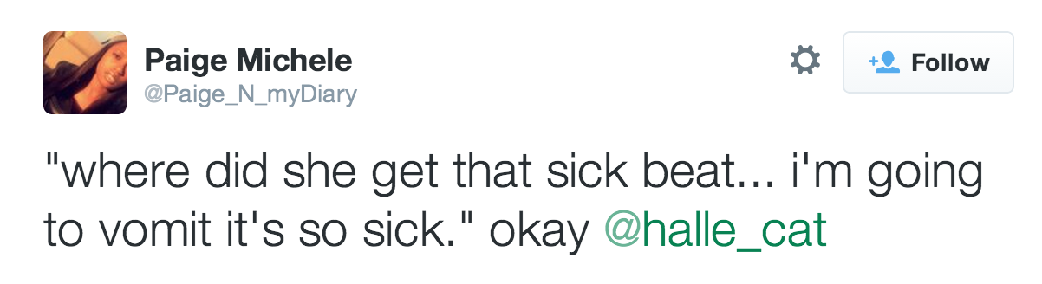
Using Social Media to Detect Foodborne Disease Outbreaks
Alden Quimby
Columbia University
aldenquimby@gmail.com
Fotis Psallidas
Columbia University
fotis@cs.columbia.edu
Luis Gravano
Columbia University
gravano@cs.columbia.edu
Background
Outbreak Identification
Food Poisoning Deaths: 3,000 per year in U.S. [www.cdc.gov, 2011]
  Foodborne Illness Factors: Incubation period, number of people affected
Government Process: NYC Dept. of Health and Mental Hygiene relies on resident complaints to launch restaurant investigations
Problem: Residents rarely file official complaints (50 per week in 2014)
Observation: Residents use social media to complain about food poisoning
Testing Alternative Techniques
Chain Handling: Determine specific location for restaurant chains
Precision-based Filter: Use epidemiology knowledge to reduce noise
Recall-based Feedback Loop: Look for additional tweets based on Yelp and 311 signals
Not enough real-world outbreaks
to use for training
DOHMH to label hypothetical
scenarios to train outbreak classifier
Final Output: List of restaurants
to investigate for foodborne illness
Yelp
Twitter
Problem Definition
Evaluation and Results
Task: Use social media to identify potential foodborne outbreaks at restaurants in near real-time for DOHMH to investigate
  Information Extraction: Extract key words, entities, temporal statements, and references from individual documents
  Document Classification: Determine food poisoning relevance of individual documents
  Data Integration: Aggregate relevant documents by restaurant
  Outbreak Identification: Flag candidate restaurants based on relevant documents
Information Extraction
Document Features: Data source, post date, user, location, and text
Extracted Features: Key words, restaurant entities, dates, and references
Identified 5 confirmed
outbreaks so far
Only 50-75 outbreaks per
year in New York state
Real Outbreak: Yelp review (above) flagged on Dec 18, 2012
Information Extracted: Possible salmonella, incident occurred on Dec 8, incubation period of one day, 7 of 9 people affected
DOHMH Investigation: Determined attendees were sick for 4 days with diarrhea, vomiting, nausea, and stomach cramps
Food preparation violations found on Jan 4, 2013 – it was the salad!
Yelp
Daily feed of NYC reviews
Google Geocoding of address for coordinates
Tokenization/classification of text for number of people affected and incubation period
Twitter
Targeted API query (#foodpoisoning, #stomachache, vomit, puke, diarrhea, …)
Scrape restaurant websites for screen names
Track conversations 1 tweet back, expand user timeline 4 days back/forward
Examples
311
Custom daily feed of food poisoning complaints
Unstructured restaurant names and locations
Key Word
Assumed Sick Date
Next Steps
Explore Additional Data Sources
  Seamless, TripAdvisor, Facebook
  Already ruled out Google+ Reviews, Foursquare Tips
Expand to Other Problems
  Bedbugs, rodents, noise complaints, illegal parking, housing violations, …
Improve Techniques
  More powerful methods for text classification
  Active learning
  Dynamic query vectors
Data
Integration
Restaurant
Chain
Location
Reference
Temporal Statement
Key Word
Key Word
Document Classification
Training: “Yes”/“No” sick labels from DOHMH experts for 500 tweets and 500 Yelp reviews
Classification: Assign sick score based on text and training labels
Classifier Key Words
Yelp Sick (SimpleCart) | Yelp Incubation (ADTree) | Yelp People (PART) | Twitter Sick (J48)
sick | morning | friend and I | food poisoning
food poisoning | days | me and my | stomachache
stomach | week | party | nausea
Key Word
Assumed Sick Date
Slang

