Slide 1
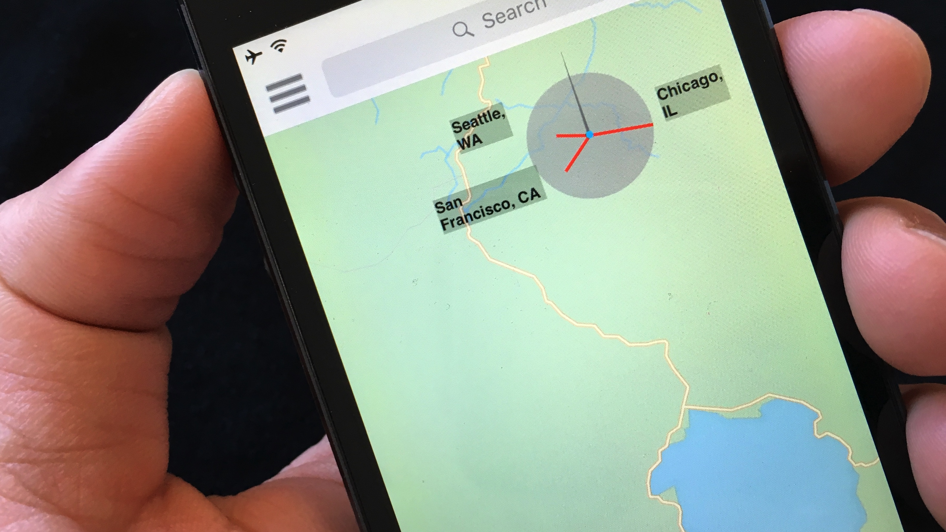
personalized compass
a compact visualization for direction and location
Daniel Miau, Steven Feiner
Columbia University

Slide 2
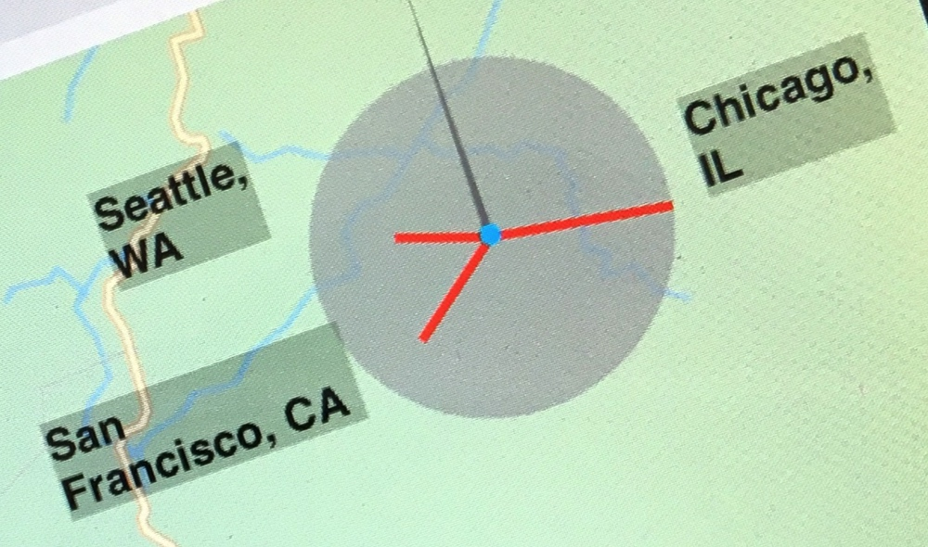
this talk is about using personalized compass to address the “where is x?” problem

Slide 3
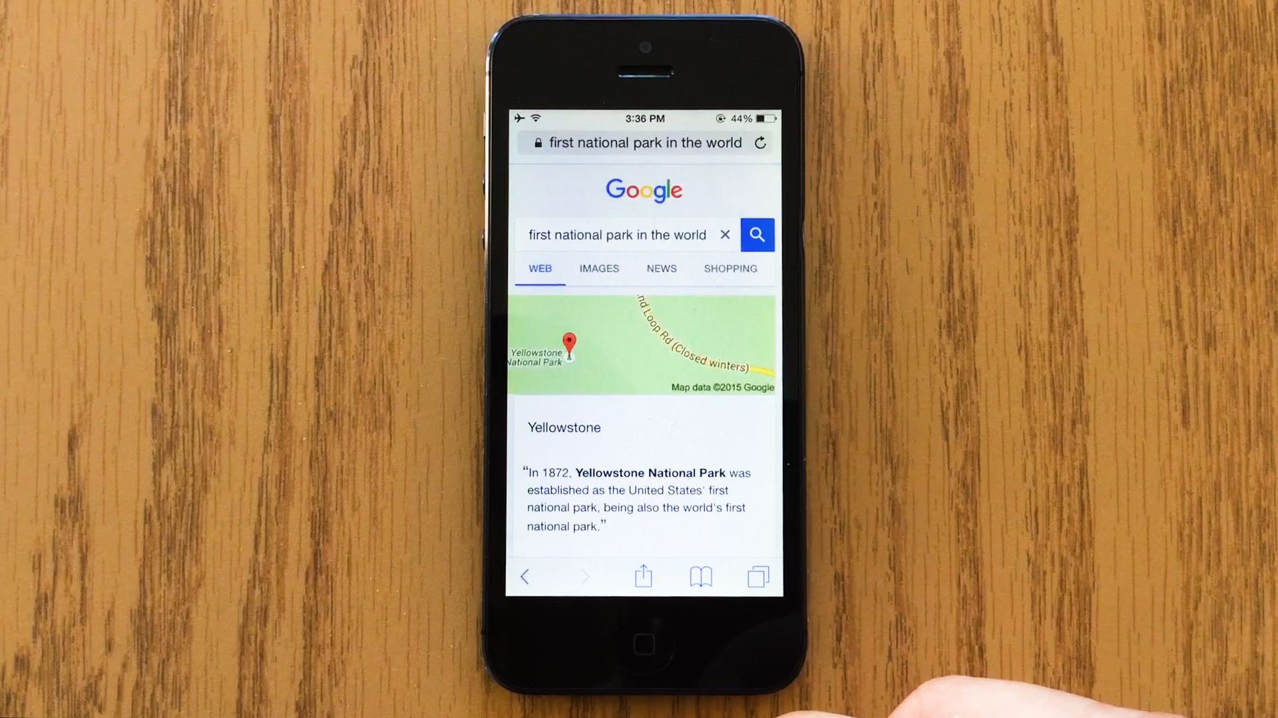
“first
national park
in the world”

Slide 4
where is Yellowstone
National Park?

Slide 5
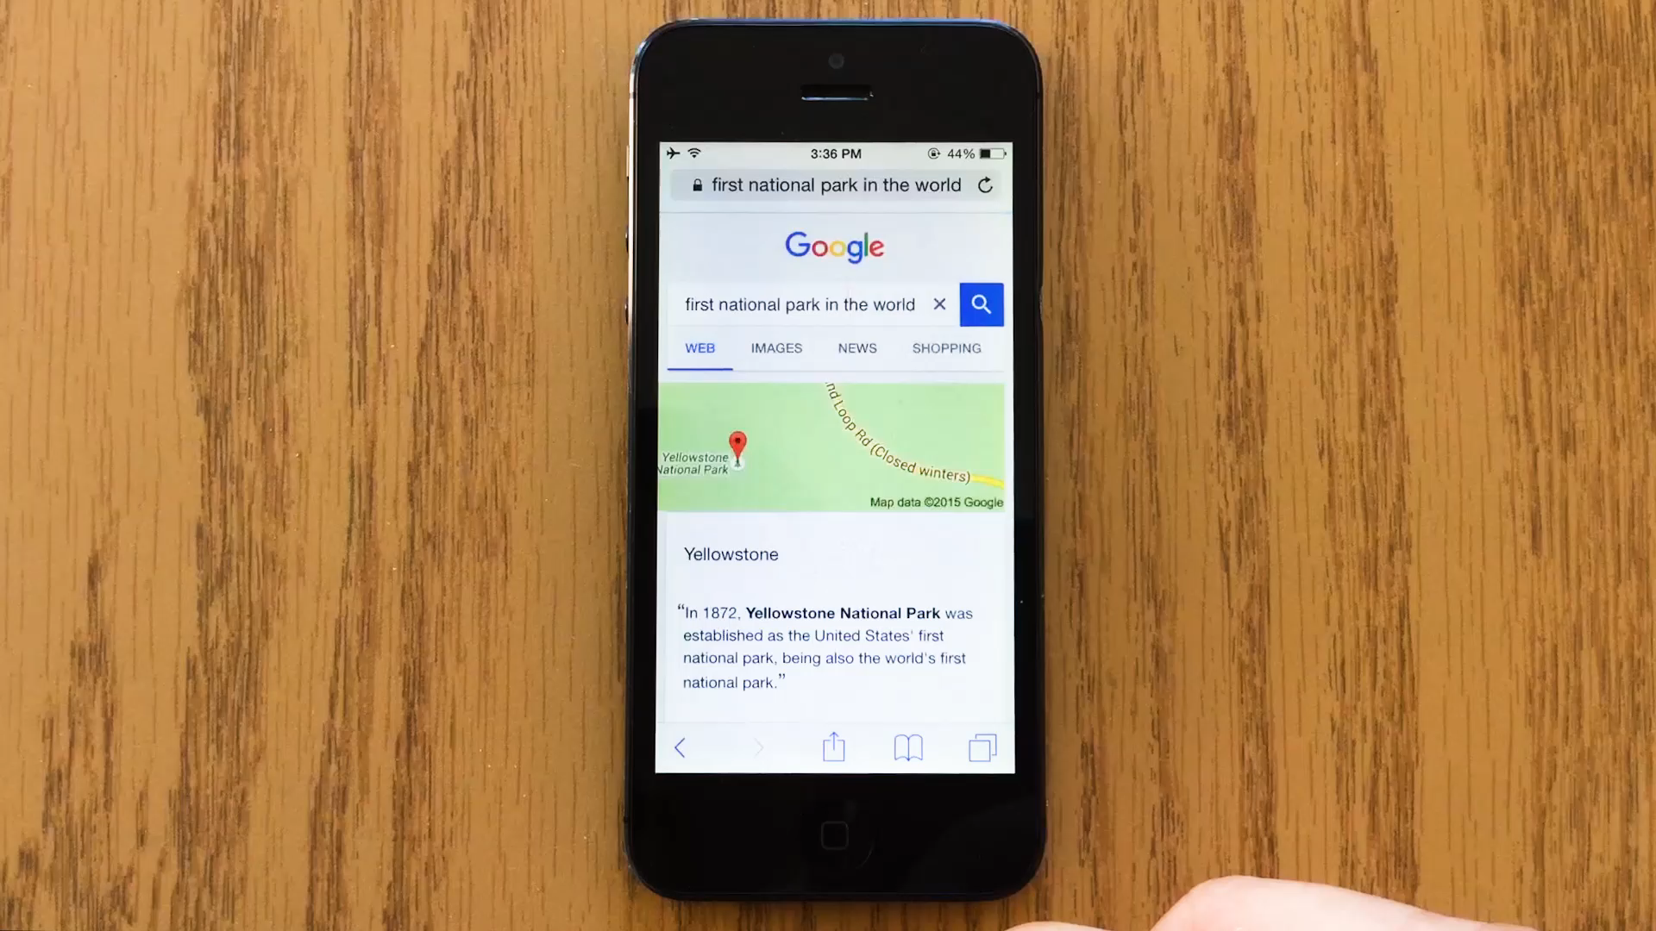

Slide 6
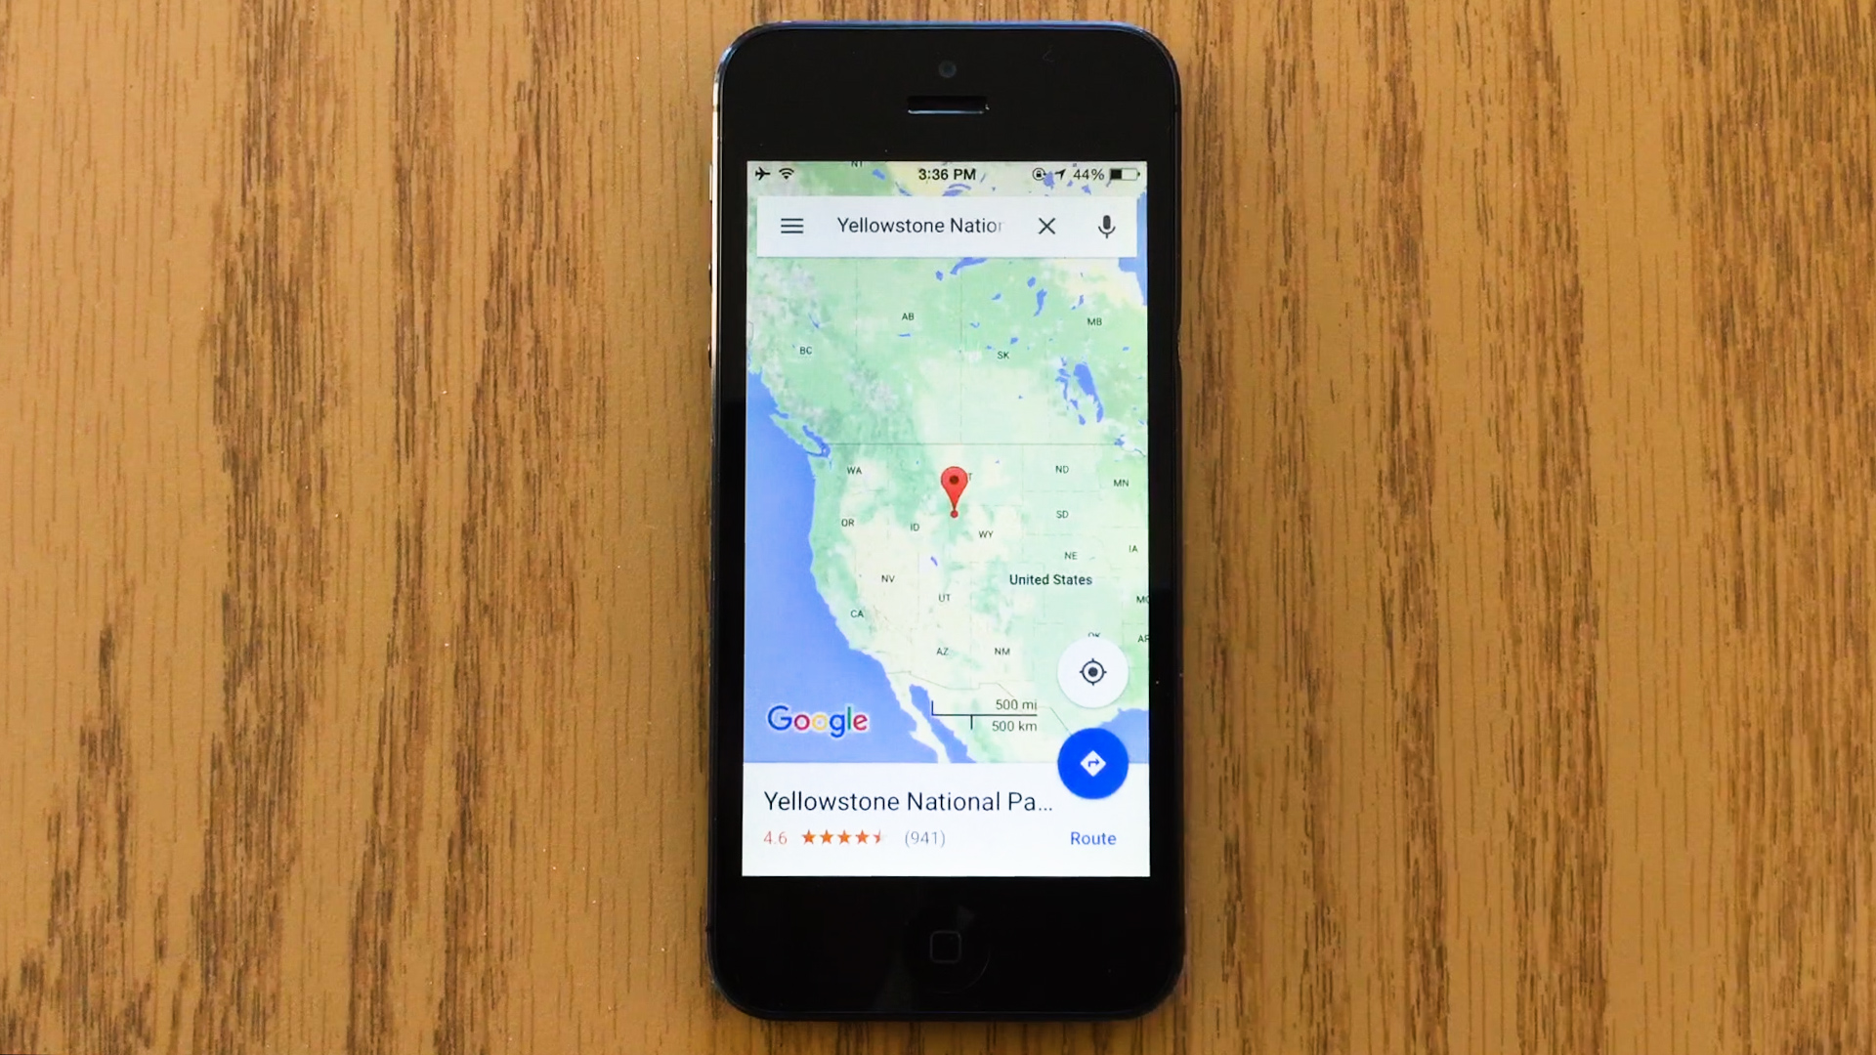
details?
search engine?

Slide 7

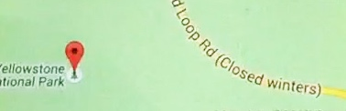
result of “Desert Fog” condition [Jul and Furnas, 98]
where is x ?
(x = Yellowstone)

Slide 8
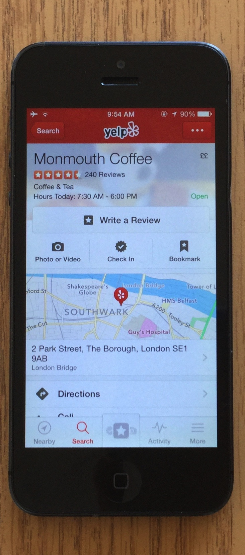
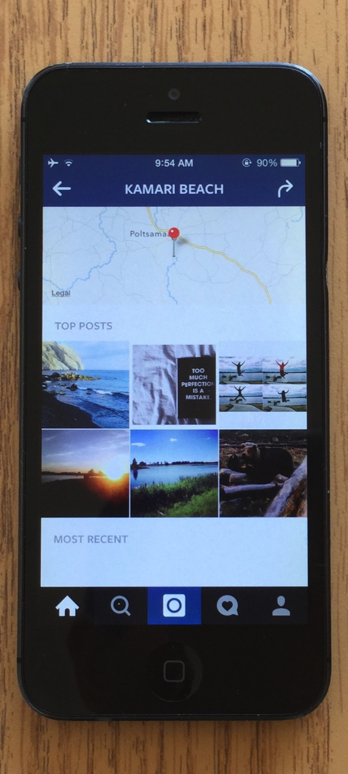
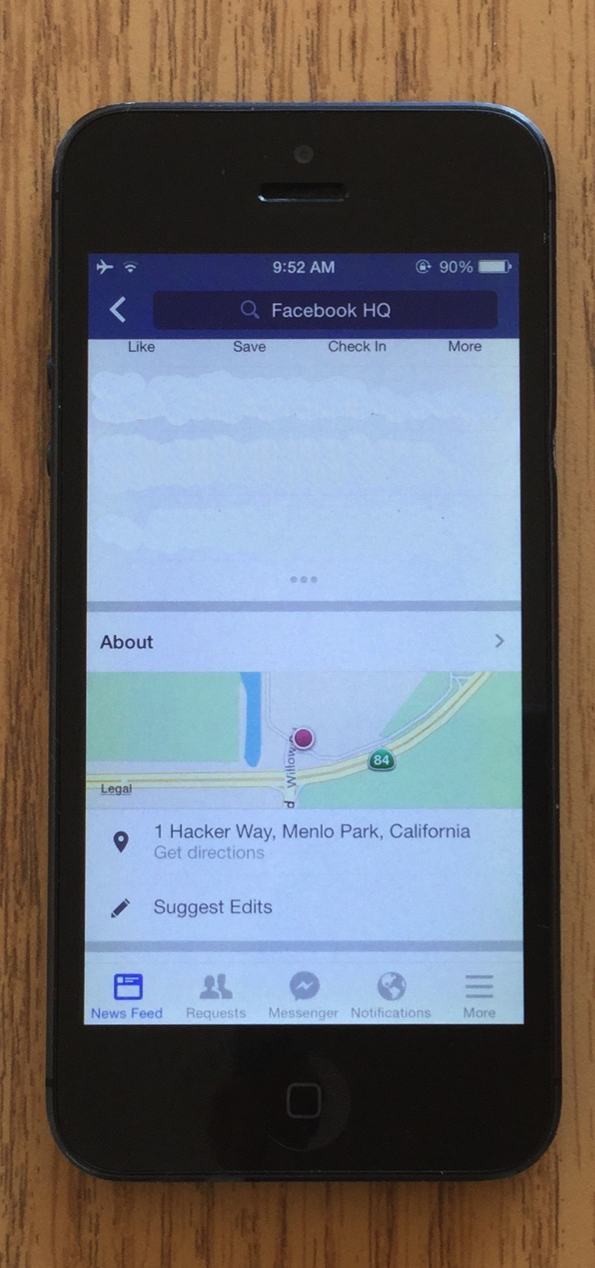
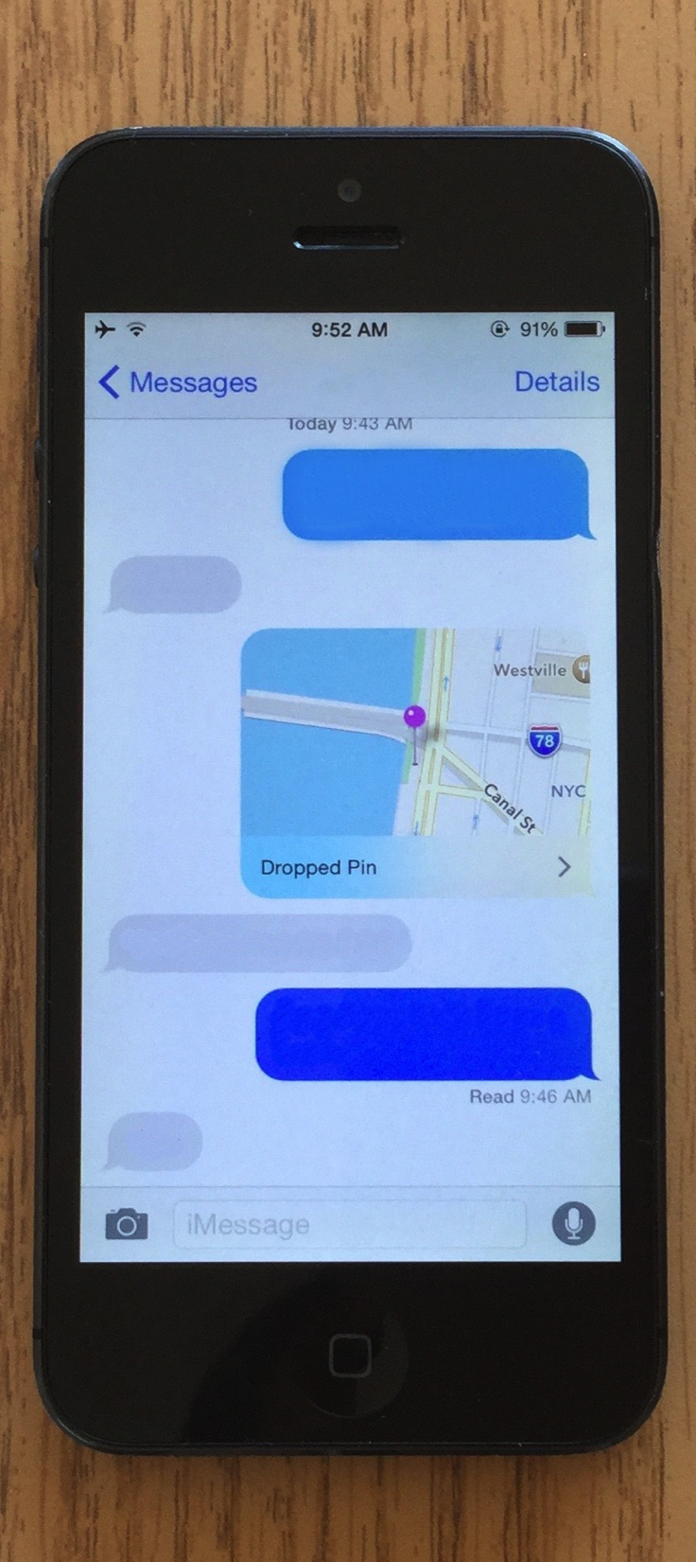
happens daily…
Yelp
Instagram
Facebook
Messages

Slide 9
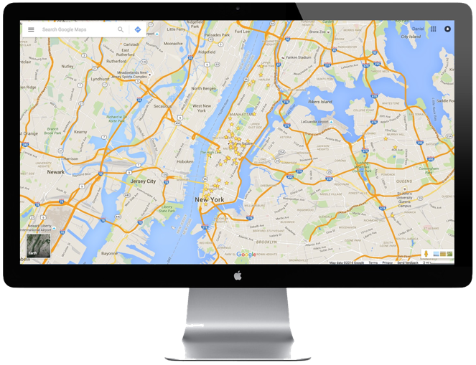
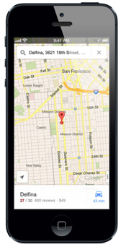
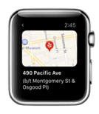
on maps of all sizes…
desktop
map size
phone
watch
(map size = 0)
e.g., Instagram geotags

Slide 10


Slide 11
want:
~location(x)
e.g., in relation to some
reference frame
need?
context switches,
interactions,
and tons of data

Slide 12
personalized compass
(p-compass)

Slide 13
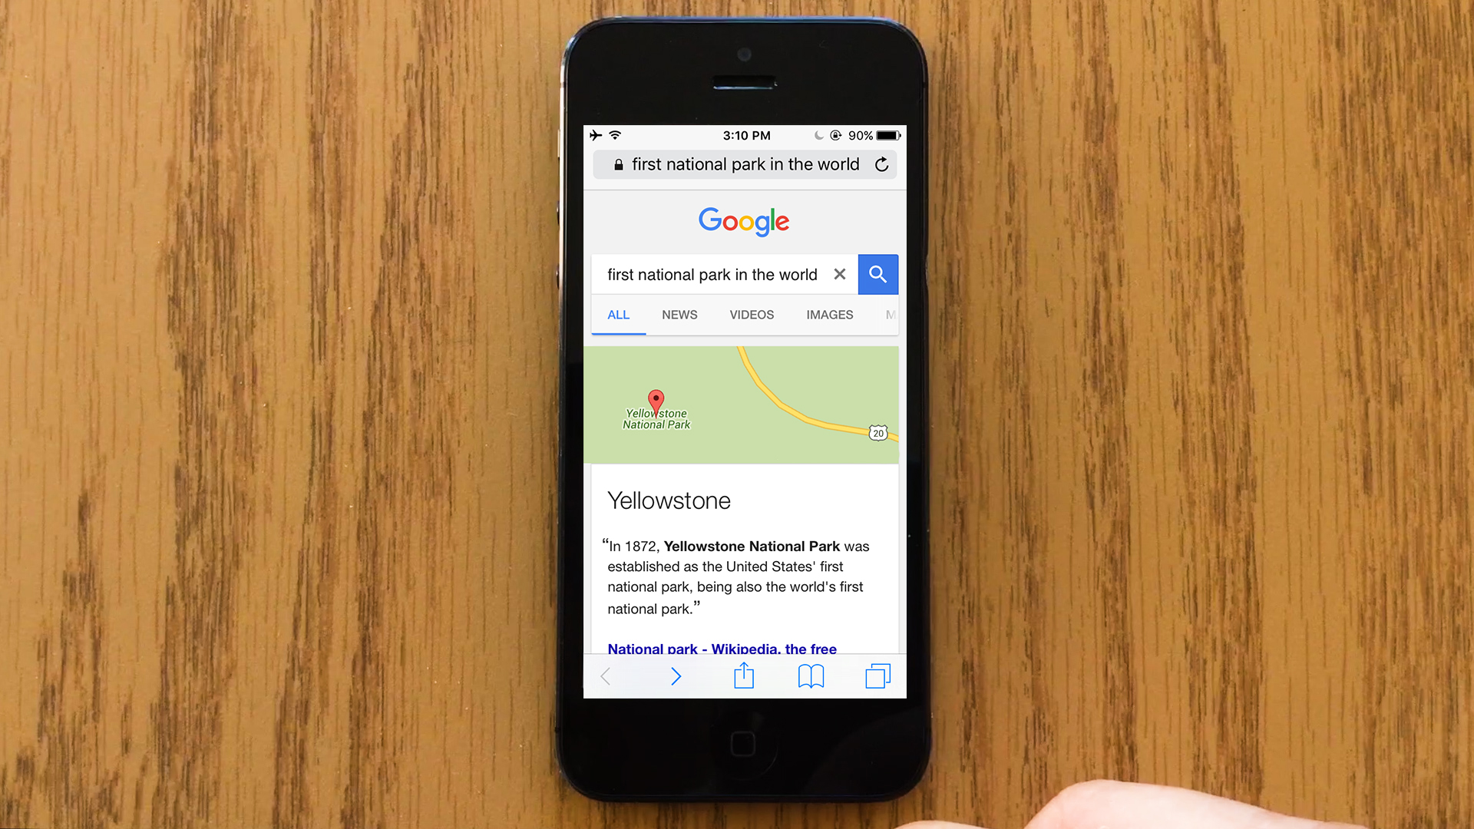
compass

Slide 14
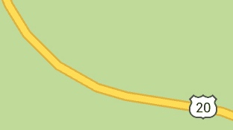
helpful?

Slide 15
N
reference point
(Yellowstone)
Seattle
Chicago
San Francisco
add needles for “landmark” cities…

Slide 16
N
reference point
(Yellowstone)
Seattle
Chicago
San Francisco
add needles for “landmark” cities…
and scale them by distance

Slide 17
N
reference point
(Yellowstone)
Seattle
Chicago
San Francisco
helps users establish a reference frame

Slide 18
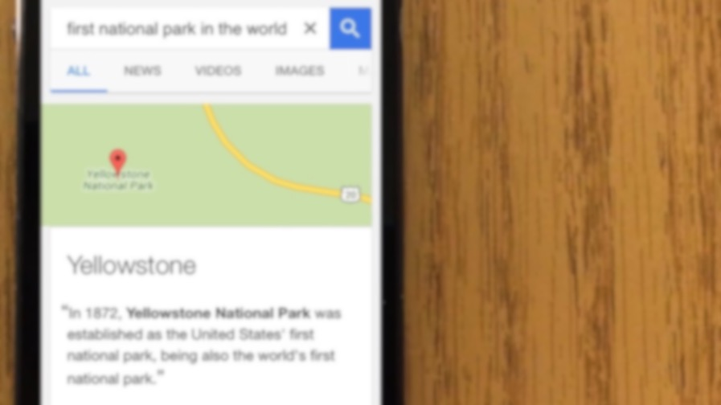
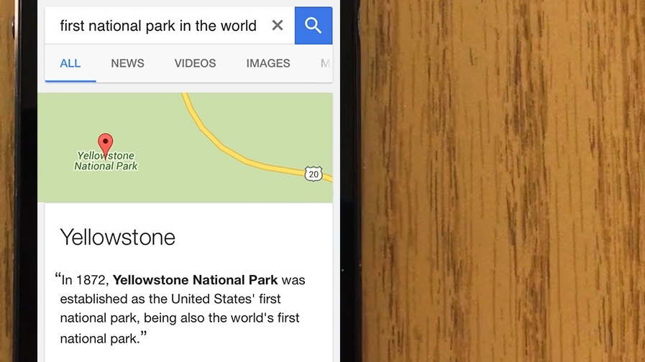
integrated
N
Seattle
San Francisco
Chicago

Slide 19

stand alone
Seattle
Chicago
(better in this case)
San Francisco

Slide 20
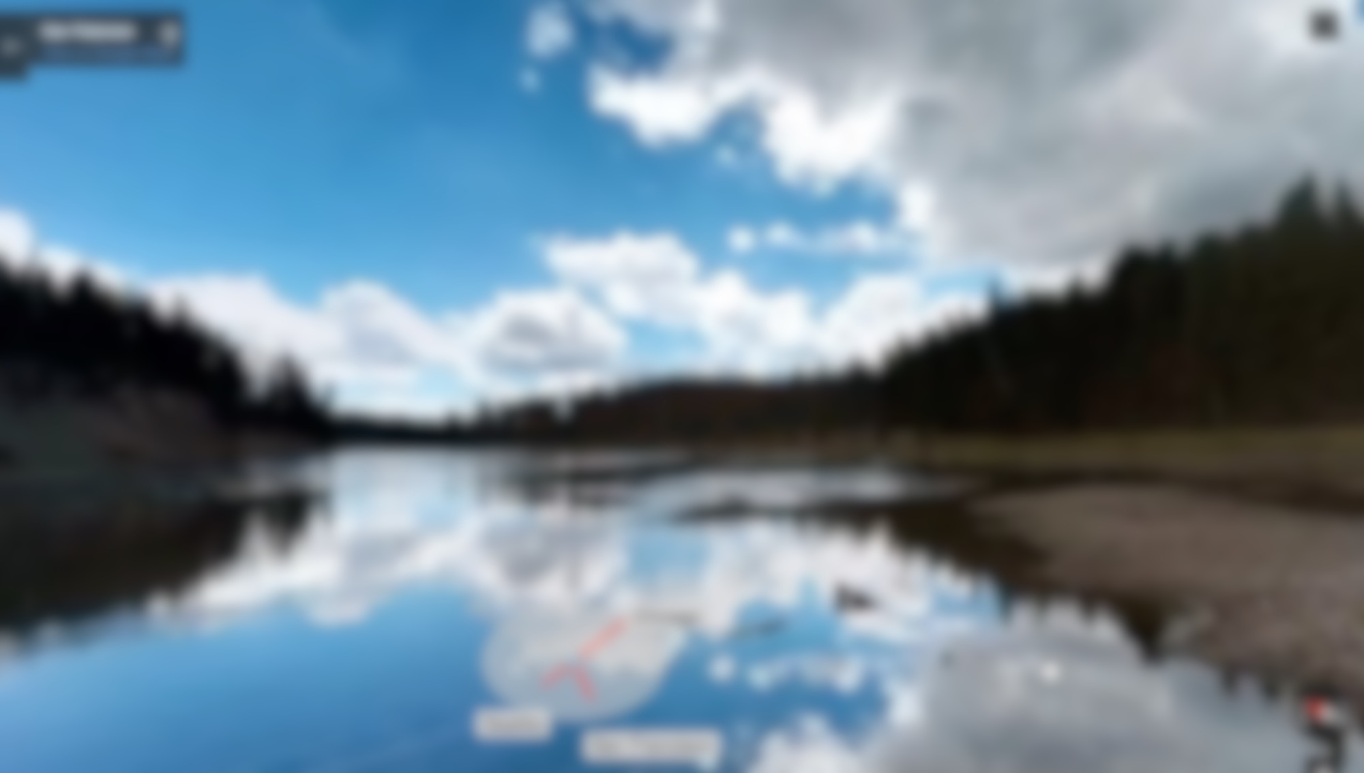

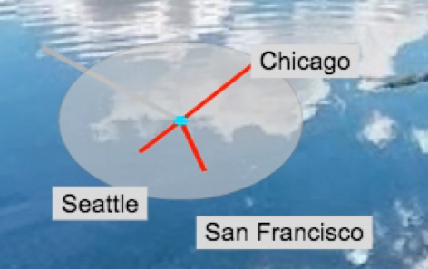
embedded in visual content
Yellowstone Natl. Park

Slide 21

embedded in interactive visual content
e.g., street view
Yellowstone Natl. Park

Slide 22
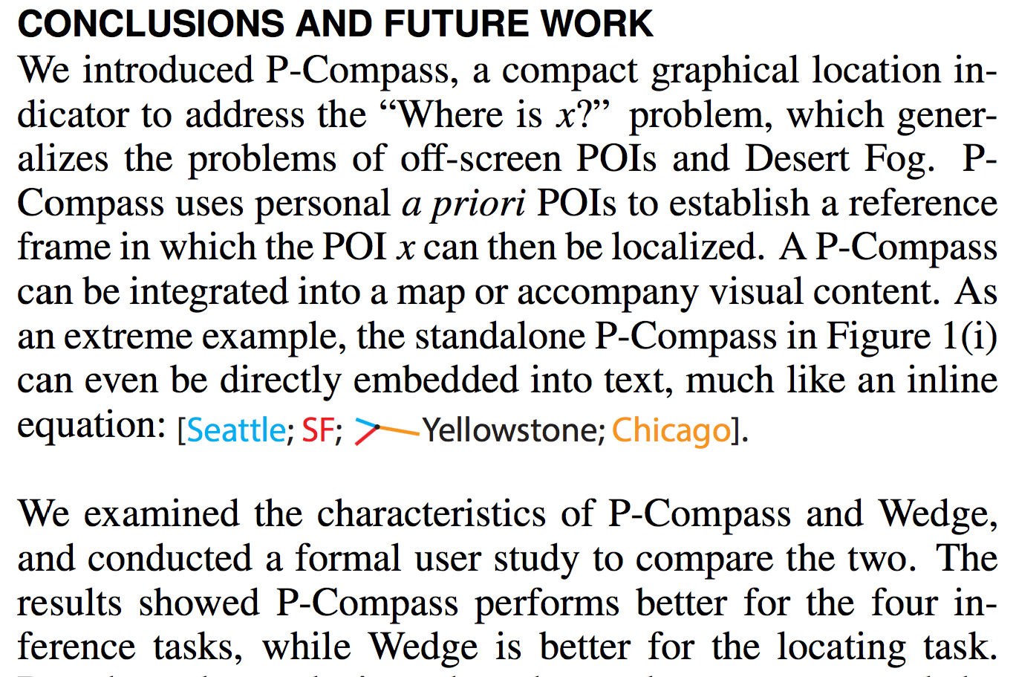

or embedded in textual content

Slide 23
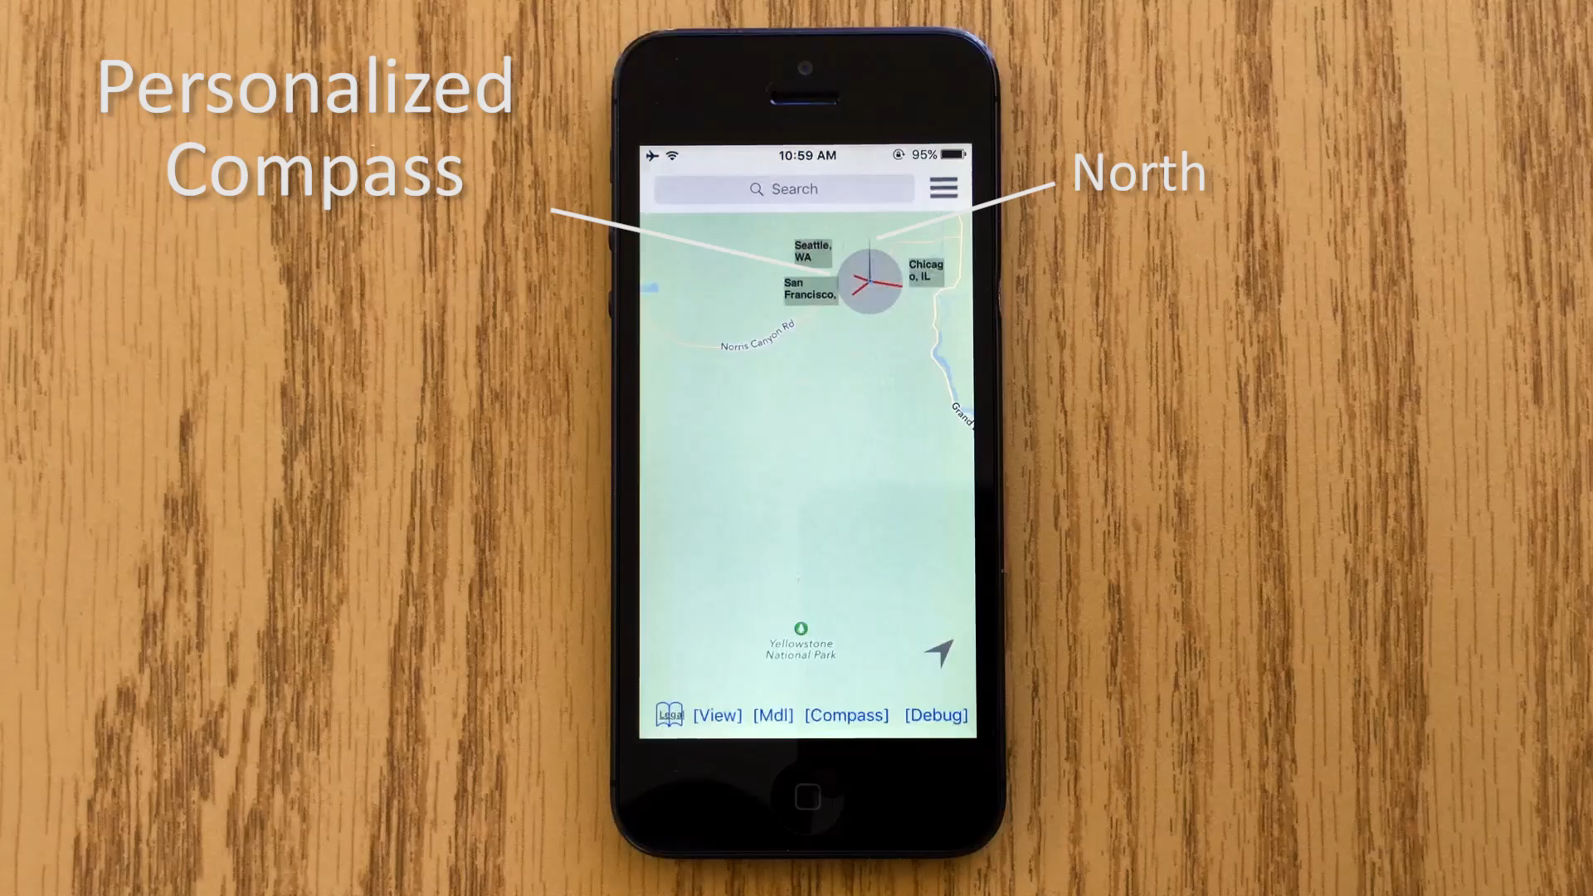

Slide 24
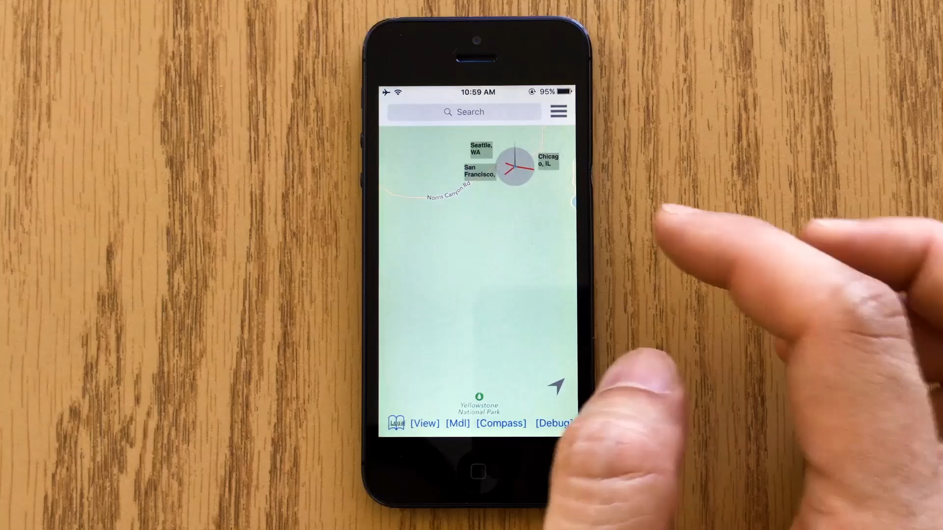

Slide 25
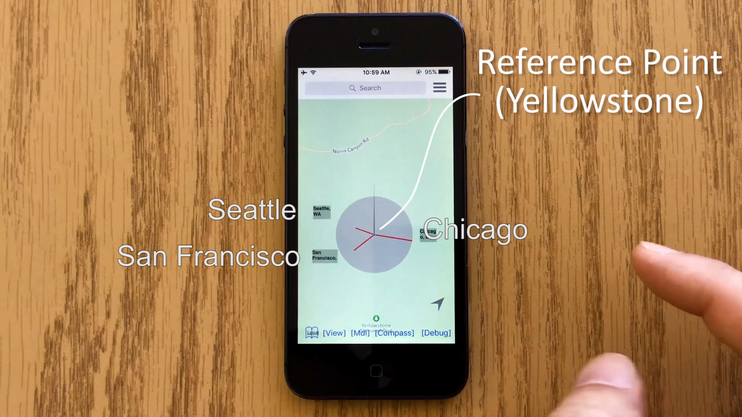

Slide 26
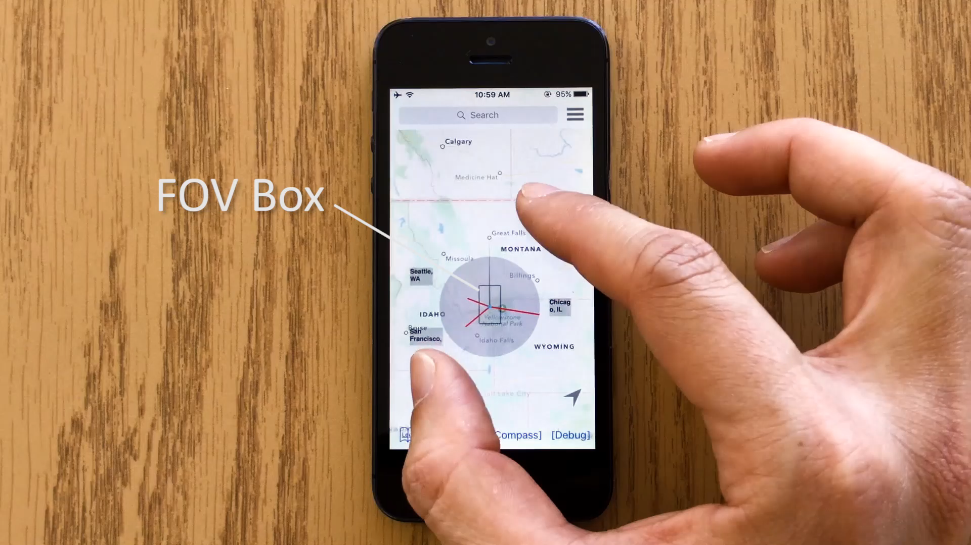

Slide 27
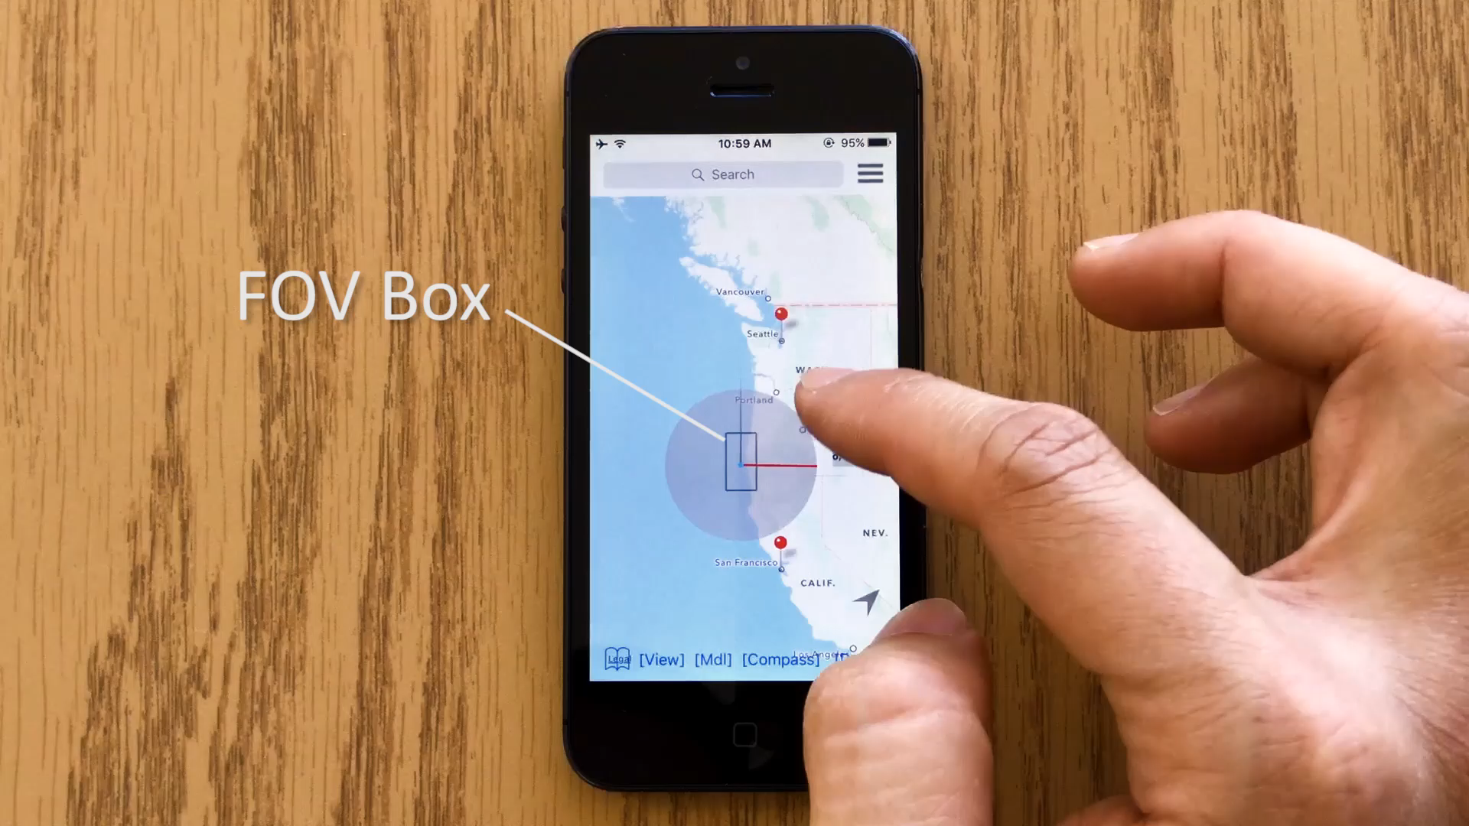

Slide 28
related work

Slide 29



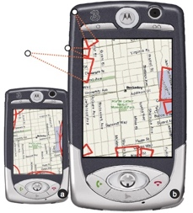
temporal separation
techniques for overview + detail
spatial separation
focus + context
cue-based
[Cockburn et al., 08]

Slide 30
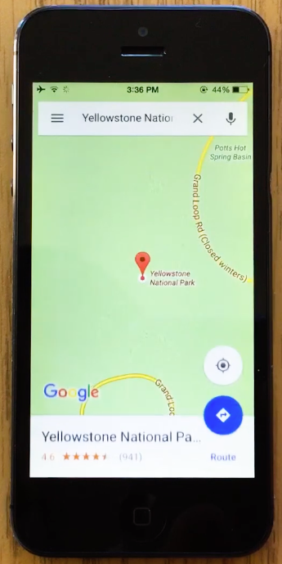
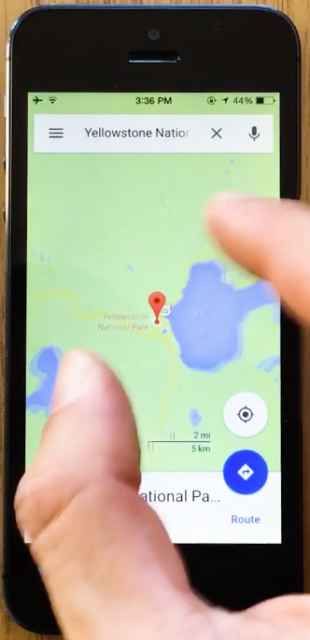
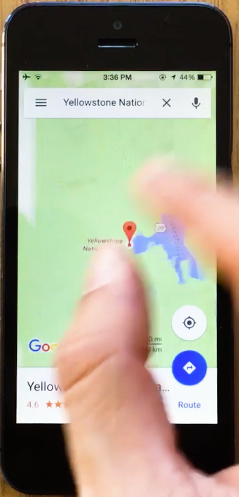
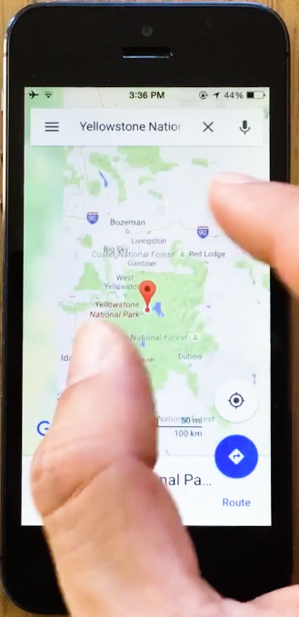
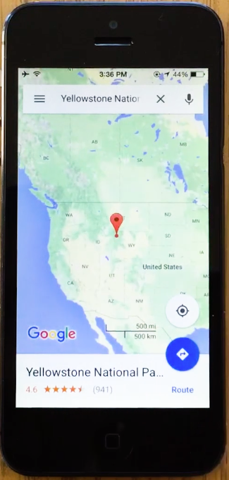
temporal separation
detail
overview
time
[Google Maps and many others, e.g., Perlin and Fox, 93]

Slide 31
[classic Google Maps and many others, e.g., Donelson, 78]
spatial separation

Slide 32
[e.g., Carpendale and Montagnese, ‘01]
focus+context

Slide 33
wedge
cue-based
[Gustafson et al, ‘08]

Slide 34
hybrid technique
overview map
proxies for
off-screen POIs

Slide 35
prototype + field experience

Slide 36
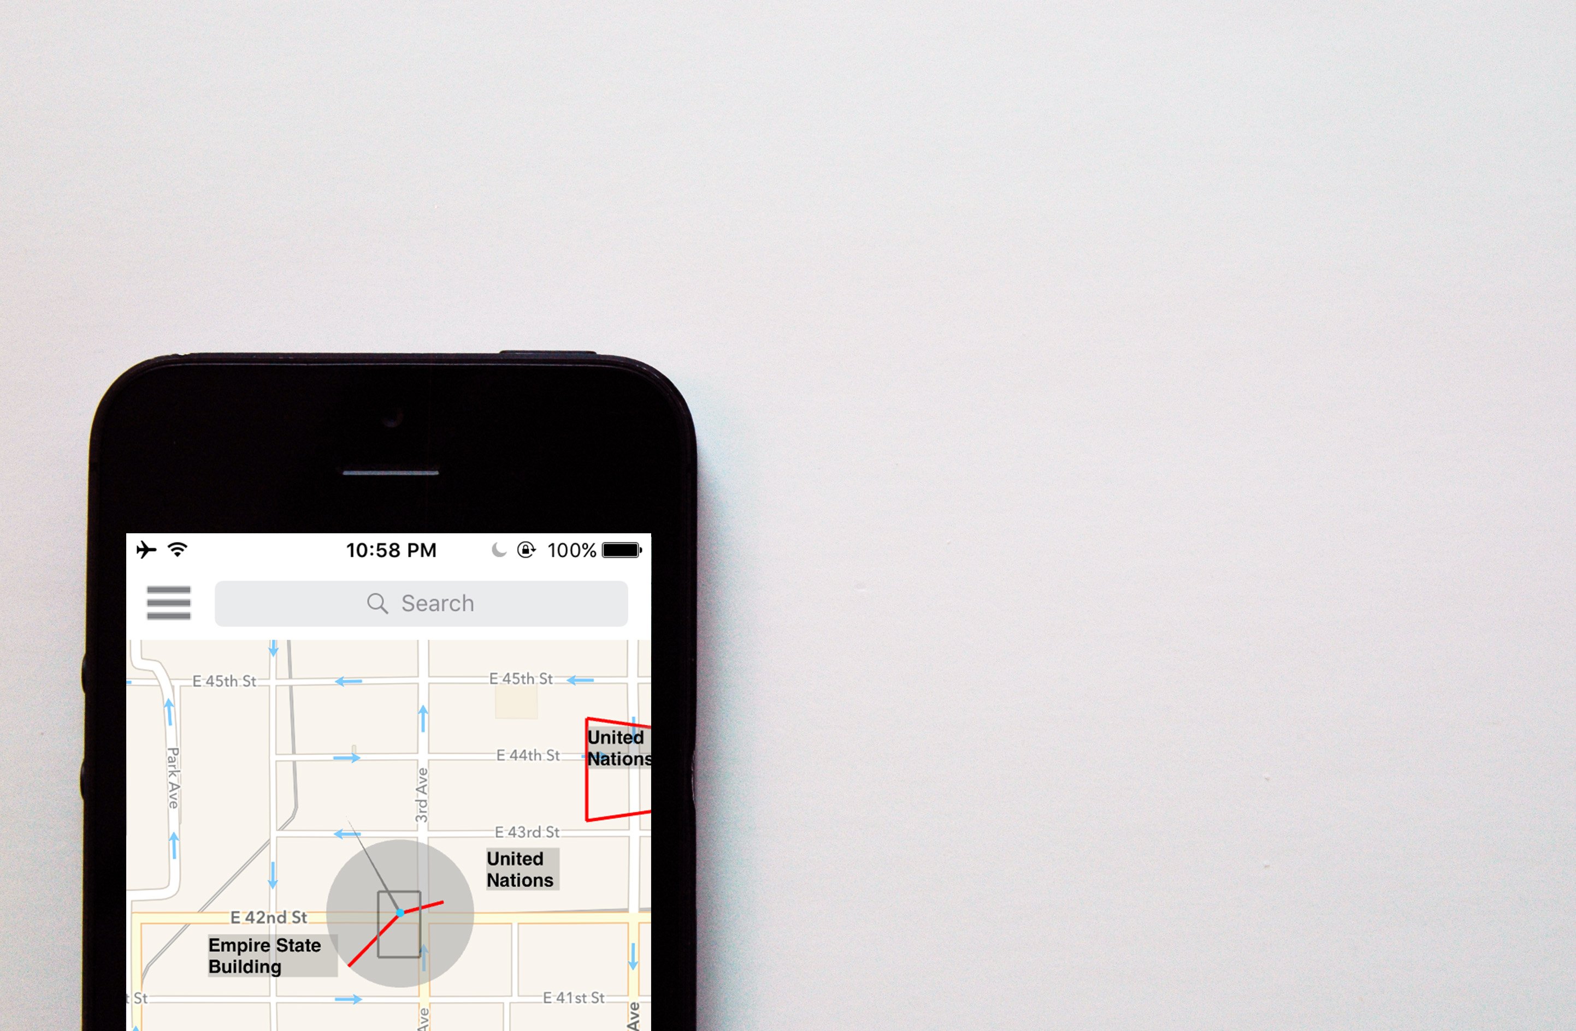
prototype
fully functional map
p-compass
wedge
manually entered a list of “landmark” POIs
used a naïve algorithm to select POIs

Slide 37


iteratively prototyped and field tested in NYC and London

Slide 38
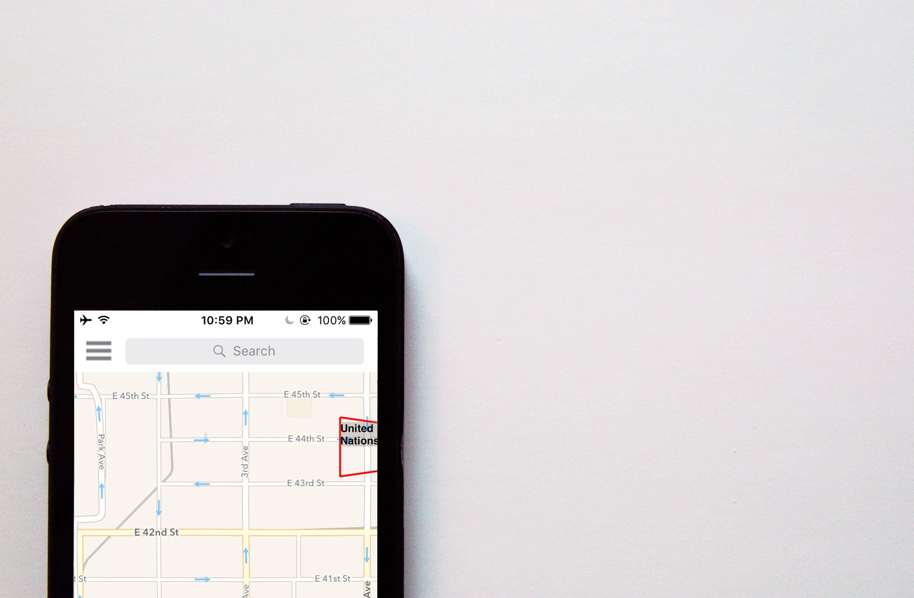
observation 1: on characteristics
wedge guides users
to locate an off-screen POI
United Nations

Slide 39
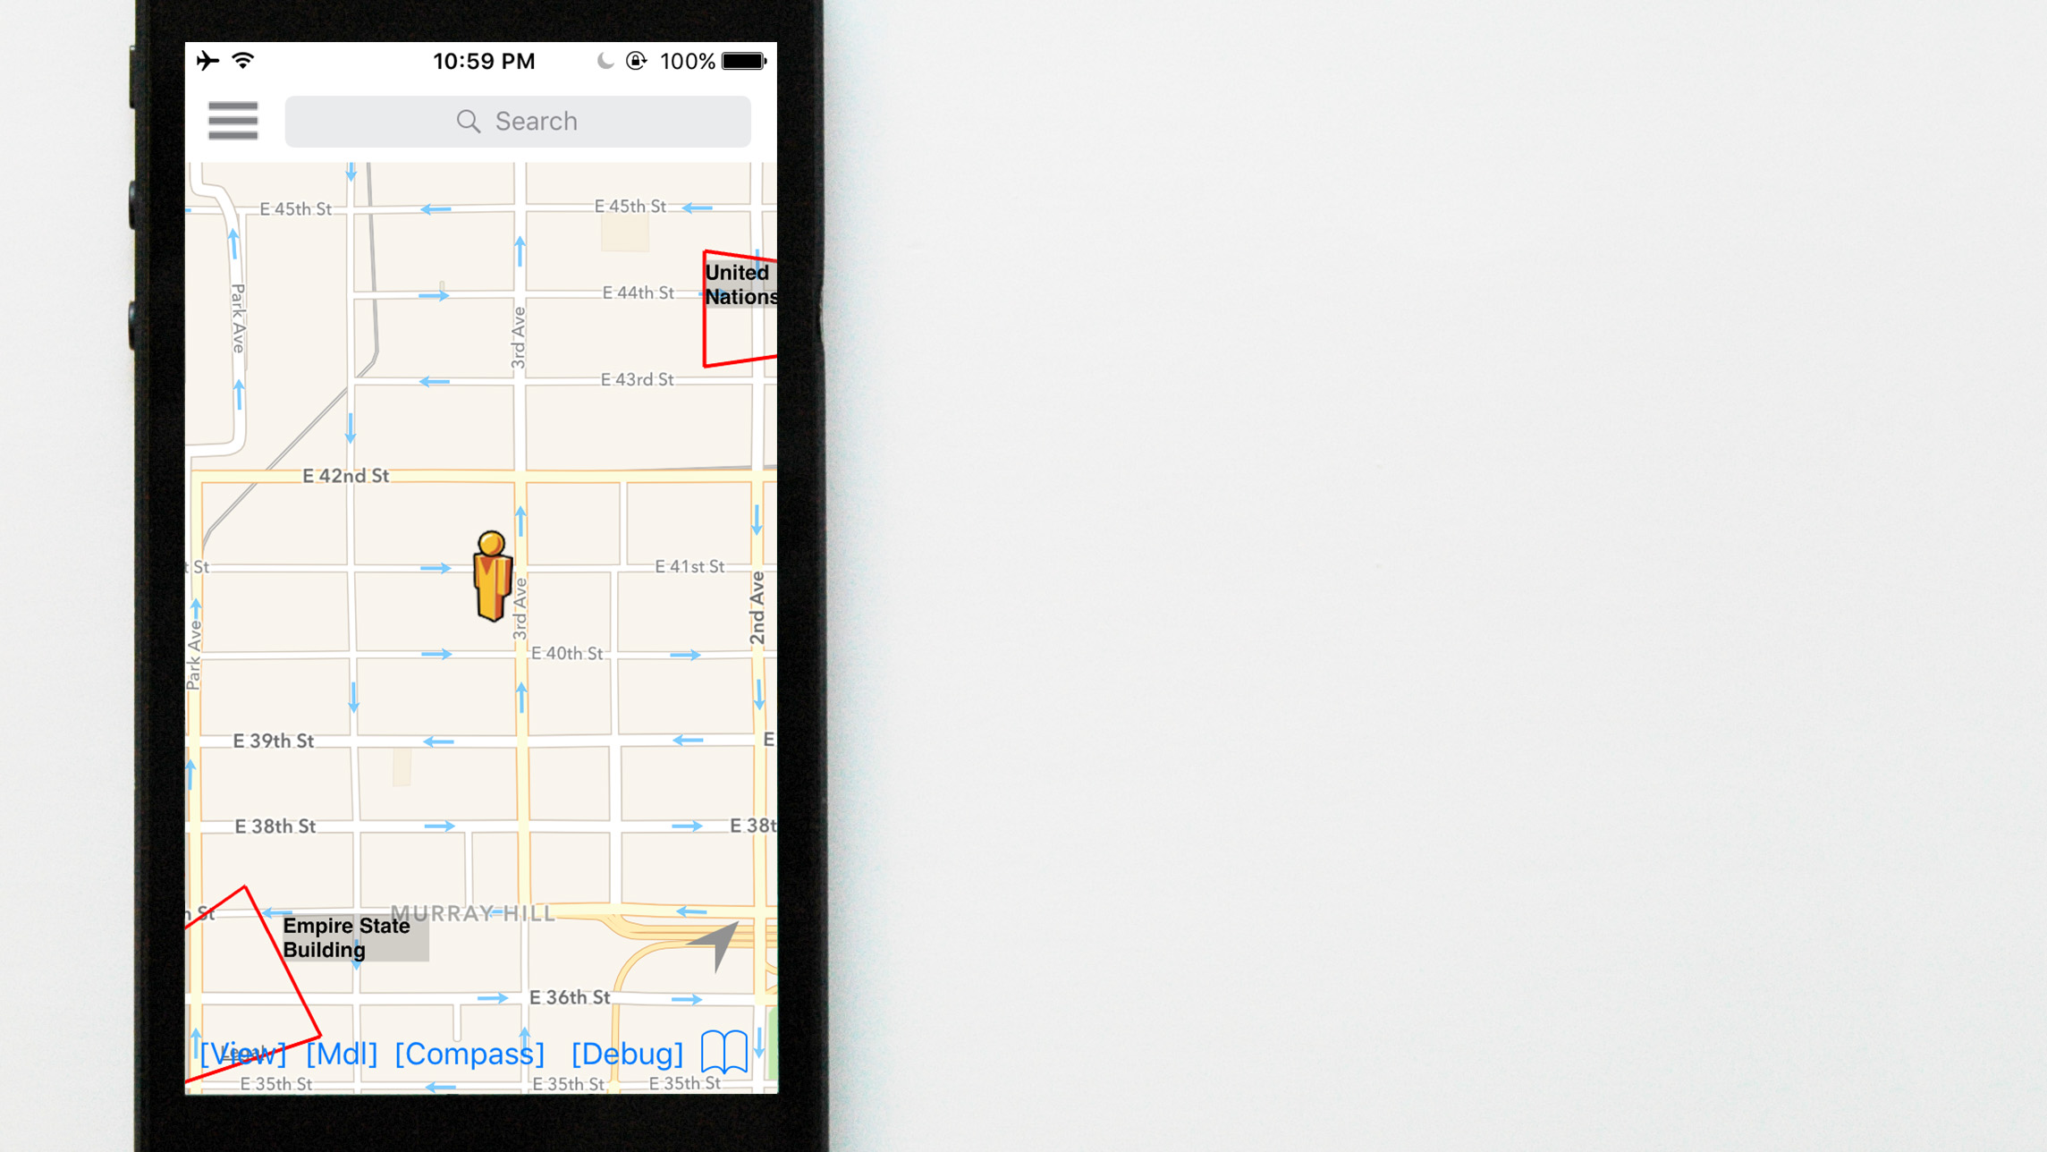
United Nations
wedge requires users to locate POIs before decision making
Empire State Bldg.

Slide 40
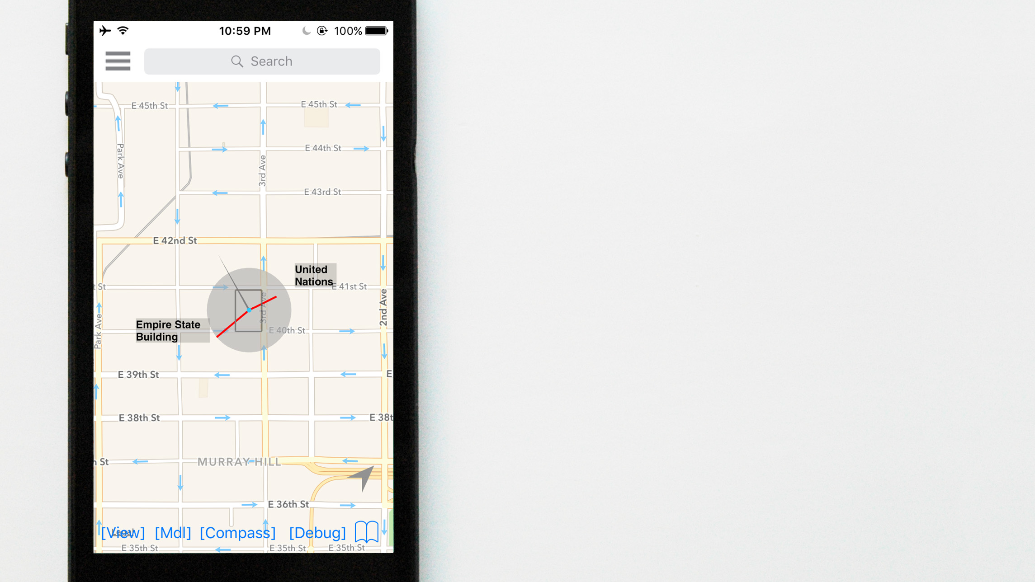
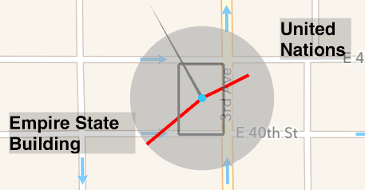
p-compass communicates relationships

Slide 41
p-compass not good at placing POIs at display edge
p-compass not good at placing POIs at display edge
FOV box

Slide 42

observation 2: on scalability
scalability is important:
not all POIs are close to the display edge
with sufficient zoom, any close POI could become distant

Slide 43
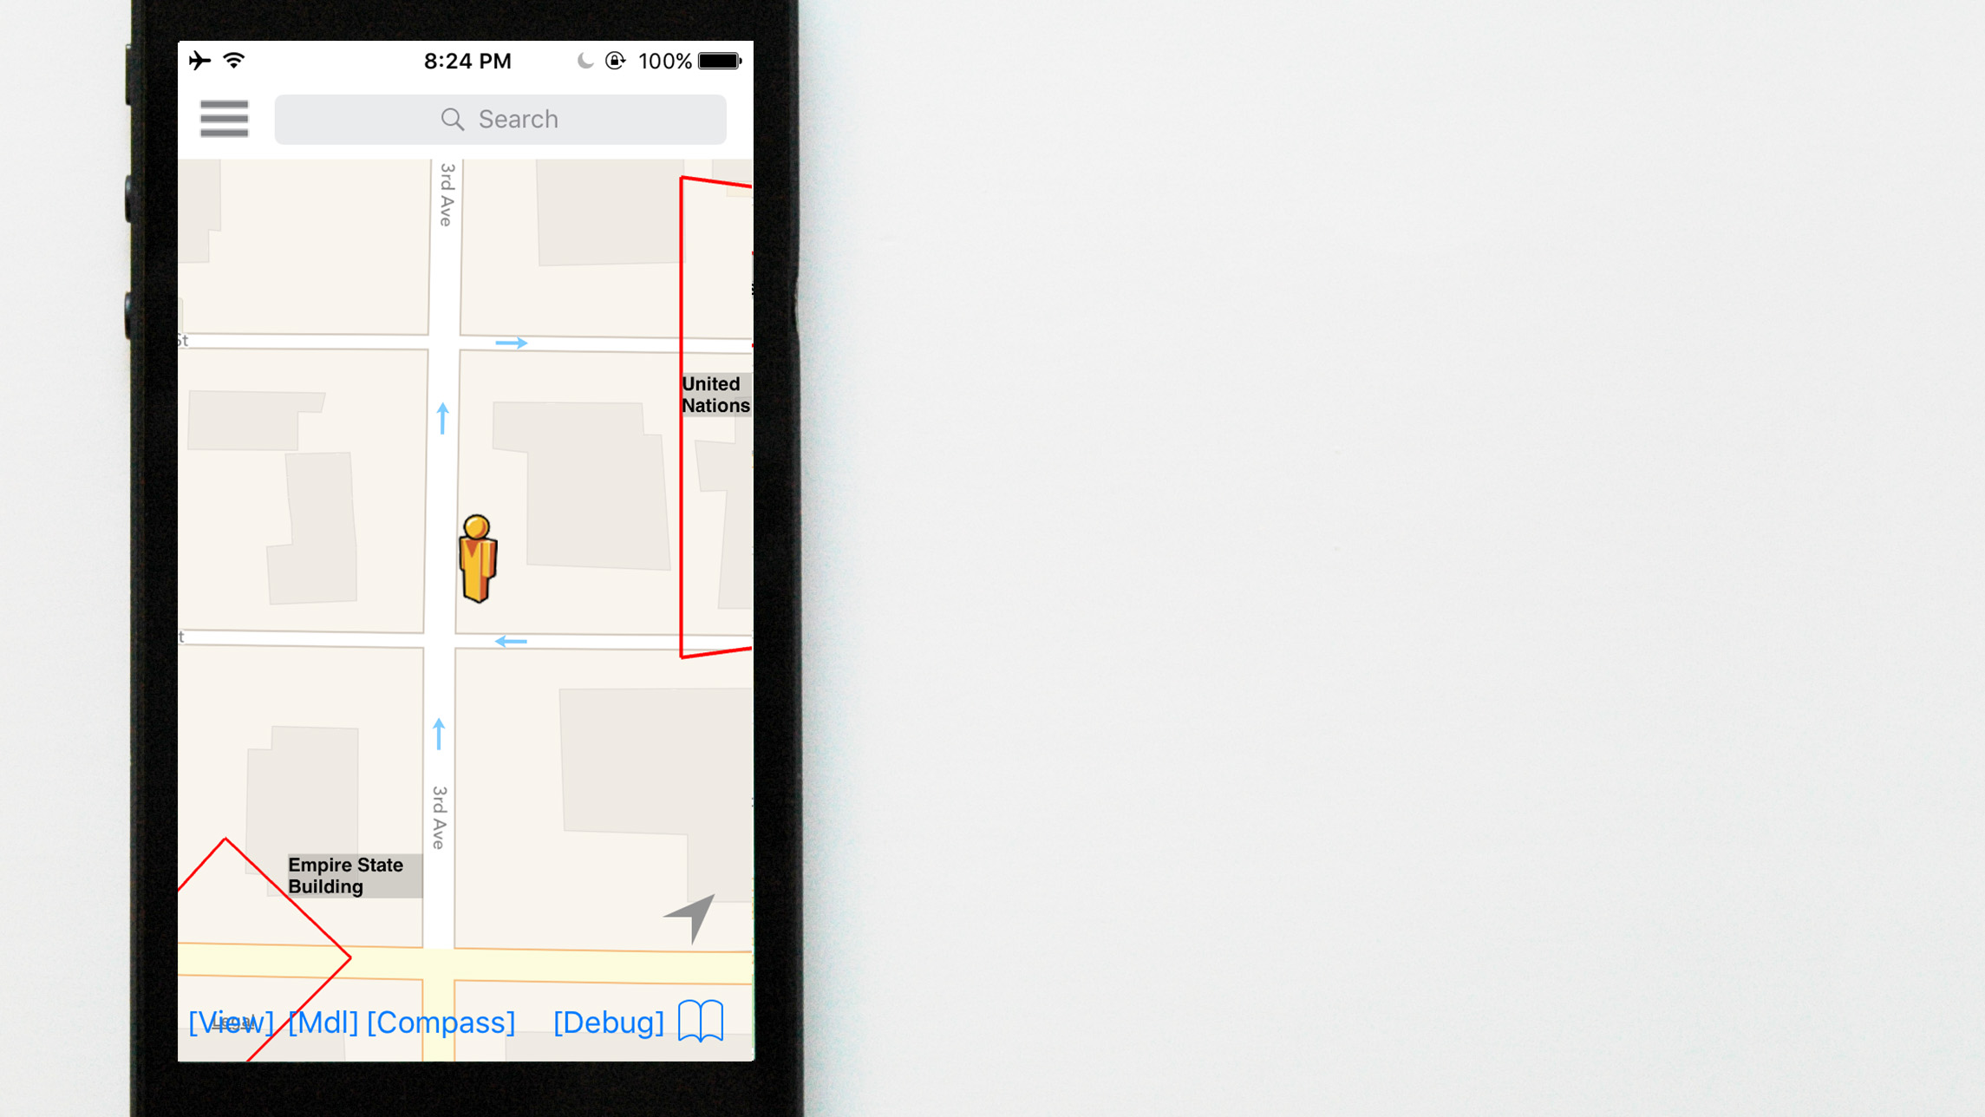
United Nations
difficult to use wedge
to locate distant POIs
Empire State Bldg.

Slide 44
United Nations
relationship?
Empire State Bldg.

Slide 45
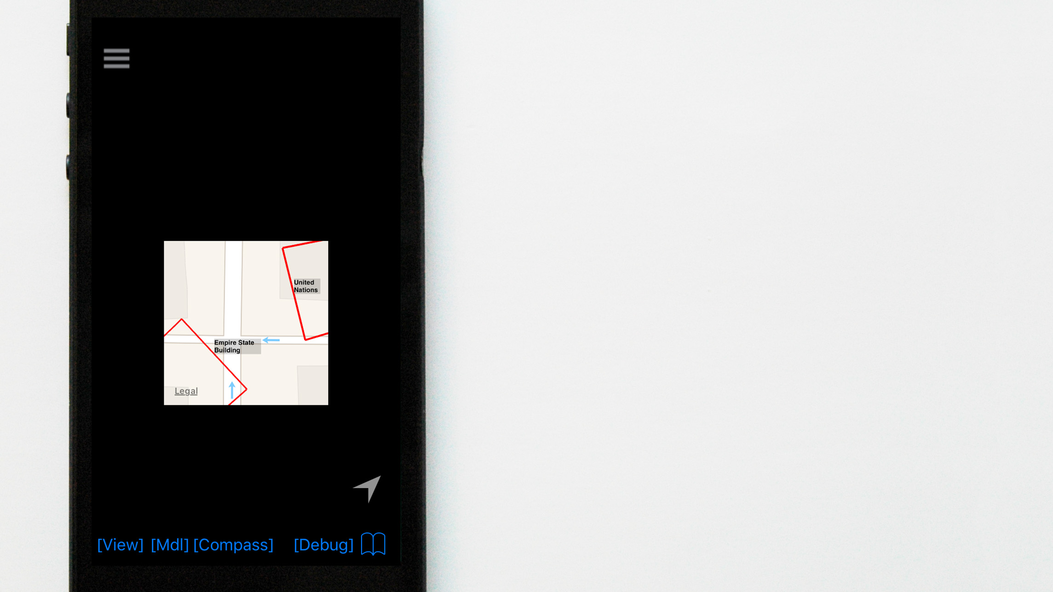
United Nations
scalability could mean
small displays, too
Empire State Bldg.

Slide 46
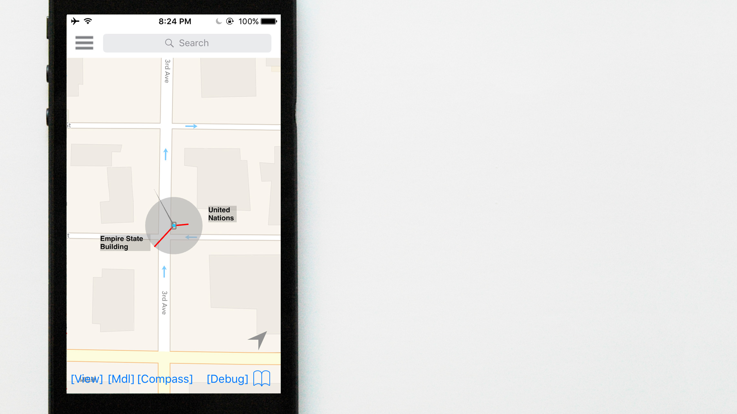

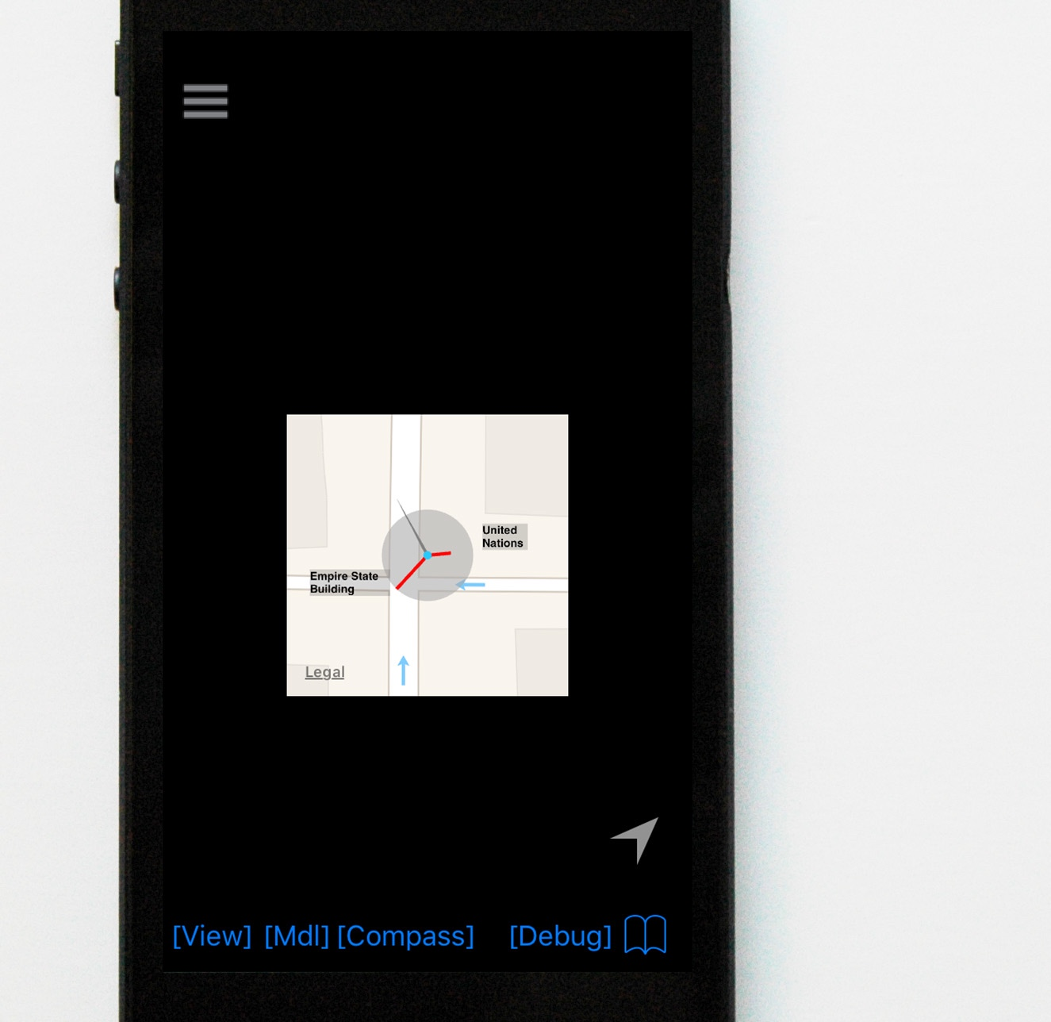
relationships stay constant

Slide 47
complementary: wedge good at placing POIs at display edge p-compass good at relationships
two observations
on characteristics:
on scalability:
choose p-compass as
distance of POI increases
display size decreases

Slide 48
user study

Slide 49
design
2 visualization (within-subject) conditions:
p-compass, wedge
P-Compass
5 tasks:
LOCATE Where is the subway station?
DISTANCE How far is the subway station?
ORIENTATION Which direction is the subway station?
LOCALIZE Where am I?
LOCATE+ Where is the coffee shop?

Slide 50
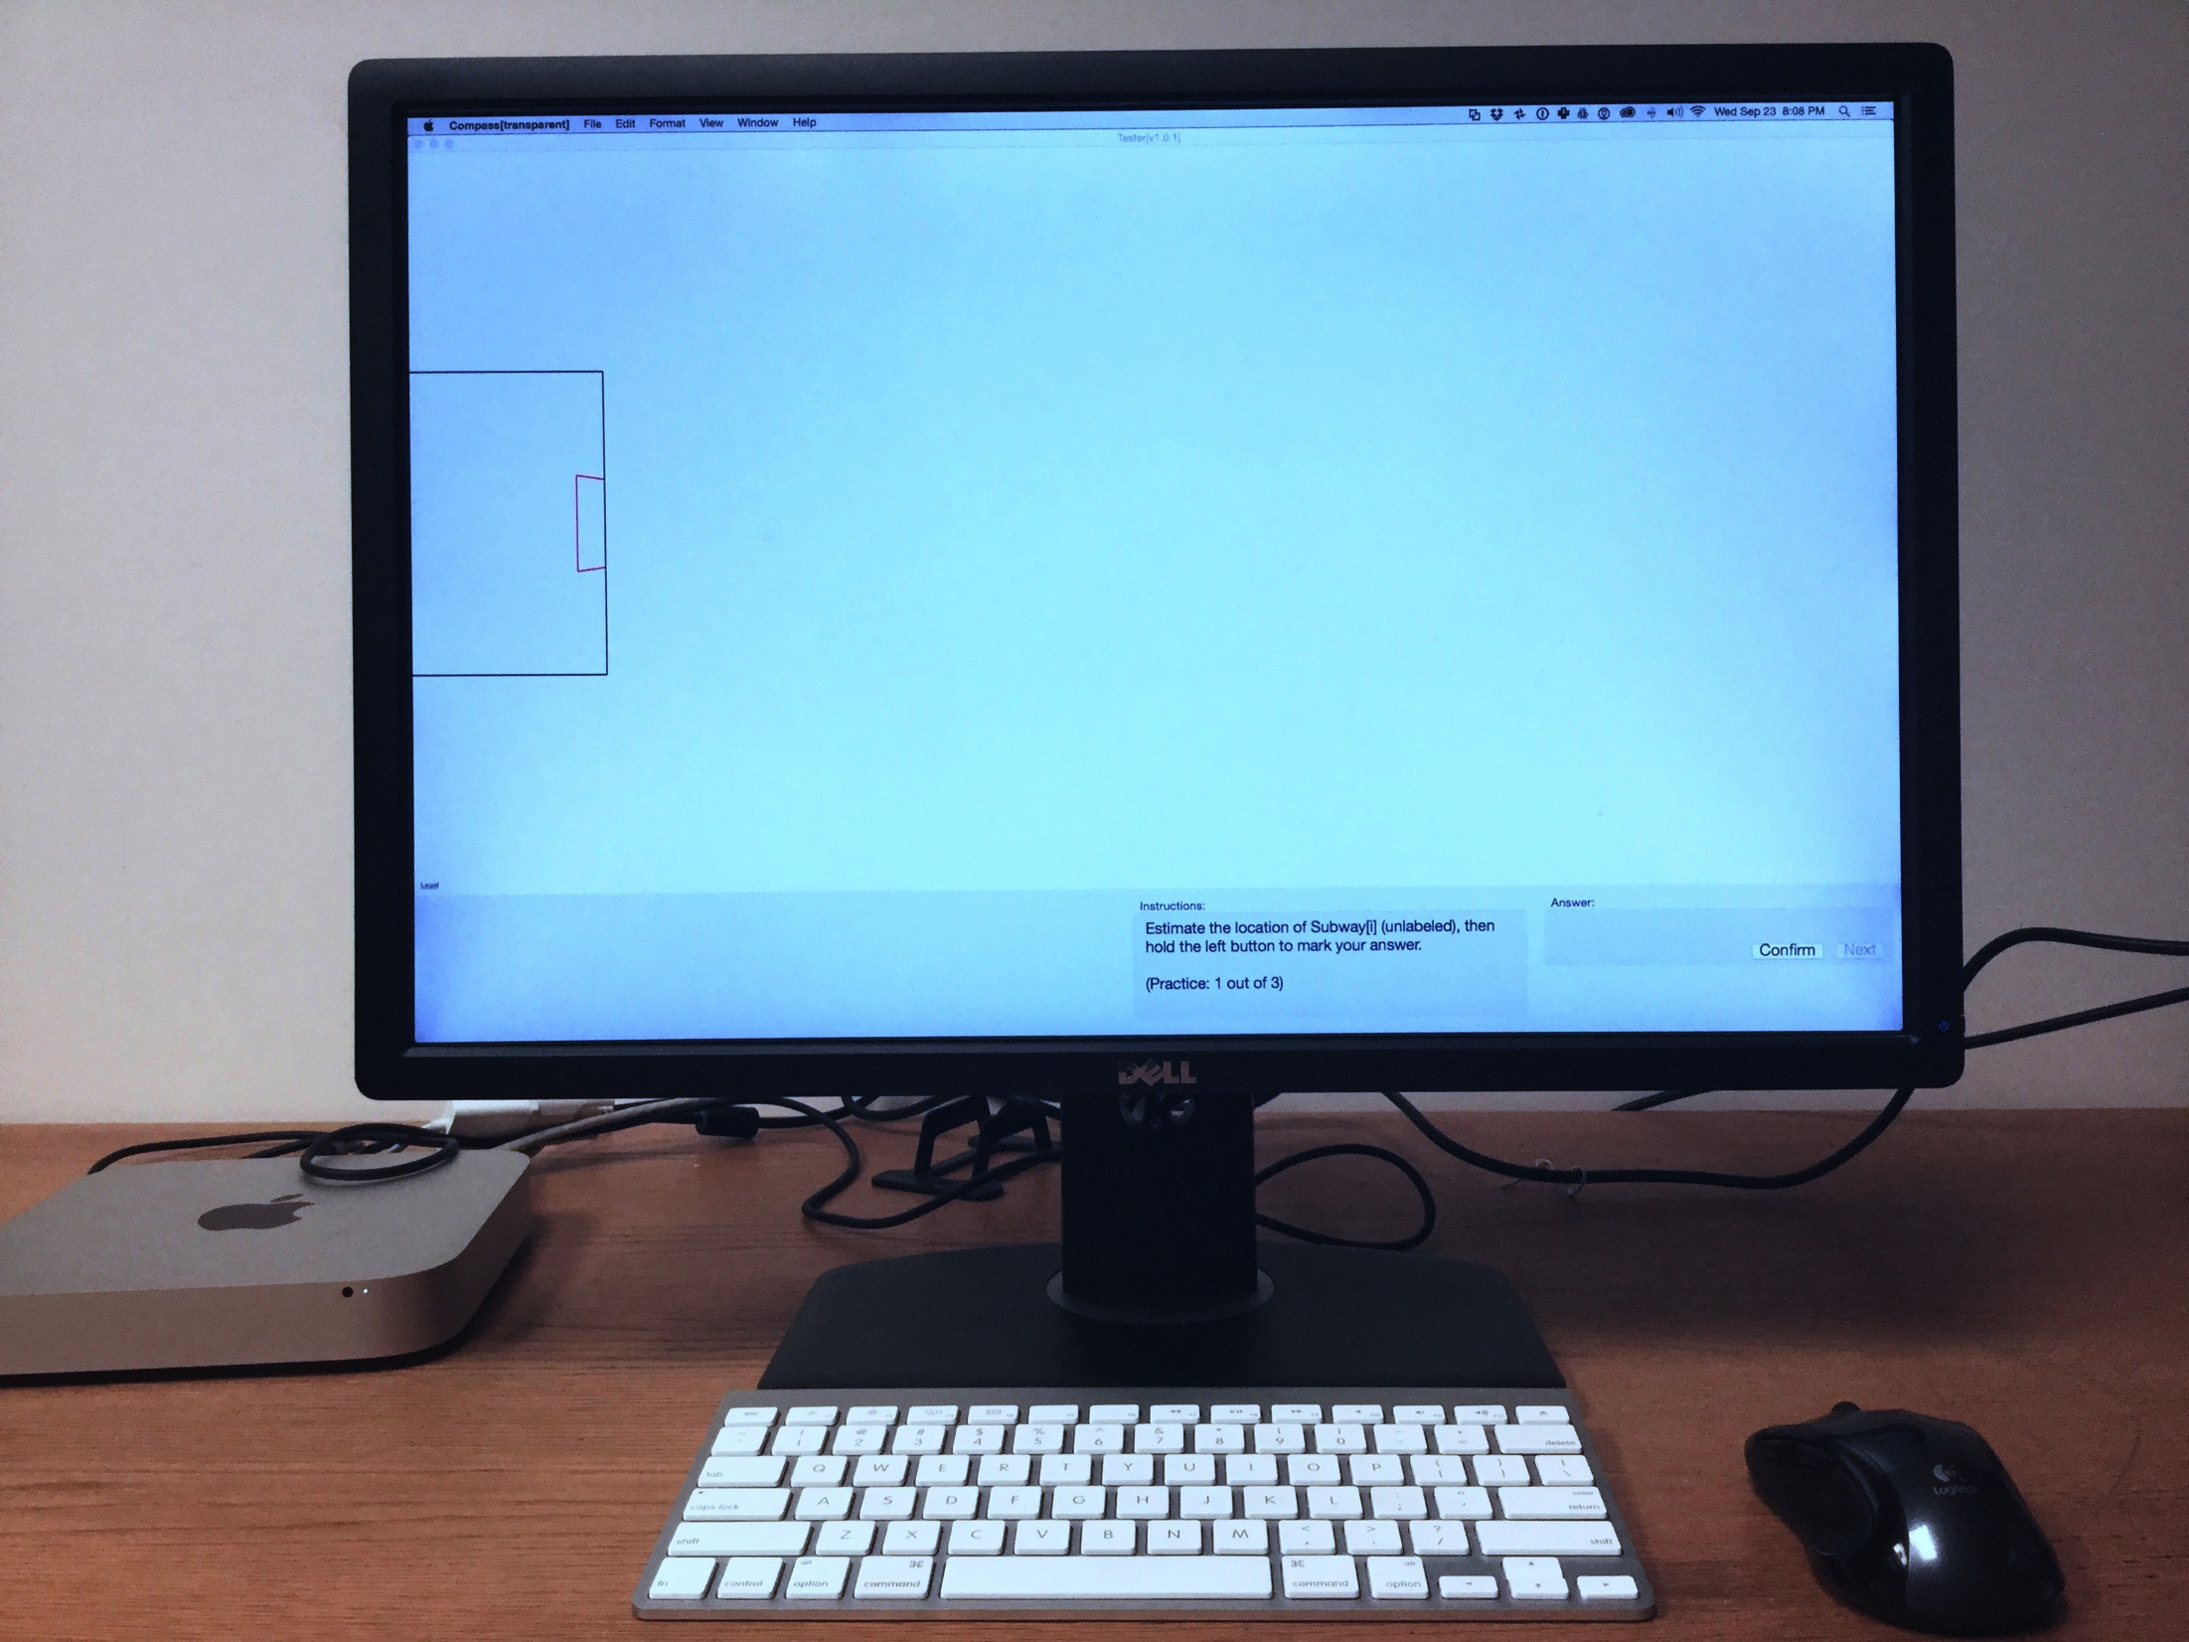
LOCATE

Slide 51
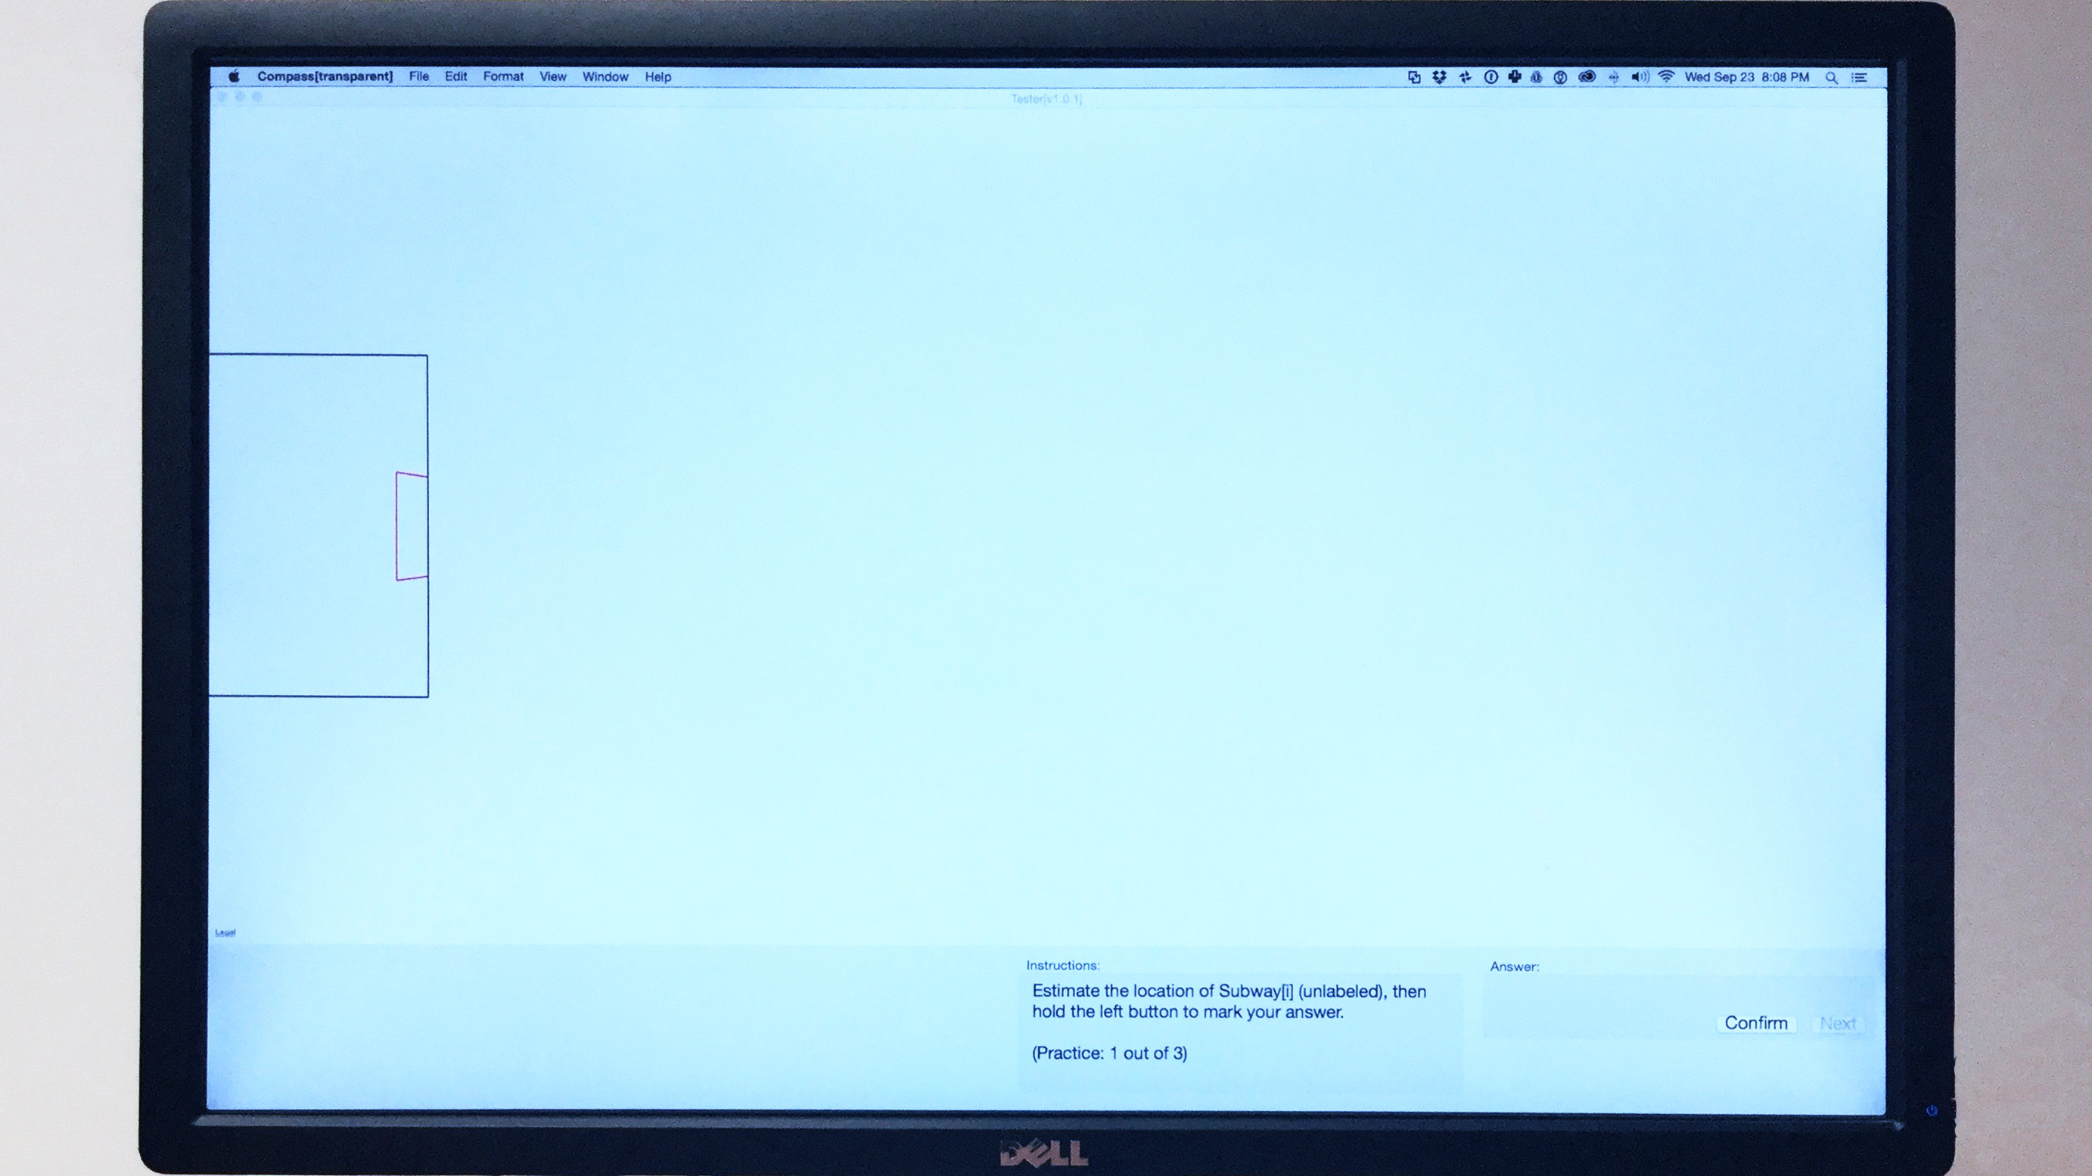
LOCATE
smartphone boundary

Slide 52
LOCATE
wedge (or p-compass)
where is
the subway station?
smartphone boundary

Slide 53
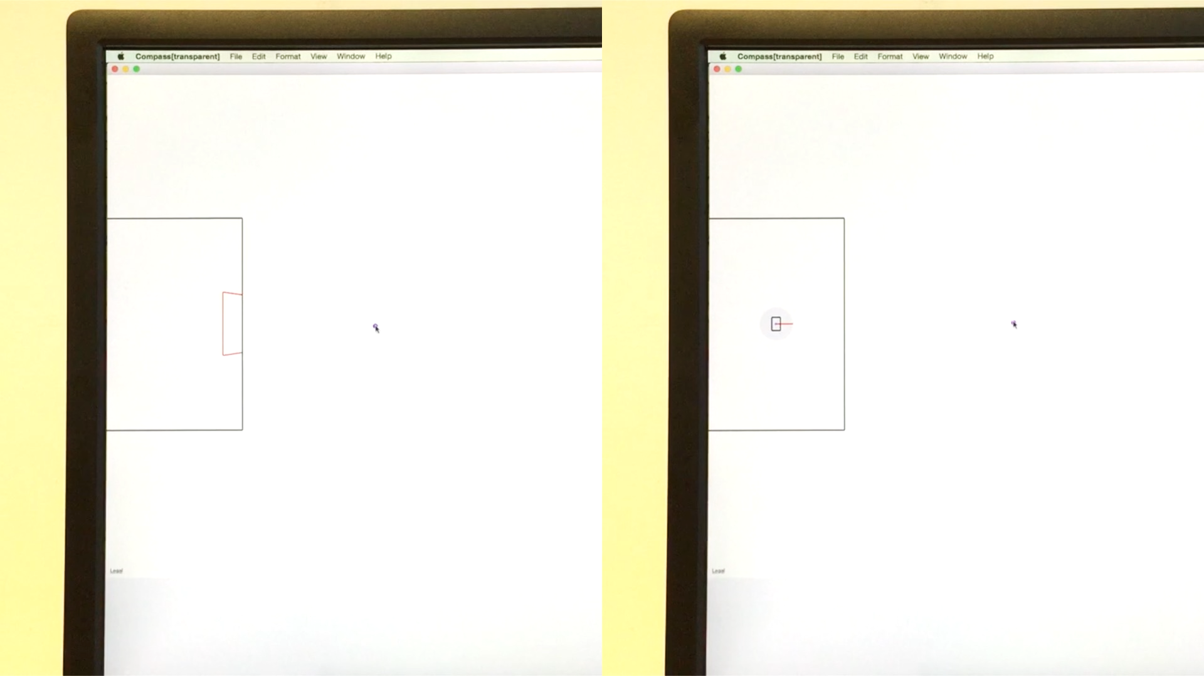
LOCATE
User’s answer
wedge
p-compass
smartphone boundary
smartphone boundary

Slide 54
LOCATE
wedge
p-compass

Slide 55
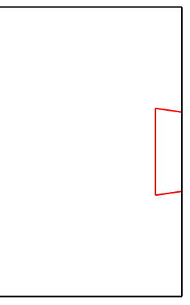
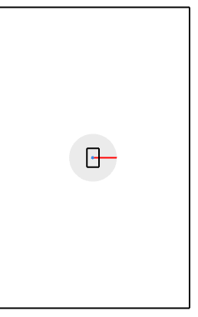
LOCATE
wedge
p-compass
smartphone boundary
smartphone boundary

Slide 56
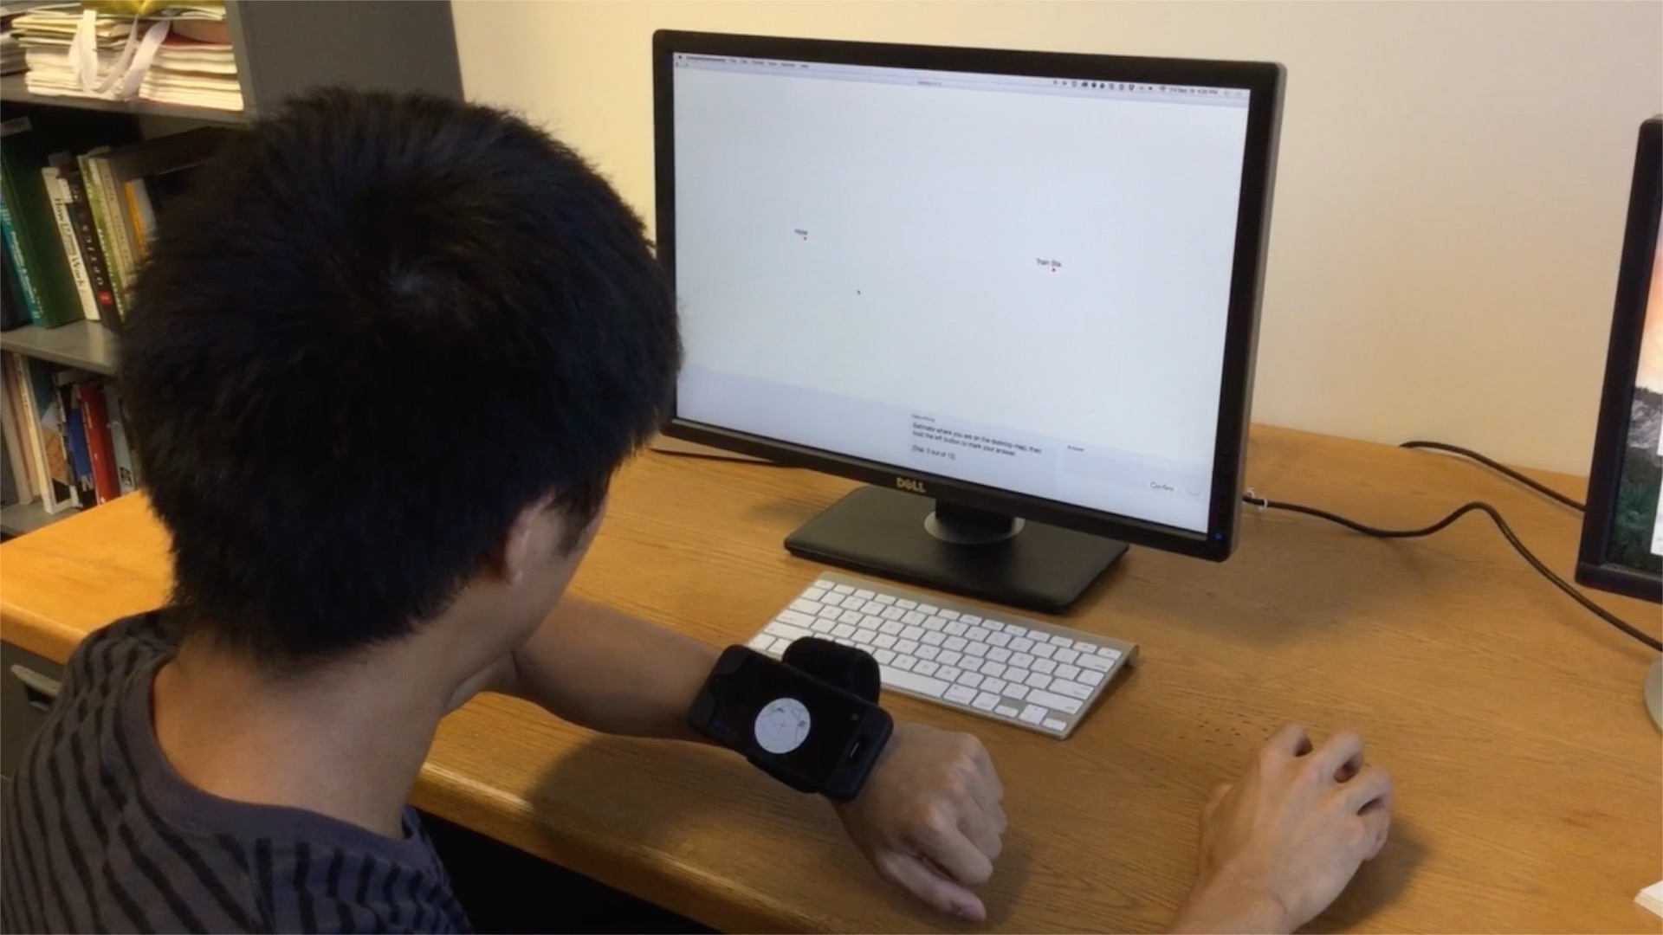
LOCALIZE
2. Answer
1. View

Slide 57
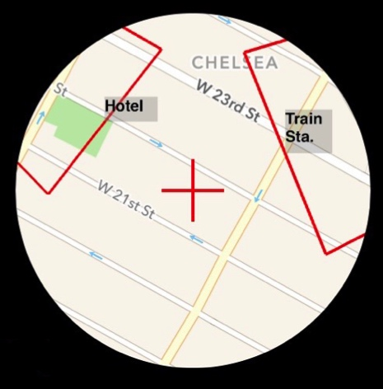
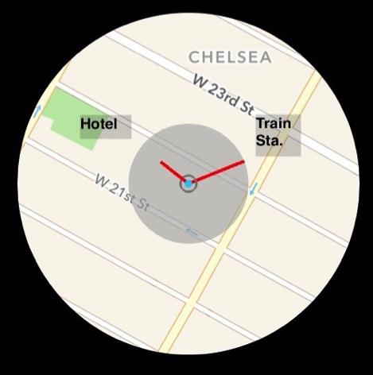
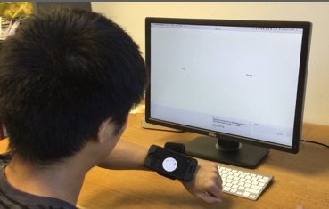
LOCALIZE
you are here
hotel
train sta.
1. view
wedge
p-compass

Slide 58
LOCALIZE
hotel
train sta.
where are you?
2. answer
1. view
wedge
p-compass

Slide 59
hypotheses
H1. LOCATE. Wedge more accurate for close POIs,
p-compass more accurate for distant POIs
H2. DISTANCE. P-Compass more accurate
H3. LOCALIZE. P-Compass more accurate
H4. LOCATE+. P-Compass more accurate
H5. Preferences. Prefer P-Compass for 4 tasks

Slide 60

26 participants (13 female)
ages 20-39 ($\overline{x}$ = 25.5, s = 4.9)

Slide 61
results

Slide 62
LOCATE

Slide 63
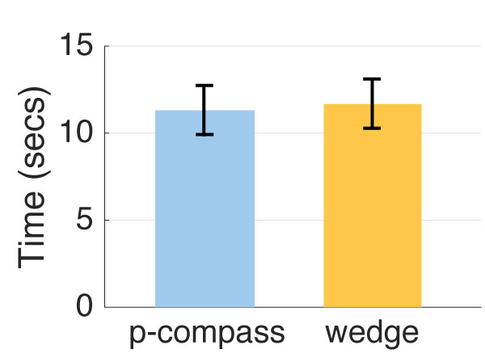

LOCALIZE

Slide 64
hypotheses
H1. LOCATE. Wedge more accurate for close POIs,
p-compass more accurate for distant POIs
H2. DISTANCE. P-Compass more accurate
H3. LOCALIZE. P-Compass more accurate
H4. LOCATE+. P-Compass more accurate
H5. Preferences. Prefer P-Compass for 4 tasks

Slide 65
limitations + future work
requires a priori knowledge of a space
POI database
POI selection algorithm

Slide 66
conclusions

Slide 67
p-compass:
extends conventional compass to address “where is x?”
user study:
- p-compass and wedge are complementary
- use p-compass as
distances to POIs increase
display size decreases

Slide 68
building blocks of mental maps:
landmarks, edges, paths, nodes, districts
p-compass
[Lynch, 60]

Slide 69

building blocks of mental maps:
landmarks, edges, paths, nodes, districts
open question:
spacepiece
?
“where is x” at a glance
vs. timepiece: “what time is it” at a glance

Slide 70
Personalized Compass
A Compact Visualization for Direction and Location
Daniel Miau, Steven Feiner
Columbia University
Acknowledgments
This material is based in part upon work supported by the National Science Foundation under Grants DGE-1144854, IIS-0905569, and IIS-1514429
Thanks to Mengu Sukan and Barbara Tversky for discussions,
Hong Guo for refining the iOS prototype, and James Xue and Kevin Lin for developing a web-based prototype
Any opinions, findings, and conclusions or recommendations expressed in this material are those of the author(s) and do not necessarily reflect the views of the National Science Foundation

