Slide 1
Focal Sweep Videography with
Deformable Optics
Daniel Miau¹, Oliver Cossairt², Shree K. Nayar¹
¹Columbia University
²Northwestern University
Supported by: ONR

Slide 2
Conventional vs. Focal Sweep Photography
Conventional
Focal Sweep
Sensor
Lens
Focal Plane
Sensor
Lens
Focal Plane
Step 1:
Focus
Step 2:
Capture
Step 1:
Sweep the focus while capturing
Determined by focal plane travel time

Slide 3
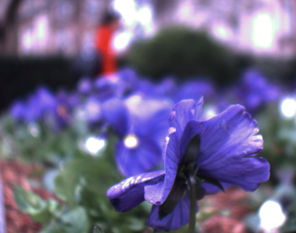

Conventional vs. Focal Sweep Photography
Conventional
Focal Sweep
Photograph
Focal Stack (played in loop)

Slide 4
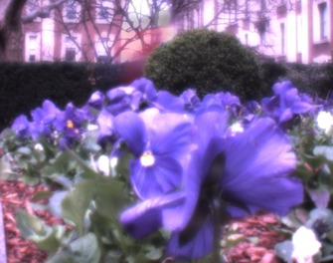
Conventional vs. Focal Sweep Photography
Conventional
Focal Sweep
Photograph
EDOF image (captured)

Slide 5
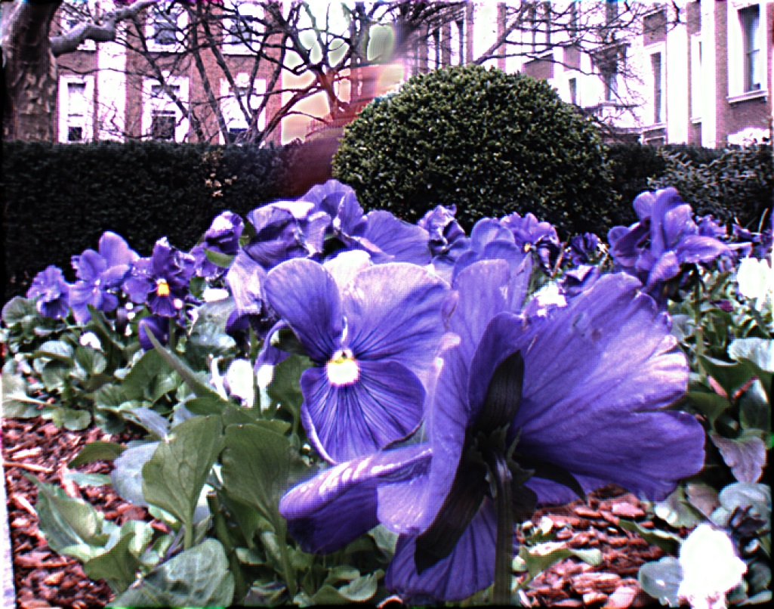
Conventional vs. Focal Sweep Photography
Conventional
Focal Sweep
Dynamic
Static
Restricted to static scenes!
Photograph
EDOF image (deblurred)

Slide 6
Focal Sweep Research Space
Microscopic
10’s~100’s μm
Daily photography
10’s~100’s cm
Telephoto
10’s~100’s m
Scene
distance
[Hausler ‘72] | [Nagahara et al. ‘08] [Hasinoff and Kutulakos ’09] [Zhao and Qu ‘12]
Static
Dynamic
Scene
type
Previous work

Slide 7
Focal Sweep Research Space
Microscopic
10’s~100’s μm
Daily photography
10’s~100’s cm
Telephoto
10’s~100’s m
Scene
distance
[Hausler ‘72] | [Nagahara et al. ‘08] [Hasinoff and Kutulakos ’09] [Zhao and Qu ‘12]
[Liu and Hua ’11] | [Nagahara et al. ‘08] [Shroff et al. ‘12]
Static
* 15fps video of a static scene
* 1.5fps video
Dynamic
This paper
* 30fps video, require motion and depth estimations
Scene
type
Previous work

Slide 8
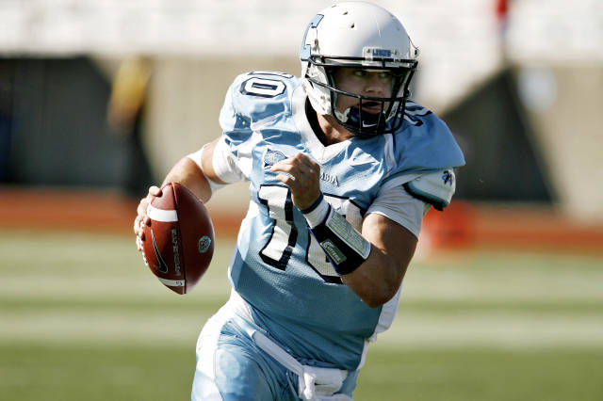
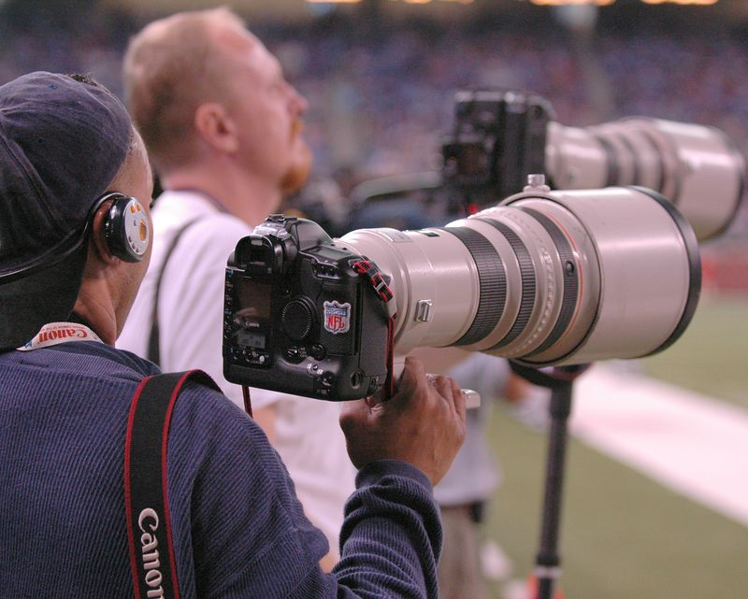
Why Telephoto Focal Sweep Videography?
Mike McLaughlin
Columbia University Athletics
Randall McAdory

Slide 9
Sensor Travel vs. Focal Length
Sensor
Lens
Focal Plane
Thin lens law
i₁
o₁
i₂
o₂
Sensor Travel Distance
Previous Work
This
Work
Telephoto Focal Sweep requires much larger sensor travel!
Notes:
\boldsymbol{
= f^2 \frac{(o_1 - o_2)}{(o_1 - f)(o_2 - f)}
}
\boldsymbol{d \propto f^2, \; if \; o_1, o_1 \gg f}

Slide 10
Challenge:
A Telephoto Focal Sweep Video Camera
Telephoto focal sweep requirements:
Large sensor travel
Focal sweep videography requirements:
High-speed focal plane travel
(dynamic scenes)
Periodic focal plane motion
(video capture)

Slide 11

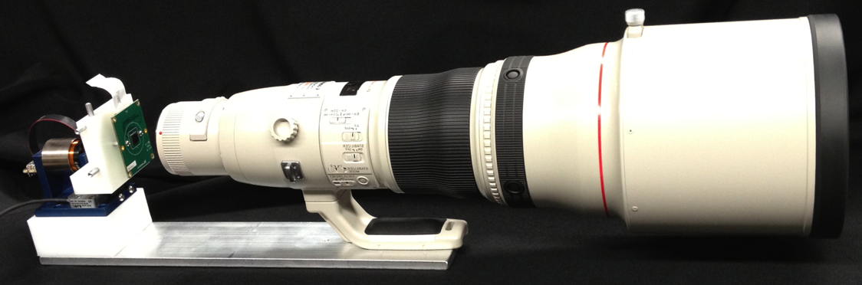
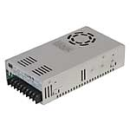
Challenge:
A Telephoto Focal Sweep Video Camera
BEI Kimco Voice Coil Motor
Elmo Motion Control Driver
Lumenera 1/3’’ CMOS Sensor
Positioning Stage
Canon 800mm EFL Lens
Power Supply
Large sensor travel + High frequency periodic motion = vibrations
Vibrations result in motion blur
Can we perform sweep without sensor motion?

Slide 12
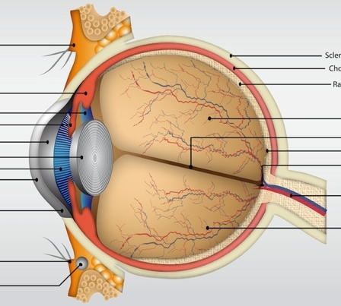
Deformable Optics:
A Proven Method for Focusing
The Lens
Human Eye Anatomy
Human Eyes use deformable optics to focus.

Slide 13
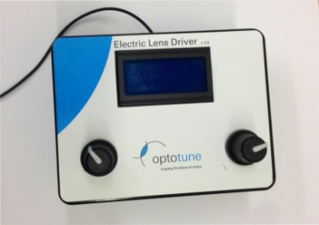
Deformable Optics:
A New Method for Focal Sweep
Deformable Lens
Focal Plane
Signal Generator
Sensor
Optotune EL-10-30 specs:
Focal length: 40mm-140 mm (controlled by current)
Step response: response time < 2.5 ms, settling time < 15 ms
Operating frequency: up to 385 Hz
Focal sweep with deformable optics inserted in the aperture plane
Microscope:
[Liu and Hua ’11]
Telecentric lens:
[Zhao and Qu ‘12]

Slide 14
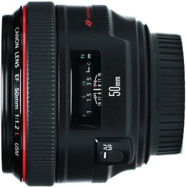
Deformable Optics:
Aperture Limitation
Deformable Lens
10mm
42mm
Tunable Lens, Ø = 10mm
Canon 50mm, f/1.2 lens, Ø = 42mm
Commercial deformable lenses (aperture <= 10mm)
are too small for daily and telephoto lenses.

Slide 15
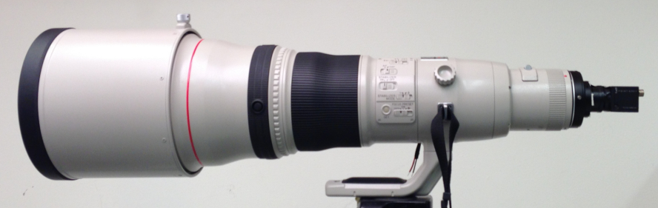
Telephoto Focal Sweep Camera
with Deformable Optics
Canon 800mm EFL Lens
Sensor
Deformable Lens
No slow mechanical moving parts
Bonus: Reduced Size, Complexity and Power Consumption

Slide 16
Extended Depth of Field

Slide 17
Modeling: Compound Thin-Lens System
Telephoto Objective
(Canon 800mm EFL Lens)
Focal Length: f₁
Deformable Lens
Focal Length: f₂(t)
Sensor

Slide 18
PSF vs. Deformable Lens Focal Length
Point Light Source
f₂(t₁)
Sensor
Objective
Deformable Lens
PSF(t₁)
f₂(t₂)
+
PSF(t₂)
+
f₂(t₃)
PSF(t₃)
=
Notes:
% (24)
\boldsymbol{b = \frac{a_2}{d_2}(d_2 - i_2(t))}

Slide 19
PSF vs. Deformable Lens Focal Length
f₂(t₁)
Sensor
Objective
Deformable Lens
PSF(t₁)
f₂(t₂)
+
PSF(t₂)
+
f₂(t₃)
PSF(t₃)
=
Goal: Control f₂(t) to engineer the best
Notes:
% (24)
\boldsymbol{b = \frac{a_2}{d_2}(d_2 - i_2(t))}

Slide 20
Engineer an Optimal Integrated PSF
Objective
Deformable Lens
f₁
f₂(t)
Sensor
a₂
i₂(t)
b(t)
o
d₁
d₂
PSF(t):
b
Circ/Top hat function with blur diameter b
[Nagahara et al. ’08]
Thin lens law:
Blur diameter:
Notes:
% (24)
\boldsymbol{b(t) = \frac{a_2}{d_2}(d_2 - i_2(t))}
\boldsymbol{\frac{db}{dt} = \gamma}

Slide 21
Engineer an Optimal Integrated PSF
Objective
Deformable Lens
f₁
f₂(t)
Sensor
a₂
i₂(t)
b(t)
o
d₁
d₂
Blur diameter varies linearly:
[Baek ’10]
: constant determined by focal sweep speed.
Optimal focal length profile:
: constants determined by depth range
Notes:
% (24)
\boldsymbol{b = \frac{a_2}{d_2}(d_2 - i_2(t))}
\boldsymbol{\frac{db}{dt} = \gamma}

Slide 22
Simulation:
Optimal and Approximated Focal Length Profiles
One Period
Optimal Control Signal for the Deformable Lens
Optimal vs. Triangle Control Signal for the Deformable Lens
Optimal IPSF
Triangle IPSF

Slide 23
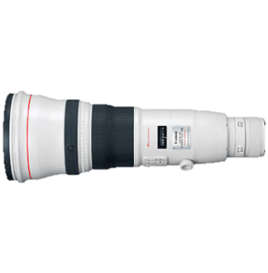
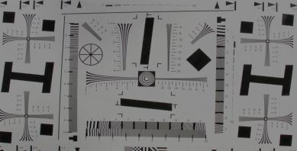
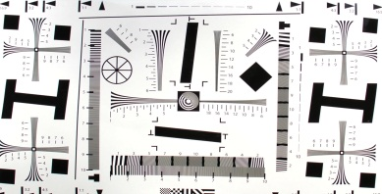
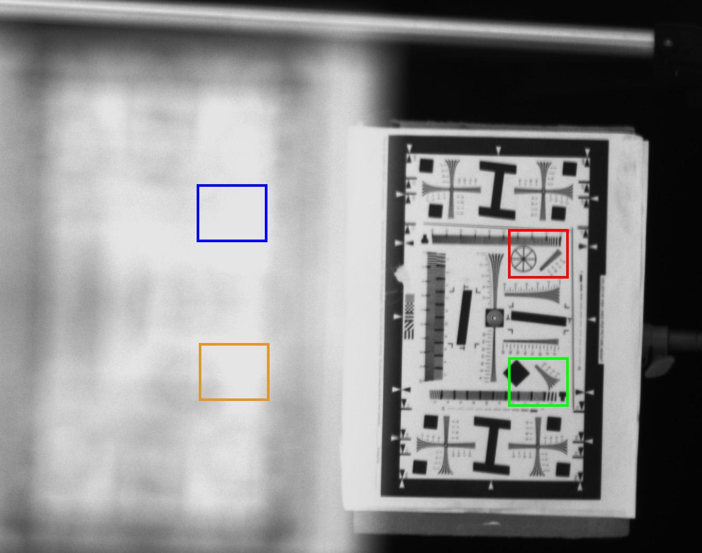




Conventional Telephoto Performance
65 m
.26 m
75 m (focused)
65 meters
75 meters
65 meters
75 meters
Captured Image
(Rear Focus)
Close-ups

Slide 24
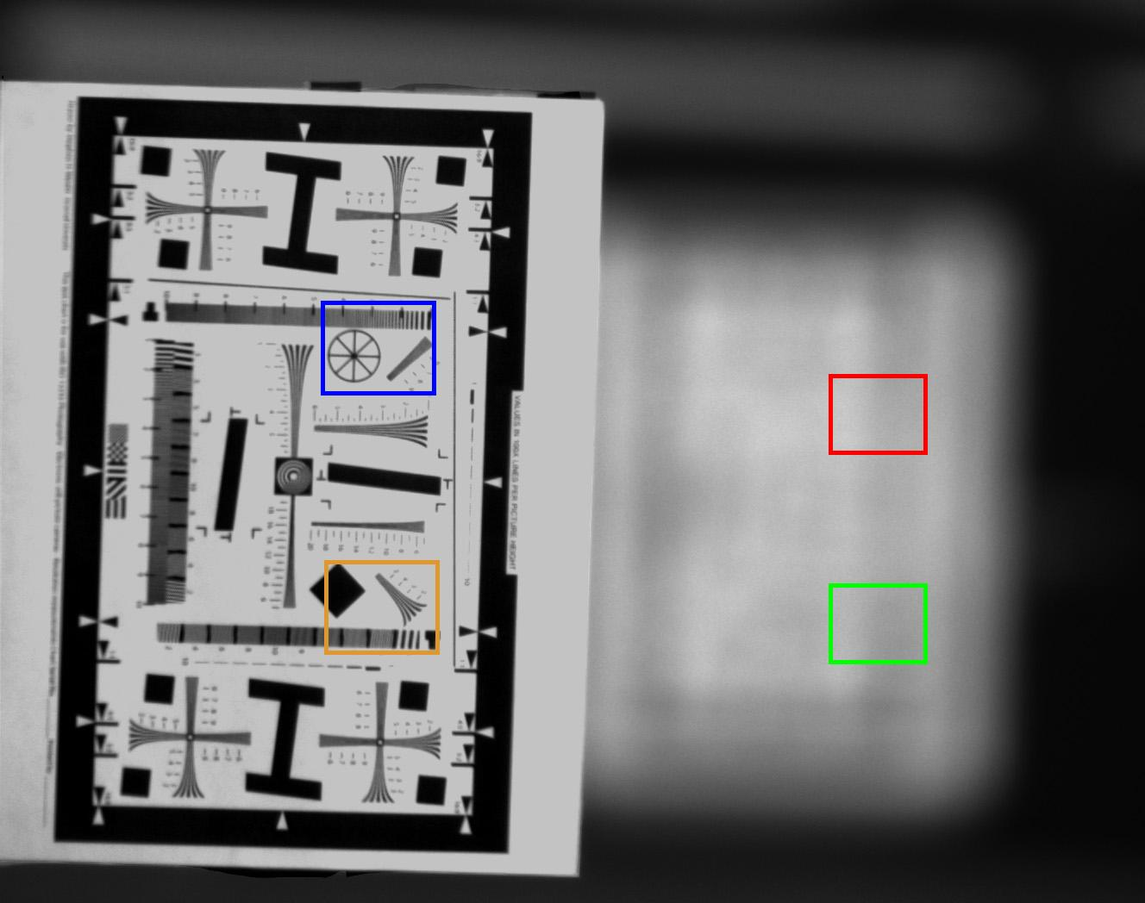




Conventional Telephoto Performance
65 m (focused)
.26 m
75 m
65 meters
75 meters
65 meters
75 meters
Captured Image
(Front Focus)
Close-ups

Slide 25

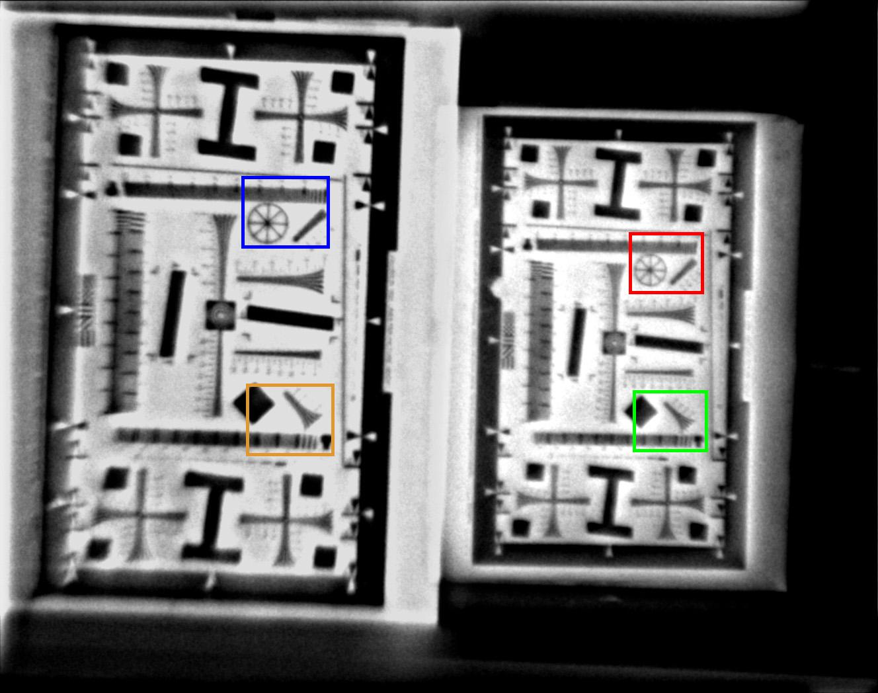
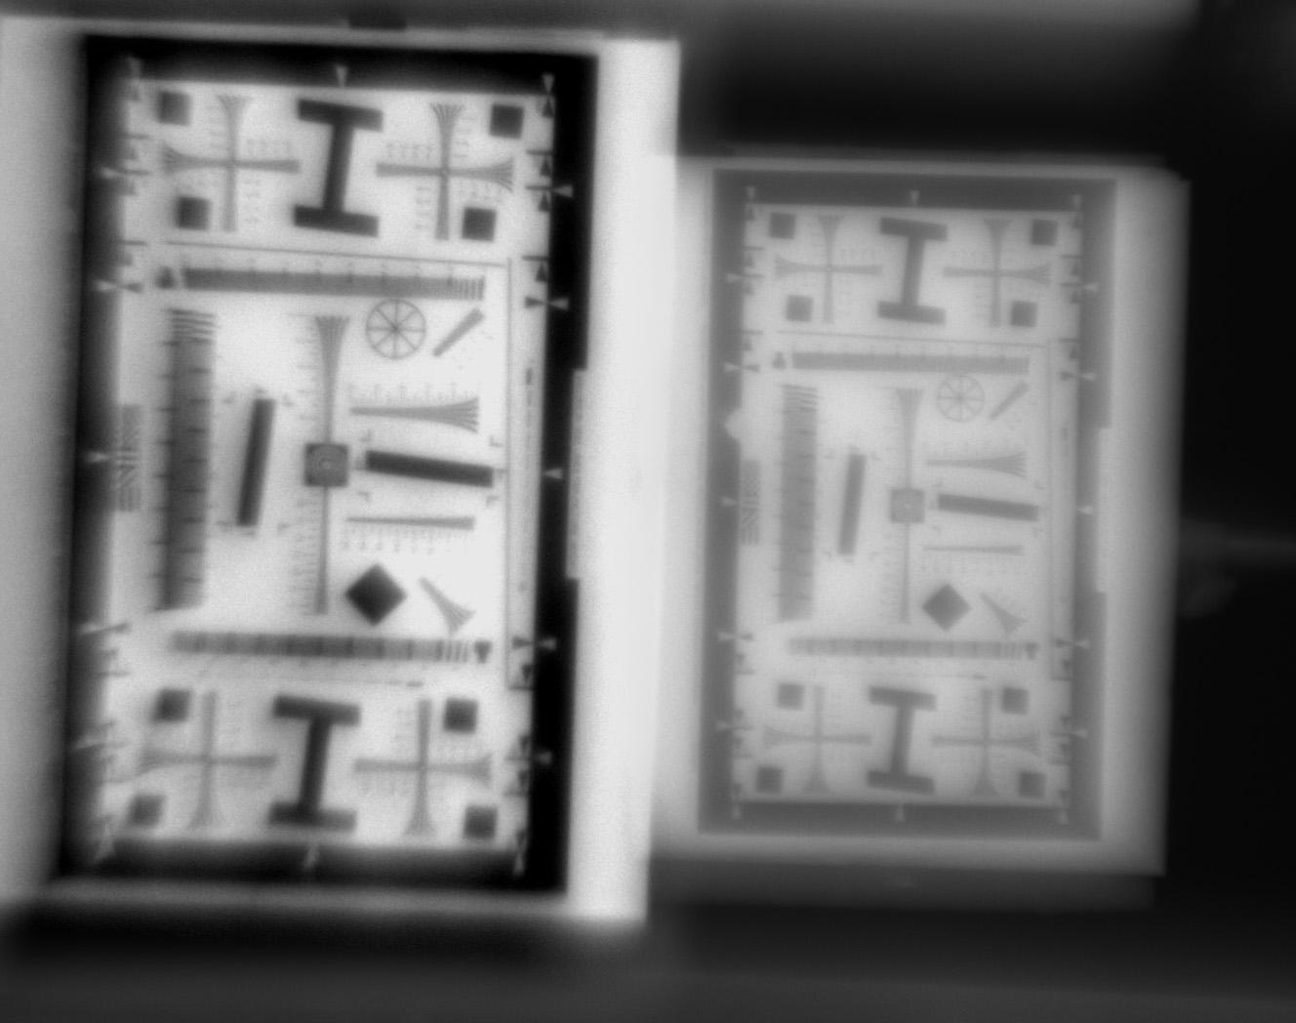




EDOF Telephoto Performance
65 m
.26 m
75 m
65 meters
75 meters
65 meters
75 meters
Deblurred Image
Close-ups
Captured Image

Slide 26
Application 1:
EDOF Videos

Slide 27
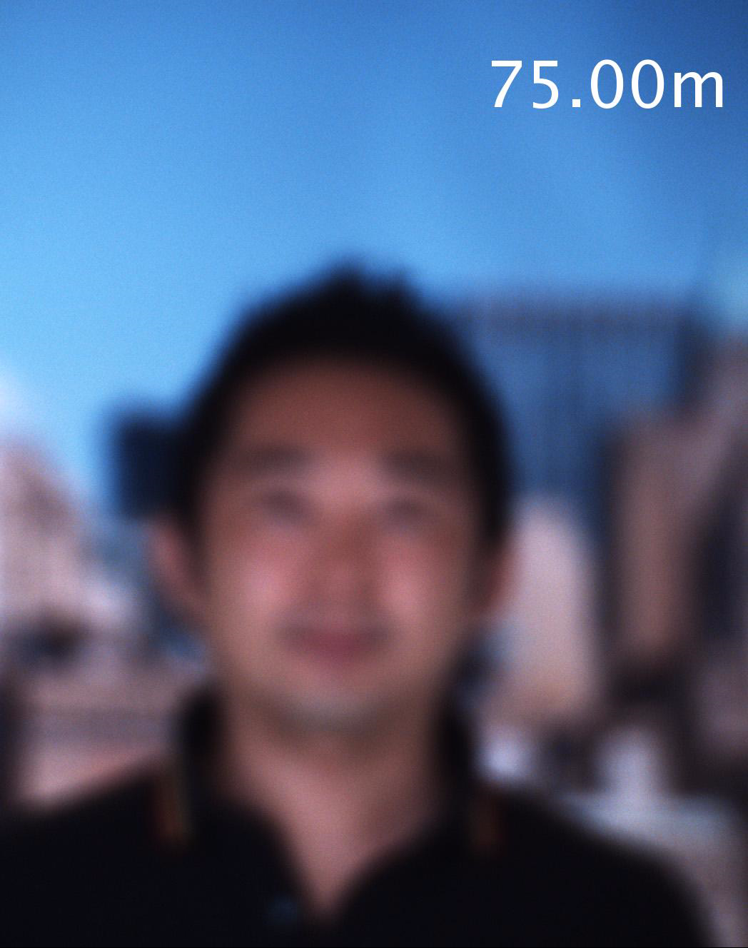
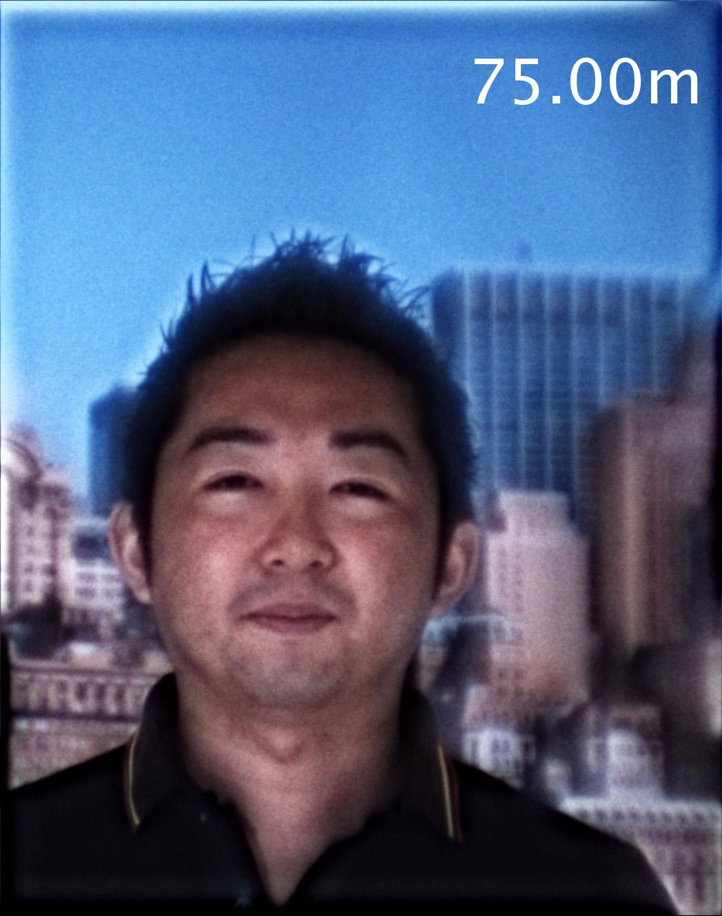
Experiment Parameters
Person walking from
75m to 65m
Focal plane: 70m
Camera framerate: 20fps
Person walking from
75m to 65m
- Focal sweep range: [65m, 75m]
- Focal sweep frequency: 30Hz
Camera framerate: 20fps
Conventional
EDOF (Deformable Lens)

Slide 28
Video Quality Comparison
Conventional
EDOF (Deformable Lens)

Slide 29
Application 2:
Periodic Focal Stacks

Slide 30
EDOF Video
Focus
Depth
One Period
One Focal Sweep
Focal Plane
Trajectory
Focal Plane
Motion
Time
Capture
Sequence
Frame 1
Frame 2
Frame 3
Frame 4

Slide 31
Periodic Focal Stack
Focus
Depth
One Period
One Focal Sweep
Focal Plane
Trajectory
Focal Plane
Motion
Time
Capture
Sequence
Stack 1
Stack 2
Stack 3
Stack 4
Periodic Focal Stack:
A rich representation of a scene.
A video captured with multiple focus settings. [Shroff et al. ‘12]

Slide 32
Sub-Sampling a Periodic Focal Stack
Focus
Depth
One Period
One Focal Sweep
Focal Plane
Trajectory
Focal Plane
Motion
Time
Capture
Sequence
Stack 1
Stack 2
Stack 3
Stack 4

Slide 33
Sub-Sample a Periodic Focal Stack
Focus
Depth
One Period
One Focal Sweep
Focal Plane
Trajectory
Focal Plane
Motion
Desired
Focus Depth
Time
Capture
Sequence
Stack 1
Stack 2
Stack 3
Stack 4
Refocused
Video
Refocused video framerate = focal stack captured rate

Slide 34
Sub-Sample a Periodic Focal Stack
Focus
Depth
One Period
One Focal Sweep
Focal Plane
Trajectory
Focal Plane
Motion
Desired
Focus Depth
Time
Capture
Sequence
Stack 1
Stack 2
Stack 3
Stack 4
Refocused
Video

Slide 35
Sub-Sample a Periodic Focal Stack
Focus
Depth
One Period
One Focal Sweep
Focal Plane
Trajectory
Focal Plane
Motion
Desired
Focus Depth
Time
Capture
Sequence
Stack 1
Stack 2
Stack 3
Stack 4
Refocused
Video

Slide 36
Sub-Sample a Periodic Focal Stack
Focus
Depth
One Period
One Focal Sweep
Focal Plane
Trajectory
Focal Plane
Motion
Moving Object
Trajectory
Time
Capture
Sequence
Stack 1
Stack 2
Stack 3
Stack 4
Focus-Following
Video
Capturing periodic focal stacks enables video refocusing

Slide 37
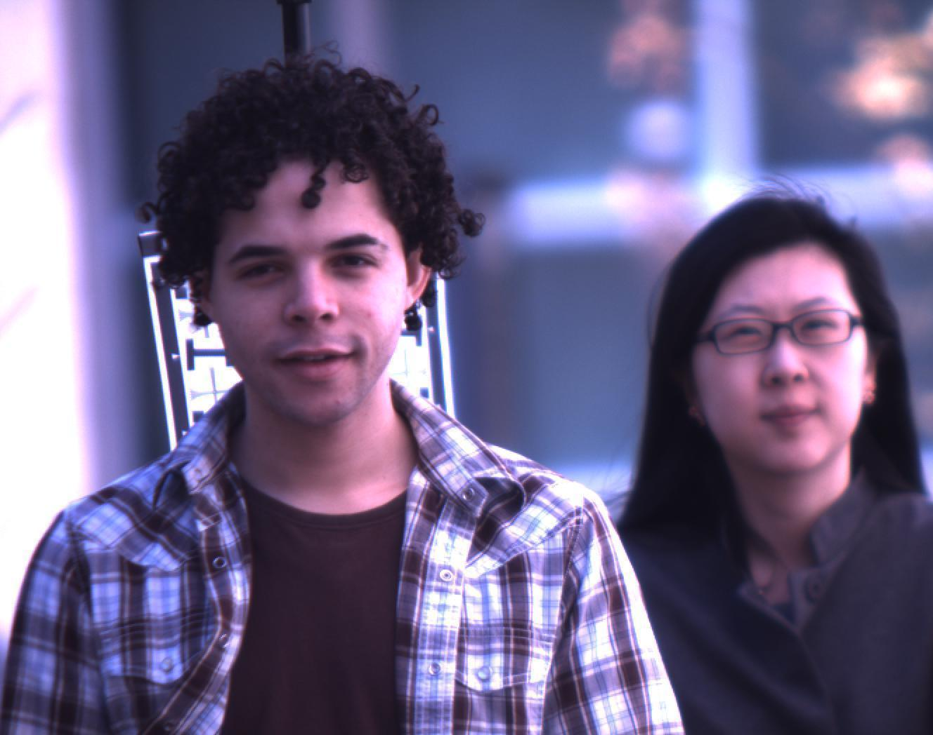
Periodic Focal Stack Applications
Refocused Videos
Depth Tracking of Moving People

Slide 38
Experiment Parameters
Two people walking from 27m to 10m
Fast
walker
Slow
walker
Camera framerate: 120 fps
Focal stack size: 14 frames
Focal sweep frequency: 4.3 Hz
(Captured with a 200mm lens + deformable lens system)

Slide 39
Processing Pipeline
1. Detect faces
2. Compute focus measure
3. Select the best focused face
from each focal stack
For each person
3.5. Estimate depth (depth from focus)
4. Compile the selected images to
produce a focus-following video

Slide 40
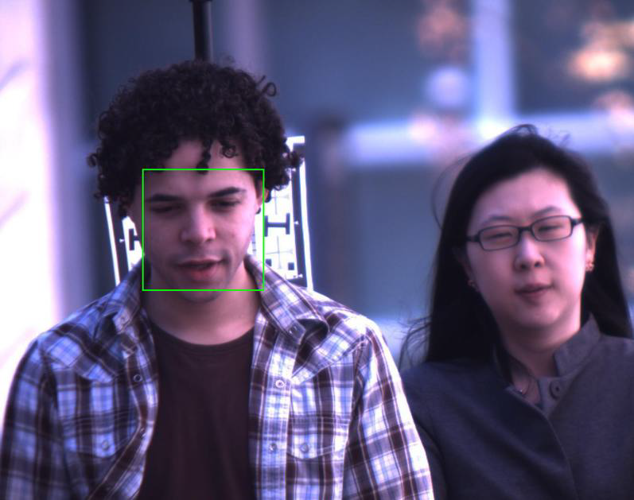
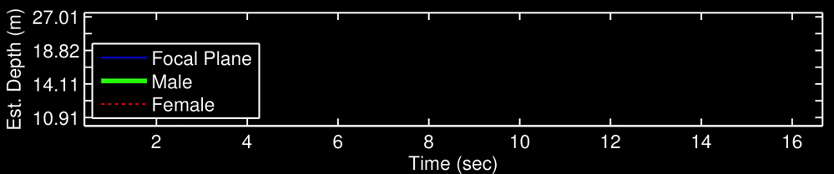
Refocusable Video:
Focus follows the Male

Slide 41

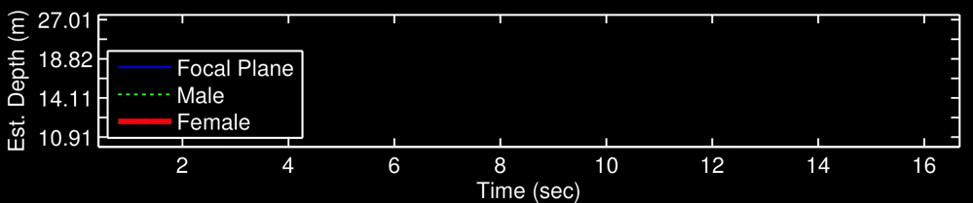
Refocusable Video:
Focus follows the Female

Slide 42
Application 3:
Space-Time Refocusing

Slide 43
Refocusing from a Focal Stack
Focus
Depth
One Period
One Focal Sweep
Focal Plane
Trajectory
Focal Plane
Motion
Time
Capture
Sequence
Stack 1
Stack 2
Stack 3
Stack 4
Space-Time Refocusing:
Compute space-time in-focus image
Compute space-time index map
[Zhou et al. ‘12]

Slide 44
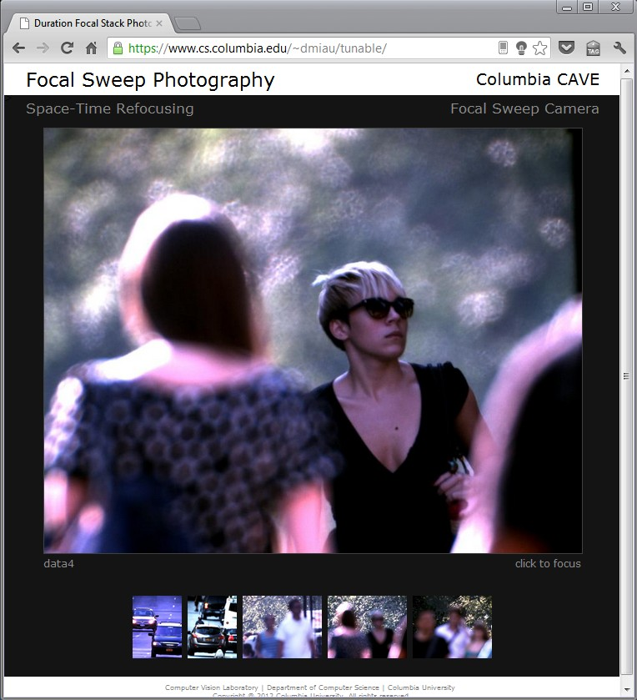
Long Distance Space-Time Refocusing
https://www.cs.columbia.edu/~dmiau/tunable/

Slide 45
Summary
Microscopic
10’s~100’s μm
Daily photography
10’s~100’s cm
Telephoto
10’s~100’s m
Scene
distance
Static
Camera:
Telephoto Focal Sweep Video Camera
Applications:
EDOF Video
Periodic Focal Stack
Space-Time Refocusing
Dynamic
Scene
type
Previous work
This work

