Slide 1
Sublinear Algorithmic Tools 3
Alex Andoni

Slide 2
Plan
Dimension reduction
Application: Numerical Linear Algebra
Sketching
Application: Streaming
Application: Nearest Neighbor Search
and more…
Dimension reduction: linear map $S:ℝ^{n}→ℝ^{k}$ s.t:
for any points $p,q∈ℝ^{n}$:
$\underset{S}{Pr}\left[\frac{||S\left(p\right)−S(q)||}{||p−q||}∈\left(1±ε\right)\right]≥1−δ$
Sketch: linear map $S:ℝ^{n}→ℝ^{m}$, estimator $E$, s.t.
for any $p∈ℜ^{n}$ : $\underset{S}{Pr}\left[\frac{E(S\left(p\right))}{||p||_{1}}∈(1±ε)\right]≥1−δ$

Slide 3
Approximate Near Neighbor Search
Preprocess: a set of $n$ point
approximation $c>1$
Query: given a query point $q$, report a point $p^{∗}∈P$ with the smallest distance to $q$
up to factor $c>1$
Near neighbor: threshold $r$
Applications to: closest pair, Max/Min inner product (MIPS), greedy coordinate descent, kernel approximation & estimation,…
Parameters: space & query time
$$r$$
$$p^{∗}$$
$$cr$$
$$q$$
$$p^{′}$$

Slide 4
Locality-Sensitive Hashing
[Indyk-Motwani’98]
$$q$$
$$p′$$
Random hash function $g$ on $ℝ^{d}$
satisfying:
for close pair (when $\left\|q−p\right\|≤r$)
$Pr⁡[g(q)=g(p)]$ is “high”
for far pair (when $\left\|q−p′\right\|>cr$)
$Pr⁡[g(q)=g(p′)]$ is “small”
Use several hash tables
$$p$$
$$q$$
$$P1=$$
“not-so-small”
$$P2=$$
$$Pr⁡[g(q)=g(p)]$$
$$ρ=\frac{\log{1/P_{1}}}{\log{1/P_{2}}}$$
1
$nρ$, where
$$P1$$
$$P2$$
$$\left\|q−p\right\|$$
$$r$$
$$cr$$

Slide 5
Locality sensitive hash functions
Hash function $g$ is usually a concatenation of “primitive” functions:
$g\left(p\right)=\left\langle h_{1}(p),h_{2}(p),…,h_{k}(p)\right\rangle$
Example: Hamming space ${\left\{0,1\right\}}^{d}$
$h\left(p\right)=p_{j}$ , i.e., choose $j^{th}$ bit for a random $j$
$g(p)$ chooses $k$ bits at random
$\operatorname{Pr}\left[h\left(p\right)=h\left(q\right)\right]= 1 –\frac{Ham\left(p,q\right)}{d}$
$P_{1}=1−\frac{r}{d}≈e^{−r/d}$
$P_{2}=1−\frac{cr}{d}≈e^{−cr/d}$
$ρ=\frac{\log{1/P_{1}}}{\log{1/P_{2}}}=\frac{r/d}{cr/d}=\frac{1}{c}$

Slide 6
Full algorithm
Data structure is just $L=n^{ρ}$ hash tables:
Each hash table uses a fresh random function $g_{i}\left(p\right)=\left\langle h_{i,1}(p),…,h_{i,k}(p)\right\rangle$
Hash all dataset points into the table
Query:
Check for collisions in each of the hash tables
until we encounter a point within distance $cr$
Guarantees:
Space: $O\left(nL\right)=O(n^{1+ρ})$, plus space to store points
Query time: $O\left(L⋅(k+d)\right)=O(n^{ρ}⋅d)$ (in expectation)
50% probability of success.
Notes:
Draw L hash tables

Slide 7
Analysis of LSH Scheme
Choice of parameters $k,L$ ?
$L$ hash tables with $g\left(p\right)=\left\langle h_{1}(p),…,h_{k}(p)\right\rangle$
Pr[collision of far pair] = $P_{2}^{k}$
Pr[collision of close pair] = $P_{1}^{k}$
Hence $L=O(n^{ρ})$ “repetitions” (tables) suffice!
set $k$ s.t.
= $1/n$
= ${\left(P_{2}^{ρ}\right)}^{k}={1/n}^{ρ}$
$$P_{1}$$
$$P_{1}^{2}$$
$$P_{2}$$
$$k=1$$
$$P_{2}^{2}$$
$$k=2$$
$$r$$
$$cr$$

Slide 8
Analysis: Correctness
Let $p^{∗}$ be an $r$-near neighbor
If does not exists, algorithm can output anything
Algorithm fails when:
near neighbor $p^{∗}$ is not in the searched buckets $g_{1}\left(q\right), g_{2}\left(q\right), …,g_{L}\left(q\right)$
Probability of failure:
Probability $q,p^{∗}$ do not collide in a hash table: $≤1−P_{1}^{k}$
Probability they do not collide in $L$ hash tables at most
$${\left(1−P_{1}^{k}\right)}^{L}={\left(1−\frac{1}{n^{ρ}}\right)}^{n^{ρ}}≤1/e$$

Slide 9
Analysis: Runtime
Runtime dominated by:
Hash function evaluation: $O(L⋅k)$ time
Distance computations to points in buckets
Distance computations:
Care only about far points, at distance $>cR$
In one hash table, we have
Probability a far point collides is at most $P_{2}^{k}=1/n$
Expected number of far points in a bucket: $n⋅\frac{1}{n}=1$
Over $L$ hash tables, expected number of far points is $L$
Total: $O\left(Lk\right)+O\left(Ld\right)=O(n^{ρ}d)$ in expectation

Slide 10
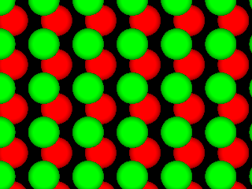
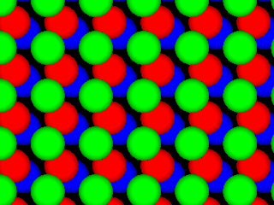
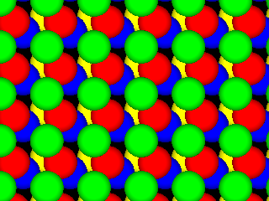
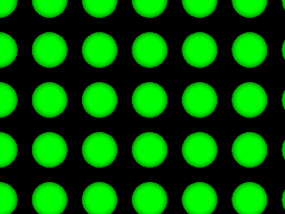
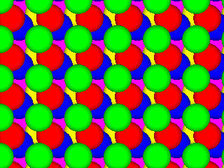
LSH maps: Euclidean space
[Datar-Indyk-Immorlica-Mirrokni’04, A.-Indyk’06]
Space | Time | Exponent | $$c=2$$
$$n^{1+ρ}$$ | $$n^{ρ}$$ | $$ρ=1/c$$ | $$ρ=1/2$$
 |  | $$ρ≈1/c^{2}$$ | $$ρ=1/4$$
 |  | $$ρ≈\frac{1}{2c^{2}}−1$$ | $$ρ=1/7$$
$$q$$
$$p$$
$$p′$$
Even better LSH maps?
NO: example of isoperimetry
[Motwani-Naor-Panigrahy’06, O’Donell-Wu-Zhou’11]
Example question:
Among bodies in $R^{d}$ of volume 1, which has the lowest perimeter?
Can get better maps, if $g$ allowed to (mildly) depend on the dataset
[A-Indyk-Nguyen-Razenshteyn’14, A-Razenshteyn’15]

Slide 11
Plan
Dimension reduction
Application: Numerical Linear Algebra
Sketching
Application: Streaming
Application: Nearest Neighbor Search
and more…
Dimension reduction: linear map $S:ℝ^{n}→ℝ^{k}$ s.t:
for any points $p,q∈ℝ^{n}$:
$\underset{S}{Pr}\left[\frac{||S\left(p\right)−S(q)||}{||p−q||}∈\left(1±ε\right)\right]≥1−δ$
Sketch: linear map $S:ℝ^{n}→ℝ^{m}$, estimator $E$, s.t.
for any $p∈ℜ^{n}$ : $\underset{S}{Pr}\left[\frac{E(S\left(p\right))}{||p||_{1}}∈(1±ε)\right]≥1−δ$

Slide 12
Sketching/NNS for other distances?
Earth Mover Distance:
Given two sets A, B of points in a metric space
EMD(A,B) = min cost bipartite matching between A and B
Applications in image vision
$$S$$
010110
$EMD(A,B)$ small or large?
$$S$$
010101

Slide 13
Tool: metric embeddings
Metric Embedding:
Map sets into vectors in $ℓ_{1}$ preserving the distance (approximately)
Then use algorithms for $ℓ_{1}$ !
Say, EMD over ${\left[s\right]}^{2}$
Theorem [Cha02, IT03]: Exists a map $f$ mapping all $A⊂{\left[s\right]}^{2}$ into $ℓ_{1}$ with distortion $O(log⁡s)$:
i.e., for any $A,B⊂{\left[s\right]}^{2}$ we have:
$$EMD\left(A,B\right)≤||f\left(A\right)−f\left(B\right)||_{1}≤O(\log{s})⋅EMD(A,B)$$
Implies sketch/NNS: $O\left(\log{s}\right)$-approximation

Slide 14
Embeddability into $ℓ_{1}$
edit( banana ,
ananas ) = 2
Metric | Upper bound
Earth-mover distance ($s$-sized sets in 2D plane) | $$O\left(\log{s}\right)$$ [Cha02, IT03]
Earth-mover distance ($s$-sized sets in ${\left\{0,1\right\}}^{d}$) | $$O(\log{s}⋅\log{d})$$ [AIK08]
Edit distance over ${\left\{0,1\right\}}^{d}$ (#indels to transform x->y) | $$2^{\tilde{O}\left(\sqrt{\log{d}}\right)}$$ [OR05]
Ulam (edit distance between permutations) | $$O\left(\log{d}\right)$$ [CK06]
Block edit distance | $$\tilde{O}\left(\log{d}\right)$$ [MS00, CM07]
edit(1234567,
7123456) = 2

Slide 15
Non-embeddability into $ℓ_{1}$
Metric | Upper bound
Earth-mover distance ($s$-sized sets in 2D plane) | $$O\left(\log{s}\right)$$ [Cha02, IT03]
Earth-mover distance ($s$-sized sets in ${\left\{0,1\right\}}^{d}$) | $$O(\log{s}⋅\log{d})$$ [AIK08]
Edit distance over ${\left\{0,1\right\}}^{d}$ (#indels to transform x->y) | $$2^{\tilde{O}\left(\sqrt{\log{d}}\right)}$$ [OR05]
Ulam (edit distance between permutations) | $$O\left(\log{d}\right)$$ [CK06]
Block edit distance | $$\tilde{O}\left(\log{d}\right)$$ [MS00, CM07]
Lower bounds
$$Ω\left(\sqrt{\log{s}}\right)$$ [NS07]
$$Ω\left(\log{s}\right)$$ [KN05]
$$Ω\left(\log{d}\right)$$ [KN05,KR06]
$$\tilde{Ω}\left(\log{d}\right)$$ [AK07]
4/3 [Cor03]

Slide 16
A sketch of the rest
Sketching
Efficient algorithms
Numerical Linear Algebra
linear sketching
Streaming (smaller space)
Nearest neighbor search
Locality Sensitive Hashing
Sketching of graphs
Sparsifiers: reduce number of edges so as to approximately preserve all cuts, distances, effective resistances etc [Benczur-Karger’94,…]
Linear sketch for graph => data structures for dynamic connectivity [AGM’12, KKM’13]
Characterization of sketching size for distance estimation:
[BO10, LNW14,AKR15, BBCKY’17]
E.g.: a normed space X has small sketch iff embeds into $ℓ_{0.9}$
Adaptive sketching: when we know we sketch set $A⊂ℝ^{d}$
Then $S\left(⋅\right)$ may depend (weakly) on $A$
Non-oblivious subspace embeddings [DMM’06,…, Woodruff’14]

