Slide 1
Affinity Propagation: Clustering by Passing Messages Between Data Points
Delbert Dueck
Department of Electrical & Computer Engineering
University of Toronto
July 30, 2008
Society for Mathematical Biology Conference

Slide 2
Affinity Propagation: Clustering by
Passing Messages Between Data Points
Delbert Dueck
Probabilistic and Statistical Inference Lab
Electrical & Computer Engineering
University of Toronto
July 30, 2008
Society for Mathematical Biology Conference
Where is the
exemplar?
An interpretation of affinity propagation by Marc Mézard, Laboratoire de Physique Théorique et Modeles Satistique, Paris
Caravaggio’s “Vocazione di San Matteo” (The Calling of St. Matthew)
Notes:
I’m Delbert Dueck and I’m a Ph.D. student in Brendan Frey’s Probabilistic and Statistical Inference group at the Department of Electrical & Computer Engineering across the street. Today I’m going to talk about a Affinity Propagation, a clustering algorithm that finds exemplars (data centers) by passing messages between data points. I guess you could say that this is work inspired by Caravaggio. I’ll describe all this in more detail and then show how it can be applied to several different problems involving DNA expression data, yeast gene deletion strains and HIV vaccine design.

Slide 3
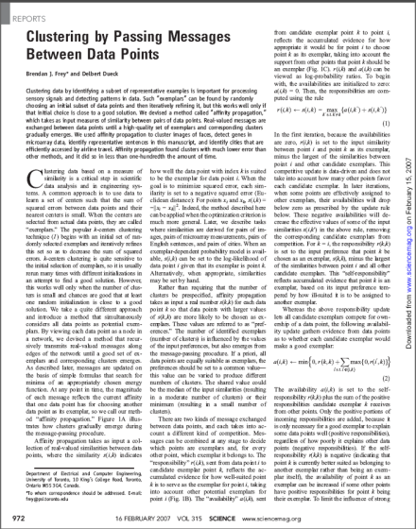
Exemplar-based clustering
Task:
Inputs: A set of real-valued pairwise similarities , {s(i,k)}, between data points and the number of exemplars (K) or a real-valued exemplar cost
Output: A subset of exemplar data points and an assignment of every other point to an exemplar
Objective Function: Maximize the sum of similarities between data points and their exemplars, minus the exemplar costs
Identify a subset of data points as exemplars and assign every other data point to one of those exemplars
Notes:
This is exemplar-based clustering – with a lot of algorithms like k-means you have cluster centers that are described by parameters (e.g. mean, variance for MOG). There are no parameters here – just pointers to the data points centers that are called exemplars.
-we’ve also shown that this can find good solutions for the facility location problem which is a close relative of what we call treatment portfolio design.
***
Similarities needn’t be symmetric, needn’t be a metric (no need for the triangle inequality to work), a matrix of these guys doesn’t need to be positive definite, and sparse similarities are no problem (implicit).
-the easiest similarity to fathom is negative Euclidean distance, but we’ve used patch/window-based similarities for clustering faces and segmenting images, clustering cities by flight time (that isn’t symmetric or triangle inequality), and identifying exons from expression profiles. If you want more information it’s in the original paper. A lot of rich models can be expressed this way – it’s not a variational method where you hope the conjugate prior makes the doable and stuff should be differentiable – no compromises, even a permutation test.
***
We also have something called preferences which are like the control knob on the number of clusters or exemplars the algorithm outputs. It’s like a cost for creating a new cluster; so we often just set it to a constant that we adjust (that’s the one knob that you to tune)

Slide 4
Exemplar-based Clustering
Why is this an important problem?
  User-specified similarities offer a large amount of flexibility
  The clustering algorithm can be uncoupled from the details of how similarities are computed
  There is potential for significant improvement on existing algorithms
Notes:
This is exemplar-based clustering – with a lot of algorithms like k-means you have cluster centers that are described by parameters (e.g. mean, variance for MOG). There are no parameters here – just pointers to the data points centers that are called exemplars.
-we’ve also shown that this can find good solutions for the facility location problem which is a close relative of what we call treatment portfolio design.
***
Similarities needn’t be symmetric, needn’t be a metric (no need for the triangle inequality to work), a matrix of these guys doesn’t need to be positive definite, and sparse similarities are no problem (implicit).
-the easiest similarity to fathom is negative Euclidean distance, but we’ve used patch/window-based similarities for clustering faces and segmenting images, clustering cities by flight time (that isn’t symmetric or triangle inequality), and identifying exons from expression profiles. If you want more information it’s in the original paper. A lot of rich models can be expressed this way – it’s not a variational method where you hope the conjugate prior makes the doable and stuff should be differentiable – no compromises, even a permutation test.
***
We also have something called preferences which are like the control knob on the number of clusters or exemplars the algorithm outputs. It’s like a cost for creating a new cluster; so we often just set it to a constant that we adjust (that’s the one knob that you to tune)

Slide 5
Greedy Method: k-medians clustering
Assign data points to
nearest centers
Assign data points to
nearest centers
Randomly choose
initial exemplars,
(data centers)
For each cluster,
pick best new
center
For each cluster,
pick best new
center
Convergence:
Final set of
exemplars
(centers)
Notes:
The greedy method that should come to mind is k-centers clustering (you can also call k-medians clustering, or k-medoids). The best way to explain it is to show a demonstration of it, too.
This algorithm is very fast but it gets easily trapped in local maxima when you’re optimizing the net utility or net similarity, so we need a lot of random restarts to get decent results. This it the algorithm we primarily compare against.

Slide 6
Affinity Propagation
How well does k-medians
clustering work?
Notes:
How are we going to do this?
With affinity propagation, an exciting clustering algorithm that I’ll spend a few minutes talking about.

Slide 7
















































































Example: Olivetti face images
Olivetti face database contains 400 greyscale 64×64 images from 40 people
  Similarity is based on sum-of-squared distance using a central 50×50 pixel window
Small enough problem to find exact solution

Slide 8
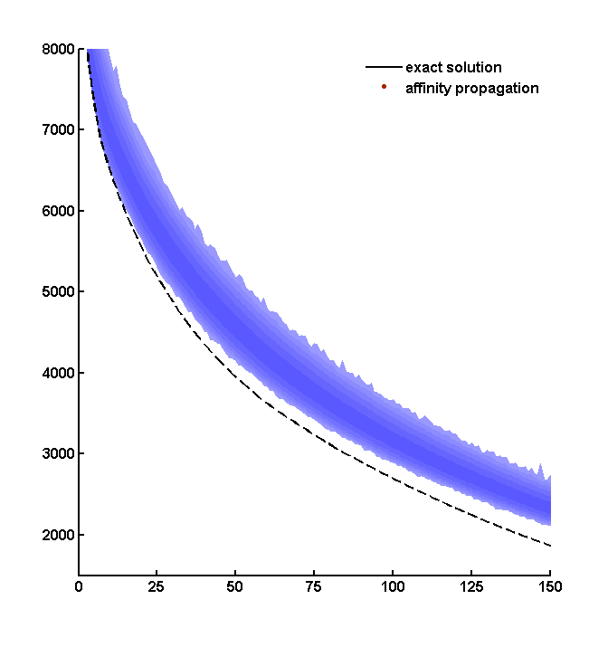
Olivetti faces: squared error achieved by
ONE MILLION runs of k-medians clustering
k-medians clustering, one million random restarts for each k
Squared error
Exact solution
(using LP relaxation + days of computation)
Number of clusters, k

Slide 9
Affinity Propagation
Closing the performance gap:
AFFINITY PROPAGATION
Notes:
How are we going to do this?
With affinity propagation, an exciting clustering algorithm that I’ll spend a few minutes talking about.

Slide 10
AFFINITY PROPAGATION
Science, 16 Feb. 2007
joint work with Brendan Frey
One-sentence summary:
All data points are simultaneously
considered as exemplars, but exchange
deterministic messages while a good set
of exemplars gradually emerges.

Slide 11
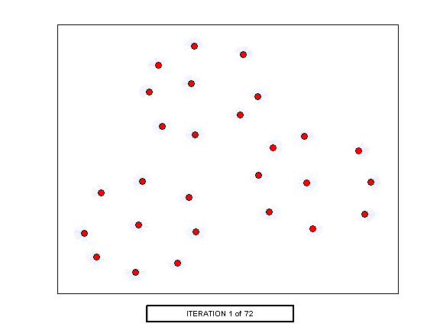
Affinity Propagation: visualization

Slide 12
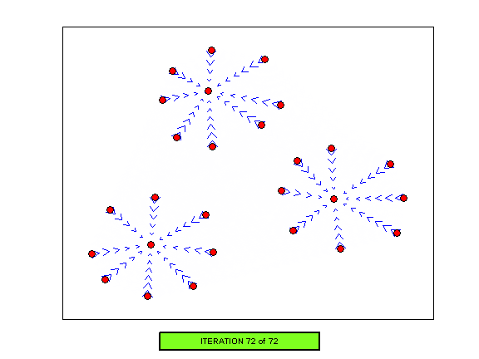
Affinity Propagation: visualization

Slide 13
Affinity Propagation
Task:
Inputs:
  A set of pairwise similarities, {s(i,k)}, where s(i,k) is a real number indicating how well-suited data point k is as an exemplar for data point i
  e.g. s(i,k) = −‖x_{i} − x_{k}‖², i≠k
  For each data point k, a real number, s(k,k), indicating the a priori preference that it be chosen as an exemplar
  e.g. s(k,k) = p ∀k
Identify a subset of data points as exemplars and assign every other data point to one of those exemplars
Need not
be metric!
Notes:
This is exemplar-based clustering – with a lot of algorithms like k-means you have cluster centers that are described by parameters (e.g. mean, variance for MOG). There are no parameters here – just pointers to the data points centers that are called exemplars.
-we’ve also shown that this can find good solutions for the facility location problem which is a close relative of what we call treatment portfolio design.
***
Similarities needn’t be symmetric, needn’t be a metric (no need for the triangle inequality to work), a matrix of these guys doesn’t need to be positive definite, and sparse similarities are no problem (implicit).
-the easiest similarity to fathom is negative Euclidean distance, but we’ve used patch/window-based similarities for clustering faces and segmenting images, clustering cities by flight time (that isn’t symmetric or triangle inequality), and identifying exons from expression profiles. If you want more information it’s in the original paper. A lot of rich models can be expressed this way – it’s not a variational method where you hope the conjugate prior makes the doable and stuff should be differentiable – no compromises, even a permutation test.
***
We also have something called preferences which are like the control knob on the number of clusters or exemplars the algorithm outputs. It’s like a cost for creating a new cluster; so we often just set it to a constant that we adjust (that’s the one knob that you to tune)

Slide 14
Affinity Propagation: message-passing
Affinity propagation can be viewed as data points exchanging messages amongst themselves
  It can be derived as belief propagation (max-product) on a completely-connected factor graph
Sending responsibilities, r
Sending availabilities, a
Candidate
exemplar k
Competing
candidate
exemplar k’
Candidate
exemplar k
r(i’,k)
r(i,k)
a(i,k’)
Supporting
data point i’
a(i,k)
Data point i
Data point i
Notes:
***
Responsibilities are how much you think you’re in someone else’s cluster. r(i,k) is the responsibility that data point i think k has for it (how much i thinks he’s in a cluster with k as its exemplar).
***
Availabilities are the opposite. a(i,k) is the availability that data point k (as a candidate exemplar) has for data point i to be in its cluster.

Slide 15
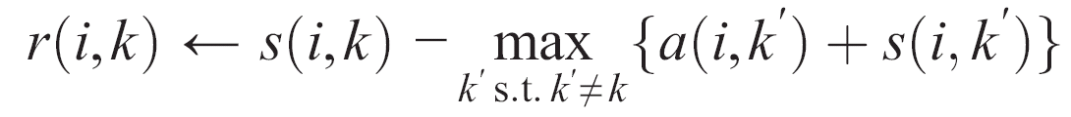
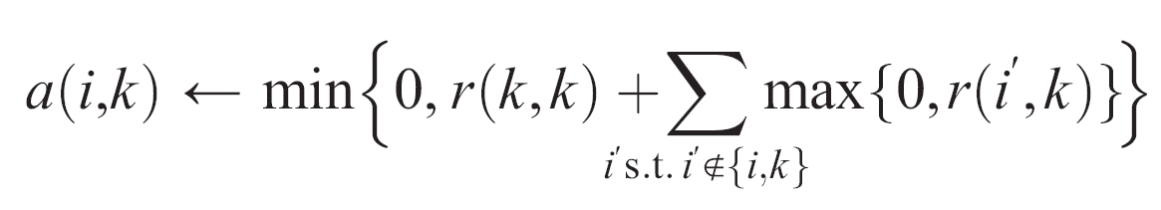
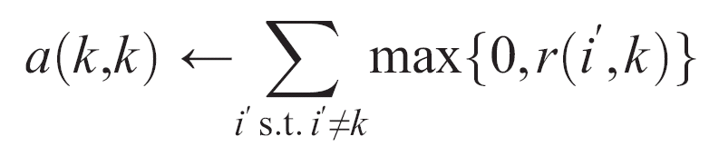
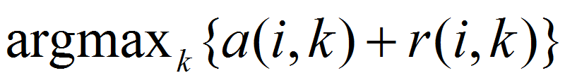
Affinity Propagation: update equations
Sending responsibilities
Candidate
exemplar k
Competing
candidate
exemplar k’
r(i,k)
a(i,k’)
Data point i
Sending availabilities
Candidate
exemplar k
r(i’,k)
Supporting
data point i’
a(i,k)
Making decisions:
Data point i
Notes:
Initially, we set responsibilities and availabilities to zero.
***
After the first iteration, you put the availability in there because it isn’t zero. So now you’re modulating these similarities by availabilities (one guy’s convinced he’s in someone else’s cluster, a third guy isn’t going to say he’s in the first guy’s cluster because his availability is low).
***
Availability is just a sum of the other responsibilities, but you don’t want to penalize someone based on what’s said miles and miles away (what does he know about the neighborhood), so you threshold at zero. You also bring in the self-responsibility r(k,k) which is based on the preference (total number of clusters). Then you threshold all that because what if one guy right next to you is sure you’re his exemplar – don’t rely on one opinion too much.
***
To make decisions about who’s an exemplar, you just add up availabilities and responsibilities and the take an argmax and that gives you the index of every point’s exemplar (or itself)

Slide 16
Affinity Propagation: Matlab code
01 N=size(S,1); A=zeros(N,N); R=zeros(N,N); % initialize messages
02 S=S+1e-12*randn(N,N)*(max(S(:))-min(S(:))); % remove degeneracies
03 lam=0.5; % Set damping factor
04 for iter=1:100,
05 Rold=R; % NOW COMPUTE RESPONSIBILITIES
06 AS=A+S; [Y,I]=max(AS,[],2);
07 for i=1:N, AS(i,I(i))=-realmax; end;
08 [Y2,I2]=max(AS,[],2);
09 R=S-repmat(Y,[1,N]);
10 for i=1:N, R(i,I(i))=S(i,I(i))-Y2(i); end;
11 R=(1-lam)*R+lam*Rold; % Dampen responsibilities
12 Aold=A; % NOW COMPUTE AVAILABILITIES
13 Rp=max(R,0); for k=1:N, Rp(k,k)=R(k,k); end;
14 A=repmat(sum(Rp,1),[N,1])-Rp;
15 dA=diag(A); A=min(A,0); for k=1:N, A(k,k)=dA(k); end;
16 A=(1-lam)*A+lam*Aold; % dampen availabilities
17 end;
18 E=R+A; % pseudomarginals
19 I=find(diag(E)>0); K=length(I); % indices of exemplars
20 [tmp c]=max(S(:,I),[],2); c(I)=1:K; idx=I(c); % assignments
More code available at www.psi.toronto.edu/affinitypropagation
Notes:
You can implement all this in about 25 lines of MATLAB

Slide 17
Recall Olivetti faces: squared error achieved by
1 million runs of k-medians clustering
k-medians clustering, one million random restarts for each K
Squared error
Exact solution
(using LP relaxation + days of computation)
Number of clusters, K

Slide 18
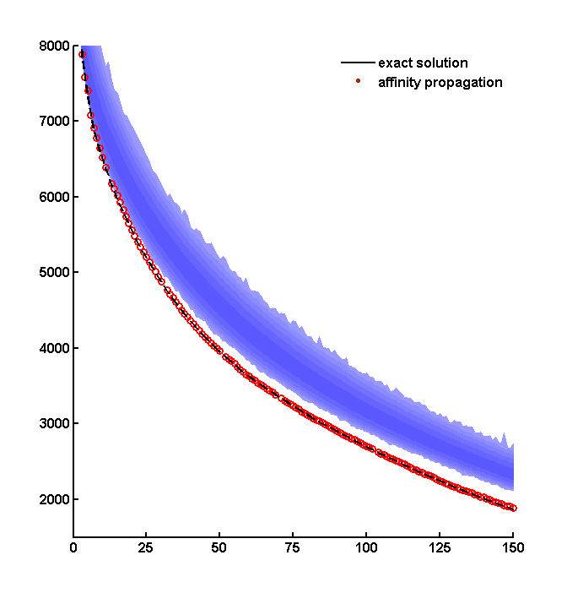
Olivetti faces: squared error achieved by Affinity Propagation
k-medians clustering, one million random restarts for each K
Squared error
Affinity propagation,
one run, 1000 times faster than 10⁶ k-medians runs
Exact solution
(using LP relaxation + days of computation)
Number of clusters, K

Slide 19
A survey of applications investigated by other researchers and developers
VQ codebook design, Jiang et al., 2007
Image segmentation, Xiao et al., 2007
Object classification, Fu et al., 2007
Finding light sources using images, An et al., 2007
Microarray analysis, Leone et al., 2007
Computer network analysis, Code et al., 2007
Audio-visual data analysis, Zhang et al., 2007
Protein sequence analysis, Wittkop et al., 2007
Protein clustering, Lees et al., 2007
Analysis of cuticular hydrocarbons, Kent et al., 2007
…

Slide 20
Affinity Propagation
Affinity Propagation:
Applications in Bioinformatics
Notes:
How are we going to do this?
With affinity propagation, an exciting clustering algorithm that I’ll spend a few minutes talking about.

Slide 21
Detecting transcripts (genes) using microarray data
(Data from Frey et al., Nature Genetics 2005)
DNA activity
Mouse
tissues
Low
High
…
Segment i
Segment k
Position in DNA
s(segment i, segment k) = Similarity of expression patterns (columns) minus distance between segments in the DNA/genome
s(segment i, garbage) = tunable constant
# segments = 76,000 for chromosome 1
Notes:
The first dataset I want to discuss is what actually motivated this research. We had a gene expression data set with 76000 DNA segments at sub-exon resolution, and expression profiles are measured across 12 mouse tissues. We want to cluster together areas of similar expression and those would might correspond to genes, and separate that from segments that don’t fit (i.e. come from a background model). Now 12 dimensions probably isn’t enough to get thousands of clusters out of the data, so we also include a term in the similarity that a data point’s exemplar must be within 100 segments – so this is a sparse 75000x75000 matrix with a band along the diagonal of width 200.

Slide 22
Detecting transcripts (genes) using microarray data
(Data from Frey et al., Nature Genetics 2005)
DNA activity
Mouse
tissues
Low
High
…
Segment i
Segment k
Position in DNA
-1.8
Affinity propagation
k-medians clustering
(10,000 runs)
40
-2.0
Random guessing
30
Gene reconstruction error
True positives (%) REFSEQ
-2.2
20
-2.4
10
-2.6
0
0
2000
4000
6000
8000
0
1
2
3
4
5
Number of clusters (“genes”)
False positive rate (%)

Slide 23
Application #2: Yeast gene-deletion strains
(presented at RECOMB 2008)
drugs
new drugs
Gene-drug interactions for 1259 drugs on 5985 genes
  Threshold to binary interaction matrix
GOAL: find small query set of genes on which new drugs could be tested to predict interactions for non-query genes
  Hold out 10% of drugs as test set
  s(i,k) = #drugs interacting with both gene i and gene j
?????????
?????????
?????????
?????????
yeast genes
query set
of genes
drugs
(training set)
drugs
(test set)
Notes:
The first application I want to describe was done on strains of yeast where you knock out one gene and then apply a drug or chemical and measure the response using TAG3 molecular barcode arrays.
***
First, we thresholded the matrix of z-scores to binarize it. It’s about 98% sparse (150,000 interactions of a possible 7.5million combinations)
***
So what we want to do is find a small query set of exemplar genes on which new drugs could be tested and predict interactions for all the other genes. That way we don’t need to perform 6000 experiments per drug.
***
So for cross-validation, what we did was use 90% of the drugs as a training set and hold out 10% as a test set. We made predictions (filled in the matrix) for that test set of drugs just by filling in the response of your exemplar gene (we don’t know each gene’s response, so we substitute it with its exemplar’s response).

Slide 24
Application #2: Yeast gene-deletion strains
net similarity
(interactions correctly predicted on training data)
Affinity Propagation
k-medians clustering (best of 10 restarts)
k-medians clustering (best of 100 restarts)
k-medians clustering (best of 1000 restarts)
k-medians clustering (best of 10,000 restarts)
k-medians clustering (best of 100,000 restarts)
K
(number of strain representatives)
Notes:
How did we do?
We’re directly maximizing the utility, which works out to be the number of interactions correctly predicted on training data.
Affinity Propagation outperforms the best of all those restarts of k-centers clustering
Affinity Propagation was compared with many random restarts of k-centers clustering
In all cases, AP took <5hr and k-centers took >3days

Slide 25
Application #2: Yeast gene-deletion strains
Affinity Propagation
k-medians clustering (best of 10 restarts)
k-medians clustering (best of 100 restarts)
k-medians clustering (best of 1000 restarts)
k-medians clustering (best of 10,000 restarts)
k-medians clustering (best of 100,000 restarts)
sensitivity
(proportion of interactions correctly
predicted in test data)
specificity
(proportion of non-interactions correctly predicted in test data)
Notes:
And if we look at sensitivity plotted as a function of specificity, affinity propagation comes out on top as well. One thing we noticed is that with a big dataset like this, the search space is highly non-convex so has a lot of local maxima. k-centers almost always finds singleton exemplar genes (that is, they have no cluster members) which is really bad for predictions.

Slide 26
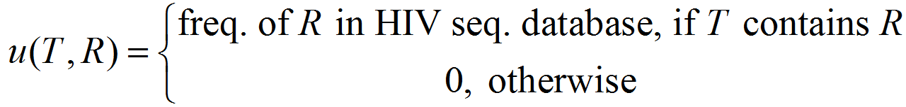
Application #3: HIV vaccine design
(presented at RECOMB 2008)
Some data points are potential treatments, T
  Correspond to HIV strain sequences
Other data points are targets, R, (sequence fragments)
  Correspond to epitopes that immune system responds to
· · ·
· · · MGARASVLSGGKLDKWEKIRLRPGGKKKYKLKHIVWASRELERF · · ·
· · · MGARASVLSGGELDRWEKIRLRPGGKKKYQLKHIVWASRELERF · · ·
· · · MGARASVLSGGELDRWEKIRLRPGGKKKYRLKHIVWASRELERF · · ·
· · ·
GARASVLSG
LSGGKLDKW
RASVLSGGE
LDKWEKIRL
RPGGKKKYR
ASVLSGGEL
PGGKKKYQL
ARASVLSGG
PGGKKKYRL
DKWEKIRLR
RASVLSGGK
KWEKIRLRP
GGKKKYQLK
EKIRLRPGG
ASVLSGGKL
GGKKKYRLK
SVLSGGELD
WEKIRLRPG
KKKYQLKHI
KIRLRPGGK
GKKKYQLKH
VLSGGELDR
GKKKYRLKH
SVLSGGKLD
LSGGELDRW
KKYQLKHIV
IRLRPGGKK
VLSGGKLDK
LKHIVWASR
SGGELDRWE
KKKYKLKHI
MGARASVLS
RLRPGGKKK
RPGGKKKYQ
KHIVWASRE
KKYKLKHIV
KYQLKHIVW
LRPGGKKKY
KLDKWEKIR
GGELDRWEK
KKKYRLKHI
SGGKLDKWE
HIVWASREL
GELDRWEKI
KYKLKHIVW
KKYRLKHIV
RPGGKKKYK
GGKLDKWEK
IVWASRELE
ELDRWEKIR
YKLKHIVWA
KYRLKHIVW
PGGKKKYKL
VWASRELER
KLKHIVWAS
GKLDKWEKI
LDRWEKIRL
YRLKHIVWA
GGKKKYKLK
WASRELERF
GKKKYKLKH
YQLKHIVWA
DRWEKIRLR
RLKHIVWAS
QLKHIVWAS
RWEKIRLRP
s(T,R)
Notes:
Our second example involves HIV vaccine cocktail design.
We’re trying to find a good set of HIV strains for the purpose of priming the immune systems of many patients; so these strains are the treatments, T. There were 1755 of them, which we got from the Los Alamos National Labs database.
***
The targets are sequence fragments (9-mers) corresponding to the epitopes that immune systems respond to. We extracted these patches from the 1755 strains in the treatments set, so T ≠ R here.
***
Ideally, we’d set the utility of each treatment for each target to be its potential for immunological protection, but we approximate this by setting it to the frequency of the target in the database (and 0 if T doesn’t contain R, thus offering no protection because it’s not present).

Slide 27
Application #3: HIV vaccine design
The net similarity of a vaccine portfolio is its coverage
  Fraction of database 9-mers the vaccine contains
  Highest-possible coverage comes from artificially-constructed strains
  e.g. Mosaics (Fischer et al., Nature Medicine 2006 )
vaccine portfolio size | Natural strains |  | Artificial Mosaic strains (upper bound)
 | Affinity Propagation | greedy method (k-medians variant)
K=20 | 77.54% | 77.34% | 80.84%
K=30 | 80.92% | 80.14% | 82.74%
K=38 | 82.13% | 81.62% | 83.64%
K=52 | 84.19% | 83.53% | 84.83%
Notes:
If we express these quantities as ratios, net utility will correspond to something known as “coverage” i.e. What proportion of the epitopes appear in your vaccine.
We compare affinity propagation’s performance with a greedy method like k-centers and then with artificially-derived strains called mosaics using an algorithm described in Nature Medicine by Fischer et al.
Not surprisingly, artificial mosaic strains have the highest coverage (because you’re not limited to the strains in the treatment set, T), but affinity propagation does substantially better than the greedy method (getting performance about half-way between it and mosaic).

Slide 28
Summary
Exemplar-based clustering offers flexibility in choosing similarities between data points
  e.g. non-Euclidean, discrete, or non-metric data spaces
Affinity Propagation achieves better clustering solutions than other methods
  number of exemplars, K, is automatically determined
  simple update equations, easy implementation
  Fast: # binary scalar operations ∝ # input similarities
Many applications in bioinformatics
  Microarray data, yeast gene-deletion strains, HIV vaccine design

Slide 29



Acknowledgements
Affinity Propagation (www.psi.toronto.edu/affinitypropagation)
Brendan J. Frey
(Electrical & Computer Engineering, University of Toronto)
Detecting transcripts (genes) using microarray data
Tim Hughes + lab
(Banting & Best Department of Medical Research, University of Toronto)
Yeast gene-deletion strains:
Andrew Emili, Gabe Musso, Guri Giaever
(Banting & Best Department of Medical Research, University of Toronto)
HIV vaccine design:
Nebojsa Jojic, Vladimir Jojic
(Microsoft Research)
Funding for this work provided by:

Slide 30
Affinity Propagation
QUESTIONS?
Notes:
How are we going to do this?
With affinity propagation, an exciting clustering algorithm that I’ll spend a few minutes talking about.

Slide 31
Affinity Propagation
Notes:
How are we going to do this?
With affinity propagation, an exciting clustering algorithm that I’ll spend a few minutes talking about.

Slide 32
Comparison of affinity propagation, linear programming, the VSH and k-medians clustering
(400 Olivetti face images)
Linear program (exact)
medians
(k)

Slide 33
Error and timing comparison of affinity propagation and the VSH
(Results from Brusco & Kohn and Frey & Dueck)

Slide 34
Selecting the “right” number of centers
Preferences influence the number of detected centers
Does affinity propagation find the proper number of centers? Yes.

