Slide 1

Teachers Encourage Students in Computer Science
Columbia University July 8, 2011

Slide 2
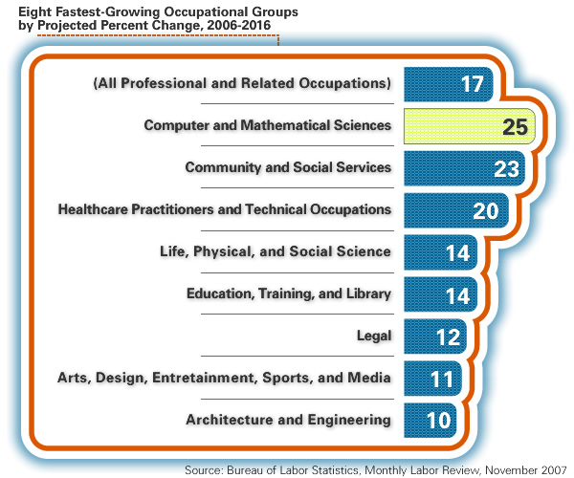
Computing Jobs Are among the Fastest-growing
Notes:
2

Slide 3
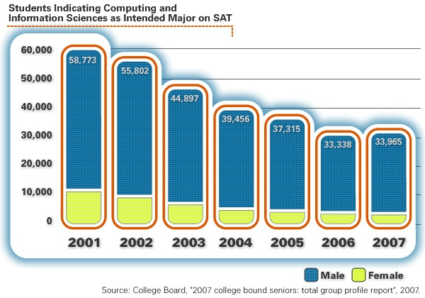
Meanwhile, Interest Has Been Declining
Notes:
3

Slide 4
The Statistics for Girls’ and Women’s Participation in CS Are Particularly Alarming
Girls comprise fewer than 15 percent of all AP computer science exam-takers: the lowest representation of any AP discipline.
Between 1984 and 2007, the share of computer science bachelor’s degrees awarded to women dropped from 36 to 19 percent.
Women hold more than half of professional positions overall, but fewer than 22 percent of software engineering positions.
Within the top Fortune 500 IT companies, fewer than five percent of Chief Technical Officers are women.
Women hold fewer than 5 percent of IT patents, contribute less than 2 percent of open source software, and start fewer than 5 percent of IT companies.
Sources: College Board, 2007; NCES, 2007; Dept. of Labor BLS, 2006; Catalyst, 2007; NCWIT, 2007; FLOSSPOLS, 2006; Center for Women’s Business Research, 2006.
Notes:
Let me put these numbers into perspective:
Women earned 45% of math degrees last year, 55% of biochemistry degrees, and nearly 60% of undergraduate degrees overall. But only 19% of CIS (Computer and Information Science) degrees. Women hold only 27 percent of computing-related jobs, despite comprising more than half of the professional workforce. Women start more than half of all new businesses, but only 5% of IT businesses.
4

Slide 5





The NCWIT Alliances
To Join the K-12 Alliance, email info@ncwit.org

Slide 6
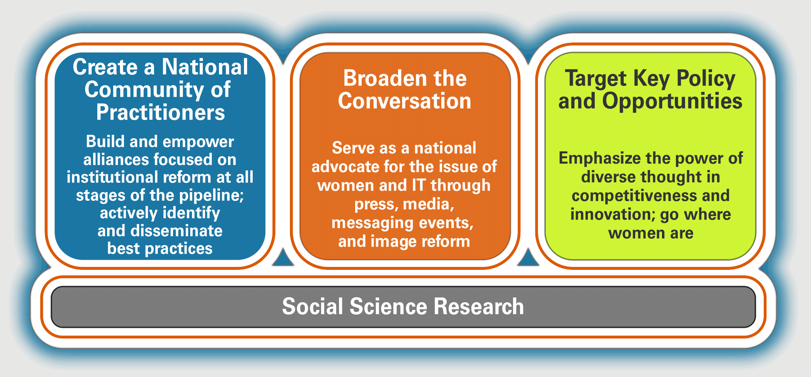
NCWIT Has a Three-Pronged Strategy for Change

Slide 7
NCWIT Resources for K-12
        Gotta Have It An all-in-one computing resource kit for educators.
        Includes high quality posters, computing career information, digital media and more!
        Builds awareness and inspires interest in computing in all students, but is especially inclusive of girls.
        more…www.ncwit.org

Slide 8
How many girls and underrepresented minorities do you know who are interested in Computer Science or Engineering?

Slide 9
Why Computer Science? Why Teachers?
Why high school girls are often not drawn into computer science:
  Few computer science opportunities exist in high school and when they do exist, they are often of uneven quality and are not integrated into the curriculum
  Negative preconceived notions of what computer scientists actually do
  Negative classroom experiences of women and minorities who do take computer science in high school which can result in social isolation and insecurity;
  A failure “to provide a compelling context and motivation for learning computer science.”
  These findings also hold true for underrepresented male students.
  Goode, Estrella & Margolis (2006)

Slide 10
Teachers are Key!
Most frequently cited high school factors indentified as assisting girls in deciding on pursuing a degree in engineering:
Did well in classes related to math/science/technology – 90%
Excellent math/science/technology teachers – 73%
Teachers who encouraged me to purse my interest in math/science/technology – 55%
Participation in extracurricular activities (i.e. math/science olympiad) – 26%
(Source: Wentling, R.M. & Camacho, C (2008) Women Engineers: Factors and Obstacles Related to the Pursuit of a Degree in Engineering)

Slide 11
Students say it too…
In a recent survey of engineering students,
61.2% of women surveyed said they consulted a teacher or guidance counselor in their decision to major in engineering

Slide 12
What Do High School Girls Think?
Engineering is for people who LOVE both math and science
Don’t know what engineering is
Aren’t interested in the field nor do they think it is “for them.”
“Someone who excels in math and science....Likes working out problems and working with other people.... Someone who is motivated, dedicated, and who doesn’t mind sitting in a
cubicle all day.”

Slide 13
What Do High School Girls Hear?
Engineering is stressful and challenging
You have to have SUPERIOR math and science abilities
“It’s not easy—but if you’re the type who when faced
with a problem some would call impossible is even
more driven to move mountains to find a solution, then
you might have it in you to be an engineer.”

Slide 14
Disconnect Between What Girls Want and What We Say!

Slide 15
Why Girls Enroll in CS Classes
Computing is useful in many fields
They have talent in and enjoy math
They have been personally encouraged by parents, teachers or friends
They enjoy problem solving
They see great job opportunities
Friends are taking the course
They enjoyed and succeeded in an earlier course
(From Margolis & Fisher (2003) Unlocking the Clubhouse)
Notes:
Why they don’t enroll
Courses are taught in a dry, abstract style focused on language details rather than applications
The classroom environment is unfriendly to girls
The course has too few girls
The course has a geeky reputation, and girls do not want to be associated with that image or with people in the class
They fear they know less than others, and some of the boys reinforce that fear
Guidance counselors or parents actively or passively discourage girls from taking computer science
They fear ruining their GPAs
They have broad interests that result in scheduling conflicts since computer science courses are often taught only in one time slot
They subscribe to the stereotype that computing is an all male activity
They find the games that are pervasive in the computer culture boring

Slide 16


What is Computer Science?
Using CS we can develop technologies to
- communicate
- solve problems
- design and imagine
- share, store, retrieve or manipulate information
It is the "brains" behind things like Google, Facebook, iPhone, and Amazon.
    Where do you see information technologies in use every day?

Slide 17
What Can You Do?
Deliberately focus on recruiting girls – recruit “friendship circles” and “recruit a posse”
Recruit at girls’ sports banquets
Have girls recruit other girls
All-Girl Computing events
Share what you learn with others
Encourage girls in computing!
Nominate a girl for the NCWIT Award for Aspirations in Computing

Slide 18
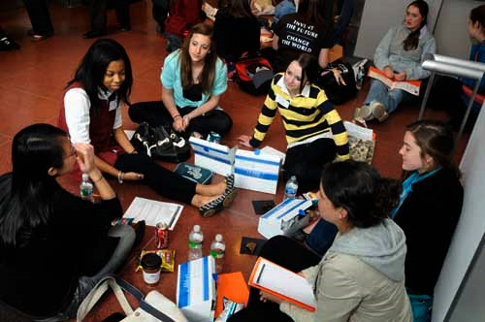
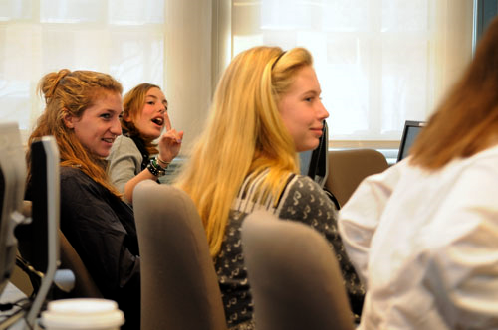
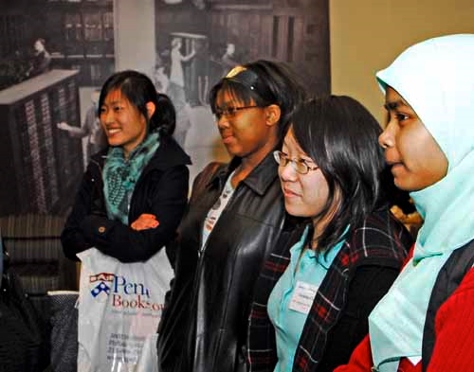
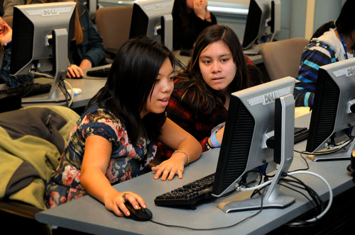
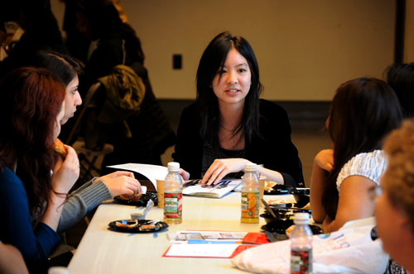
Recruit a Posse

Slide 19
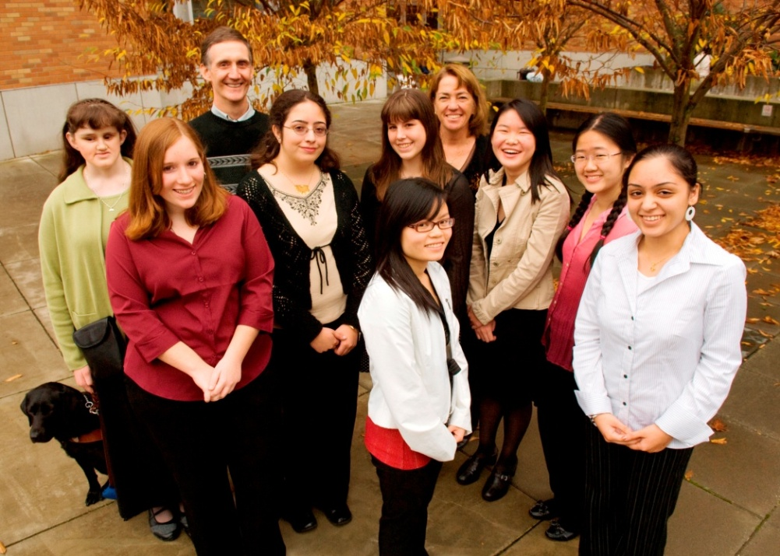
Broadening the Conversation:
NCWIT Award for Aspirations in Computing
Sponsored by Bank of America, the NCWIT Award for Aspirations in Computing recognizes young women at the high-school level for their computing-related achievements and interests.
We are looking for the next generation of technical talent.
National and Regional awards!
Award winners receive cool prizes, gadgets, scholarships and all girls can join a community of fellow technically-inclined young women. Like us on Facebook to stay informed. Applications are accepted 9/15-10/31.
http://www.ncwit.org/work.awards.aspiration.html

Slide 20
Dispel These Myths!
You need to have programmed in high school to pursue computer science in college
A computer science degree leads only to a career as a programmer
Programming is a solitary activity
Employment continues to be in decline
Eventually, all the programming jobs will be overseas
Computer science lacks opportunities for making a positive impact on society
There’s nothing intellectually challenging in computer science
There have been no recent breakthroughs in computer science
Computer science lacks compelling research visions
(From Ed Lazowska, Bill & Melinda Gates Chair in Computer Science & Engineering University of Washington)

Slide 21


