Slide 1
Cellular Networks and Mobile Computing
COMS 6998-8, Spring 2012
Instructor: Li Erran Li (lel2139@columbia.edu)
http://www.cs.columbia.edu/~coms6998-8/
Lecture 12: Mobile Security

Slide 2
Mobile Security
Inter application communication related
  Permission re-delegation
  other inter app attacks
    ComDroid detection tool
Rootkits

Slide 3
Permission Re-delegation:
Attacks and Defenses
Adrienne Porter Felt¹, Helen J Wang², Alexander Moshchuk², Steve Hanna¹, Erika Chin¹
¹University of California, Berkeley
²Microsoft Research

Slide 4
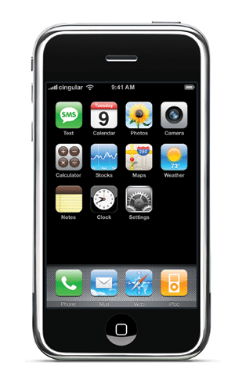
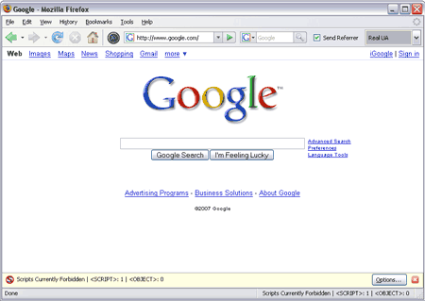
modern client platforms
Applications are untrusted, or partially trusted
  Isolated from each other, except for IPC
  By default, denied access to private devices and data
Users explicitly grant permissions for devices, data
Each application may have its own set of permissions
Courtesy: Felt et. al

Slide 5
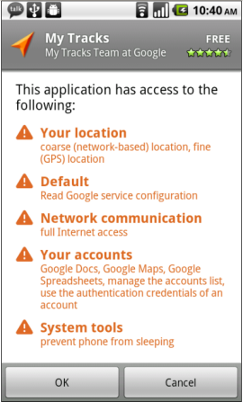
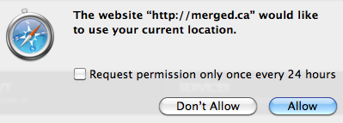
permissions
Android, iOS, HTML5, browser extensions…
Courtesy: Felt et. al

Slide 6
permission re-delegation
Permission re-delegation occurs when an application without a permission gains additional privileges through another application
A special case of the confused deputy problem
  Privilege obtained through user permissions
Courtesy: Felt et. al
Notes:
We have client platforms with both per-application permissions and application communication. A privileged application that accidentally or carelessly provides a public interface can provide a path for another application to access a protected resource without the appropriate permission. We call such an attack a permission re-delegation attack.

Slide 7
Demo malware
pressButton(0)
Settings
toggleWifi()
Permission System
API
Courtesy: Felt et. al

Slide 8
Outline
Threat model
Permission re-delegation is a real problem, and
systems should not permit permission re-delegation
We propose IPC Inspection as a defense mechanism
Courtesy: Felt et. al

Slide 9


The permission system
Permission system enforces user’s permission policy
Malware
Deputy
toggleWifi()
toggleWifi()
Permission System
API
Courtesy: Felt et. al
Notes:
The purpose of this slide is to help assert that a system-enforced mechanism is better than a developer-enforced mechanism

Slide 10
The deputy
Has user authorization
Not malicious, but not a security watchdog
Exposes public services Confused? Careless?
Malware
Malware
Deputy
toggleWifi()
Permission System
API
Courtesy: Felt et. al

Slide 11
The attacker
User installs/runs it, but doesn’t trust it
Exploits a deputy to access a resource
Malware
Malware
pressButton(0)
Deputy
toggleWifi()
Permission System
API
Courtesy: Felt et. al

Slide 12
Real world permission re-delegation attacks
Android case study,
precautionary for the future of the web
Courtesy: Felt et. al

Slide 13
Identifying candidates
Two necessary preconditions for an attack:
  Has a dangerous permission
  Has a public interface
Analyzed manifests of 872 Android applications
  16 system apps, 756 most popular, 100 recently uploaded
320 apps (37%) are candidates for attacks
Courtesy: Felt et. al

Slide 14
Finding exploits
Built tool for finding attacks
Call graph analysis:
find paths from public entry points to protected API calls
Manually verified all exploits
Public
entry points
API calls
Courtesy: Felt et. al
Notes:
Disassembled applications
Built the call graph
Looked for paths from public entry points to dangerous API calls
Mention that it’s for “proof of concept” – this is why we do not provide either a false positive or false negative analysis

Slide 15
attacks
Built attacks using 5 of the 16 system apps
Found 15 attacks in the 5 applications
Several confirmed and fixed
This is a lower bound; likely more exist
Courtesy: Felt et. al

Slide 16
Attack on the settings app
Demo malware
Message:
0://0#0
User pressed button[0]
Settings
com.android.settings.widget.
SettingsAppWidgetProvider
wifiManager.setWifiEnabled(true)
Permission System
API
Courtesy: Felt et. al

Slide 17
More example attacks
DeskClock:
  Start an internal service
  Tell it to infinitely vibrate with a WAKE_LOCK on
Phone:
  Trigger the “phone call answered” message receiver
  Phone call will be silenced, vibrate cancelled
Courtesy: Felt et. al
Notes:
Also attacks in the Music player and Launcher applications

Slide 18
Preventing permission re-delegation
Courtesy: Felt et. al

Slide 19
Our goals
We don’t want to rely on application developers for prevention
Enable the system to prevent permission re-delegation
We don’t want to break applications
Courtesy: Felt et. al
Notes:
Developers can’t be trusted to prevent these types of attacks. They make mistakes! As we just showed, a third of the built-in Android system applications have these attacks – and those apps were written by Google Android engineers, who are probably among the best developers out there.
If you don’t want to place the responsibility on a system, you’ll get a very different looking defense mechanism. The next talk from Rice presents such a system.

Slide 20
IPC Inspection
When a deputy receives a message, system reduces deputy’s permissions (for the session) to:
{requester’s permissions} {deputy’s permissions}
A deputy’s current set of permissions captures its communication history
Deputy can specify who can(not) send it messages
Generalizes stack inspection to IPC calls
Courtesy: Felt et. al
Notes:
Say that we are focused on preventing access to API calls, not tracking the resulting data

Slide 21
Handling a potential attack
Time-of-use system
  Add a new runtime prompt for permission re-delegation
Install-time system
  Requester must statically ask for necessary permissions
  Permission re-delegation is simply blocked at runtime
Courtesy: Felt et. al
Notes:
When I say “prevent permission re-delegation”, I don’t mean that I want to stop applications from communicating with each other. Instead, our goal is to keep the decision of what applications have what permissions in the user’s hands.

Slide 22
Application instances
Deputy might need to service user and multiple app requesters simultaneously
Solution: create one instance per request
  User interacts with primary instance
  When new interaction starts, create a new “application instance”
  Each instance has its own set of current permissions
  However, instances share app storage, etc.
Courtesy: Felt et. al

Slide 23
implementation
Android implementation: modify PackageManager, ActivityManager
  PackageManager installs applications, stores permissions, enforces permission requirements
  ActivityManager notifies PackageManager when relevant events happen, e.g. starting Activity, receiving Broadcast Intent
A few hundred lines of code
Courtesy: Felt et. al

Slide 24
evaluation
Do we break applications?
Do we stop attacks?
Courtesy: Felt et. al

Slide 25
Broken applications
20 Android applications
Developers might need to make changes to these applications:
Intentional Deputy | 5 applications (25%)
Requester | 6 applications (30%)
One application is both an intentional deputy and a requester
Of those requesters:
2 of 6 requesters (10% of apps) need to add permissions
Courtesy: Felt et. al
Notes:
20 randomly selected applications

Slide 26
Effectiveness at Attack prevention
20 Android applications
IPC Inspection prevents these from being exploited:
Unintentional Deputy | 4 applications (20%)
Also stops all the attacks on the built-in system applications
Courtesy: Felt et. al
Notes:
20 randomly selected applications

Slide 27
Conclusion
Real world permission re-delegation vulnerabilities exist
  A third of Android system applications contain permission re-delegation attacks
Future systems should be designed to prevent permission re-delegation
IPC Inspection: an OS mechanism that prevents permission re-delegation
  Install-time: some requesters will need to add permissions
Courtesy: Felt et. al

Slide 28
Analyzing Inter-Application Communication in Android
Erika Chin
Adrienne Porter Felt
Kate Greenwood
David Wagner
UC Berkeley

Slide 29

Inter-Application Communication
Yelp App
Eavesdropping Attacks
Injection Attacks
Inter-Application Communication
Other App
Maps App
Dialer App
Malicious App
Courtesy: Chin et. al
Notes:
Inter-application communication is designed to promote the development of complex applications. Specifically, it eases developer burden by allowing them to re-use existing data and services from other applications.
Let’s look at the Yelp application. The Yelp app allows users to search for restaurants and browse reviews, and it also allows users to call or find directions to the restaurant. Instead of implementing the latter two features, the Yelp application sends a request to the dialer app asking it call the restaurant and sends a request to the maps app asking it to show directions to the restaurant. And Yelp may also allow other apps to use its review service. All this communication gives the appearance of having one seamless, multi-functional application, when in fact, multiple applications are being used.
We performed a security analysis of this communication space and found that apps can be vulnerable to attack through communications. A malicious application can attack outgoing communication via various eavesdropping attacks and it can attack incoming communication via injection attacks.

Slide 30
Organization
Android communication model
Security analysis of Android
ComDroid
Analysis of third-party applications
Recommendations
Courtesy: Chin et. al

Slide 31

Android Overview
Intents = Android IPC
Applications are divided into components
Intents can be sent between components
Intents can be used for intra- and inter-application communication
Sender
Receiver
Intent
Courtesy: Chin et. al
Notes:
Applications can communicate between one another through Intents. Intents can basically be thought of as messages. Applications are divided into components and Intents can be sent between components. Furthermore, Intents can be sent between components within an app and also between components in different apps – so the same mechanism is used for both intra- and inter-application communication.

Slide 32
Explicit Intents
Name: MapActivity
Map
App
Yelp
To: MapActivity
Only the specified destination receives this message
Courtesy: Chin et. al
Notes:
There are two types of Intents: explicit Intents and implicit Intents. Explicit Intents are Intents where the sender specifies the recipient by name.
In this example, the Yelp app may want use a specific application to display maps. To do this, Yelp can address the Intent explicitly with that map app’s name. Sending this Intent will then launch that map application.
It is important to note, only the specified destination receives this message.

Slide 33
Implicit Intents
Handles Action: VIEW
Map
App
Yelp
Handles Action: DISPLAYTIME
Clock
App
Implicit Intent
Action: VIEW
Courtesy: Chin et. al
Notes:
The second type of Intents are implicit Intents. These are messages w/o explicit destinations; instead the developer specifies an “action” in the message and leaves it up to the system to determine which component is most suited to handle the message based on that action.
Actions are meant to describe the general requirements of Intent, so that an application (e.g. Yelp) does not need to know what other apps are installed. Actions specify what the receiving component should do. Some common actions include VIEW and EDIT, but the action can really be any string created by the developer.
In this example, Yelp sends an implicit Intent with the VIEW action. The system then looks at the receiving components, and in this case, there is only one component that can handle the VIEW action. So this message is delivered to the Map application.

Slide 34
Implicit Intents
Handles Action: VIEW
Map
App
Yelp
Handles Action: VIEW
Browser
App
Implicit Intent
Action: VIEW
Courtesy: Chin et. al
Notes:
In some cases, there may be more than one application that can handle the action, so, depending on the type of the component, either the user will be prompted to choose the receiving app or the system will decide which application will receive the Intent. In this example, the system might send the Intent to the Browser app.
To recap: Explicit Intents should be used when the developer has a specific receiving component in mind. Implicit Intent should be used when the developer just needs some component that handles a general task.

Slide 35
Security Analysis Of Android
Courtesy: Chin et. al
Notes:
Now that I’ve given you an overview of intents, I’ll discuss a few examples of the attack surfaces that we identified in the communication model.
I’ll start by showing an example of a common developer mistake and then show how that can lead to an attack. I’ll explain these in the context of some of the real vulnerabilities we found in existing apps as a result of our manual analysis on applications (which I’ll explain later when I discuss our tool).

Slide 36
Common Developer Pattern:
Unique Action Strings
IMDb App
Handles Actions: willUpdateShowtimes,
showtimesNoLocationError
Showtime
Search
Results UI
Implicit Intent
Action: willUpdateShowtimes
Courtesy: Chin et. al
Notes:
One common pattern we’ve seen developer use are to send implicit Intents between internal components. To do this, they send an implicit Intent with a unique action string, and expect that their own internal receiving component is the only one that can handle that action.
Let’s take the IMDb app for example. This app has a feature where the user can get the showtimes for movies in the area. To do this, the app has a component, Showtime Search, that sends information and requests to the component, Results UI, which then updates the user’s screen. The display will either update with the latest showtimes or return that there are no shows available.

Slide 37

Courtesy: Chin et. al
Notes:
This is an example of what the user might see when the message is sent. The user sees a list of the movie showtimes in the area.

Slide 38
Common Developer Pattern:
Unique Action Strings
IMDb App
Handles Actions: willUpdateShowtimes,
showtimesNoLocationError
Showtime
Search
Results UI
Implicit Intent
Action: willUpdateShowtimes
Courtesy: Chin et. al
Notes:
Instead of sending a direct, explicit Intent between the components, the developer chose to send an implicit Intent,
making both the Intent and the receiver public. This creates two vulnerabilities in the application.

Slide 39
ATTACK #1: Eavesdropping
IMDb App
Eavesdropping App
Handles Action: willUpdateShowtimes,
showtimesNoLocationError
Showtime
Search
Malicious Receiver
Implicit Intent
Action: willUpdateShowtimes
Sending Implicit Intents makes communication public
Courtesy: Chin et. al
Notes:
The first attack exploits a weakness on the sending side. The problem is that the IMDb is sending an Implicit intent to be resolved by the system - which means it can potentially be seen by any application. All a malicious app needs to do is declare that it can handle the same action as the Intent and it may receive the Intent.
In the case of the IMDb app, the attacker can find that the user is 1) using the IMDb app and 2) looking for showtimes. If the Intent contains any additional data, the attacker can also steal that.
Sidenote: We’ve also seen unique actions strings used in other apps. Another example is a bus application that gives the user information on where the bus is and when it will arrive. In that app, an attacker can eavesdrop on the bus request and determine the user’s location. This is a clear privacy violation.

Slide 40
ATTACK #2: Intent Spoofing
Malicious Injection App
IMDb App
Handles Action: willUpdateShowtimes,
showtimesNoLocationError
Malicious Component
Results UI
Action: showtimesNoLocationError
Receiving Implicit Intents makes the component public
Courtesy: Chin et. al
Notes:
The second attack exploits a vulnerability on the receiving side. The problem is that the developer is publically exposing the receiving component. To be able to receive the implicit Intent, the receiver component is also made public to all applications. This means that any application can send messages to the component either explicitly or implicitly. And thus it is vulnerable to an intent spoofing attack.
In the IMDb example, a malicious app could inject an Intent into the results UI by sending an implicit or explicit Intent. If the malicious application sends the NoLocationError action, the receiver would report that no showtimes were found.

Slide 41
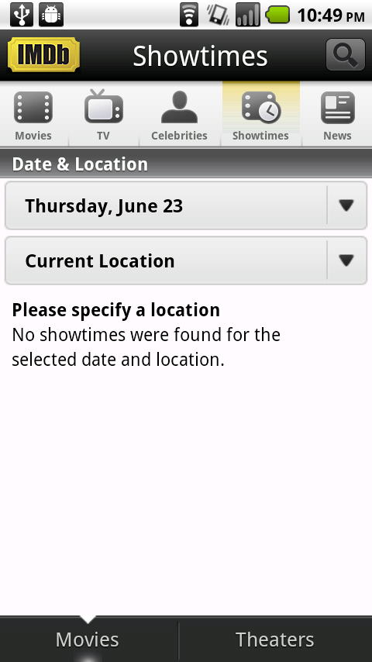
Attack case
Typical case
Courtesy: Chin et. al
Notes:
Instead of seeing a display like the one on the left (the showtimes of movies in the error), the user would see no information (on the right), resulting in a denial of service.

Slide 42
ATTACK #3: Man in the Middle
IMDb App
Man-in-the-Middle App
Handles Action: willUpdateShowtimes,
showtimesNoLocation Error
Handles Action: willUpdateShowtimes,
showtimesNoLocationError
Showtime
Search
Results UI
Malicious Receiver
Action: willUpdateShowtimes
Action: showtimesNoLocation
Error
Courtesy: Chin et. al
Notes:
The third attack exploits both vulnerabilities. IMDb’s message can get intercepted by a malicious man-in-the-middle, and the malicious app can then send a different message (like the NoLocationError) to the legitimate Results UI.
Other attacks you could imagine would be for a man-in-the-middle to consistently delete one of his competitor’s movie entries or only display a movie that the attacker wants to promote.
Going back to the bus application, an attacker can eavesdrop on the bus request and inject fake bus information, potentially making the user wait for a bus that never arrives.
Recap: Using unique actions strings for internal communication results in two vulnerabilities – one on the sending side and one of the receiving side. It exposes the message and also the receiving component. The developer used public communication when direct, explicit communication between the two components would have been safer.

Slide 43
ATTACK #4: System Intent Spoofing
Background – System Broadcast
  Event notifications sent by the system
  Some can only be sent by the system
Receivers become accessible to all applications when listening for system broadcast
Courtesy: Chin et. al
Notes:
Now we present another attack with a new example: System Intent spoofing. This is a special case of the Intent Spoofing attack (the 2nd attack we presented).
System broadcasts are event notifications sent by the system. Events can include: battery_low, power_disconnected, boot_completed, etc. Some of these events can only be sent by the system. The problem here is that receivers listening for the system broadcast are made accessible to all applications.

Slide 44
System Broadcast
App 1
Component
Handles Action: BootCompleted
System
Notifier
App 2
Component
Handles Action: BootCompleted
App 3
Action:
BootCompleted
Component
Handles Action: BootCompleted
Courtesy: Chin et. al
Notes:
In the typical case, when an event occurs, the system notifier broadcasts an implicit Intent with that system action. All the applications that registered to receive notice of that event will receive the implicit Intent containing the BootCompleted system action.
As I stated earlier, only the system can send an implicit Intent with this action.

Slide 45
System Intent Spoofing: Failed Attack
Malicious App
App 1
Handles Action: BootCompleted
Malicious
Component
Component
Action: BootCompleted
Courtesy: Chin et. al
Notes:
How could an attacker attack this receiver? You may think, “This is like the earlier spoofing attack. The attacker can send an implicit Intent with the BootCompleted action.” But, no. In this case, the attacker cannot send an implicit action containing the BootCompleted action -- the system has a blacklist of actions that an application cannot send and system broadcast actions are on that list.

Slide 46
System Intent Spoofing: Successful Attack
Malicious App
App 1
Handles Action: BootCompleted
Malicious
Component
Component
To: App1.Component
Courtesy: Chin et. al
Notes:
However, the attacker can still mount an attack. By registering for the action, the app is made globally visible to all applications (public). Recall that we have two types of Intents: implicit Intents and explicit Intents. The receiver can receive any sort of message if it is sent explicitly. The malicious app can directly address an Intent to the App 1. If the receiving app does not check for a specific action type, then the malicious app can inject the message. Depending on what the receiving component does, the malicious app may be able to inject information, change state of the application, and it some cases launch other private components in the application that shouldn’t be accessible to other applications.

Slide 47
Real World Example: ICE App
ICE App: Allows doctors access to medical information on phones
Contains a component that listens for the BootCompleted system broadcast
On receipt of the Intent, it exits the application and locks the screen
Courtesy: Chin et. al
Notes:
What can really happen with this vulnerability? We present an example of a real world example of the system Intent spoofing: the ICE App.
ICE stands for In Case of Emergency. A user can input their medications, allergies, medical conditions, etc. and in case of an emergency, doctors can get access to the user’s medical information through the phone.
This application contains a component that listens for the BOOTCOMPLETED system broadcast. On receipt of the Intent, it closes any app and locks the screen.

Slide 48

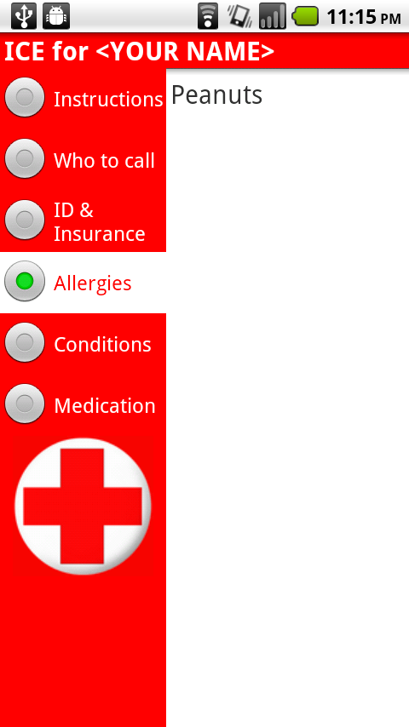
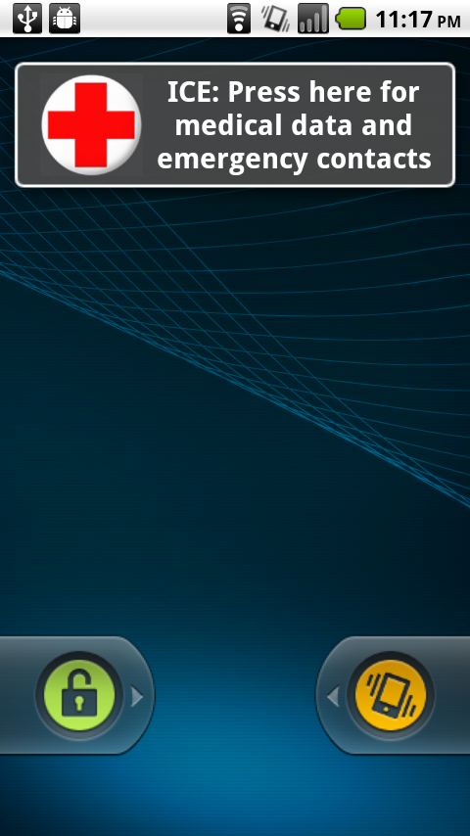
Real World Example: ICE
Courtesy: Chin et. al
Notes:
This receiver is always listening in the background, so regardless of the application, the attacker can close the application and lock the screen.
This application can be attacked in a couple ways:
The attacker can constantly send the explicit message to the receiver, keeping the phone locked at all times.
The attacker can target the ICE application. When the user is accessing the ICE app, the attacker can send the explicit message, causing the application to close and the screen to lock. This results in a denial of service – potentially when the user needs the information the most.
Insidious attack: The attacker can target another application. It can detect when the application is being used and send the Intent only when the user is in that app, making it appear like that app is the failing app. This could lead the user to blame the app and uninstall it erroneously.
You can read the paper for more attacks types and recommended solutions.

Slide 49
ComDroid
Security Warnings for Exposed Communication
Android Executable File
ComDroid
ComDroid analyzes applications to detect Intent-based attack surfaces
Courtesy: Chin et. al
Notes:
We present ComDroid, a tool that analyzes applications to detect Intent-based attack surfaces. ComDroid takes Android executable files as input -- no source code is needed. This means that not only can this tool be used by developers, but it can also be used by end users and third-party reviewers.
ComDroid outputs security warnings for exposed communication.

Slide 50
Evaluation
Manually verified ComDroid’s warnings for 20 applications
60% of applications examined have at least 1 exploitable IPC vulnerability
Type | # of Warnings | # of Apps
Severe Vulnerability | 34 | 12
Bad Practice | 16 | 6
Spurious Warning | 6 | 6
Courtesy: Chin et. al
Notes:
We ran ComDroid on the top 100 free and paid applications and manually verified ComDroid’s warnings in 20 of these apps.
60% of applications we examined have at least 1 exploitable IPC vulnerability. This shows that these are prevalent vulnerabilities and are a serious threat to application security.
A couple other stats:
34 warnings (in 12 apps) were found to be severe vulnerabilities. We define severe vulnerabilities to mean vulnerabilities that expose data or functionality that can be detrimental to the user (ex. Resulting in payment to the attacker, break expected and crucial functionality application, dos, etc.).
16 warnings showed components or Intents that exhibited bad practices. They may not result in severe vulnerabilities, but they can be exploited and show a clear developer misunderstanding of Intent. This communication is unintentionally exposed.
6 warnings were spurious warnings introduced by our tool.
We also did an analysis on the full 100 apps and you can look in the paper for more details.

Slide 51
Recommendations
Treat inter- and intra-application communication as different cases
Prevent public internal communication
  21% of severe vulnerabilities
  63% of bugs due to bad practice
Verify system broadcasts
  6% of severe vulnerabilities
  13% of bugs due to bad practice
Can be fixed by either developers or platform
Courtesy: Chin et. al
Notes:
The fundamental problem is that Android’s IPC mechanism is complex and difficult for developers to use safely. There are a lot of side effects to developer design decisions and unfortunately, Android documentation does not help developers avoid these problems.
We propose that inter- and intra-application communication be treated as different cases. Preventing public internal communication (unique action string use) would reduce 21% of the severe vulnerabilities and 63% of bugs due to bad practices. Verifying system broadcasts (system Intent spoofing) would reduce 6% of severe vulnerabilities and 13% of bugs due to bad practices.
Either of these can be fixed by either application developers or platform developers. Admittedly, platform changes might be more effective.

Slide 52
Conclusion
Applications may be vulnerable to other applications through Android Intent communication
Many developers misuse Intents or do not realize the consequences of their program design
60% of applications examined had at least 1 vulnerability
ComDroid tool to be publically accessible soon at
www.comdroid.org
Courtesy: Chin et. al

Slide 53

Rootkits on Smart Phones:
Attacks, Implications and Opportunities
Jeffrey Bickford, Ryan O’Hare, Arati Baliga, Vinod Ganapathy,
and Liviu Iftode
Department of Computer Science, Rutgers University
Notes:
Say who authors are
Bold my name – joint work with

Slide 54



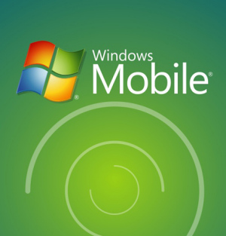


Smart Phone Operating Systems
Complexity comparable to desktops
OS | Lines of Code
Linux 2.6 Kernel | 10 million
Android | 20 million
Symbian | 20 million
Courtesy: Bickford et. al
Notes:
Smart phone operating systems are becoming increasingly complex. From the tables we can see that some OSes are on the order of 20 million lines of code.

Slide 55

The Rise of Mobile Malware
spreads via Bluetooth
drains battery
Receive message via Bluetooth?
Yes No
Cabir
2004
Courtesy: Bickford et. al
Notes:
Various other malware that then spread by MMS, Bluetooth and memory card.

Slide 56

The Rise of Mobile Malware
first J2ME malware
sends texts to premium numbers
RedBrowser
2004
2006
Courtesy: Bickford et. al

Slide 57

The Rise of Mobile Malware
Kaspersky Labs report:
  106 types of mobile malware
  514 modifications
2004
2006
2009

Slide 58
Contributions
Introduce rootkits into the space of
mobile malware
Demonstrate with three proof-of concept
rootkits
Explore the design space for detection
Notes:
Move article before contributions – mention malware has risin so far that even non jailbroken iphones can be attacked.

Slide 59
Rootkits
User Space
App
App
AntiVirus
App
Virus
Libraries
System
Call
Table
Drivers
Process
Lists
Kernel Code
Kernel Space

Slide 60
Rootkits
User Space
App
App
AntiVirus
App
Virus
Libraries
Rootkit
System
Call
Table
Drivers
Process
Lists
Kernel Code
Kernel Space
Notes:
Rootkits have been damaging – bottom 600 percent increase in desktop rootkits
Name the rootkit
Add virus back

Slide 61
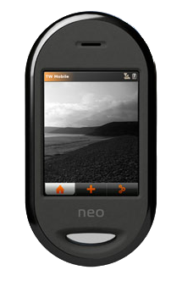
Proof of Concept Rootkits
1. Conversation Snooping Attack
2. Location Attack
3. Battery Depletion Attack
Openmoko Freerunner
Note: We did not exploit vulnerabilities
Notes:
List 3 rootkits
Smaller font
Move openmoko to under picture
As I have shown you early iphone, android all vulnerable to attacks
Discuss note

Slide 62


1. Conversation Snooping Attack
Rootkit Infected
Attacker
Send SMS
Delete SMS
Dial me “666-6666”
Call Attacker
Turn on Mic
Rootkit stops if user tries to dial
Notes:
Attacker Infected phone
Send Special SMS
Turn on microphone
Call attacker
Delete SMS should not overlap – put on bottom don’t make it red
Make dial me light red
Delete SMS
Remove then say instead of doing it this way we can also do it from a calendar application

Slide 63
1. Conversation Snooping Attack
Rootkit Infected
Attacker
Calendar Notification
Call Attacker
Turn on Mic

Slide 64
2. Location Attack
Rootkit Infected
Attacker
Send SMS
Delete SMS
Send Location “666-6666”
SMS Response
N40°28', W074°26
Query GPS
Notes:
Repeat slide before
Put coordinates in box.
Add delete SMS

Slide 65
3. Battery Depletion Attack
Attack :
Rootkit turns on high powered devices
Rootkit shows original device status

Slide 66
Rootkit Detection
User Space
App
App
Rootkit Detector
App
Libraries
DOES NOT WORK!
Rootkit
System
Call
Table
Drivers
Process
Lists
Kernel Code
Kernel Space
Notes:
Rootkits have been damaging – bottom 600 percent increase in desktop rootkits
Name the rootkit
Add virus

Slide 67
Memory Introspection
Training Phase
Monitor Machine
Target Machine
Monitor
Kernel
Sys Call
Table
Fetch
and
Copy
Notes:
Training Phase

Slide 68
Memory Introspection
Detection Phase
Monitor Machine
Target Machine
System OK
Monitor
Kernel
Fetch
Compare
Notes:
Detection Phase

Slide 69
Memory Introspection
Detection Phase
Rootkit Detected
Monitor Machine
Target Machine
Monitor
Kernel
mal_write()
Fetch
Rootkit
Compare

Slide 70


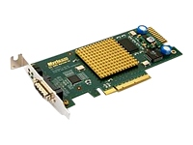
Monitoring Approaches
1. Hardware Approach
Monitor Machine
Target Machine
Rootkit Infected
NIC with remote
DMA support
Notes:
Monitor Machine can be physical
with remote memory access or a virtual machine over VMM
Intelligent NIC I-NIC
NIC PCI card with remote DMA support

Slide 71
Smart Phone Challenge
Monitor Machine
Rootkit Infected
Problem:
  Need interface allowing memory access
  without OS intervention (FireWire?)
Notes:
Need interface with memory access without OS intervention (FireWire?)
Backdoor because we connect with access to memory without OS. If it is wireless in theory someone can use maliciously.
Removes requires physical connection

Slide 72

Monitoring Approaches
2. VMM-based Approach
Dom0
OS
Detector
Hypervisor
Host Machine

Slide 73
Smart Phone Challenge
Problem: CPU-intensive detection
algorithms exhaust phone battery
Solution: Offload detection work to the
service provider
Send Pages
Response
CPU intensive work

Slide 74
Optimizations for Energy-Efficiency
Problem: Too many memory pages may have
to be transferred
Page Table
Fetch
Monitor

Slide 75
Optimizations for Energy-Efficiency
Solution: Only fetch and scan pages that have been recently modified
Page Table
Monitor
0
0
1
Fetch
0
0
1
0
0

Slide 76
Related Work (1/2)
Rootkit Detection
Enforcement of Kernel Data Structure Invariants
[Baliga, et al., ACSAC 2008]
Virtual Machine Introspection
[Garfinkel and Rosenblum, NDSS 2003]
Mobile Security and Detection
Semantically Rich Application-Centric Security in Android
[Ongtang, et al., ACSAC 2009]
Detecting Energy-Greedy Anomalies
[Kim, et al., MobiSys 2008]
Notes:
Rootkit detection
Mobile malware
- SMS patrick mcdaniel
- Cellular botnets patrick traynor
- Michigan DBLP mobile malware kangshin

Slide 77
Related Work (2/2)
Mobile Malware
Cellular Botnets: Impact on Network Core
[Traynor, et al., CCS 2009]
Exploiting MMS Vulnerabilities to Exhaust Battery
[Racic, et al., SecureComm 2006]
Exploiting SMS-Capable Cellular Network
[Enck, et al., CCS 2005]

Slide 78
Conclusion and Future Work
Conclusions:
  Rootkits are now a threat to smart phones
Future Work:
  Energy efficient rootkit detection techniques
  Develop a rootkit detector for smart phone

