Slide 1
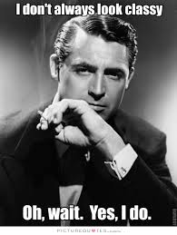
“Classy” sample correctors¹
Ronitt Rubinfeld
MIT and Tel Aviv University
joint work with Clement Canonne (Columbia) and Themis Gouleakis (MIT)
¹thanks to Clement and G for inspiring this classy title
Notes:
1
This is joint work with

Slide 2
Our usual model:
p
samples
Test/Learn
Notes:
In this model, we assume we have access to samples from a discrete distribution p on an n-element set. I will use integers 1 through n as the domain, and denote this set by [n]. I will call p to be a black-box distribution since we get only samples and have no other information on p. With a slight abuse of notation, I will use same p for the n-vector that describes the distribution. Therefore, p sub i will be the probability the distribution p outputs i. We will devise tests for some properties, which I am about to present in the next slide, and our main concern will be the sample complexity of the tests.

Slide 3
What if your samples aren’t quite right?

Slide 4
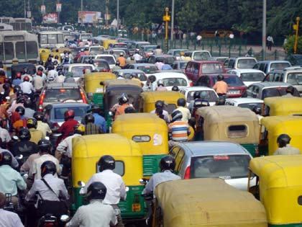
What are the traffic patterns?
Some sensors lost power, others went crazy!

Slide 5
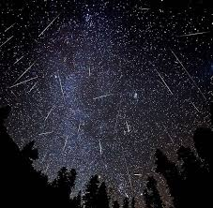
Astronomical data
A meteor shower confused some of the measurements

Slide 6

Teen drug addiction recovery rates
Never received data from three of the community centers!

Slide 7
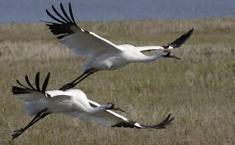
Whooping cranes
Correction of location errors for presence-only species distribution models
[Hefley, Baasch, Tyre, Blankenship 2013]

Slide 8
What is correct?

Slide 9
What is correct?

Slide 10
What to do?
Outlier detection/removal
Imputation
Missingness
Robust statistics
…
What if don’t know that the distribution (and even noise)
is normal, Gaussian, …?
Weaker assumption?

Slide 11
A suggestion for a methodology

Slide 12
What is correct?
Sample corrector assumes that original distribution in class P
(e.g., P is class of Lipshitz, monotone, k-modal, or k-histogram distributions)

Slide 13

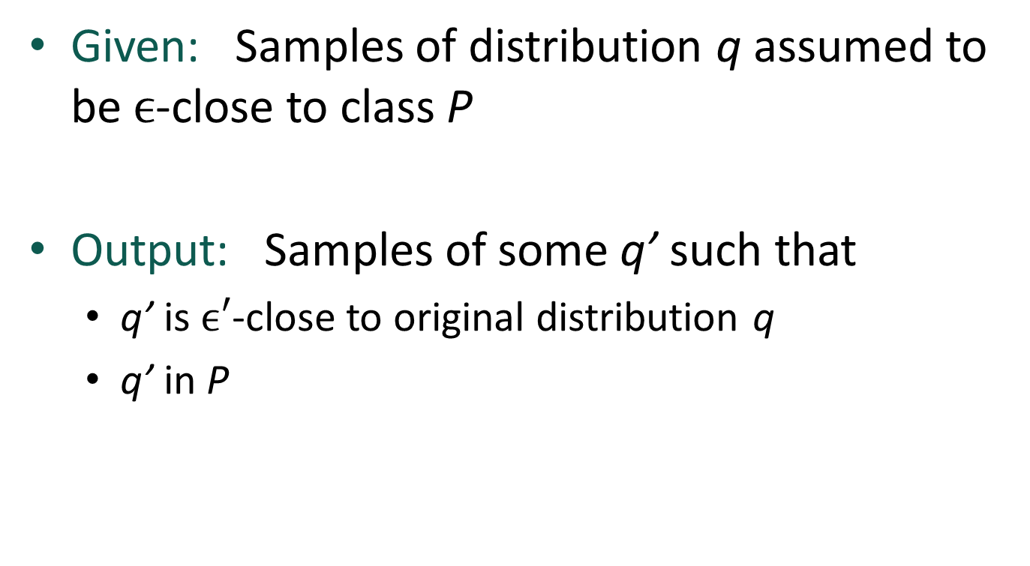

Classy Sample Correctors
Given: Samples of distribution q assumed to be $ϵ$-close to class P
Output: Samples of some q’ such that
  q’ is $ϵ′$-close to original distribution q
  q’ in P
P
$$ε$$
q
$$ε′$$
q’

Slide 14
Classy Sample Correctors
Given: Samples of distribution q assumed to be $ϵ$-close to class P
Output: Samples of some q’ such that
  q’ is $ϵ′$-close to original distribution q
  q’ in P
1. Sample complexity per output sample of q’?
2. Randomness complexity per output sample of q’?

Slide 15
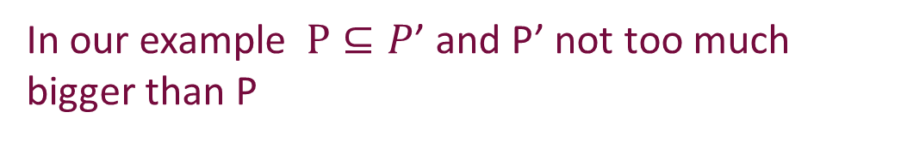


Classy “non-Proper” Sample Correctors
Given: Samples of distribution q assumed to be $ϵ$-close to class $P$
Output: Samples of some q’ such that
  q’ is $ϵ′$-close to distribution q
  q’ in P’
In our example $P⊆P$’ and P’ not too much bigger than P
P’
P
$$ε$$
q
$$ε′$$
q’

Slide 16
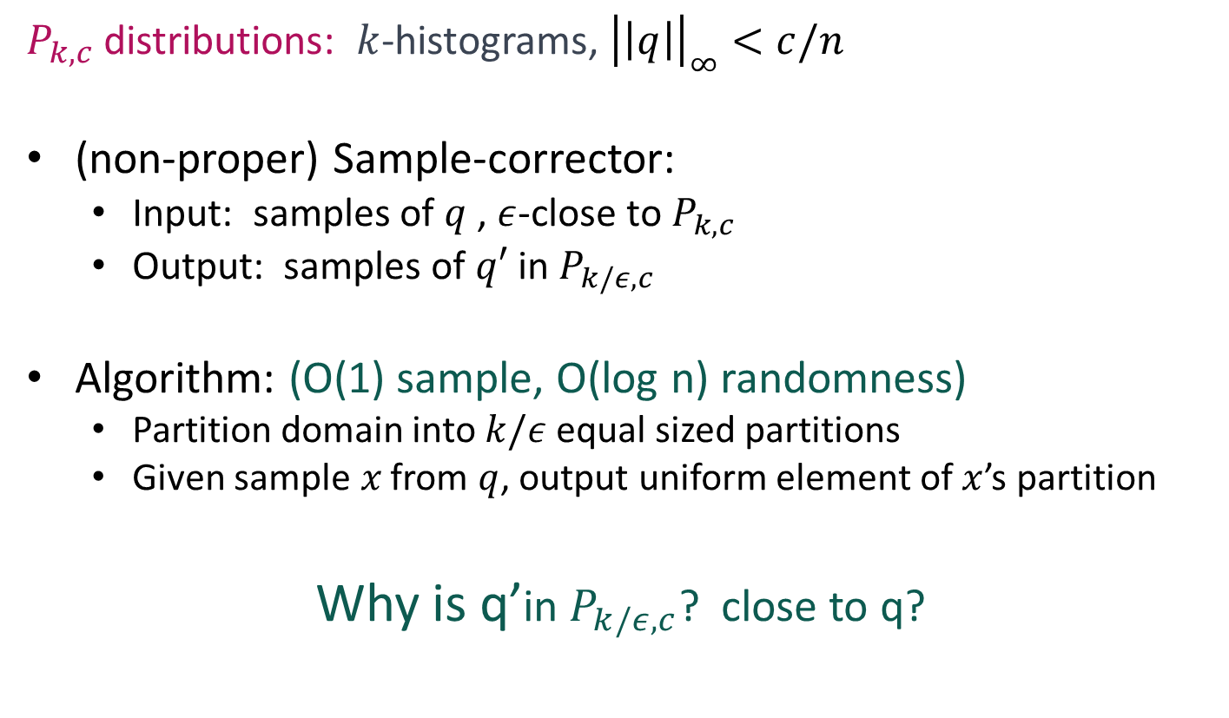
A very simple (nonproper) example
$P_{k,c}$ distributions: $k$-histograms, ${\left|\left|q\right|\right|}_{∞}<c/n$
(non-proper) Sample-corrector:
  Input: samples of $q$ , $ε$-close to $P_{k,c}$
  Output: samples of $q′$ in $P_{k/ε,c}$
Algorithm: (O(1) sample, O(log n) randomness)
  Partition domain into $k/ε$ equal sized partitions
  Given sample$x$ from $q$, output uniform element of $x$’s partition
Why is q’in $P_{k/ε,c}$? close to q?

Slide 17

k-histogram distribution
$$q_{i}$$
1
n

Slide 18
Close to k-histogram distribution
$$q_{i}$$
1
n

Slide 19
A generic way to get a sample corrector:

Slide 20
An observation
Agnostic learner
Sample corrector
What is an agnostic learner? Or even a learner?

Slide 21
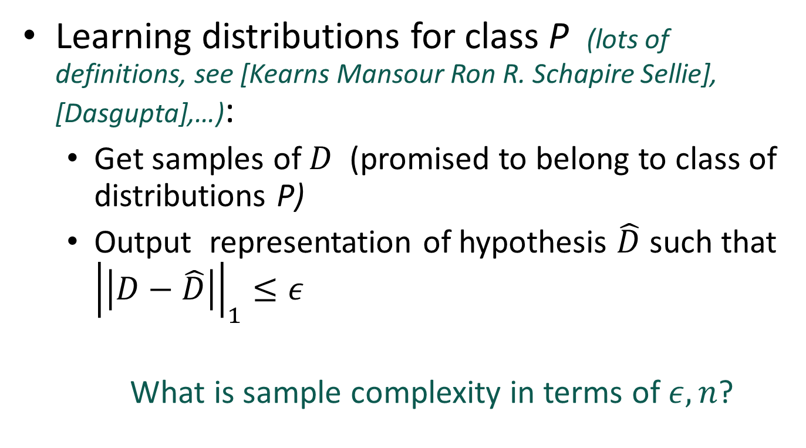
What is a ``classy’’ learner?
Learning distributions for class P (lots of definitions, see [Kearns Mansour Ron R. Schapire Sellie], [Dasgupta],…):
  Get samples of $D$ (promised to belong to class of distributions P)
  Output representation of hypothesis $\hat{D}$ such that ${\left|\left|D−\hat{D}\right|\right|}_{1}≤ε$
  What is sample complexity in terms of $ε,n$?

Slide 22
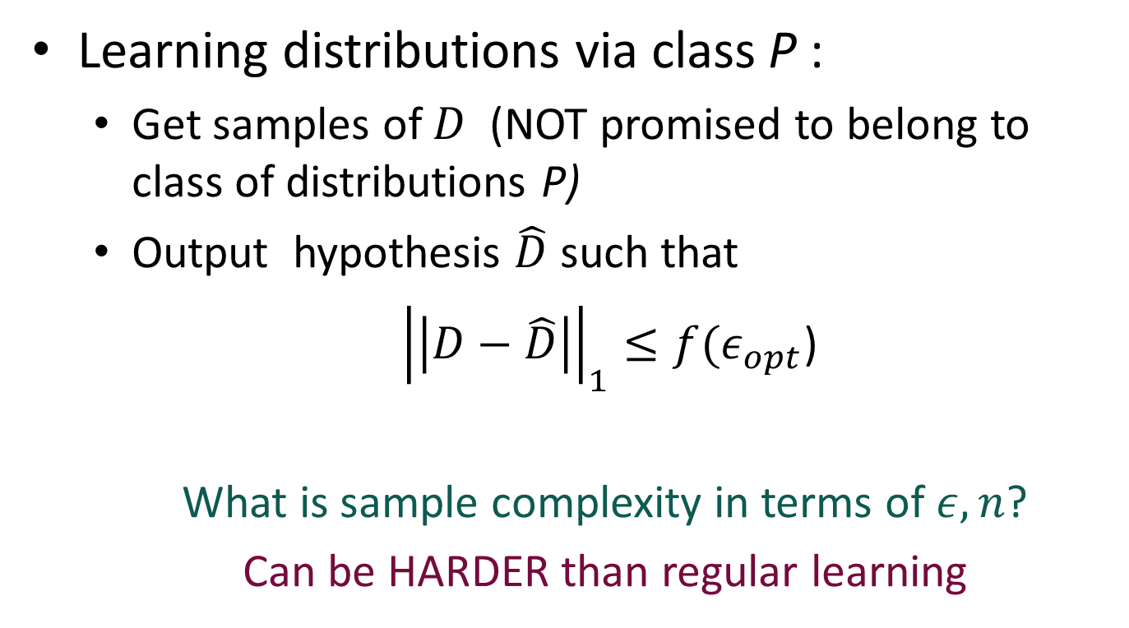
What is a ``classy’’ agnostic learner?
Learning distributions via class P :
  Get samples of $D$ (NOT promised to belong to class of distributions P)
  Output hypothesis $\hat{D}$ such that
  ${\left|\left|D−\hat{D}\right|\right|}_{1}≤{f(ε}_{opt}$)
  What is sample complexity in terms of $ε,n$?
  Can be HARDER than regular learning

Slide 23
An observation
Agnostic learner
Sample corrector
Corollaries: Sample correctors for
monotone distributions
histogram distributions
histogram distributions under promises (e.g., distribution is MHR or monotone)

Slide 24
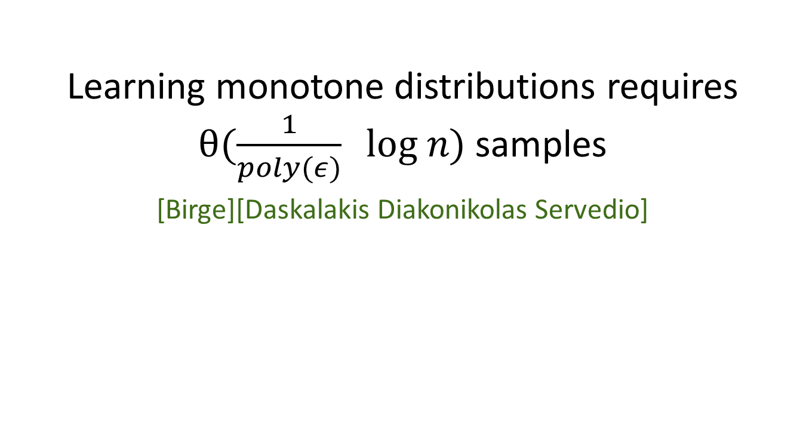
Learning monotone distributions
Learning monotone distributions requires $θ(\frac{1}{poly(ε)} log n)$ samples
[Birge][Daskalakis Diakonikolas Servedio]

Slide 25
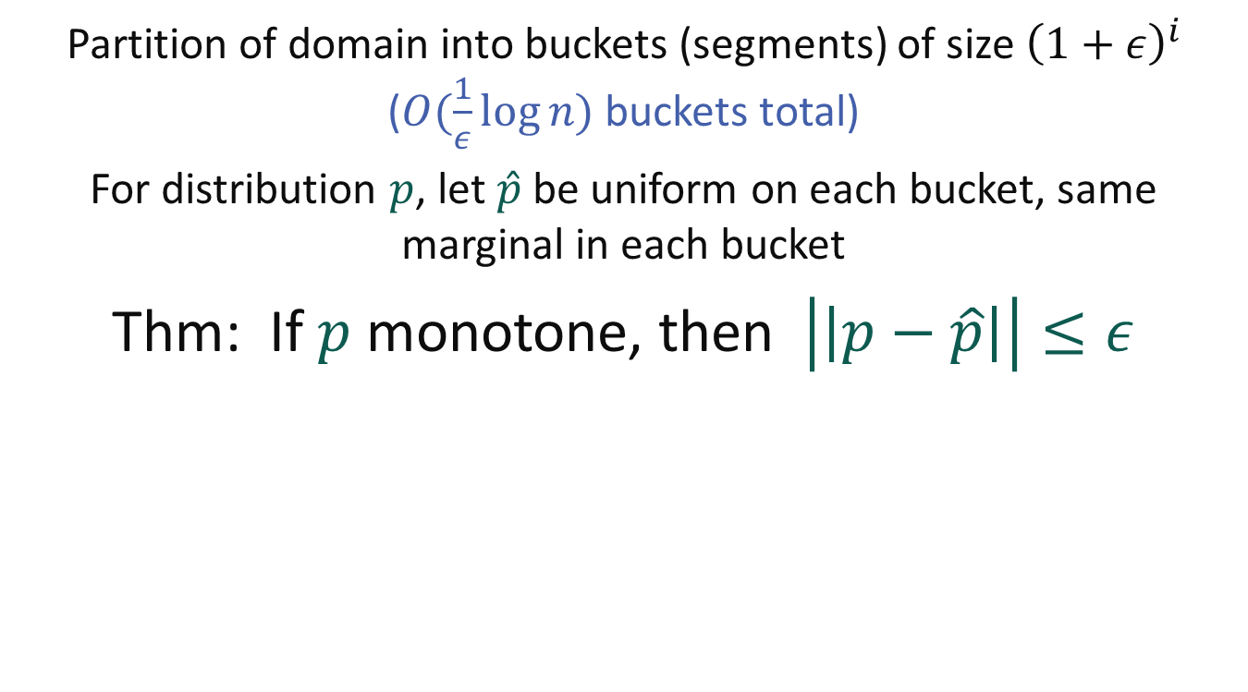
Birge Buckets
Partition of domain into buckets (segments) of size ${\left(1+ε\right)}^{i}$ ($O(\frac{1}{ε}log{n) }$buckets total)
For distribution $p$, let $\hat{p}$ be uniform on each bucket, same marginal in each bucket
Thm: If $p$ monotone, then $\left|\left|p−\hat{p}\right|\right|≤ε$
You know the boundaries!
Enough to learn the marginals of each bucket

Slide 26

A very special kind of error
Suppose ALL error located internally to Birge Buckets
Then, easy to correct to $\hat{p}$:
1. Pick sample x from p
2. Output y chosen UNIFORMLY from x’s Birge Bucket
“Birge Bucket Correction”

Slide 27
The big open question:
When can sample correctors be more efficient than agnostic learners?
  Some answers for monotone distributions:
    Error is REALLY small
    Have access to powerful queries
    Missing consecutive data errors
    Unfortunately, not likely in general case (constant arbitrary error, no extra queries) [P. Valiant]

Slide 28
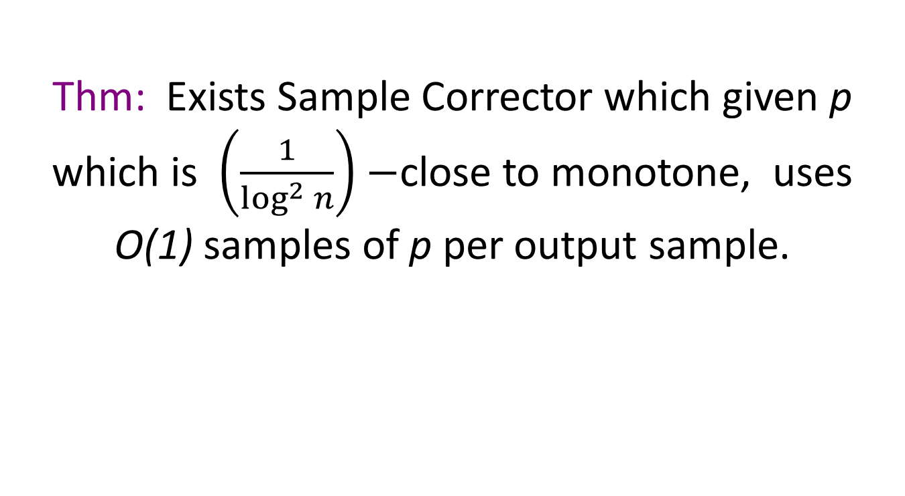
Learning monotone distributions
Thm: Exists Sample Corrector which given p which is $\left(\frac{1}{\log^{2} n}\right)−$close to monotone, uses O(1) samples of p per output sample.
OBLIVIOUS CORRECTION!!
Proof Idea:
Mix Birge Bucket correction with slightly decreasing distribution (flat on buckets with some space between buckets)

Slide 29
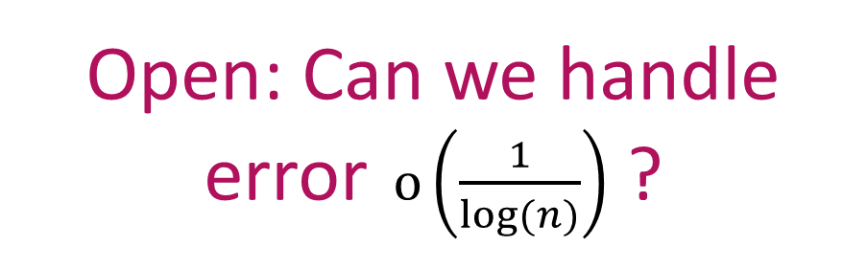

A lower bound [P. Valiant]
Sample correctors for $Ω\left(\frac{1}{log(n)}\right)$-close to monotone distributions require $Ω(\log{n ) }$samples
Open: Can we handle error$o\left(\frac{1}{log(n)}\right)$ ?

Slide 30
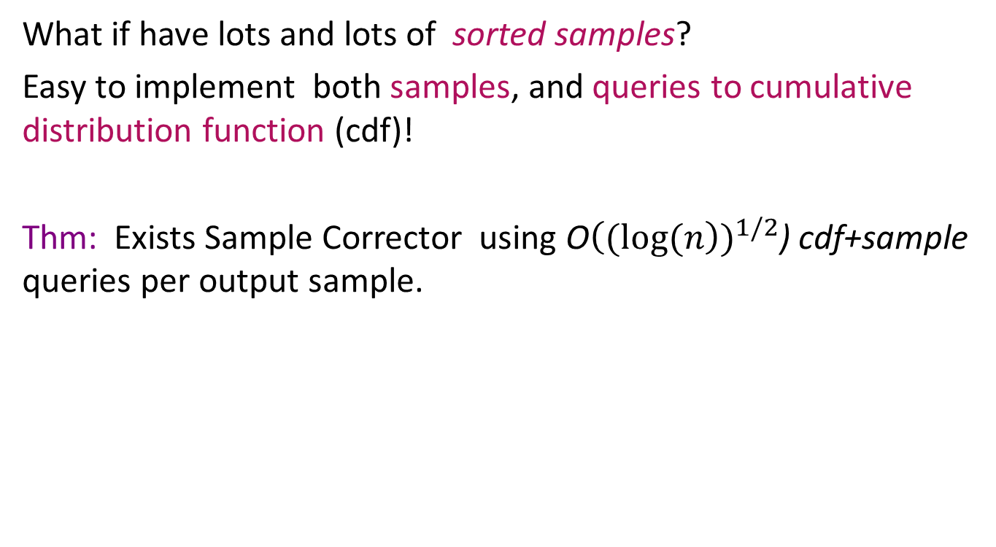
What about stronger queries?
What if have lots and lots of sorted samples?
Easy to implement both samples, and queries to cumulative distribution function (cdf)!
Thm: Exists Sample Corrector using O${\left((log(n\right))}^{1/2}$) cdf+sample queries per output sample.

Slide 31
First step
Use Birge bucketing to reduce p to an O(log n)-histogram distribution

Slide 32

Fixing with CDF queries
Each super bucket is $\sqrt{\log{n}}$ consecutive Birge buckets
Query conditional distribution of superbuckets and reweight if needed
superbuckets

Slide 33

Fixing with CDF queries
Each super bucket is $\sqrt{\log{n}}$ consecutive Birge buckets
Query conditional distribution of superbuckets and reweight if needed (decide how using LP)
Remove some weight
Add some weight

Slide 34
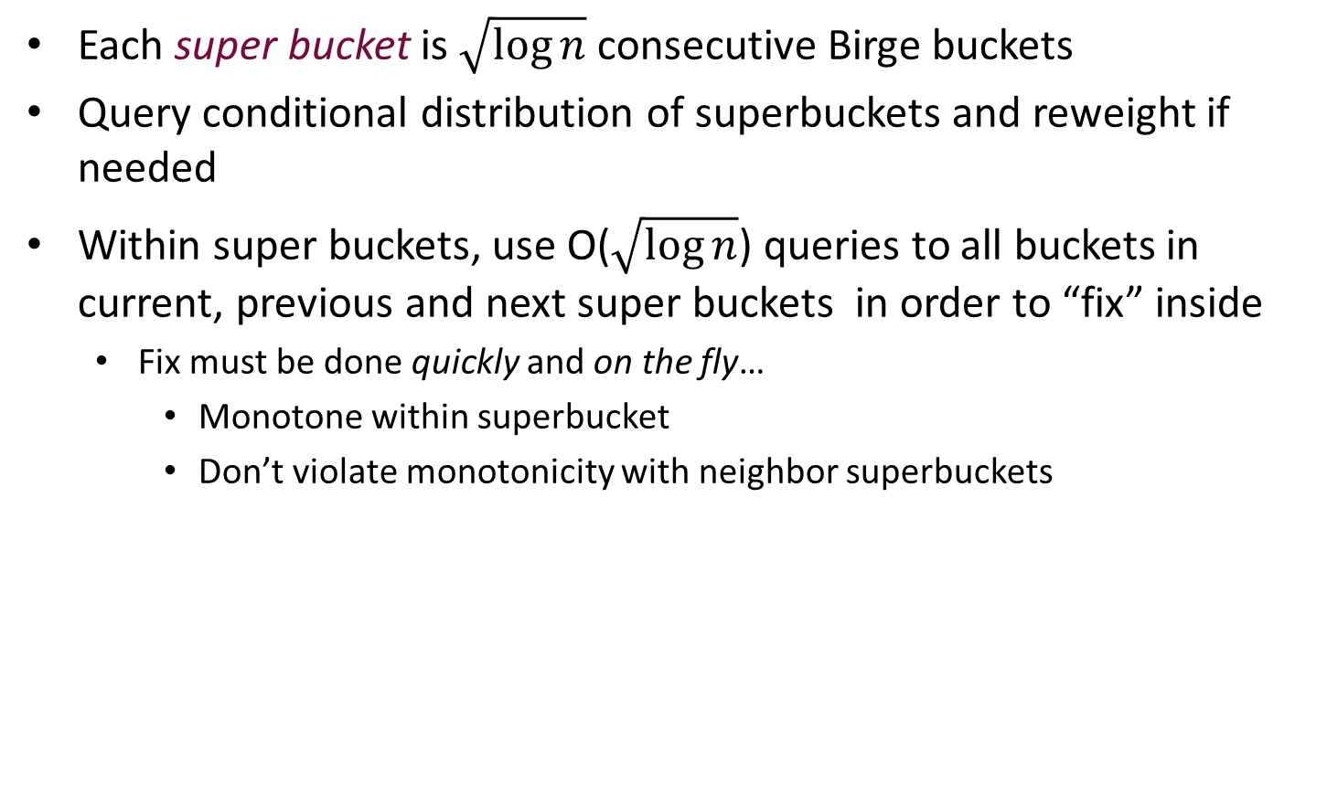
Fixing with CDF queries
Each super bucket is $\sqrt{\log{n}}$ consecutive Birge buckets
Query conditional distribution of superbuckets and reweight if needed
Within super buckets, use O($\sqrt{\log{n}}$) queries to all buckets in current, previous and next super buckets in order to “fix” inside
  Fix must be done quickly and on the fly…
    Monotone within superbucket
    Don’t violate monotonicity with neighbor superbuckets

Slide 35
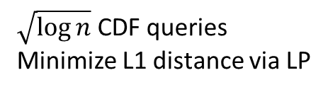
Reweighting within a superbucket
$\sqrt{\log{n}}$ CDF queries
Minimize L1 distance via LP

Slide 36

“Water pouring” to fix superbucket boundaries
Extra “water”
Could it cascade arbitrarily far?
What if there is not enough pink water?
What if there is too much pink water?

Slide 37
Special error classes
Missing data segment errors – p is a member of P with a segment of the domain removed
  E.g. power failure for a whole block in traffic data
More efficient sample correctors via “learning” missing part

Slide 38

Sample correctors provide power!

Slide 39
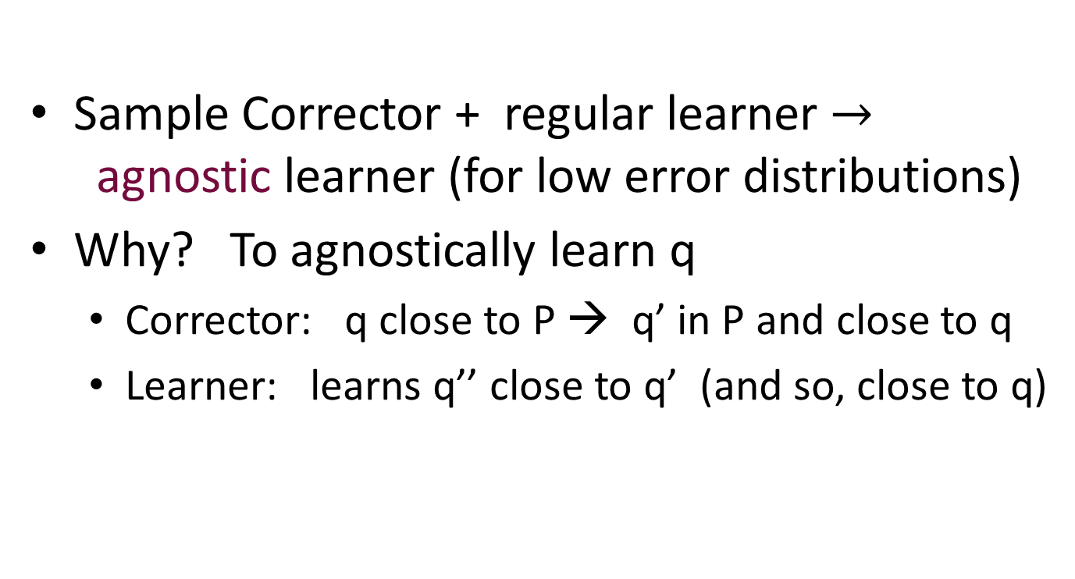
Sample correctors provide more powerful learners:
Sample Corrector + regular learner $→$agnostic learner (for low error distributions)
Why? To agnostically learn q
  Corrector: q close to P → q’ in P and close to q
  Learner: learns q’’ close to q’ (and so, close to q)

Slide 40
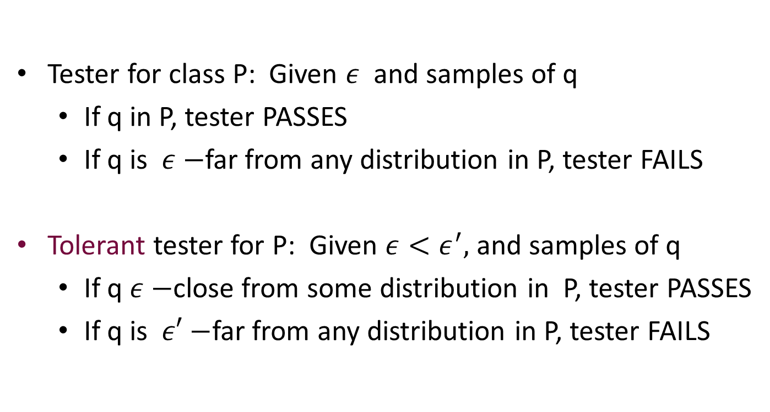
Sample correctors provide more powerful property testers:
Tester for class P: Given $ε$ and samples of q
  If q in P, tester PASSES
  If q is $ε−$far from any distribution in P, tester FAILS
Tolerant tester for P: Given $ε<ε^{′},$and samples of q
  If q $ε−$close from some distribution in P, tester PASSES
  If q is $ε′−$far from any distribution in P, tester FAILS
Often much harder

Slide 41

Sample correctors provide more powerful testers:
Sample Corrector + distance approximator + tester $→$ tolerant tester

Slide 42
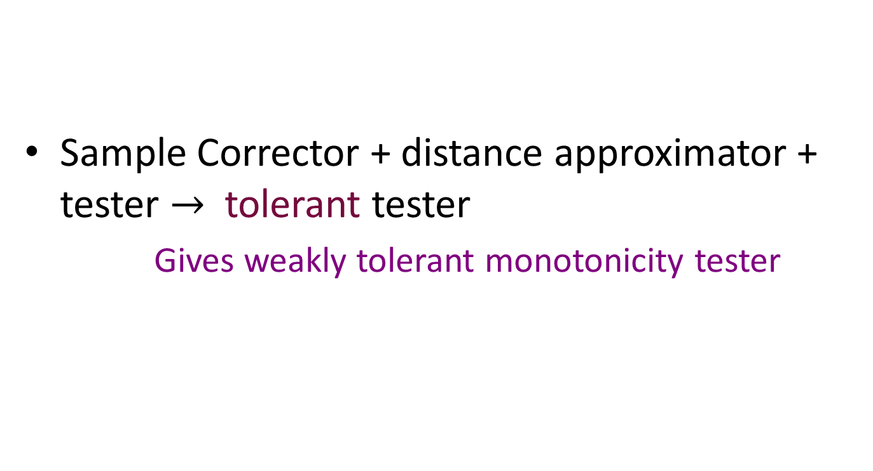
Sample correctors provide more powerful testers:
Sample Corrector + distance approximator + tester $→$ tolerant tester
  Gives weakly tolerant monotonicity tester
Estimates distance between two distributions

Slide 43
Proof: Modifying Brakerski’s idea to get tolerant tester
Use sample corrector on p to output p’
Test that p’ in D
Ensure that p’ close to p using distance approximator
If p close to D, then p’ close to p and in D
If p not close to D, we know nothing about p’:
(1) may not be in D
(2) may not be close to p

Slide 44
Randomness Scarcity
Can we correct using little randomness of our own?
  Note that agnostic learning method relies on using our own random source
  Compare to extractors (not the same)

Slide 45
Randomness Scarcity
Can we correct using little randomness of our own?
  Generalization of Von Neumann corrector of biased coin
  For monotone distributions, YES!

Slide 46
Randomness scarcity: a simple case
Correcting to uniform distribution
  Output convolution of a few samples

Slide 47
In conclusion…
Yet another new model!

Slide 48
What next for correction?
What classes can we correct?

Slide 49
What next for correction?
When is correction easier than agnostic learning?
When is correction easier than (non-agnostic) learning?

Slide 50
How good is the corrected data?
Estimating averages of survey/experimental data
Learning

Slide 51
Thank you

