Slide 1
Distribution testing
in the 21 ^{1/2 th} century
Ryan O’Donnell
Carnegie Mellon University
based on joint work with Costin Bădescu (CMU) & John Wright (MIT)

Slide 2
Slide 1, in which I get defensive

Slide 3
Quantum.
Why should you care?

Slide 4
Quantum Distribution Testing: Why care?
1. Practically relevant problems at the vanguard of computing
2. You get to do it all again
3. The math is (even more) beautiful

Slide 5
Quantum Distribution Testing: Why care?
1. Practically relevant problems at the vanguard of computing
2. You get to do it all again
3. The math is (even more) beautiful

Slide 6
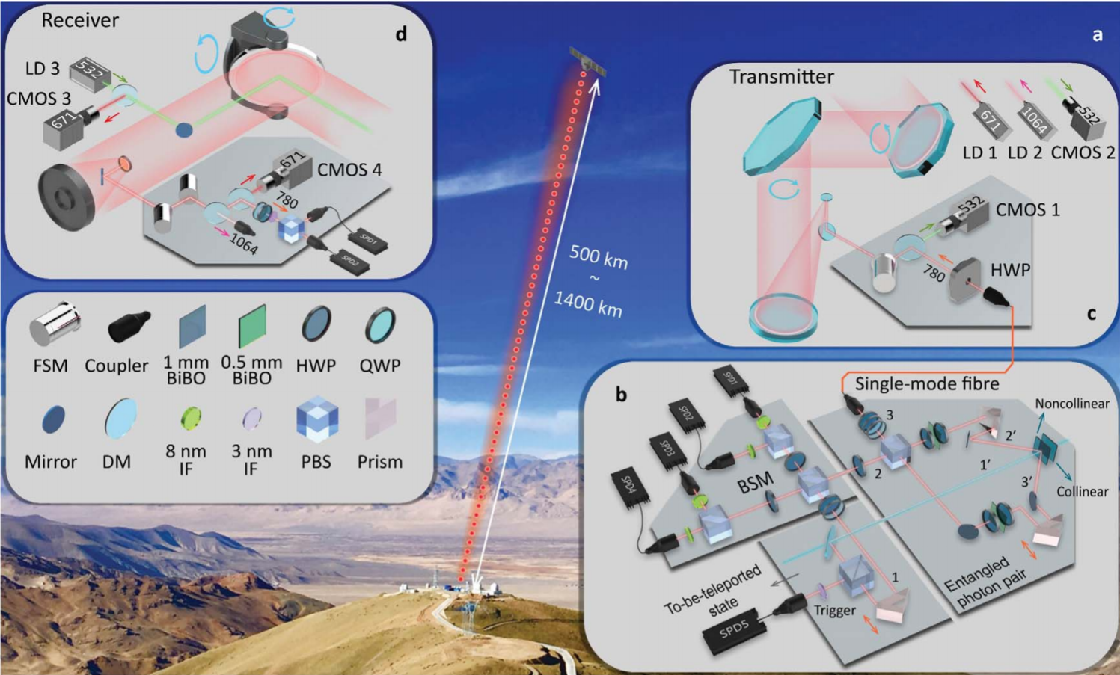
Quantum teleportation, July 2017
Jian-Wei Pan et al.
Micius satellite, space
Ngari, Tibet
Notes:
So they’re trying to teleport qubits, in various states, from the ground station in Tibet to the satellite, ~1200km away (on average, varies over days). One reason quantum teleportation is cool is “no-cloning theorem”, proven by Mary Wootters’s dad. Relatedly, if you have a qubit, you can’t just look at its state and find out what it is. Identical to the fact that if you make 1 draw from a probability distribution, you can’t learn it. Anyway, question: How the heck do you check that you teleported the bit correctly? You would have to… learn the state of the photon on the satellite. So… yeah, you do it m times, and try to… learn the state. Or ‘test’ the hypothesis that it’s equal to the known state that you sent. Or ‘estimate’ the distance of the received state from the sent one. They did the latter. They took m = 911. Why? Because they could get about m = 28 per day, and they did it for a month. Getting one copy took about 12s. 6 mins per day. And what did they do? Estimated the (quantum version of) Hellinger distance of what they received, from the target. They estimated it was ~.45. Not bad, I guess. Remember, TV <= Hellinger <= sqrt(2). And apparently, the way things work, if you did something classical, the best Hellinger you could hope for is .61.

Slide 7
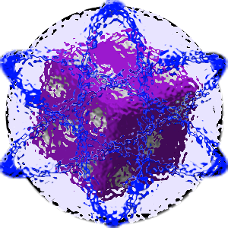
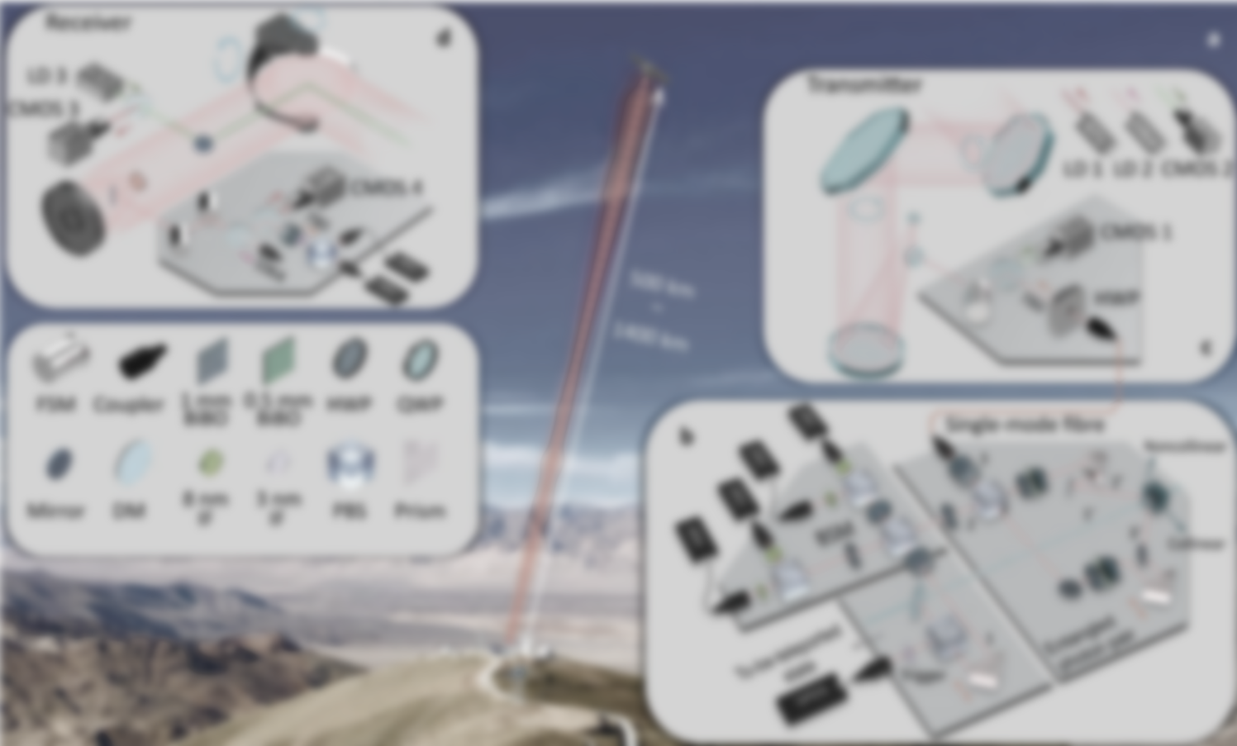
Quantum teleportation, July 2017
Jian-Wei Pan et al.
in state ρ
Fidelity(ρ,ρ)?
in state ρ

Slide 8
Quantum teleportation, July 2017
Jian-Wei Pan et al.
in state ρ
^{(quantum-)} Hellinger²-Dist(ρ,ρ) = ?21±.01
in state ρ

Slide 9
Quantum teleportation, July 2017
Jian-Wei Pan et al.
∙∙∙ in state ρ^{⊗911}
^{(quantum-)} Hellinger²-Dist(ρ,ρ) = ?21±.01
in state ρ

Slide 10
Quantum teleportation, July 2017
Jian-Wei Pan et al.
∙∙∙ in state ρ^{⊗911}
^{(quantum-)} Hellinger²-Dist(ρ,ρ) = 0.21 ±.01
in state ρ

Slide 11
Quantum Distribution Testing: Why care?
1. Practically relevant problems at the vanguard of computing
2. You get to do it all again
3. The math is (even more) beautiful

Slide 12
Quantum Distribution Testing: Why care?
1. Practically relevant problems at the vanguard of computing
2. You get to do it all again
3. The math is (even more) beautiful

Slide 13
What is classical Probability Density Testing?

Slide 14
Unknown n-outcome
source of randomness ρ

Slide 15
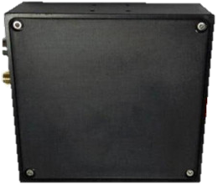
m samples
Algorithm
X
x ∈ ℝ
Unknown n-outcome
source of randomness p
p^{⊗m}
Maybe x ∈ {0,1} is a guess as to whether p is uniformly random.
Maybe x is an estimate of Dist(q,p) for some hypothesis q.
Maybe x is an estimate of Entropy(p).

Slide 16
m samples
Algorithm
X
x ∈ ℝ
Unknown n-outcome
source of randomness p
p^{⊗m}
Example:
You have a hope that p ≡ 1/n, the uniform distribution.
You want to estimate Dist(1/n, p), where “Dist” ∈ { TV, Hellinger², Chi-Squared, , …}
Latter two are the same here, so let’s choose them.

Slide 17
m samples
Algorithm
X
x ∈ ℝ
Unknown n-outcome
source of randomness p
p^{⊗m}
Example:
You have a hope that p ≡ 1/n, the uniform distribution.
You want to estimate -Dist(1/n, p)

Slide 18
m samples
Algorithm
X
x ∈ ℝ
Unknown n-outcome
source of randomness p
p^{⊗m}
You basically want to estimate
(the “collision probability”)
Say m = 2. What should Algorithm X be?
Algorithm X: Given sample (a,b) ~ p^{⊗2}, output
Var[X] =
large

Slide 19
m samples
Algorithm
X
x ∈ ℝ
Unknown n-outcome
source of randomness p
p^{⊗m}
You basically want to estimate
Say m > 2. What should Algorithm X be?
Algorithm X: Average the m=2 algorithm over all pairs.
Var[X] = (tedious but straightforward)

Slide 20
m samples
Algorithm
X
x ∈ ℝ
Unknown n-outcome
source of randomness p
p^{⊗m}
Var[X] = (tedious but straightforward)
Chebyshev ⇒
samples suffice to distinguish
to distinguish -Dist(1/n, p) ≤ .99ϵ²/n
vs. -Dist(1/n, p) ≥ ϵ²/n whp.

Slide 21
m samples
Algorithm
X
x ∈ ℝ
Unknown n-outcome
source of randomness p
p^{⊗m}
Var[X] = (tedious but straightforward)
Chebyshev ⇒
samples suffice to distinguish
to distinguish -Dist(1/n, p) ≤ .99ϵ²/n
vs. TV-Dist(1/n, p) ≥ ϵ whp.

Slide 22
m samples
Algorithm
X
x ∈ ℝ
Unknown n-outcome
source of randomness p
p^{⊗m}
Remember two things:
The algorithm: Average, over all transpositions τ ∈ S_{m}, of 0/1 indicator that τ leaves samples unchanged
Any alg. is just a random variable, based on randomness p^{⊗m}

Slide 23
m samples
Algorithm
X
x ∈ ℝ
Unknown n-outcome
source of randomness p
p^{⊗m}
Classical probability density testing picture, m=1:

Slide 24
sample
Algorithm
X
x ∈ ℝ
Unknown n-outcome
source of randomness p
Classical probability density testing picture, m=1:
ensional vector
p
p is an n-dim. symm. matrix, p ≥ 0, = 1
X is an n-dimensional vector
“ ”
E_{p}[X] = 〈p,X〉 =
p
E_{p}[X²] = 〈p,X²〉 =
p

Slide 25
Changing the picture: Classical → Quantum
Replace “vector” with “symmetric matrix” everywhere.
(Hermitian)

Slide 26
sample
Algorithm
X
x ∈ ℝ
Unknown n-outcome
source of randomness p
Classical probability density testing picture, m=1:
ensional vector
p
p is an n-dim. symm. matrix, p ≥ 0, = 1
X is an n-dimensional vector
“ ”
E_{ρ}[X] = 〈p,X〉 =
p
E_{p}[X²] = 〈p,X²〉 =
p

Slide 27
sample
Algorithm
X
x ∈ ℝ
Unknown n-outcome
source of randomness ρ
Quantum probability density testing picture, m=1:
ρ
ρ is an n-dim. symm. matrix, ρ ≥ 0, = 1
X is an n-dim. symm. matrix
E_{ρ}[X] = 〈ρ,X〉 =
ρ
E_{ρ}[X²] = 〈ρ,X²〉 =
ρ

Slide 28
m samples
Algorithm
X
x ∈ ℝ
Unknown n-outcome
source of randomness ρ
ρ^{⊗m}
Quantum probability density testing picture: m=1:
ρ
ρ is an n-dim. symm. matrix, ρ ≥ 0, = 1
X is an n-dim. symm. matrix
E_{ρ}[X] = 〈ρ,X〉 =
ρ
E_{ρ}[X²] = 〈ρ,X²〉 =
ρ

Slide 29
Changing the picture: Quantum → Classical
Let ρ and X be diagonal matrices.

Slide 30
m samples
Algorithm
X
x ∈ ℝ
Unknown n-outcome
source of randomness ρ
ρ^{⊗m}
Quantum probability density testing picture: m=1:
ρ
ρ is an n-dim. symm. matrix, ρ ≥ 0, = 1
X is an n-dim. symm. matrix
E_{ρ}[X] = 〈ρ,X〉 =
ρ
E_{ρ}[X²] = 〈ρ,X²〉 =
ρ

Slide 31
What’s going on, physically?
ρ = “state” of a particle-system
e.g., 4 polarized photons
n = # “basic outcomes”; 2 for a “qubit”, 16 for 4 photons
X = “observable” = measuring device
X
(quantum circuit)
READOUT

Slide 32
What’s going on, physically?
ρ = “state” of a particle-system
e.g., 4 polarized photons
n = # “basic outcomes”; 2 for a “qubit”, 16 for 4 photons
X = “observable” = measuring device
X
(quantum circuit)
READOUT
0.03

Slide 33
What’s going on, physically?
ρ = “state” of a particle-system
Don’t read this: Readout is λ_{i} with probability d
where are the eigvals/vecs of X.
X = “observable” = measuring device
X
(quantum circuit)
READOUT
0.03

Slide 34
sample
Algorithm
X
x ∈ ℝ
Unknown n-outcome
source of randomness ρ
Quantum probability density testing picture: m=1:
ρ
ρ is an n-dim. symm. matrix, ρ ≥ 0, = 1
X is an n-dim. symm. matrix
E_{ρ}[X] = 〈ρ,X〉 =
ρ
E_{ρ}[X²] = 〈ρ,X²〉 =
ρ

Slide 35
sample
Algorithm
X
x ∈ ℝ
Unknown n-outcome
source of randomness ρ
Baseline: Learning ρ
(“quantum tomography”)
ρ is an n-dim. symm. matrix
X is an n-dim. symm. matrix
E_{ρ}[X] = 〈ρ,X〉 =
ρ

Slide 36
sample
Algorithm
X
x ∈ ℝ
Unknown n-outcome
source of randomness ρ
Baseline: Learning ρ
Naive method:
Use X’s like
to learn each ρ_{ij} separately.
O(n⁴) samples.
ρ is an n-dim. symm. matrix
X is an n-dim. symm. matrix
E_{ρ}[X] = 〈ρ,X〉 =
ρ

Slide 37
sample
Algorithm
X
x ∈ ℝ
Unknown n-outcome
source of randomness ρ
Baseline: Learning ρ
Theorem: [HHJWY15,OW15] It is necessary & sufficient to have
m = Θ(n²/ϵ²) samples
to learn ρ to ϵ-accuracy in “trace (l1) distance”.
ρ is an n-dim. symm. matrix
X is an n-dim. symm. matrix
E_{ρ}[X] = 〈ρ,X〉 =
ρ

Slide 38
A better way to think about the scenario

Slide 39
m samples
Algorithm
X
x ∈ ℝ
Unknown n-outcome
source of randomness ρ
ρ^{⊗m}
Quantum probability density testing picture: m=1:
ρ
ρ is an n-dim. symm. matrix, ρ ≥ 0, = 1
X is an n-dim. symm. matrix
E_{ρ}[X] = 〈ρ,X〉 =
ρ
E_{ρ}[X²] = 〈ρ,X²〉 =
ρ

Slide 40
m samples
Algorithm
X
x ∈ ℝ
Unknown n-outcome
source of randomness ρ
ρ^{⊗m}
Quantum probability density testing picture: m=1:
ρ
ρ is an n-dim. symm. matrix, ρ ≥ 0, = 1
ρ is PSD
trace(ρ) = 1
⇔ ρ’s eigenvalues are ≥ 0
⇔ ρ’s eigenvalues sum to 1
⇔ ρ’s eigenvalues form a probability distribution! Call it p₁, …, p_{n}

Slide 41
m samples
Algorithm
X
x ∈ ℝ
Unknown n-outcome
source of randomness ρ
ρ^{⊗m}
Quantum probability density testing picture: m=1:
ρ’s eigenvalues form a probability distribution! Call it p₁, …, p_{n}
“Over” ρ’s orthonormal eigenvectors in ℂ^{n}. Call them v₁, …, v_{n}
Think of ρ as emitting v_{i} with probability p_{i}.
Exercise: Conditioned on v_{i}, E[X] = 〈Xv_{i}, v_{i}〉.

Slide 42
m samples
Algorithm
X
x ∈ ℝ
Unknown n-outcome
source of randomness ρ
ρ^{⊗m}
Quantum probability density testing picture: m=1:
ρ’s eigenvalues form a probability distribution! Call it p₁, …, p_{n}
“Over” ρ’s orthonormal eigenvectors in ℂ^{n}. Call them v₁, …, v_{n}
Think of ρ as emitting v_{i} with probability p_{i}.
Also: ρ^{⊗5} emits v₃⊗v₁⊗v₄⊗v₁⊗v_{n} with probability p₃·p₁·p₄·p₁·p_{n}…

Slide 43
Classical World
Quantum World
(p₁, …, p_{n})
no analogue
{p₁, …, p_{n}}
{p₁, …, p_{n}}
no analogue
v₁, …, v_{n}
support-size(p) = # nonzero p_{i}’s
rank(ρ) = # nonzero p_{i}’s
Entropy(p) =
vN-Entropy(ρ) =
uniform distribution, p = 1/n
maximally mixed state, ρ = I/n
total variation distance
trace distance
Hellinger² distance
infidelity
L-distance
Frobenius²-distance

Slide 44
Quantum Distribution Testing: Why care?
1. Practically relevant problems at the vanguard of computing
2. You get to do it all again
3. The math is (even more) beautiful

Slide 45
Quantum Distribution Testing: Why care?
1. Practically relevant problems at the vanguard of computing
2. You get to do it all again
3. The math is (even more) beautiful

Slide 46
Estimating L-distance between ρ and I/n
(AKA testing if ρ is the maximally mixed state)
[Bădescu-O-Wright’17]
||I/n − ρ||_{F}
²
(Same as in classical case!)

Slide 47
Estimating L-distance between ρ and I/n
You basically want to estimate
(the “quantum purity”)
Say m = 2. What should Algorithm X be?
ρ emits v_{a}⊗v_{b} ∈ (ℂ^{n})^{⊗2} with probability p_{a}·p_{b}
The “algorithm” should be an operator X on (ℂ^{n})^{⊗2}
Doesn’t know v₁, …, v_{n}, but does understand “tensor structure”
Let X act by swapping tensor components: X e_{a}⊗e_{b} = e_{b}⊗e_{a}
⇒ X v_{a}⊗v_{b} = v_{b}⊗v_{a}

Slide 48
Estimating L-distance between ρ and I/n
You basically want to estimate
Say m = 2. What should Algorithm X be?
Let X act by swapping tensor components: X e_{a}⊗e_{b} = e_{b}⊗e_{a}
⇒ X v_{a}⊗v_{b} = v_{b}⊗v_{a}
Conditioned on ρ emitting v_{a}⊗v_{b}, E[X] = 〈X v_{a}⊗v_{b}, v_{a}⊗v_{b}〉
= 〈v_{b}⊗v_{a}, v_{a}⊗v_{b}〉
=
∴E[X] =

Slide 49
Estimating L-distance between ρ and I/n
Let X act by swapping tensor components: X e_{a}⊗e_{b} = e_{b}⊗e_{a}
⇒ X v_{a}⊗v_{b} = v_{b}⊗v_{a}
∴E[X] =
Var[X] =
E[X²] − E[X]²
Conditioned on ρ emitting v_{a}⊗v_{b}, E[X²] = 〈X² v_{a}⊗v_{b}, v_{a}⊗v_{b}〉
= 〈v_{a}⊗v_{b}, v_{a}⊗v_{b}〉
= 1
∴Var[X] = extra large

Slide 50
Estimating L-distance between ρ and I/n
You basically want to estimate
Say m > 2. What should Algorithm X be?
X = avg { R(τ) : transpositions τ ∈ S_{m} }
where, in general, R(π) acts on (ℂ^{n})^{⊗m} by permuting tensor components according to π
∴E[X] =
For Var[X], need to compute X².

Slide 51
Estimating L-distance between ρ and I/n
You basically want to estimate
X = avg { R(τ) : transpositions τ ∈ S_{m} }
X² = avg {R(σ) R(τ) : transpositions σ,τ ∈ S_{m} }
= avg { R(στ) : transpositions σ,τ ∈ S_{m} }
R : S_{m} → {Matrices acting on (ℂ^{n})^{⊗m}} is a group representation!

Slide 52
Estimating L-distance between ρ and I/n
You basically want to estimate
X = avg { R(τ) : transpositions τ ∈ S_{m} }
X² = avg {R(σ) R(τ) : transpositions σ,τ ∈ S_{m} }
= avg { R(στ) : transpositions σ,τ ∈ S_{m} }
= + c₁ avg { R(π) : cycleType(π) = (1) }
= + c₂ avg { R(π) : cycleType(π) = (2,2) }
= + c₃ avg { R(π) : cycleType(π) = (3) }
for some straightforward but slightly annoying to compute coefficients c₁, c₂, c₃

Slide 53
Estimating L-distance between ρ and I/n
You basically want to estimate
E[X²] = + c₁ avg { R(π) : cycleType(π) = (1) }
= + c₂ avg { R(π) : cycleType(π) = (2,2) }
= + c₃ avg { R(π) : cycleType(π) = (3) }
for some straightforward but slightly annoying to compute coefficients c₁, c₂, c₃
Exercise: Let A_{(7,4,2)} = avg { R(π) : cycleType(π) = (7,4,2) }. Then E[A_{(7,4,2)}] =

Slide 54
Estimating L-distance between ρ and I/n
You basically want to estimate
Can now compute the variance, bound it asymptotically, use Chebyshev, etc. etc.,
just like in the classical case.
(It’s actually somewhat cleaner.)
E[X²] = + c₁ avg { R(π) : cycleType(π) = (1) }
= + c₂ avg { R(π) : cycleType(π) = (2,2) }
= + c₃ avg { R(π) : cycleType(π) = (3) }
for some straightforward but slightly annoying to compute coefficients c₁, c₂, c₃
Exercise: Let A_{(7,4,2)} = avg { R(π) : cycleType(π) = (7,4,2) }. Then E[A_{(7,4,2)}] =

Slide 55
Estimating L-distance between ρ and I/n
Long story short:
m = O(n/ϵ²) samples suffice to distinguish
to distinguish -Dist(I/n, ρ) ≤ .99ϵ²/n
vs. TV-Dist(I/n, ρ) ≥ ϵ whp.
Also in [Bădescu-O-Wright’17]: Same for distinguishing closeness of two unknown ρ,
q
[O-Wright’15]: m = Ω(n/ϵ²) samples needed for testing “ρ = I/n”

Slide 56
Estimating L-distance between ρ and I/n
You basically want to estimate
E[X²] = + c₁ avg { R(π) : cycleType(π) = (1) }
I promised you “beautiful math”...
= + c₂ avg { R(π) : cycleType(π) = (2,2) }
= + c₃ avg { R(π) : cycleType(π) = (3) }
for some straightforward but slightly annoying to compute coefficients c₁, c₂, c₃
Exercise: Let A_{(7,4,2)} = avg { R(π) : cycleType(π) = (7,4,2) }. Then E[A_{(7,4,2)}] =

Slide 57
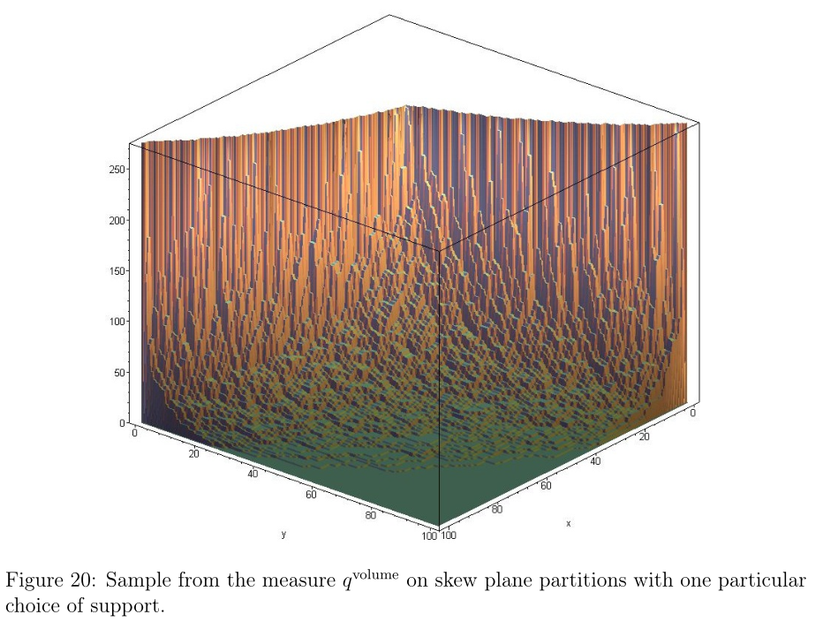
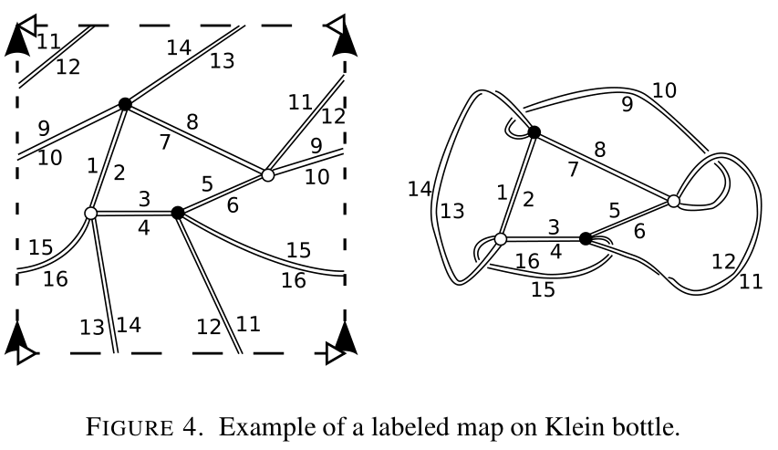
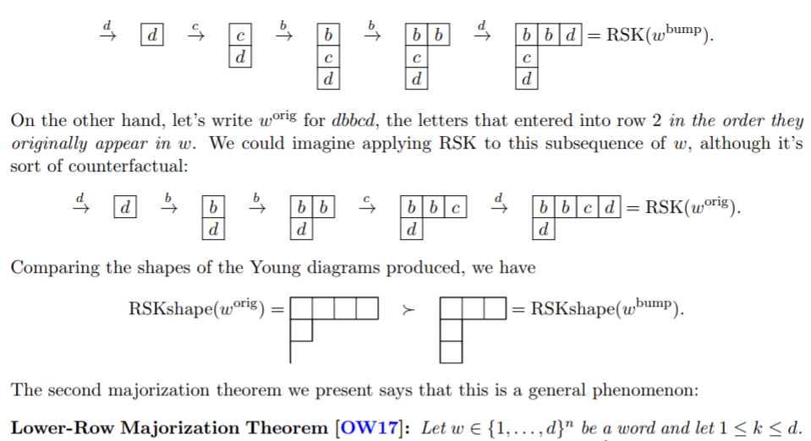
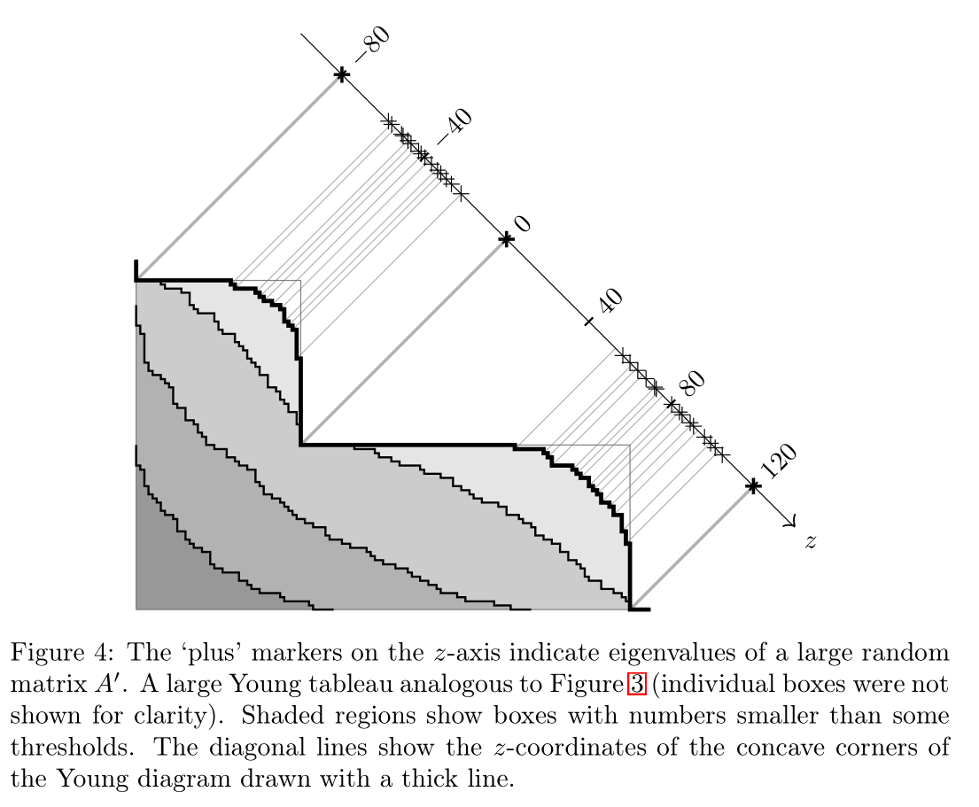
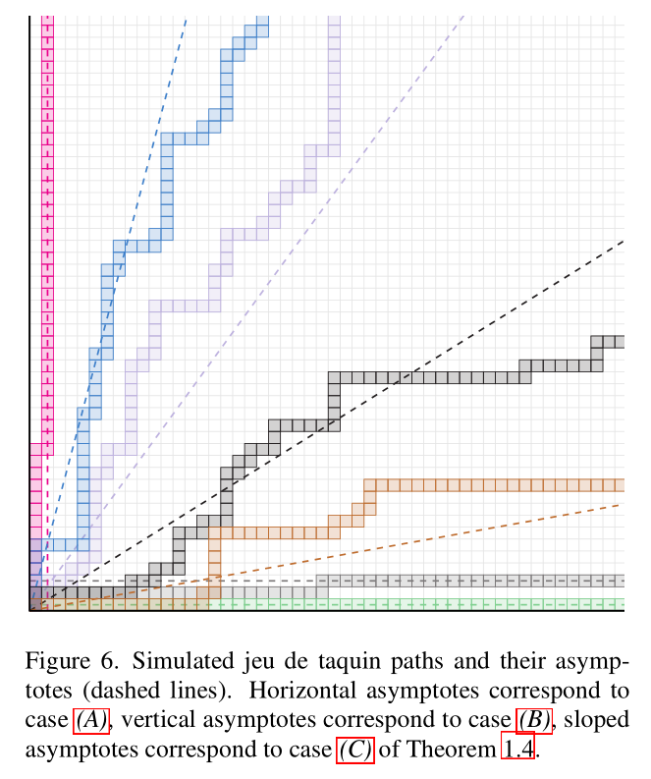
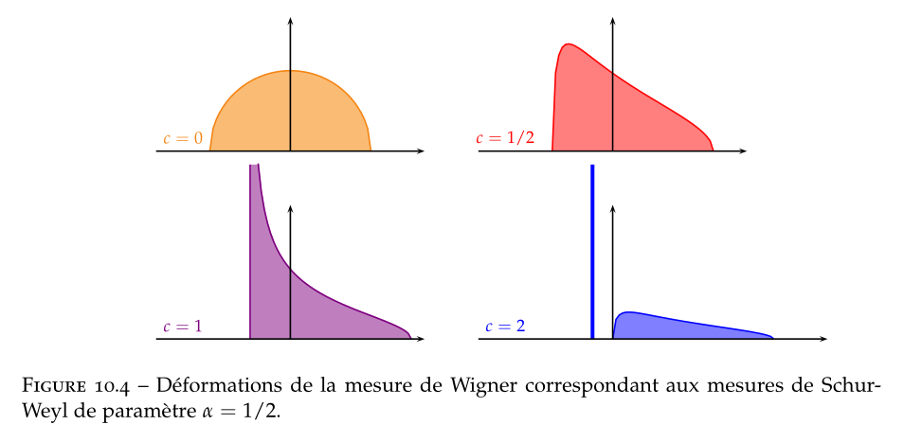
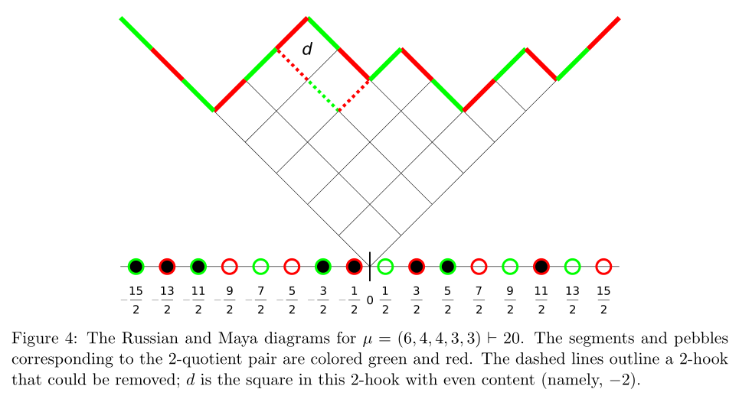
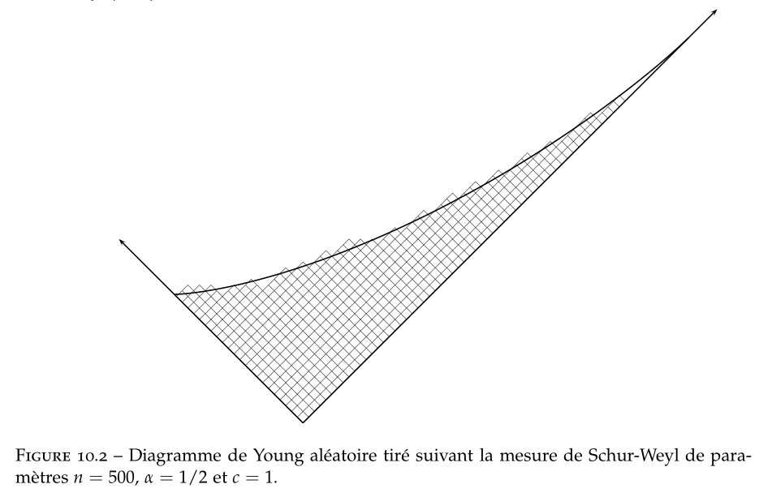
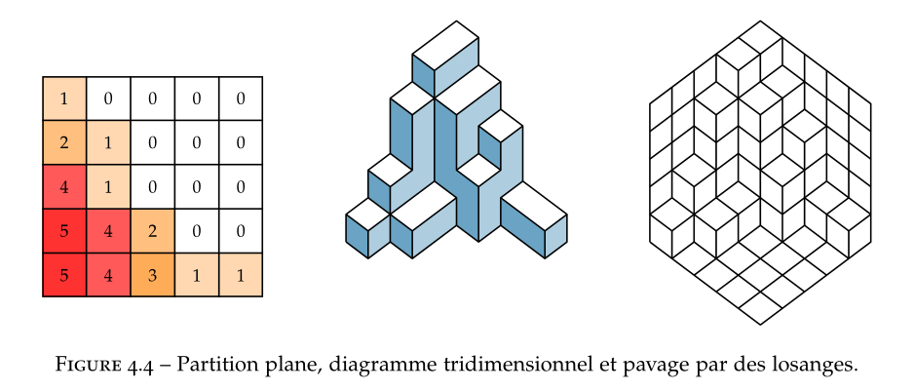
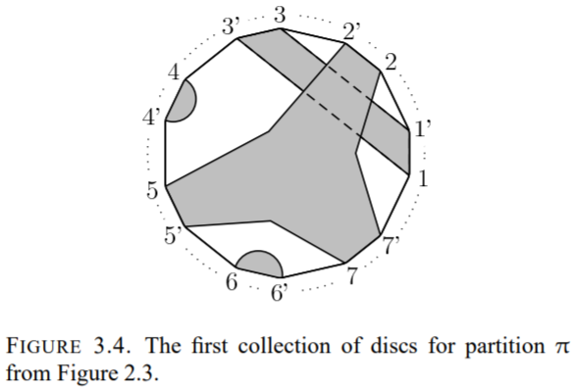
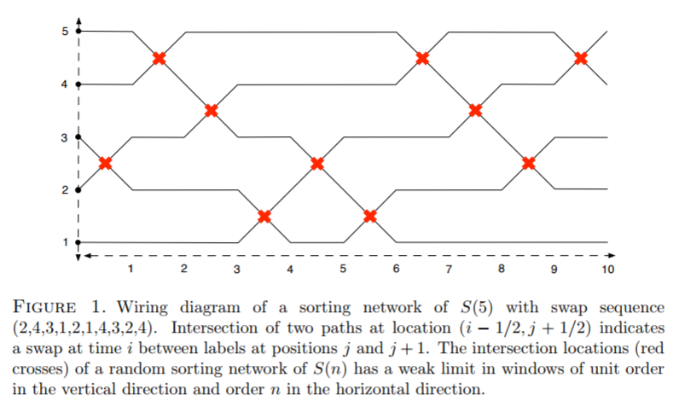
The right way to compute them involves representation theory of S_{m}.
Which leads to stuff like…

Slide 58
Free Probability!
Tracy-Widom Distributions!
Donald Knuth!
Geometric Complexity Theory!
Longest Increasing Subsequences!
Sorting Networks!
Queueing Theory!
Traffic Models!
For more: www.cs.cmu.edu/~odonnell/papers/tomography-survey.pdf

Slide 59
Thanks!
For more: www.cs.cmu.edu/~odonnell/papers/tomography-survey.pdf

