Slide 1
High-Dimensional
Distribution Testing
Constantinos “Costis” Daskalakis
CSAIL and EECS, MIT

Slide 2
What properties do your BIG distributions have?

Slide 3
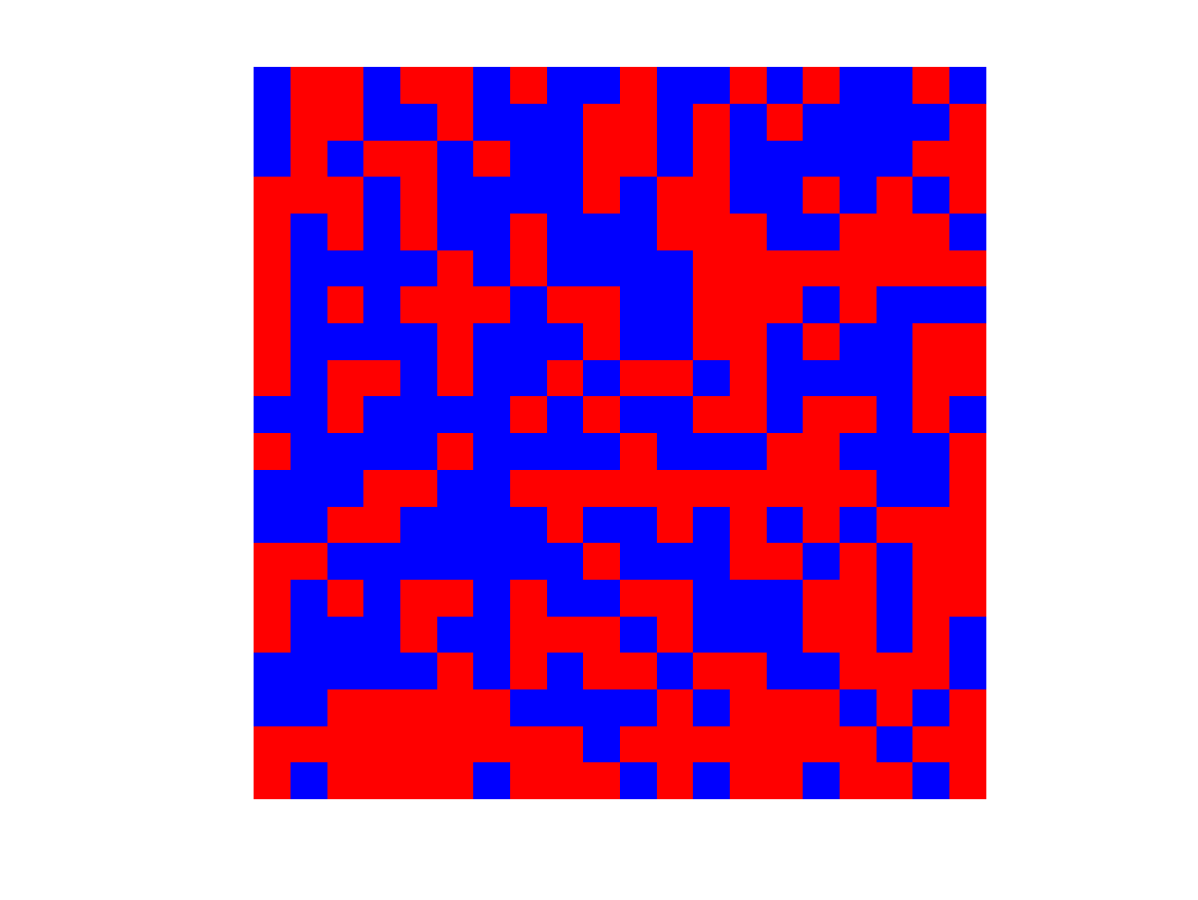
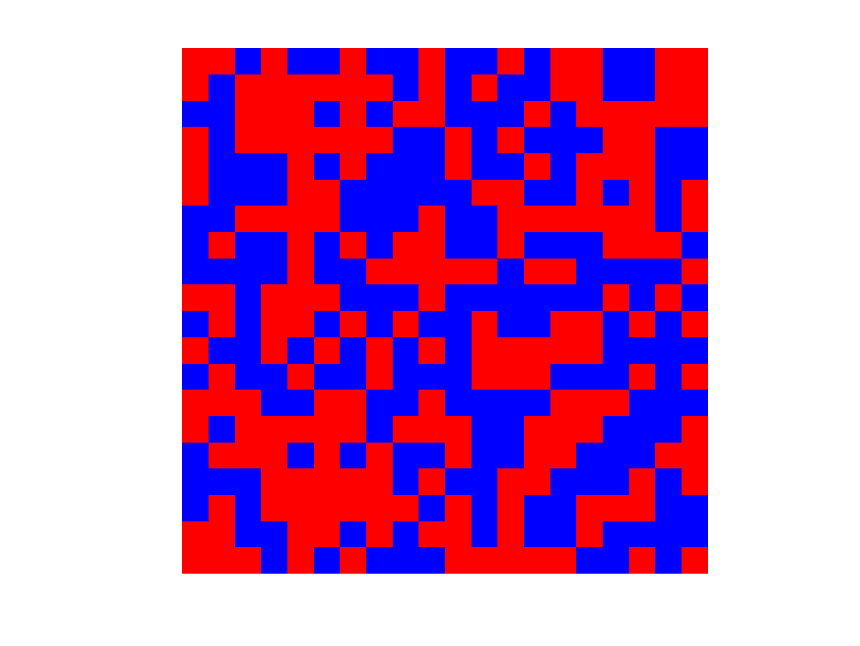
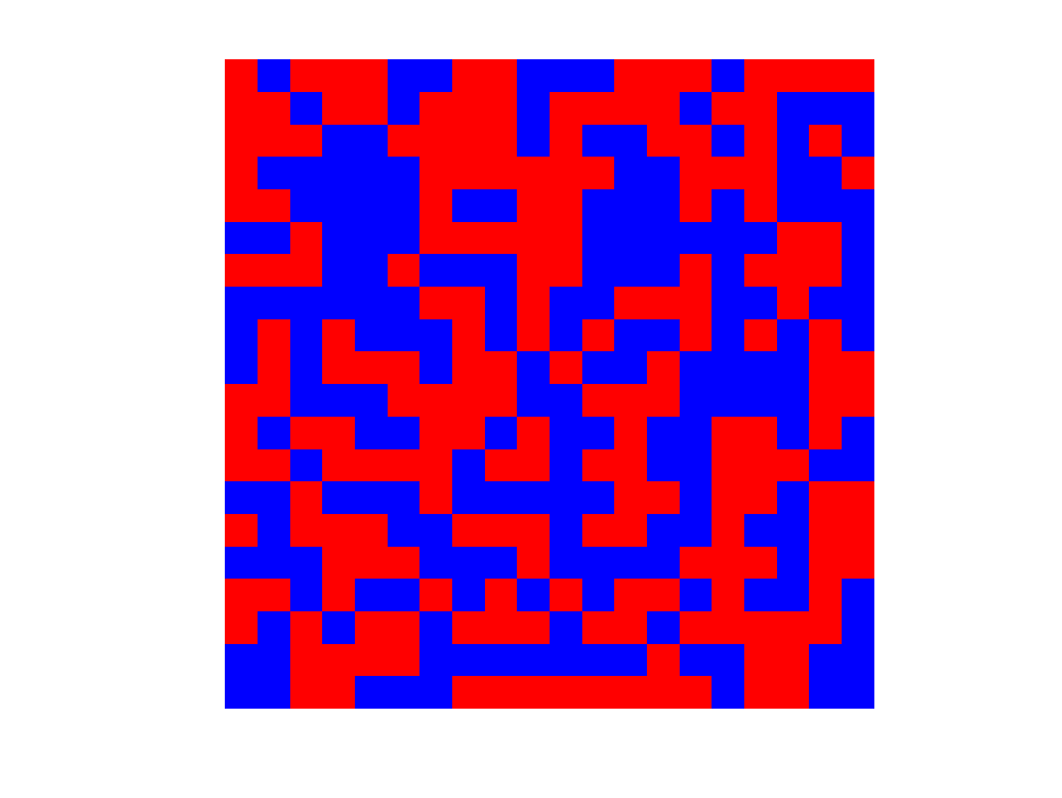
e.g. 1 Testing Uniformity
$n$ bit images
Consider source $p$ generating $n$-bit strings$∈{\left\{0,1\right\}}^{n}$
0011010101 (sample 1)
0101001110 (sample 2)
0011110100 (sample 3)
…
Is $p=U_{{\left\{0,1\right\}}^{n}}$ or is it far from uniform?
…

Slide 4
e.g.2: Linkage Disequilibrium
Genome
locus 1
locus 2
locus $n$
Single Nucleotide Polymorphisms (SNPs), are they independent?
Suppose $n$ loci, $2$ possible states each, then:
state of one’s genome $∈\{0,1\}^{n}$
humans: some distribution $p$ over $\{0,1\}^{n}$
Question: Is $p$ a product dist’n OR far from all product dist’ns?
1000 samples (you patients)

Slide 5
e.g.3: Behavior in a Social Network
Q: Are nodes behaving independently or far from independently?
Q’: Do adopted technologies exhibit weak or strong network effects?
1 sample

Slide 6
Problem formulation
Distribution Property:
$𝒫$: subset of all distributions over ${D=Σ}^{n}$
e.g. $𝒫$ = product measures, $𝒫$ = {uniform distribution over $D$}
Problem:
Given: samples from unknown $p$
w/ prob $≥0.9$, distinguish: $p∈𝒫$ vs $d(p,𝒫)>ε$
Objective
Minimize sample and time complexity
[Acharya-Daskalakis-Kamath NIPS’15]: A broad set of properties $𝒫$can be tested efficiently from an optimal $Θ\left(\sqrt{\left|D\right|}/ε^{2}\right)$ number of samples.
e.g. monotonicity and independence of high-dimensional dist’ns, unimodality, log-concavity, monotone-hazard rate of one-dimensional dist’ns
c.f. [Paninksi’04], [Valiant-Valiant’14], [Canonne et al’16]
The sample complexity of $Θ\left({\left|Σ\right|}^{n/2}/ε^{2}\right)$ is optimal, but unsettling
TV (c.f. G’s talk)
$≪|D|$?

Slide 7
What do we really know about our BIG distributions of interest?

Slide 8
Inspecting the LB Instance
Task: Distinguish $p=U_{{\left\{0,1\right\}}^{n}}$ vs $d_{TV}\left(p,U_{{\left\{0,1\right\}}^{n}}\right)>ε$?
[Paninski’04]: $Θ\left(\frac{2^{n/2}}{ε^{2}}\right)$ samples are necessary and sufficient
“Proof:”
Universe 1: $p$ is uniform over ${\left\{0,1\right\}}^{n}$
Universe 2: $p$ is randomly chosen as follows
if $u,v$ differ only in last bit, set $\left(p_{u},p_{v}\right)=\left(\frac{1}{2^{n}}\left(1±ε\right), \frac{1}{2^{n}}\left(1∓ε\right) \right)$
average distribution in Universe 2 = uniform (formally use LeCam)
To index a dist’n in Universe 2, need $2^{n}/2$ bits
Nature doesn’t have this many bits
often high dimensional systems have structure,
modeled as Markov Random Fields (MRFs), Bayesian Networks, etc
Testing high-dimensional distributions with structure?
u.a.r.

Slide 9
Today’s Menu
Motivation
Testing Bayesian Networks
Testing Ising Models
Closing Thoughts

Slide 10
Today’s Menu
Motivation
Testing Bayesian Networks
Testing Ising Models
Closing Thoughts

Slide 11
Bayesian Networks
Probability distribution defined in terms of a DAG $G=(V,E)$
Nodes $v$ associated w/ random variable $X_{v}∈Σ$
Distribution factorizable in terms of parenthood relationships
$$\operatorname{Pr}{(x)} =\prod_{v}{Pr_{X_{v}|X_{Π_{v}}}\left(x_{v}|x_{Π_{v}}\right)}, ∀x∈Σ^{V}$$
Parents of $v$ in $G$
$$X_{1}$$
$$X_{2}$$
$$X_{3}$$
$$Pr\left[\vec{x}\right]=Pr\left[x_{1}\right]⋅\operatorname{Pr}\left[x_{2}\right]⋅\operatorname{Pr}\left[x_{3} | x_{1},x_{2}\right]⋅\operatorname{Pr}\left[x_{4} | x_{3}\right]⋅\operatorname{Pr}\left[x_{5}\right|x_{3},x_{4}]$$
$$X_{4}$$
$$X_{5}$$

Slide 12
Testing Bayesian Networks
Bayesnet$P$on DAG $G$ with:
- $n$ nodes
- in-degree $d$
Bayesnet $Q$ on DAG $H$ with:
- $n$ nodes
- in-degree $d$
$$X^{1},X^{2},…$$
$$…{,Y}^{2},Y^{1}$$
Goal: distinguish $P=Q$ vs $d_{TV}\left(P,Q\right)>ε$
[Daskalakis-Pan COLT’17]: There exist efficient testers using:
- $\tilde{O}\left(\frac{{\left|Σ\right|}^{0.75 \left(d+1\right)}n}{ε^{2}}\right)$ samples, if DAGs $G$= $H$ and unknown
- $\tilde{O}\left(\frac{{\left|Σ\right|}^{9/2}n}{ε^{2}}\right)$ samples, if $G$ and $H$ are unknown and potentially different trees
Moreover, the dependence on $n,ε$ of both bounds is tight up to a $O(\log{n})$ factor, and the exponential in $d$ dependence is necessary and essentially tight.
[Canonne et al. COLT’17]: Identify conditions under which dependence on $n$ can be made $\sqrt{n}$when one of the two Bayesnets is known (goodness-of-fit problem)
Notes:
N.B. sample complexity above beats sample complexity of exponential time tournament based learning algorithm

Slide 13
Testing Bayesian Networks (cont’d)
Goal: distinguish $P=Q$ vs $d_{TV}\left(P,Q\right)>ε$
Idea: distance localization
prove statements of the form: “If P and Q are far in TV, there exists a small size witness set $S$ of variables such that $P_{S}$ and $Q_{S}$, the marginals of P and Q on variables $S$, are also somewhat far away”
reduces the original problem to identity testing on small size sets
Question: which distance to localize in?
Attempt 1: $d_{TV}\left(P,Q\right)≤\sum_{v}{d_{TV}}\left(P_{v∪Π_{v}},Q_{v∪Π_{v}}\right)+\sum_{v}{d_{TV}}\left(P_{Π_{v}},Q_{Π_{v}}\right)$ (hybrid argument)
Hence:$d_{TV}\left(P,Q\right)>ε ⇒ ∃v s.t.d_{TV}\left(P_{v∪Π_{v}},Q_{v∪Π_{v}}\right)>\frac{ε}{2n}$ or $d_{TV}\left(P_{Π_{v}},Q_{Π_{v}}\right)>\frac{ε}{2n}$
But leads to suboptimal sample complexity $Ω_{d,\left|Σ\right|}\left(\frac{n^{2}}{ε^{2}}\right)$
Attempt 2: $KL\left(P||Q\right)≤\sum_{v}{KL}\left(P_{v∪Π_{v}}||Q_{v∪Π_{v}}\right)$ (chain rule of KL)
Hence:$d_{TV}\left(P,Q\right)>ε ⇒KL\left(P||Q\right)>{2ε}^{2} ⇒ ∃v s.t.KL\left(P_{v∪Π_{v}}||Q_{v∪Π_{v}}\right)>\frac{2ε^{2}}{n}$
But KL testing requires infinitely many samples, b.c. of low probability events ☹

Slide 14
Testing Bayesian Networks (cont’d)
Goal: distinguish $P=Q$ vs $d_{TV}\left(P,Q\right)>ε$
Idea: distance localization
prove statements of the form: “If P and Q are far in TV, there exists a small size witness set $S$ of variables such that $P_{S}$ and $Q_{S}$, the marginals of P and Q on variables $S$, are also somewhat far away”
reduces the original problem to identity testing on small size sets
Attempt 3: Use Hellinger distance!
Defined as: $H\left(P,Q\right)=\frac{1}{\sqrt{2}}⋅\sqrt{\sum_{x}{{\left(\sqrt{P\left(x\right)}−\sqrt{Q\left(x\right)}\right)}^{2}}}$
Satisfies: $d_{TV}\left(P,Q\right)≤\sqrt{2}⋅H\left(P,Q\right)≤\sqrt{KL(P||Q)}$
We show that $H^{2}$ satisfies subadditivity over neighborhoods:
$$H^{2}\left(P,Q\right)≤\sum_{v}{H^{2}}\left(P_{v∪Π_{v}},Q_{v∪Π_{v}}\right)$$
Hence:$d_{TV}\left(P,Q\right)>ε ⇒ ∃v s.t.H^{2}\left(P_{v∪Π_{v}},Q_{v∪Π_{v}}\right)>\frac{ε^{2}}{2n}$
c.f. G’s talk: distinguishing $H^{2}\left(P_{v∪Π_{v}},Q_{v∪Π_{v}}\right)=0$ versus $>\frac{ε^{2}}{2n}$, requires $O_{d,\left|Σ\right|}\left(\frac{n}{ε^{2}}\right)$ samples

Slide 15
Today’s Menu
Motivation
Testing Bayesian Networks
Testing Ising Models
Closing Thoughts

Slide 16
Ising Model
Probability distribution defined in terms of a graph $G=\left(V,E\right)$
State space ${\left\{±1\right\}}^{V}$
Given edge potentials $θ_{e}$, node potentials $θ_{v}$:
$$p_{θ}\left(x\right)∝\exp\left(\sum_{e=\left(u,v\right)∈E}{θ_{e}x_{u}x_{v}}+\sum_{v∈V}{θ_{v}x_{v}}\right)$$
High $|θ_{e}|$’s $⟹$ strongly (anti-)correlated spins
Statistical physics, computer vision, neuroscience, social science

Slide 17
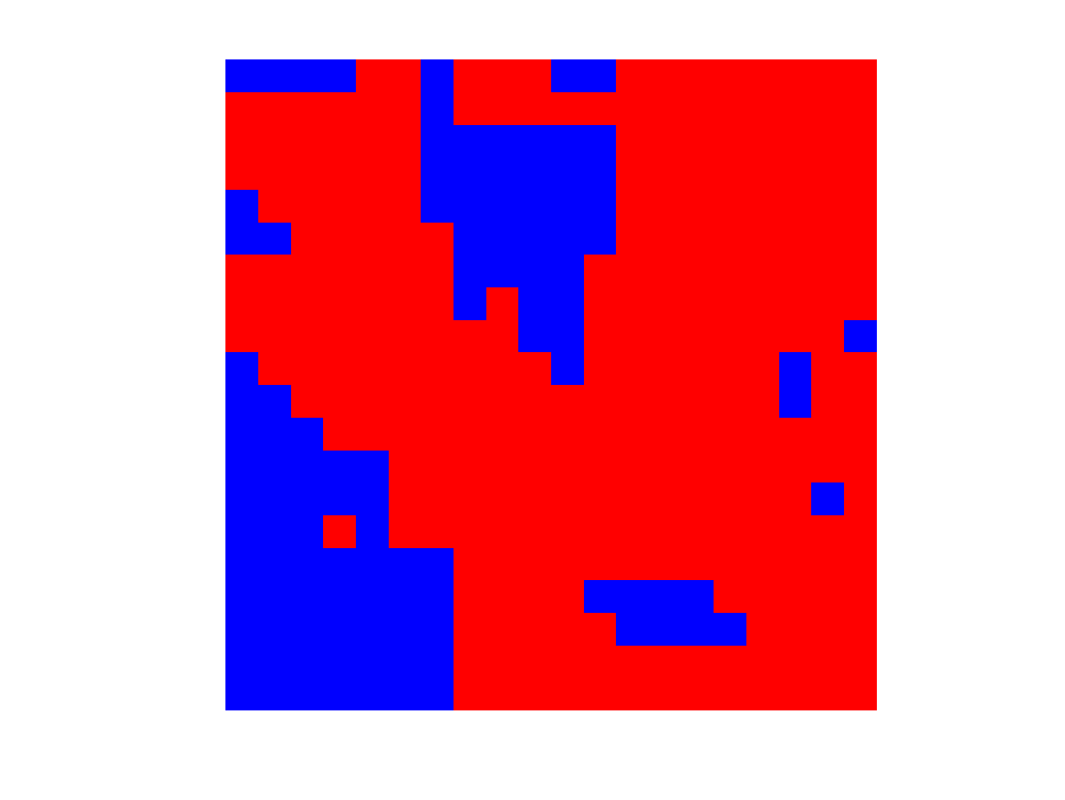
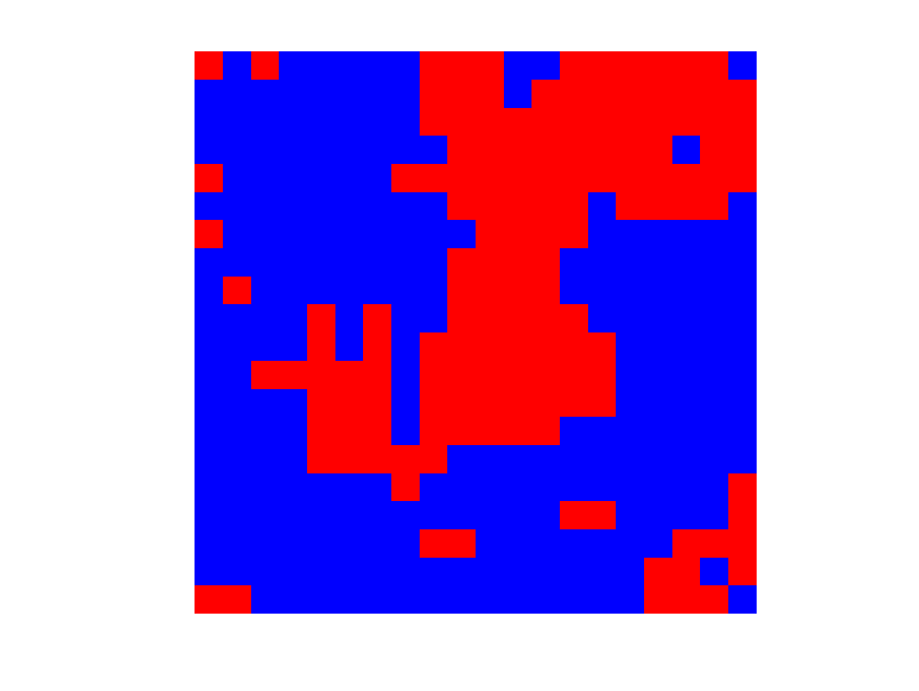
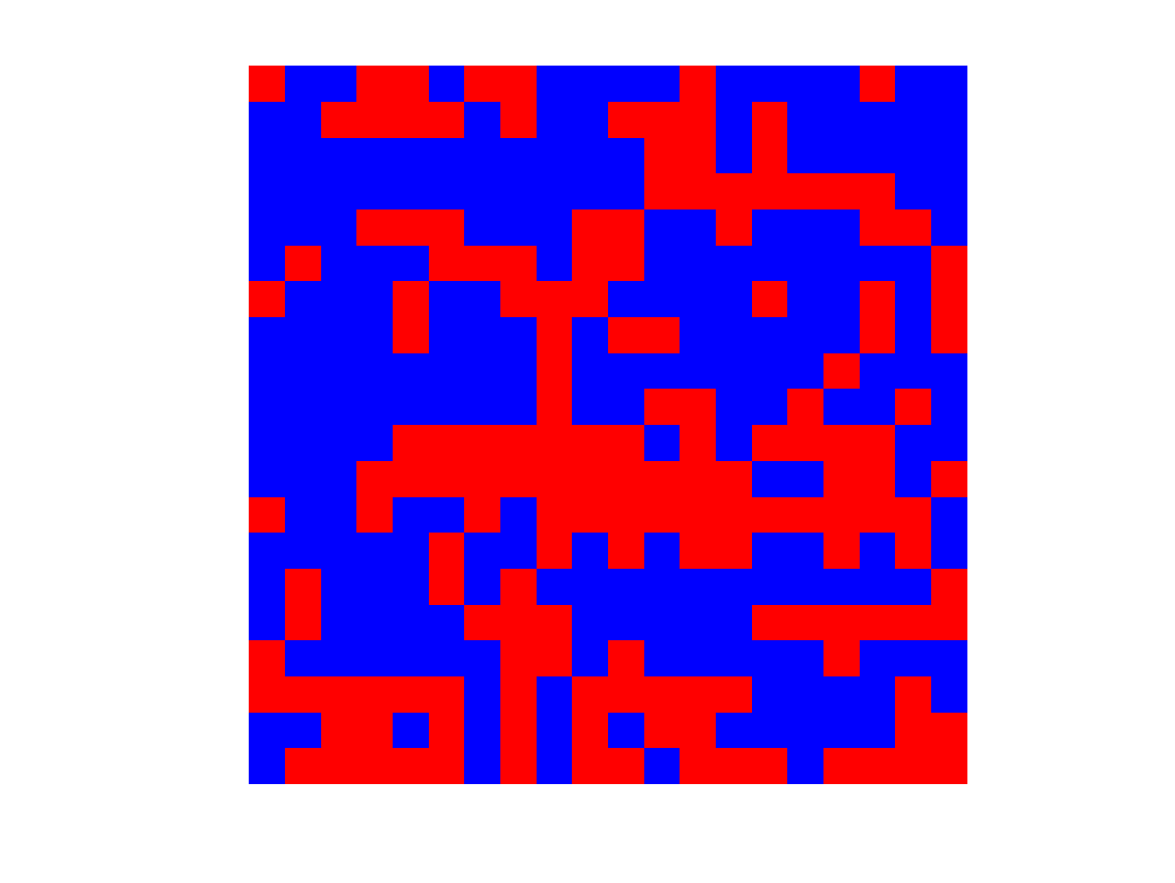
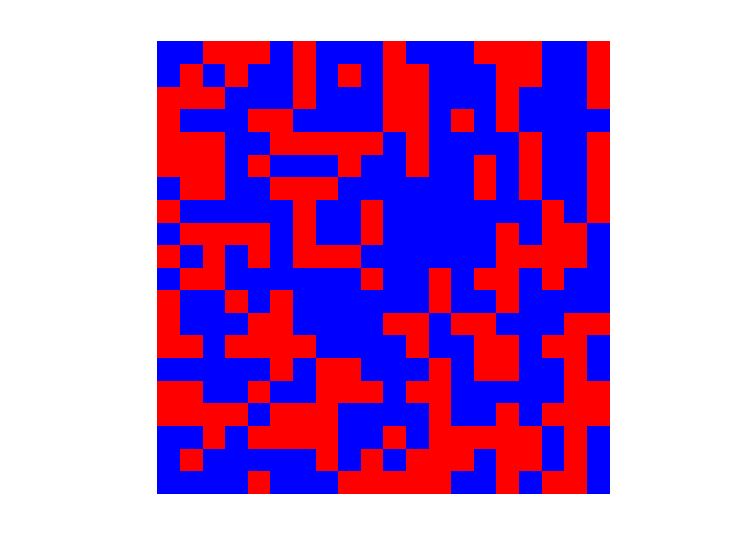
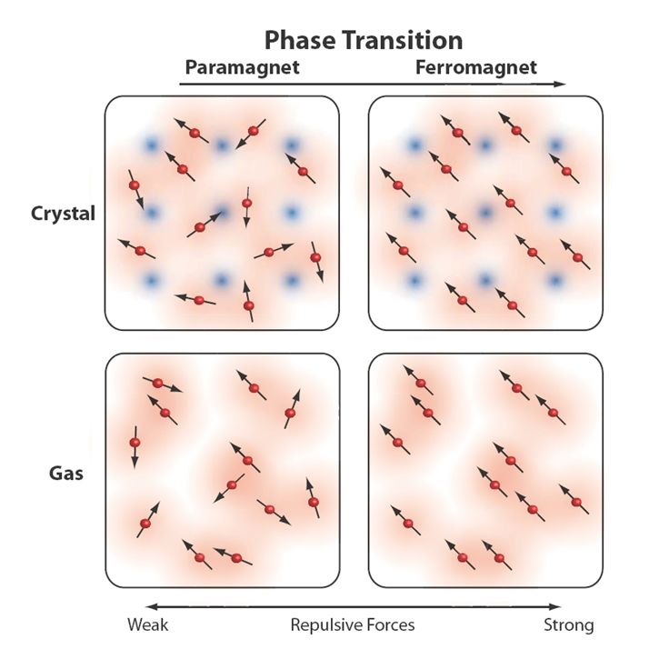
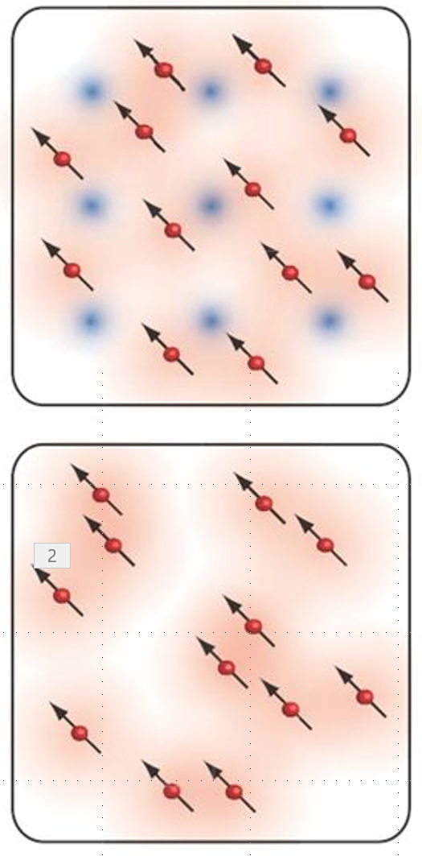
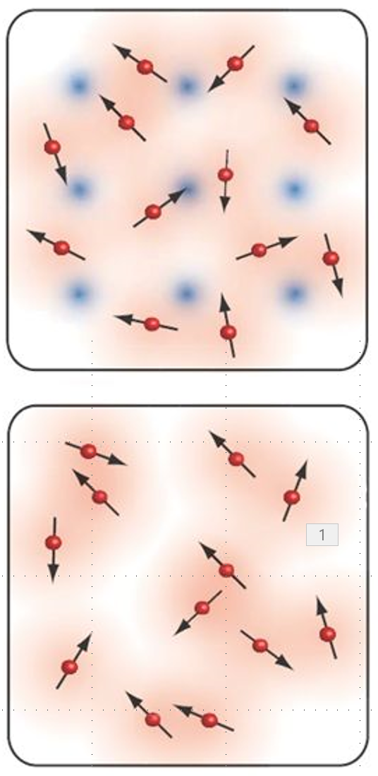
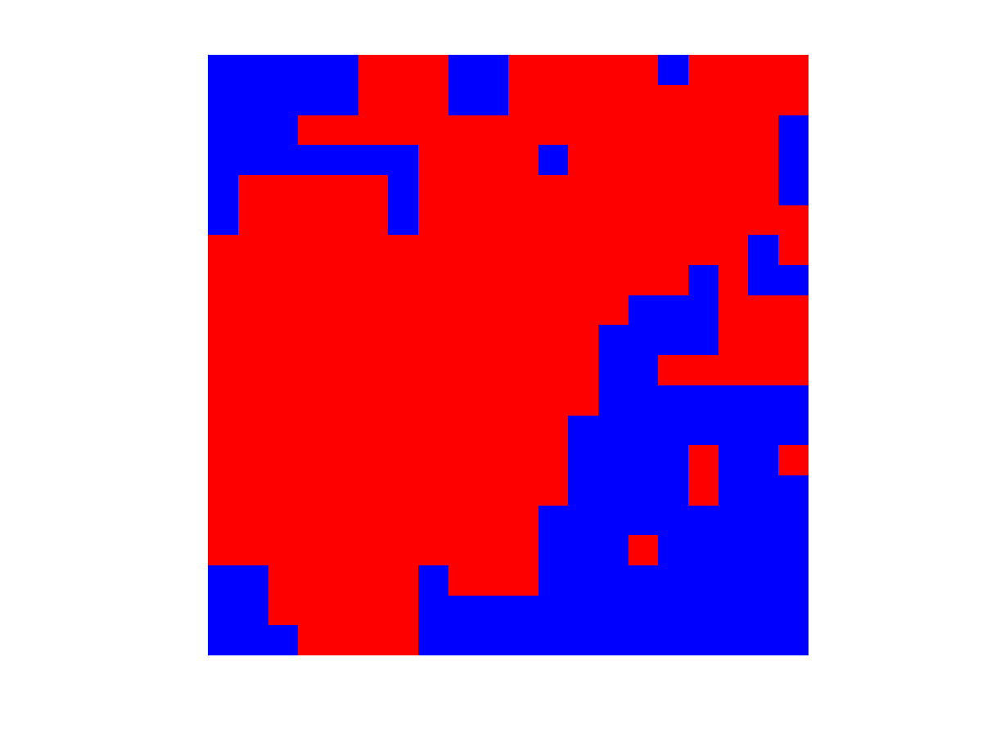
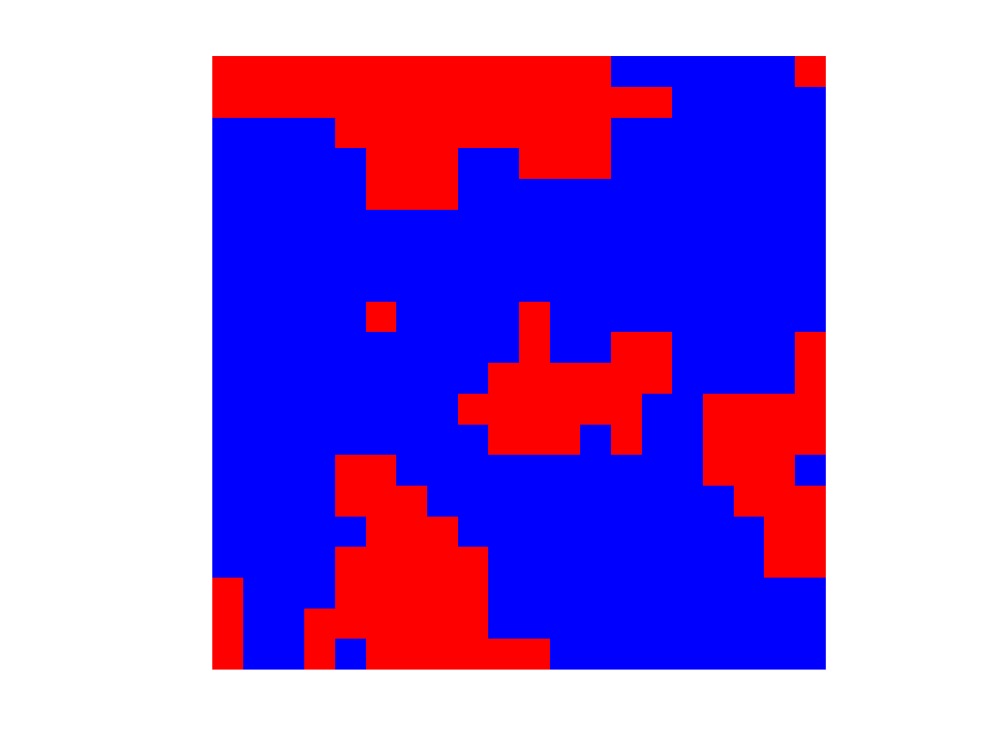
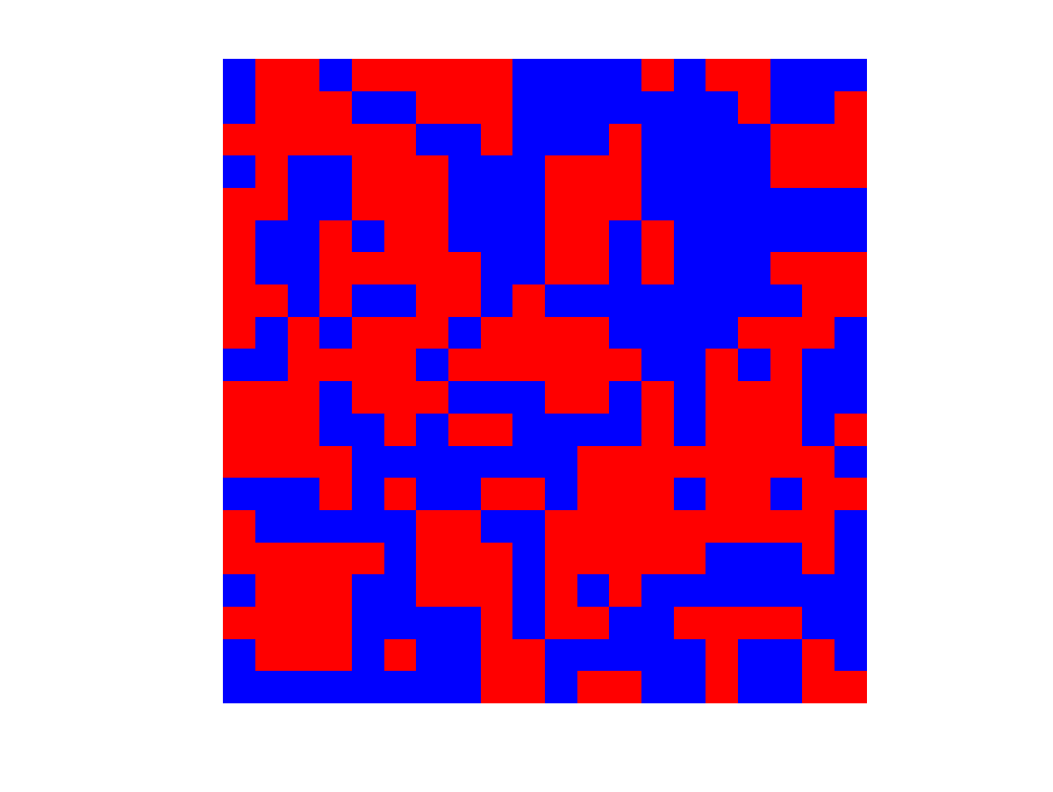
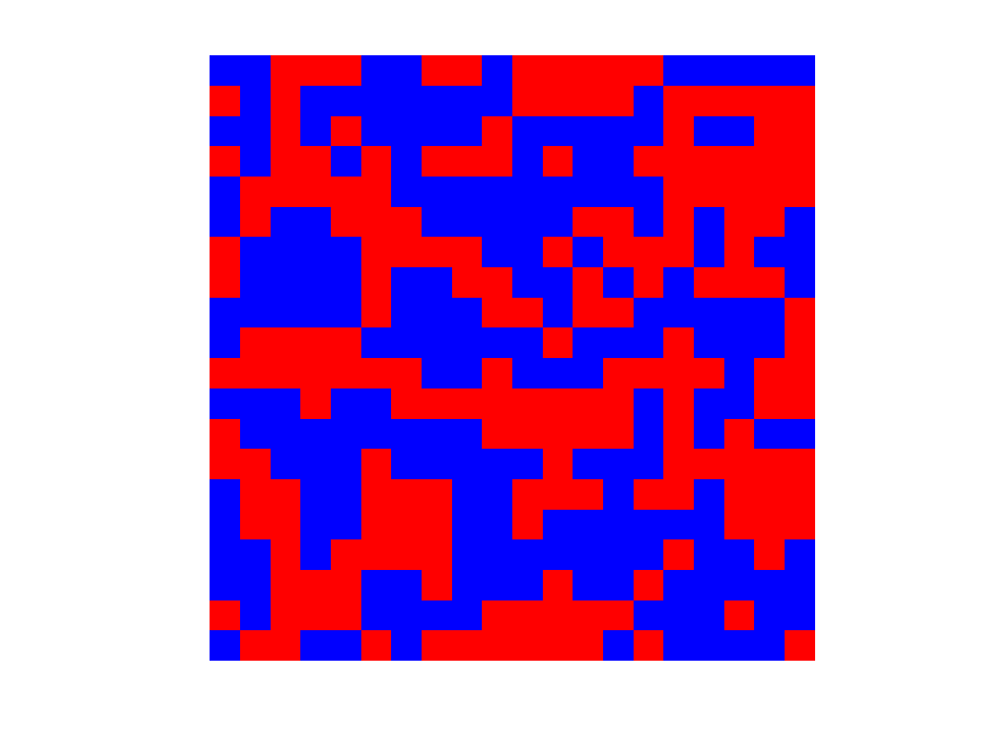
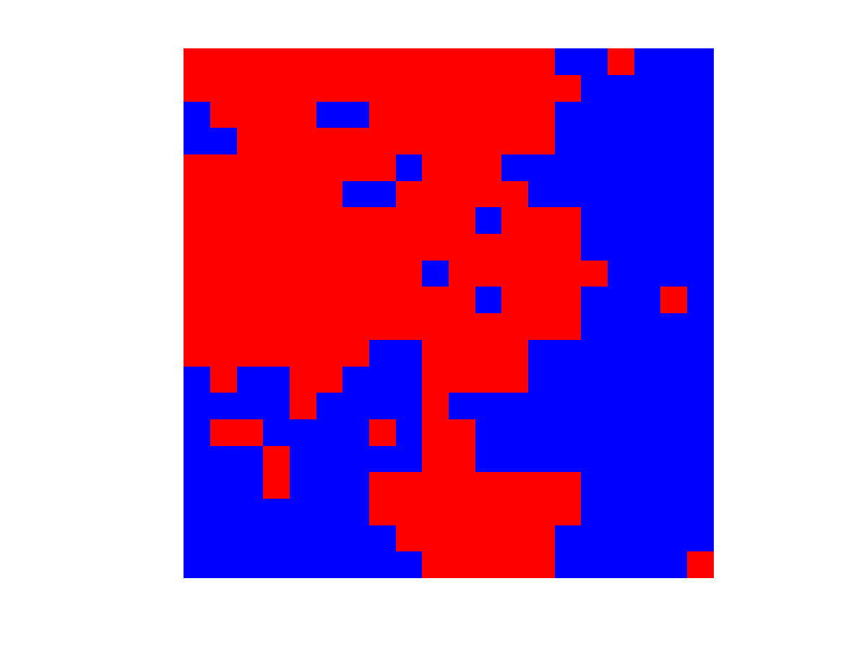
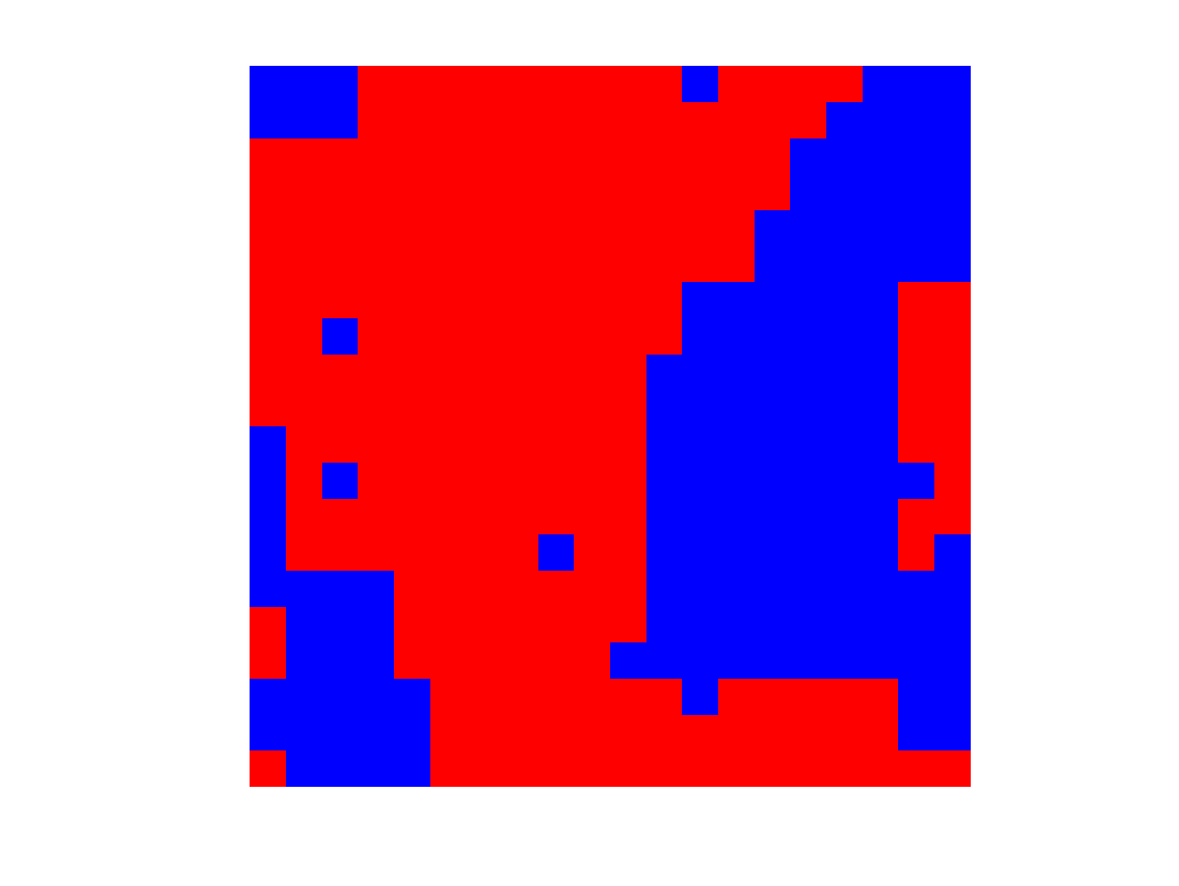
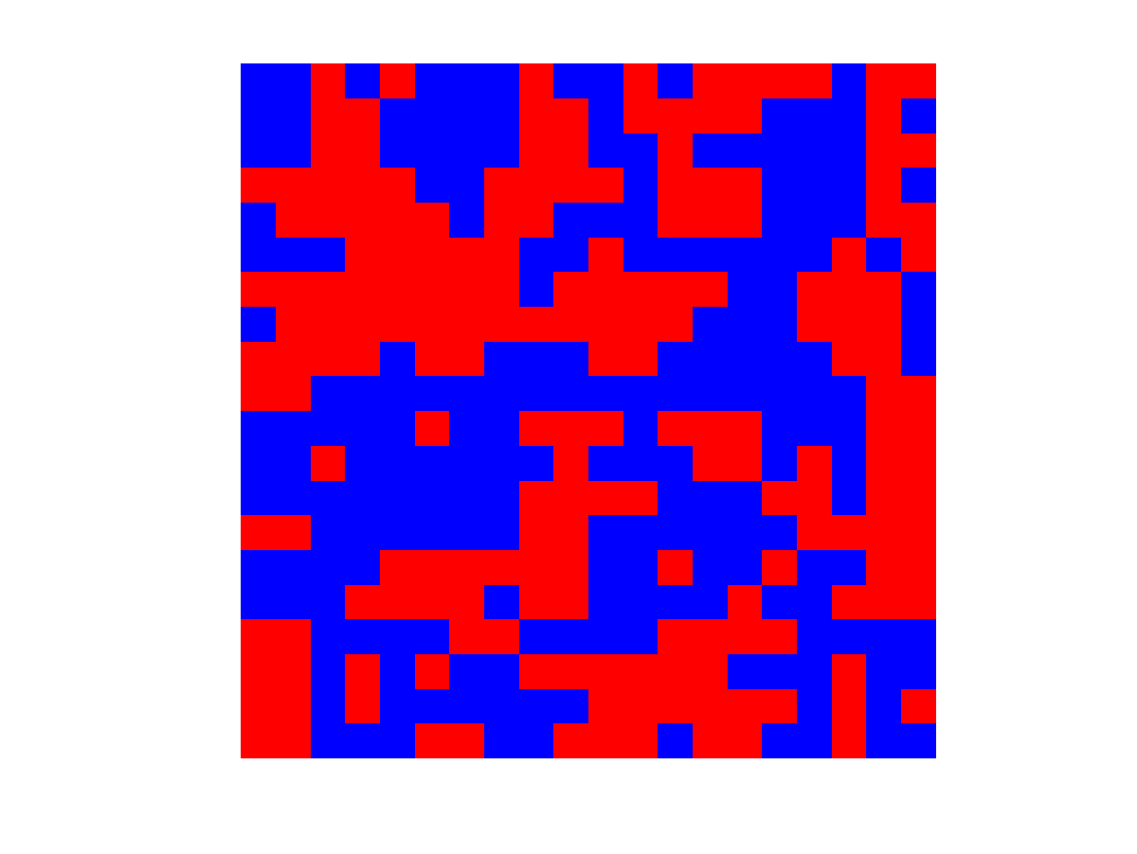
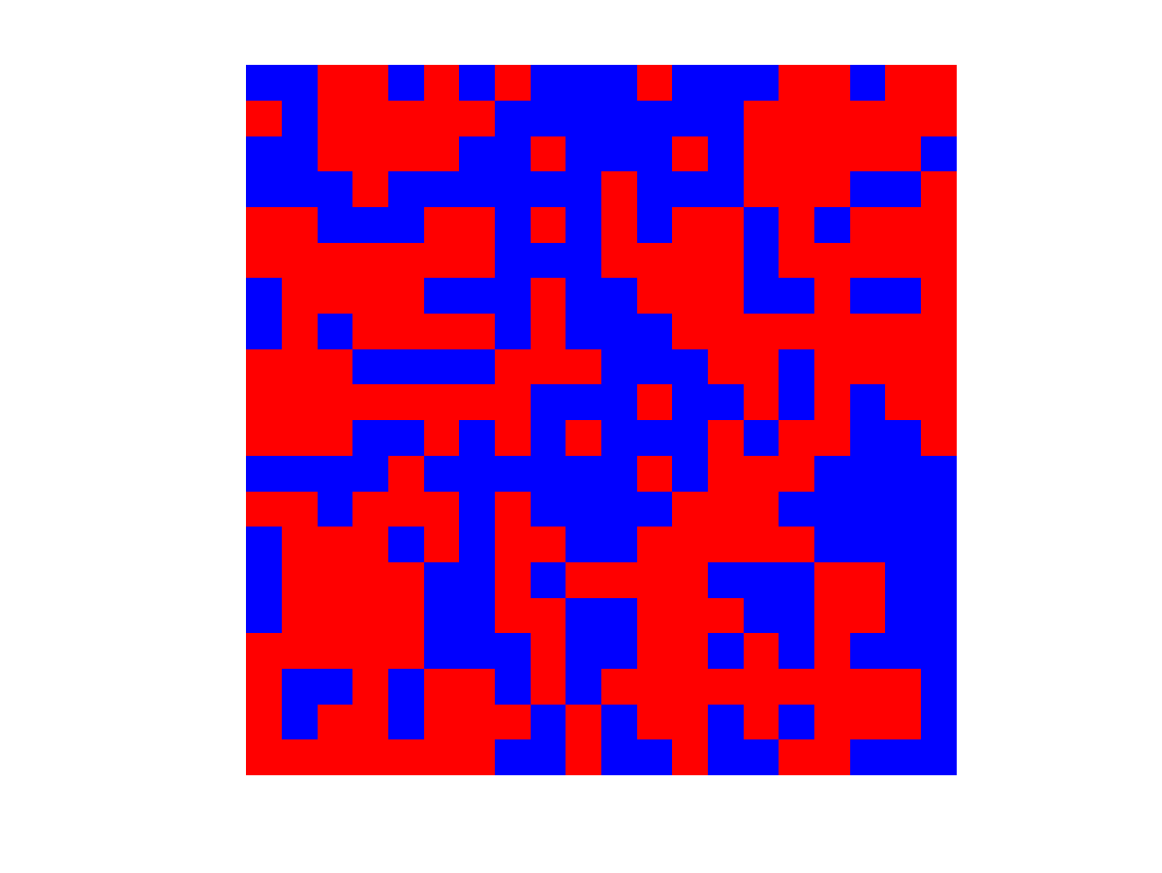
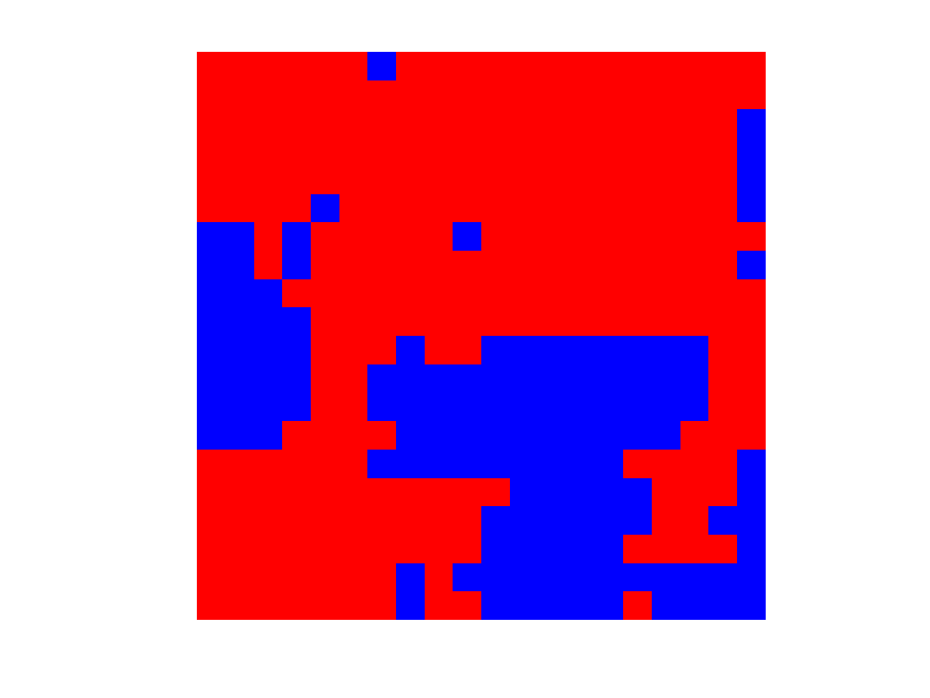
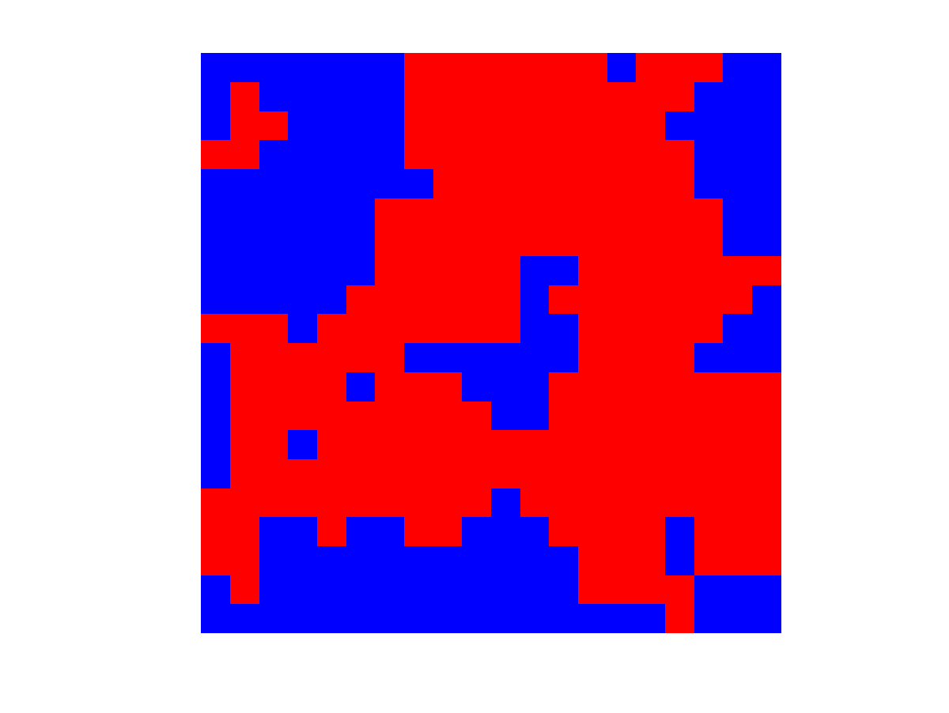
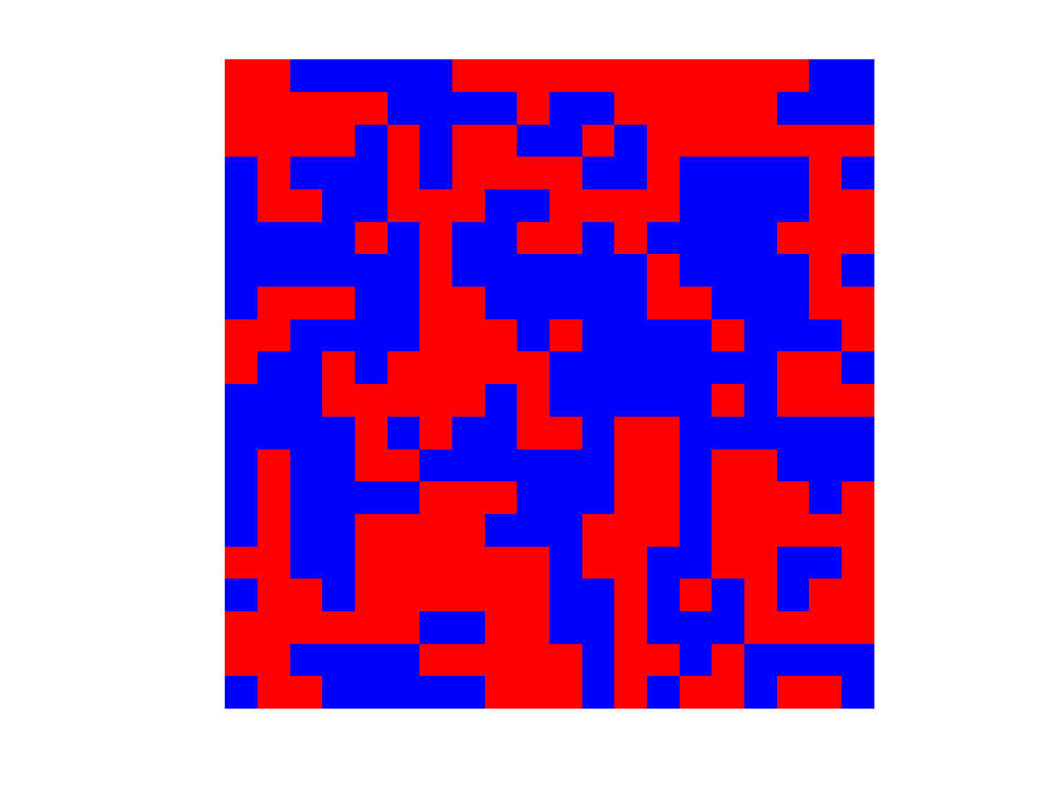
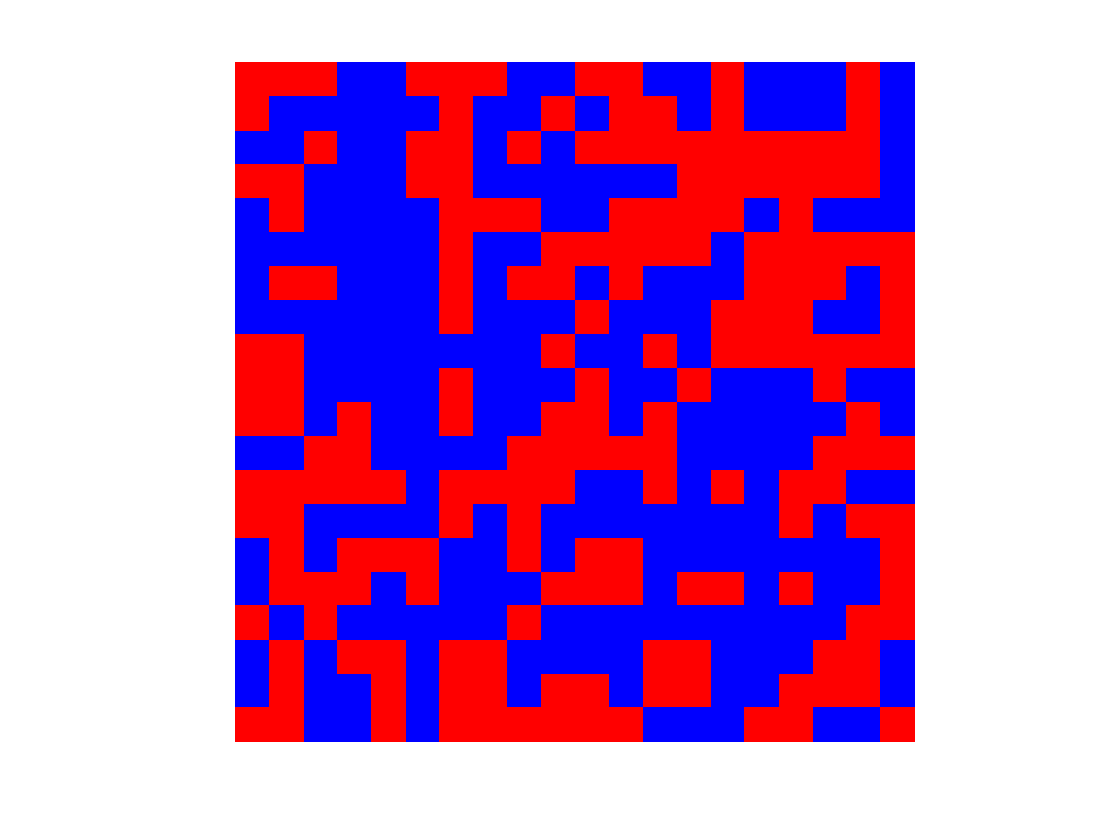
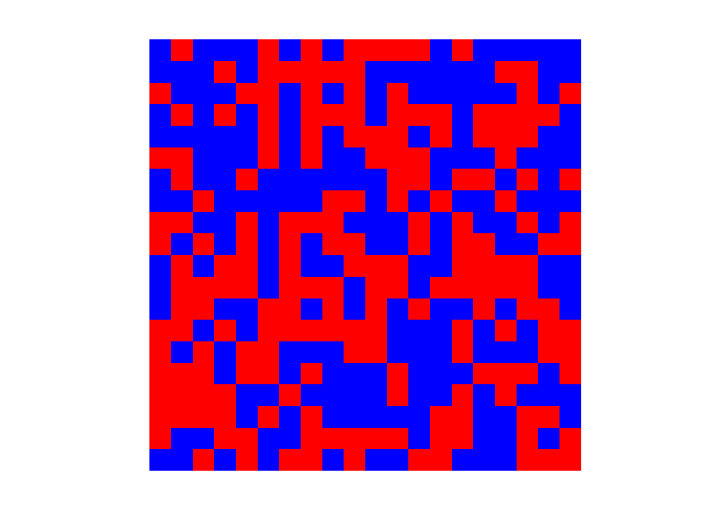
Ising Model: Strong vs weak ties
$$θ_{v}=0$$
“low temperature regime”
“high temperature regime”
Forces
$$θ_{e}=1$$
$$θ_{e}=0.5$$
$$θ_{e}=0.25$$
$$θ_{e}=0.125$$
$$θ_{e}=0$$

Slide 18
Testing Ising Models
$$p_{θ}\left(x\right)∝\exp\left(\sum_{\left(u,v\right)}{θ_{uv}x_{u}x_{v}}+\sum_{v∈V}{θ_{v}x_{v}}\right)$$
Identity Testing: Given sample access to two Ising models $p_{θ}$ and $p_{θ^{′}}$,
distinguish $p_{θ}=p_{θ^{′}}$ vs $d_{TV}\left(p_{θ},p_{θ^{′}}\right)>ε$
Independence Testing: Given sample access to an Ising model $p_{θ}$,
distinguish $p_{θ}∈ℐ_{{\left\{±1\right\}}^{V}}$ vs $ℓ_{1}\left(p_{θ},ℐ_{{\left\{±1\right\}}^{V}}\right)>ε$
[w/ Dikkala, Kamath SODA’18]: small-$poly\left(n,\frac{1}{ε}\right)$ samples suffice to do this efficiently
Poly depends on the regime: high vs low temperature, ferromagnetic ($θ_{uv}≥0,∀u,v$) vs non-ferromagnetic, non-external fields ${(θ}_{v}=0, ∀v$) vs external fields, tree vs general graph, independence vs identity, etc.
Technical vignettes: localization, concentration of measure
product measures

Slide 19
Testing Ising Models
$$p_{θ}\left(x\right)∝\exp\left(\sum_{\left(u,v\right)}{θ_{uv}x_{u}x_{v}}+\sum_{v∈V}{θ_{v}x_{v}}\right)$$
Identity Testing: Given sample access to two Ising models $p_{θ}$ and $p_{θ^{′}}$,
distinguish $p_{θ}=p_{θ^{′}}$ vs $d_{TV}\left(p_{θ},p_{θ^{′}}\right)>ε$
Independence Testing: Given sample access to an Ising model $p_{θ}$,
distinguish $p_{θ}∈ℐ_{{\left\{±1\right\}}^{V}}$ vs $ℓ_{1}\left(p_{θ},ℐ_{{\left\{±1\right\}}^{V}}\right)>ε$
[w/ Dikkala, Kamath SODA’18]: small-$poly\left(n,\frac{1}{ε}\right)$ samples suffice to do this efficiently
Poly depends on the regime: high vs low temperature, ferromagnetic ($θ_{uv}≥0,∀u,v$) vs non-ferromagnetic, non-external fields ${(θ}_{v}=0, ∀v$) vs external fields, tree vs general graph, independence vs identity, etc.
Technical vignettes: localization, concentration of measure
product measures

Slide 20
Testing Ising Models
$$p_{θ}\left(x\right)∝\exp\left(\sum_{\left(u,v\right)}{θ_{uv}x_{u}x_{v}}+\sum_{v∈V}{θ_{v}x_{v}}\right)$$
Identity Testing: Given sample access to two Ising models $p_{θ}$ and $p_{θ^{′}}$,
distinguish $p_{θ}=p_{θ^{′}}$ vs $d_{TV}\left(p_{θ},p_{θ^{′}}\right)>ε$
Independence Testing: Given sample access to an Ising model $p_{θ}$,
distinguish $p_{θ}∈ℐ_{{\left\{±1\right\}}^{V}}$ vs $ℓ_{1}\left(p_{θ},ℐ_{{\left\{±1\right\}}^{V}}\right)>ε$
Bi-linear functions of the Ising model serve as useful distinguishing statistics
For $X∼p_{θ}$ consider:
$f\left(X\right)=\sum_{u,v}{c_{uv}{(X}_{u}−E[X_{u}])(X_{v}−E[X_{v}])}$, where say $c_{uv}∈[±1]$
Technical Challenge: can’t bound $Var[f\left(X\right)]$ intelligently
If $θ_{uv}=0, ∀uv$, then $Var\left[f(X)\right]=n^{2}$
O.w. best can say is (trivial) $Var\left[f(X)\right]=O(n^{4}$)
and, in fact, this is tight
consider two disjoint cliques with super-strong $θ_{uv}$’s inside, 0 across, and all $θ_{v}$’s zero everywhere
suppose also $c_{u,v}=1,$ for all $u,v$
Then $f(X)$ dances around its mean by $Ω\left(n^{2}\right)$
Low temperature.
How about high temperature?
$$θ_{uv}=+∞$$
$$θ_{uv}=+∞$$

Slide 21
High Temperature Ising
Several conditions
Dobrushin’s uniqueness criterion:
$$\max_{v}{\sum_{u≠v}{\tanh\left(\left|θ_{uv}\right|\right)<1}}$$
Think:
$$\max_{v}{\sum_{u≠v}{\left|θ_{uv}\right|<1}}$$
Implies:
$O\left(n logn\right)$ mixing of natural MC
Correlation decay properties

Slide 22
Ising Model: Strong vs weak ties
$$θ_{v}=0$$
“low temperature regime”
“high temperature regime”
Exponential mixing of the Glauber dynamics
$O\left(n⋅log n\right)$ mixing of the Glauber dynamics
$$θ_{e}=1$$
$$θ_{e}=0.5$$
$$θ_{e}=0.25$$
$$θ_{e}=0.125$$
$$θ_{e}=0$$
$$θ_{c}$$

Slide 23
Testing Ising Models
$$p_{θ}\left(x\right)∝\exp\left(\sum_{\left(u,v\right)}{θ_{uv}x_{u}x_{v}}+\sum_{v∈V}{θ_{v}x_{v}}\right)$$
Identity Testing: Given sample access to two Ising models $p_{θ}$ and $p_{θ^{′}}$,
distinguish $p_{θ}=p_{θ^{′}}$ vs $d_{TV}\left(p_{θ},p_{θ^{′}}\right)>ε$
Independence Testing: Given sample access to an Ising model $p_{θ}$,
distinguish $p_{θ}∈ℐ_{{\left\{±1\right\}}^{V}}$ vs $ℓ_{1}\left(p_{θ},ℐ_{{\left\{±1\right\}}^{V}}\right)>ε$
Bi-linear functions of the Ising model serve as useful distinguishing statistics
For $X∼p_{θ}$ consider:
$$f\left(X\right)=\sum_{u,v}{c_{uv}{(X}_{u}−E[X_{u}])(X_{v}−E[X_{v}])}$$
Low temperature: $Var\left[f\left(X\right)\right]=O\left(n^{4}\right)$
[w/ Dikkala, Kamath]: High temperature: $Var\left[f\left(X\right)\right]=O\left(n^{2}\right)$
proof by tightening exchangeable pair technology [Stein,…,Chatterjee 2006]

Slide 24
Concentration of Measure
$$p_{θ}\left(x\right)∝\exp\left(\sum_{\left(u,v\right)}{θ_{uv}x_{u}x_{v}}+\sum_{v∈V}{θ_{v}x_{v}}\right)$$
[w/ Dikkala, Kamath NIPS’17]: Under high temperature, any centered polynomial function of the Ising model concentrates essentially as well as if the variables where independent.
High temperature = Dobrushin’s condition holds, think ${\left\|[θ_{uv}]\right\|}_{∞}<1$
Centered multi-linear function of degree $d$:
$$f\left(X\right)=\sum_{S, \left|S\right|≤d}{c_{S}\prod_{v∈S}{(X_{v}−E\left[X_{v}\right])}}$$
Essentially as well as if the variables where independent:
$$Pr\left[\left|f\left(X\right)−E\left[f\left(X\right)\right]\right|>r\right]≤\exp\left(−Ω_{d}\left(\frac{r^{\frac{2}{d}}}{n\log{n}}\right)\right)$$
Improves from known concentration results on Lipschitz fn’s of Ising model
$n^{d−0.5}$ $→$ $n^{d/2}$ radius of concentration

Slide 25
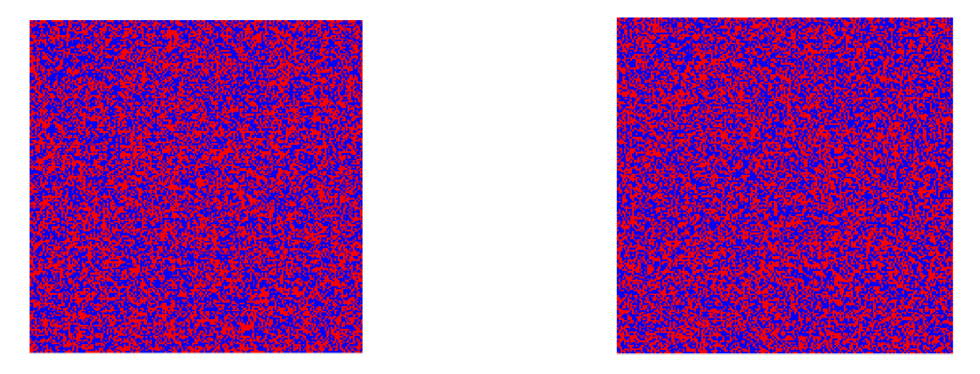
Using Concentration to Test
$$p_{θ}\left(x\right)∝\exp\left(\sum_{\left(u,v\right)}{θ x_{u}x_{v}}+\sum_{v∈V}{θ_{v}x_{v}}\right)$$
Is it high-temperature Ising $\left(θ<θ_{c}=\frac{\ln\left(1+\sqrt{2}\right)}{2}\right)?$
One is a sample from a product measure, the other is product measure but every node selects a friend or friend of friend and copies him with probability $τ$
Bilinear statistics catch the deviation at 10x smaller $τ$ value compared to MLE on $θ$ and comparison to $θ_{c}$

Slide 26
Testing Weak vs Strong Network Ties
e.g. Who listens to the Beatles?
Q: Given one sample (from last.fm dataset) of who does/doesn’t listen to a particular band, can we reject the hypothesis that this decision comes from high-temperature Ising model (lack of long range correlation)?
A: we can for Taylor Swift, Britney Spears, Katy Perry, Rihanna, Lady Gaga; we cannot for Beatles and Muse

Slide 27
Conclusions
Testing properties of high-dimensional distributions requires exponentially many samples
Making assumptions about the distribution being sampled gives leverage
[w/ Pan COLT’17]: Testing Bayes nets with linearly many samples
[w/ Dikkala, Kamath SODA’18]: Testing Ising models with polynomially many samples
[w/ Dikkala, Kamath NIPS’17]: Testing weak vs strong ties from one sample

Slide 28
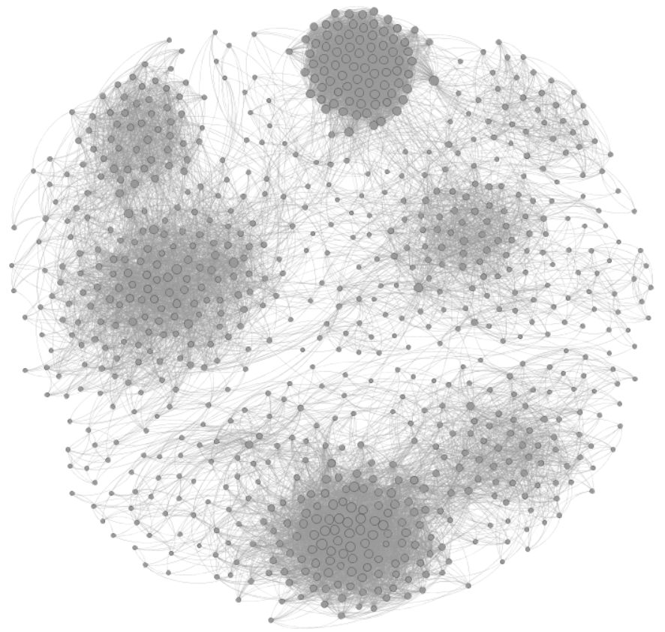
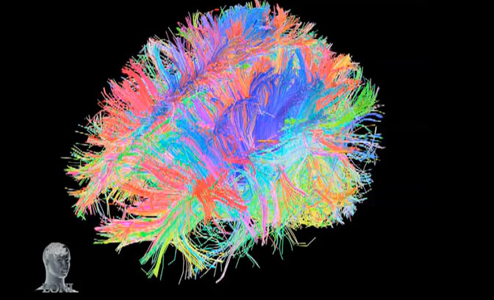
Testing from a Single Sample
Given one social network, one brain, etc., how can we test the validity of a certain generative model?
Ongoing with Aliakbarpour-Rubinfeld-Zampetakis, testing preferential attachment models

Slide 29
Testing Markov Chains
Given one trajectory of an unknown Markov Chain $M,$ whose starting state we cannot control, can we test whether it came from a given Markov Chain $M^{∗}$ over $n$ states?
Question: test $M=M^{∗} vs dist\left(M,M^{∗}\right)>ε$
[Ongoing w/ Dikkala, Gravin]: We propose a distance measure capturing the limiting behavior of the TV distance between trajectories of the two chains
$$dist\left(M,M^{∗}\right)=1−ρ\left(\sqrt{M_{ij}⋅M_{ij}^{∗}}\right)$$
Show that one trajectory of $n/ε^{2}$ length suffices
How to quantify distance between Markov chains?
Thanks!

