Slide 1
Cookbook: Lower Bounds for Statistical Inference in Distributed and Constrained Settings
Jayadev Acharya, Clément Canonne, Himanshu Tyagi
FOCS 2020
Part IV: Upper bounds and discussion

Slide 2
Those were lower bounds.

Slide 3
Those were lower bounds.
Are they tight?

Slide 4
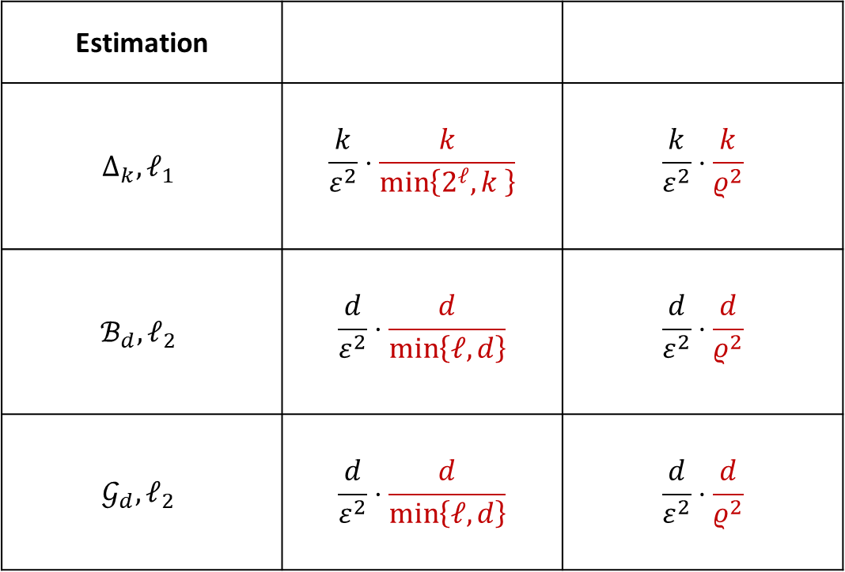
Upper bounds for learning
Estimation
$$Δ_{k}, ℓ_{1}$$ | $$\frac{k}{ε^{2}}⋅\frac{k}{\min\left\{2^{ℓ}, k \right\}}$$ | $$\frac{k}{ε^{2}}⋅\frac{k}{ρ^{2}}$$
$$ℬ_{d},ℓ_{2}$$ | $$\frac{d}{ε^{2}}⋅\frac{d}{\min\left\{ℓ, d\right\}}$$ | $$\frac{d}{ε^{2}}⋅\frac{d}{ρ^{2}}$$
$$𝒢_{d},ℓ_{2}$$ | $$\frac{d}{ε^{2}}⋅\frac{d}{\min\left\{ℓ, d\right\}}$$ | $$\frac{d}{ε^{2}}⋅\frac{d}{ρ^{2}}$$
4

Slide 5
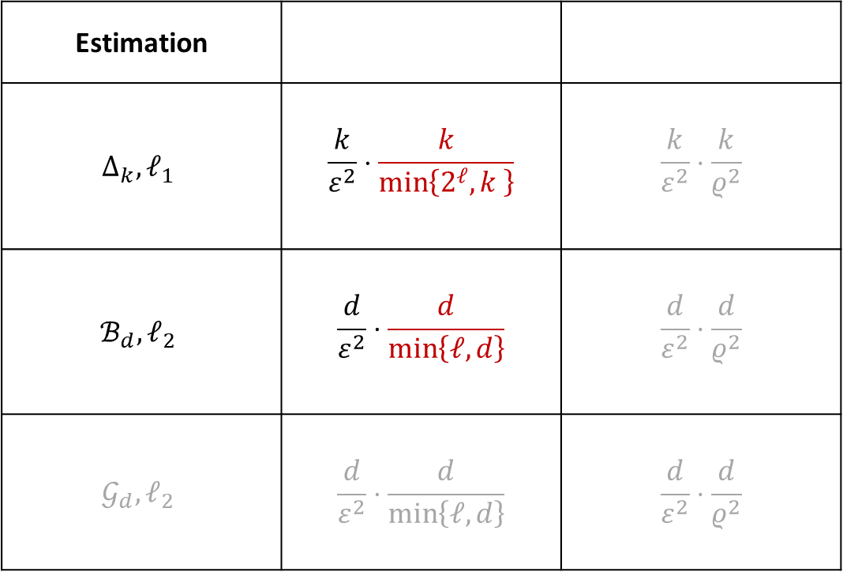
Upper bounds for learning
Estimation
$$Δ_{k}, ℓ_{1}$$ | $$\frac{k}{ε^{2}}⋅\frac{k}{\min\left\{2^{ℓ}, k \right\}}$$ | $$\frac{k}{ε^{2}}⋅\frac{k}{ρ^{2}}$$
$$ℬ_{d},ℓ_{2}$$ | $$\frac{d}{ε^{2}}⋅\frac{d}{\min\left\{ℓ, d\right\}}$$ | $$\frac{d}{ε^{2}}⋅\frac{d}{ρ^{2}}$$
$$𝒢_{d},ℓ_{2}$$ | $$\frac{d}{ε^{2}}⋅\frac{d}{\min\left\{ℓ, d\right\}}$$ | $$\frac{d}{ε^{2}}⋅\frac{d}{ρ^{2}}$$
Focus on communication for this part
5

Slide 6
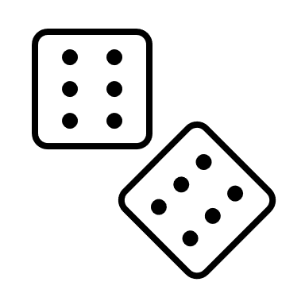
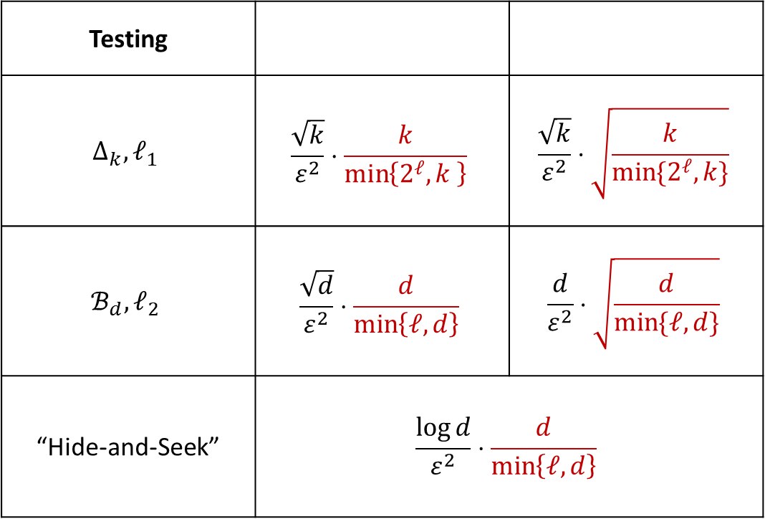
Upper bounds for testing
Testing
$$Δ_{k}, ℓ_{1}$$ | $$\frac{\sqrt{k}}{ε^{2}}⋅\frac{k}{\min\left\{2^{ℓ}, k \right\}}$$ | $$\frac{\sqrt{k}}{ε^{2}}⋅\sqrt{\frac{k}{\min{\{2^{ℓ},k\}}}}$$
$$ℬ_{d},ℓ_{2}$$ | $$\frac{\sqrt{d}}{ε^{2}}⋅\frac{d}{\min\left\{ℓ, d\right\}}$$ | $$\frac{d}{ε^{2}}⋅\sqrt{\frac{d}{\min{\{ℓ,d\}}}}$$
“Hide-and-Seek” | $$\frac{\log{d}}{ε^{2}}⋅\frac{d}{\min\left\{ℓ, d\right\}}$$
6

Slide 7
Upper bounds for testing
Testing
$$Δ_{k}, ℓ_{1}$$ | $$\frac{\sqrt{k}}{ε^{2}}⋅\frac{k}{\min\left\{2^{ℓ}, k \right\}}$$ | $$\frac{\sqrt{k}}{ε^{2}}⋅\sqrt{\frac{k}{\min{\{2^{ℓ},k\}}}}$$
$$ℬ_{d},ℓ_{2}$$ | $$\frac{\sqrt{d}}{ε^{2}}⋅\frac{d}{\min\left\{ℓ, d\right\}}$$ | $$\frac{d}{ε^{2}}⋅\sqrt{\frac{d}{\min{\{ℓ,d\}}}}$$
“Hide-and-Seek” | $$\frac{\log{d}}{ε^{2}}⋅\frac{d}{\min\left\{ℓ, d\right\}}$$
(analogous for privacy)
7

Slide 8
That’s seven upper bounds to prove. (in ≈30 minutes)

Slide 9
That’s seven upper bounds to prove. (in ≈30 minutes)
Discrete distributions under $ℓ_{1}$ loss: 3
Bernoulli product under $ℓ_{2}$ loss: 3
Bernoulli product hide-and-seek: 1

Slide 10
Let’s do several at once: simulate-and-infer
Idea: if, under constraints, given messages from $s$ users the server can simulate one sample from the unknown $p$, then
$$n=s⋅n_{centralized}$$
users suffice.

Slide 11
Let’s do several at once: simulate-and-infer
Theorem (easy). For $ℬ_{d}$, noninteractive private-coin simulate-and-infer is possible with $s=\frac{d}{ℓ}$.

Slide 12
Let’s do several at once: simulate-and-infer
Theorem (easy). For $ℬ_{d}$, noninteractive private-coin simulate-and-infer is possible with $s=\frac{d}{ℓ}$.
Proof. First user sends the first $ℓ$ bits of $X_{1}$, …, $s$-th user sends last $ℓ$ bits of $X_{s}$. Server creates
$$\tilde{X}≔\left(X_{11},…,X_{1ℓ},X_{21},…,X_{2ℓ},…,X_{s1},…,X_{sℓ}\right)∈{\left\{±1\right\}}^{d}$$
Since $p$ is a product distribution, $\tilde{X}∼p$. $□$

Slide 13
Let’s do several at once: simulate-and-infer
Corollary. For $ℬ_{d}$, noninteractive private-coin mean estimation under $ℓ_{2}$ loss is possible with $n=O\left(\frac{d}{ε^{2}}⋅\frac{d}{ℓ}\right)$.
Proof. Recall that the centralized sample complexity is $O\left(\frac{d}{ε^{2}}\right)$, by taking the empirical mean. $□$

Slide 14
Let’s do several at once: simulate-and-infer
Corollary. For $ℬ_{d}$, noninteractive private-coin mean testing under $ℓ_{2}$ loss is possible with $n=O\left(\frac{\sqrt{d}}{ε^{2}}⋅\frac{d}{ℓ}\right)$.
Proof. Recall that the centralized sample complexity is $O\left(\frac{\sqrt{d}}{ε^{2}}\right)$, by taking the squared $ℓ_{2}$ norm empirical mean (and computing its expectation and variance). $□$

Slide 15
Let’s do several at once: simulate-and-infer
Corollary. For $ℬ_{d}$, noninteractive private-coin hide-and-seek can be performed with $n=O\left(\frac{\log{d}}{ε^{2}}⋅\frac{d}{ℓ}\right)$.
Proof. Recall that the centralized sample complexity is $O\left(\frac{\log{d}}{ε^{2}}\right)$, by computing the empirical mean of each coordinate to $±\frac{ε}{2}$ (and taking a union bound). $□$

Slide 16
Let’s do several at once: simulate-and-infer
That’s three upper bounds via simulate-and-infer. Let’s do two more.

Slide 17
Let’s do several at once: simulate-and-infer
That’s three upper bounds via simulate-and-infer. Let’s do two more.
Theorem ([ACT20d]). For $Δ_{k}$, noninteractive private-coin simulate-and-infer is possible with $s=\frac{k}{2^{ℓ}}$.

Slide 18
Let’s do several at once: simulate-and-infer
Theorem. For $Δ_{k}$, noninteractive private-coin simulate-and-infer is possible with $s≍\frac{k}{2^{ℓ}}$ (in expectation).

Slide 19
Let’s do several at once: simulate-and-infer
Theorem. For $Δ_{k}$, noninteractive private-coin simulate-and-infer is possible with $s≍\frac{k}{2^{ℓ}}$ (in expectation).
Proof. First, $ℓ=1$. Take $s=2k$ users, pair them: users $2i−1$ and $2i$ send ${Y_{2i−1}=𝕀}_{X_{2i−1}=i}$ and $Y_{2i}=𝕀_{X_{2i}=i}$, resp.
If
there is a unique $i∈\left[k\right]$ s.t. $Y_{2i−1}=1$, and
for that $i$ we also have $Y_{2i}=0$
then the server outputs that $i$. Otherwise, it outputs $⊥$.

Slide 20
Let’s do several at once: simulate-and-infer
Theorem. For $Δ_{k}$, noninteractive private-coin simulate-and-infer is possible with $s≍\frac{k}{2^{ℓ}}$ (in expectation).
Proof. First, $ℓ=1$. Take $s=2k$ users, pair them: users $2i−1$ and $2i$ send ${Y_{2i−1}=𝕀}_{X_{2i−1}=i}$ and $Y_{2i}=𝕀_{X_{2i}=i}$, resp.
If
there is a unique $i∈\left[k\right]$ s.t. $Y_{2i−1}=1$, and
for that $i$ we also have $Y_{2i}=0$
then the server outputs $\tilde{X}=i$. Otherwise, $\tilde{X}= ⊥$.
$$\operatorname{Pr}{[\tilde{X}=i∣\tilde{X}≠⊥]}=p_{i}\prod_{j≠i}{\left(1−p_{j}\right)}⋅\left(1−p_{i}\right)=p_{i}⋅\prod_{j}{\left(1−p_{j}\right)}$$

Slide 21
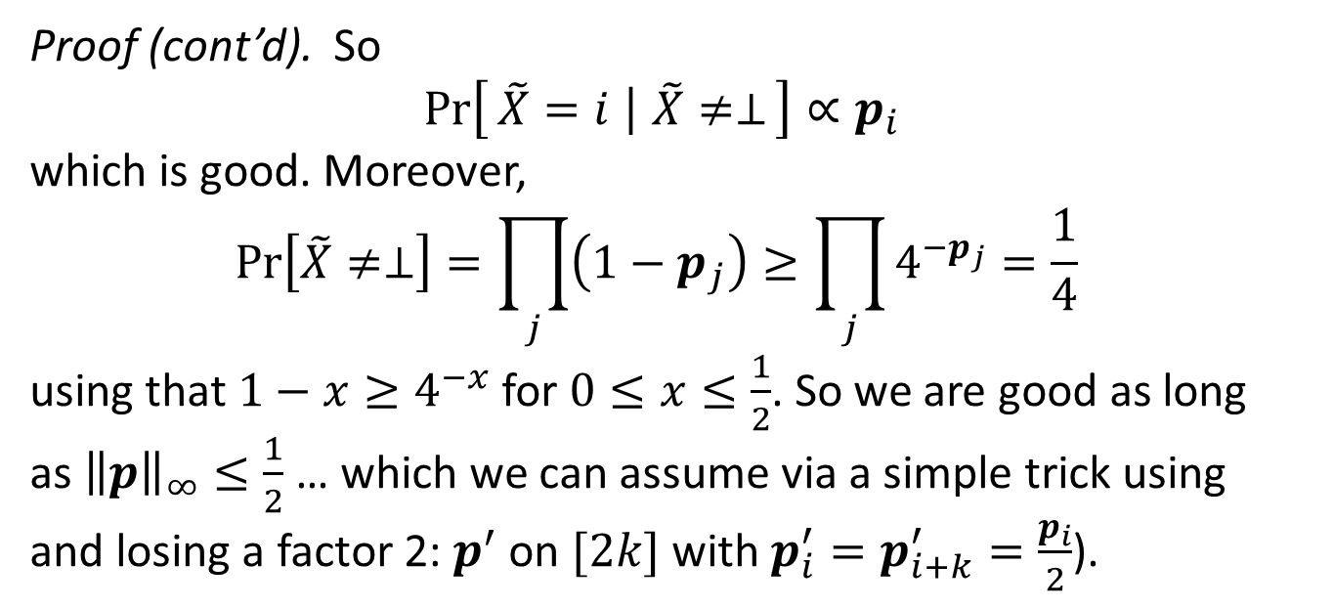
Let’s do several at once: simulate-and-infer
Theorem. For $Δ_{k}$, noninteractive private-coin simulate-and-infer is possible with $s≍\frac{k}{2^{ℓ}}$ (in expectation).
Proof (cont’d). So $$\operatorname{Pr}\left[\tilde{X}=i ∣ \tilde{X}≠⊥\right]∝p_{i}$$
which is good. Moreover,
$$\operatorname{Pr}\left[\tilde{X}≠⊥\right]=\prod_{j}{\left(1−p_{j}\right)≥\prod_{j}{4^{−p_{j}}=\frac{1}{4}}}$$
using that $1−x≥4^{−x}$for $0≤x≤\frac{1}{2}$. So we are good as long as ${\left\|p\right\|}_{∞}≤\frac{1}{2}$ … which we can assume via a simple trick using and losing a factor 2: $p^{′}$ on $[2k]$ with $p_{i}^{′}=p_{i+k}^{′}=\frac{p_{i}}{2}$).

Slide 22
Let’s do several at once: simulate-and-infer
Theorem. For $Δ_{k}$, noninteractive private-coin simulate-and-infer is possible with $s≍\frac{k}{2^{ℓ}}$ (in expectation).
Proof (cont’d). We just proved that $𝔼\left[s\right]≤4k$, for $ℓ=1$. For $ℓ≥1$, partition $[k]$ in sets $S_{1},…, S_{\frac{k}{2^{ℓ}−1}}$ of size $2^{ℓ}−1$. Users $2i−1$ and $2i$ send $0$ if their sample is outside $S_{i}$, or the index of their sample inside $S_{i}$ otherwise. Same analysis as for the case $ℓ=1$. $□$

Slide 23
Let’s do several at once: simulate-and-infer
Corollary. For$Δ_{k}$, noninteractive private-coin estimation under $ℓ_{1}$ loss is possible with $n=O\left(\frac{k}{ε^{2}}⋅\frac{k}{2^{ℓ}}\right)$.
Proof. Recall that the centralized sample complexity is $O\left(\frac{k}{ε^{2}}\right)$, by taking the empirical distribution. $□$

Slide 24
Let’s do several at once: simulate-and-infer
Corollary. For $Δ_{k}$, noninteractive private-coin identity testing under $ℓ_{1}$ distance is possible with $n=O\left(\frac{\sqrt{k}}{ε^{2}}⋅\frac{k}{2^{ℓ}}\right)$.
Proof. Recall that the centralized sample complexity is $O\left(\frac{\sqrt{k}}{ε^{2}}\right)$, e.g., via a $χ^{2}$-type test (and computing its expectation and variance). $□$

Slide 25
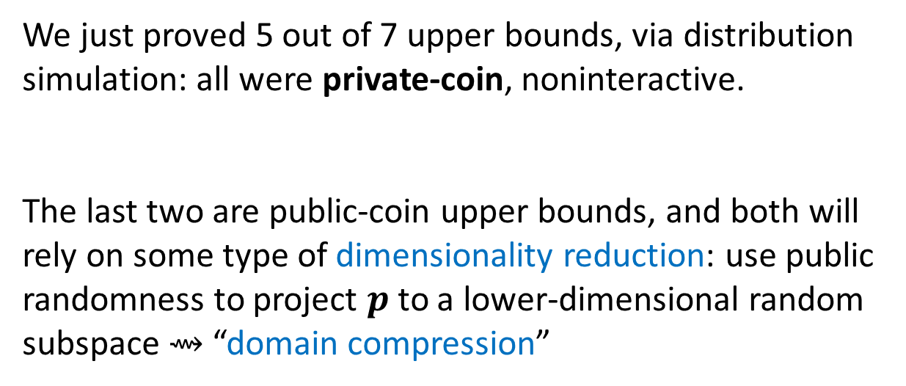
Two more to go, and public coins to use
We just proved 5 out of 7 upper bounds, via distribution simulation: all were private-coin, noninteractive.
The last two are public-coin upper bounds, and both will rely on some type of dimensionality reduction: use public randomness to project $p$ to a lower-dimensional random subspace ⇝ “domain compression”

Slide 26
Domain compression for $ℬ_{d}$
Theorem. For $ℬ_{d}$, noninteractive public-coin mean testing under $ℓ_{2}$ loss is possible with $n=O\left(\frac{\sqrt{d}}{ε^{2}}⋅\sqrt{\frac{d}{ℓ}}\right)$.

Slide 27
Domain compression for $ℬ_{d}$
Theorem. For $ℬ_{d}$, noninteractive public-coin mean testing under $ℓ_{2}$ loss is possible with $n=O\left(\frac{\sqrt{d}}{ε^{2}}⋅\sqrt{\frac{d}{ℓ}}\right)$.
Proof. Pick a common u.a.r. random vector $Z∈\{±1\}^{d}$: all users replace their $X_{i}$ by $X_{i}^{′}≔Z⋅X_{i}∈\{±1\}^{d}.$
Conditioned on $Z$, new mean s.t. ${\left\|Z⋅μ\right\|}_{2}^{2}={\left\|μ\right\|}_{2}^{2}$.
Partition the $d$ coordinates in $ℓ$ groups $S_{1},…,S_{ℓ}$ of same size. User $i$ computes $𝕀[\sum_{j∈S_{t}}{X_{ij}^{′}>0]}$ for all $1≤t≤ℓ$ and send those $ℓ$ bits.
So the server gets $n$ i.i.d. samples from some $p_{Z}$ on $\{±1\}^{ℓ}$.

Slide 28
Domain compression for $ℬ_{d}$
Theorem. For $ℬ_{d}$, noninteractive public-coin mean testing under $ℓ_{2}$ loss is possible with $n=O\left(\frac{\sqrt{d}}{ε^{2}}⋅\sqrt{\frac{d}{ℓ}}\right)$.
Proof (cont’d). Why is this good?
This $p_{Z}$ is a product distribution on $\{±1\}^{ℓ}$
If $p$ has mean $μ=0$, then $p_{Z}$ has mean $μ_{Z}=0$
If $p$ has mean ${\left\|μ\right\|}_{2}>ε$, “then”
$$\underset{Z}{Pr}\left[{\left\|μ_{Z}\right\|}_{2}>ε⋅\sqrt{ℓ/d} \right]=Ω(1)$$

Slide 29
Domain compression for $ℬ_{d}$
Theorem. For $ℬ_{d}$, noninteractive public-coin mean testing under $ℓ_{2}$ loss is possible with $n=O\left(\frac{\sqrt{d}}{ε^{2}}⋅\sqrt{\frac{d}{ℓ}}\right)$.
Proof (cont’d). This last part is not quite obvious. Helps to think of each $\frac{1}{\sqrt{|S_{t}|}}\sum_{j∈S_{t}}{X_{ij}^{′}=\sqrt{\frac{ℓ}{d}}\sum_{j∈S_{t}}{X_{ij}Z_{j}}}$ as roughly normal:
$$N_{t}≈ 𝒩\left(\sqrt{\frac{ℓ}{d}}\sum_{j∈S_{t}}{{Z_{j}μ}_{j}},1\right)$$
So $t$-th bit has parameter $\operatorname{Pr}\left[ N_{t}≥0\right]=Ω\left(\sqrt{\frac{ℓ}{d}}\sum_{j∈S_{t}}{Z_{j}μ_{j}}\right)$…

Slide 30
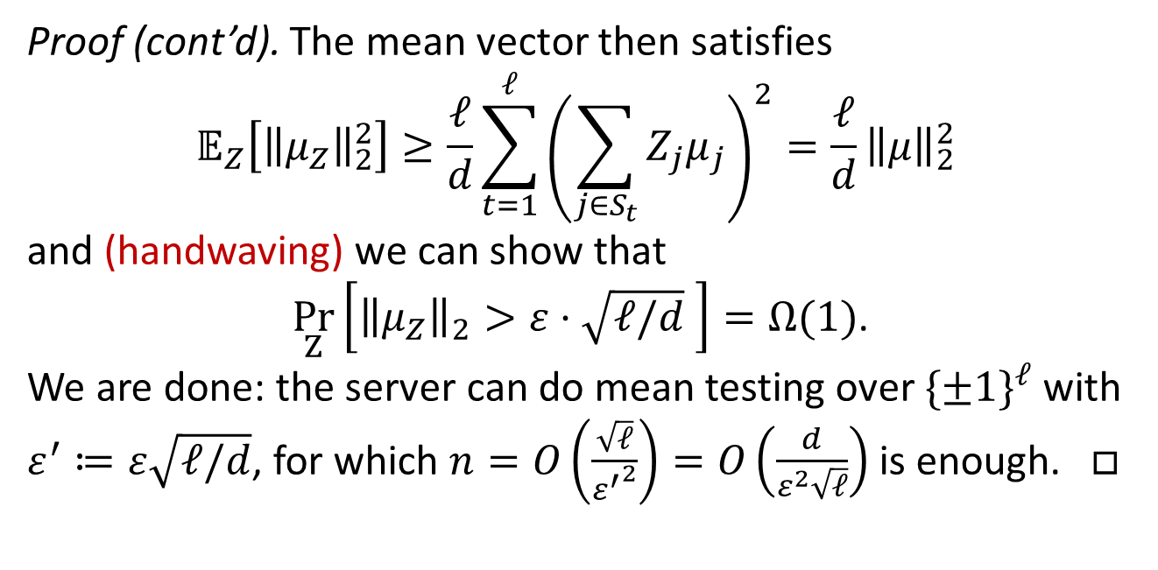
Domain compression for $ℬ_{d}$
Theorem. For $ℬ_{d}$, noninteractive public-coin mean testing under $ℓ_{2}$ loss is possible with $n=O\left(\frac{\sqrt{d}}{ε^{2}}⋅\sqrt{\frac{d}{ℓ}}\right)$.
Proof (cont’d). The mean vector then satisfies
$$𝔼_{Z}\left[{\left\|μ_{Z}\right\|}_{2}^{2}\right]≥\frac{ℓ}{d}\sum_{t=1}^{ℓ}{{\left(\sum_{j∈S_{t}}{Z_{j}μ_{j}}\right)}^{2}}=\frac{ℓ}{d}{\left\|μ\right\|}_{2}^{2}$$
and (handwaving) we can show that
$\underset{Z}{Pr}\left[{\left\|μ_{Z}\right\|}_{2}>ε⋅\sqrt{ℓ/d} \right]=Ω(1)$.
We are done: the server can do mean testing over $\{±1\}^{ℓ}$ with $ε^{′}≔ε\sqrt{ℓ/d}$, for which $n=O\left(\frac{\sqrt{ℓ}}{{ε^{′}}^{2}}\right)=O\left(\frac{d}{ε^{2}\sqrt{ℓ}}\right)$ is enough. $□$

Slide 31
Domain compression for $Δ_{k}$
Theorem ([ACT20d,ACHST20]). For $Δ_{k}$, noninteractive public-coin identity testing under $ℓ_{1}$ distance is possible with $n=O\left(\frac{\sqrt{k}}{ε^{2}}⋅\sqrt{\frac{k}{2^{ℓ}}}\right)$.

Slide 32
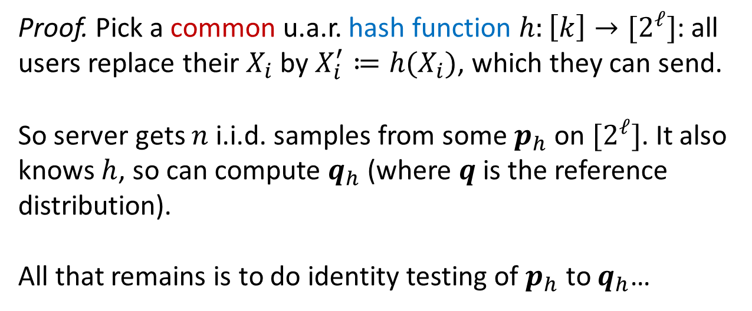
Domain compression for $Δ_{k}$
Theorem. For $Δ_{k}$, noninteractive public-coin identity testing under $ℓ_{1}$ distance is possible with $n=O\left(\frac{\sqrt{k}}{ε^{2}}⋅\sqrt{\frac{k}{2^{ℓ}}}\right)$.
Proof. Pick a common u.a.r. hash function $h:\left[k\right]→[2^{ℓ}]$: all users replace their $X_{i}$ by $X_{i}^{′}≔h(X_{i})$, which they can send.
So server gets $n$ i.i.d. samples from some $p_{h}$ on $[2^{ℓ}]$. It also knows $h$, so can compute $q_{h}$ (where $q$ is the reference distribution).
All that remains is to do identity testing of $p_{h}$ to $q_{h}$…

Slide 33
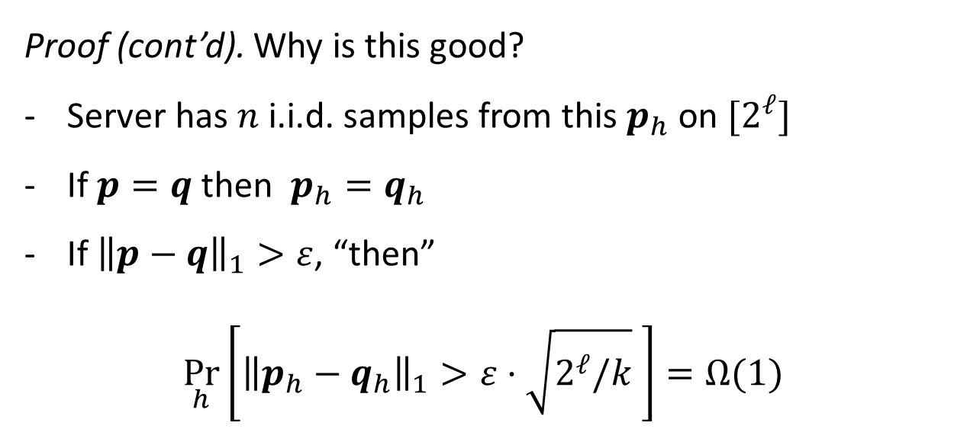
Domain compression for $Δ_{k}$
Theorem. For $Δ_{k}$, noninteractive public-coin identity testing under $ℓ_{1}$ distance is possible with $n=O\left(\frac{\sqrt{k}}{ε^{2}}⋅\sqrt{\frac{k}{2^{ℓ}}}\right)$.
Proof (cont’d). Why is this good?
Server has $n$ i.i.d. samples from this $p_{h}$ on $[2^{ℓ}]$
If $p=q$ then $p_{h}=q_{h}$
If ${\left\|p−q\right\|}_{1}>ε$, “then”
$$\underset{h}{Pr}\left[{\left\|p_{h}−q_{h}\right\|}_{1}>ε⋅\sqrt{2^{ℓ}/k} \right]=Ω(1)$$

Slide 34
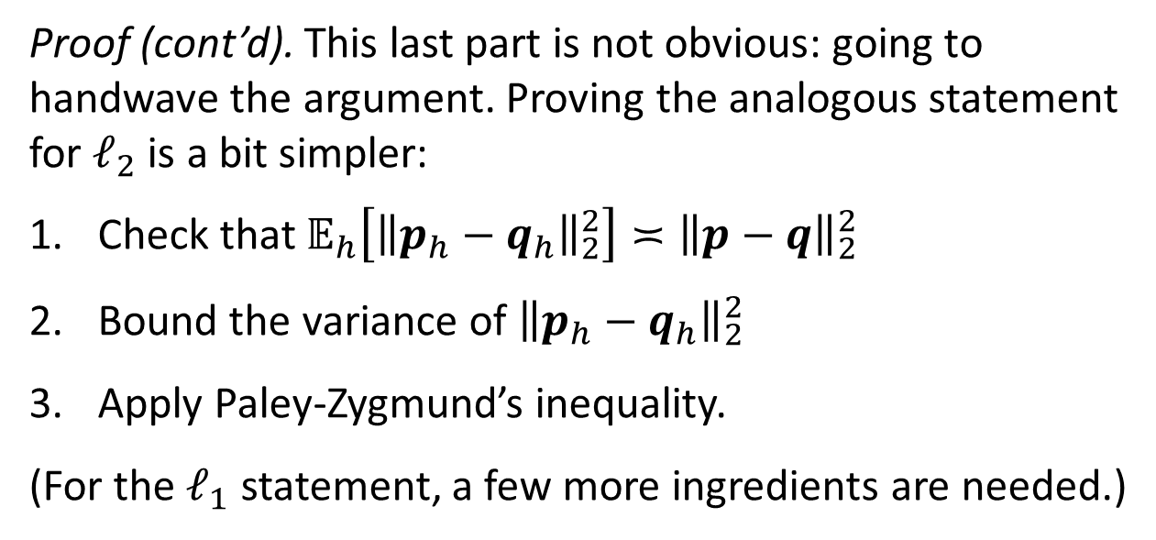
Domain compression for $Δ_{k}$
Theorem. For $Δ_{k}$, noninteractive public-coin identity testing under $ℓ_{1}$ distance is possible with $n=O\left(\frac{\sqrt{k}}{ε^{2}}⋅\sqrt{\frac{k}{2^{ℓ}}}\right)$.
Proof (cont’d). This last part is not obvious: going to handwave the argument. Proving the analogous statement for $ℓ_{2}$ is a bit simpler:
Check that $𝔼_{h}\left[{\left\|p_{h}−q_{h}\right\|}_{2}^{2}\right]≍{\left\|p−q\right\|}_{2}^{2}$
Bound the variance of ${\left\|p_{h}−q_{h}\right\|}_{2}^{2}$
Apply Paley-Zygmund’s inequality.
(For the $ℓ_{1}$ statement, a few more ingredients are needed.)

Slide 35
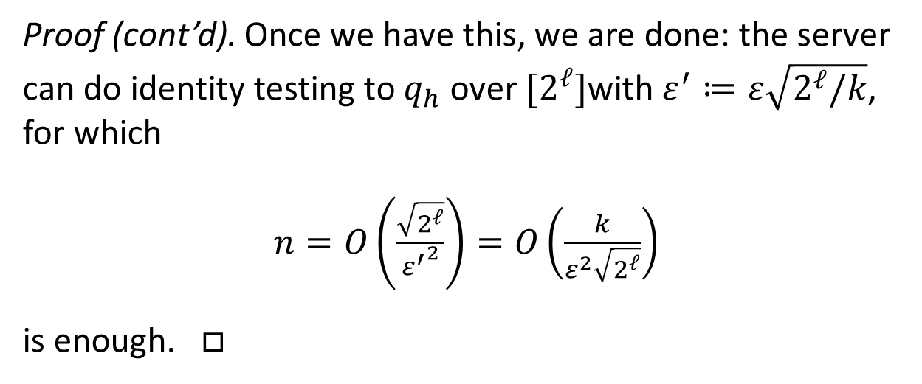
Domain compression for $Δ_{k}$
Theorem. For $Δ_{k}$, noninteractive public-coin identity testing under $ℓ_{1}$ distance is possible with $n=O\left(\frac{\sqrt{k}}{ε^{2}}⋅\sqrt{\frac{k}{2^{ℓ}}}\right)$.
Proof (cont’d). Once we have this, we are done: the server can do identity testing to $q_{h}$ over $[2^{ℓ}]$with $ε^{′}≔ε\sqrt{2^{ℓ}/k}$, for which
$n=O\left(\frac{\sqrt{2^{ℓ}}}{{ε^{′}}^{2}}\right)=O\left(\frac{k}{ε^{2}\sqrt{2^{ℓ}}}\right)$
is enough. $□$

Slide 36
That’s seven upper bounds we proved. (in ≈30 minutes)

Slide 37
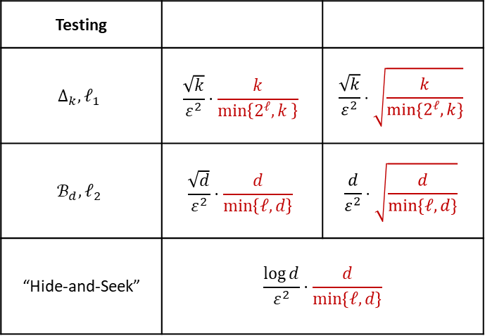
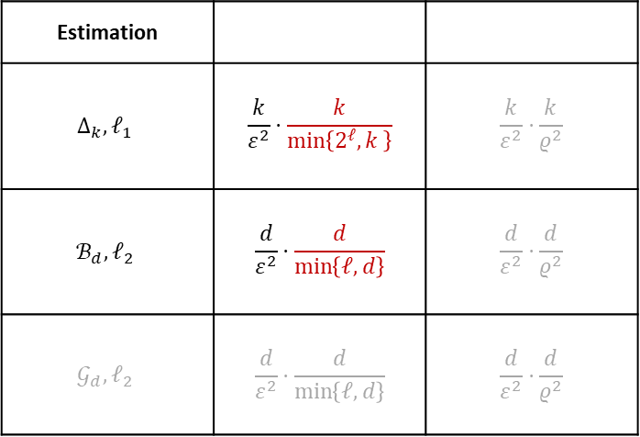
That’s seven upper bounds we proved. (in ≈30 minutes)
Estimation
$$Δ_{k}, ℓ_{1}$$ | $$\frac{k}{ε^{2}}⋅\frac{k}{\min\left\{2^{ℓ}, k \right\}}$$ | $$\frac{k}{ε^{2}}⋅\frac{k}{ρ^{2}}$$
$$ℬ_{d},ℓ_{2}$$ | $$\frac{d}{ε^{2}}⋅\frac{d}{\min\left\{ℓ, d\right\}}$$ | $$\frac{d}{ε^{2}}⋅\frac{d}{ρ^{2}}$$
$$𝒢_{d},ℓ_{2}$$ | $$\frac{d}{ε^{2}}⋅\frac{d}{\min\left\{ℓ, d\right\}}$$ | $$\frac{d}{ε^{2}}⋅\frac{d}{ρ^{2}}$$
Testing
$$Δ_{k}, ℓ_{1}$$ | $$\frac{\sqrt{k}}{ε^{2}}⋅\frac{k}{\min\left\{2^{ℓ}, k \right\}}$$ | $$\frac{\sqrt{k}}{ε^{2}}⋅\sqrt{\frac{k}{\min{\{2^{ℓ},k\}}}}$$
$$ℬ_{d},ℓ_{2}$$ | $$\frac{\sqrt{d}}{ε^{2}}⋅\frac{d}{\min\left\{ℓ, d\right\}}$$ | $$\frac{d}{ε^{2}}⋅\sqrt{\frac{d}{\min{\{ℓ,d\}}}}$$
“Hide-and-Seek” | $$\frac{\log{d}}{ε^{2}}⋅\frac{d}{\min\left\{ℓ, d\right\}}$$
37
37

Slide 38
Summary
This tutorial: techniques for proving lower bounds, in both interactive and noninteractive settings, for statistical estimation and testing under “local constraints.”
38
38

Slide 39
Summary
This tutorial: techniques for proving lower bounds, in both interactive and noninteractive settings, for statistical estimation and testing under “local constraints.”
Introduction Clément
Lower Bounds for Estimation Jayadev
Lower Bounds for Testing Himanshu
Some upper bounds, and discussion Clément
39
39

Slide 40
Some open problems
First, happy to discuss those (and more) in detail during the conference, interactively! Please feel free reach out.

Slide 41
Some directions
First, happy to discuss those (and more) in detail during the conference, interactively! Please feel free reach out.
Open Problem #1: What if all users had different constraints? E.g., different bandwidth constraints, or different privacy requirements…
Open Problem #2: Other types of constraints! Linear measurements, threshold measurements (univariate case), or malicious noise à la Massart…

Slide 42
References and previous work
For a detailed bibliography:
www.cs.columbia.edu/~ccanonne/tutorial-focs2020/bibliography.html

