Slide 1

Cookbook: Lower Bounds for Statistical Inference in Distributed and Constrained Settings
Jayadev Acharya, Clement Canonne, Himanshu Tyagi
FOCS 2020
Part III: Lower bounds for hypothesis testing

Slide 2
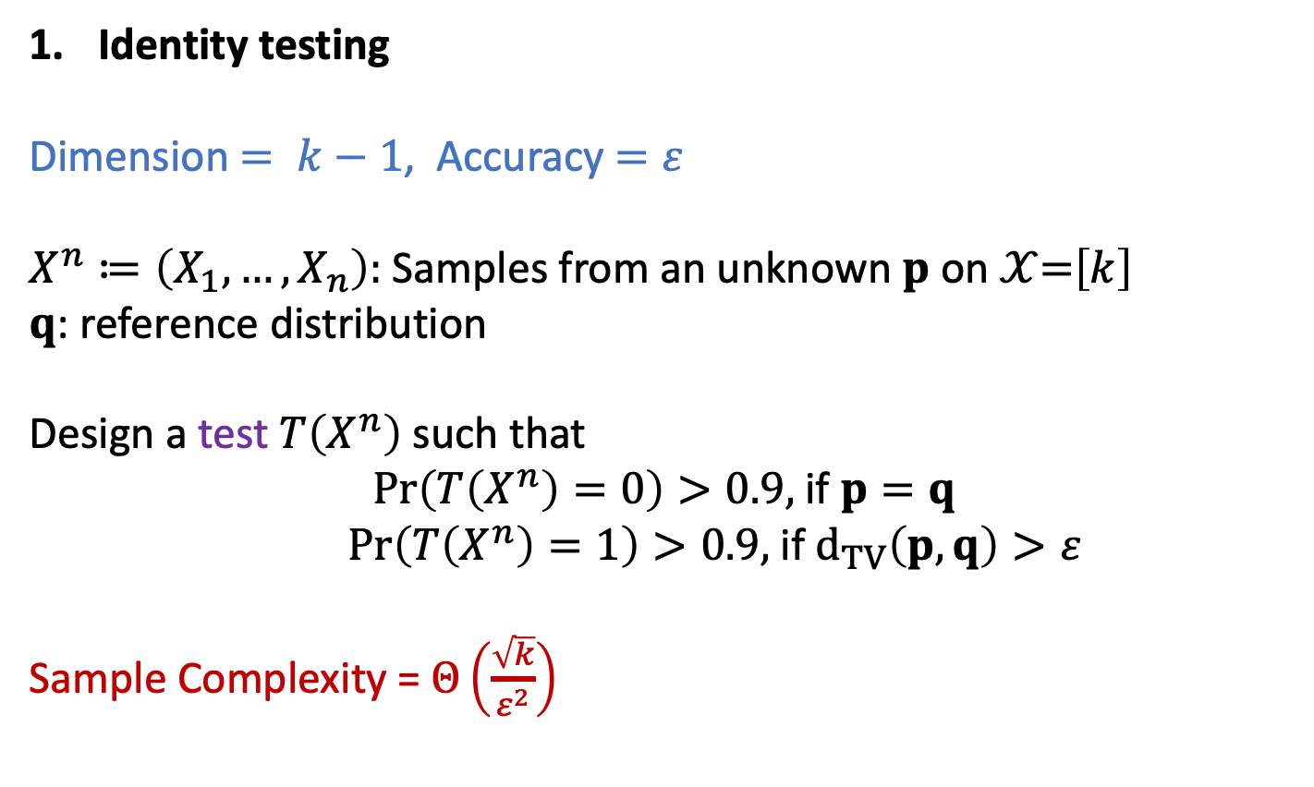
Hypothesis testing
Identity testing
Dimension $= k−1$, Accuracy$=ε$
$X^{n}≔\left(X_{1}, …,X_{n}\right):$ Samples from an unknown $p$ on $𝒳$=$\left[k\right]$
$q$: reference distribution
Design a test $T\left(X^{n}\right)$ such that
$\operatorname{Pr}\left(T\left(X^{n}\right)=0\right)>0.9,$if $p=q$
$\operatorname{Pr}\left(T\left(X^{n}\right)=1\right)>0.9,$if $d_{TV}\left(p, q\right)>ε$
Sample Complexity = $Θ\left(\frac{\sqrt{k}}{ε^{2}}\right)$

Slide 3
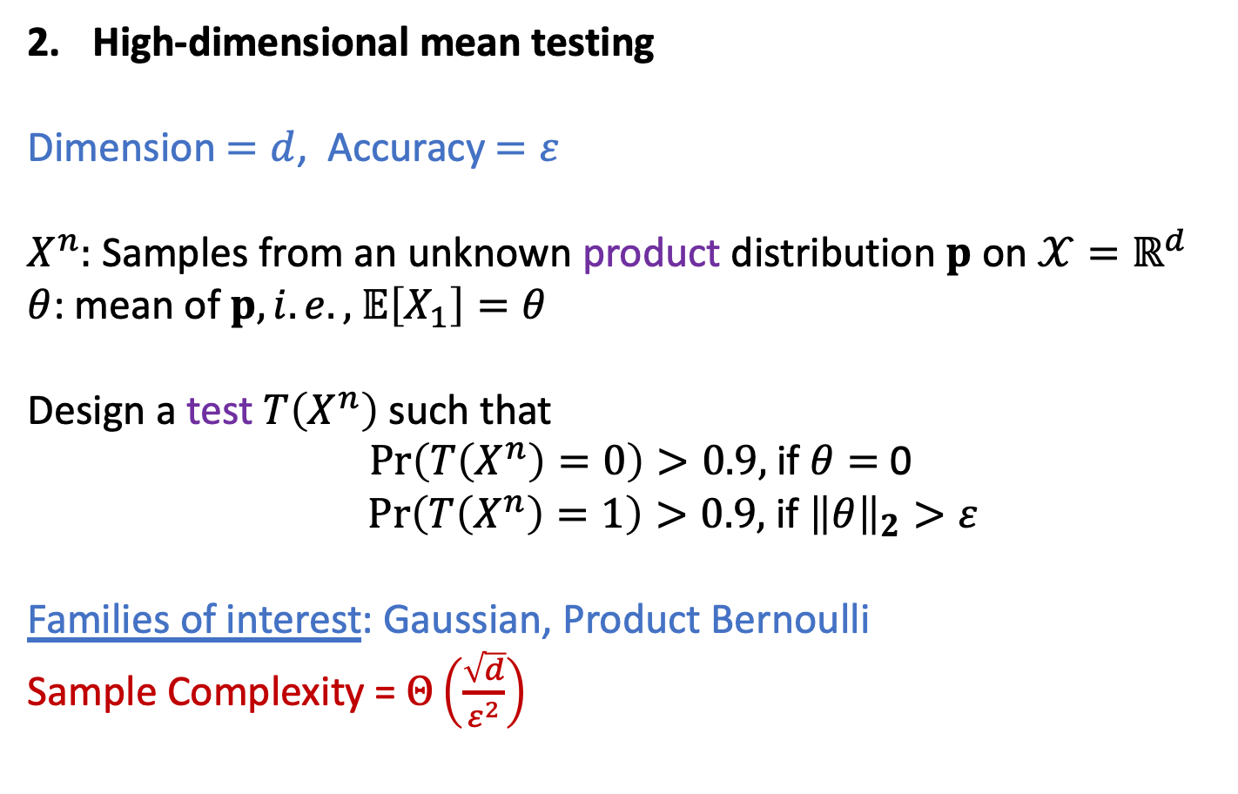
Hypothesis testing
High-dimensional mean testing
Dimension $=d$, Accuracy$=ε$
$X^{n}:$ Samples from an unknown product distribution $p$ on $𝒳=ℝ^{d}$
$θ$: mean of $p, i.e.,$ $𝔼\left[X_{1}\right]=θ$
Design a test $T\left(X^{n}\right)$ such that
$\operatorname{Pr}\left(T\left(X^{n}\right)=0\right)>0.9,$if $θ=$ 0
$\operatorname{Pr}\left(T\left(X^{n}\right)=1\right)>0.9,$if ${\left\|θ\right\|}_{2}>ε$
Families of interest: Gaussian, Product Bernoulli
Sample Complexity = $Θ\left(\frac{\sqrt{d}}{ε^{2}}\right)$

Slide 4
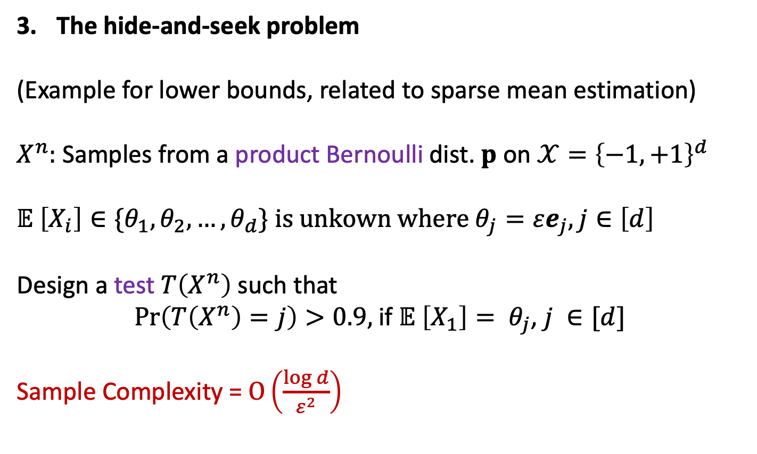
Hypothesis testing
The hide-and-seek problem
(Example for lower bounds, related to sparse mean estimation)
$X^{n}:$ Samples from a product Bernoulli dist. $p$ on $𝒳={\left\{−1, +1\right\}}^{d}$
$$𝔼 \left[X_{i}\right]∈\{θ_{1},θ_{2},…,θ_{d}\} is unkown where θ_{j}=εe_{j}, j∈\left[d\right]$$
Design a test $T\left(X^{n}\right)$ such that
$\operatorname{Pr}\left(T\left(X^{n}\right)=j\right)>0.9,$if $𝔼 \left[X_{1}\right]= θ_{j}$, $j ∈[d]$
Sample Complexity = $O\left(\frac{\log{d}}{ε^{2}}\right)$

Slide 5













Types of protocols
$$p$$
Private-coin SMP protocols
$${ X}_{1}$$
$${ X}_{2}$$
. . .
$${ X}_{n}$$
$$W_{1}$$
$$W_{2}$$
$$W_{n}$$
$$∈ 𝒲$$
$${ Y}_{1}$$
$${ Y}_{2}$$
. . .
$${ Y}_{n}$$
$$ℜ$$
Referee $ℜ applies$ test $T\left(Y^{n}\right)$

Slide 6
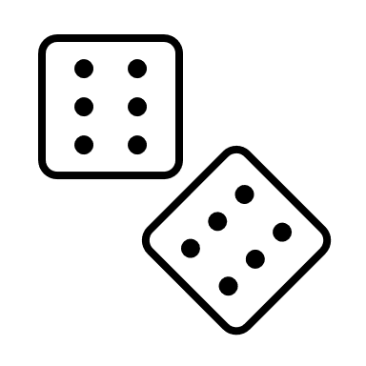


Types of protocols
$$p$$
Public-coin SMP protocols
$${ X}_{1}$$
$${ X}_{2}$$
. . .
$${ X}_{n}$$
$$U$$
$$W_{1}$$
$$W_{2}$$
$$W_{n}$$
$$∈ 𝒲$$
$${ Y}_{1}$$
$${ Y}_{2}$$
. . .
$${ Y}_{n}$$
$$ℜ$$
Referee $ℜ applies$ test $T\left(Y^{n}, U\right)$

Slide 7
Types of protocols
$$p$$
Sequentially Interactive
protocols
$${ X}_{1}$$
$${ X}_{2}$$
. . .
$${ X}_{n}$$
$$U$$
$$W_{1}$$
$$W_{2}$$
$$W_{n}$$
$$∈ 𝒲$$
$${ Y}_{1}$$
$${ Y}_{2}$$
. . .
$${ Y}_{n}$$
$$ℜ$$
Referee $ℜ applies$ test $T\left(Y^{n}, U\right)$

Slide 8
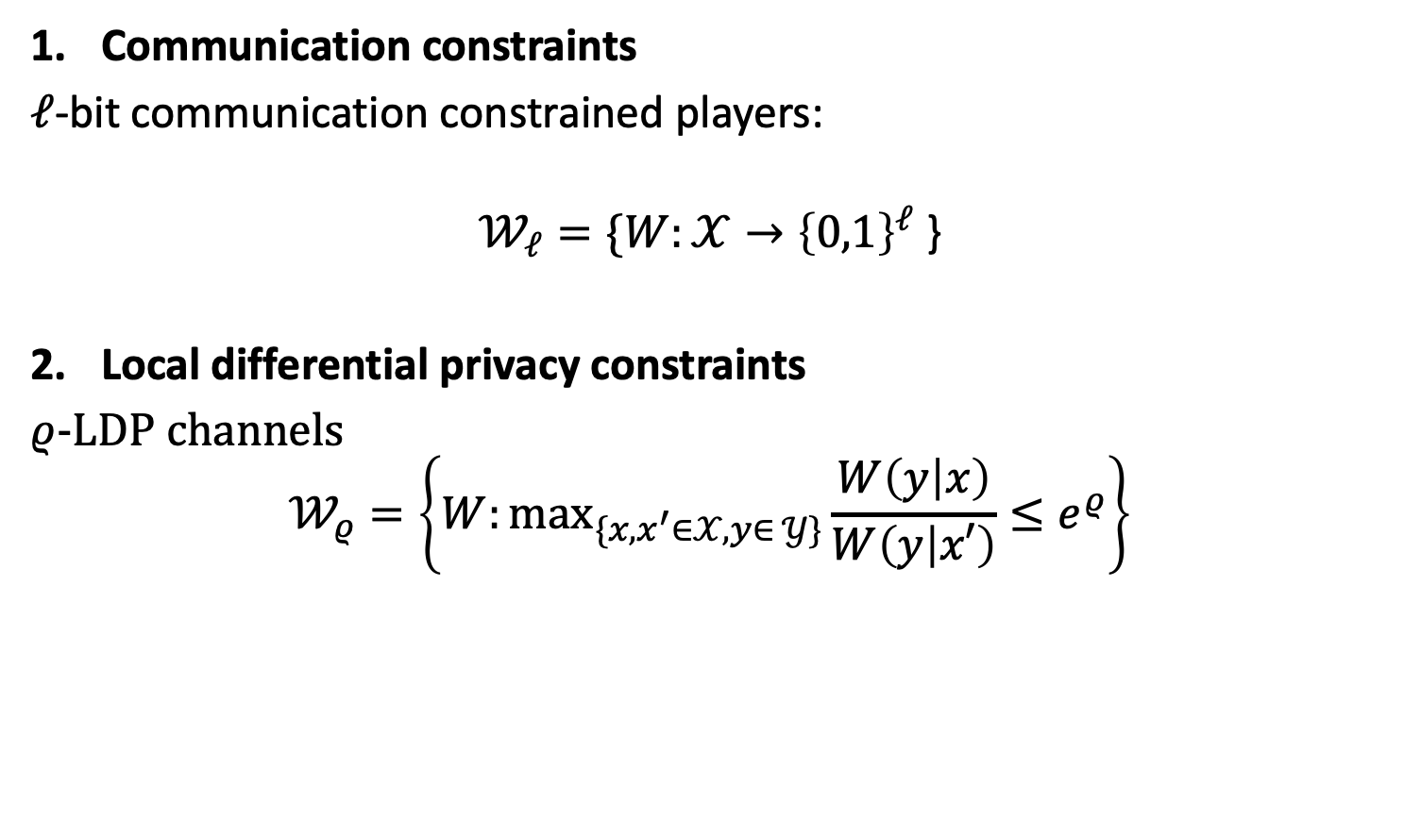
Information constrained setting
Communication constraints
$ℓ$-bit communication constrained players:
$$𝒲_{ℓ}=\{W:𝒳→{\left\{0,1\right\}}^{ℓ}\text{ \}}$$
Local differential privacy constraints
$ρ$-LDP channels
$$𝒲_{ρ}=\left\{W:⁡\max_{\{x,x^{′}∈𝒳,y∈ 𝒴\}}\frac{W\left(y | x\right)}{W\left(y | x′\right)}≤e^{ρ}\right\}$$

Slide 9
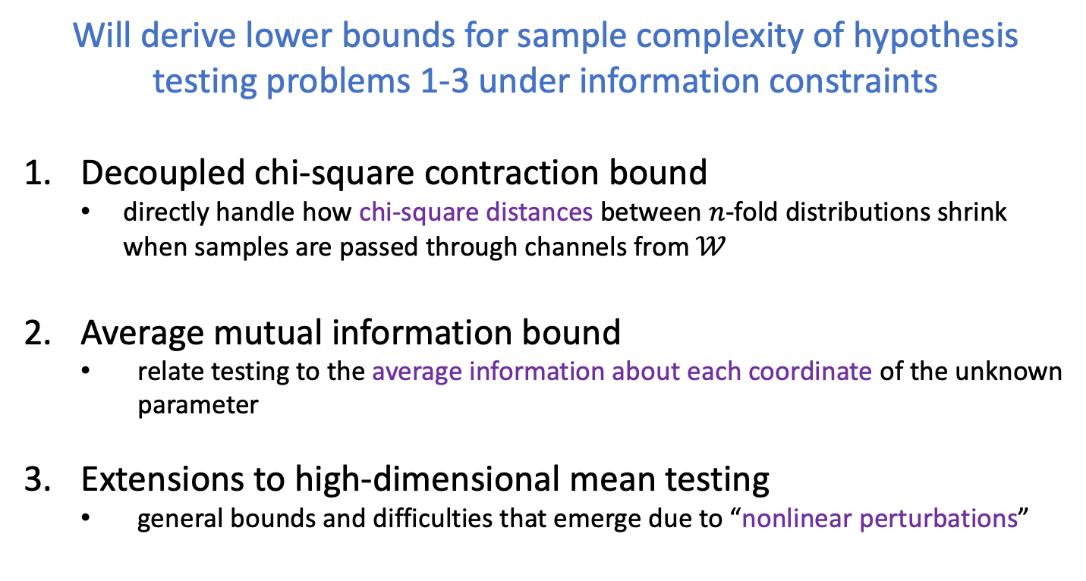
The plan for this hour
Will derive lower bounds for sample complexity of hypothesis testing problems 1-3 under information constraints
Decoupled chi-square contraction bound
  directly handle how chi-square distances between $n$-fold distributions shrink when samples are passed through channels from $𝒲$
Average mutual information bound
  relate testing to the average information about each coordinate of the unknown parameter
Extensions to high-dimensional mean testing
  general bounds and difficulties that emerge due to “nonlinear perturbations”

Slide 10
1. The Decoupled Chi-square Contraction Bound

Slide 11


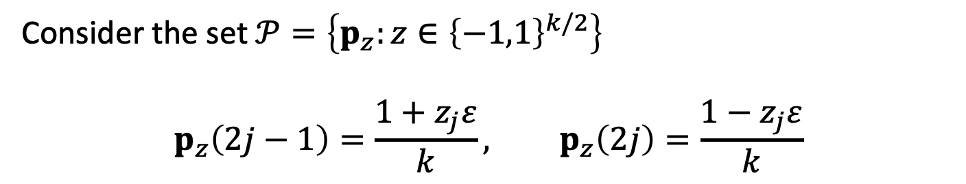



Ingster’s method
Use-case: Lower bound for $(k, ε)$-identity testing [Paninski ’08]
Consider the set $𝒫=\left\{p_{z}:z∈{\left\{−1,1\right\}}^{k/2}\right\}$
$$p_{z}\left(2j−1\right)=\frac{1+z_{j}ε}{k}, p_{z}\left(2j\right)=\frac{1−z_{j}ε}{k}$$
$$1/k$$
Perturbations around $u$, $d_{TV}\left(p_{z}, u\right)=ε$
…
1
2
3
4
5
6
…
$z_{1}$=$1$
$z_{2}$=$1$
$z_{3}$=$−1$
[Paninski ’08] L. Paninski, “A coincidence-based test for uniformity given very sparsely sampled discrete data,” IEEE Transactions on Information Theory, 2008

Slide 12
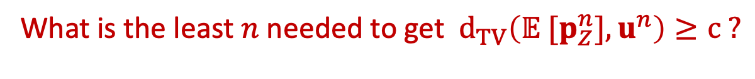
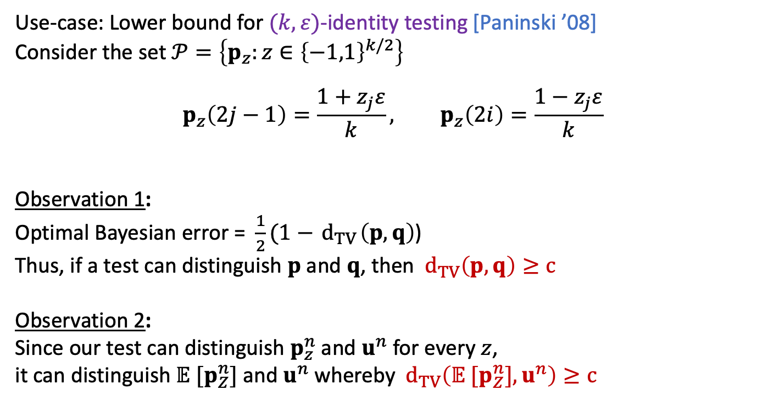
Ingster’s method
Use-case: Lower bound for $(k, ε)$-identity testing [Paninski ’08]
Consider the set $𝒫=\left\{p_{z}:z∈{\left\{−1,1\right\}}^{k/2}\right\}$
$$p_{z}\left(2j−1\right)=\frac{1+z_{j}ε}{k}, p_{z}\left(2i\right)=\frac{1−z_{j}ε}{k}$$
Observation 1:
Optimal Bayesian error = $\frac{1}{2}(1−{ d}_{TV}\left(p, q\right)$)
Thus, if a test can distinguish $p$ and $q$, then ${ d}_{TV}\left(p, q\right)≥c$
Observation 2:
Since our test can distinguish $p_{z}^{n}$ and $u^{n}$ for every $z$,
it can distinguish $𝔼 [p_{Z}^{n}]$and $u^{n}$ whereby ${ d}_{TV}\left(𝔼 [p_{Z}^{n}],u^{n}\right)≥c$
What is the least $n$ needed to get ${ d}_{TV}\left(𝔼 [p_{Z}^{n}],u^{n}\right)≥c ?$

Slide 13
Ingster’s method
The mixture $𝔼 [p_{Z}^{n}]$ is much closer to $u^{n}$ than any individual $p_{z}^{n}$

Slide 14
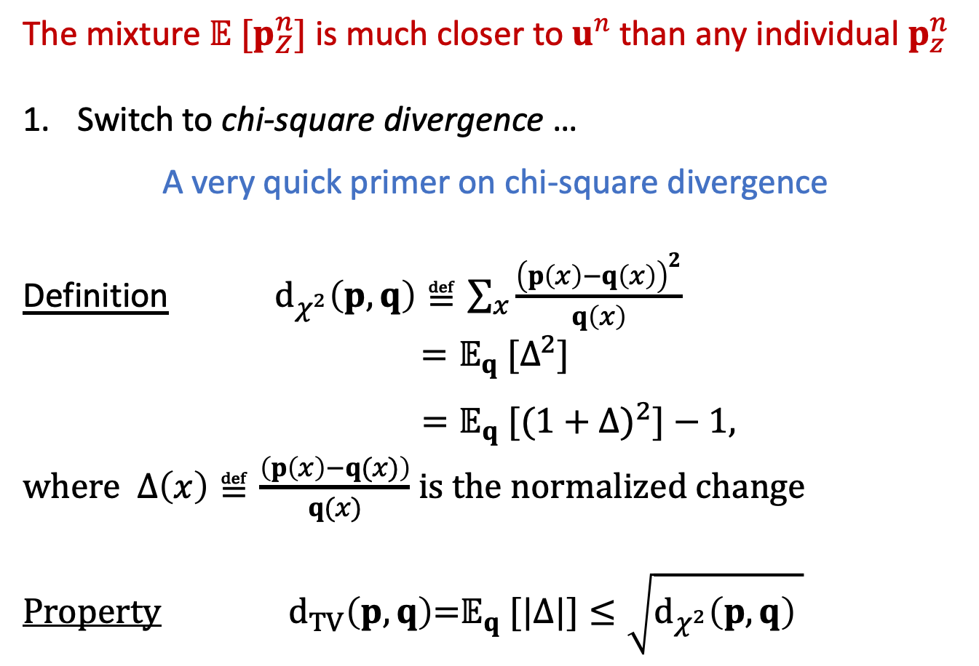
Ingster’s method
The mixture $𝔼 [p_{Z}^{n}]$ is much closer to $u^{n}$ than any individual $p_{z}^{n}$
Switch to chi-square divergence …
A very quick primer on chi-square divergence
Definition ${ d}_{χ^{2}}\left(p,q\right)≝\sum_{x}{\frac{{\left(p\left(x\right)−q\left(x\right)\right)}^{2}}{q\left(x\right)}}$
$$=𝔼_{q}\text{ [}Δ^{2}\text{]}$$
$=𝔼_{q}\text{ [}{(1+Δ)}^{2}\text{]}−\text{1, }$
where $Δ\left(x\right)≝\frac{\left(p\left(x\right)−q(x)\right)}{q(x)}$ is the normalized change
Property $d_{TV}\left(p,q\right)\text{=}𝔼_{q}\text{ [}|Δ|]≤\sqrt{d_{χ^{2}}\left(p,q\right) }$

Slide 15
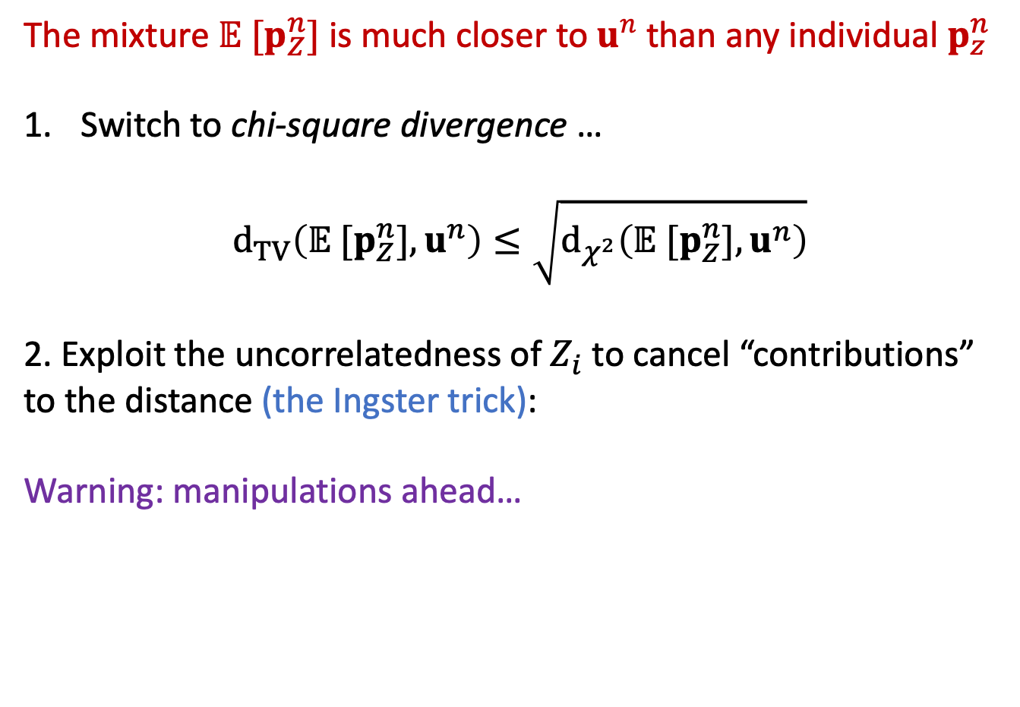
Ingster’s method
The mixture $𝔼 [p_{Z}^{n}]$ is much closer to $u^{n}$ than any individual $p_{z}^{n}$
Switch to chi-square divergence …
$${ d}_{TV}\left(𝔼 [p_{Z}^{n}],u^{n}\right)≤\sqrt{d_{χ^{2}}\left(𝔼 [p_{Z}^{n}],u^{n}\right)}$$
2. Exploit the uncorrelatedness of $Z_{i}$to cancel “contributions”
to the distance (the Ingster trick):
Warning: manipulations ahead…

Slide 16

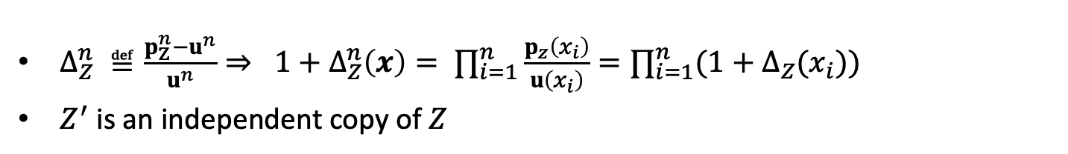
Ingster’s method
$Δ_{Z}^{n} ≝\frac{p_{Z}^{n}−u^{n}}{u^{n}}⇒ 1+Δ_{Z}^{n}\left(x\right)= ∏_{i=1}^{n}\frac{p_{z}\left(x_{i}\right)}{u\left(x_{i}\right)}=∏_{i=1}^{n}(1+Δ_{Z}(x_{i}))$
$Z^{′}$ is an independent copy of $Z$
(The Decoupling Step)
$d_{χ^{2}}\left(𝔼_{Z} [p_{Z}^{n}],u^{n}\right)$
$$={{𝔼[(1+𝔼_{Z}[Δ}_{Z}^{n}])}^{2}] −1$$
$$={𝔼[𝔼_{ZZ^{′}}[(1+Δ}_{Z}^{n})({1+Δ}_{Z^{′}}^{n})]] −1$$
$$={𝔼_{ZZ^{′}}[𝔼[(1+Δ}_{Z}^{n})({1+Δ}_{Z^{′}}^{n})]] −1$$

Slide 17

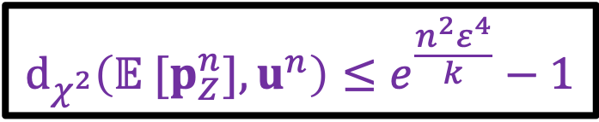
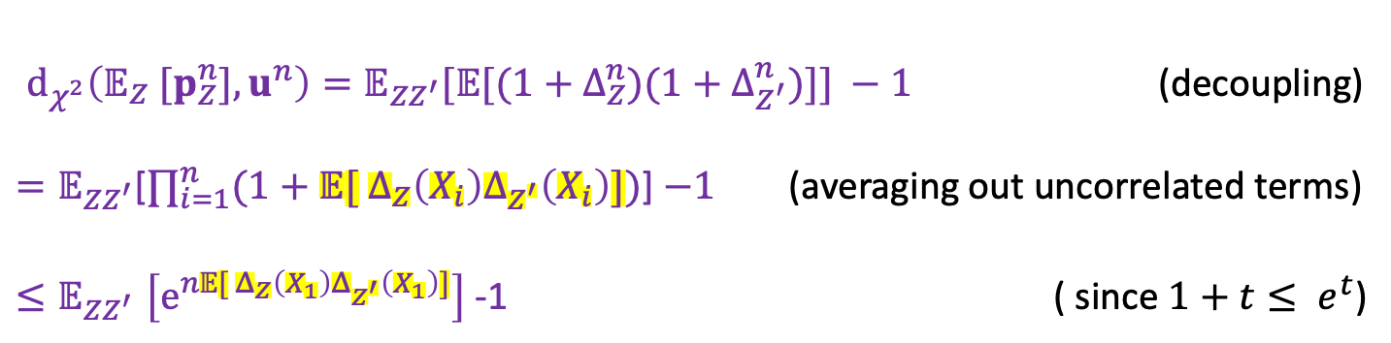
Ingster’s method
$Δ_{Z}^{n} ≝\frac{p_{Z}^{n}−u^{n}}{u^{n}}⇒ 1+Δ_{Z}^{n}\left(x\right)= ∏_{i=1}^{n}\frac{p_{z}\left(x_{i}\right)}{u\left(x_{i}\right)}=∏_{i=1}^{n}(1+Δ_{Z}(x_{i}))$
$Z^{′}$ is an independent copy of $Z$
$d_{χ^{2}}\left(𝔼_{Z} [p_{Z}^{n}],u^{n}\right)={𝔼_{ZZ^{′}}[𝔼[(1+Δ}_{Z}^{n})({1+Δ}_{Z^{′}}^{n})]] −1$ (decoupling)
$=𝔼_{ZZ^{′}}$[$∏_{i=1}^{n}(1+𝔼[ Δ_{Z}\left(X_{i}\right)Δ_{Z^{′}}\left(X_{i}\right)])$] $−1$ (averaging out uncorrelated terms)
${≤𝔼}_{ZZ^{′}}\left[e^{n𝔼[ Δ_{Z}\left(X_{1}\right)Δ_{Z^{′}}\left(X_{1}\right)]}\right]$ -1 ( since $1+t≤ e^{t}$)
Noting that $𝔼\left[ Δ_{Z}\left(X_{1}\right)Δ_{Z^{′}}\left(X_{1}\right)\right]=\frac{{2ε}^{2}}{k} ∑_{j=1}^{k/2}{ Z}_{j}Z_{j}^{′}$ and using Hoeffding’s bound
$$d_{χ^{2}}\left(𝔼 [p_{Z}^{n}],u^{n}\right)≤e^{\frac{{n^{2}ε}^{4}}{k}}−1$$

Slide 18
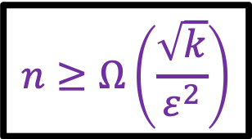

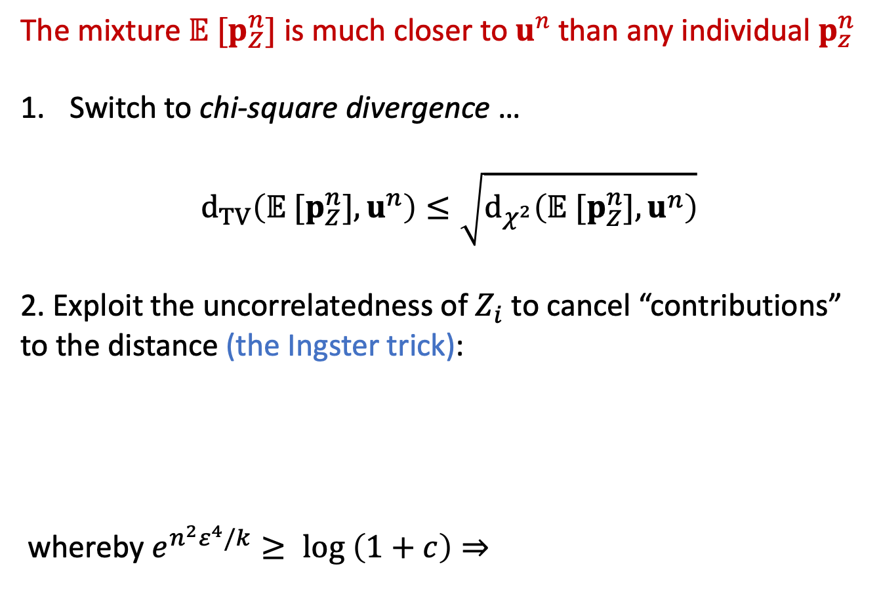
Ingster’s method (as used in [Paninski’08])
The mixture $𝔼 [p_{Z}^{n}]$ is much closer to $u^{n}$ than any individual $p_{z}^{n}$
Switch to chi-square divergence …
$${ d}_{TV}\left(𝔼 [p_{Z}^{n}],u^{n}\right)≤\sqrt{d_{χ^{2}}\left(𝔼 [p_{Z}^{n}],u^{n}\right)}$$
2. Exploit the uncorrelatedness of $Z_{i}$to cancel “contributions”
to the distance (the Ingster trick):
whereby $e^{{n^{2}ε}^{4}/k}≥ log \left(1+c\right)⇒$
$$d_{χ^{2}}\left(𝔼 [p_{Z}^{n}],u^{n}\right)≤e^{\frac{{n^{2}ε}^{4}}{k}}−1$$
$$n≥Ω\left(\frac{\sqrt{k}}{ε^{2}}\right)$$

Slide 19
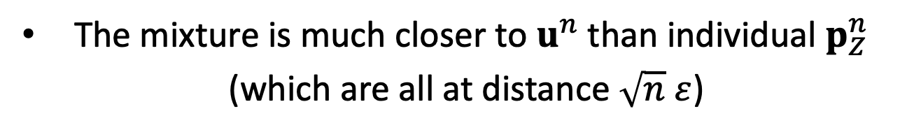

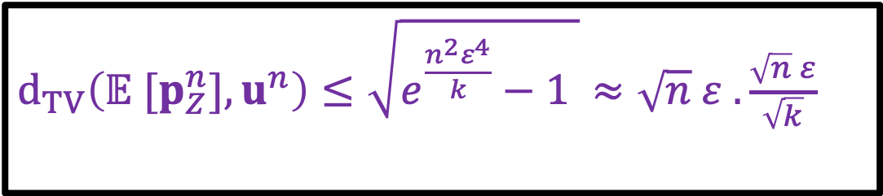
Take away 1: Summary of Ingster’s method
The mixture is much closer to $u^{n}$than individual $p_{Z}^{n}$
(which are all at distance $\sqrt{n} ε$)
$d_{TV}\left(𝔼 [p_{Z}^{n}],u^{n}\right)≤\sqrt{e^{\frac{{n^{2}ε}^{4}}{k}}−1 }≈\sqrt{n} ε .\frac{\sqrt{n} ε}{\sqrt{k}}$
Smaller than 1 if $n<k/ε^{2}$
The quadratic form of $d_{χ^{2}}$ is useful to handle mixtures

Slide 20
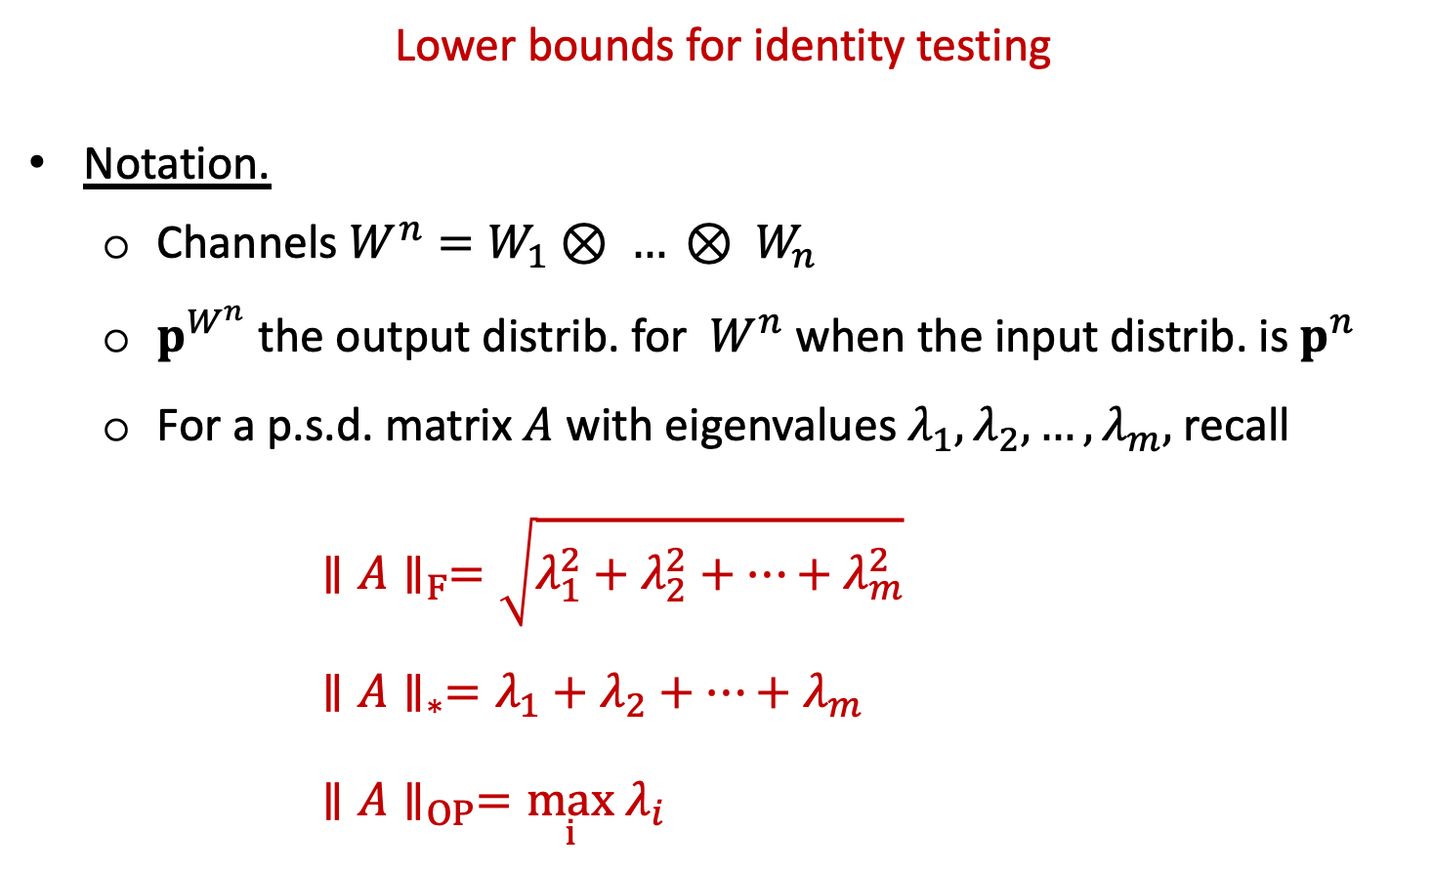
Ingster’s method in the information constrained setting
Lower bounds for identity testing
Notation.
  Channels $W^{n}=W_{1}⊗ … ⊗ W_{n}$
  $p^{W^{n}}$ the output distrib. for $W^{n}$ when the input distrib. is $p^{n}$
  For a p.s.d. matrix $A$ with eigenvalues $λ_{1},λ_{2},…,λ_{m},$ recall
        $$∥A∥_{F}=\sqrt{λ_{1}^{2}+λ_{2}^{2}+…+λ_{m}^{2}}$$
        $$∥A∥_{∗}=λ_{1}+λ_{2}+…+λ_{m}$$
        $$∥A∥_{OP}=\max_{i} λ_{i}$$

Slide 21
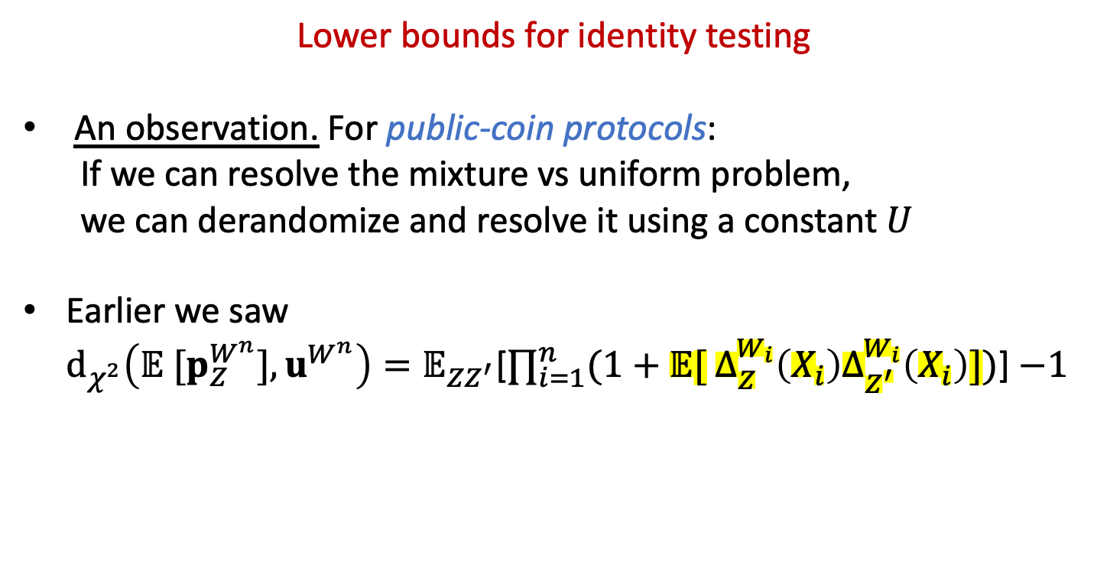
Ingster’s method in the information constrained setting
Lower bounds for identity testing
An observation. For public-coin protocols:
  If we can resolve the mixture vs uniform problem,
  we can derandomize and resolve it using a constant $U$
Earlier we saw
$d_{χ^{2}}\left(𝔼 [p_{Z}^{W^{n}}],u^{W^{n}}\right)=𝔼_{ZZ^{′}}$[$∏_{i=1}^{n}(1+𝔼[ Δ_{Z}^{W_{i}}\left(X_{i}\right)Δ_{Z^{′}}^{W_{i}}\left(X_{i}\right)])$] $−1$

Slide 22
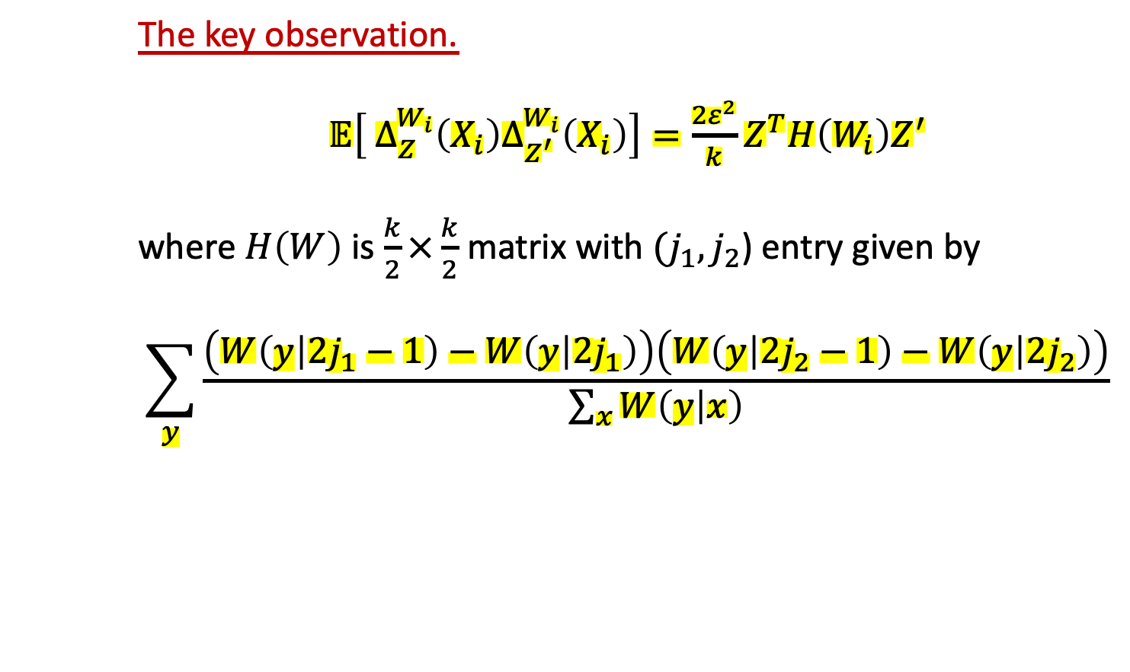
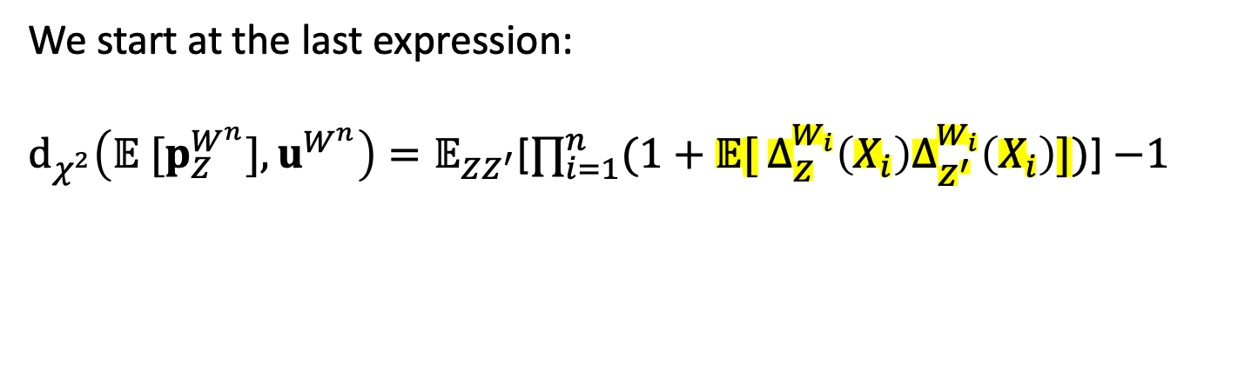
Ingster’s method in the information constrained setting
We start at the last expression:
$d_{χ^{2}}\left(𝔼 [p_{Z}^{W^{n}}],u^{W^{n}}\right)=𝔼_{ZZ^{′}}$[$∏_{i=1}^{n}(1+𝔼[ Δ_{Z}^{W_{i}}\left(X_{i}\right)Δ_{Z^{′}}^{W_{i}}\left(X_{i}\right)])$] $−1$
The key observation.
$𝔼\left[ Δ_{Z}^{W_{i}}\left(X_{i}\right)Δ_{Z^{′}}^{W_{i}}\left(X_{i}\right)\right]=\frac{{2ε}^{2}}{k}Z^{T}H\left(W_{i}\right)Z^{′}$
where $H\left(W\right)$ is $\frac{k}{2}×\frac{k}{2}$ matrix with $(j_{1},j_{2}$) entry given by
$$\sum_{y}{\frac{\left(W\left(y | 2j_{1}−1\right)−W\left(y | 2j_{1}\right)\right)\left(W\left(y | 2j_{2}−1\right)−W\left(y | 2j_{2}\right)\right)}{\sum_{x}{W\left(y | x\right)}}}$$

Slide 23
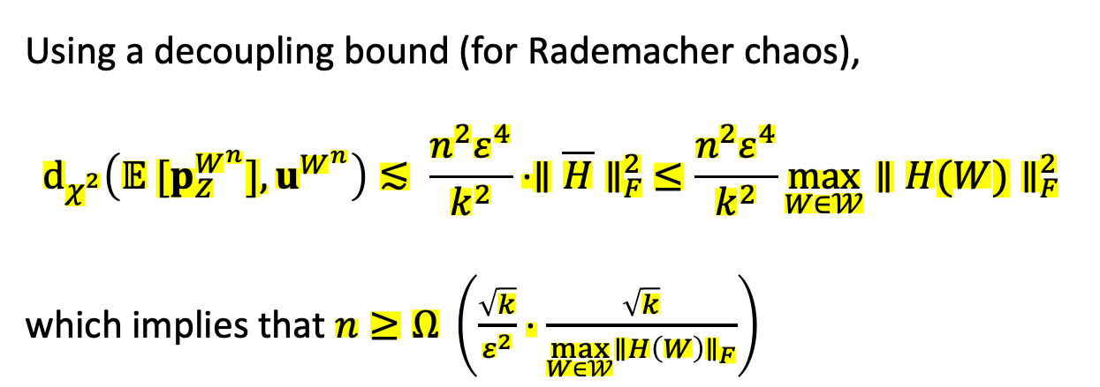
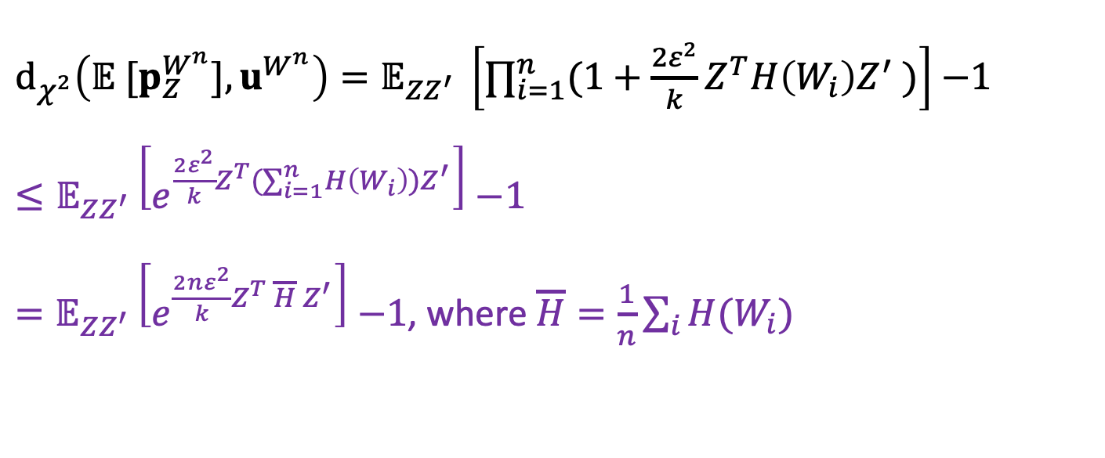
Ingster’s method in the information constrained setting
$d_{χ^{2}}\left(𝔼 [p_{Z}^{W^{n}}],u^{W^{n}}\right)=𝔼_{ZZ^{′}} \left[∏_{i=1}^{n}(1+{\frac{{2ε}^{2}}{k}Z}^{T}H\left(W_{i}\right)Z^{′} )\right]$ $−1$
$≤𝔼_{ZZ^{′}}\left[e^{{\frac{{2ε}^{2}}{k}Z}^{T}(∑_{i=1}^{n}H\left(W_{i}\right))Z^{′}}\right]$ $−1$
$=𝔼_{ZZ^{′}}\left[e^{{\frac{{2nε}^{2}}{k}Z}^{T} \overline{H}{ Z}^{′}}\right]$ $−1$, where $\overline{H}=\frac{1}{n}\sum_{i}{H(W_{i})}$
Using a decoupling bound (for Rademacher chaos),
$$d_{χ^{2}}\left(𝔼 [p_{Z}^{W^{n}}],u^{W^{n}}\right)≲ \frac{{n^{2}ε}^{4}}{k^{2}}⋅∥\overline{H}∥_{F}^{2} ≤\frac{{n^{2}ε}^{4}}{k^{2}}\max_{W∈𝒲}∥H(W)∥_{F}^{2}$$
which implies that $n≥Ω \left(\frac{\sqrt{k}}{ε^{2}}⋅\frac{\sqrt{k}}{\max_{W∈𝒲}∥H\left(W\right)∥_{F}}\right)$
Chi-square contraction
due to information constraints

Slide 24
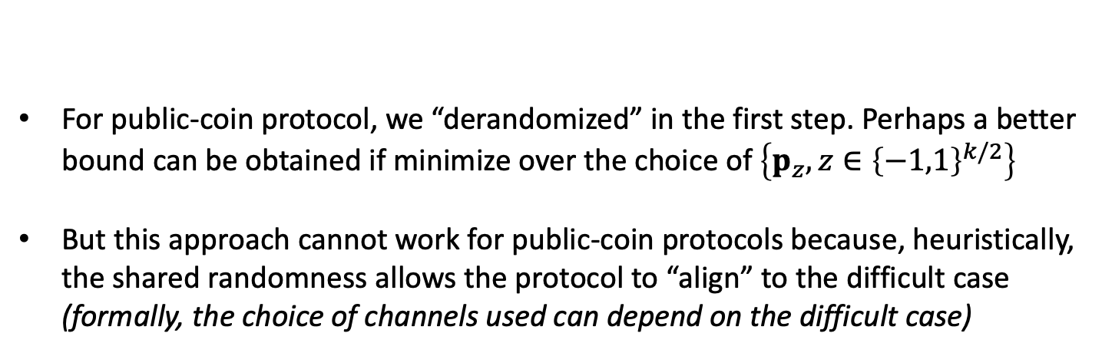
Private-coin protocols
Ingster’s method applied to private-coin identity testing
For public-coin protocol, we “derandomized” in the first step. Perhaps a better bound can be obtained if minimize over the choice of $\left\{p_{z}, z∈{\left\{−1,1\right\}}^{k/2}\right\}$
But this approach cannot work for public-coin protocols because, heuristically, the shared randomness allows the protocol to “align” to the difficult case
(formally, the choice of channels used can depend on the difficult case)
However, this can be done for private-coin protocols!

Slide 25
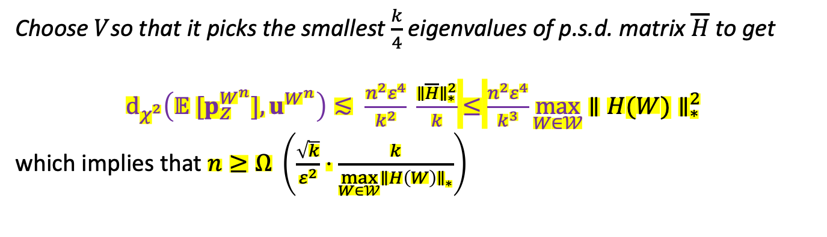
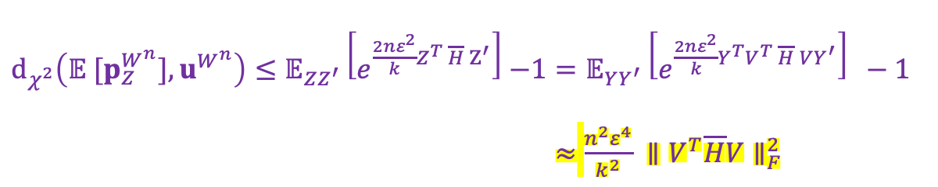
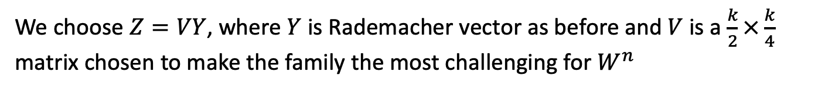
Private-coin protocols
Ingster’s method applied to private-coin identity testing
We choose $Z=VY$, where $Y$ is Rademacher vector as before and $V$ is a $\frac{k}{2}×\frac{k}{4}$ matrix chosen to make the family the most challenging for $W^{n}$
$d_{χ^{2}}\left(𝔼 [p_{Z}^{W^{n}}],u^{W^{n}}\right)≤𝔼_{ZZ^{′}}\left[e^{{\frac{{2nε}^{2}}{k}Z}^{T} \overline{H}{ Z}^{′}}\right]$ $−1=𝔼_{YY^{′}}\left[e^{{\frac{{2nε}^{2}}{k}Y}^{T}V^{T} \overline{H}{ VY}^{′}}\right] −1$
$≈$ $\frac{{n^{2}ε}^{4}}{k^{2}} ∥V^{T}\overline{H}V∥_{F}^{2}$
Choose $V$so that it picks the smallest $\frac{k}{4}$ eigenvalues of p.s.d. matrix $\overline{H}$ to get
$d_{χ^{2}}\left(𝔼 [p_{Z}^{W^{n}}],u^{W^{n}}\right)≲ \frac{{n^{2}ε}^{4}}{k^{2}} \frac{∥\overline{H}∥_{∗}^{2}}{k}$ $≤$ $\frac{{n^{2}ε}^{4}}{k^{3}}\max_{W∈𝒲}$ $∥H(W)∥_{∗}^{2}$
which implies that $n≥Ω \left(\frac{\sqrt{k}}{ε^{2}}⋅\frac{k}{\max_{W∈𝒲}∥H\left(W\right)∥_{∗}}\right)$
Chi-square contraction
due to information constraints

Slide 26
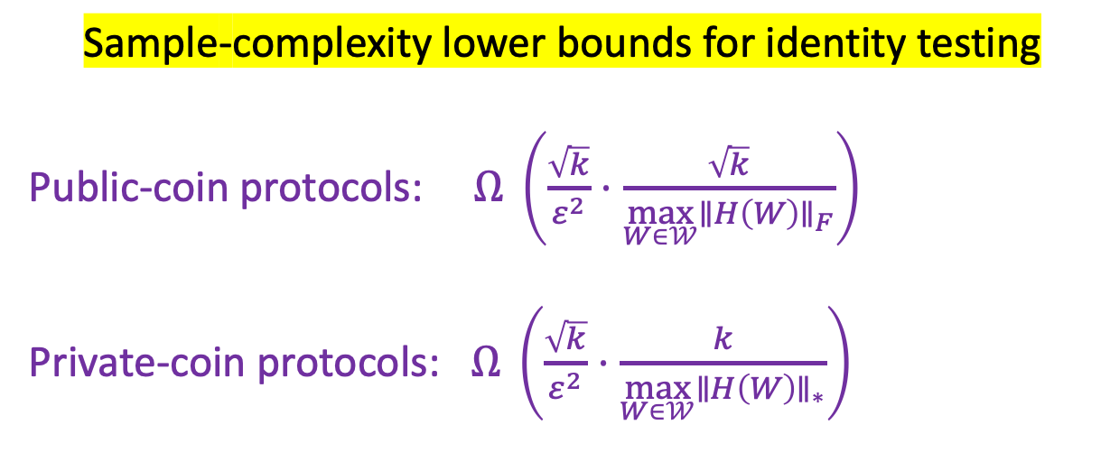
Take away 2: SMP chi-square contraction
We can bound the contraction in chi-square divergences between mixture and the uniform using Ingster’s method
We get more restrictive bounds for private-coin protocols:
Sample-complexity lower bounds for identity testing
Public-coin protocols: $Ω \left(\frac{\sqrt{k}}{ε^{2}}⋅\frac{\sqrt{k}}{\max_{W∈𝒲}∥H\left(W\right)∥_{F}}\right)$
Private-coin protocols: $Ω \left(\frac{\sqrt{k}}{ε^{2}}⋅\frac{k}{\max_{W∈𝒲}∥H\left(W\right)∥_{∗}}\right)$

Slide 27
2. The average information bound for interactive testing

Slide 28
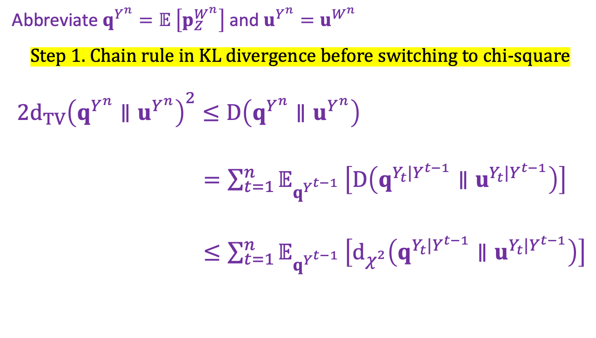
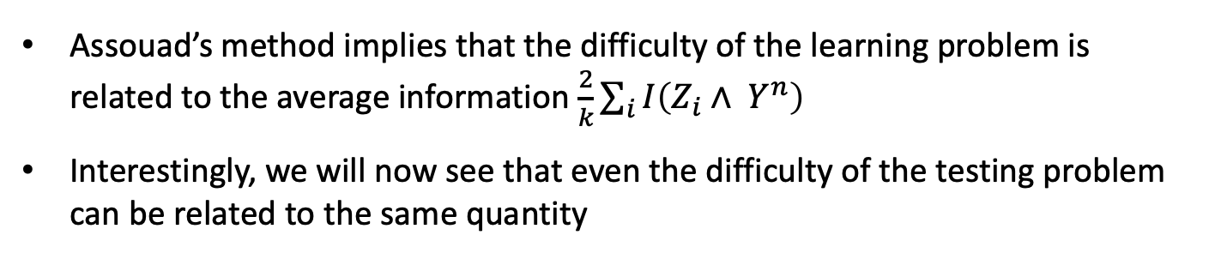
Relating testing to average information
Assouad’s method implies that the difficulty of the learning problem is related to the average information $\frac{2}{k}\sum_{i}{I\left(Z_{i}∧ Y^{n}\right) }$
Interestingly, we will now see that even the difficulty of the testing problem can be related to the same quantity
Abbreviate $q^{Y^{n}}=𝔼 \left[p_{Z}^{W^{n}}\right]$and $u^{Y^{n}}=u^{W^{n}}$
Step 1. Chain rule in KL divergence before switching to chi-square
$2d_{TV}{\left(q^{Y^{n}}∥u^{Y^{n}}\right)}^{2}≤D\left(q^{Y^{n}}∥u^{Y^{n}}\right)$
$=\sum_{t=1}^{n}{𝔼_{q^{Y^{t−1}}}}\left[D\left(q^{Y_{t}|Y^{t−1}}∥u^{Y_{t}|Y^{t−1}}\right)\right]$
$≤\sum_{t=1}^{n}{𝔼_{q^{Y^{t−1}}}}\left[d_{χ^{2}}\left(q^{Y_{t}|Y^{t−1}}∥u^{Y_{t}|Y^{t−1}}\right)\right]$

Slide 29
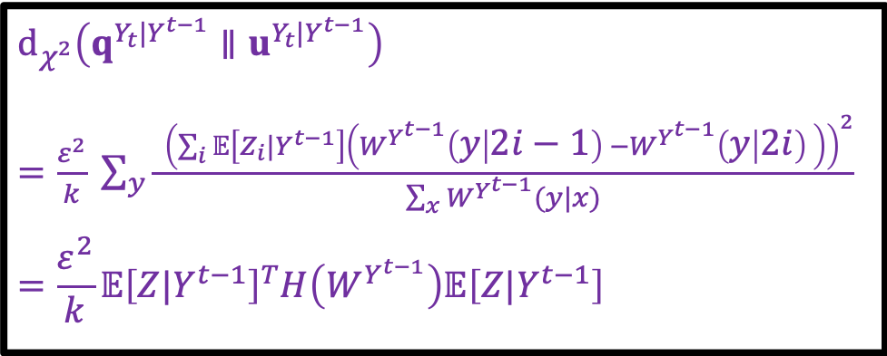
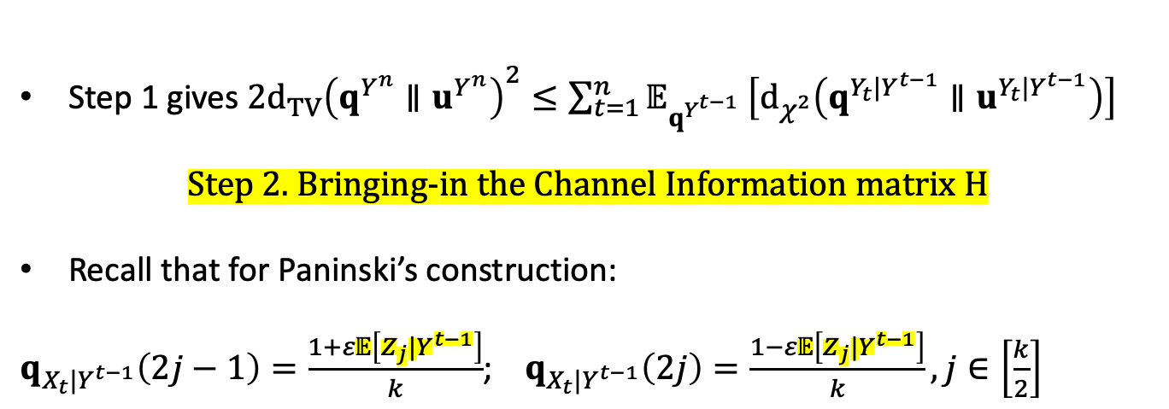
Relating testing to average information
Step 1 gives $2d_{TV}{\left(q^{Y^{n}}∥u^{Y^{n}}\right)}^{2}≤\sum_{t=1}^{n}{𝔼_{q^{Y^{t−1}}}}\left[d_{χ^{2}}\left(q^{Y_{t}|Y^{t−1}}∥u^{Y_{t}|Y^{t−1}}\right)\right]$
Step 2. Bringing-in the Channel Information matrix H
Recall that for Paninski’s construction:
$q_{X_{t}|Y^{t−1}}\left(2j−1\right)=\frac{1+ε𝔼\left[Z_{j}|Y^{t−1}\right]}{k}$; $q_{X_{t}|Y^{t−1}}\left(2j\right)=\frac{1−ε𝔼\left[Z_{j}|Y^{t−1}\right]}{k}, j∈\left[\frac{k}{2}\right]$
$$d_{χ^{2}}\left(q^{Y_{t}|Y^{t−1}}∥u^{Y_{t}|Y^{t−1}}\right)$$
$=\frac{ε^{2}}{k} \sum_{y}{\frac{ {\left(\sum_{i}{𝔼\left[Z_{i}|Y^{t−1}\right]\left(W^{Y^{t−1}}\left(y | 2i−1\right) −W^{Y^{t−1}}\left(y | 2i\right) \right)}\right)}^{2}}{\sum_{x}{W^{Y^{t−1}}(y|x)}}}$
$$=\frac{ε^{2}}{k}𝔼{\left[Z|Y^{t−1}\right]}^{T}H\left(W^{Y^{t−1}}\right)𝔼\left[Z|Y^{t−1}\right]$$

Slide 30
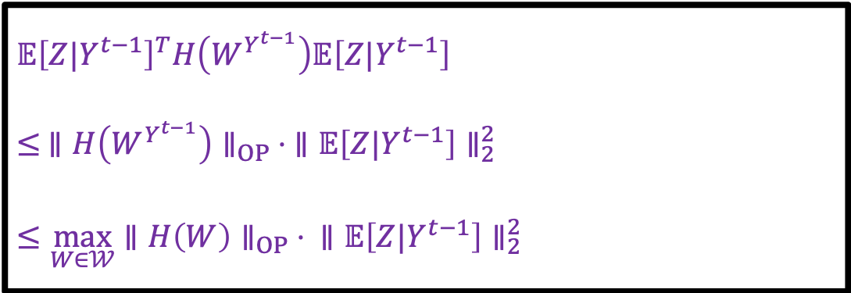
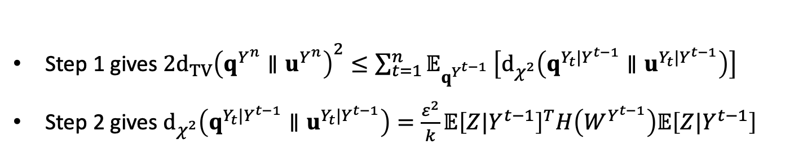
Relating testing to average information
Step 1 gives $2d_{TV}{\left(q^{Y^{n}}∥u^{Y^{n}}\right)}^{2}≤\sum_{t=1}^{n}{𝔼_{q^{Y^{t−1}}}}\left[d_{χ^{2}}\left(q^{Y_{t}|Y^{t−1}}∥u^{Y_{t}|Y^{t−1}}\right)\right]$
Step 2 gives $d_{χ^{2}}\left(q^{Y_{t}|Y^{t−1}}∥u^{Y_{t}|Y^{t−1}}\right)=\frac{ε^{2}}{k}𝔼{\left[Z|Y^{t−1}\right]}^{T}H\left(W^{Y^{t−1}}\right)𝔼\left[Z|Y^{t−1}\right]$
Step 3. “Channel Alignment” Bound
$$𝔼{\left[Z|Y^{t−1}\right]}^{T}H\left(W^{Y^{t−1}}\right)𝔼\left[Z|Y^{t−1}\right]$$
$$≤ ∥{H\left(W^{Y^{t−1}}\right)∥}_{OP} ⋅ ∥𝔼\left[Z|Y^{t−1}\right]∥_{2}^{2}$$
$$≤\max_{W∈𝒲}{∥{H\left(W\right)∥}_{OP}}⋅ ∥𝔼\left[Z|Y^{t−1}\right]∥_{2}^{2}$$
Finally, the average information bound for testing …

Slide 31
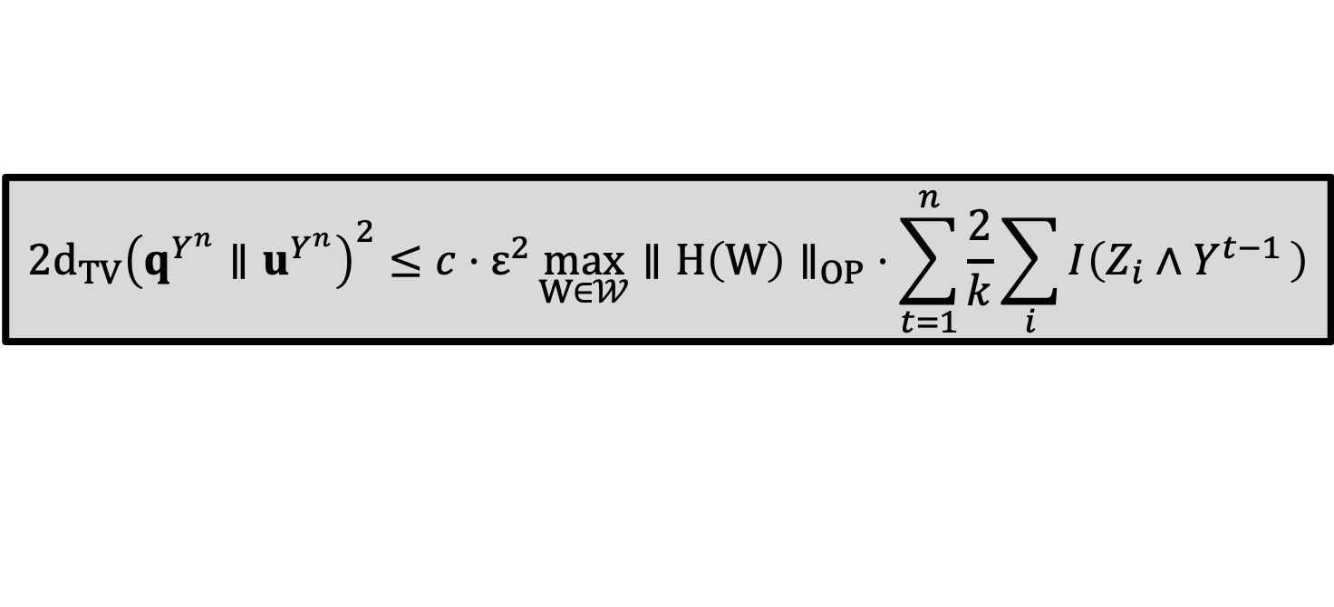
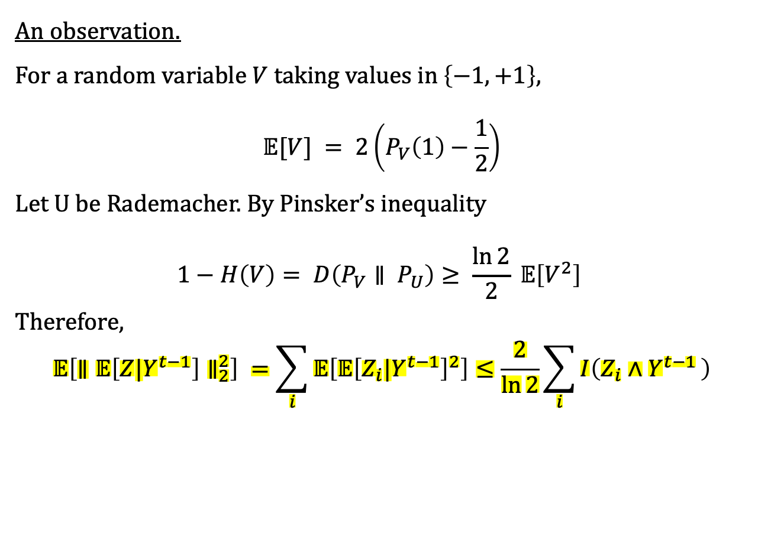
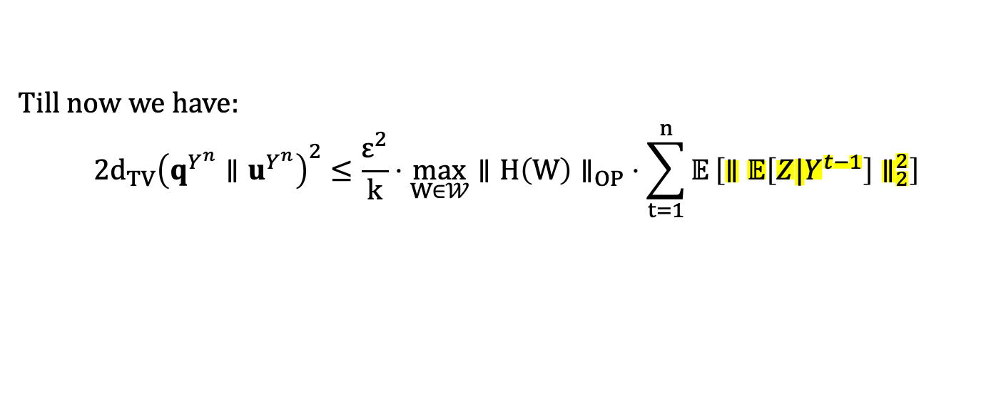
The average information bound for testing
Till now we have:
$$2d_{TV}{\left(q^{Y^{n}}∥u^{Y^{n}}\right)}^{2}≤\frac{ε^{2}}{k}⋅\max_{W∈𝒲}{∥{H\left(W\right)∥}_{OP}}⋅\sum_{t=1}^{n}{𝔼}\left[∥𝔼\left[Z|Y^{t−1}\right]∥_{2}^{2}\right]$$
An observation.
For a random variable $V$ taking values in $\left\{−1, +1\right\},$
$$𝔼[V] = 2\left(P_{V}\left(1\right)−\frac{1}{2}\right)$$
Let U be Rademacher. By Pinsker’s inequality
$$1−H\left(V\right)= D\left(P_{V}∥ P_{U}\right)≥ \frac{\ln{2}}{2} 𝔼\left[V^{2}\right]$$
Therefore,
$$𝔼\left[∥𝔼\left[Z|Y^{t−1}\right]∥_{2}^{2}\right] =\sum_{i}{𝔼\left[𝔼{\left[Z_{i}|Y^{t−1}\right]}^{2}\right]}≤\frac{2}{\ln{2}}\sum_{i}{I\left(Z_{i}∧Y^{t−1 }\right)}$$
$$2d_{TV}{\left(q^{Y^{n}}∥u^{Y^{n}}\right)}^{2}≤c⋅ε^{2}\max_{W∈𝒲}{∥{H\left(W\right)∥}_{OP}}⋅\sum_{t=1}^{n}{\frac{2}{k}\sum_{i}{I\left(Z_{i}∧Y^{t−1 }\right)}}$$

Slide 32
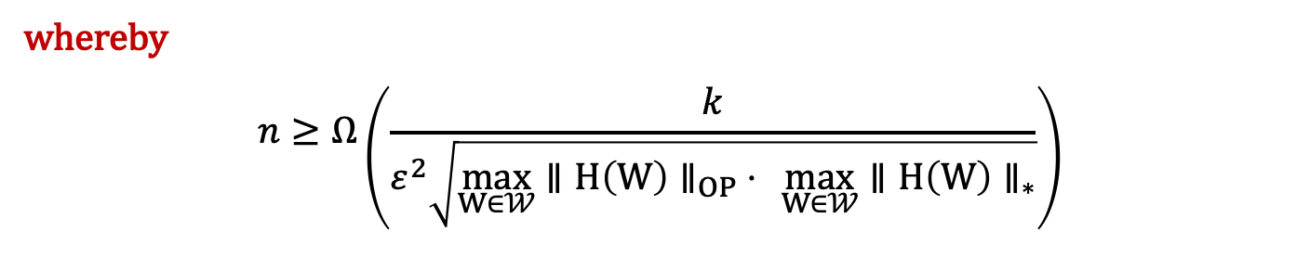
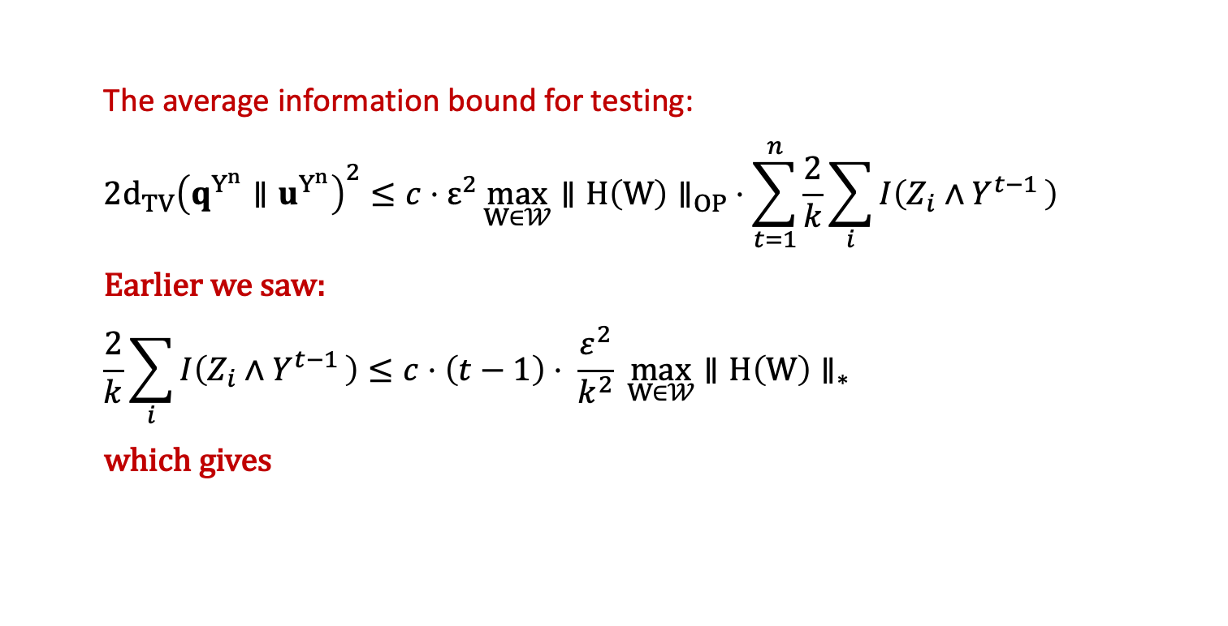
Bounding the average information
The average information bound for testing:
$$2d_{TV}{\left(q^{Y^{n}}∥u^{Y^{n}}\right)}^{2}≤c⋅ε^{2}\max_{W∈𝒲}{∥{H\left(W\right)∥}_{OP}}⋅\sum_{t=1}^{n}{\frac{2}{k}\sum_{i}{I\left(Z_{i}∧Y^{t−1 }\right)}}$$
Earlier we saw:
$$\frac{2}{k}\sum_{i}{I\left(Z_{i}∧Y^{t−1 }\right)}≤c⋅\left(t−1\right)⋅ \frac{ε^{2}}{k^{2}} \max_{W∈𝒲}{∥{H\left(W\right)∥}_{∗ }}$$
which gives
$2d_{TV}{\left(q^{Y^{n}}∥u^{Y^{n}}\right)}^{2}≤c.\frac{{n^{2}ε}^{4}}{k^{2}}\max_{W∈𝒲}{∥{H\left(W\right)∥}_{OP}}⋅$ $\max_{W∈𝒲}{∥{H\left(W\right)∥}_{∗}}$
whereby
$$n≥Ω\left(\frac{k}{ε^{2}\sqrt{\max_{W∈𝒲}{∥{H\left(W\right)∥}_{OP}}⋅ \max_{W∈𝒲}{∥{H\left(W\right)∥}_{∗}}}}\right)$$

Slide 33
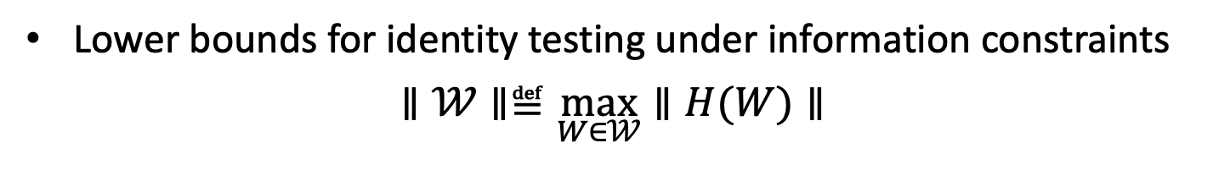
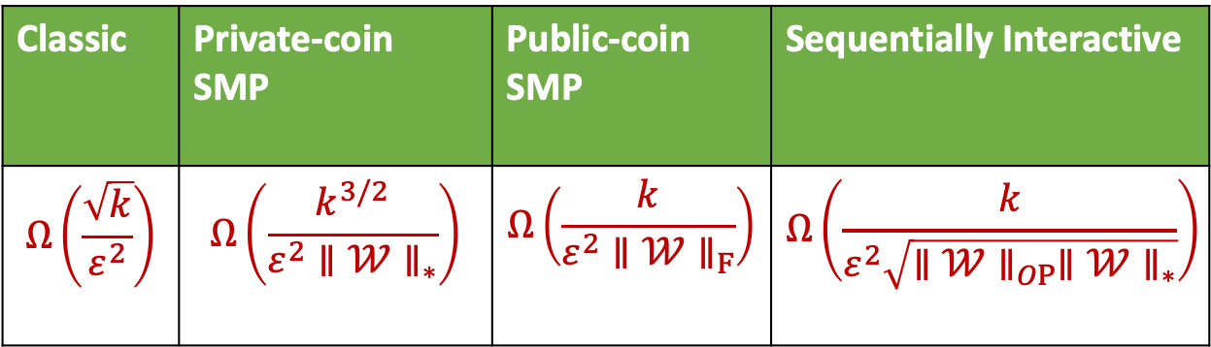
Take away 3: All chi-square contraction bounds
Lower bounds for identity testing under information constraints
$$∥𝒲∥≝\max_{W∈𝒲}∥H(W)∥$$
Classic | Private-coin SMP | Public-coin SMP | Sequentially Interactive
$$Ω\left(\frac{\sqrt{k}}{ε^{2}}\right)$$ | $$Ω\left(\frac{k^{3/2}}{ε^{2}∥𝒲∥_{∗}}\right)$$ | $$Ω\left(\frac{k}{ε^{2}∥𝒲∥_{F}}\right)$$ | $$Ω\left(\frac{k}{ε^{2}\sqrt{∥𝒲∥_{OP}∥𝒲∥_{∗}}}\right)$$
For the sequentially interactive lower bound:
  Can be improved, in general, using the same recipe
  We can find an example of constraints where interaction helps

Slide 34
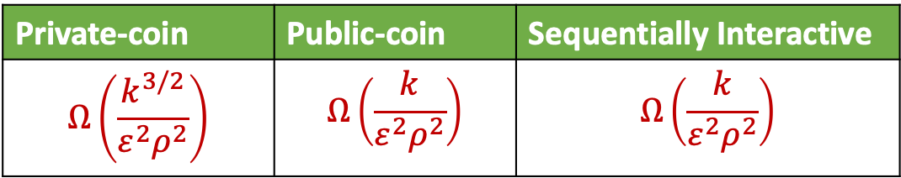

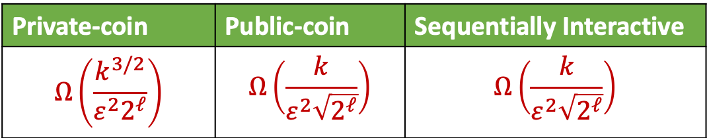

Application: Identity testing for different $𝒲$
Communication constraints: $𝒲_{ℓ}=\{W:𝒳→{\left\{0,1\right\}}^{ℓ}\text{ \}}$
$∥𝒲_{ℓ}∥_{F}≤\sqrt{2^{ℓ}}$ , $∥𝒲_{ℓ}∥_{∗}≤2^{ℓ}$, $∥𝒲_{ℓ}∥_{OP}≤2$
LDP constraints: $𝒲_{ρ}=\left\{W:⁡\max_{\{x,x^{′}∈𝒳,y∈ 𝒴\}}\frac{W\left(y | x\right)}{W\left(y | x′\right)}≤e^{ρ}\right\}$
$∥𝒲_{ρ}∥_{F}≤𝒪(ρ^{2})$, $∥𝒲_{ρ}∥_{∗}≤𝒪(ρ^{2})$, $∥𝒲_{ρ}∥_{OP}≤𝒪(ρ^{2})$
Private-coin | Public-coin | Sequentially Interactive
$$Ω\left(\frac{k^{3/2}}{ε^{2}2^{ℓ}}\right)$$ | $$Ω\left(\frac{k}{ε^{2}\sqrt{2^{ℓ}}}\right)$$ | $$Ω\left(\frac{k}{ε^{2}\sqrt{2^{ℓ}}}\right)$$
These bounds will be seen to be tight
Interaction doesn’t help, but public coins do
Private-coin | Public-coin | Sequentially Interactive
$$Ω\left(\frac{k^{3/2}}{ε^{2}ρ^{2}}\right)$$ | $$Ω\left(\frac{k}{ε^{2}ρ^{2}}\right)$$ | $$Ω\left(\frac{k}{ε^{2}ρ^{2}}\right)$$

Slide 35
3. High-dimensional mean testing
(under communication constraints)

Slide 36
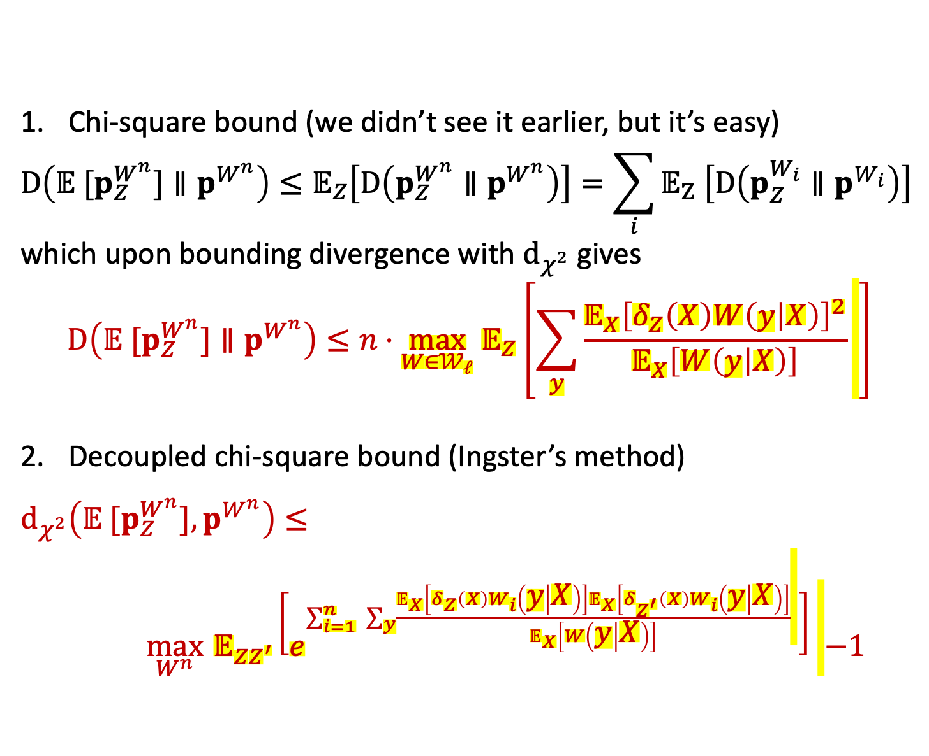
General chi-square bounds for public-coin SMP
Chi-square bound (we didn’t see it earlier, but it’s easy)
$$D\left(𝔼 [p_{Z}^{W^{n}}]∥p^{W^{n}}\right)≤𝔼_{Z}\left[D\left(p_{Z}^{W^{n}}∥p^{W^{n}}\right)\right]=\sum_{i}{𝔼_{Z} \left[D\left(p_{Z}^{W_{i}}∥p^{W_{i}}\right)\right]}$$
which upon bounding divergence with $d_{χ^{2}}$ gives
$$D\left(𝔼 [p_{Z}^{W^{n}}]∥p^{W^{n}}\right)≤n⋅{\max_{W∈𝒲_{ℓ}} 𝔼}_{Z}\left[\sum_{y}{\frac{𝔼_{X}{\left[δ_{Z}\left(X\right)W\left(y | X\right)\right]}^{2}}{𝔼_{X}\left[W\left(y | X\right)\right]}} \right]$$
Decoupled chi-square bound (Ingster’s method)
$d_{χ^{2}}\left(𝔼 [p_{Z}^{W^{n}}],p^{W^{n}}\right)≤ \max_{W^{n}}{ 𝔼}_{ZZ^{′}}\left[e^{\sum_{i=1}^{n}{ \sum_{y}{\frac{𝔼_{X}\left[δ_{Z}\left(X\right)W_{i}\left(y | X\right)\right]𝔼_{X}\left[δ_{Z^{′}}\left(X\right)W_{i}\left(y | X\right)\right]}{𝔼_{X}\left[W\left(y | X\right)\right]}} }}\right]$ $−1$

Slide 37
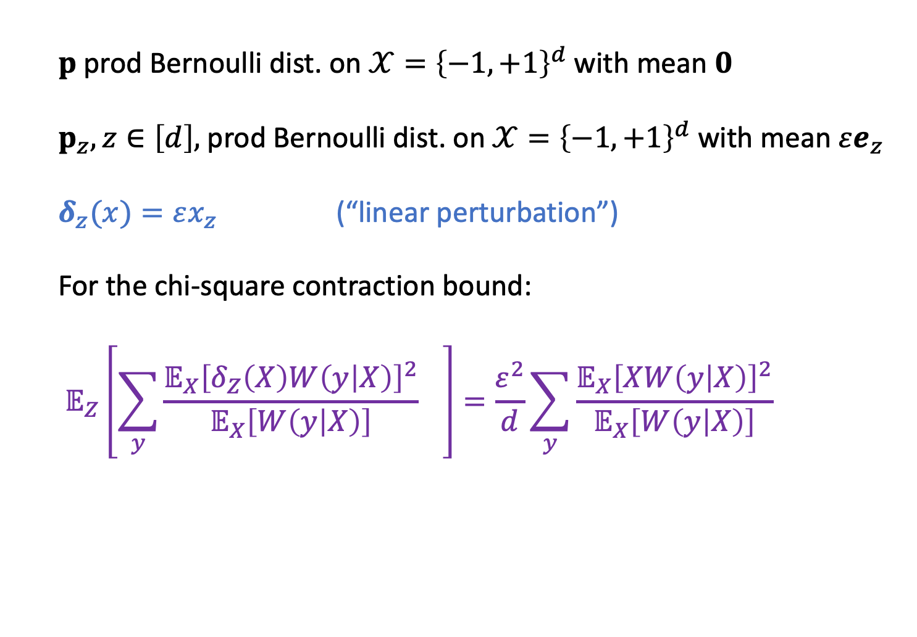
Hide-and-seek for public-coin SMP
$p$prod Bernoulli dist. on $𝒳={\left\{−1, +1\right\}}^{d}$ with mean $0$
$p_{z}, z∈\left[d\right],$prod Bernoulli dist. on $𝒳={\left\{−1, +1\right\}}^{d}$ with mean $εe_{z}$
$δ_{z}(x)=εx_{z}$ (“linear perturbation”)
For the chi-square contraction bound:
$$𝔼_{Z}\left[\sum_{y}{\frac{𝔼_{X}{\left[δ_{Z}\left(X\right)W\left(y | X\right)\right]}^{2}}{𝔼_{X}\left[W\left(y | X\right)\right]} } \right]=\frac{ε^{2}}{d}\sum_{y}{\frac{𝔼_{X}{\left[XW\left(y | X\right)\right]}^{2}}{𝔼_{X}\left[W\left(y | X\right)\right]}}$$

Slide 38
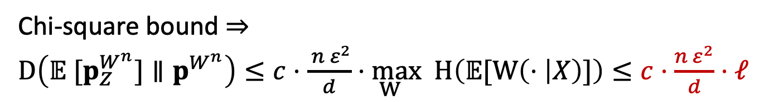
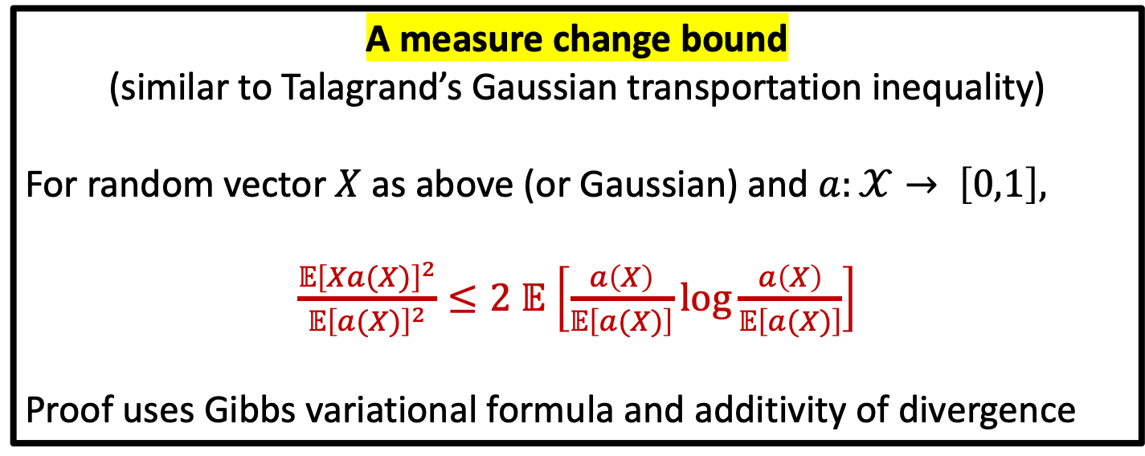

Hide-and-seek for public-coin SMP
$$\sum_{y}{𝔼_{Z}\left[\frac{𝔼_{X}{\left[δ_{Z}\left(X\right)W\left(y | X\right)\right]}^{2}}{𝔼_{X}\left[W\left(y | X\right)\right]}\right] = }\frac{ε^{2}}{d}\sum_{y}{\frac{𝔼_{X}{\left[XW\left(y | X\right)\right]}^{2}}{𝔼_{X}\left[W\left(y | X\right)\right]}}$$
A measure change bound
(similar to Talagrand’s Gaussian transportation inequality)
For random vector $X$as above (or Gaussian) and $a:𝒳→ \left[0,1\right],$
$\frac{𝔼{\left[Xa(X)\right]}^{2}}{𝔼{\left[a(X)\right]}^{2}}≤2$ $𝔼$ $\left[\frac{a\left(X\right)}{𝔼\left[a(X)\right]}log\frac{a\left(X\right)}{𝔼\left[a(X)\right]}\right]$
Proof uses Gibbs variational formula and additivity of divergence
Chi-square bound $⇒$
$D\left(𝔼 [p_{Z}^{W^{n}}]∥p^{W^{n}}\right)≤c⋅\frac{ {n ε}^{2}}{d}\underset{W}{⋅max} H\left(𝔼[W\left(⋅ | X\right)]\right)≤c⋅\frac{{n ε}^{2}}{d}⋅ℓ$

Slide 39

Hide-and-seek for sequentially interactive
We used:
$$D\left(𝔼 [p_{Z}^{W^{n}}]∥p^{W^{n}}\right)≤n⋅{\max_{W∈𝒲} 𝔼}_{Z}\left[\sum_{y}{\frac{𝔼_{X}{\left[δ_{Z}\left(X\right)W\left(y | X\right)\right]}^{2}}{𝔼_{X}\left[W\left(y | X\right)\right]}} \right]$$
Even for sequentially interactive protocol, we can show
$$𝔼_{Z}\left[D\left(p_{Z}^{W^{n}}∥p^{W^{n}}\right)\right]≤𝔼_{Z} \left[\sum_{i}{𝔼_{Y^{i−1}}}\left[D\left(p_{Z}^{Y_{i}|Y^{i−1}}∥p^{Y_{i}|Y^{i−1}}\right)\right] \right]$$
$≤n 𝔼_{Z}\left[\max_{W∈𝒲_{ℓ}}\sum_{y}{\frac{𝔼_{X}{\left[δ_{Z}\left(X\right)W\left(y | X\right)\right]}^{2}}{𝔼_{X}\left[W\left(y | X\right)\right]}} \right]$
But our previous bound requires us to take average over $Z$ before taking the $max⁡$
Alternatively, we can derive an average information bound for this case as well
[Shamir ‘14]

Slide 40

High-dimensional mean testing
$p$ Gaussian distribution $𝒩(0, 𝕀_{d})$
$$p_{z}, z∈{\left\{−1, +1\right\}}^{d},\text{Gaussian} \text{distribution} 𝒩\left(\frac{ε}{\sqrt{d}}z, 𝕀_{d}\right)$$
The main difficulty: nonlinear perturbation (in $x$)
$δ_{z}(x)= e^{−ε^{2}/2}$ $e^{\frac{ε}{\sqrt{d}} ⟨x,z⟩} −1$
But we can still derive a partial bound (using the chi-square bound)

Slide 41



High-dimensional mean testing
$δ_{z}(x)= e^{−ε^{2}/2}$ $e^{\frac{ε}{\sqrt{d}} ⟨x,z⟩} −1$
Chi-square divergence bound for Gaussian mean testing
For $ℓ≤\frac{\sqrt{d}}{ε^{2}}, 𝔼_{Z}\left[\sum_{y}{\frac{𝔼_{X}{\left[δ_{Z}\left(X\right)W(y|X)\right]}^{2}}{𝔼_{X}\left[W(y|X)\right]} } \right]≤𝒪\left(\max_{}\left\{\frac{ε^{2}ℓ}{d} , \frac{ε^{4}ℓ^{2}}{d}\right\}\right)$
It is tight for constant $ℓ$ or small enough $ε$
The proof is tedious, uses level-$k$ inequalities instead of our earlier Talagrand-type bound
Does not work for interactive protocols –
we need to take expectation over Z and cannot handle
$𝔼_{Z}\left[\max_{W}\sum_{y}{\frac{𝔼_{X}{\left[δ_{Z}\left(X\right)W(y|X)\right]}^{2}}{𝔼_{X}\left[W(y|X)\right]} } \right]$

Slide 42
In conclusion
Bounds seen
  the chi-square contraction bounds for SMP protocols
  the average information bound for sequentially interactive protocols
The decoupled chi-square contraction bound obtained using Ingster’s method shows separation of private- and public-coin protocols for identity testing
The average information bound can be used to obtain a family of channels where interaction helps for testing
Only partial results available for high-dimensional mean testing – the basic approach extends, but difficulty handling the resulting terms

