Slide 1

Cookbook: Lower Bounds for Statistical Inference in Distributed and Constrained Settings
Jayadev Acharya, Clément Canonne, Himanshu Tyagi
FOCS 2020
Part I: What is this all about?

Slide 2
Techniques and recipes for distributed learning and testing under constraints

Slide 3
Techniques and recipes for distributed learning and testing under constraints
Parameter/density estimation
Goodness-of-fit / identity testing

Slide 4




Techniques and recipes for distributed learning and testing under constraints
Parameter/density estimation
Goodness-of-fit / hypothesis testing
Local constraints

Slide 5


Techniques and recipes for distributed learning and testing under constraints
Parameter/density estimation
Goodness-of-fit / hypothesis testing
Local constraints

Slide 6



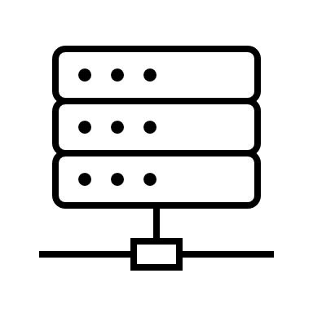
Techniques and recipes for distributed learning and testing under constraints

Slide 7
Techniques and recipes for distributed learning and testing under constraints
(“Motivation” slide)

Slide 8

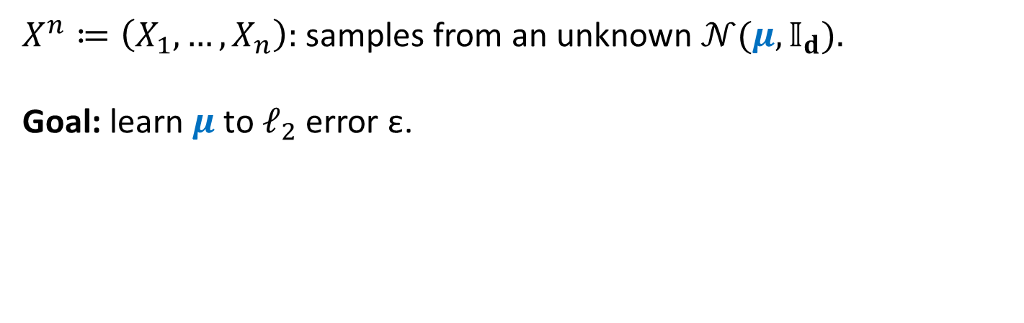
An example: high-dimensional Gaussian
$X^{n}≔\left(X_{1}, …,X_{n}\right):$ samples from an unknown $𝒩(μ,𝕀_{d})$.
Goal: learn $μ$ to $ℓ_{2}$ error ε.

Slide 9
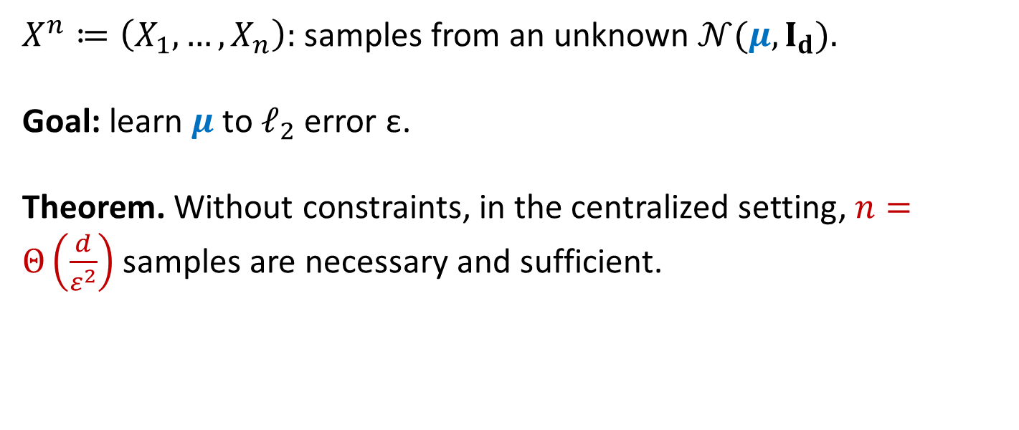

An example: high-dimensional Gaussian
$X^{n}≔\left(X_{1}, …,X_{n}\right):$ samples from an unknown $𝒩(μ,𝕀_{d})$.
Goal: learn $μ$ to $ℓ_{2}$ error ε.
Theorem. Without constraints, in the centralized setting, $n=Θ\left(\frac{d}{ε^{2}}\right)$ samples are necessary and sufficient.

Slide 10
An example: high-dimensional Gaussian
$X^{n}≔\left(X_{1}, …,X_{n}\right):$ samples from an unknown $𝒩(μ,I_{d})$.
Goal: learn $μ$ to $ℓ_{2}$ error ε.
Theorem. Without constraints, in the centralized setting, $n=Θ\left(\frac{d}{ε^{2}}\right)$ samples are necessary and sufficient.
“Folklore/easy”

Slide 11
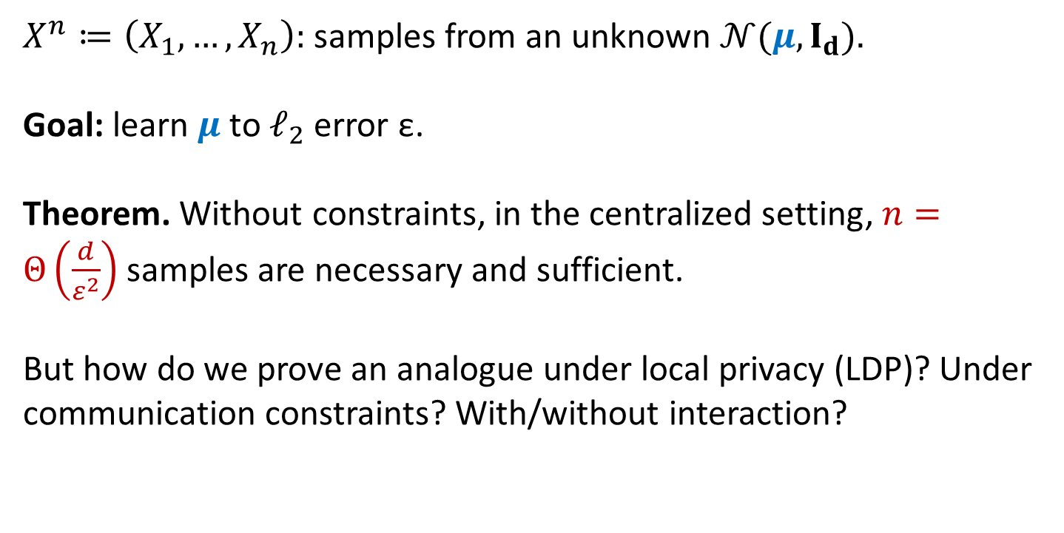
An example: high-dimensional Gaussian
$X^{n}≔\left(X_{1}, …,X_{n}\right):$ samples from an unknown $𝒩(μ,I_{d})$.
Goal: learn $μ$ to $ℓ_{2}$ error ε.
Theorem. Without constraints, in the centralized setting, $n=Θ\left(\frac{d}{ε^{2}}\right)$ samples are necessary and sufficient.
But how do we prove an analogue under local privacy (LDP)? Under communication constraints? With/without interaction?

Slide 12
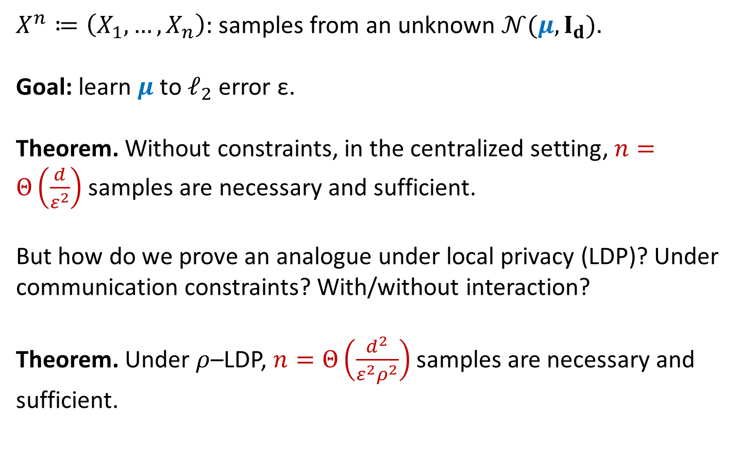
An example: high-dimensional Gaussian
$X^{n}≔\left(X_{1}, …,X_{n}\right):$ samples from an unknown $𝒩(μ,I_{d})$.
Goal: learn $μ$ to $ℓ_{2}$ error ε.
Theorem. Without constraints, in the centralized setting, $n=Θ\left(\frac{d}{ε^{2}}\right)$ samples are necessary and sufficient.
But how do we prove an analogue under local privacy (LDP)? Under communication constraints? With/without interaction?
Theorem. Under $ρ$–LDP, $n=Θ\left(\frac{d^{2}}{ε^{2}ρ^{2}}\right)$ samples are necessary and sufficient.

Slide 13
Goal of this tutorial, refined
General, re-usable techniques to establish lower bounds on the sample complexity of such distributed/constrained statistical problems (in various settings)

Slide 14
Some definitions before we start

Slide 15



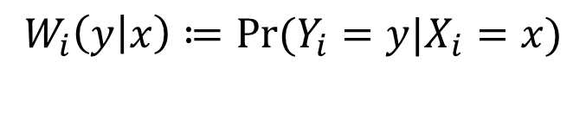
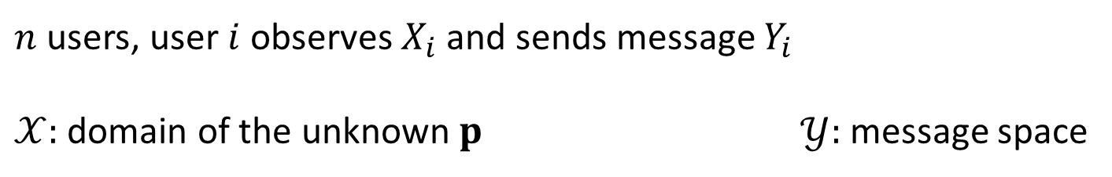
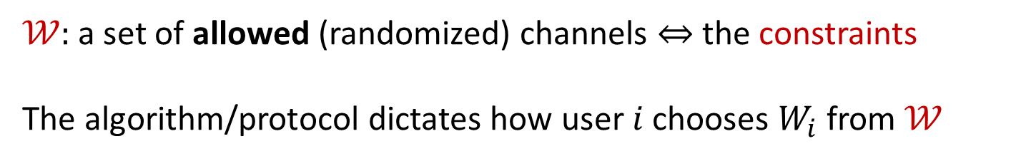

Modeling the constraints
[ACT20c]
$n$ users, user $i$ observes $X_{i}$ and sends message $Y_{i}$
$𝒳:$ domain of the unknown $p$ $𝒴:$ message space
$$W_{i}$$
$$X_{i}$$
$$Y_{i}$$
$$W_{i}\left(y | x\right)≔\operatorname{Pr}{(Y_{i}=y|X_{i}=x)}$$
$𝒲:$ a set of allowed (randomized) channels $⇔$the constraints
The algorithm/protocol dictates how user $i$ chooses $W_{i}$ from $𝒲$

Slide 16

Example 1: Communication constraints
[Sha14,HMÖW18,ACT20d…]
$$𝒲_{ℓ}=\{W:𝒳→{\left\{0,1\right\}}^{ℓ} \text{\}}$$
Each $X_{i}$is mapped to $ℓ$ bits.
Tight bandwidth constraints
Notes:
Shamir
Han, Mukherjee,Özgür, and Weissman

Slide 17

Example 2: Local Differential Privacy (LDP)
[Warner65, EPR03, KLNRS11]
$W:𝒳→{\left\{0,1\right\}}^{∗}$ is $ρ$-LDP if $∀x, x^{′}∈𝒳, ∀y$,
$$\frac{W\left(y | x\right)}{W\left(y | x′\right)}≤e^{ρ}≈1+ρ$$
$$𝒲_{ρ}=\left\{all ϱ−LDP channels\right\}$$
Privacy guarantees even “against” the server
Notes:
Warner
Erlingsson, Pihur, Korolova
Kasiviswanathan, Lee, Nissim, Raskhodnikova, and Smith

Slide 18












Types of protocols
$$p$$
Private-coin SMP protocols
$${ X}_{1}$$
$${ X}_{2}$$
. . .
$${ X}_{n}$$
$$W_{1}$$
$$W_{2}$$
$$W_{n}$$
$$∈ 𝒲$$
$${ Y}_{1}$$
$${ Y}_{2}$$
. . .
$${ Y}_{n}$$
$$ℜ$$
Noninteractive (“simultaneous message-passing”),
no common random seed

Slide 19


Types of protocols
$$p$$
Public-coin SMP protocols
$${ X}_{1}$$
$${ X}_{2}$$
. . .
$${ X}_{n}$$
$$U$$
$$W_{1}$$
$$W_{2}$$
$$W_{n}$$
$$∈ 𝒲$$
$${ Y}_{1}$$
$${ Y}_{2}$$
. . .
$${ Y}_{n}$$
$$ℜ$$
Noninteractive (“simultaneous message-passing”),
but common random seed

Slide 20
Types of protocols
$$p$$
Sequentially Interactive
protocols
$${ X}_{1}$$
$${ X}_{2}$$
. . .
$${ X}_{n}$$
$$U$$
$$W_{1}$$
$$W_{2}$$
$$W_{n}$$
$$∈ 𝒲$$
$${ Y}_{1}$$
$${ Y}_{2}$$
. . .
$${ Y}_{n}$$
$$ℜ$$
Interactive (“one-pass, sequential”),
and common random seed

Slide 21









Types of protocols
$$p$$
Blackboard protocols
$${ X}_{1}$$
$${ X}_{2}$$
. . .
$${ X}_{n}$$
$$U$$
$$W_{1}$$
$$W_{2}$$
$$W_{n}$$
$$∈ 𝒲$$
$${ Y}_{1}$$
$${ Y}_{2}$$
. . .
$${ Y}_{n}$$
$$ℜ$$
Fully interactive (“many passes”),
and common random seed

Slide 22
Types of protocols
Each of these models is at least as powerful as the previous
private-coin ≼ public-coin ≼ sequentially interactive ≼ blackboard
Each has its pros and cons (both in theory and practice), and may require different techniques to analyze.

Slide 23
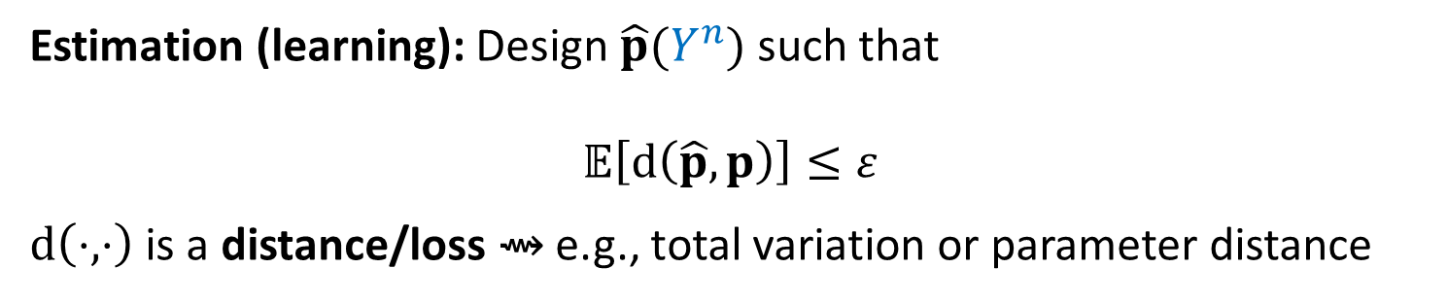
Types of problems
$ε:$ accuracy parameter
Estimation (learning): Design $\hat{p}(Y^{n})$ such that
$$𝔼\left[d\left(\hat{p},p\right)\right]≤ε$$
$d\left(⋅, ⋅\right)$ is a distance/loss ⇝ e.g., total variation or parameter distance

Slide 24

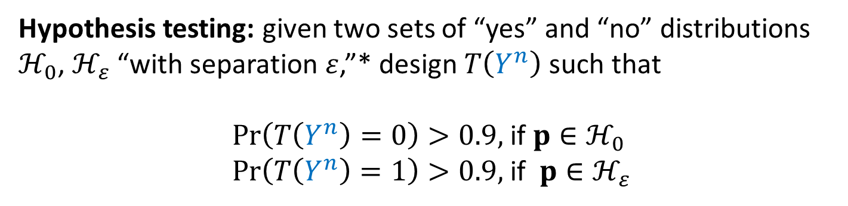
Types of problems
$ε:$ accuracy parameter
Estimation (learning): Design $\hat{p}(Y^{n})$ such that
$$𝔼\left[d\left(\hat{p},p\right)\right]≤ε$$
$d\left(⋅, ⋅\right)$ is a distance/loss ⇝ e.g., total variation or parameter distance
Hypothesis testing: given two sets of “yes” and “no” distributions $ℋ_{0}$, $ℋ_{ε}$ “with separation $ε$,”* design $T\left(Y^{n}\right)$ such that
$\operatorname{Pr}\left(T\left(Y^{n}\right)=0\right)>0.9,$if $p∈ℋ_{0}$
$\operatorname{Pr}\left(T\left(Y^{n}\right)=1\right)>0.9,$if ${p∈ℋ}_{ε}$
* I.e., $d\left(p,q\right)$ > $ε$ for every $p∈ℋ_{0}$, ${q∈ℋ}_{ε}$

Slide 25

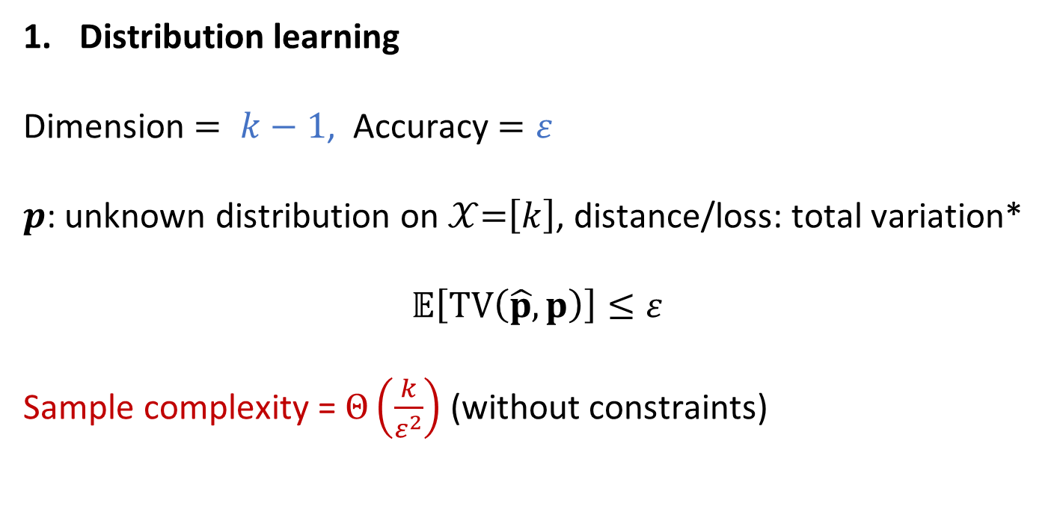
Types of problems: Estimation
Distribution learning
Dimension $= k−1$, Accuracy$=ε$
$p$: unknown distribution on $𝒳$=$\left[k\right]$, distance/loss: total variation*
$$𝔼\left[TV\left(\hat{p},p\right)\right]≤ε$$
Sample complexity = $Θ\left(\frac{k}{ε^{2}}\right)$ (without constraints)
* $TV\left(p, q\right)=\sup_{S⊆[k]}(p\left(S\right)−q(S)$)

Slide 26
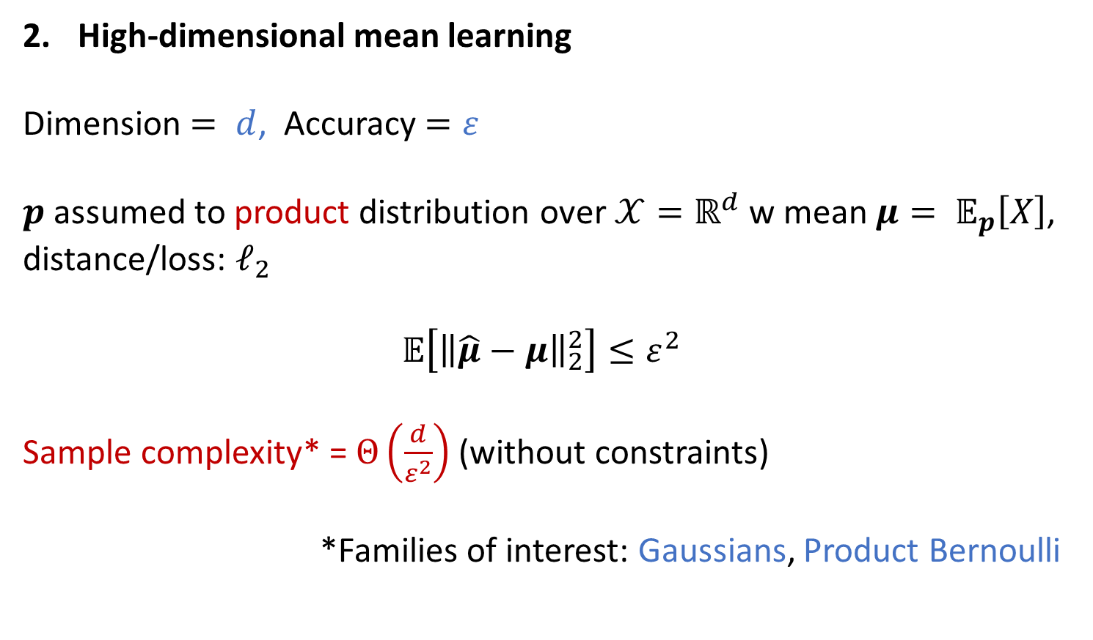
Types of problems: Estimation
High-dimensional mean learning
Dimension $= d$, Accuracy$=ε$
$p$ assumed to product distribution over $𝒳=ℝ^{d}$ w mean $μ= 𝔼_{p}\left[X\right]$, distance/loss: $ℓ_{2}$
$$𝔼\left[{\left\|\hat{μ}−μ\right\|}_{2}^{2}\right]≤ε^{2}$$
Sample complexity* = $Θ\left(\frac{d}{ε^{2}}\right)$ (without constraints)
*Families of interest: Gaussians, Product Bernoulli

Slide 27
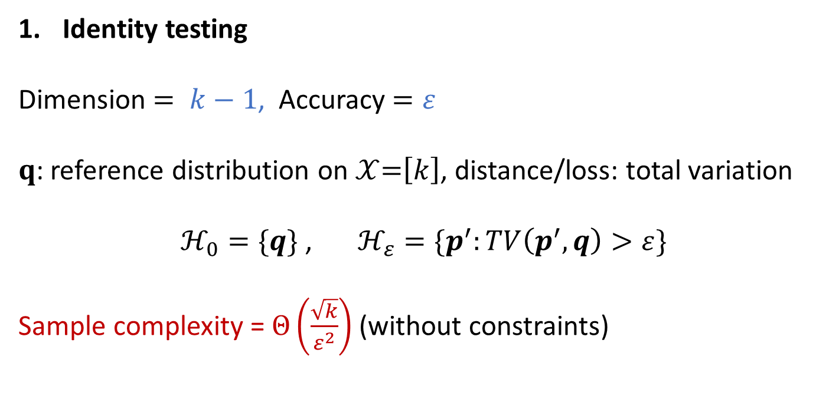
Types of problems: Hypothesis testing
Identity testing
Dimension $= k−1$, Accuracy$=ε$
$q$: reference distribution on $𝒳$=$\left[k\right]$, distance/loss: total variation
$ℋ_{0}=\{q\}$ , $ℋ_{ε}=\{p^{′}:TV\left(p^{′}, q\right)>ε\}$
Sample complexity = $Θ\left(\frac{\sqrt{k}}{ε^{2}}\right)$ (without constraints)

Slide 28
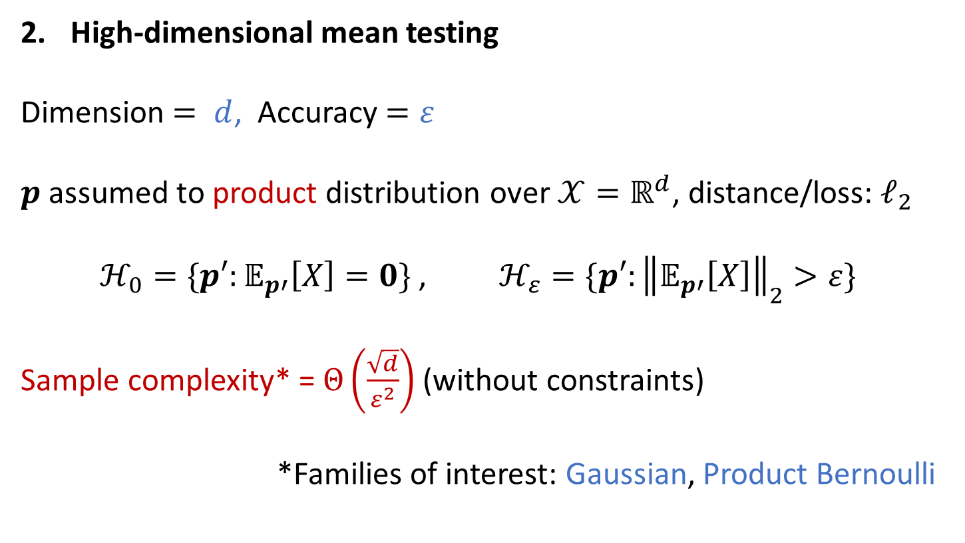
Types of problems: Hypothesis testing
High-dimensional mean testing
Dimension $= d$, Accuracy$=ε$
$p$ assumed to product distribution over $𝒳=ℝ^{d}$, distance/loss: $ℓ_{2}$
$ℋ_{0}=\{p′:𝔼_{p′}\left[X\right]=0\}$ , $ℋ_{ε}=\{p′:{\left\|𝔼_{p′}\left[X\right]\right\|}_{2}>ε\}$
Sample complexity* = $Θ\left(\frac{\sqrt{d}}{ε^{2}}\right)$ (without constraints)
*Families of interest: Gaussian, Product Bernoulli

Slide 29
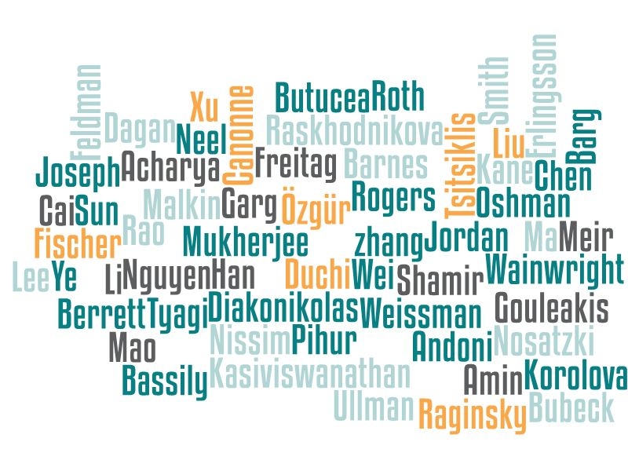
Some references and previous work
Zhang, Jordan, Wainwright, Tsitsiklis Shamir, Mukherjee, Özgür, Weissman, Han, Garg, Ma, Nguyen Fischer, Meir, Oshman, Duchi, Rogers Diakonikolas, Gouleakis Kane, Rao, Cai, Wei, Barnes, Chen, Andoni, Malkin, Nosatzki, Acharya, Canonne, Freitag, Tyagi, Liu, Sun, Ye, Barg, Erlingsson, Pihur, Korolova, Kasiviswanathan, Lee, Nissim, Raskhodnikova, Smith, Berrett, Butucea Amin, Joseph, Mao, Bubeck, Li, Neel, Roth, Dagan, Feldman, Ullman Bassily, Xu, Raginsky

Slide 30
Some references and previous work
Zhang, Jordan, Wainwright, Tsitsiklis Shamir, Mukherjee, Özgür, Weissman, Han, Garg, Ma, Nguyen Fischer, Meir, Oshman, Duchi, Rogers Diakonikolas, Gouleakis Kane, Rao, Cai, Wei, Barnes, Chen, Andoni, Malkin, Nosatzki, Acharya, Canonne, Freitag, Tyagi, Liu, Sun, Ye, Barg, Erlingsson, Pihur, Korolova, Kasiviswanathan, Lee, Nissim, Raskhodnikova, Smith, Berrett, Butucea Amin, Joseph, Mao, Bubeck, Li, Neel, Roth, Dagan, Feldman, Ullman Bassily, Xu, Raginsky
(not in that order)

Slide 31

Some references and previous work
Too many for a single slide, or two. Starts, more or less, with Tsitsiklis’89, picks up again in the mid-2000’s with a slightly different focus: local privacy, various types of communication constraints, ML-related motivations…
For a detailed bibliography:
www.cs.columbia.edu/~ccanonne/tutorial-focs2020/bibliography.html

Slide 32

Plan for the tutorial
Introduction Clément
Lower Bounds for Estimation Jayadev
Lower Bounds for Testing Himanshu
Some upper bounds, and discussion Clément

